Slide 1
Introduction to MSBuild
How to make Visual Studio do more than just compile
Presented by Robert Francis
To DigiPen Game Engine Architecture Club

Slide 2
Who am I?
Full-time programmer at Microsoft
  Xbox ADK, Feb 2012 to Present
Digipen Alumni – 2012
  Technical Director for Sophomore Game “Solace”

Slide 3
Why am I talking to you?
Bring awareness of MSBuild and its flexibility
Give you another tool for your engine
Introduce a technology actively used in the industry
Notes:
I wish I had known about it earlier.
This is widely used in the build systems for a lot of large companies.
Each Microsoft team has only a couple people that fully understand MSBuild and their team’s build system

Slide 4
Overview
You and your project files
Syntax and basic concepts
Built in Tasks
Targets
How to customize your build process
Custom Tasks
Practical examples relevant to game engines
Notes:
Ask audience: Who has written a MSBuild script before?

Slide 5
What is MSBuild?
Scripting language
Syntax is XML
Located in your project files (vcproj, csproj, etc)
Can use to go beyond just compiling code
Useful for build automation

Slide 6
MSBuild vs Visual C++ vs C++ Compiler
C++ Compiler compiles C++ code only
MSBuild runs MSBuild scripts only
Visual C++ is the suite of project templates, MSBuild scripts, Visual Studio plugins, etc in Visual Studio

Slide 7
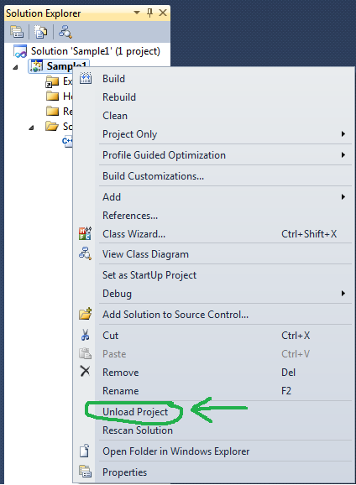
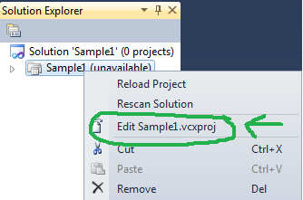
How to access in Visual Studio

Slide 8
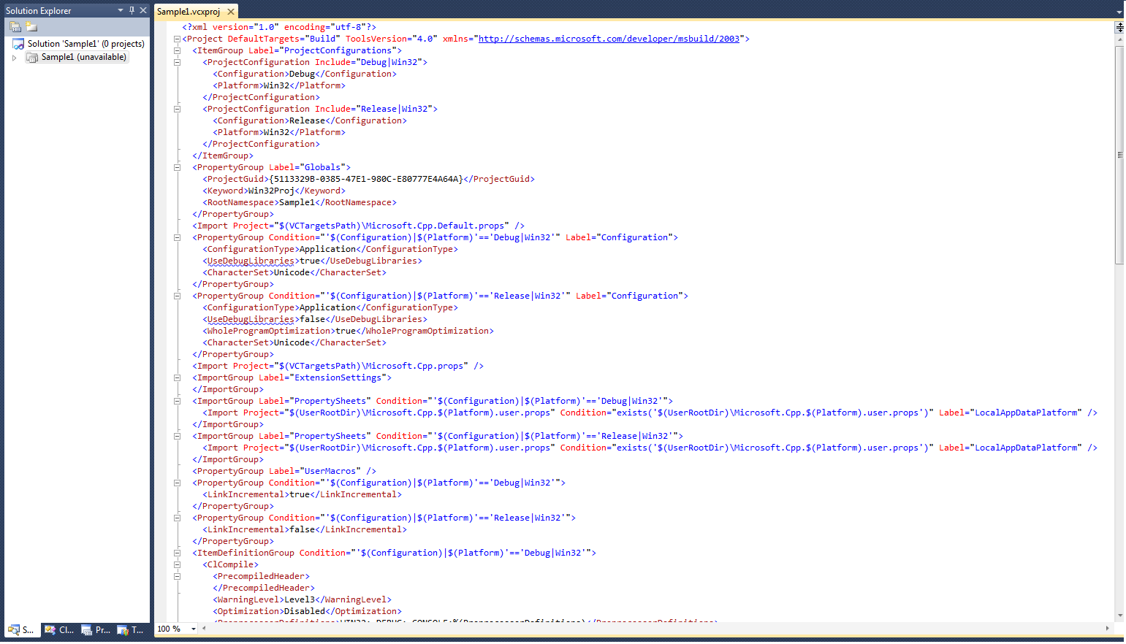
How to access in Visual Studio
Notes:
Big chunk of XML. By the end of this you should hopefully understand most of it and be a little more comfortable working in it.
If you look closer, you’ll notice a lot of stuff that you set because you went to the properties page of your project from Visual Studio… well here’s how all that gets stored.

Slide 9
Language Basics
Two ways to store variables
  PropertyGroup
    Stores a single string
    Accessed with $ operator
  ItemGroup
    Can store multiple items
    Can be looped over
    Can contain “metadata” for each item
    Accessed with % and @ operators
All variables are global… kinda
Notes:
All variables pretty must hold strings
All variables are global… kinda, I’ll explain that later.
As with most scripting languages, variables can be used without being declared. Just have an empty string for a value.
You can override variables at any time as well.

Slide 10
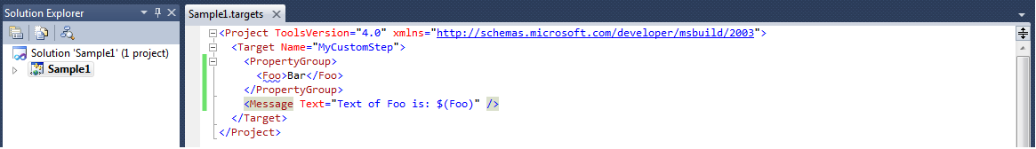
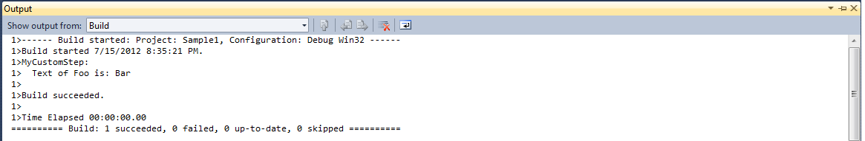
PropertyGroup
Notes:
Here’s a basic MSBuild script.
Should have done hello world, but foo bar will suffice
Declare variable, print it, $ used to access

Slide 11
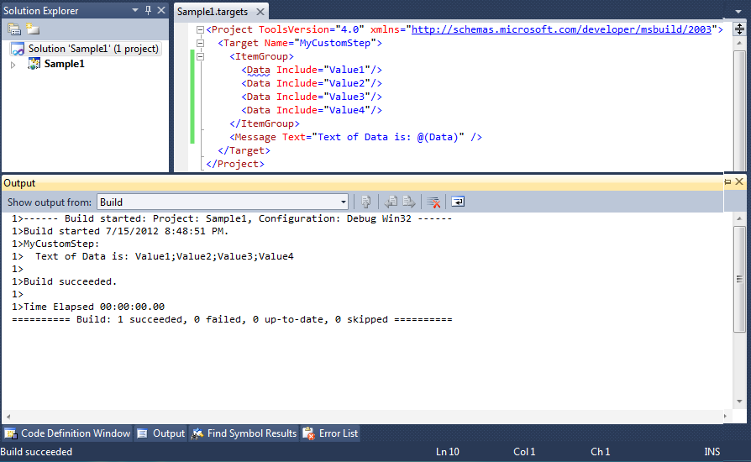
ItemGroup - @ operator
Notes:
Here’s showing how to declare an ItemGroup
Notice you are setting the “Include” parameter, instead of text in the tag.
Notice to access an ItemGroup the @ is used, instead of $ like a propertygroup

Slide 12
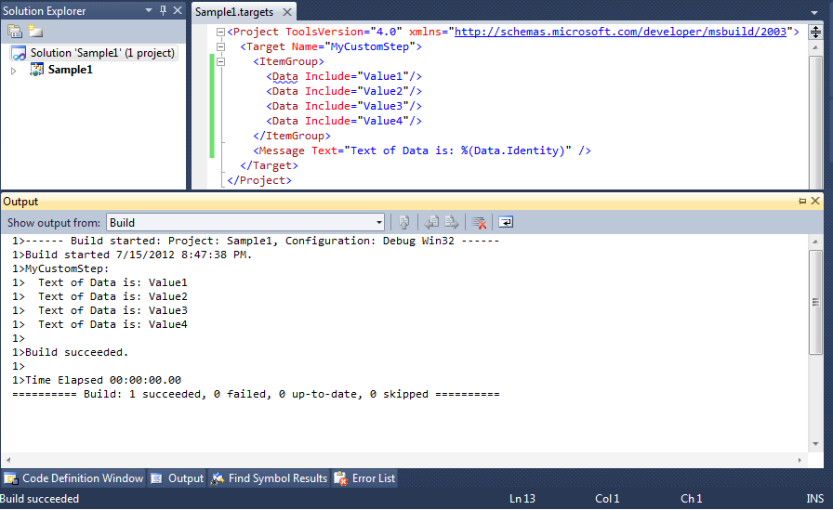
ItemGroup - % operator
Notes:
Same as previous slide, but notice the percent sign is used instead, and does a “foreach” type of action with the itemgroup
ItemGroups can do this, property groups can’t
Notice “Include” is used to declare the value, but “Identity” is used to print it.

Slide 13
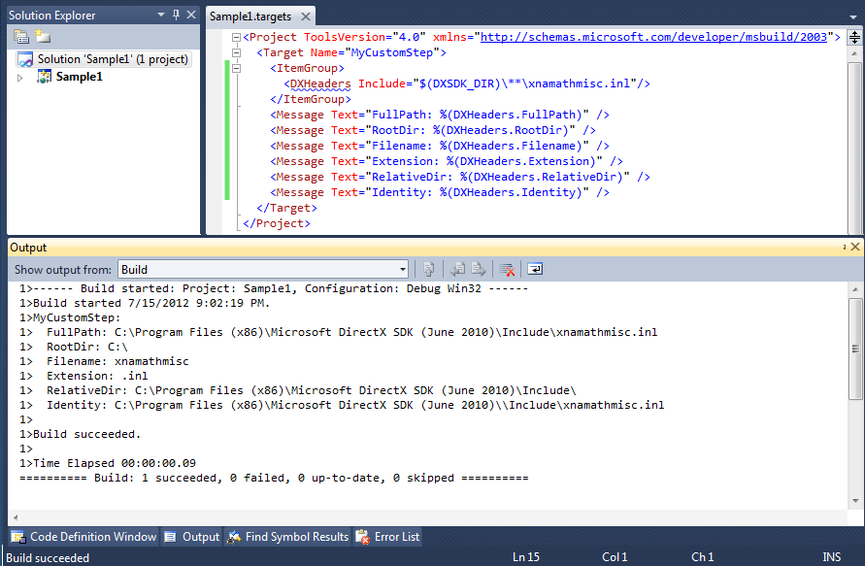
ItemGroup – Well Known MetaData
Notes:
Another benefit of ItemGroups is what is called meta data.
If your include is for a file, you have access to a pre-set pieces of meta data known as well known meta data about the file.
Did anyone notice the DXSDK_DIR variable? Where is it declared? Does anyone recognize it?
Environment variables are carried over into MSBuild. If an identifier is used, MSBuild PropertyGroups are checked first, then environment variables

Slide 14
ItemGroup – Well Known MetaData
More info:
    http://msdn.microsoft.com/en-us/library/ms164313.aspx

Slide 15
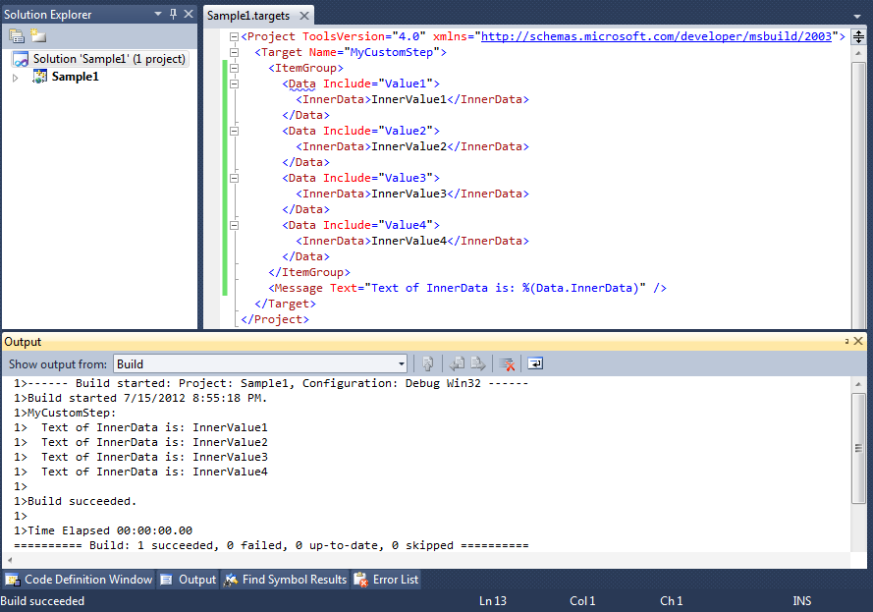
ItemGroup – Custom MetaData
Notes:
You can also declare custom metadata like this. The Xml tag has the name of the metadata, while the content of the tag has the value.
Accessed the same way as well known meta data.

Slide 16
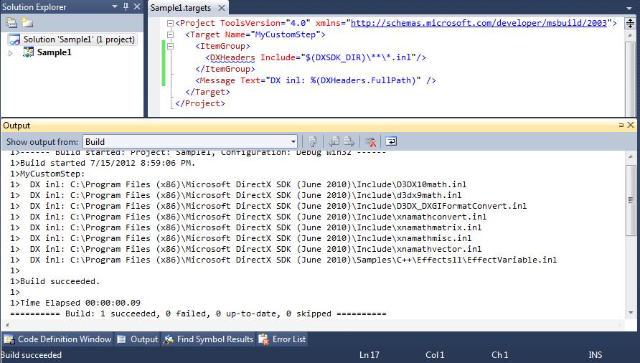
ItemGroup - Wildcards
Notes:
Another benefit of ItemGroups is using WildCards to populate them
Notice the include statement has a wildcard for the file name, now notice all the files that got populated in it.

Slide 17
Tasks
Built in Tasks
  Message
  Exec
  Warning
  Error
  More at:
    http://msdn.microsoft.com/en-us/library/7z253716
Notes:
Now that you’ve seen variables, here’s stuff you can use them with… tasks
You saw the “Message” task before, that’s how we were printing stuff. Other useful tasks include Exec, Warning, and Error.
Of course there’s more, but these are some of the most useful.

Slide 18
Tasks
Built in Parameters for all Tasks
  Condition
    Boolean expression deciding if task will run
  ContinueOnError
    True or False
    If task fails, whether to run remaining tasks after it

Slide 19
Tasks - Exec
Executes a command line string
Standard output piped into VS Output window
  Can be formatted to display as error/warning
    More here http://msdn.microsoft.com/en-us/library/yxkt8b26.aspx
Returns error codes
  Stops build on anything but an error code 0
    More info:
      http://msdn.microsoft.com/en-us/library/x8zx72cd
Notes:
Exec is how you can run something you could otherwise run from the command line… batch files, executables, etc
Standard output from running the Exec task is put into the Visual Studio Output window… and if formatted correctly can translate into a Visual Studio Warning or Error
A lot more information about Exec at the link there

Slide 20
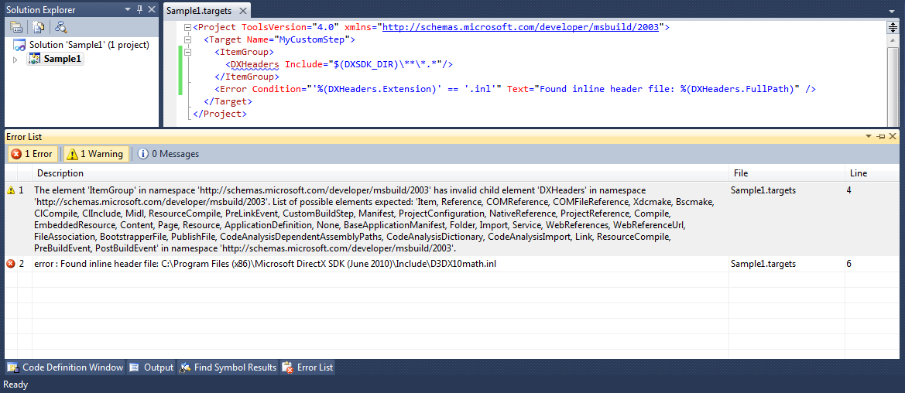
Tasks - Error
Notes:
Another useful task is Error.
It does exactly what you think it does, prints the given text as a visual studio error.
The

Slide 21
Tasks - Condition
All tasks have Condition attribute
If true, it runs. If false, it doesn’t.
==, !=, Exists, !Exists, And, Or
Syntax
  Condition=“’$(FOO)’ == ‘$(BAR)’”
  Condition=“Exists(‘$(FILENAME)’)”
More here:
    http://msdn.microsoft.com/en-us/library/7szfhaft.aspx
Notes:
Previous slide saw Conditon
Since we all are programmers, conditions are pretty straight forward
Syntax is a little wonky, but it’s straight forward
Since we just deal with strings and files, we have equality comparisons, and file existence

Slide 22
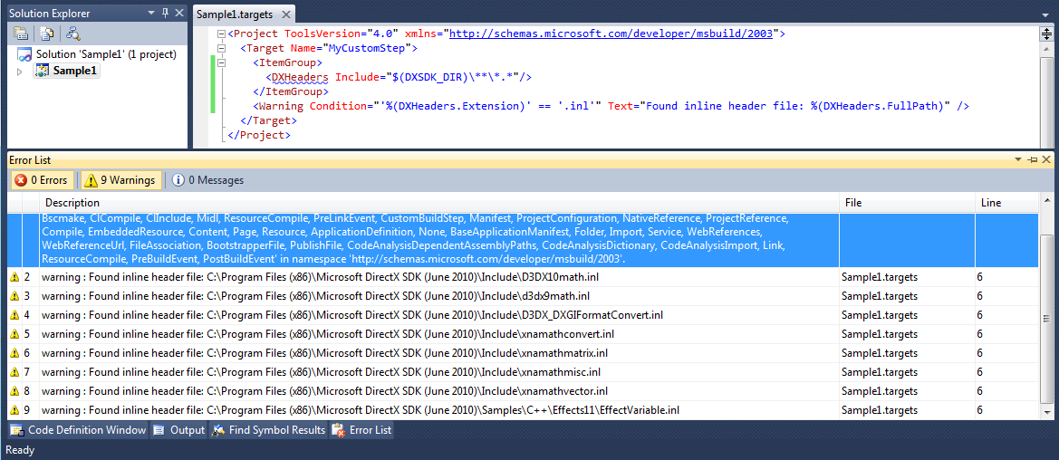
Tasks - Warning
Notes:
Similar to Error, there is also the Warning task
Being programmers, we all know what the difference is… error stops compilation, warning keeps going

Slide 23
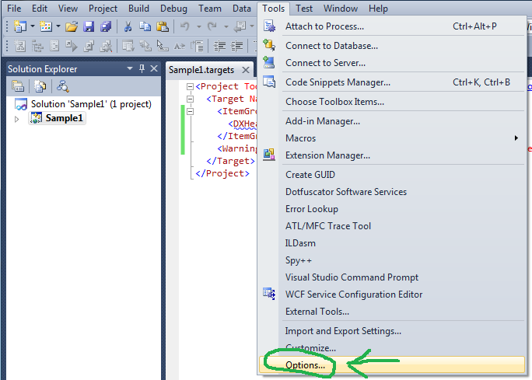
Enable Diagnostic Output
Notes:
This is a good time to show you a technique for debugging your Msbuild
Go to Tools, Options

Slide 24
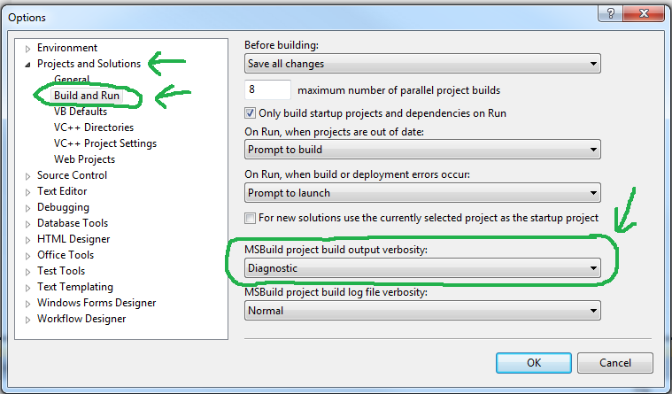
Enable Diagnostic Output
Notes:
Then under the Projects and Solutions header, click the Build and Run tab
Then at the bottom under MSBuild project build output verbosity, put Diagnostic

Slide 25
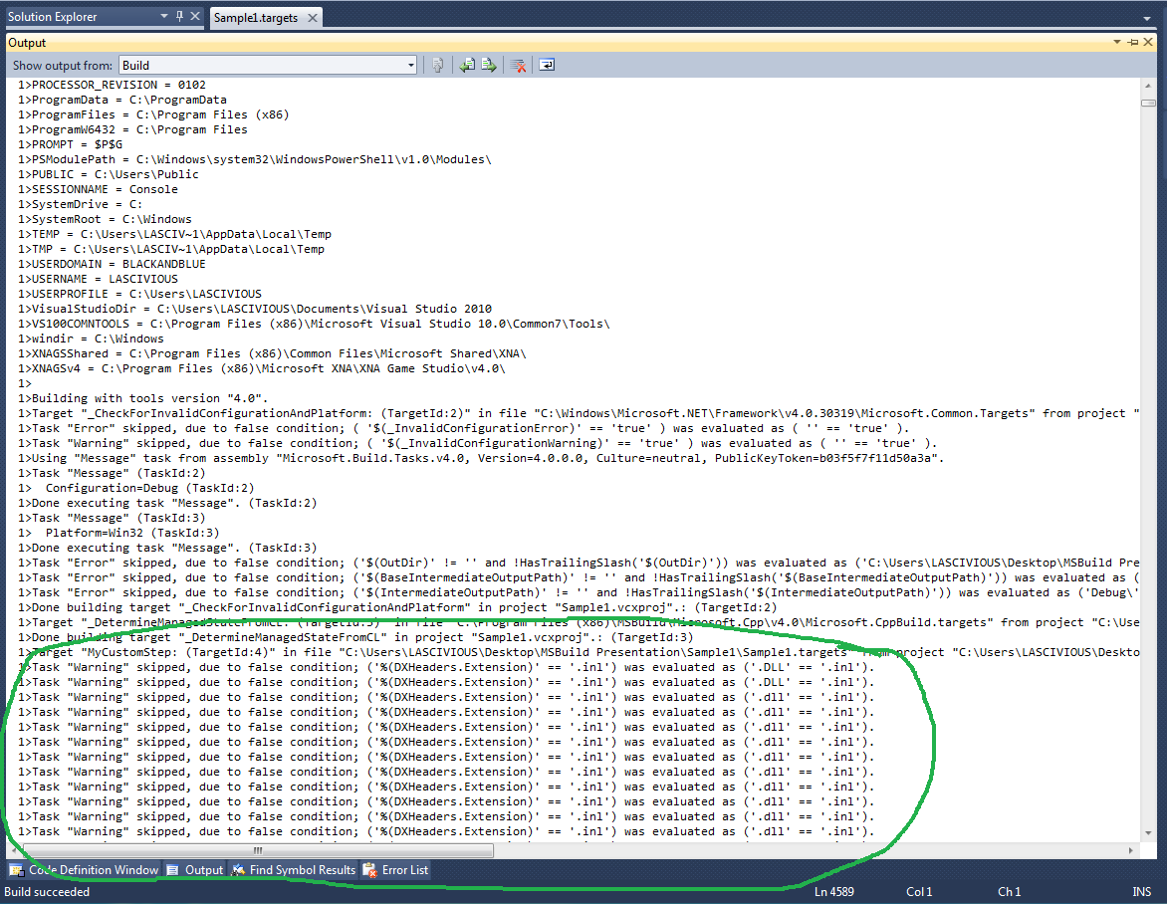
Enable Diagnostic Output
Notes:
Then you get a bunch more spew that looks like this
At the top you can see some values set for PropertyGroups , and then at the bottom you can see warnings from the last example, and why they were skipped

Slide 26
Targets
MSBuild version of a function
Can’t explicitly pass/return variables
  Have to do everything globally
Syntax and options:
    http://msdn.microsoft.com/en-us/library/t50z2hka.aspx
Notes:
Next are Targets.
These are kind of like functions, but you can’t pass or return variables. All variables are global anyways so it’s not a big deal.

Slide 27
Targets
Notes:
Here’s an example from earlier, and on the second line you can see the target declaration with just setting the name.
Now, some of you might be wondering how I was getting my Target to get called in the first place?

Slide 28
How to make your Project call your Target
Override a Visual C++ PropertyGroup
  BuildDependsOn
  CleanDependsOn
  CompileDependsOn
  More at:
    http://blogs.msdn.com/b/msbuild/archive/2006/02/10/528822.aspx
Notes:
Here’s a step by step of one way to do it.
There are many PropertyGroups set by Visual C++, and you can utilize, or override any of them.
Here’s some of the most useful ones

Slide 29
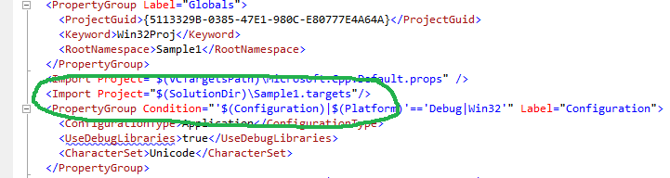
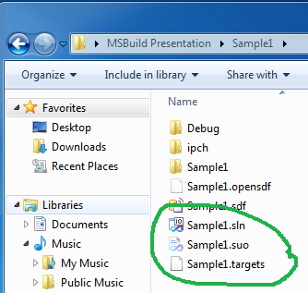
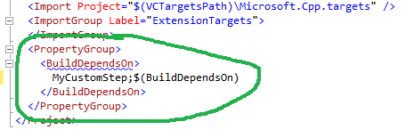
Override Visual C++ Properties
…
Notes:
So if you open your C++ project file like I showed at the beginning,
You add a line to import the file with the Target you declared
And then at the bottom of your project, ensuring PropertyGroups from other imports don’t override it, you add your custom target before the rest of the normal build ones.
Note about Import, it’s like a C++ include, where you are logically inserting the code from that file where you call it.
Some of you might notice the SolutionDir PropertyGroup being used…

Slide 30
PropertyGroups set by Visual C++
SolutionDir
OutputPath
ConfigurationType
  Application, Library, etc
Configuration
  Debug, Release, etc
ProjectName
ProjectFileName
ProjectDir
ProjectPath
UserRootDir
ProjectExt
Notes:
That’s one a bunch that Visual C++ sets for you.
These are all set because of how you set up your project, and how you are building.

Slide 31
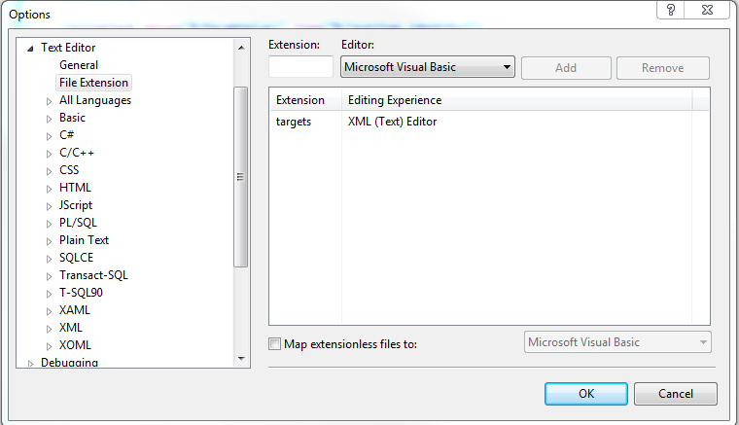
Make Visual Studio Color Coordinate
Notes:
As a side note, if you find that when you create a MSBuild file, Visual Studio isn’t coloring it the way you’d like,
Just go to Tools->Options->Text Editor, and you can define how it colors a certain extension.

Slide 32
Scoping Between Targets
Variables are set when the Target is done executing
  Even variables that override previous ones
Variables are grabbed when a Target starts
Notes:
Remember when I said variables are “kinda” global, here’s my clarification
Variables are “pushed” to the global scope when a Target finishes executing.
This is even the case if you are changing a global variable.

Slide 33
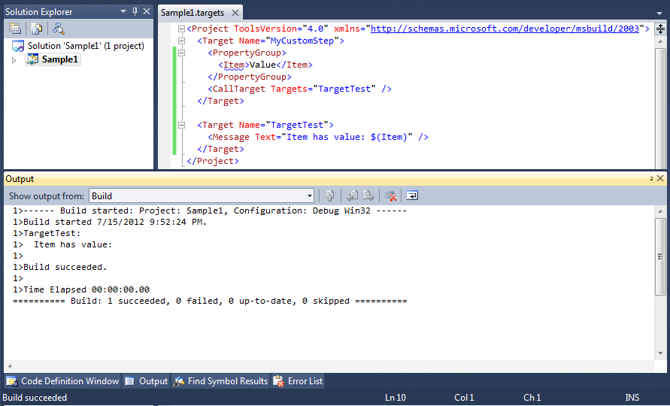
Scoping Between Targets
Notes:
Here are some samples to show you this.
CallTarget does exactly what you think it does.
If you recall, we have the build call “MyCustomStep” first, so you see we declare the variable “Item”, then we call TargetTest
TargetTest tries to print “Item” and gets nothing

Slide 34
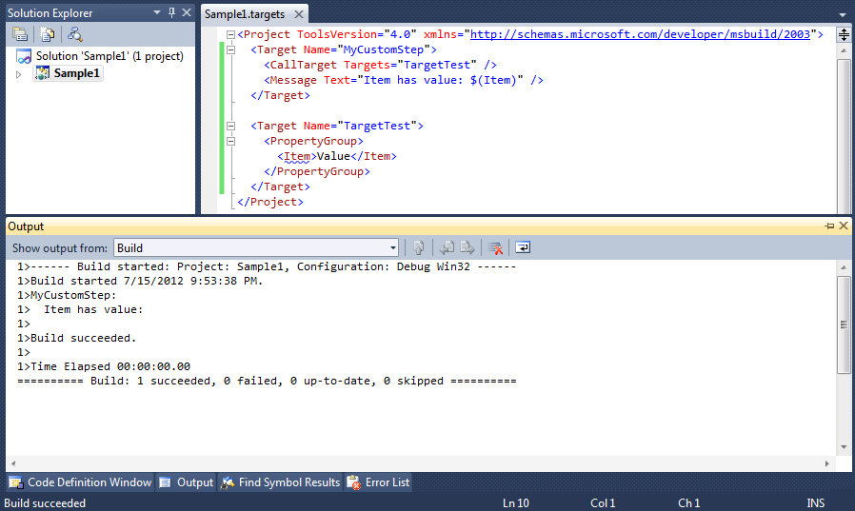
Scoping Between Targets
Notes:
Here’s another example…
So first we call TargetTest, which sets the value of “Item”
Then we try and print out “item” and we see that it still doesn’t have the value

Slide 35
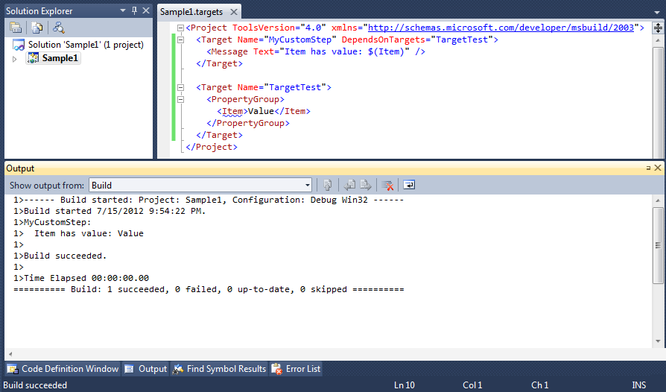
Scoping Between Targets
Notes:
Finally, you now see we use the attribute “DependsOnTargets”
This ensures that the Targets listed there are called, and finished before this target is run
So in this case, TargetTest is run and completed, THEN MyCustomStep is called.
So “Item” is for sure set, and as you can see “value” gets printed

Slide 36
Targets
Ways to run other Targets
  DependsOnTargets
  BeforeTargets
  AfterTargets
  CallTarget
Notes:
Here’s some other ways to have a target run another target
The first three are attributes in the Target declaration, and you saw how you use CallTarget a couple slides ago

Slide 37
Custom Tasks
Can write your own tasks
Multiple ways to write them
  Inline code fragment (single function)
  Full inline class declaration
  Located in separate .dll
Notes:
Remember talking about tasks earlier? You can write your own.
You can do code, inline in your MSBuild script file, with either a single function, or a full class declaration
Or you can have it located in a separate DLL

Slide 38
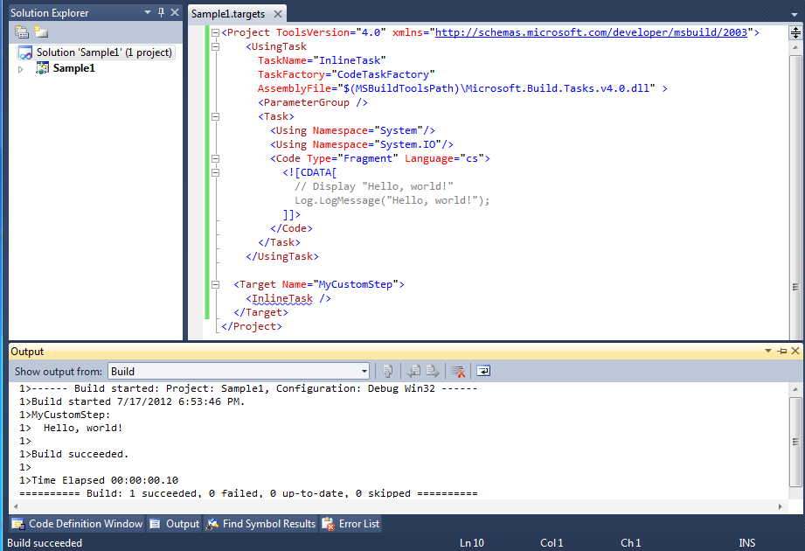
Custom Tasks – Inline Fragment
Notes:
Here’s an Example of an Inline fragment. The gray stuff in the middle is inline C# code.
Yes, you’ll have to use C#. Get used to it.
So you see the “UsingTask” tag declares the task, and gives it a name, then at the bottom you see how you call the Task.
Inside tasks, you use the LogMessage function to get text to the Output Window.

Slide 39
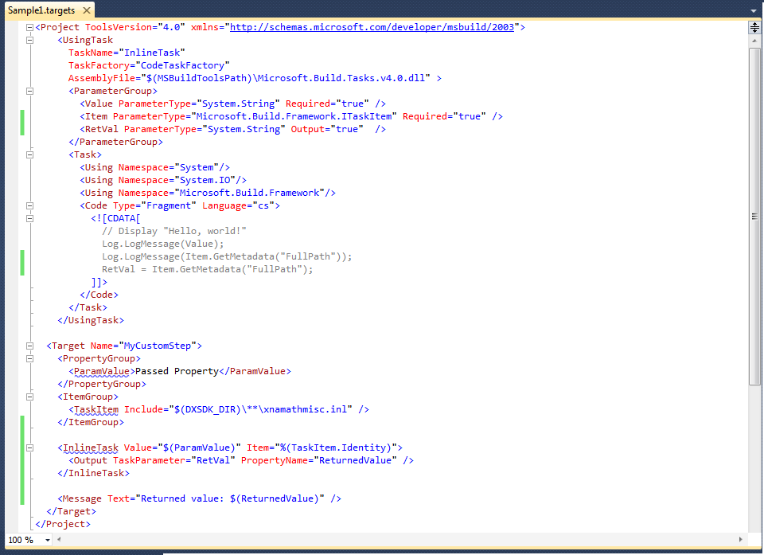
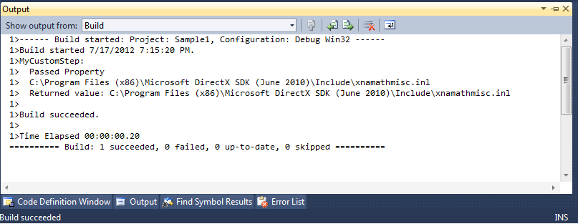
Custom Tasks – Inline Fragment
Notes:
Here’s one that’s a bit more involved. The difference now is when the Task is declared, you see the “ParameterGroup” tag. This is how you declare variables that this task takes in, and outputs.
So, you see it takes a string named “Value” and it’s required, then you see it takes an ITaskItem named “Item”.
This is how you pass in something from an itemgroup if you want to keep its metadata.
You can pass something from an ItemGroup into a string, but only the “Identity” value will get sent in.
In the code, you can see how to extract metadata from the ITaskItem passed in.
Lastly, you see the variable marked as output, and then in the Target at the bottom you can see how to get that output.

Slide 40
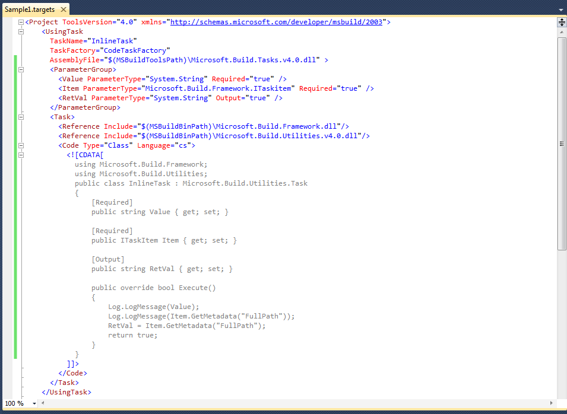
Custom Tasks – Inline Class
Notes:
Here is the inline class version of the code you just saw on the last slide.
Notice the namespace “using” statements have been migrated to the code, additionally you have to explicitly say what DLL’s the code is referencing.
In addition to declaring your input / output variables in the ParameterGroup, you need to declare them in the class itself.
Notice the Required and Output tags.
Lastly, you have to inherit from the “Task” class, and your point of entry is by overriding the Execute function.

Slide 41
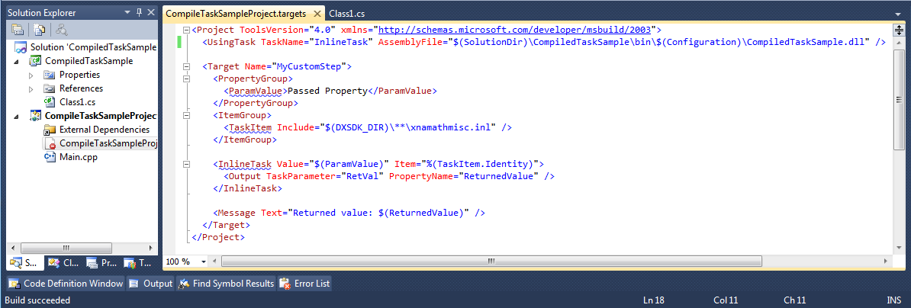
Custom Tasks – Task From DLL
Notes:
Lastly, you can take all that inline C# code from the last file, wrap it into a C# Library project,
Put it into the same solution as your C++ project, and then reference it with that using statement at the top
Don’t worry, I have this as a sample.

Slide 42
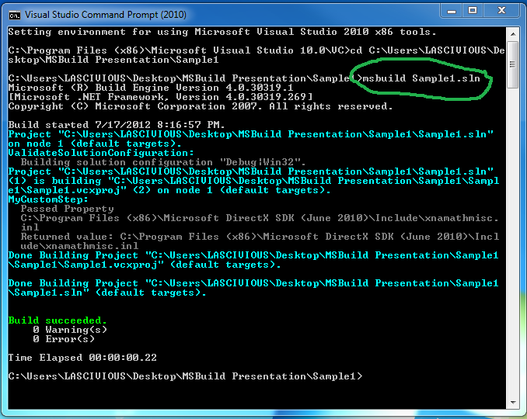
MSBuild From Command Line
Notes:
On a side note, you can use msbuild to build your solution from the command line.
You have to do this from a Visual Studio Command prompt (Program Files, visual studio, tools)
You can pass in PropertyGroups you want to give a value for, or targets you want to explicitly call as well
If you just build like I show here, it uses the defaults.

Slide 43
Custom Tasks – Inline vs DLL
Debugging inline code sucks
Inline compiles each time you build
Inline is more visible
Task’s project part of Solution makes debugging / programming easy
Notes:
So, pros and cons of inline tasks versus ones in a DLL
Compiler syntax errors are annoying to debug with inline code, because an intermediary file is generated, and THAT is compiled, and that’s what the errors are in
Run time errors just get spit into the output window as a stack trace with inline, but if it’s part of the solution it’ll show you the line it broke on.

Slide 44
Proper Naming Conventions
.proj
  A project file
.targets
  A file containing targets shared across other files
.props
  Default settings for a build process
.tasks
  The file containing UsingTask declarations
Notes:
Now, just to be proper, here’s a slide on the naming conventions you should be using for your MSBuild files

Slide 45
Samples!

Slide 46
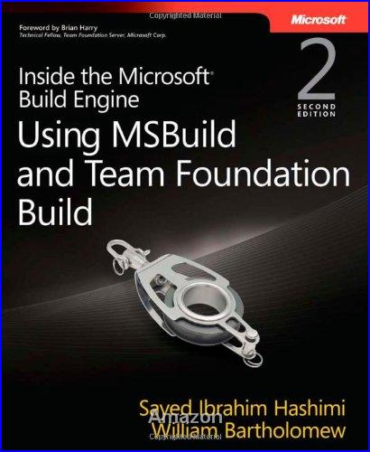
References
MSBuild for Visual C++ on MSDN
  http://msdn.microsoft.com/en-us/library/ee662426
MSBuild on MSDN
  http://msdn.microsoft.com/en-us/library/dd393574
Notes:
This book is amazing, highly recommended.
Here’s also specific links for Msbuild on MSDN

Slide 47
Questions?

Slide 48
Thanks!
Contact Info:
  Francis.robert.b@gmail.com
  facebook.com/rbfrancis
Slides and Samples!
    http://robertbfrancis.com/MSBuildPresentation.zip

