Slide 1
PROJECT PRESENTATION
SHOPIFUL
Enterprise E-Commerce Intelligence Platform
Industry: E-Commerce — Online Retail & Enterprise Business Analytics
Technologies: MySQL | SQL | Power BI | DAX | Power Query | Excel
Author: Sathya Sri M
AF05247775

Slide 2
INTRODUCTION
Project Overview
1
SHOPIFUL is a data analytics and business intelligence project designed to analyze the sales, customer, product, order, payment, return, delivery, review, and warehouse performance of an e-commerce business.
2
The project uses MySQL and SQL for database creation, data storage, validation, and analysis, and Microsoft Power BI for interactive dashboards and business intelligence reporting.
3
The solution integrates customers, products, categories, orders, payments, returns, deliveries, reviews, and warehouse operations to identify sales trends, customer behaviour, product performance, operational issues, payment patterns, and inventory-related insights.
SHOPIFUL — Enterprise E-Commerce Intelligence Platform
1

Slide 3
BACKGROUND
Industry & Problem Statement
Industry: E-Commerce — Online Retail & Enterprise Business Analytics
Business Areas Covered
Sales and revenue performance
Customer behaviour and order frequency
Product and category performance
Order analysis
Payment analysis
Returns and delivery performance
Product reviews and ratings
Warehouse and inventory operations
Geographical business performance
SHOPIFUL — Enterprise E-Commerce Intelligence Platform
2

Slide 4
BACKGROUND
Project Objectives
Build a structured relational database for e-commerce operations.
Organize customer, product, category, order, payment, return, delivery, review, and warehouse data.
Analyze sales, orders, revenue, discounts, and product performance.
Identify top-performing products and categories.
Analyze customer purchasing behaviour and geographical distribution.
Evaluate payment methods and payment revenue.
Analyze return patterns and delivery performance.
Monitor warehouse capacity and stock distribution.
Build interactive Power BI dashboards for management reporting.
Generate actionable business recommendations.
SHOPIFUL — Enterprise E-Commerce Intelligence Platform
3

Slide 5
METHODOLOGY
Tools & Technologies
Tool / Technology | Purpose
Microsoft Excel | Dataset source, inspection and initial preparation
MySQL | Database creation and data storage
SQL | Data validation, querying and business analysis
Power Query | Data cleaning and transformation
Microsoft Power BI | Interactive dashboard development
DAX | KPI and calculated measure creation
GitHub | Project documentation and version control
SHOPIFUL — Enterprise E-Commerce Intelligence Platform
4

Slide 6
DATA FOUNDATION
Dataset Introduction & Source
The project uses an Enterprise E-Commerce Dataset containing multiple related tables. The dataset was sourced and initially inspected and prepared in Microsoft Excel.
Customers Customer details and geographical information
Products Product details, pricing and product information
Categories Product category information
Orders Main order transaction data
Order_Items Individual products and quantities within orders
Payment Payment method and payment transaction information
Returns Return status and return-related information
Deliveries Delivery and delivery partner information
Reviews Customer ratings and product review information
Warehouse Warehouse capacity, stock and location information
SHOPIFUL — Enterprise E-Commerce Intelligence Platform
5

Slide 7
DATABASE LAYER
MySQL — Database & Tables
The database follows a relational structure where Orders and Order_Items act as the main transaction areas, connected with customer, product, category, payment, return, delivery, review, and warehouse information.
SQL was used for:
Database creation
Table creation
Data inspection
Data validation
Record-count validation
Duplicate checking
NULL / value checking
KPI validation
Cross-table business analysis
SHOPIFUL — Enterprise E-Commerce Intelligence Platform
6

Slide 8
INTEGRATION
Connecting MySQL with Power BI
After the MySQL database was built and validated with SQL, it was connected to Microsoft Power BI to enable interactive dashboard development and business intelligence reporting.
MySQL Database
(Validated via SQL)
Power BI
Data Connection
Power Query
Transformation
SHOPIFUL — Enterprise E-Commerce Intelligence Platform
7

Slide 9
INTEGRATION
Loading Data to ETL
Following the Power BI connection, data moved through the ETL (Extract, Transform, Load) stage using Power Query — transforming raw MySQL data and preparing it for data modelling and relationships within Power BI.
Power BI
Data Connection
Power Query
Transformation
Data Modelling &
Relationships
DAX Measures
& KPIs
SHOPIFUL — Enterprise E-Commerce Intelligence Platform
8

Slide 10
DATA PREPARATION
Data Cleaning
Data cleaning and validation was carried out as part of the project workflow, using Power Query for cleaning and transformation and SQL for record-count validation, duplicate checking, and NULL/value checking.
Power Query
Data cleaning and transformation
Record-Count Validation
Confirms expected row totals per table
Duplicate Checking
Identifies and removes duplicate records
NULL / Value Checking
Verifies data completeness and validity
SHOPIFUL — Enterprise E-Commerce Intelligence Platform
9

Slide 11
MODELLING
Basic DAX Measures — Key KPIs
DAX was used for KPI and calculated-measure creation, powering the following key performance indicators across the dashboards.
Total Sales
Measures overall revenue generated
Total Orders
Measures order volume
Total Customers
Measures customer base
Total Units Sold
Measures product sales volume
Average Order Value
Measures average revenue per order
Total Profit
Measures overall profitability
Return Rate
Measures return frequency
Payment Amount
Measures payment revenue
Warehouse Capacity
Measures available warehouse capacity
Stock Quantity
Measures inventory availability
SHOPIFUL — Enterprise E-Commerce Intelligence Platform
10

Slide 12
POWER BI DASHBOARDS
Dashboard Design — Pages Overview
01
02
03
Executive Overview
Customer Intelligence
Product Performance
04
05
06
Sales & Orders
Returns & Delivery
Payment & Revenue
07
Warehouse & Inventory Intelligence
SHOPIFUL — Enterprise E-Commerce Intelligence Platform
11

Slide 13
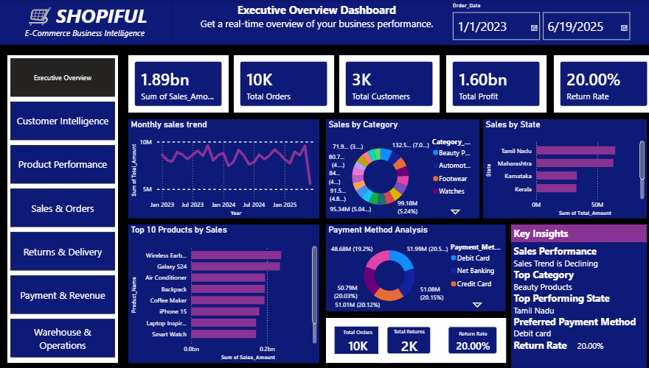
DASHBOARD PAGES / VISUALS
01
Dashboard 1 — Executive Overview
Key Visuals
Monthly Sales Trend
Sales by Category
Sales by State
Top 10 Products by Sales
Payment Method Analysis
SHOPIFUL — Enterprise E-Commerce Intelligence Platform
12

Slide 14
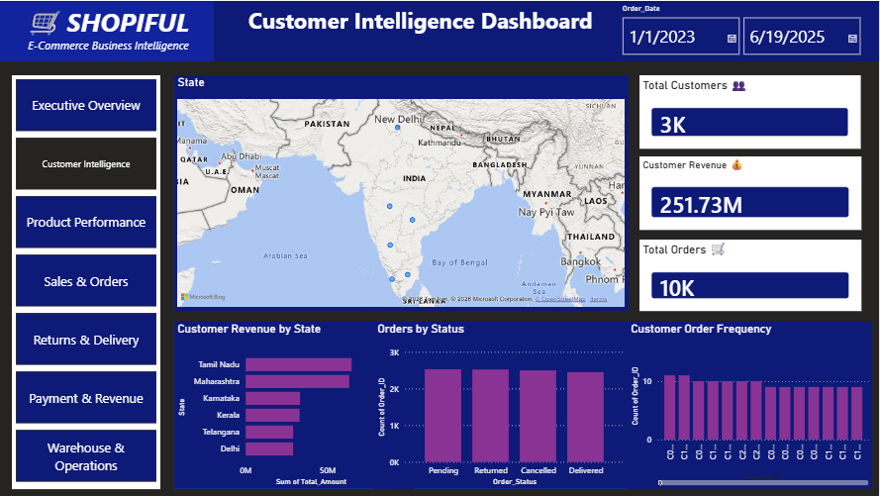
DASHBOARD PAGES / VISUALS
02
Dashboard 2 — Customer Intelligence
Key Visuals
Customer Revenue by State
Orders by Status
Customer Order Frequency
Geographic Customer Distribution
SHOPIFUL — Enterprise E-Commerce Intelligence Platform
13

Slide 15
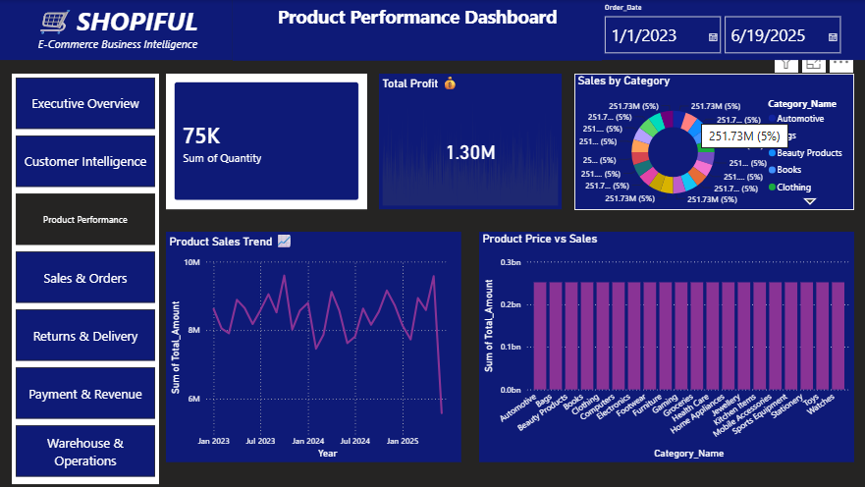
DASHBOARD PAGES / VISUALS
03
Dashboard 3 — Product Performance
Key Visuals
Sales by Category
Product Sales Trend
Product Price vs Sales
Product Rating Distribution
Top Products / Units Sold
SHOPIFUL — Enterprise E-Commerce Intelligence Platform
14

Slide 16
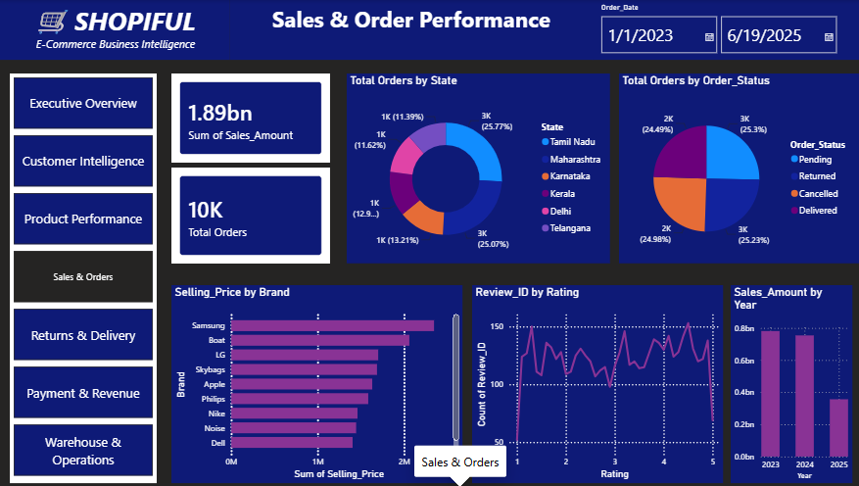
DASHBOARD PAGES / VISUALS
04
Dashboard 4 — Sales & Orders
Key Visuals
Total Orders by State
Total Orders by Order Status
Selling Price by Brand
Reviews by Rating
Sales Amount by Year
SHOPIFUL — Enterprise E-Commerce Intelligence Platform
15

Slide 17
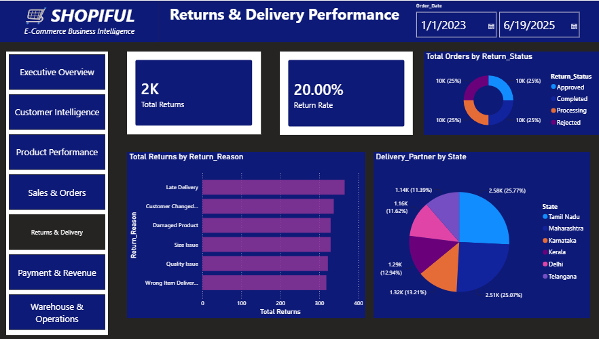
DASHBOARD PAGES / VISUALS
05
Dashboard 5 — Returns & Delivery
Key Visuals
Total Orders by Return Status
Total Returns by Reason
Delivery Partner by State
SHOPIFUL — Enterprise E-Commerce Intelligence Platform
16

Slide 18
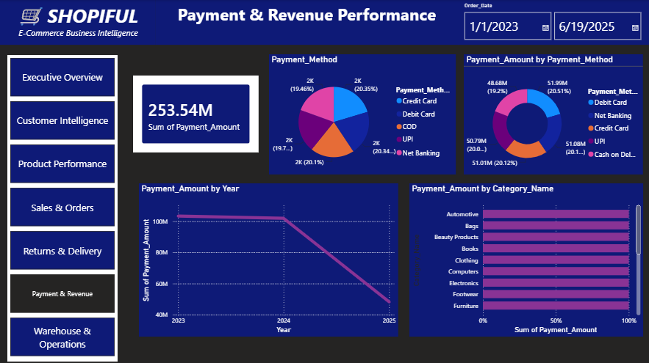
DASHBOARD PAGES / VISUALS
06
Dashboard 6 — Payment & Revenue
Key Visuals
Payment Method Distribution
Payment Amount by Method
Payment Amount by Year
Payment Amount by Category
SHOPIFUL — Enterprise E-Commerce Intelligence Platform
17

Slide 19
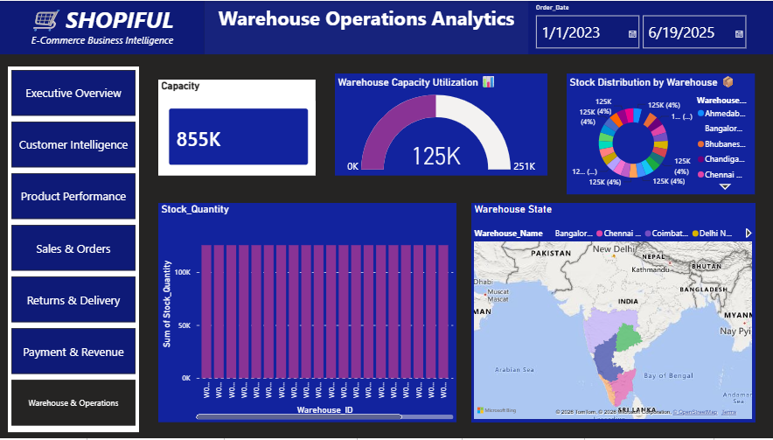
DASHBOARD PAGES / VISUALS
07
Dashboard 7 — Warehouse & Inventory Intelligence
Key Visuals
Warehouse Capacity Utilization
Stock Distribution by Warehouse
Stock Quantity by Warehouse ID
Warehouse State Map
SHOPIFUL — Enterprise E-Commerce Intelligence Platform
18

Slide 20
INTERACTIVITY
Filters & Slicers
Each dashboard page is built around the core business dimensions used across the visuals, enabling users to filter and slice results dynamically.
Category
State
Year
Payment Method
Order Status
Return Status
Brand
Rating
Warehouse ID
SHOPIFUL — Enterprise E-Commerce Intelligence Platform
19

Slide 21
FINDINGS
Key Business Insights (1/2)
Sales Performance Monitor sales trends across months, years, categories, and states.
Product Performance Identify products and categories contributing significantly to sales.
Customer Behaviour Understand customer distribution, revenue contribution, and order frequency.
Order Performance Analyze order volume and order-status patterns.
Payment Behaviour Identify popular payment methods and payment revenue contribution.
SHOPIFUL — Enterprise E-Commerce Intelligence Platform
20

Slide 22
FINDINGS
Key Business Insights (2/2)
Returns Analysis Identify return patterns and major return reasons.
Delivery Analysis Understand delivery partner distribution across states.
Warehouse Performance Monitor warehouse capacity and stock distribution.
Geographical Analysis Identify states contributing significantly to customers, orders, and revenue.
Management Reporting Provide a centralized dashboard for faster, data-driven decisions.
SHOPIFUL — Enterprise E-Commerce Intelligence Platform
21

Slide 23
PROCESS
Project Workflow
1. Raw Dataset
2. Data Inspection
3. Data Cleaning & Validation
4. MySQL Database Creation
5. Table Creation
6. SQL Data Validation
7. SQL Analysis
8. Power BI Data Connection
9. Power Query Transformation
10. Data Modelling & Relationships
11. DAX Measures & KPIs
12. Dashboard Development
13. Business Insights
14. Recommendations
SHOPIFUL — Enterprise E-Commerce Intelligence Platform
22

Slide 24
DOCUMENTATION
GitHub Repository
GitHub was used for project documentation and version control. The repository is organized as follows:
SHOPIFUL-Enterprise-Ecommerce-Intelligence/
├── README.md
├── Dataset/
│ └── SHOPIFUL_Ecommerce_Dataset.xlsx
├── SQL/
│ ├── Database_Creation.sql
│ ├── Table_Creation.sql
│ ├── Data_Validation.sql
│ └── Analysis_Queries.sql
├── PowerBI/
│ └── SHOPIFUL_Enterprise_Analytics.pbix
├── Dashboard_Screenshots/
│ ├── Executive_Overview.png
│ ├── Customer_Intelligence.png
│ ├── Product_Performance.png
│ ├── Sales_Orders.png
│ ├── Returns_Delivery.png
│ ├── Payment_Revenue.png
│ └── Warehouse_Inventory.png
└── Documentation/
└── Project_Report.pdf
License
This project is created for educational, portfolio, and data analytics demonstration purposes.
Author
Sathya Sri M
Project Focus: Data Analytics | Business Intelligence | Sales Analytics | Customer Analytics | Product Analytics | Operations Analytics
SHOPIFUL — Enterprise E-Commerce Intelligence Platform
23

Slide 25
OUTCOMES
Recommendations
Focus on high-performing products and categories.
Develop targeted strategies for high-revenue states.
Improve customer retention by monitoring order frequency.
Analyze unsuccessful and returned orders to reduce operational losses.
Optimize payment options based on customer preferences.
Monitor delivery partner performance across states.
Improve warehouse capacity utilization.
Maintain appropriate stock levels based on demand.
Use Power BI dashboards as a recurring management reporting system.
SHOPIFUL — Enterprise E-Commerce Intelligence Platform
24

Slide 26
OUTCOMES
Future Enhancements
Real-time sales monitoring
Sales and demand forecasting
1
2
Customer churn prediction
Product demand prediction
3
4
Automated inventory-reorder recommendations
Advanced customer segmentation
5
6
Automated Power BI data refresh
Predictive return analysis
7
8
Delivery performance prediction
AI-based business recommendations
9
10
SHOPIFUL — Enterprise E-Commerce Intelligence Platform
25

Slide 27
Thank You
SHOPIFUL — Enterprise E-Commerce Intelligence Platform
Sathya Sri M

