Slide 1
ALM 11 : New Features
HP Application Lifecycle Management 11.00
HP Quality Center 11.00
Day - 2

Slide 2
Objectives
What is HP Sprinter?
Test Execution
Screen Annotation & Tools
Defect logging from Sprinter
Power Mode Features
Data Injection
Exploratory Testing
Mirror Testing
HP ALM Integration with other tools
Reporting Capabilities
Admin Features of ALM 11

Slide 3
HP Sprinter – Manual Testing
HP Application Lifecycle Management 11.00
HP Quality Center Enterprise 11.00

Slide 4
Manual Testing Today
Manual testing has not changed in 15 – 20 years – It’s challenging
Executing Tests
Defect Remediation
QA Team
Development Team
Significant time spent executing tests
Bug descriptions are rarely complete
Following and executing test steps is challenging
Information needed to recreate the bug is often missing
Repetitive test steps waste execution time
Significant time spent trying to recreate and figure out defects
Test multiple environments is time consuming
No history of user actions when exploratory testing
Entering data is a chore and can be error prone

Slide 5
What is HP Sprinter?
HP Sprinter provides a suite of advanced features and tools that make manual testing more efficient and effective.
Sprinter displays steps in a clear, organized, and user-friendly design.
Sprinter enables you to create annotated screen captures of your application and attach them to an ALM defect or the actual result of a step. You can also attach a movie of your run to a defect in ALM.
Sprinter can keep a record of all the user actions you performed during your test.
This enables Sprinter to create detailed defect scenarios for you.
This greatly increases the value of exploratory tests that you run without pre-defined steps.
Sprinter can inject data automatically into fields in your application.
Sprinter enables you to create and run macros to perform a set of actions in your application for you.
Sprinter can replicate your user actions on multiple computers with different configurations. This allows you to increase your coverage matrix and saves you time testing different configurations.

Slide 6
HP Sprinter Add-in
Hp Sprinter is not a module in ALM. It is a an additional feature which can be installed from the add-in page.
Editions:
HP ALM and HP Quality Center Enterprise Edition enable manual testing with Sprinter.
Sprinter is not available for HP Quality Center Starter Edition or HP ALM Performance Center Edition.
Download Link:
http://update.external.hp.com/qualitycenter/qc110/mictools/sprinter/index.html

Slide 7
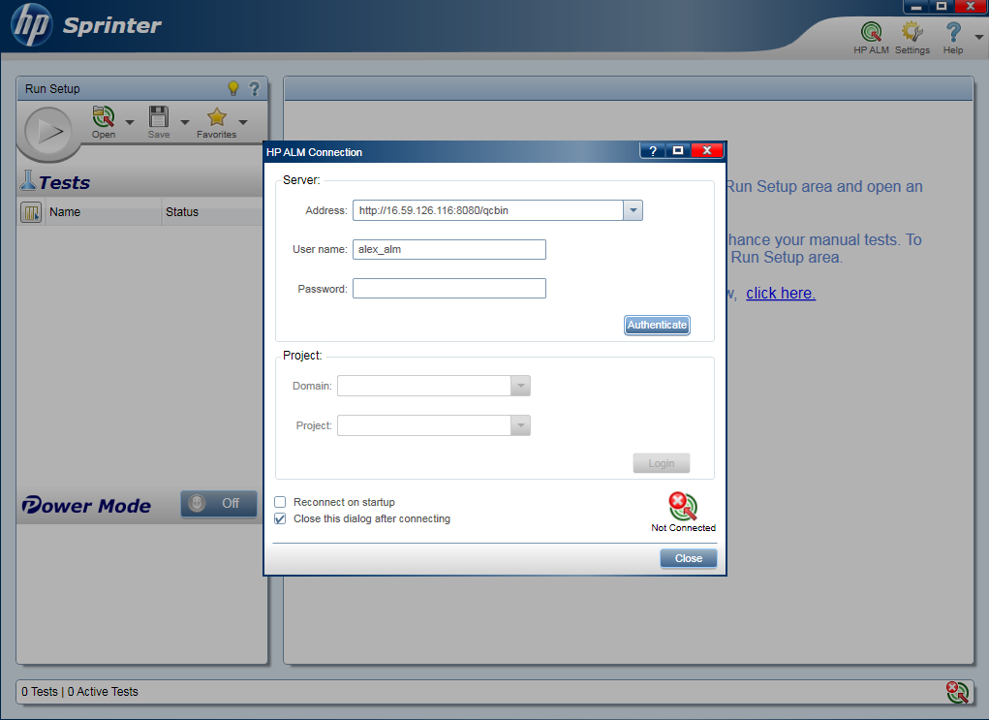
Connects directly to HP Quality Center
HP Sprinter
Open test cases from HP Quality Center
Connects directly to HP Quality Center
Included with HP Quality Center 11.0 and HP ALM 11.0
Save results directly into HP Quality Center

Slide 8
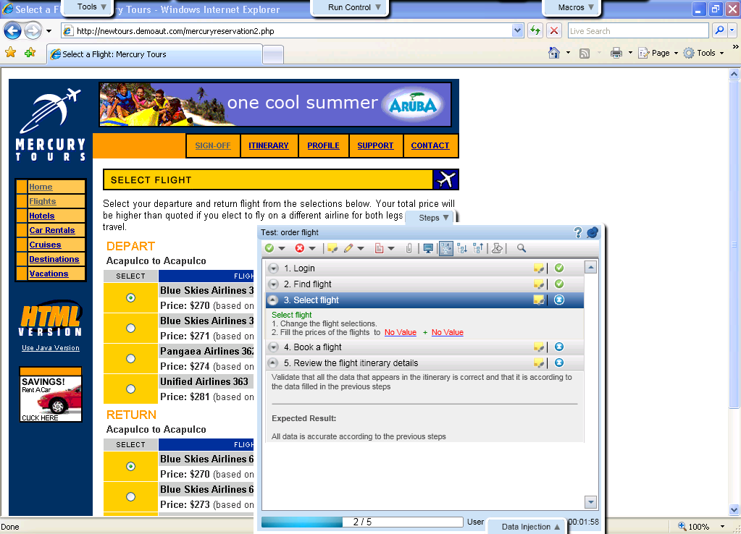
Test Execution
Tabs around application under test
Test steps for execution
Easy to use, unobtrusive and maximizes application under test real estate

Slide 9
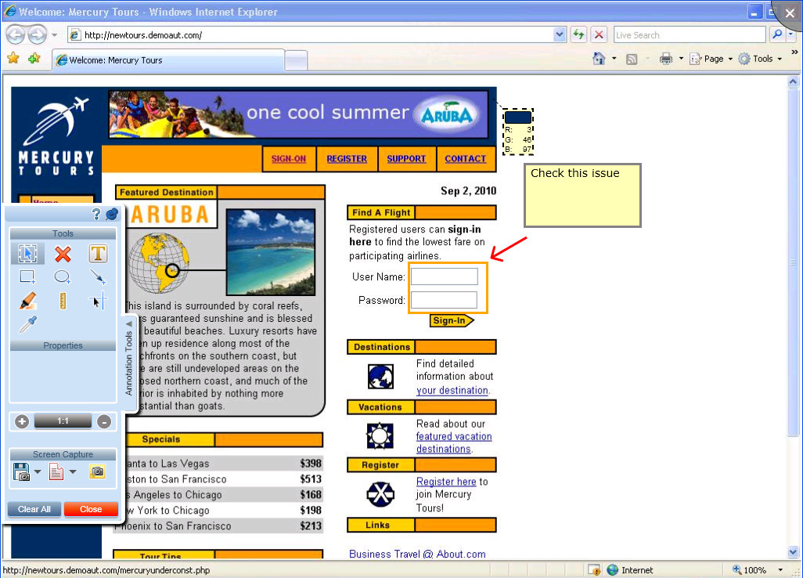
Screen Annotation and Tools
Check application elements
- color, position
Annotation Tools
Annotate directly on the screen
Clearly communicate defects to developers using visual tools

Slide 10
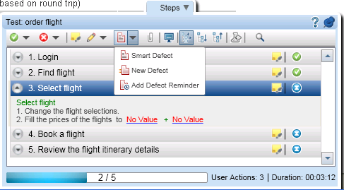
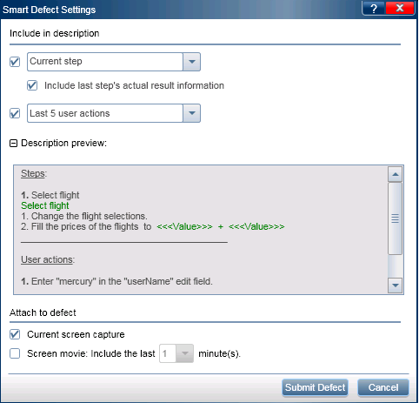
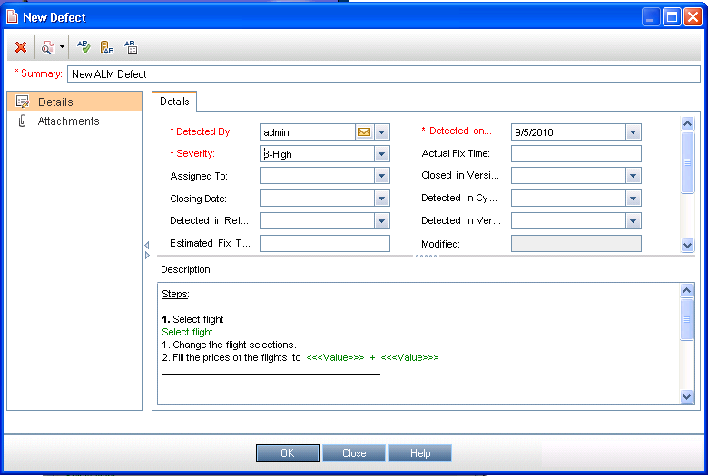
Log defects in QC
Easily give developer the most possible information
Simply create a defect
Create defect without entering QC

Slide 11
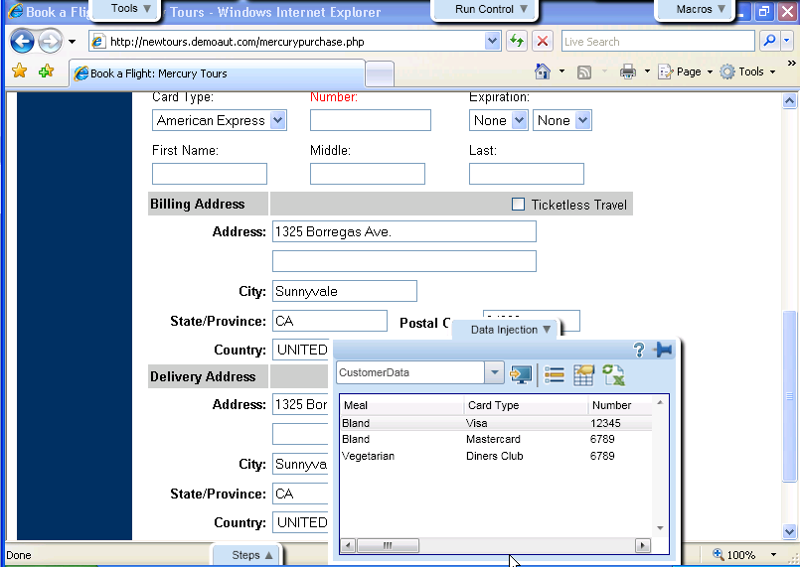
Data Injection
Save significant time on most tedious manual testing activity
Automatically insert data into the application

Slide 12
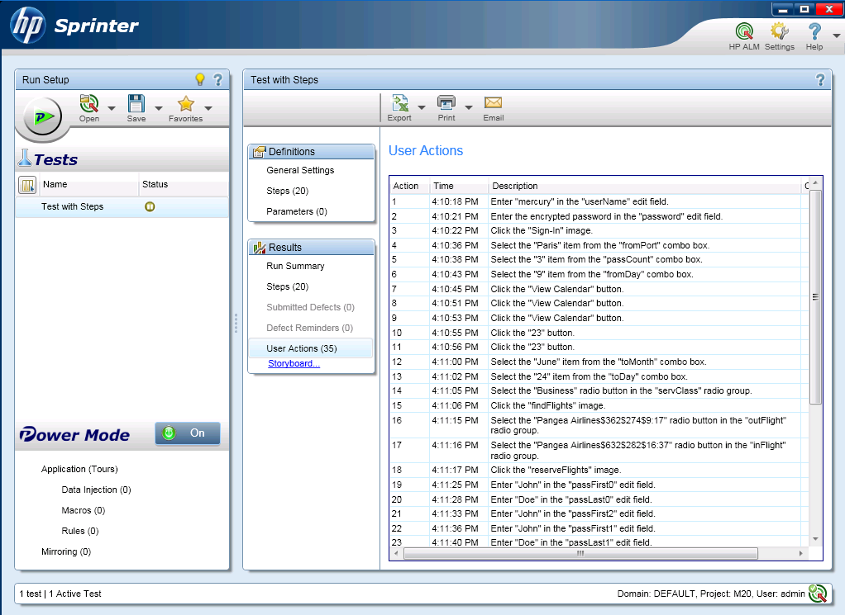
Exploratory Testing
HP Sprinter
Create formal test script from exploratory test
Log user all actions performed during test
Communicate user actions taken clearly to development
Increase value of exploratory testing and improve communication of results
Notes:
Becoming more common with Agile adoption
Used to test how the software is working and handles different actions in order to uncover defects quickly
Challenge: The history or actions that led to that outcome cannot be communicated as the test was ad-hoc and wasn’t following a specific test case or use case
With HP Sprinter:
You can keep a record and log of all the user actions you performed during your test
Increase the value of exploratory testing by better communicating what lead to the result or defect

Slide 13
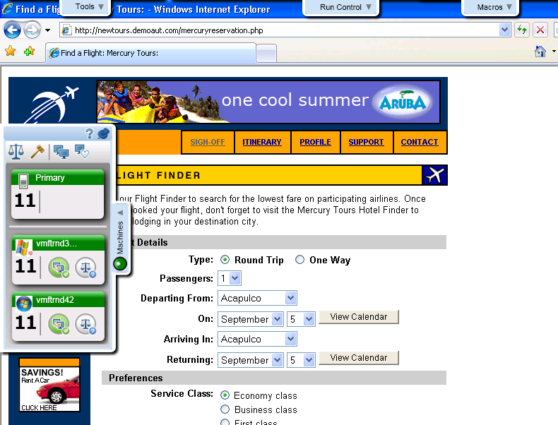
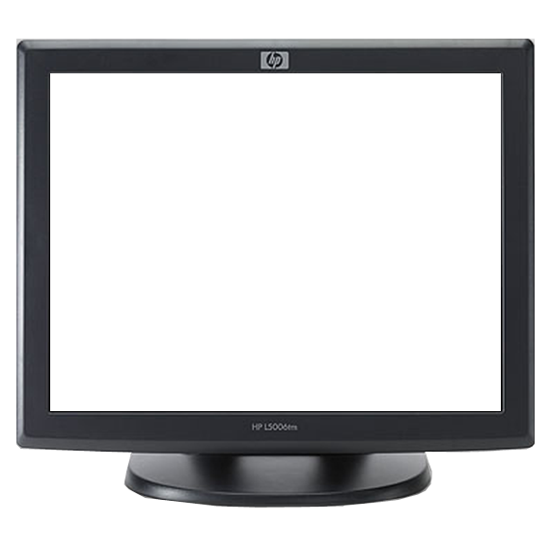
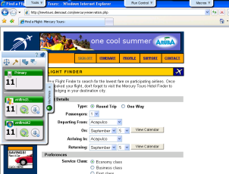
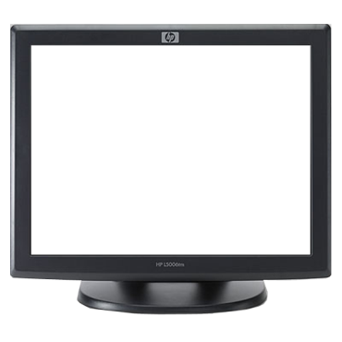
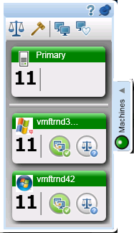
Mirror Testing
Test multiple environments at the same time
HP Sprinter
vmftrnd3
vmftrnd42

Slide 14

Let’s Take a

Slide 15
Development Management
HP Application Lifecycle Management 11.00
HP Quality Center Enterprise 11.00

Slide 16



Key Developer Integration and Collaboration
Addressing the developer in their home environment
Work directly on ALM/ QC entities within the Eclipse IDE creating traceability between reqs, defects and source code.
Work directly on ALM/QC entities within the Visual Studio IDE creating traceability between reqs, defects and source code.
Bi-directional synchronization of ALM/ QC user stories to Team Forge work tasks creating traceability between reqs, defects and source code.
Bidirectional synchronization of ALM/QC reqs and defects with TFS bugs and work items.
Available on ALM/QC Add-ins page
Available on ALM/QC Add-ins page
Available:
www.collab.net/go/hp

Slide 17
Reporting
HP Application Lifecycle Management 11.00
HP Quality Center Enterprise 11.00

Slide 18
Reporting
A new Project Report reporting tool is available in the Analysis View module, enabling you to design and generate comprehensive reports of project data
Using templates designed by the project administrator for each ALM entity, users create project reports, by selecting the entities that are included in report sections, and defining data filters

Slide 19
Reporting
Project Reporting
- Comprehensive reports displaying project data
Embedded Web Scorecards & Graphs
- Design & share reports to track project
Notes:
Easily design fully custom report
templates to generate comprehensive reports displaying
project data from HP ALM or HP QC to multiple output
file types. These templates can be shared between
users.
Embeded Web Scorecar
Design and generate comprehensive scorecards and graphs of project data that can be embeded in team SharePoints, Wikis or Web sites.

Slide 20
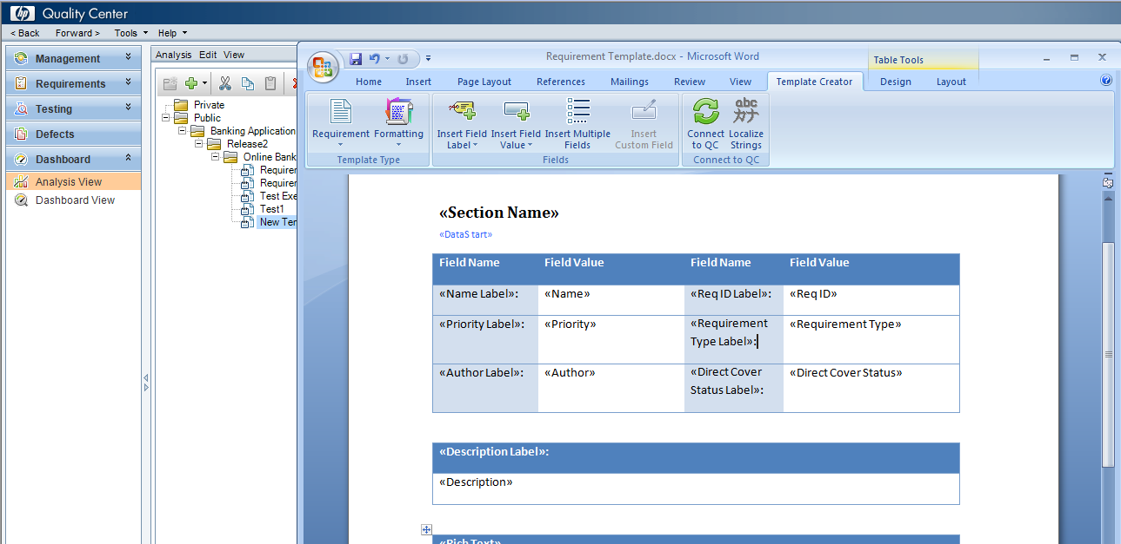
Create Templates
Project Reporting
Easily create report template with custom layout
Add in to Microsoft Word
Notes:
generate comprehensive reports displaying
project data

Slide 21
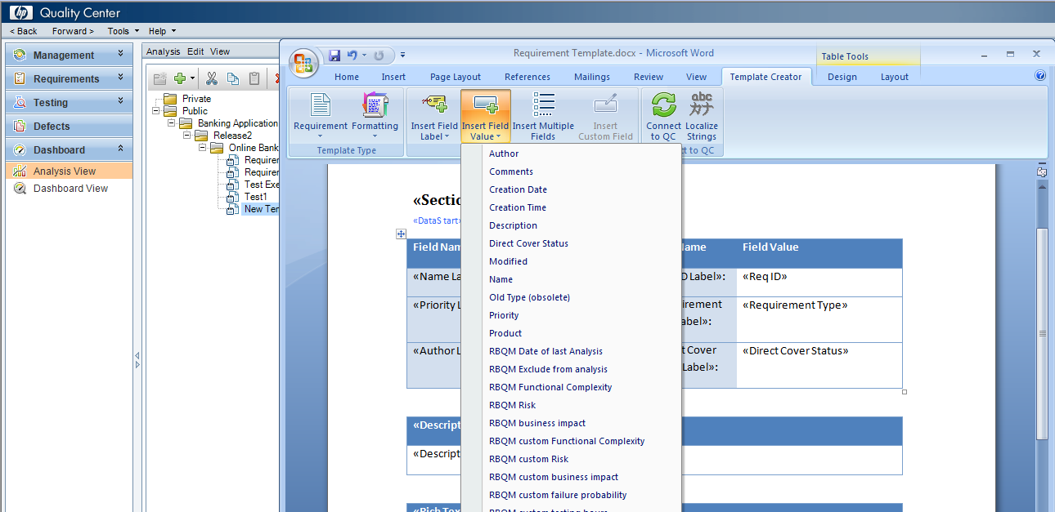
Customize Templates
Project Reporting
Easily edit templates by selecting fields from QC or ALM

Slide 22
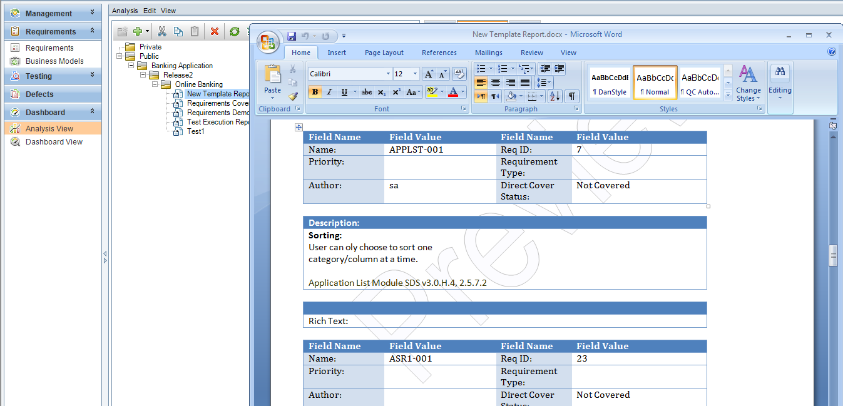
Generate Reports
Project Reporting
Generate template reports with QC Data
Save template reports as private or public (Shared)

Slide 23
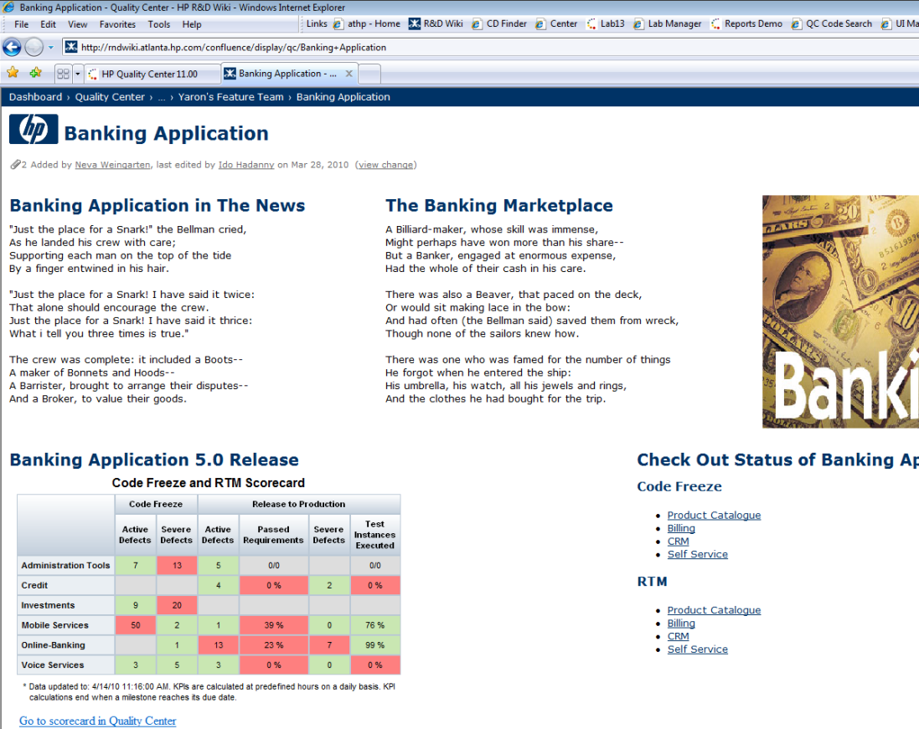
Embedded Web Scorecards & Graphs
Share on Web Portals, Wikis, SharePoint
Publish scorecards and graphs in HTML pages

Slide 24
Sharing Graphs
You can now share graphs for viewing in a Web browser, without downloading an ALM client
Dash board also provides a feature called Release Analysis

Slide 25
Administration & Integration
HP Application Lifecycle Management 11.00
HP Quality Center Enterprise 11.00

Slide 26
Administration & Integration
Side by Side Clients
- Allows running multiple clients connecting to different versions of ALM and QC Servers (ALM 11; QC 9.2, 10.0, 11.0)
Client Installation
- User can install client on desktop without system administration rights
REST APIs
- New web services technology for simple integration with ALM platform. The ALM Synchronizer now leverages the REST APIs.
QC Sense
- Internal monitoring tool that collects data and reports on user actions performed in the user interface, and all client and server activity resulting from those actions
Smart Repository
- Optimized repository system, that creates better performance for common actions, and reduces the size of the file system
Notes:
Side by Side Clients: Allows running multiple clients connecting to different versions of ALM and QC Servers (ALM 11; QC 9.2, 10.0, 11.0).
Client Installation: User can install client on desktop without system administration rights
REST APIs: New web services technology for simple integration with ALM platform. The Synchronizer now leverages the REST APIs.
QC Sense: Internal monitoring tool that collects data and reports on user actions performed in the user interface, and all client and server activity resulting from those actions.
Smart Repository: Optimized repository system, that creates better performance for common actions, and reduces the size of the file system.

Slide 27
Environment Support
HP Application Lifecycle Management 11.00
HP Quality Center Enterprise 11.00

Slide 28
New Environment Support
HP Quality Center and HP Application Lifecycle Management 11.00
Windows Server 2008 (64 Bit)
Server Environments
SQL Server 2008 SP1
Oracle 11g R2
Database Servers
Windows 7 (32 Bit)
Internet Explorer 7 & above
Client Environments
MS Office 2010
Add ins

Slide 29

Pause for a Question

Slide 30
Whiteboard Discussion
Which feature in ALM 11, YOU think , will be most Useful for efficient Testing?
Note : Use Text Tool “A” to write on whiteboard

Slide 31
You have successfully completed Day-2 : ALM 11 – New Features

