Slide 1
ALM 11 : New Features
HP Application Lifecycle Management 11.00
HP Quality Center 11.00
Day - 1

Slide 2
Objectives
Introduction to ALM 11
ALM Architecture
ALM 11 Compatible browsers and OS
ALM 11 Licensing and different editions
Key themes of ALM 11 overview
What new in ALM 11 comparative to QC 10
Project Planning and Tracking
Release milestone & KPIs
Master Plan , Scorecards & Dashboards
Requirements Management
Business Process Model(BPM) Integrations
Requirements Templates
Traceability Matrix
Test Configuration

Slide 3
ALM Licensing Options
ALM 11 comes with 4 different editions :
HP Quality Center 11.00 – Starter Edition
HP Quality Center 11.00 – Enterprise Edition
HP Application Lifecycle Management 11.00
HP Performance Center 11.00

Slide 4
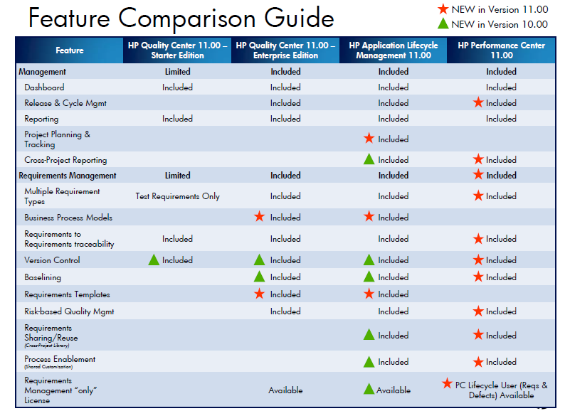
What’s new in ALM comparative to QC 10

Slide 5
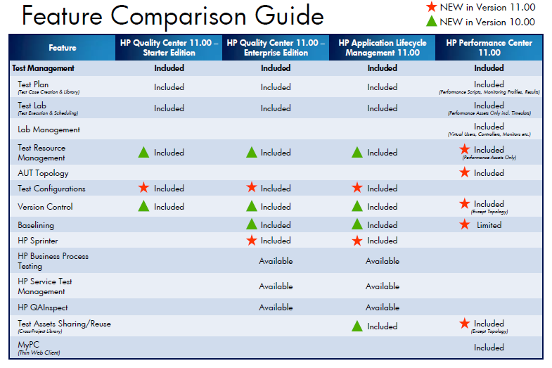
What’s new in ALM comparative to QC 10 (Contd.)

Slide 6
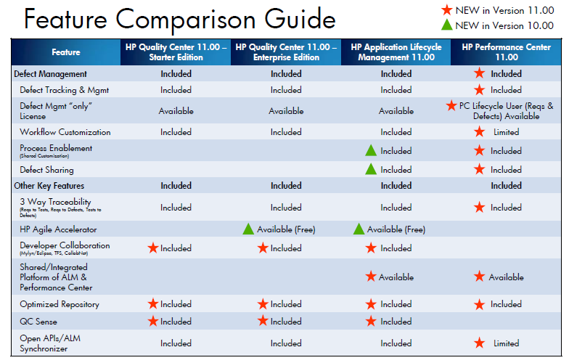
What’s new in ALM comparative to QC 10 (Contd.)

Slide 7
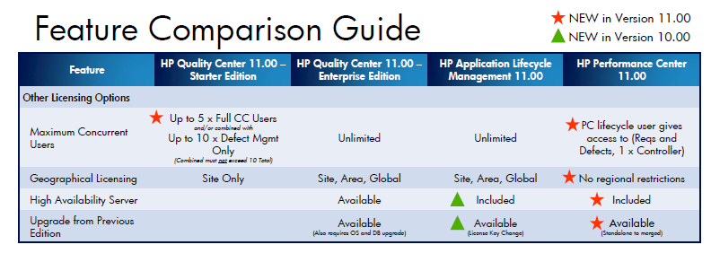
What’s new in ALM comparative to QC 10 (Contd.)

Slide 8
HP Solutions to Master the Core Application Lifecycle
Application Lifecycle Management
New!
Project Planning & Tracking
Enterprise Release Management
Requirements Management
Development
Management
Quality
Management
New!
New!
More!
Requirements Definition*
Requirements Management
Development Integrations
Defect Management
Secure Development
Functional
Performance
Security
More!
Foundation
Traceability
Process Standardization
(i.e. Waterfall, Agile)
Reporting
Extensibility
(Open APIs)
More!
New!
* Textual RD, Business Process Model (BPM) and industry leading 3rd party RD tools integration

Slide 9
HP Quality Center
Manage and optimize application quality
Dashboard
HP Quality Center
Release Management
Requirements Management
Business Models
Test Plan
Test Lab
Defect Management
HP Unified Functional Testing
Application Security Testing
Business Application Validation
Services
HP QuickTest Professional
HP Service Test
HP QAInspect
HP Business Process Testing
Service Test Management
Test Data Management
ALM Platform
Single Data Repository
Project Workflow
Reporting
Open APIs (REST)
Notes:
This is the introductory slide for HP Quality Center 11.00
Light Grey – The Core modules of and foundation for HP Quality Center
Dark grey – Key extensions that leverage the QC & platform to extend to perform specific functions (e.g.. Functional, Performance, Security testing)
Description from the Apps portfolio brochure:
HP Quality Center Software Industry-leading requirements, test and defect management.
HP Quality Center is a complete quality management platform that scales from a single project to multiple, enterprise-wide projects and releases. It enables Quality Assurance (QA) organizations to manage application quality with a consistent, repeatable process that minimizes risk, reduces costs and increases efficiencies for testing and QA teams across the organization.
HP Quality Center is available standalone or as a core part of HP ALM software. It delivers requirements management, release and cycle management, test management, defects management and reporting all within a single platform, providing traceability and visibility across your entire process.
HP Quality Center also drives communication and collaboration among Business Analysts, QA and Development teams. It is a Web-based solution, giving distributed teams access to a steel thread of critical project information regardless of geographic and organizational boundaries. Simply put, it delivers the information you need to make informed application release decisions.

Slide 10
ALM 11 Client Compatible Browsers & OS
BROWSERS:
ALM 11 support only IE7 and above
If IE is not available users can install
“ALM Explorer” which is HP’s own browser
NOTE: ALM Explorer can be installed from below link
http://update.external.hp.com/qualitycenter/qc110/others/almexplorer/index.html
OPERATING SYSTEM:
ALM 11 works on following client operating system
Windows XP
Windows Vista
Windows 7

Slide 11
Key themes of ALM/QC 11.00
Communication & Collaboration across the application lifecycle
Accelerated Test Execution
Project Planning, Tracking & Reporting

Slide 12
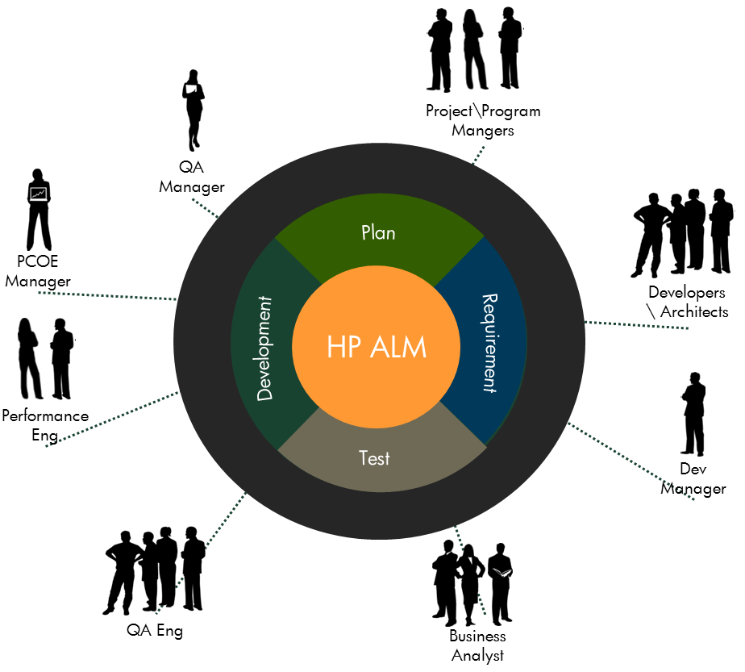
QC Premier is now HP Application Lifecycle Management Why? -Significant investment in addressing more than QA -Business -Project -Development -Common & Extended Platform

Slide 13
What’s new?
Module navigation sidebars
Project Planning and Tracking (PPT) Releases
Business Models
Traceability Matrix View in Requirements
Test Configurations
HP Sprinter
Project Reports
Requirements Ordering
Test Runs tab
Sharing Graphs
Task Manager
Session Reconnect

Slide 14
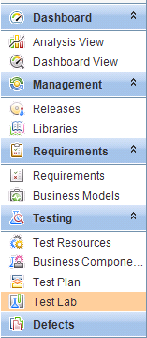
Module navigation sidebars
A new module navigation sidebar enables quick access to the modules available in ALM.

Slide 15
Project Planning & Tracking
HP Application Lifecycle Management 11.00

Slide 16

Project Planning & Tracking
Track and measure project milestones and KPIs
?
The Current Challenge
?
Visibility into application project progress and status
Team visibility into key project milestones
Proactive adjustment of plans when project is not on track
Identifying poor quality before it impacts on schedule
Updating project status against project plan
?
?
Notes:
Track and report against key project milestones
Plan your effort based on
Dev delivery, risk and execution history
Set release milestones and objectives
Track on execution and progress toward milestones goals
Adjust plan to accommodate changes in resources and delivery

Slide 17
Project Planning & Tracking
Using the Project Planning and Tracking (PPT) feature, you can now track application readiness by defining milestones for activities of an application release in the Releases module
PPT uses key performance indicators (KPIs) to analyze the data of your defined milestones.
The overall health and deployment readiness of a release in displayed in the form of a scorecard.
The scorecard monitors and tracks how well each milestone is being met on a daily basis.
?
?
?
?
Notes:
Track and report against key project milestones
Plan your effort based on
Dev delivery, risk and execution history
Set release milestones and objectives
Track on execution and progress toward milestones goals
Adjust plan to accommodate changes in resources and delivery

Slide 18
Track & measure project milestones and KPIs
Project Planning & Tracking
Defects High
Defects Med
Test Auth
Test Exec
Tests Passed
10
10%
25%
Requirements Progress
93%
Defects High
Defects Med
Test Exec
Tests Passed
45
93%
95
89%
Defects High
Defects Med
Test Exec
Tests Passed
0
Req Reviewed
Req Approved
78%
0
92%
E2E Testing
15
75%
Development Progress
90%
15
98%
98%
Testing Progress
98%
92%
Req Implemented
Tests Reviewed
Readiness Assessment
85%
95%
Requirements Authoring
Development
Test Execution
Integration
E2E Testing
User Acceptance Testing
Test Authoring
Functional, Performance and Security
January Enterprise Release
Notes:
Track and report against key project milestones
Plan your effort based on
Dev delivery, risk and execution history
Set release milestones and objectives
Track on execution and progress toward milestones goals
Adjust plan to accommodate changes in resources and delivery

Slide 19
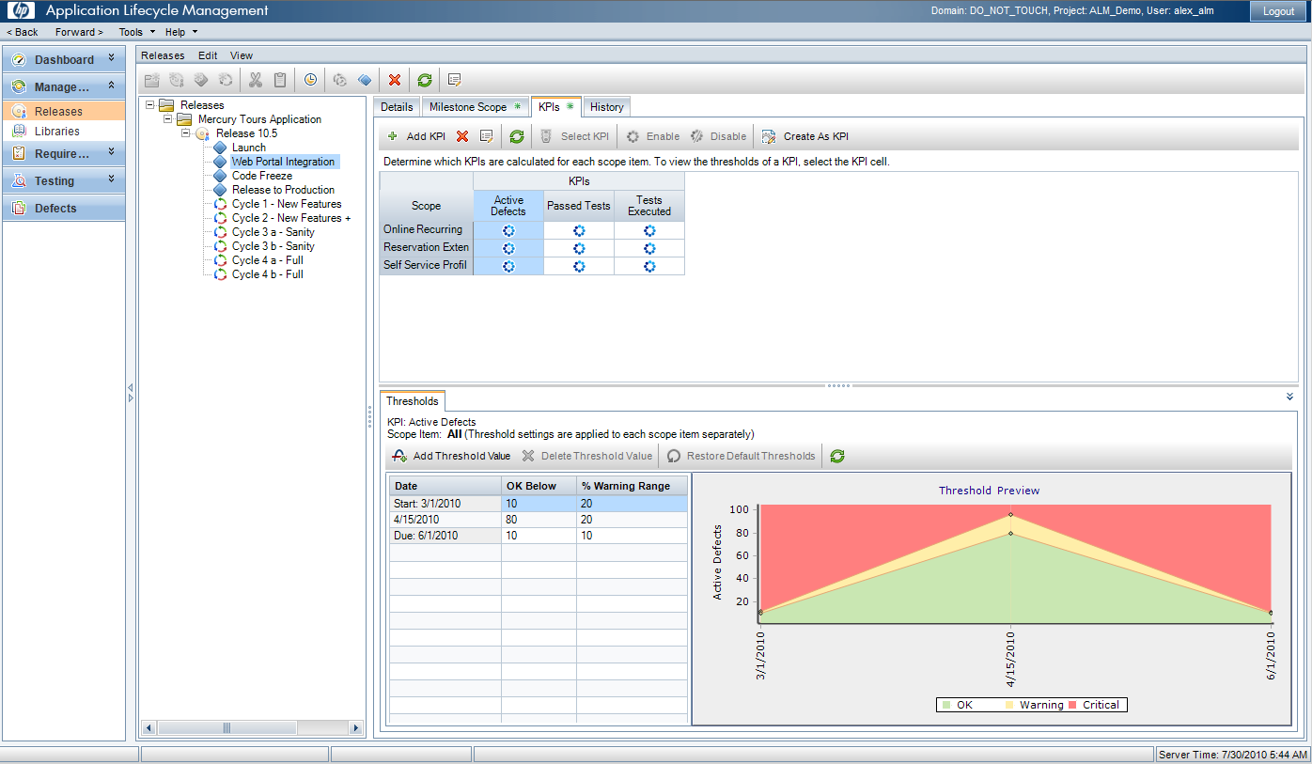
Release Milestones & KPIs
Project Planning & Tracking
Define Releases
Define KPI’s for milestones
♦ Define milestones
Define & preview thresholds
Notes:
Milestones – Quality Gates
KPIs – Exit Criteria

Slide 20
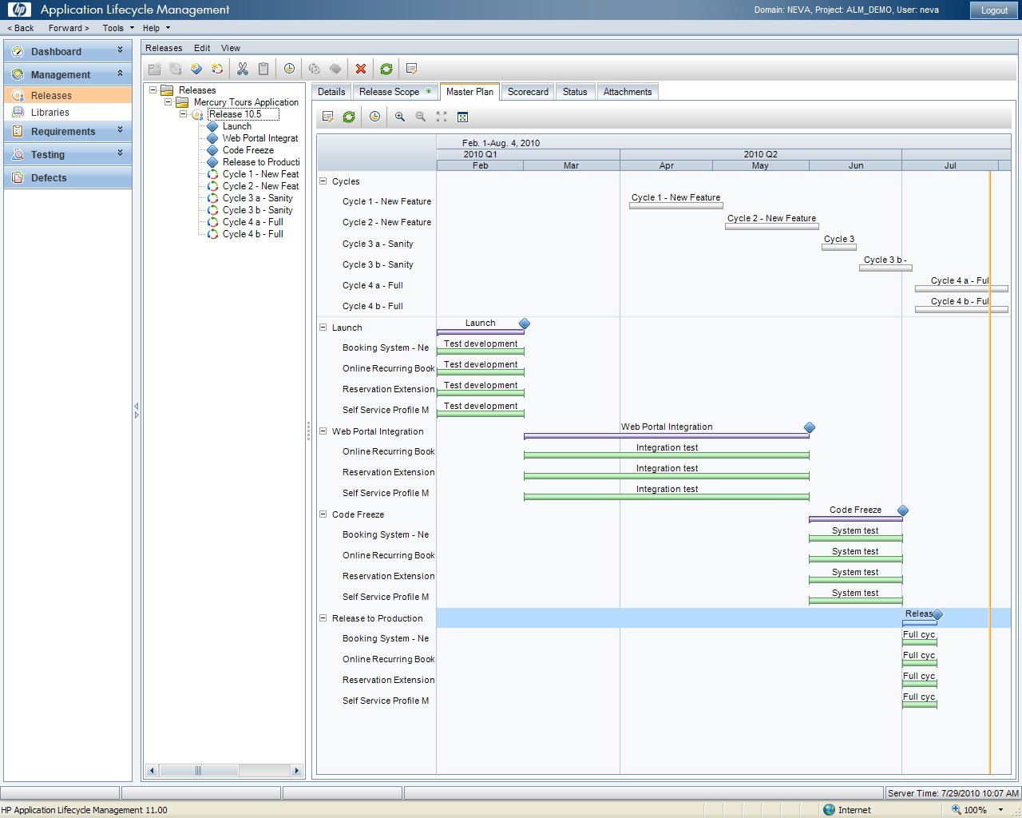
Master Plan
Track milestones in a Gantt chart
Project Planning & Tracking
Immediate visibility if project is delayed

Slide 21
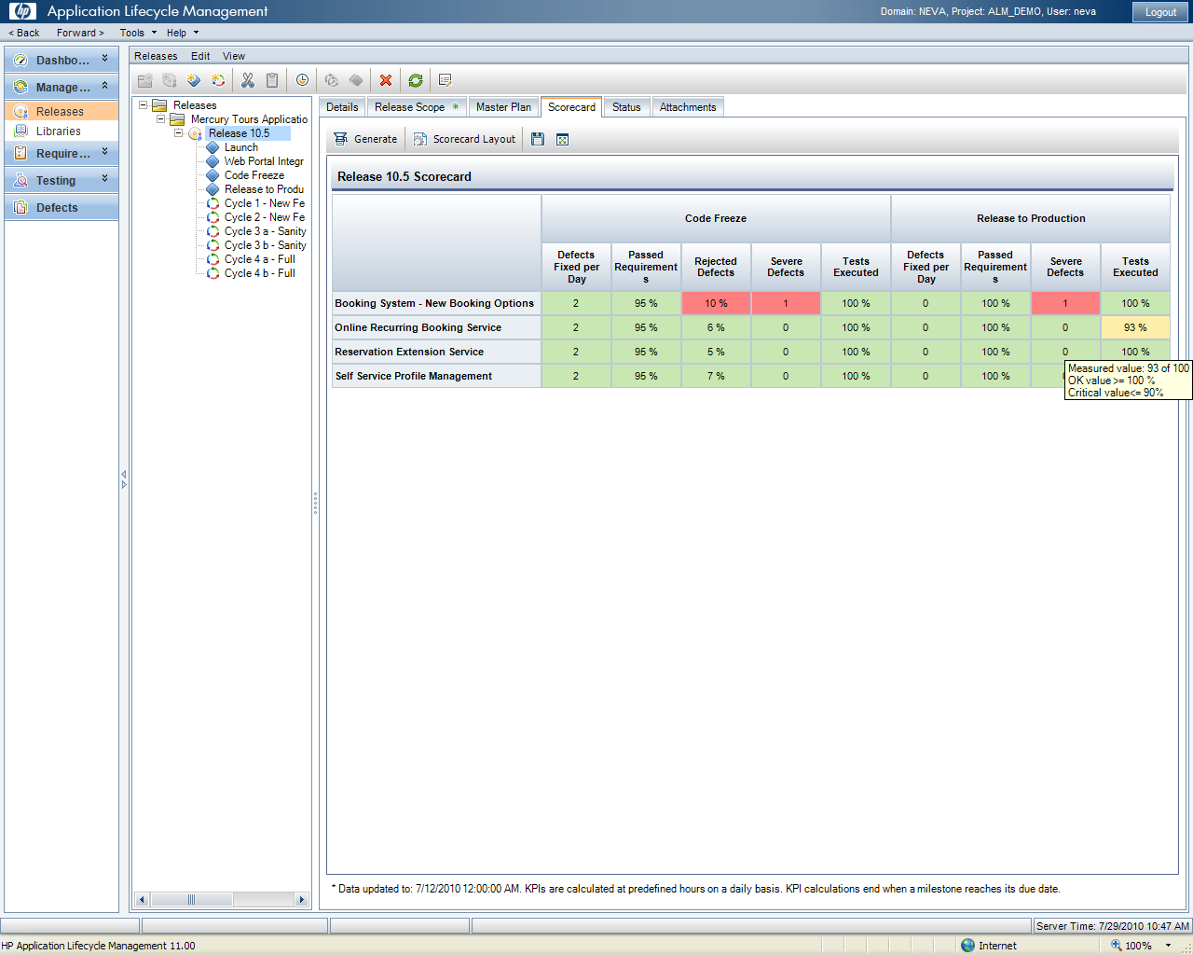
Scorecard
Project Planning & Tracking
Track release progress and status with KPIs
Drilldown into KPIs for more detail

Slide 22
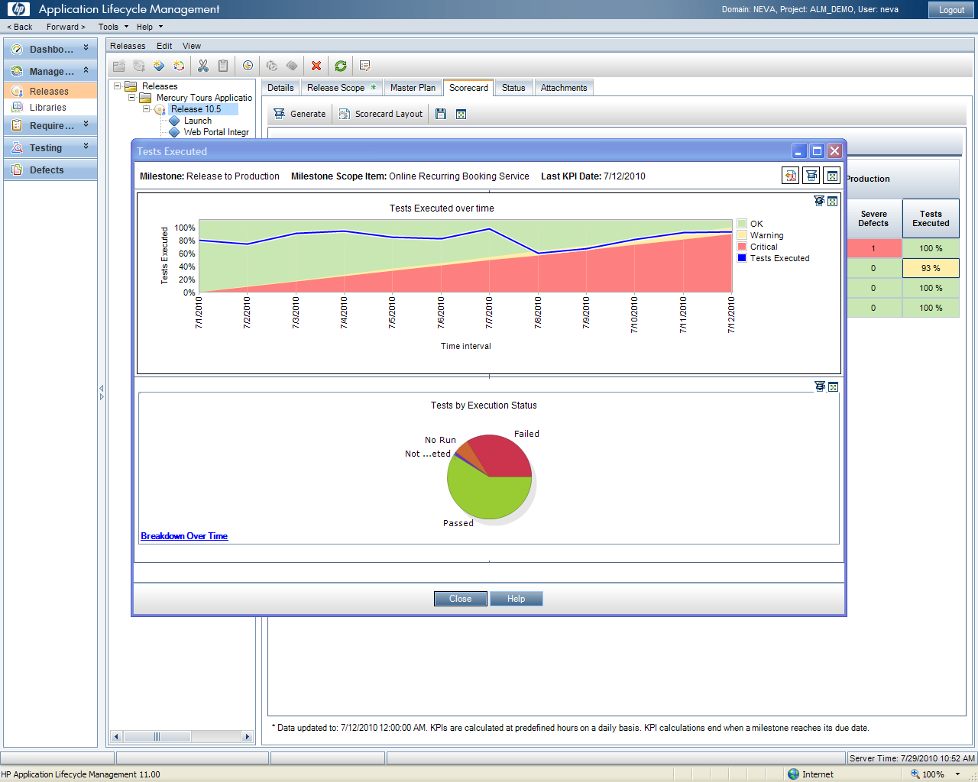
Scorecard Drilldown
Project Tracking & Planning
Visibility into trends
Drilldown further into data

Slide 23
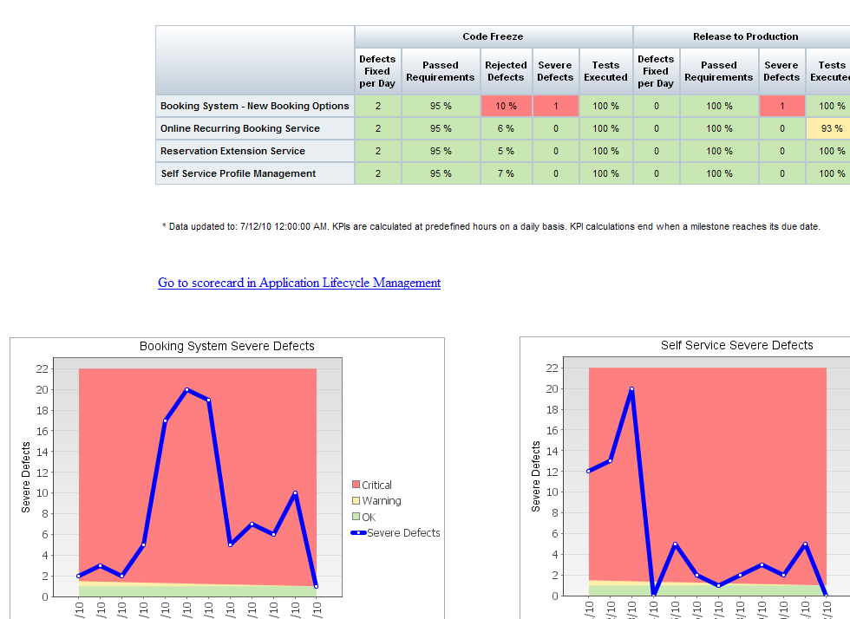
Dashboard
Project Planning & Tracking
Create dashboard with scorecard and drilldown graphs

Slide 24

Break Ahead!

Slide 25
Requirements Management
HP Application Lifecycle Management 11.00
HP Quality Center Enterprise 11.00

Slide 26


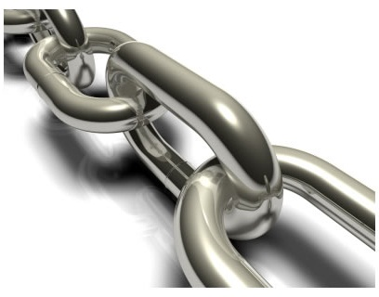
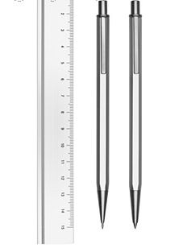
The 4 Principles of Requirements Mgmt
Capturing
requirements and having a "single version of the truth"
Collaborating
on requirements to make sure the right thing is being captured
Linking
requirements to other development assets - tests, defects, code...
Standardizing
requirements so that everyone works in a common way

Slide 27
Business Process Models(BPM) Integration
You can now import business process models created in external model authoring tools
Importing business process models into the new Business Models module automatically creates a framework of requirements representing each model and activity.
You can then create test coverage and assess the quality of your business process models.
In addition, you can add path entities to your models that represent end-to-end sequences of activities, enabling you to test your business flows

Slide 28
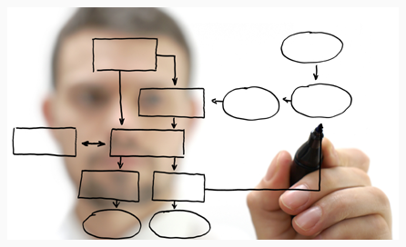
Business Process Model (BPM) Integration
Requirements Management
The Current Challenge
Misalignment between business processes and business requirements
Clear understanding of the exact business process and critical paths
End to End coverage by development and QA is hard

Slide 29
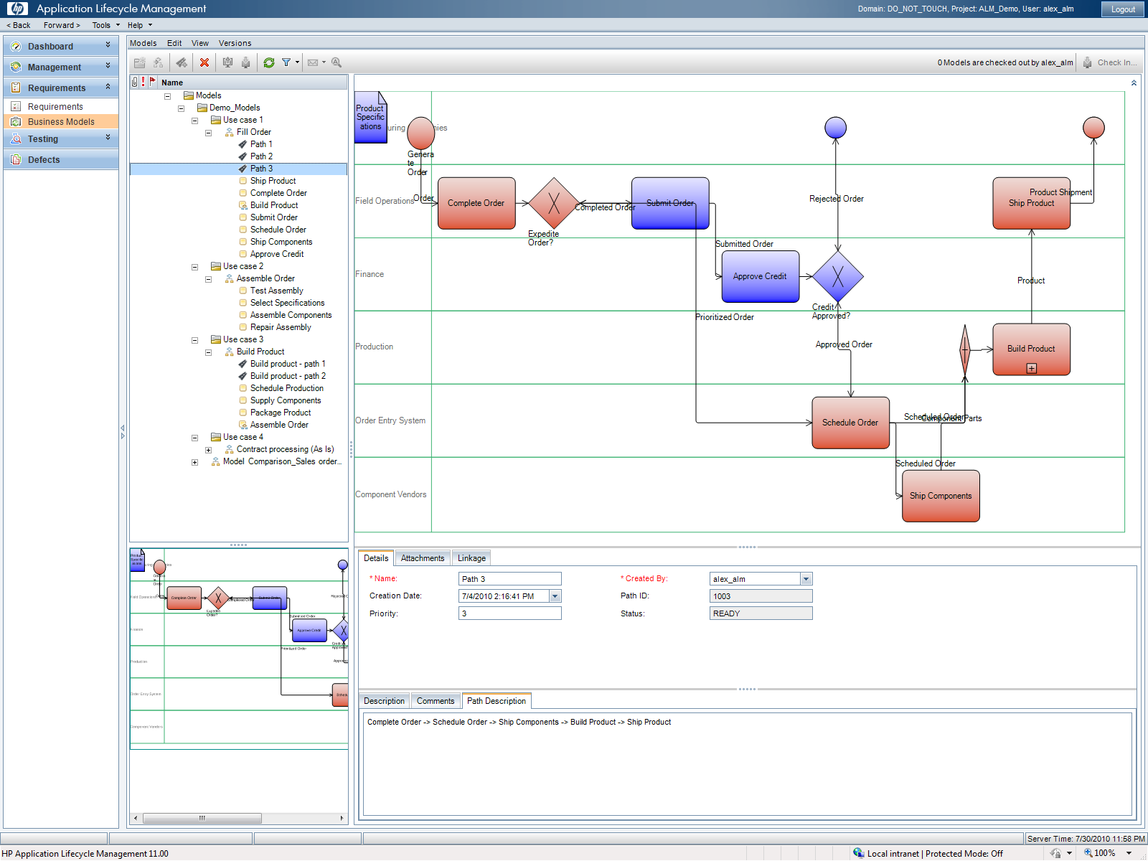
Business Process Model (BPM) Integration
Requirements Management
Import Business Process Models
View critical paths for development and testing
Link Requirements to Model

Slide 30

Business Process Model (BPM) Integration
Requirements Management
Other Capabilities
Automatically generate requirements hierarchy
Mapping requirements directly to BPM
Supports standard BPMN format
i.e. Provision, Aris
BPM available to a wider audience
Developers, QA
Clear end to end business process communication
Better testing; understand what can be componentized
Improvement in requirements coverage
Key Benefits

Slide 31

New Rich Text Editor & Requirements Templates
Requirements Management
The Current Challenge
!
“Requirements Management tools are hard to use”
Easy to default to using MS Word, that results in…….
No ‘single point of truth’ for requirements
Capturing requirements and getting the right data
Lack of standardization
Requirement details missed
Inconsistent requirements (High amounts of Overwork & underwork)
!
!
!

Slide 32
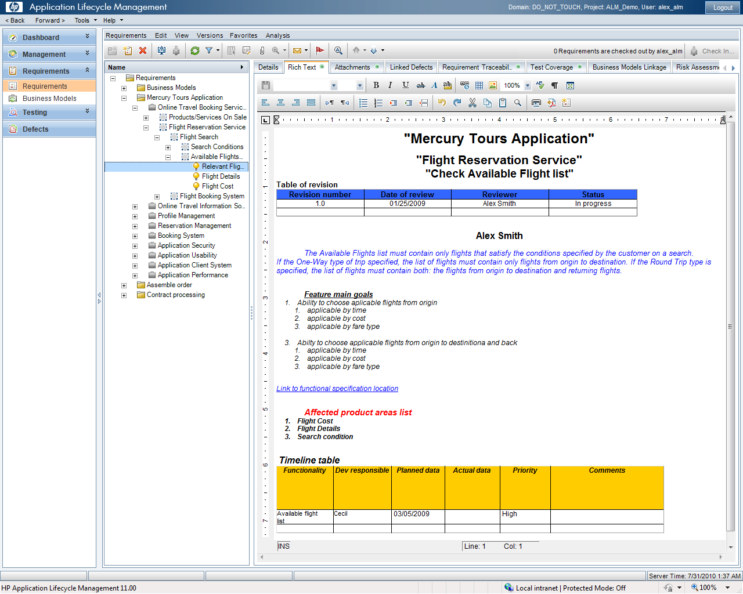
New Rich Text Editor
Requirements Management
Entire content is searchable
BAs can work in QC like they work in MS Word

Slide 33
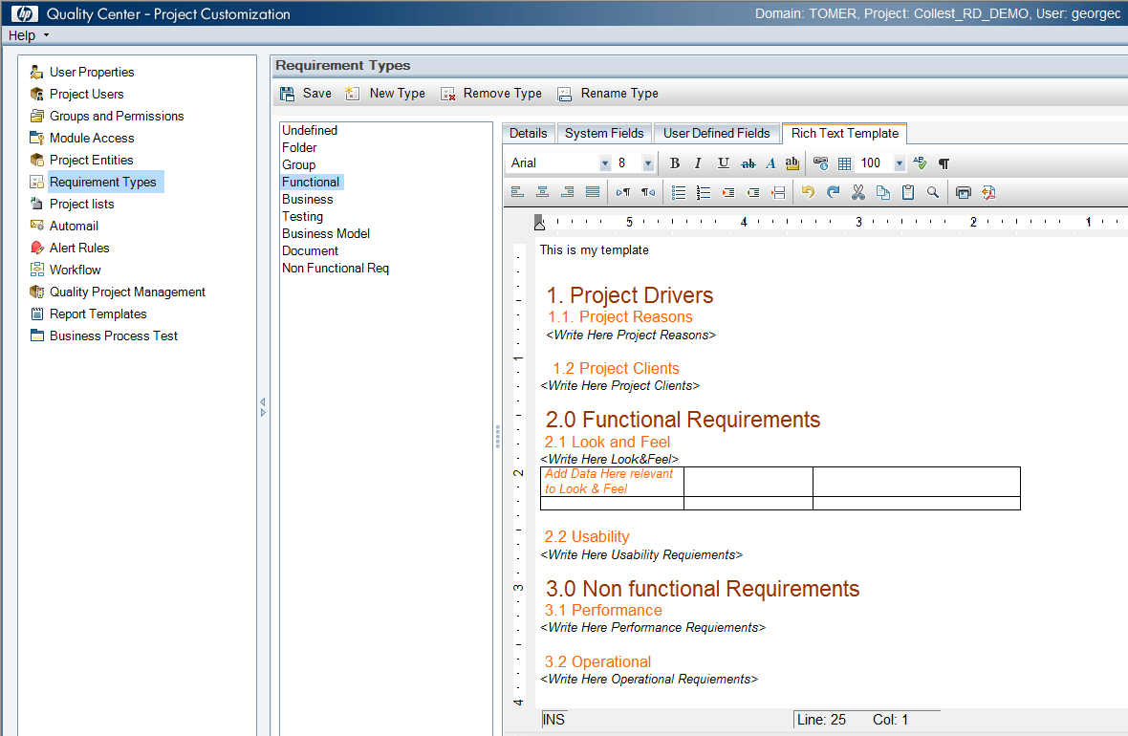
Requirements Templates
Requirements Management
Define rich text template
- Familiar interface
Specify exact requirement structure
Template per requirement type

Slide 34
Traceability Matrix
You can now determine the extent of relationships between requirements and other requirements, and between requirements and tests using the Traceability Matrix view in the Requirements module.
The traceability matrix helps you verify that all requirements are met, and identify changes to the scope of your requirements when they occur

Slide 35
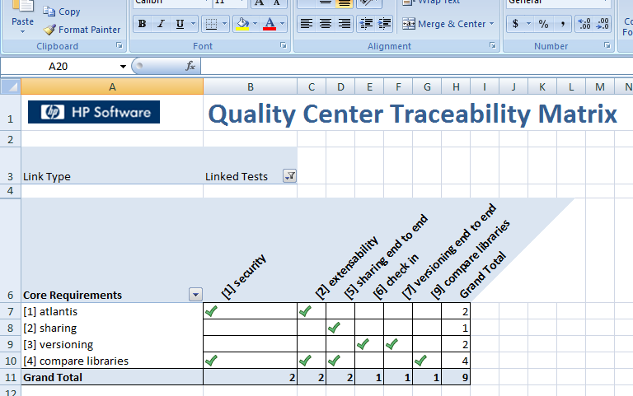
Traceability Matrix
Requirements Management
Trace Relationships
Key Benefits
Requirements
Verify that all requirements are met
Identify changes to the scope when they occur
Requirements
Choose Entities to trace
and
Requirements
Quickly identify traced entities
Tests
Notes:
You can now determine the extent of relationships between requirements
and other requirements, and between requirements and tests using the
Traceability Matrix view in the Requirements module. The traceability
matrix helps you verify that all requirements are met, and identify changes
to the scope of your requirements when they occur. For more information,
refer to the HP Application Lifecycle Management User Guide.

Slide 36
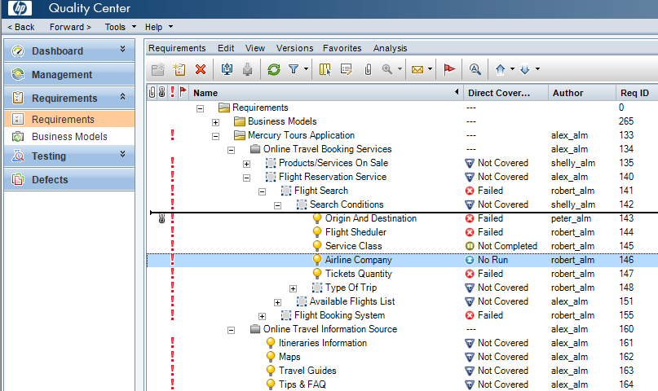
Custom Order Requirements
Requirements Management
Drag and drop to reorder requirements

Slide 37
Test Configurations
HP Application Lifecycle Management 11.00
HP Quality Center Enterprise 11.00

Slide 38
Test Configurations
Using the Test Configurations tab in the Test Plan module, you can now design tests that run according to different use-cases, each with different sets of data.
Each use-case is called a test configuration. Values for the test configurations are supplied from within your ALM project or from an external data resource.

Slide 39
Test Configurations
Test Management
The Past Situation
When a requirement has multiple configurations or use cases:
Requirement/Use Case A:
Gold Member
Test Script 1:
Login as Gold Member
A test script for each configuration was needed
Requirement/Use Case B:
Silver Member
Test Script 2:
Login as Silver Member
Requirement/Use Case C:
Bronze Member
Test Script 3:
Login as Bronze Member
…..or Sometimes all configurations are in one requirement
Results in:
High test script maintenance costs
Lower requirement coverage accuracy

Slide 40
Test Configurations
Test Management
Only 1 test script needed for all configuration
With Test Configurations
Test Script:
Login as
Requirement/Use Case A:
Gold Member
Configuration 1:
Gold Member
Requirement/Use Case B:
Silver Member
Configuration 2:
Silver Member
Traceability between Reqs and Configuration
Requirement/Use Case C:
Blue Member
Configuration 3:
Bronze Member
Key Benefits
Significantly lower test script maintenance costs
Increased requirement scenario accuracy
Test all use cases
Share and leverage data sources and definitions

Slide 41
You have successfully completed Day 1 : ALM 11 – New Features

