Slide 1
KRpep-Zero
Chemistry and control validation for KRAS peptide modeling
STOP
Study overview | 15 September 2026
separation gate failed
Decision-ready evidence from 18 retained control predictions
12 Boltz + 6 Protenix | 2 control identities
Notes:
Scope: computational validation study around a GDP-state KRAS G12D reference. This deck reports recorded outcomes and limits; it does not claim a binder or therapeutic result.

Slide 2
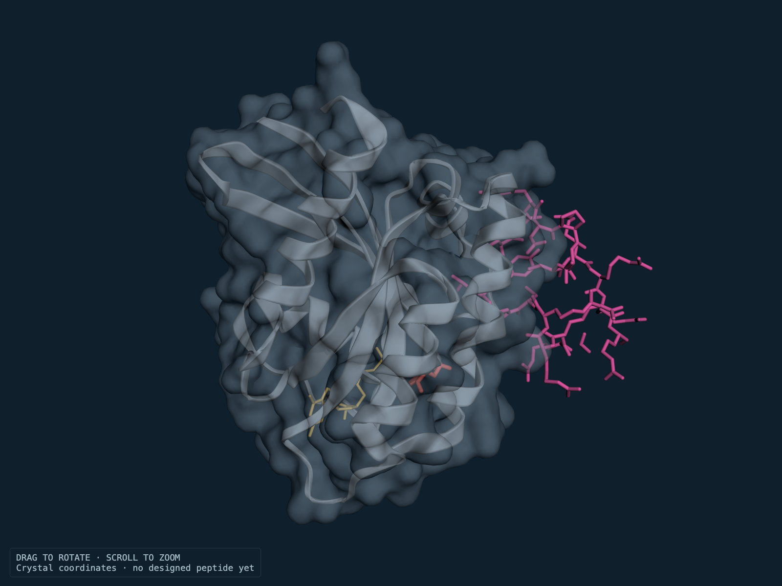
01 / reference identity
15 September 2026
Target reference and positive control
The benchmark molecule is KRpep-2d bound to GDP-state KRAS G12D in 5XCO.
KRpep-2d
Ac-RRRRCPLYISYDPVCRRRR-NH2
19 residues | Cys5–Cys15 disulfide | N-acetyl | C-terminal amide
Assay | KRAS G12D | KRAS WT | WT / G12D
SPR KD, GDP | 8.9 nM | 58 nM | 6.52×
SPR KD, GTP | 11 nM | 200 nM | 18.18×
Meaning | affinity | affinity | arithmetic ratio
Source: Sogabe et al. 2017, 5XCO / crystal paper. Ratios are arithmetic from Table 1.
Notes:
Primary source: Sogabe et al., 2017, PMID 28740607, DOI 10.1021/acsmedchemlett.7b00128; RCSB 5XCO. The displayed assay ratios are arithmetic from the published SPR KD values.

Slide 3
02 / method boundary
15 September 2026
Validation workflow and ESMC context
The campaign moved from sequence diagnostics to two control revisions, then stopped at the declared gate.
01
Reference
5XCO + GDP-state KRAS4B 1–169
What ESMC can support
Sequence
Sequence-model diagnostics
Masked-logit profile
No pocket affinity
No binding classifier
02
ESMC300M profile, seed 17
03
Boltz controls
12 runs: 2 identities x 3 seeds x 2 representations
04
Protenix check
6 runs: 2 identities x 3 seeds; chemistry failed
05
Decision
No candidate generation after failed separation
Notes:
ESMC300M is a sequence-model diagnostic. It does not measure pocket affinity. Method context from PROVENANCE.md and the retained ESMC metadata.

Slide 4
03 / v1 gate
15 September 2026
Revision 1: confidence did not separate the controls
The positive and proposed scramble scored almost identically across all three seeds.
Mean gap
−0.003868
required ≥ +0.15
Outcome
Positive exceeded scramble in 2/3 seeds, but the mean-gap criterion failed. No seeds were dropped or repeated.
Confidence is not affinity. The scramble was a proposed negative control, not an experimentally established nonbinder.
Notes:
Source: results/CALIBRATION_REPORT.md and dashboard/data/per-seed.csv. Pair ipTM is the arithmetic mean of parsed directional fields after chain mapping checks.

Slide 5
04 / v2 representation
15 September 2026
Revision 2: chemistry repair passed the declared checks
Full molecular graphs preserved the intended control identities across every saved prediction.
Control | Seeds | Bonds in bounds | Stereocenters | Critical links
KRpep-2d | 17 · 42 · 101 | 183 / 183 | 20 / 20 | PASS
SCRAMBLE-20260914 | 17 · 42 · 101 | 183 / 183 | 20 / 20 | PASS
Gate | all six | 100% | 100% | PASS
Meaning |  | geometry only |  | not biological activity
What changed
Complete SMILES / graph input
183 molecular bonds checked
20 mapped stereocenters
All six outputs retained
Chemistry pass supports representation integrity under these checks. It does not validate molecular energy or biological activity.
Notes:
Source: results/REMEDIATION_V2_REPORT.md; results/control-remediation-v2-002/; PROTOCOL_REMEDIATION_V2.md. Chemistry pass means all 183 bonds and 20 stereocenters passed in every seed.

Slide 6
05 / v2 gate
15 September 2026
Revision 2: chemistry passed, separation still failed
The within-revision mean confidence gap remained below the preregistered threshold.
Observed gap
+0.033214
required ≥ +0.150
Seed | Positive | Scramble | Δ
17 | 0.5640 | 0.6509 | −0.0870
42 | 0.6490 | 0.4855 | +0.1636
101 | 0.6569 | 0.6338 | +0.0230
Positive wins 2/3 paired seeds. The mean-gap criterion fails.
Notes:
Source: results/REMEDIATION_V2_REPORT.md and dashboard/data/v2-gate-summary.json. Positive core RMSDs after fitting target Cα1–169: 21.3955, 12.2365, 11.0290 Å for seeds 17, 42, 101.

Slide 7
06 / literature and limits
15 September 2026
Next benchmark: verified controls before any new inference
The evidence supports a bounded benchmark plan, not a claim of generalization.
Literature anchors
Boundaries for the next benchmark
Lim et al. (2021)
Disulfide / thioacetal chemistry changes the molecule and assay context.
Guan & Keating (2025)
High-confidence incorrect peptide poses show confidence can mislead.
Li et al. (2026, preprint)
Pose confidence and ranking are separate questions in cyclic-peptide benchmarks.
• Verify exact chemistry and assay meaning for every control
• Keep pose metrics separate from confidence and binding
• Treat 18 runs as model runs of 2 identities, not biological replicates
• Use declared criteria before any new outputs
• Stop after the bounded batch if the gate remains inconclusive
Discussion focus: are the verified controls and pose metrics sufficient for a later candidate-selection study?
Notes:
Primary literature: Lim et al., PMC8672774; Guan/Keating, PMC12518507, DOI 10.1002/pro.70331; Li et al., 2026, unreviewed preprint, DOI 10.64898/2026.08.20.746104.

Slide 8
07 / handoff
15 September 2026
Conclusion and reproducible decision
Chemistry repair improved input integrity. Control separation remains insufficient for candidate selection.
Repro package
Dashboard guide
DECISION
18 retained control predictions
12 Boltz + 6 Protenix
Per-seed CSVs and gate summaries
Saved structures and hashes
Offline reproduction checks
Use the all-18 table's View pose for one selected row. Set Model / representation to reference, v1, v2 or protenix, then choose Control and Seed. The UI shows one selected prediction plus the reference at a time. Use Reference peptide, Predicted target, Target surface and Prediction focus; change Seed to compare runs.
STOP
No candidate-generation claim
Discussion framing: chemistry integrity improved, but confidence separation and reference-pose recovery remain inadequate for candidate selection.
Notes:
Conclusion from PROVENANCE.md and v2 report. This is a reproducible validation study; successful binder discovery is not established.

Slide 9
08 / independent model check
15 September 2026
Protenix diagnostic addendum
A separate Protenix diagnostic completed six runs after the Boltz gates had already failed. It adds evidence, not candidate selection.
Protenix-v2
Full base fallback
failed before prediction
completed
Output: 0 CIFs
Checkpoint HTTP 403 before prediction
Model: protenix_base_default_v1.0.0
Output: 6 CIFs
Question | Current evidence | Boundary
Why not v2? | Official checkpoint returned HTTP 403 before model load | No v2 predictions were produced
Base result | 6 CIFs; positive 0/41 each seed (17, 42, 101); scramble NA; RMSD 29.06 / 30.93 / 30.58 | Chemistry checks failed
Research use | One selected prediction + reference; change Seed to compare runs | Descriptive only; no new gate
Protenix base positive control recovered 0/41 native contacts in each seed; scramble is NA. Chemistry checks failed and the Boltz stop decision remains unchanged.
Notes:
Source: PROTOCOL_PROTENIX_DIAGNOSTIC.md and results/submission/protenix-diagnostic-summary.json. Protenix-v2 failed at upstream checkpoint download with HTTP 403 before scientific outputs. The completed base diagnostic produced six CIFs, 0/41 native contacts in seeds 17, 42 and 101, positive-control core RMSDs 29.06 / 30.93 / 30.58 Å, and failed chemistry checks.

