Slide 1
Contents
Wallet Over View
Types of Wallet
Components and Architecture
Customer and Merchant Services
Wallet web / Wallet Admin(Customer Care Services)
Technologies Used
1 Mule Application/ESB
2 EIG (External Interface Gateway)
3 Wallet API
4 MAM
Framework
1 Spring
2 Hibernate
Build Tool
        1 Maven

Slide 2
Wallet Overview
Mobiquity® Wallet offers a feature-rich digital wallet for consumers and a robust and flexible platform for service providers and their partners.
Wallet enables financial institutions, retailers, telecom operators and other consumer service providers to re-engage and connect directly with their consumers, drive growth, and strengthen their brand by staying abreast of an ever-evolving market and consumer behavior.
Wallet platform provides a unique service creation platform which allows for easy customization of consumers experience and quick turnaround to the market with these customizations.
Mobiquity® Money delivers a host of mobile money services that transforms the way consumers save, borrow, transfer and spend money. Built around a stored value account, the solution empowers consumers to securely make merchant payments, pay bills, and send or receive money using a mobile.

Slide 3
Types of E-Wallets
The three kinds of E-Wallets: -
Closed:
These are issued by companies to their clients for buying goods and services. These wallets allow transactions only with that particular service provider.
They do not allow you to withdraw cash.
Semi-Closed:
These are used to buy goods and services (including financial ones) at specified establishments. These merchant sites or establishments have contracts with the wallet issuer to accept payment from the wallet.
These also do not allow you to withdraw cash.
Open:
Open wallets are similar to semi-closed wallets in that, they too allow the purchase of goods and services at sale terminals.
However, these also allow cash withdrawal at ATM's or business locations.

Slide 4
Wallet Components
Mobiquity Money
Wallet Components
        API manager
        Wallet server
        MT940
        Wallet Admin
        Shulka Data
        Eig Outflow
        Eig Inflow
        CNP(Card Not Present)
        ESB(Enterprise service bus)
        MP clear(PS MP clear--- mobile payment clearing and switching system)
        CBS
        Data Bases used
        Money, Wallet, Open service

Slide 5
Components Overview
An MT940 is a standard structured SWIFT(Society of worldwide interbank financial Telecommunication) Customer Statement message. In short, it is an electronic bank account statement which has been developed by SWIFT. It is a end of day statement file which details all entries booked to an account.
enterprise service bus (ESB) and integration platform that allows developers to connect applications together quickly and easily, enabling them to exchange data. The key advantage of an ESB is that it allows different applications to communicate with each other by acting as a transit system for carrying data between applications within your enterprise or across the Internet.
MP-Clear- a 24/7 mobile payment system that enable payment transactions to be done through a mobile application. PS-mpClear facilitates the registration of the mobile payment service provider(s) with the Central Bank. This grants an open system for multiple service providers and allows for interoperability among all of them.

Slide 6
Flow of Data
MAM
DB
CustomerApp
E
B
S
C
S
B
M
P
C
L
E
A
R
MAM
EIG Inflow
API manager
Wallet Server
EIG Outflow
Wallet Admin
MerchantApp
Money Txn
Wallet
DB
Money
DB
Money Web

Slide 7
Wallet Services
Load Money (Credit Card, Debit Card, Net Banking and ATM/CDM).
Send Money ( Unreg and Reg, QR code, Email, Social Media, NFC).
Request Money (Mobile and Email).
Split Bill (Mobile and Email).
Utility / Bill Payment
Merchant Payment
Self Services :-
        Change MPIN
        Change Language
        Change Mobile/Email
        Add/Update Profile pic
        Delete or Deactivate Account
Banking Services :-
        Wallet to bank
        Bank to Wallet – Shivam check
        Wallet to other Bank wallet
        Wallet to other Bank account

Slide 8
Wallet Services
Notifications :-
        Transaction History
        Pending Transaction/Read/Unread/
Favourite Transactoin:--
Forget PIN

Slide 9
Wallet Admin - CCE
The mobiquity Wallet administration module allows back office users to manage admin users, consumers, transactions, and tariff, manage blacklist and manage configurations such as thresholds and system variables.
Services:-
    Admin User Management(User Management ,Group Management, Role Management).
    Consumer Management (Consumer Management ,Group Management, Role Management).
    Transaction Management(Transaction, Ambiguous Management, Reconciliation, Transaction Reversal).
    Configure Management(Service Step UP, Service threshold, System Configuration, Thresholds, Incentives , Home bank bin configuration).
    Fraud Management(Black list management).

Slide 10
Wallet Admin - CCE
Partner Management(Merchant Bulk upload, Agent and Merchant, Biller)SSO.
Pseudo User
Access Management(Reset PIN/Reset Password of Channel user and operator)
Pricing Engine.
Pentaho Report Management.
MP clear management(Delete MP Clear User).

Slide 11
Technologies Used

Slide 12
Mule Application
Mule, the runtime engine of Anypoint Platform, is a lightweight Java-based enterprise service bus (ESB) and integration platform that allows developers to connect applications together quickly and easily, enabling them to exchange data.
It enables easy integration of existing systems, regardless of the different technologies that the applications use, including JMS, Web Services, JDBC, HTTP, and more. The ESB can be deployed anywhere, can integrate and orchestrate events in real time or in batch, and has universal connectivity.
The key advantage of an ESB is that it allows different applications to communicate with each other by acting as a transit system for carrying data between applications within your enterprise or across the Internet.

Slide 13
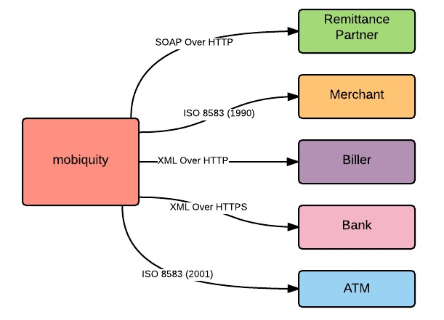
Point – to – Point Integration

Slide 14
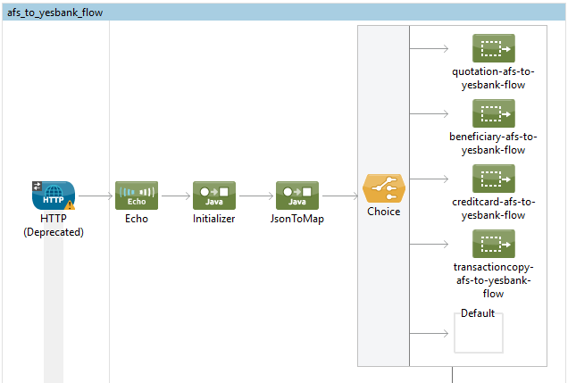
Example :-

Slide 15
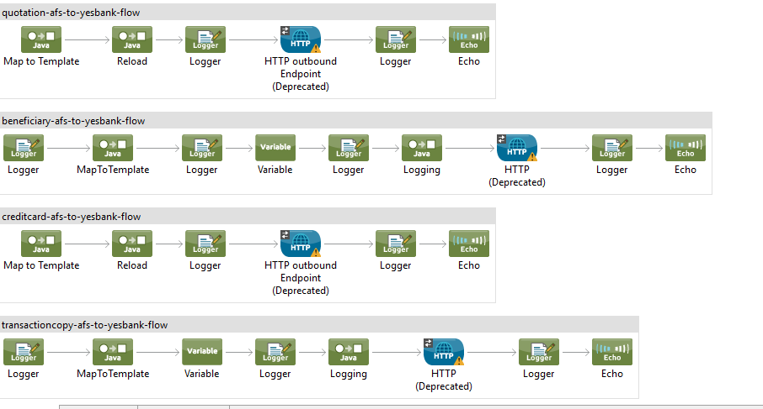

Slide 16
Wallet API
Wallet provides global e-commerce merchant services and payment processing solutions. Wallet series of APIs allow customers to automate online payment processing.
When you use an application on your mobile phone, the application connects to the Internet and sends data to a server. The server then retrieves that data, interprets it, performs the necessary actions and sends it back to your phone. The application then interprets that data and presents you with the information you wanted in a readable way. This is what an API is - all of this happens via API.

Slide 17
Steps to make API :-

Slide 18
Request/Response Code :-
<complexType name="ViewCRNUniqueIdDetailsInput">
<sequence>
<element name="msisdn" maxOccurs="1" minOccurs="1">
<simpleType>
<restriction base="string">
<maxLength value="10"></maxLength>
<minLength value="10"></minLength>
<pattern value="\d+"></pattern>
</restriction>
</simpleType>
</element>
</sequence>
</complexType>
<comp </complexType>lexType name="ViewCRNUniqueIdDetailsOutput">
<complexContent>
<extension base="tns:Response">
<sequence>
<element name="uniqueId" type="string"></element>
<element name="customerId" type="string"></element>
</sequence>
</extension>
</complexContent>
<complexType name="ViewCRNUniqueIdDetailsRequest">
<sequence>
<element name="requestHeader" type="mwct:RequestHeader"></element>
<element name="viewCRNUniqueIdDetailsInput" type="mwct:ViewCRNUniqueIdDetailsInput"></element>
</sequence>
</complexType>
<complexType name="ViewCRNUniqueIdDetailsResponse">
<sequence>
<element name="responseHeader" type="mwct:ResponseHeader"></element>
<element name="viewCRNUniqueIdDetailsOutput" type="mwct:ViewCRNUniqueIdDetailsOutput"></element>
</sequence>
</complexType>

Slide 19
Flows -
<when expression="#[sessionVars['SERVICE_CONTEXT'].operation=='GetCustIdByMsisdn']">
<component doc:name="View CRN and UniqueId Details">
<spring-object bean="viewCRNUniqueIdDetailsComponent" />
</component>
</when>
Demo-core.xml -
<spring:bean id="viewCRNUniqueIdDetailsComponent" name="viewCRNUniqueIdDetailsComponent"
class="com.mahindracomviva.openservice.components.CallableComponent">
<spring:property name="action" ref="VIEWCRNUNIQUEIDDETAILS"/>
</spring:bean>
mwallet action -
<bean id="VIEWCRNUNIQUEIDDETAILS" name="VIEWCRNUNIQUEIDDETAILS"
class="com.mahindracomviva.mwallet.action.ViewCRNUniqueIdDetails">
<property name="daoFactory" ref="daoFactory" />
</bean>

Slide 20
MAM (Mobile Application Manager)
Mobile Application Manager(MAM) is an intermediate lightweight Micro service Component which acts as a via server and reside in between the Mobile APP and Mobiquity Server.
Features of MAM -
1 Dynamic Menu Management:- MAM makes mobile app dynamic in terms of menus and fields of services to be displayed on App screen. You can add or remove any of the menu or fields that you do not want to show to the end user without pushing new version of Mobile APP in the Play Store.
2 Service disablement/enablement:-It can be used to disable or enable of any services at any point of time without code changes at Mobile APP.
3 Force/Recommend Upgrade:- It provides the supporting logic for Mobile APP force/recommend upgrade functionality.
4 Data Encryption/Decryption:- For Security Purpose it provides the functionality to encrypt and decrypt request comes from the Mobile APP.
5 Dynamic Asset Change:- It provides the functionality to dynamically change the mobile app assets without changing the Mobile App code.

Slide 21
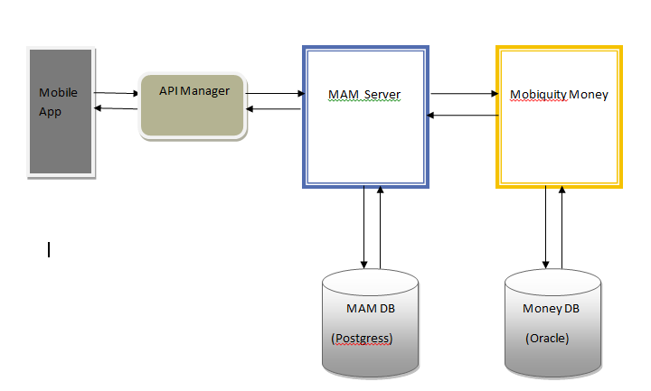
MAM Architecture Diagram

Slide 22
Thank You

