Slide 1



INWI Automation Suite Guide
Comviva

Slide 2

agenda
Introduction​
Functional specifications​
Sequence Flow
Reporting

Slide 3

Introduction
The document covers the usage of Inwi Mobile Application Framework using Appium, Selenium & TestNG. This document is targeted for following audience:
Test Engineers
Engineering Teams
QA Team

Slide 4
Set up
Prerequisite:- Install the listed software before the setup.
Install Node JS:
Download the Node Js from given Path : https://nodejs.org/en/download/
Install Appium Through CMD :
For Installing : npm install -g npm
For Installing : npm install -g Appium For Starting : open terminal and enter “Appium”.
Note : By Default it will run on : 127.0.0.1:4723
Install SDK(Android Studio) :
Download and install the sdk from given url: https://developer.android.com/studio?gclid=Cj0KCQjw_4-SBhCgARIsAAlegrUKHwPaKl0v4Fl6Uz5uGOlX5mnEB5gYWvmN7Q0lCRF2QbbcWHnUeJYaAutdEALw_wcB&gclsrc=aw.ds

Slide 5
Set up
Enable adb debugging on your device :
To use adb with a device connected over USB, you must enable USB debugging in the device system settings, under Developer options.
On Android 4.2 and higher, the Developer options screen is hidden by default. To make it visible, go to Settings > About phone and tap Build number seven times. Return to the previous screen to find Developer options at the bottom.
You can now connect your device with USB. You can verify that your device is connected by executing adb devices from the android_sdk/platform-tools/ directory. If connected, you'll see the device name listed as a "device."

Slide 6
Set up
Install Any IDE like IntelliJ
Install JDK(1.8 minimum)
Set Environment Variables as mentioned in below lines :-
Vaiable Name :- %ANDROID_HOME%\platform-tools
Path :- C:\Users\<username>\ AppData\Local\Android\sdk\platform-tools
Vaiable Name :- %ANDROID_HOME%\tools
Path :- C:\Users\<username>\ AppData\Local\Android\sdk\tools
Vaiable Name :- %ANDROID_HOME%\tools\bin
Path :- C:\Users\<username>\ AppData\Local\Android\sdk\tools\bin
Vaiable Name :- ANDROID_SDK_HOME
Path :- C:\Users\ <username> \AppData\Local\Android\sdk
Vaiable Name :- ANDROID_HOME
Path :- C:\Users\<username>\AppData\Local\Android\sdk
Vaiable Name :- JAVA_HOME
Path :- C:\Program Files\Java\jdk1.8.0_171

Slide 7
SET up
Add/Open the project in IDE as maven project.
Let the dependency get download automatically.
After successfully importing libraries, re-build the project.
Below are the mentioned mandatory changes required for the execution of test cases:- 1. mobile.properties device.udid = “” app.package=“” app.activity=“” application.name=“” project.name=“” language.code=“” country.code=“” device.name=“” device.platform=“” device.version=“”

Slide 8
Set up
Mandatory data needs to be filled in credentials.xlsx:-
MSISDN | STATUS | COUNTRY | PIN
77565681 | BL | BM | 14709
77885544 | S | BM | 25809
77123478 | Y | BM | 14709
77898944 | B | BM | 25809

Slide 9
Reporting
The Reporting feature of the Automation Suite is implemented by using Extent Report.
The Automation Suite has very good reporting, one can easily understand the Test Results by seeing the report. For each failure case there would be one Screenshot attached and also Error logs would be there.

Slide 10
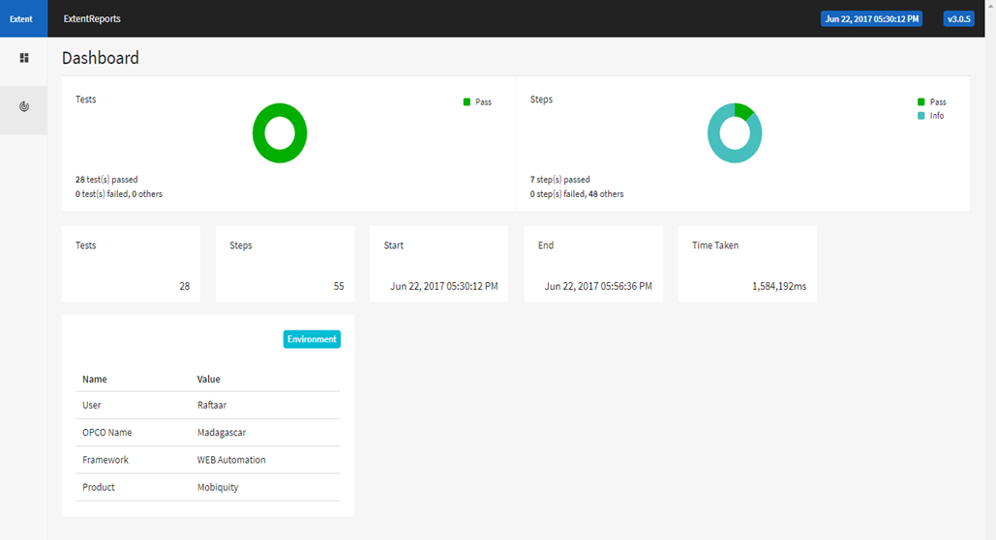
reporting

