Slide 1
Lab 2
Boolean Retrieval System using Python
and Inverted index
Satima Valsony
Vytautas Magnus University

Slide 2
Text Processing stages
Tokenization
Normalization
Stemming
Stop words

Slide 3
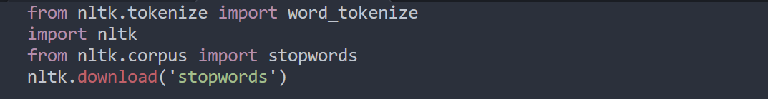
My text processing stages (1)
Import necessary libraries
One of the most popular libraries in NLP is NLTK.
I used it to remove stopwords and for tokenizaton

Slide 4
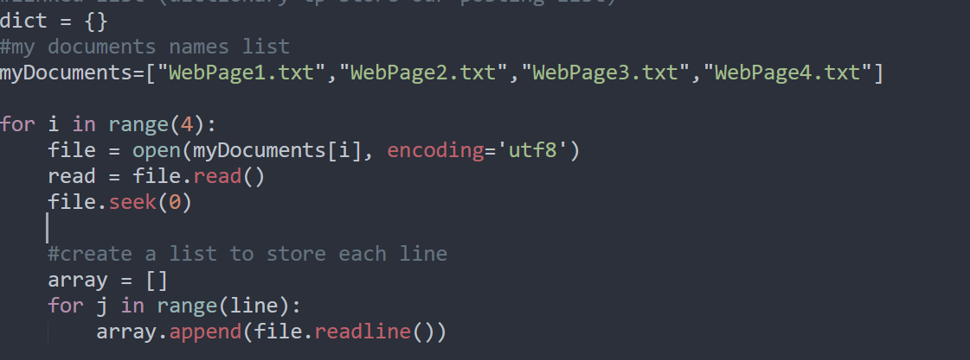
My text processing stages (2)
Creation of dictionary (to store my posting list), list containing documents name, next inside loop I’ll read each file and add text inside array

Slide 5
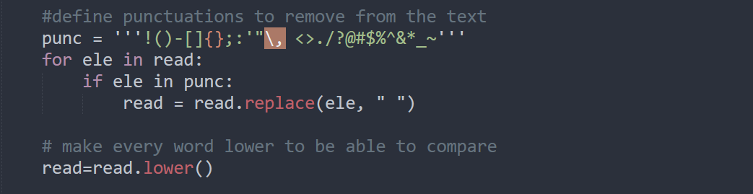
My text processing stages (3)
I defined punctuations I want to remove from the texts and for each item and replaced it with empty space “ “.
Also used function lower() to customize

Slide 6
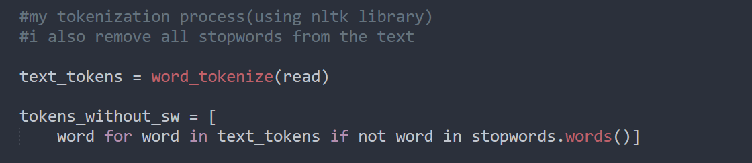
My text processing stages (4)
Tokenization process using NLTK library also removed stopwords.

Slide 7
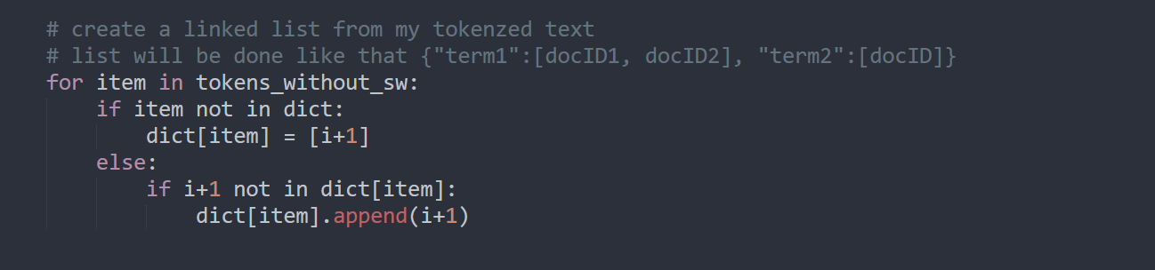
My text processing stages (5)
Last stage- creation of posting list. Term as the key and array of docID’s as value.

Slide 8
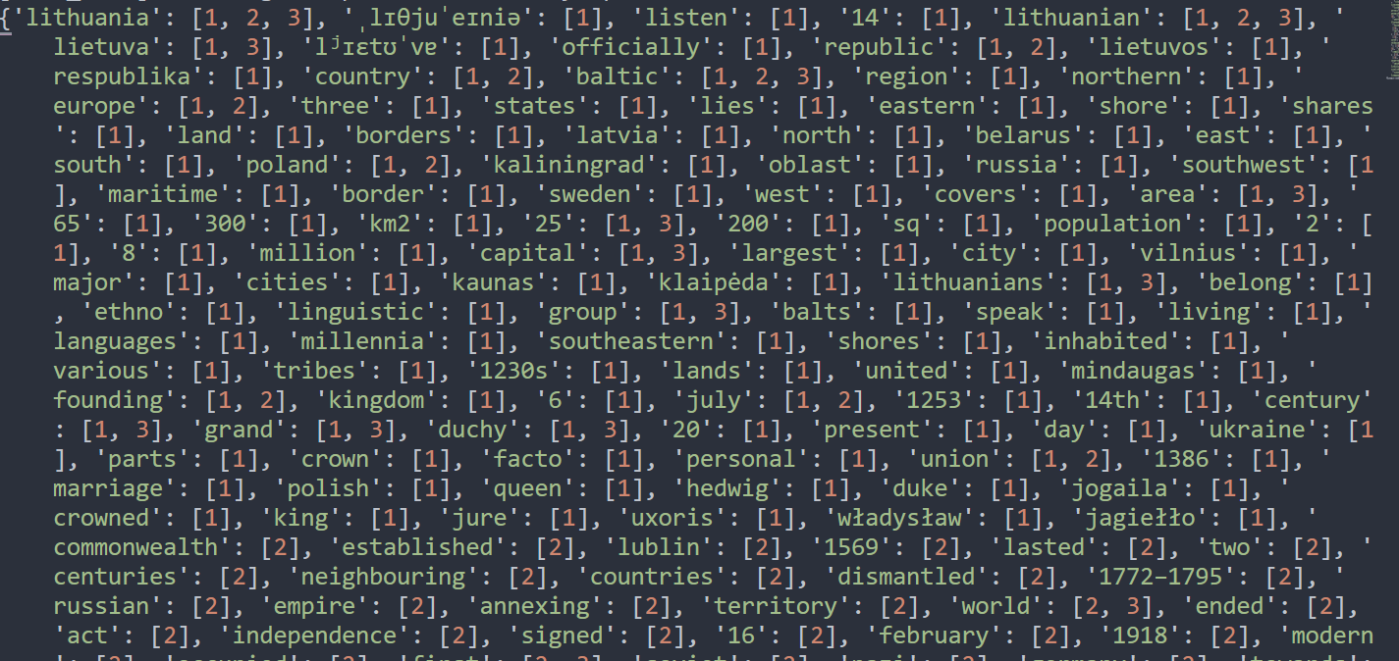
Here is how my posting list look like

Slide 9
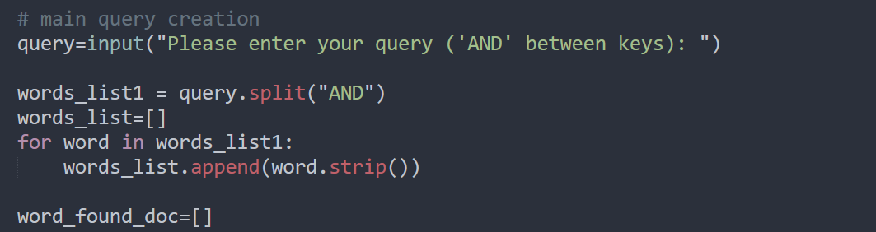
Query formulation (6)
Creation of query and other stuff

Slide 10
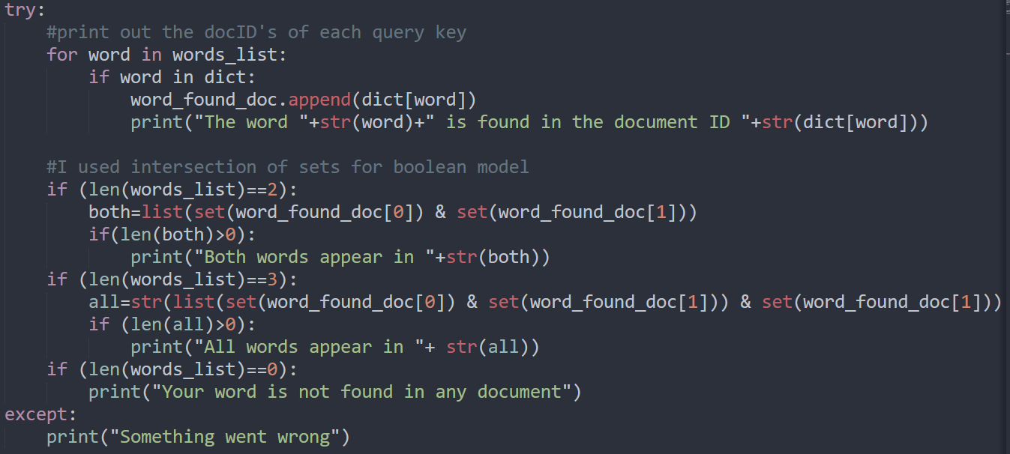
Intersection of posting lists(7)
Next I used sets for intersection of posting lists which is used for boolean retrieval. My query works with no morethan 3 words and with AND operator only.

Slide 11
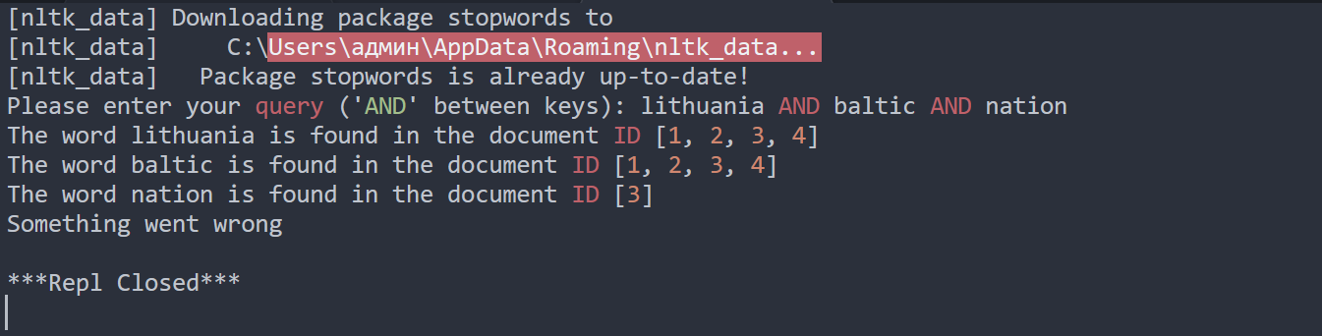
Final result

Slide 12
Thank you for attention!

