Slide 1
Lab 3
Boolean Retrieval System using Python
and Inverted index
Satima Valsony
Vytautas Magnus University

Slide 2
Text Processing stages
Tokenization
Normalization
Stemming
Stop words

Slide 3
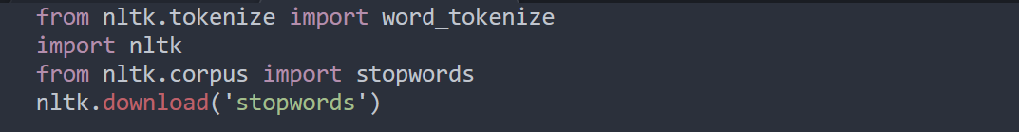
My text processing stages (1)
Import necessary libraries
One of the most popular libraries in NLP is NLTK.
I used it to remove stopwords and for tokenizaton

Slide 4
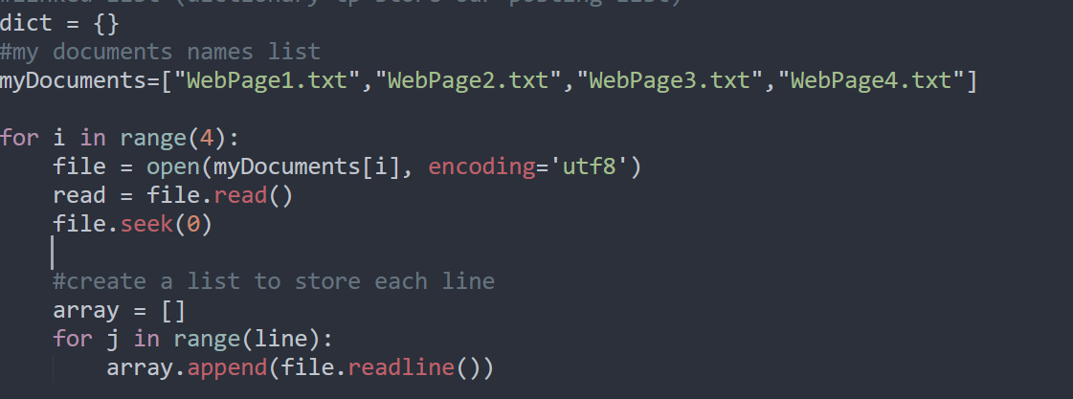
My text processing stages (2)
Creation of dictionary (to store my posting list), list containing documents name, next inside loop I’ll read each file and add text inside array

Slide 5
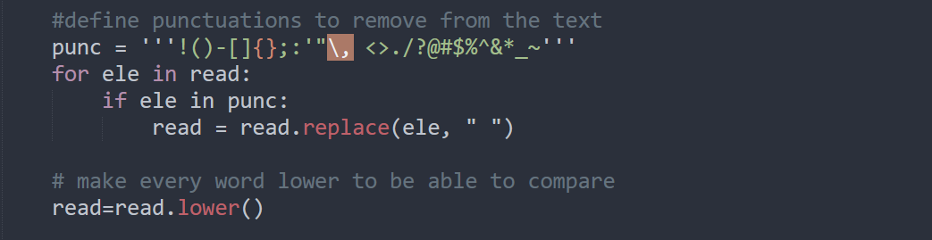
My text processing stages (3)
I defined punctuations I want to remove from the texts and for each item and replaced it with empty space “ “.
Also used function lower() to customize

Slide 6
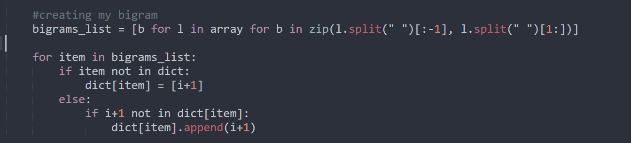
My text processing stages (4)
My bigrams creation and adding them into dictionary

Slide 7
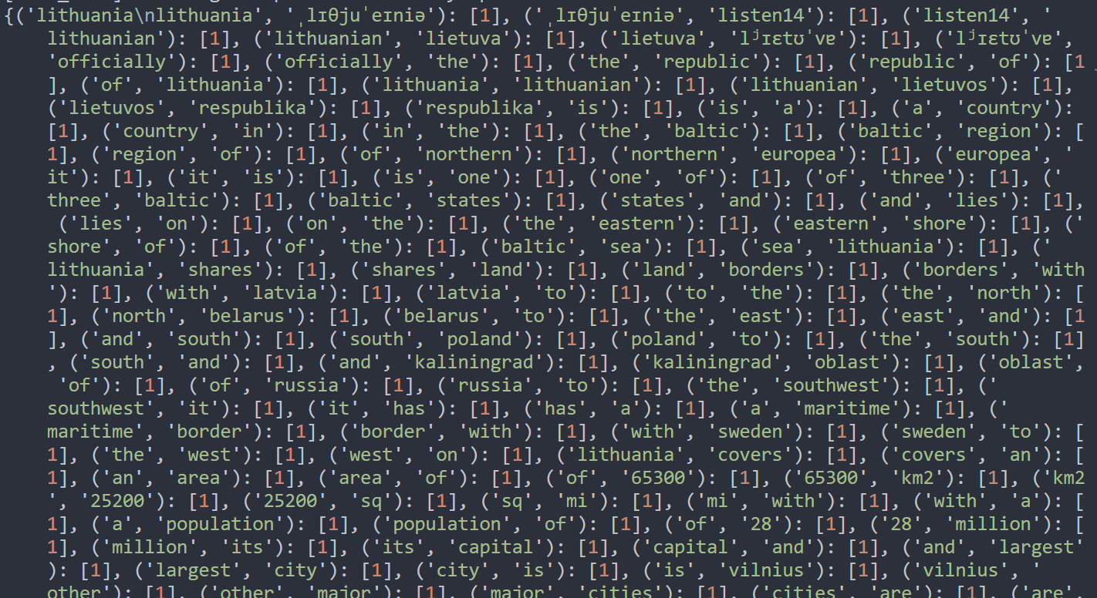
Here is how my posting list look like

Slide 8
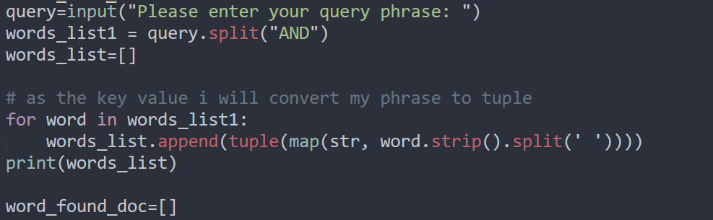
Query formulation (6)
Creation of query and other stuff

Slide 9
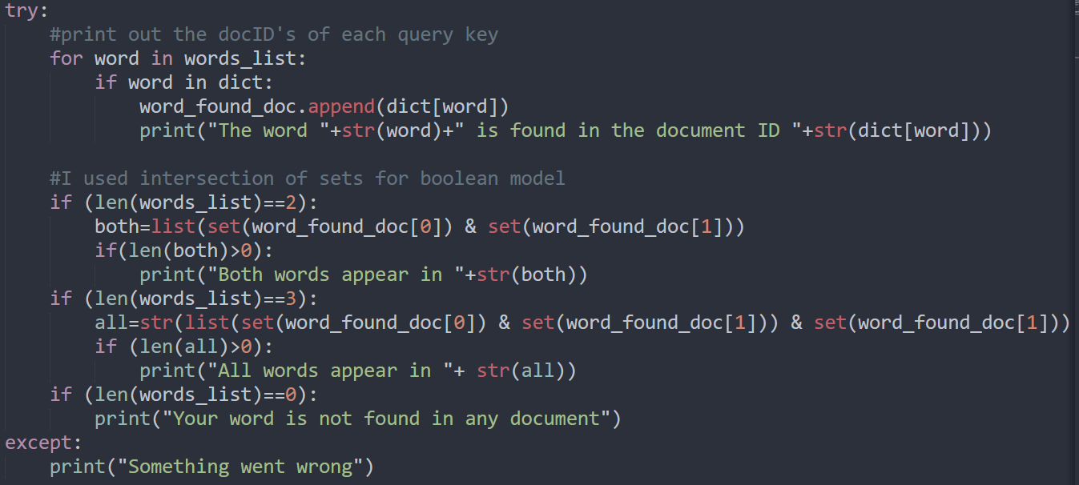
Intersection of posting lists(7)
Next I used sets for intersection of posting lists which is used for boolean retrieval. My query works with no morethan 3 words and with AND operator only.

Slide 10
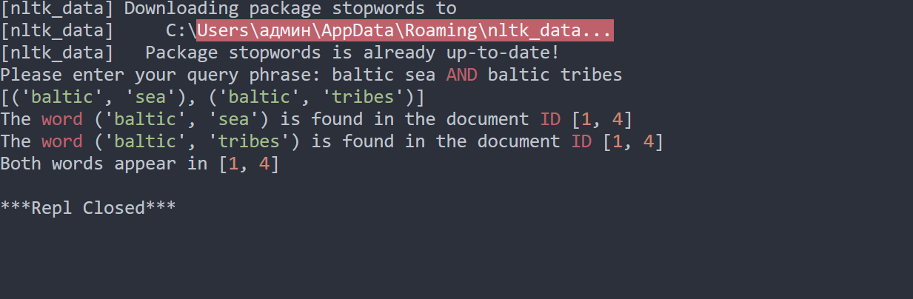
Final result

Slide 11
how indexing with bigrams is better than simple indexing with AND operator?
My answer
In simple Boolean query we can just break down if phrase query will be entered then we will search by breaking phrases into separate words instead of entire phrases.
Without docs we can’t verify matching the Boolean query do contain the phrase.

Slide 12
Thank you for attention!

