Slide 1
Lab 4
Program vector model based information retrieval system.
Satima Valsony
Vytautas Magnus University

Slide 2
What is TF-IDF
TF-IDF is the product of Term Frequency and Inverse Document Frequency. Here’s the formula for TF-IDF calculation.
TF-IDF = Term Frequency (TF) * Inverse Document Frequency (IDF)

Slide 3
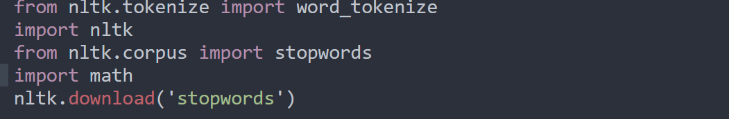
Start of process
Import necessary libraries
One of the most popular libraries in NLP is NLTK.
I used it to remove stopwords and for tokenizaton

Slide 4
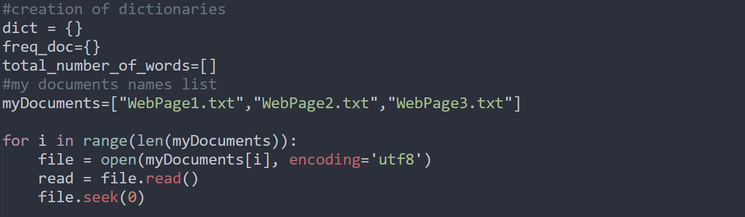
My text processing stages (2)
Creation of dictionary (to store my posting list), list containing documents name, next inside loop I’ll read each file and add text inside array

Slide 5
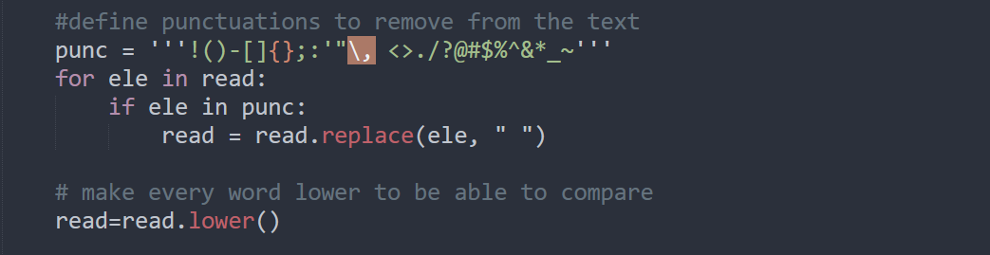
My text processing stages (3)
I defined punctuations I want to remove from the texts and for each item and replaced it with empty space “ “.
Also used function lower() to customize

Slide 6
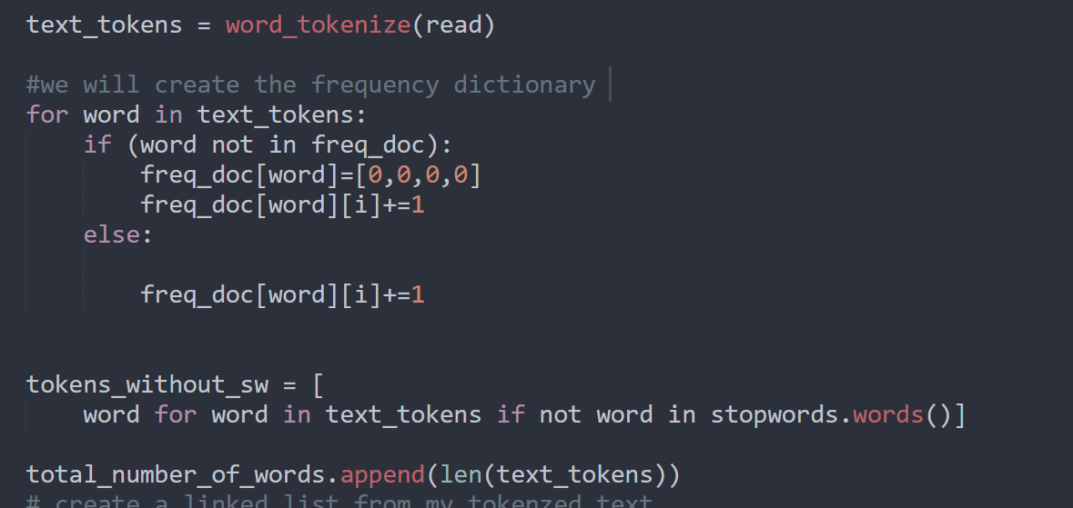
My text processing stages (4)
From tokenized text I’ll create a dictionary of frequency. It will be in format: {“word”:[freq1,freq2,freq3]}

Slide 7
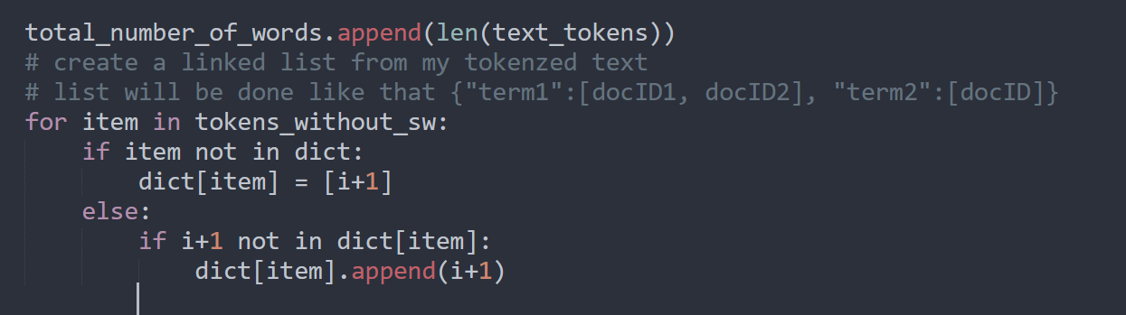
Dictionary with index of words

Slide 8
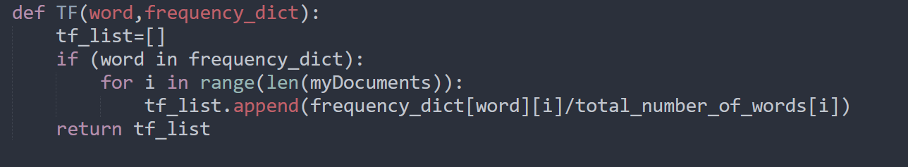
Def TF (Term Frequency)

Slide 9
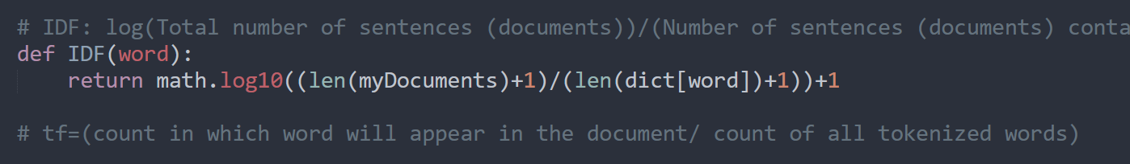
Def IDF (Inverse Document Frequency)

Slide 10
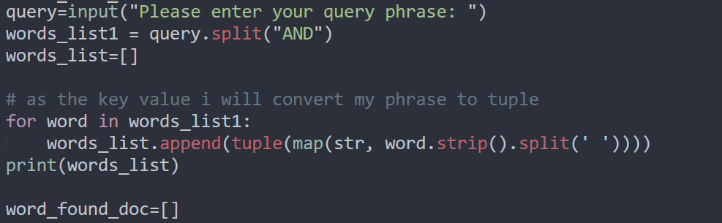
Query formulation (6)
Creation of query and other stuff

Slide 11
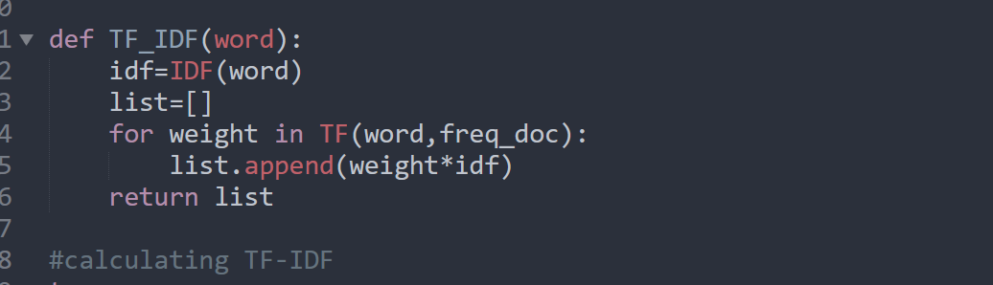
Def TF-IDF (combination)
.

Slide 12
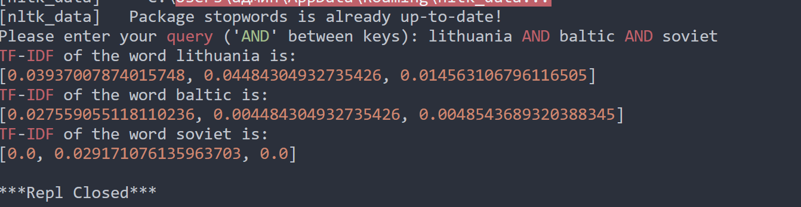
Final result

Slide 13
Thank you for attention!

