Slide 1
Lab 5
Website crawling with Python
Satima Valsony
Vytautas Magnus University

Slide 2
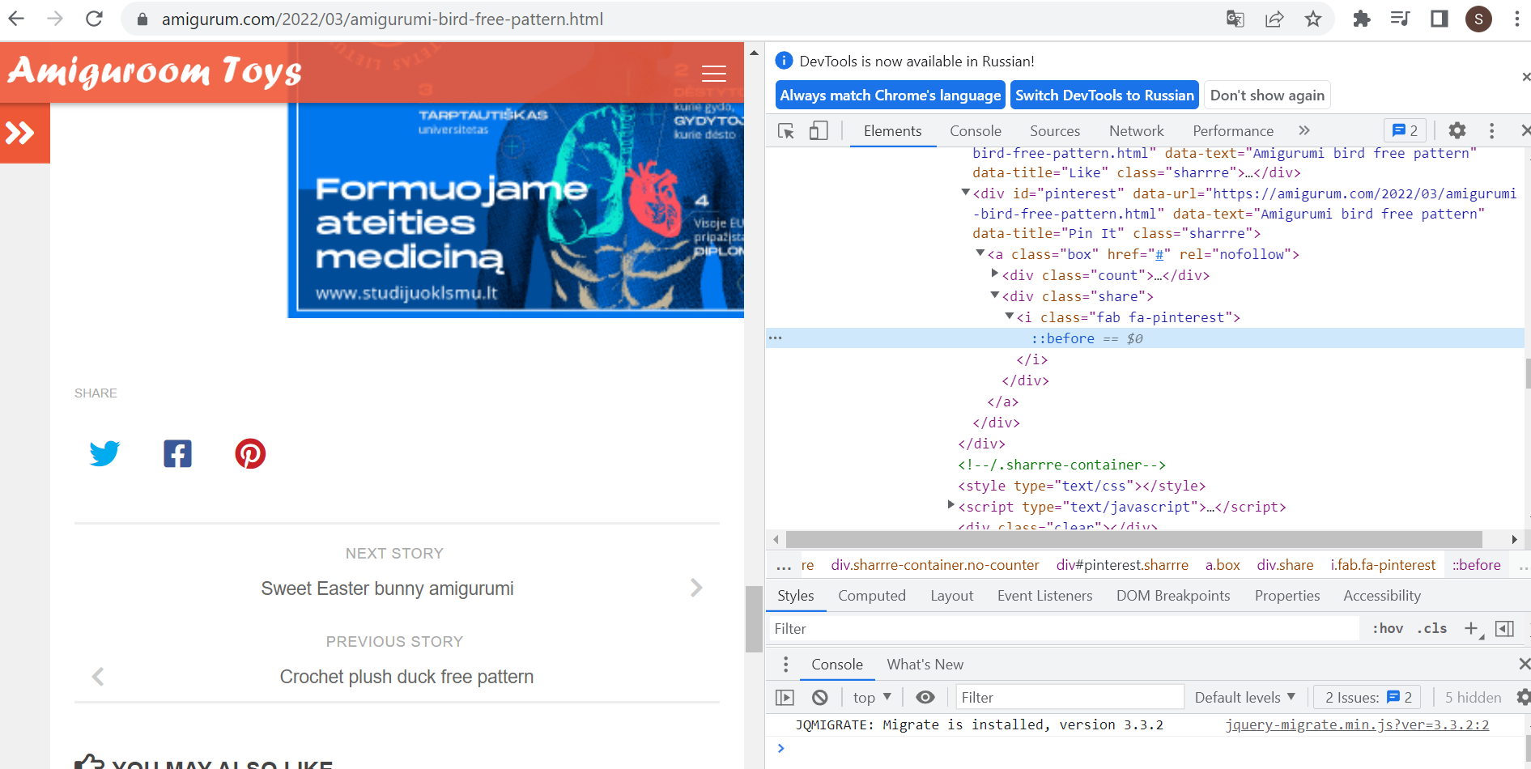
Website investigation

Slide 3
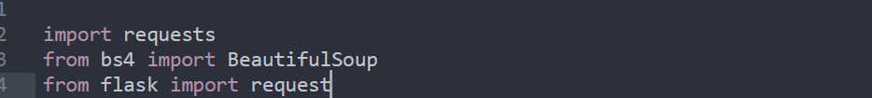
Import libraries

Slide 4
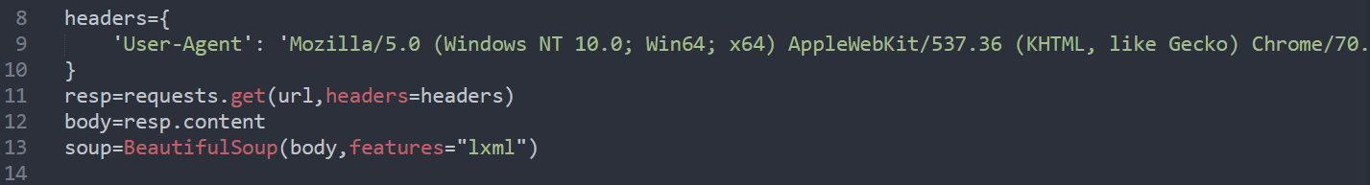
Start of process

Slide 5
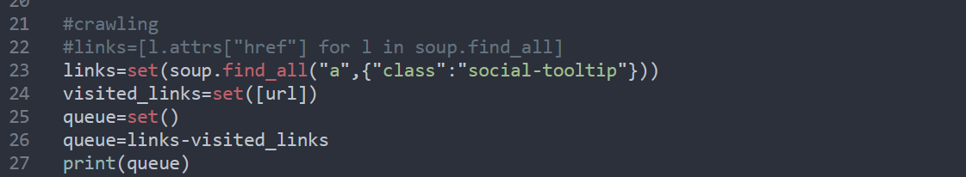
Crawling

Slide 6
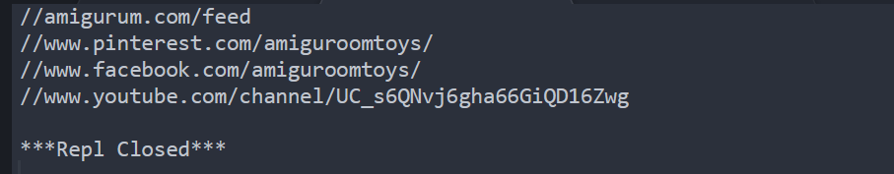
Final result

Slide 7
Thank you for attention!

