Slide 1
ENSC 251 Final Project
Sahaj Singh, Nicholas Mah, Zach Hsu, Daniel Yu

Slide 2
Design Process
01
02
03
04
Agile Methodology
Fundamentals
Implementation
Information from lectures and other resources
Creating programs in code
Testing
Improvement
Rigorous testing and debugging
Editing functions to improve efficiency and reduce bugs

Slide 3
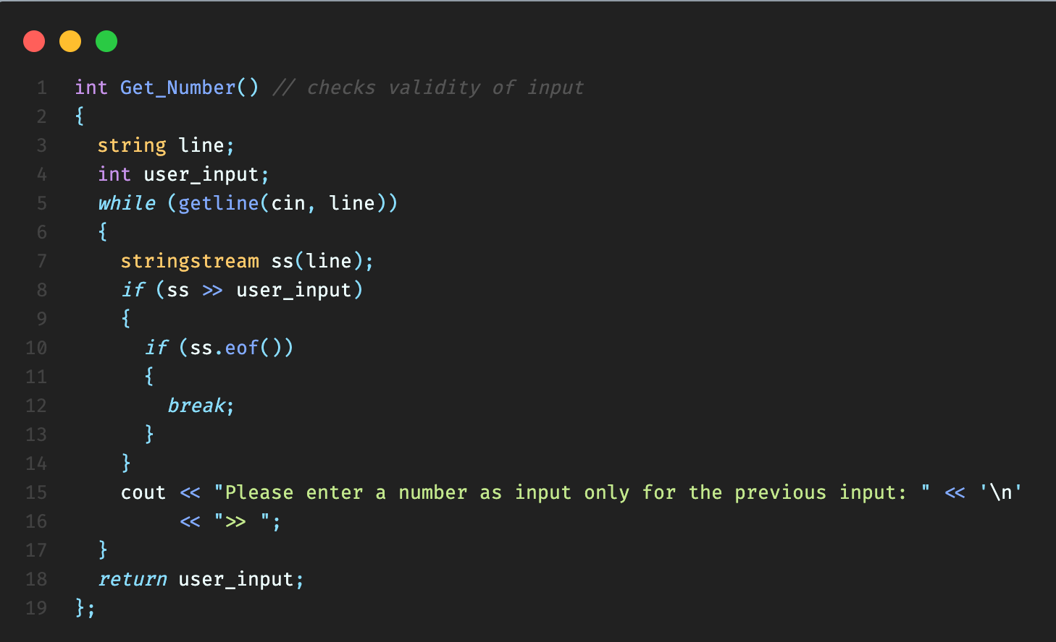
Design Process
Implemented various helper functions

Slide 4
User Interface
Characters
Used spacers such as “>>” and “—” to create space between menu options and outputs
Terminal
Submenus
Console based User Interface with robust error checking
A main menu simple and easy to understand

Slide 5
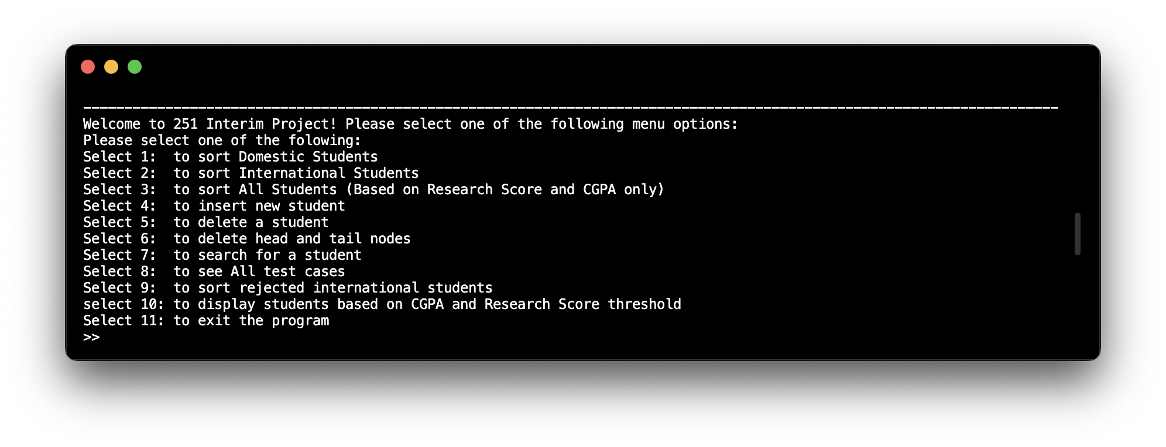
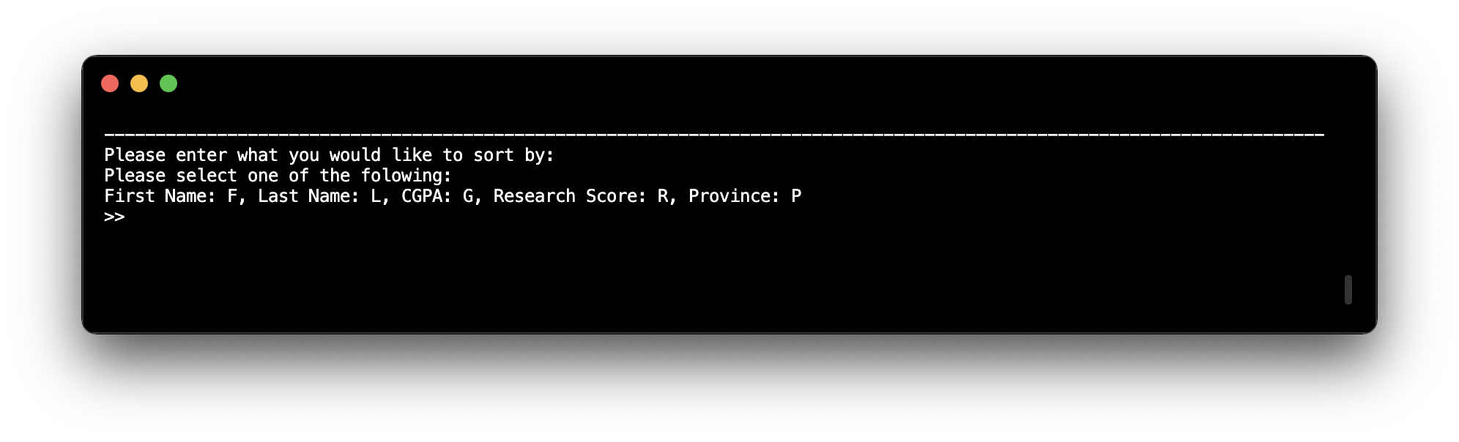
User Interface

Slide 6
Core Classes
Domestic/International/Student
students’ information based on classification wanted
DomesticStudentList/InternationalStudentList/StudentList
create and append lists based on classification wanted

Slide 7
Core Functions
Stu_Sort
Merge sort functions responsible for creating all lists based on respective hierarchies
Get_Number
Ensuring validity of inputs whenever needed
Find Functions
Traverses linked lists based on specific classification

Slide 8
Our Innovations
Re-structured code to use interim material .
Read data into array → Convert Array to Linked List → Delete Array and Maintain linked lists
Additional option to display and sort:
merged student list
rejected international students
Display student type in merged student list rather than displaying excess information
All lists are maintained despite merging
Can even look up students using threshold in all lists
Showcase head and tail nodes to user

Slide 9
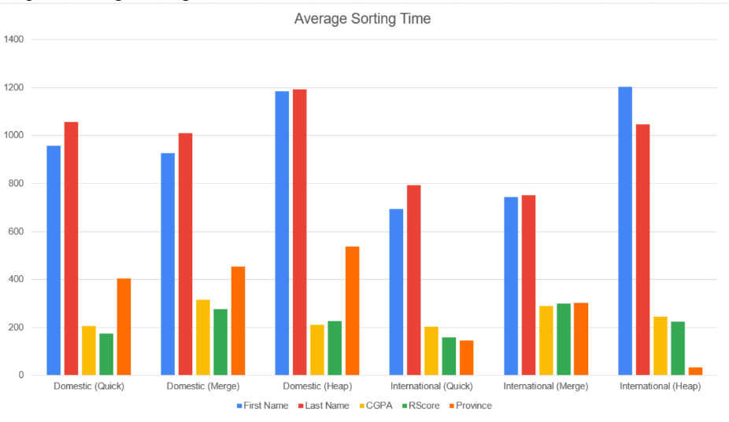
Average Sorting Times

Slide 10
Project Management
Meetings
Github
Met frequently both in person and online
Utilised a private Github repository to keep files organized
VSCode
Discord
IDE of choice, used the Github extension with Live Share
Primary form of communication

Slide 11
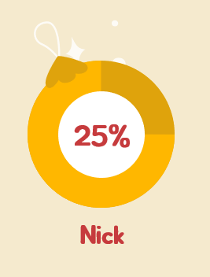
Work Distribution
25%
25%
25%
Equal Work Distribution amongst all members
Zach
Daniel
Sahaj

Slide 12
Key Takeaways
Github
Time Management
Used Github in a professional manner as a team
Linked Lists
Planning and exercising conscious control of time
Learned about data structures such as linked lists
Polymorphism
OOP
Exercised modularization throughout the program
Communication
Gained in depth understanding in regards with object-oriented programing
Teamwork between members

Slide 13
Thanks!
Does anyone have any questions?

