Slide 1
ENSC 251 Final Project
Sahaj Singh, Nicholas Mah, Zach Hsu, Daniel Yu

Slide 2
Design Process
01
02
03
04
Fundamentals
Implementation
Information from lectures and other resources
Creating programs in code
Testing
Improvement
Rigourous debugging
Editing functions to improve efficiency and fix bugs

Slide 3
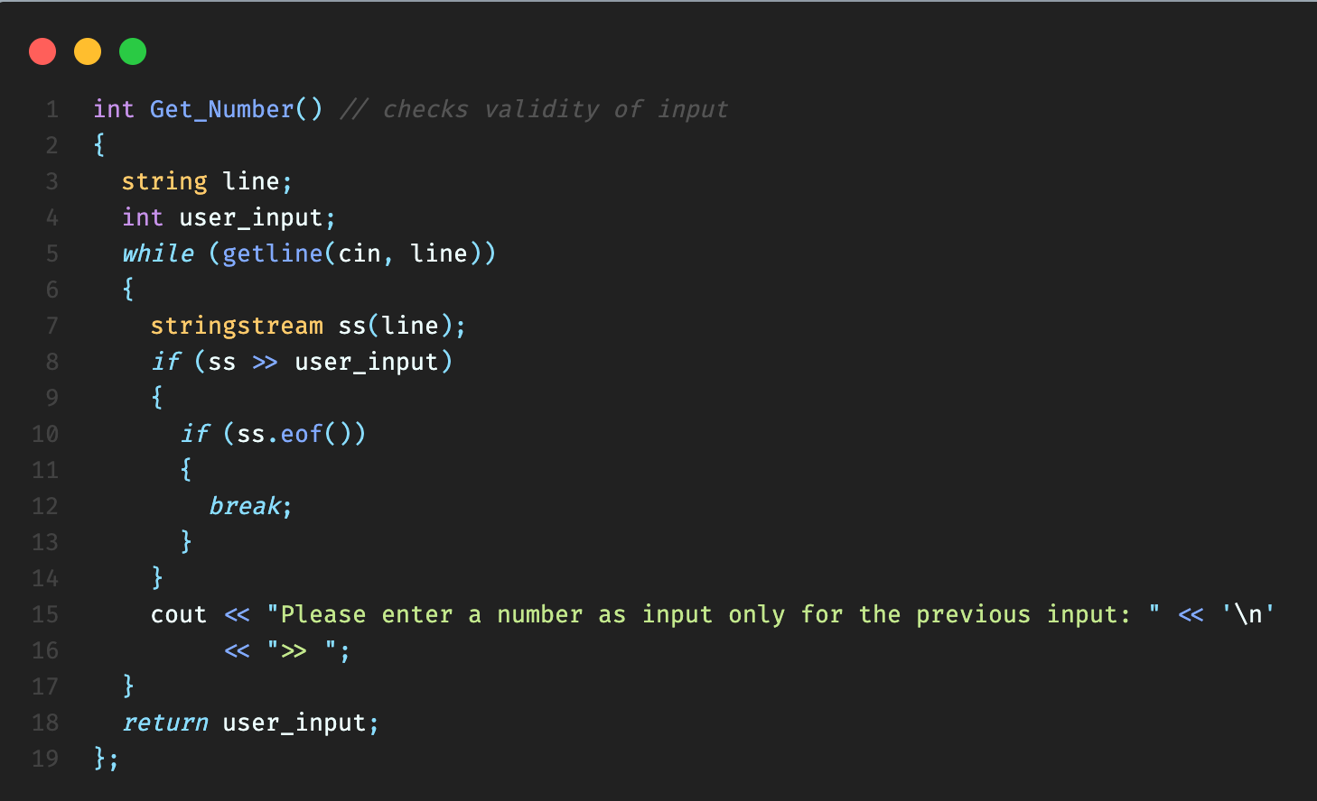
Design Process

Slide 4
User Interface
Characters
Used “>>” and “—” to create space between menus and functions
Terminal
Submenus
Based in terminal
Keep main menu simple and easy to understand

Slide 5
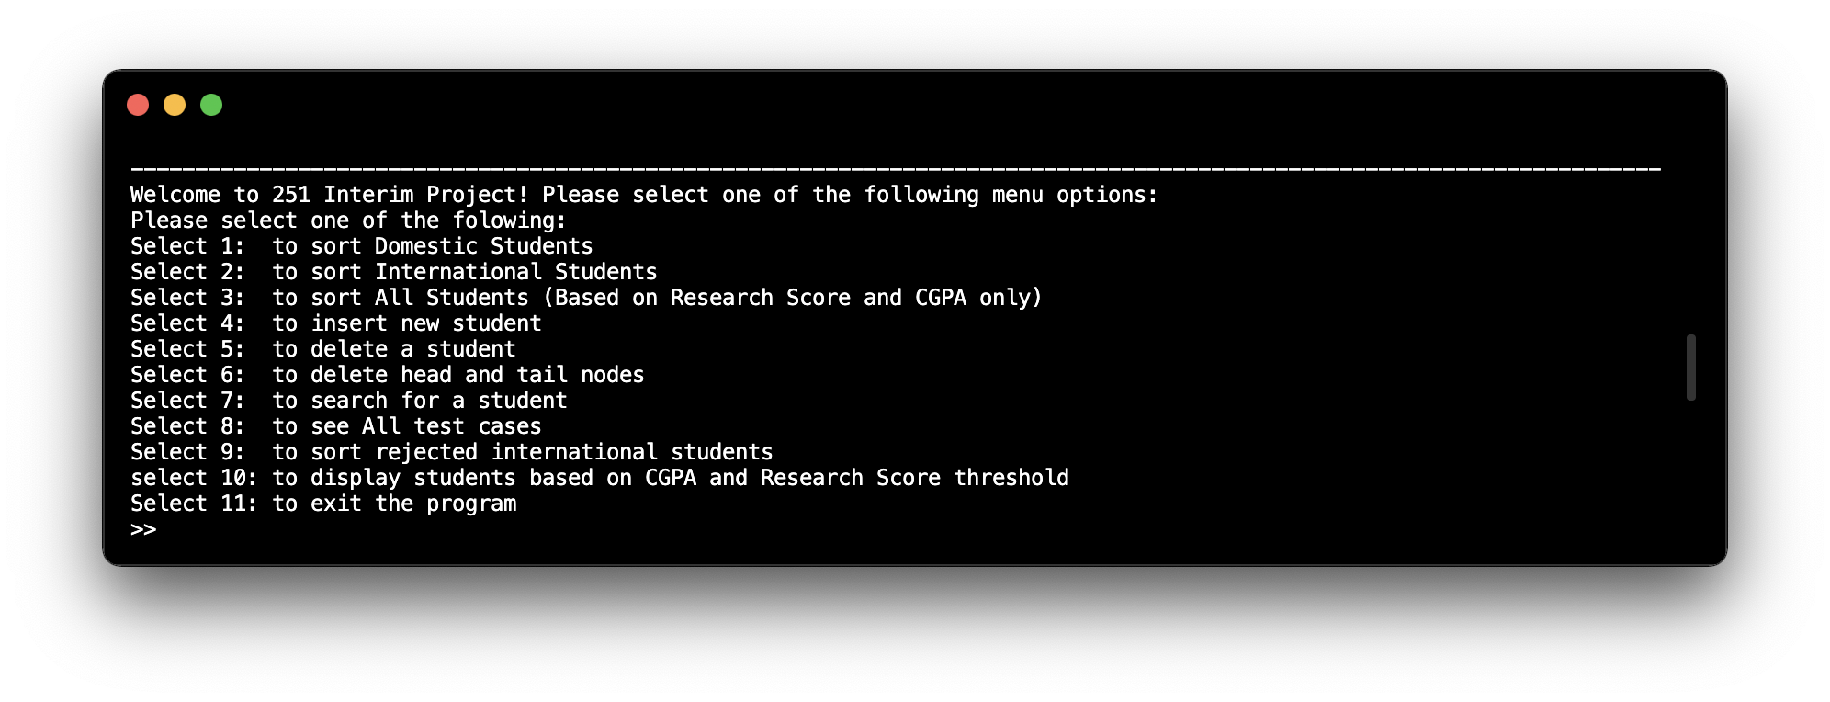
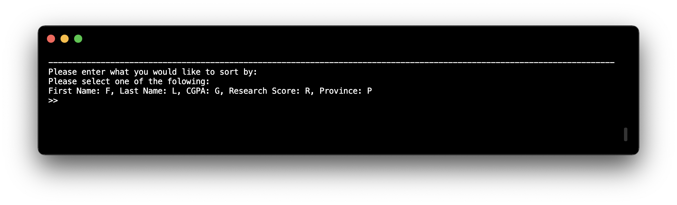
User Interface

Slide 6
Core Classes
Domestic/International/Student
students’ information based on classification wanted
DomesticStudentList/InternationalStudentList/StudentList
create and append lists based on classification wanted

Slide 7
Core Functions
Stu_Sort
Merge sort functions responsible for creating all lists based on respective hierarchies
Get_Number
Ensuring validity of inputs whenever needed
Find Functions
Traverses linked lists based on specific classification

Slide 8
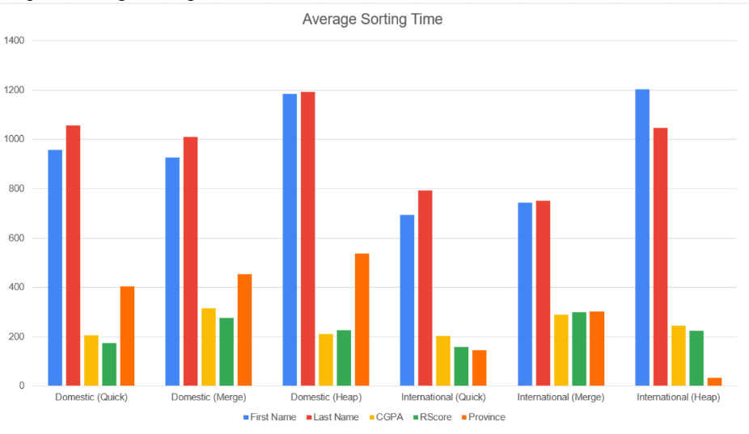
Average Sorting Times

Slide 9
Our Innovations
Option to show and sort rejected international students
During initial sort of international students, rejected students are sorted in a separate list
In lists with all students, shows whether they are domestic or international
All lists are maintained despite merging

Slide 10
Project Management
Meetings
Github
Met frequently both in person and online
Utilised a private Github repository to keep files oragnized
VSCode
Discord
IDE of choice, used the Github extension with Live Share
Primary form of communication

Slide 11
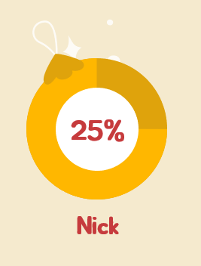
Work Distribution
25%
25%
25%
Zach
Daniel
Sahaj

Slide 12
Key Takeaways
Github
Communication
Time Management
Using Github in a professional manner within a team enviroment
Teamwork between members
Planning and exercising conscious control of time

Slide 13
Thanks!
Does anyone have any questions?

