Slide 1

SATIS GROUP · BACKEND WEBINAR SERIES
SATIS
GROUP
Editing the website with Claude.
How anyone on the team changes pages, photos and copy, just by describing the change in plain English.
BACKEND WEBINAR 01 OF 07
Notes:
Welcome everyone. This session shows how we make changes to satisgroup.co.uk without a developer on call: we describe the change to Claude in plain English, and it edits the website's master copy for us. By the end you'll be able to request any content change yourself. No technical background needed.

Slide 2
IN THIS WEBINAR
SATIS
GROUP
What this session covers.
Under an hour, no technical background needed. By the end you can request any website change yourself — and look at it before anyone else does.
01
The one idea behind everything
05
The magic words
The live site is a printed brochure: you change the master copy, not the print.
“…then commit and push the change”, and what happens next.
02
Starting a Claude session
06
Previewing before it goes live
Where to go, what to click, what you need access to.
Branch previews on Vercel, and how to find one.
03
Connecting a different GitHub account
07
Bigger jobs
Pointing Claude at a repository another account or organisation owns.
Adding a whole new development in one request.
04
How to ask for changes
08
Skills and safety nets
Proven plain-English requests you can copy verbatim.
Where the 105 playbooks live, and how nothing is ever lost.
SATIS GROUP · EDITING THE WEBSITE WITH CLAUDE
02
Notes:
Run through the agenda quickly. Two sections are new since the last run of this webinar: connecting a different GitHub account (03), and previewing a change on its own web address before it reaches the live site (06). Emphasise the promise: by the end of the session everyone here can change the website themselves, safely.

Slide 3
THE BIG IDEA
SATIS
GROUP
The live site is a printed brochure.
You cannot scribble on a printed brochure: you change the master copy and print a new one. The master copy of this website lives in a shared, version-tracked folder called the repository, and the live site reprints itself automatically whenever the master changes.
You describe a change
in plain English, to Claude
Claude edits the master copy
the GitHub repository
The site reprints itself
Vercel rebuilds automatically
Change is live
www.satisgroup.co.uk
MINUTES, NOT DAYS
Two rules cover everything: nothing changes until it reaches the master copy, and every change to the master is recorded, so nothing is ever lost.
SATIS GROUP · EDITING THE WEBSITE WITH CLAUDE
03
Notes:
This mental model comes from the operations guide and explains every behaviour they'll meet: why changes take a minute to appear, why nothing can be broken by browsing, and why every change is traceable. Repeat the brochure line. It lands.

Slide 4
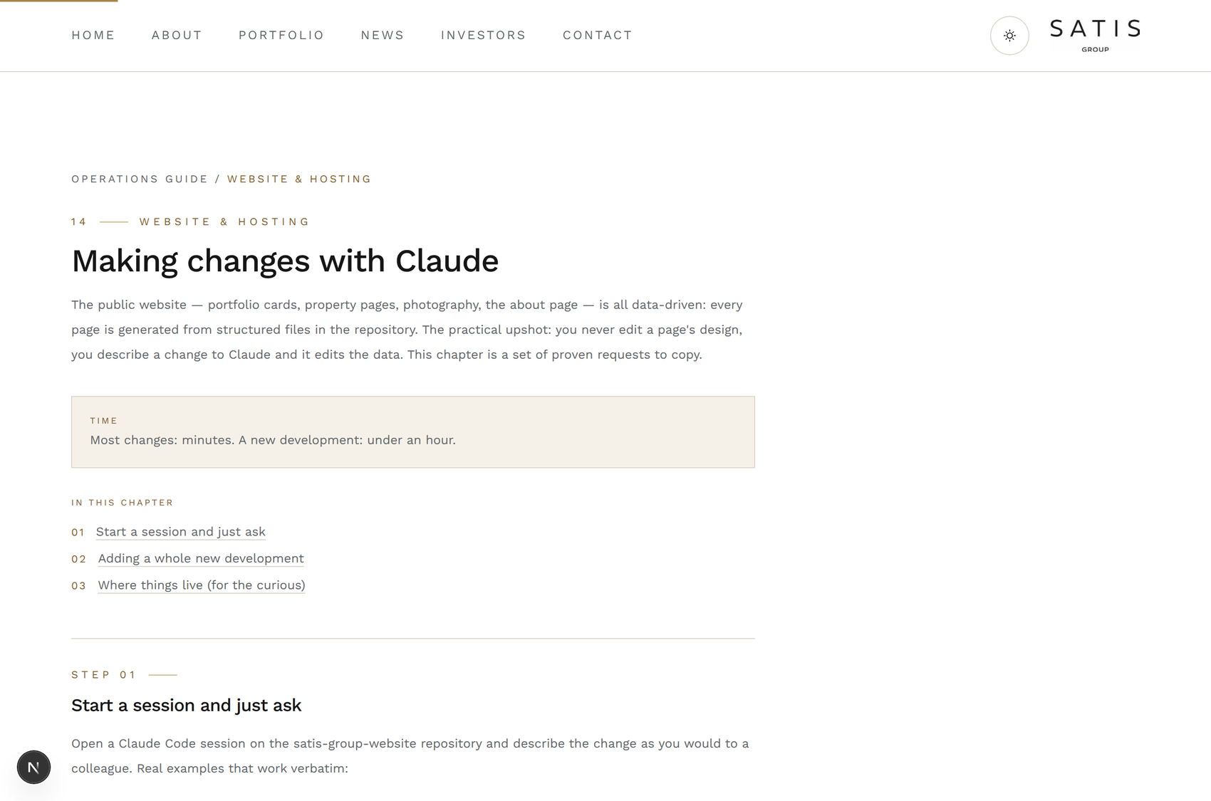
GETTING STARTED
SATIS
GROUP
Starting a Claude session on the website.
Claude Code is Claude working directly on the website's repository. You reach it from a web browser; there is nothing to install.
1
Open claude.ai/code in your browser
Sign in with your work Claude account. The development team sets up your access the first time; ask once, use forever.
2
Choose the website repository
Select satis-group-website from the repository list. That connects the session to the site's master copy.
3
Describe your change and send
Type what you want changed as if briefing a colleague. Claude reads the site's files, makes the edit, and shows you what it did.
GOOD TO KNOW
You cannot break anything by asking Claude works on a copy until the change is committed and merged. Asking questions, exploring, or changing your mind costs nothing.
The written version of this walkthrough lives at /admin/guide, chapter “Making changes with Claude”.
SATIS GROUP · EDITING THE WEBSITE WITH CLAUDE
04
Notes:
Reassure the room: a Claude session is a conversation, not a control panel. Nothing they type goes live by itself. There is a deliberate step (commit, then the automatic republish) between conversation and the public site.

Slide 5
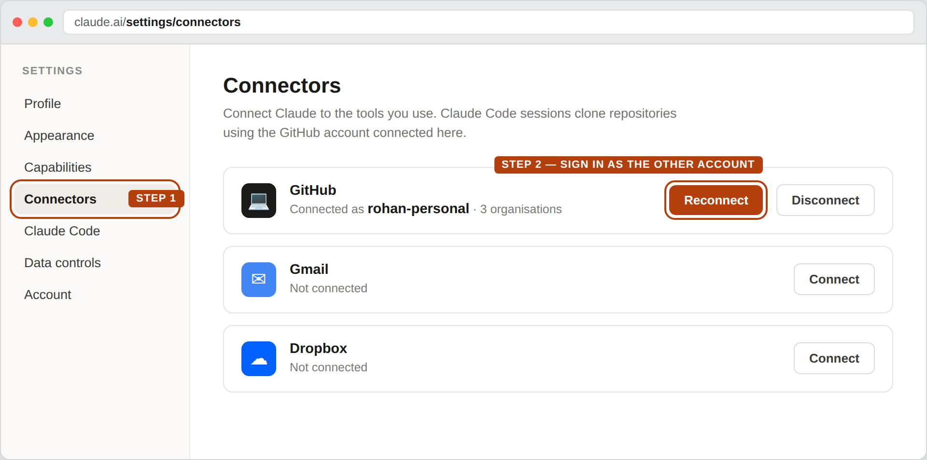
ACCESS
SATIS
GROUP
Connecting Claude to a different GitHub account.
The repositories you can pick in a session are exactly the ones the connected GitHub account can see. Working on a site owned by another account or organisation means changing that connection. It is a one-time job.
1
Settings → Connectors → GitHub
In claude.ai, open Settings, then Connectors. The GitHub row names the account in use.
2
Choose Reconnect
Or Disconnect and then Connect. Either way GitHub asks you to authorise the connection again.
3
Sign in as the other account
If the browser signs you straight back in as the old one, sign out of github.com first, then retry.
GOOD TO KNOW
Two things people confuse A session can reach any repository the connected account can see. Installing the Claude app on a repository is a separate step — that is what switches on pull-request previews and automatic CI fixes.
claude.ai → Settings → Connectors The account named here is the one every session will use. Change it here and the repository list changes with it.
SATIS GROUP · EDITING THE WEBSITE WITH CLAUDE
05
Notes:
This is the question that comes up whenever somebody joins with a personal GitHub login. The model to give them: Claude sees exactly what the connected GitHub account sees, no more and no less. So "I cannot find the repository" is almost always "I am connected as the wrong account". Step three is where people get stuck — the browser silently reuses the old GitHub session, so tell them to sign out of github.com first.

Slide 6
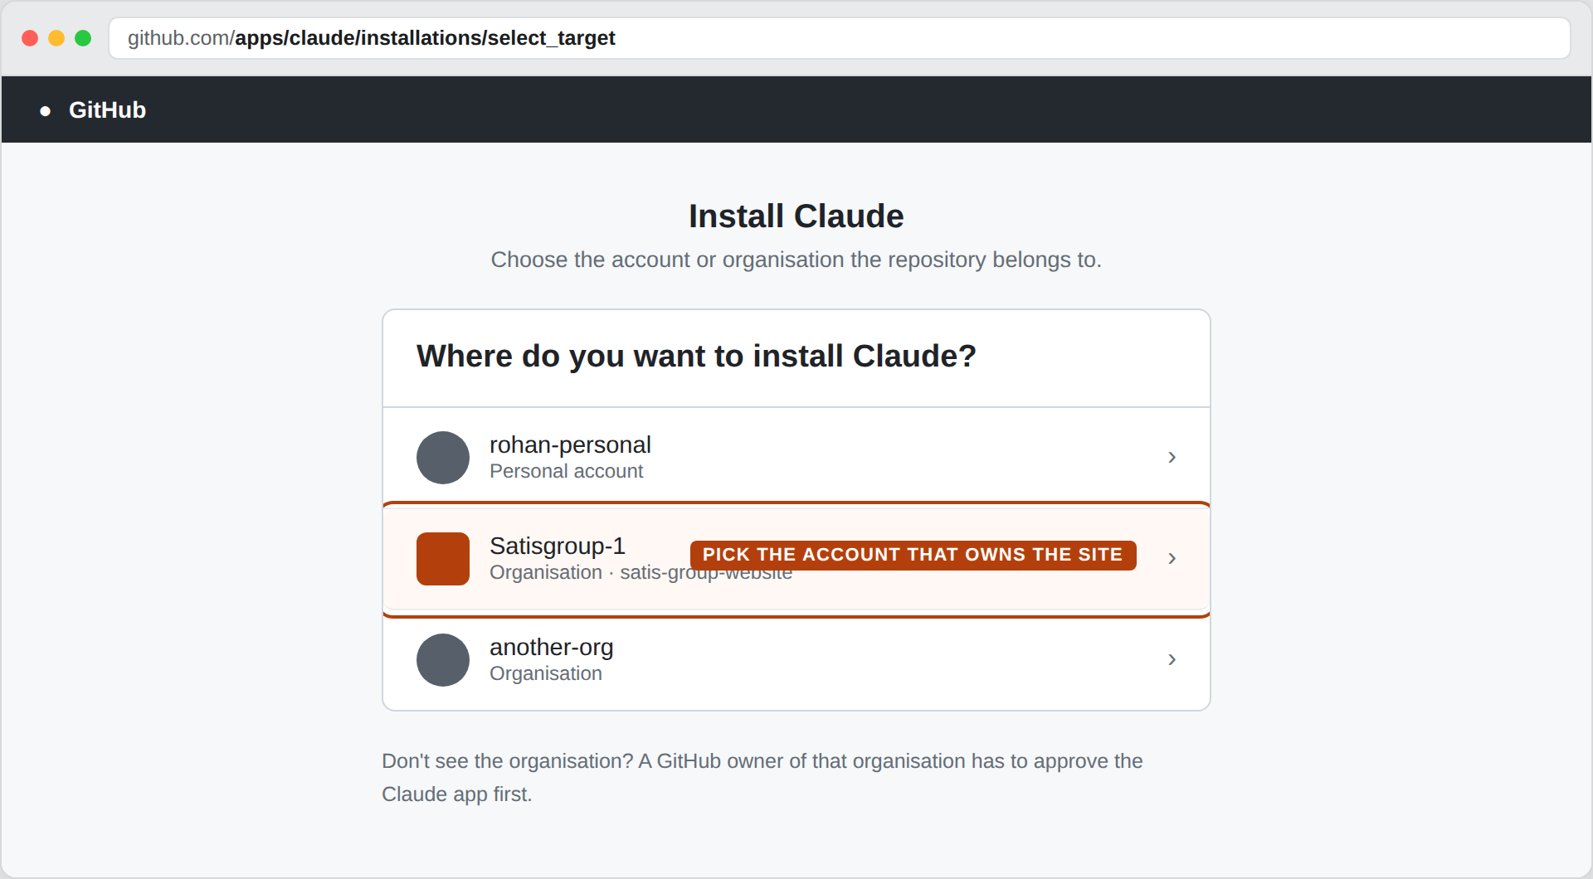
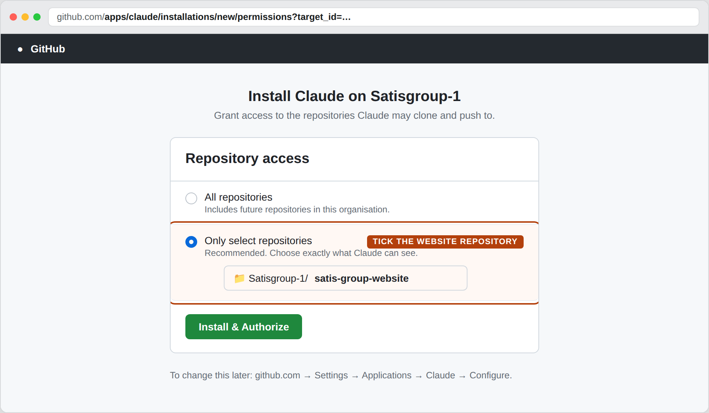
ACCESS
SATIS
GROUP
Choosing the account, then the repositories.
GitHub then asks two questions in turn: whose repositories, and which of them. Answer both for the organisation that owns the site.
1 — Where do you want to install Claude? Pick the organisation that owns the site: Satisgroup-1. Your personal account will not contain it. If the organisation is missing from the list, a GitHub owner has to approve the Claude app once.
2 — Repository access Choose “Only select repositories” and tick satis-group-website, then Install & Authorize. To change it later: github.com → Settings → Applications → Claude → Configure.
SATIS GROUP · EDITING THE WEBSITE WITH CLAUDE
06
Notes:
Two screens, two questions. The first is about the owner and the second about the repositories. Recommend "Only select repositories" over "All repositories" — it is the safer default and it costs one extra tick. The line worth repeating is the last one: this is all reversible at any time from GitHub Settings, Applications, Claude, Configure.

Slide 7
HOW TO ASK
SATIS
GROUP
Proven requests, copy these word for word.
Describe the outcome, not the mechanics. These real examples all work verbatim:
“Change the status of 22 St John Street to ‘Fully let’ on its portfolio card and property page.” Content edits: statuses, copy, dates, figures.
“Replace the hero photo on the Courthouse page with the attached image.” Photography: attach the image to your message.
“Add this award to the About page: RESI Awards Rising Star 2026.” Additions: awards, team members, accolades.
“Fix a typo on the contact page: ‘recieve’ should be ‘receive’.” Small fixes: describe what's wrong and what right looks like.
SATIS GROUP · EDITING THE WEBSITE WITH CLAUDE
07
Notes:
These four examples come straight from the operations guide and cover 90% of day-to-day requests. Encourage people to include the page name and exact wording they want. Precision in, precision out.

Slide 8
THE MAGIC WORDS
SATIS
GROUP
End every request with: “…then commit and push the change.”
A commit is a saved, dated snapshot of the master copy with a note of what changed and why. Committing and pushing is what sends your change to the master, and the master is what the live site reprints from.
“Replace the hero photo on the Courthouse page with the attached image, then commit and push the change.”
GOOD TO KNOW
Why it matters Without the magic words the edit stays in the session: reviewed but not sent. With them, Claude commits, pushes, and tells you when it is done.
Commits are the audit trail. Every change is dated, described and attributed, and any mistake can be rolled back to the snapshot before it. Ask Claude “what changed this month?” and it can tell you.
SATIS GROUP · EDITING THE WEBSITE WITH CLAUDE
08
Notes:
“Commit and push” is the one phrase worth memorising. Explain the audit trail: this is why the repository approach is safer than editing a live site. Every version of every page, forever.

Slide 9
AFTER YOU ASK
SATIS
GROUP
What happens next, and how to check.
1
Claude confirms the commit
It tells you what it changed and that the change is pushed. If the team reviews changes first, it opens a pull request instead (a change waiting for approval).
WHAT YOU SHOULD SEE
A good session ends with A confirmation naming what changed, and the live page showing it. Keep the session open until you have seen both.
2
The site republishes itself
Vercel, the hosting platform, notices the new master copy and reprints the site automatically. Typically a few minutes. There is nothing to press.
3
Verify on the live page
Open the page and check your change is showing. Not there after ten minutes? Ask in the same Claude session: “Was the commit pushed, and did the deployment succeed?” Claude can check both.
SATIS GROUP · EDITING THE WEBSITE WITH CLAUDE
09
Notes:
Set the expectation of a few minutes' delay. It prevents the “it didn't work” moment when a change hasn't propagated yet. The verification habit (always look at the live page) catches misunderstandings early.

Slide 10
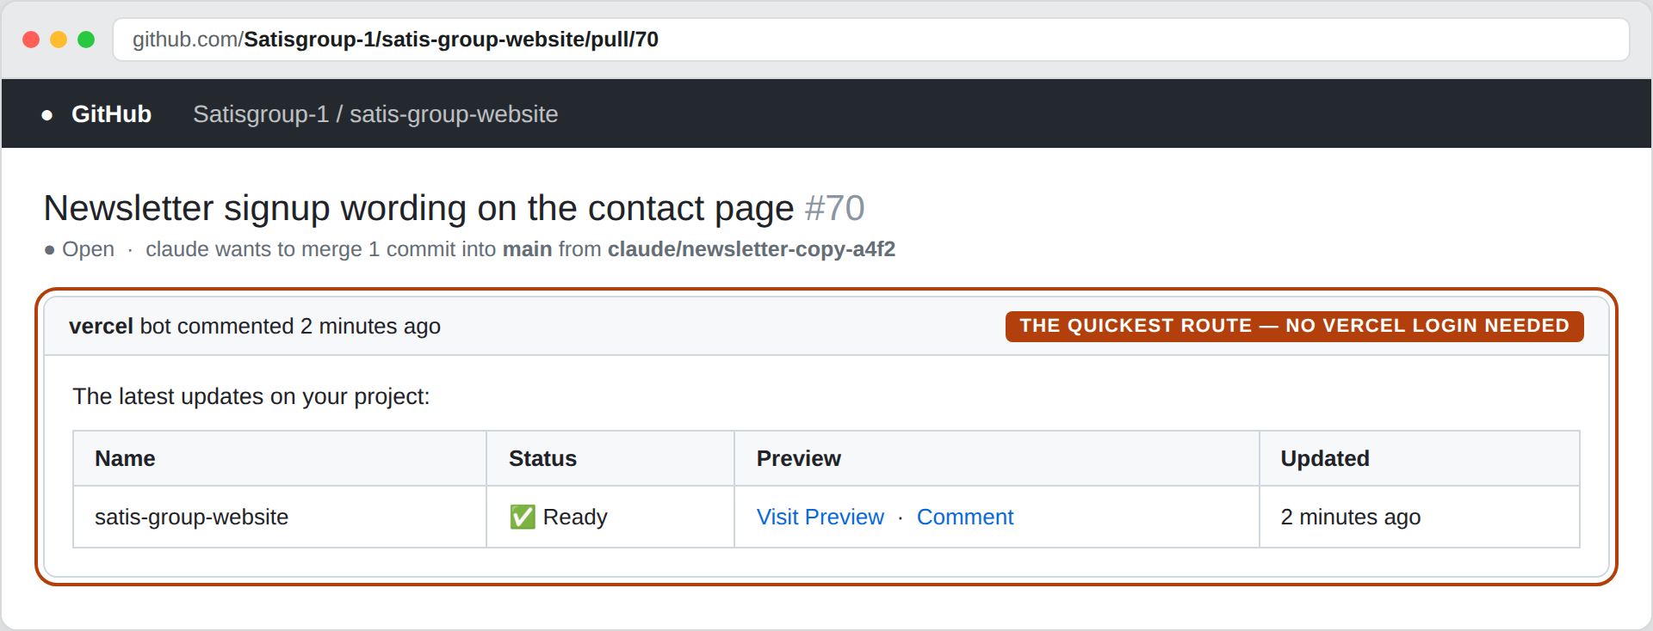
PREVIEWS
SATIS
GROUP
Seeing a change before it goes live.
Every branch gets its own private copy of the whole website, at its own web address. Vercel builds it automatically. Nothing on www.satisgroup.co.uk moves until that branch is merged.
1
Ask for a branch, not a direct change
End your request with: “…then commit and push to a new branch and open a pull request.” Claude will not touch the live site.
2
Vercel builds the preview by itself
Within a minute or two the branch has a complete copy of the site — pages, photographs, navigation, all of it — on its own address.
3
Ask Claude for the link
“What is the preview URL for this branch?” is the fastest route of all. Claude reads it off the pull request and hands you the address.
WHAT YOU SHOULD SEE
Every pull request grows a table Vercel posts it as a comment within a couple of minutes: the project name, a green Ready, and a Visit Preview link. That link is your change, working, on its own address — and anyone can open it without a Vercel login.
GOOD TO KNOW
A preview is a rehearsal, not a broadcast The address is unlisted and entirely separate from the live site. Share it, click around it, change your mind — the public site is untouched until someone merges the branch.
SATIS GROUP · EDITING THE WEBSITE WITH CLAUDE
10
Notes:
This is the slide that changes behaviour. Until now people have asked for a change and hoped; from here they can look first. Make the distinction explicit: a preview is a full working copy of the site at a different address, not a screenshot and not a staging server anyone has to maintain. Land the last point hard — the quickest route to a preview is to ask Claude, in the same session, for the link.

Slide 11
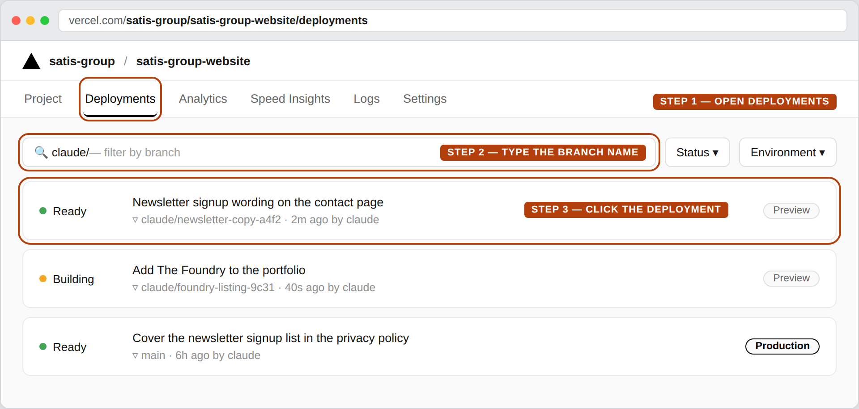
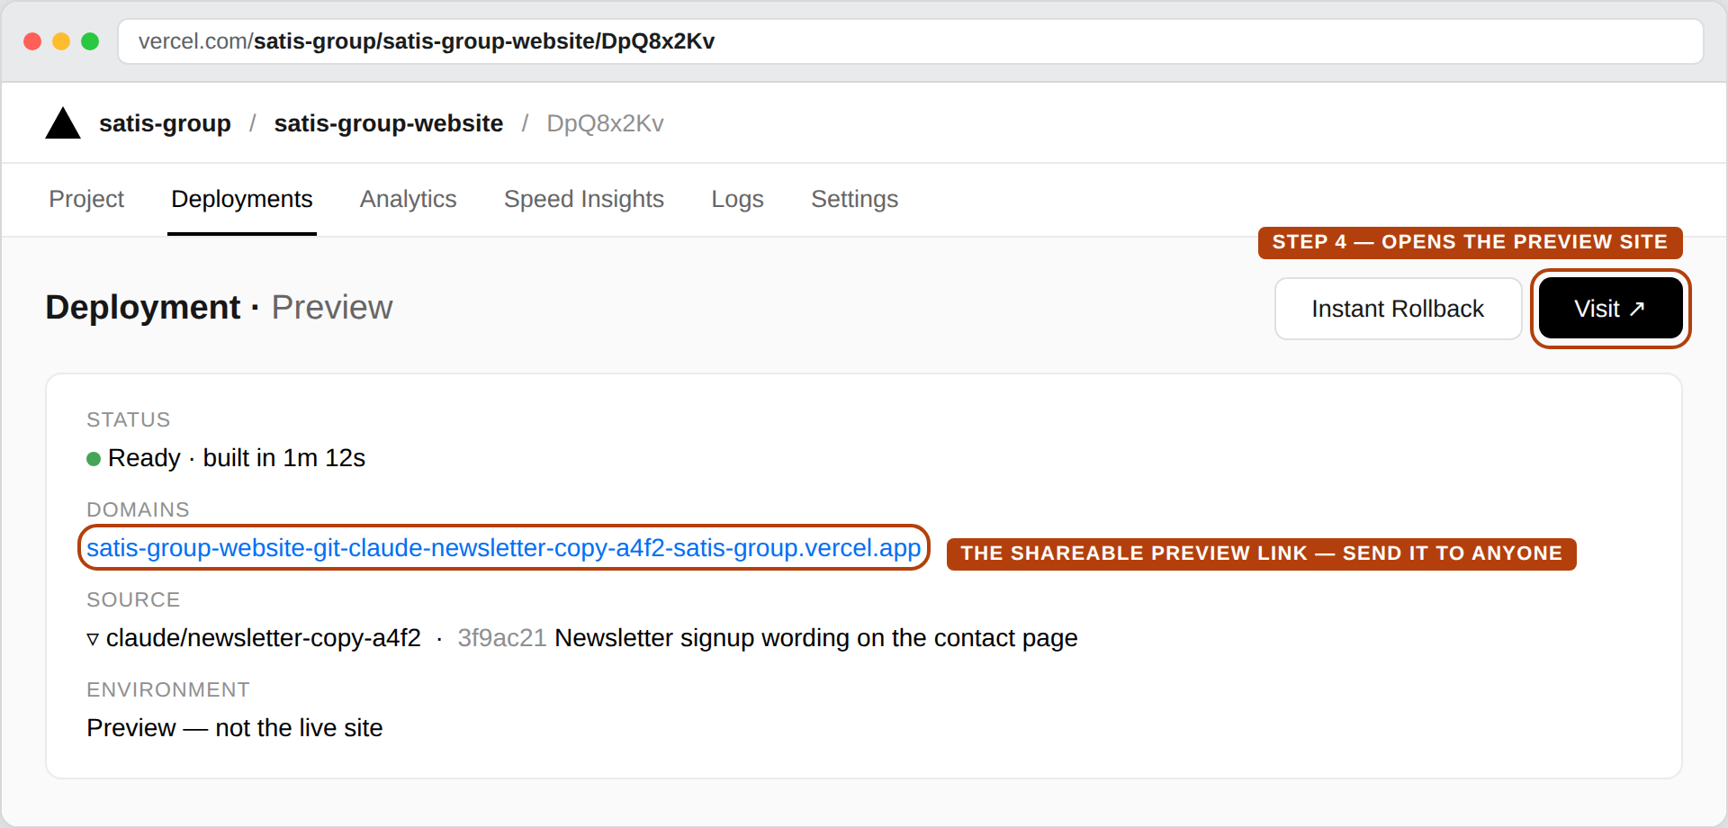
PREVIEWS
SATIS
GROUP
Finding a preview in Vercel, click by click.
If you would rather go and look for yourself, the route is four clicks from the Vercel dashboard. Sign in with the Satis Group team account.
1
Open the project
2
Deployments, then filter
3
Open the Ready one
4
Visit, or copy the link
vercel.com → the satis-group team → satis-group-website.
Every build ever made, newest first. Type the branch name to find yours.
Green is built. Amber is still building — wait a moment and refresh.
Visit opens the preview. The …-git-branch-… address is the one to share.
SATIS GROUP · EDITING THE WEBSITE WITH CLAUDE
11
Notes:
Walk the room along the two screenshots, left to right. The one thing worth memorising is the shape of the preview address: the project name, then -git-, then the branch, then the team. Anyone who sees that in a browser bar knows straight away they are looking at a preview and not the live site. Amber means still building, and that is the single most common "the link is broken" report.

Slide 12
BIGGER JOBS
SATIS
GROUP
Adding a whole new development, in one request.
A new development touches the portfolio grid, its own property page, the map and the investor platform. Claude follows a set checklist; you just supply the ingredients:
1
Name, brand and address
e.g. “The Foundry, Altrincham” and the full address.
2
Status and phase
e.g. Acquired / Pre-construction.
3
Photography
A hero photograph, any gallery photos, and the project logo if the scheme is branded. Attach them to the message.
4
Brochure PDF, if there is one
It becomes a download on the property page.
5
Investor-platform figures
SPV name, equity value, total committed, senior debt and forecast IRR.
WHAT YOU SHOULD SEE
Afterwards, check four places The portfolio grid shows the new card · its property page opens · the map shows its pin · the Developments & SPVs tab lists its SPV.
SATIS GROUP · EDITING THE WEBSITE WITH CLAUDE
12
Notes:
This is the guide's own recipe. The point to land: gather the five ingredients before starting, then it's one message and under an hour, most of which is Claude working, not you.

Slide 13

WHERE THINGS LIVE
SATIS
GROUP
What Claude is actually editing.
The public website is data-driven: every page is generated from structured files in the repository. You never edit a page's design; you change the data and the design applies itself. For the curious: Portfolio cards: lib/portfolio-data.ts Property pages: lib/property-pages.ts Photography: public/images/ News stories: content/newsletters/ Investor data: content/investors/
GOOD TO KNOW
You never need these paths Claude finds the right file from your description. They are here to demystify, not to memorise.
Every card on the portfolio grid is generated from a data file. No page is edited by hand.
SATIS GROUP · EDITING THE WEBSITE WITH CLAUDE
13
Notes:
One slide of gentle demystification. The takeaway isn't the file names. It's that the site is structured data plus a design system, which is why plain-English requests work so reliably.

Slide 14
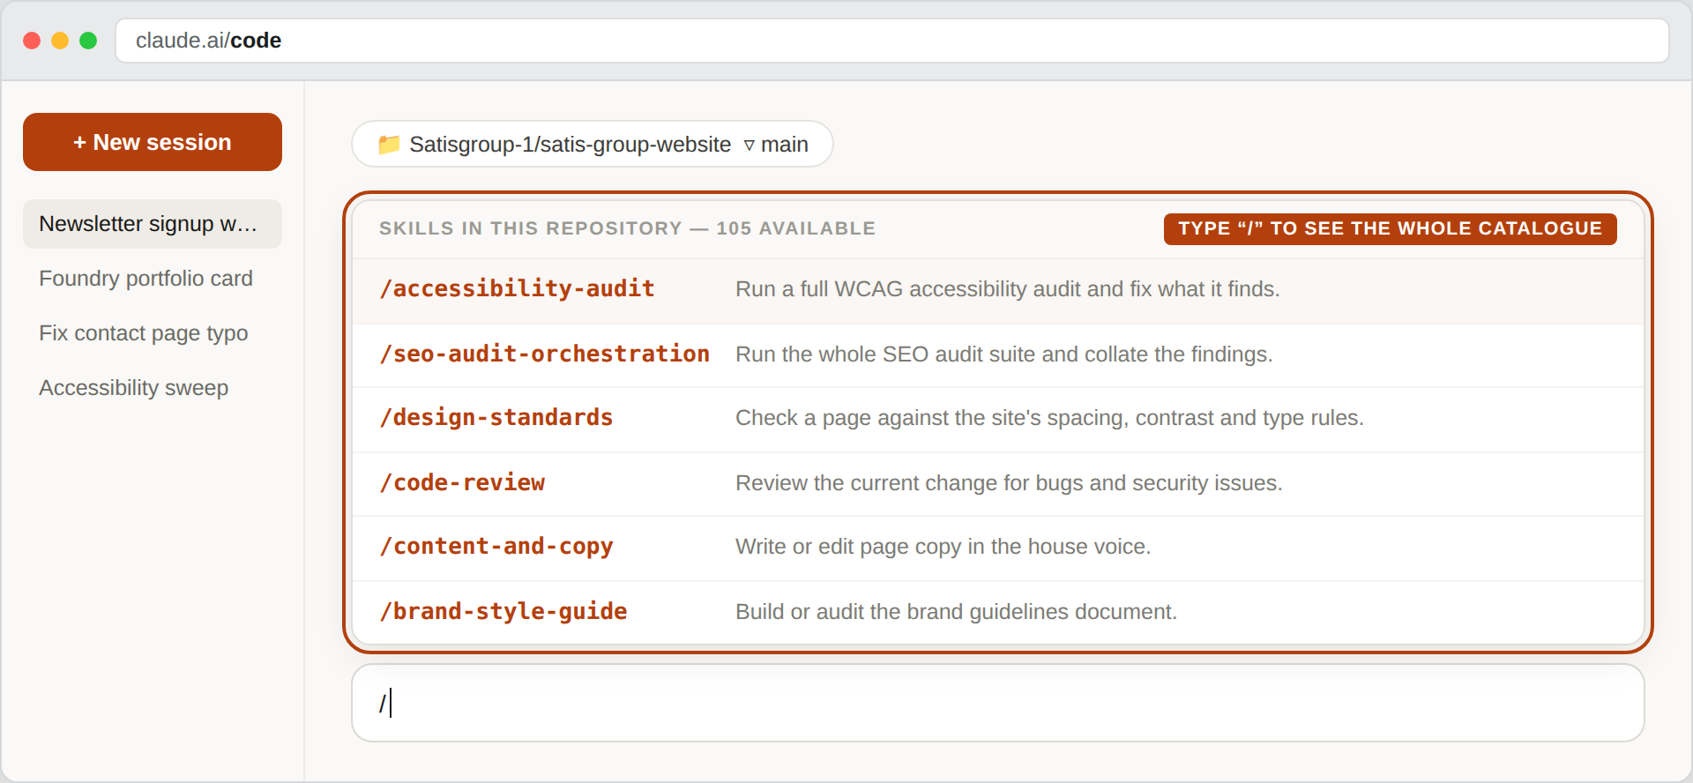
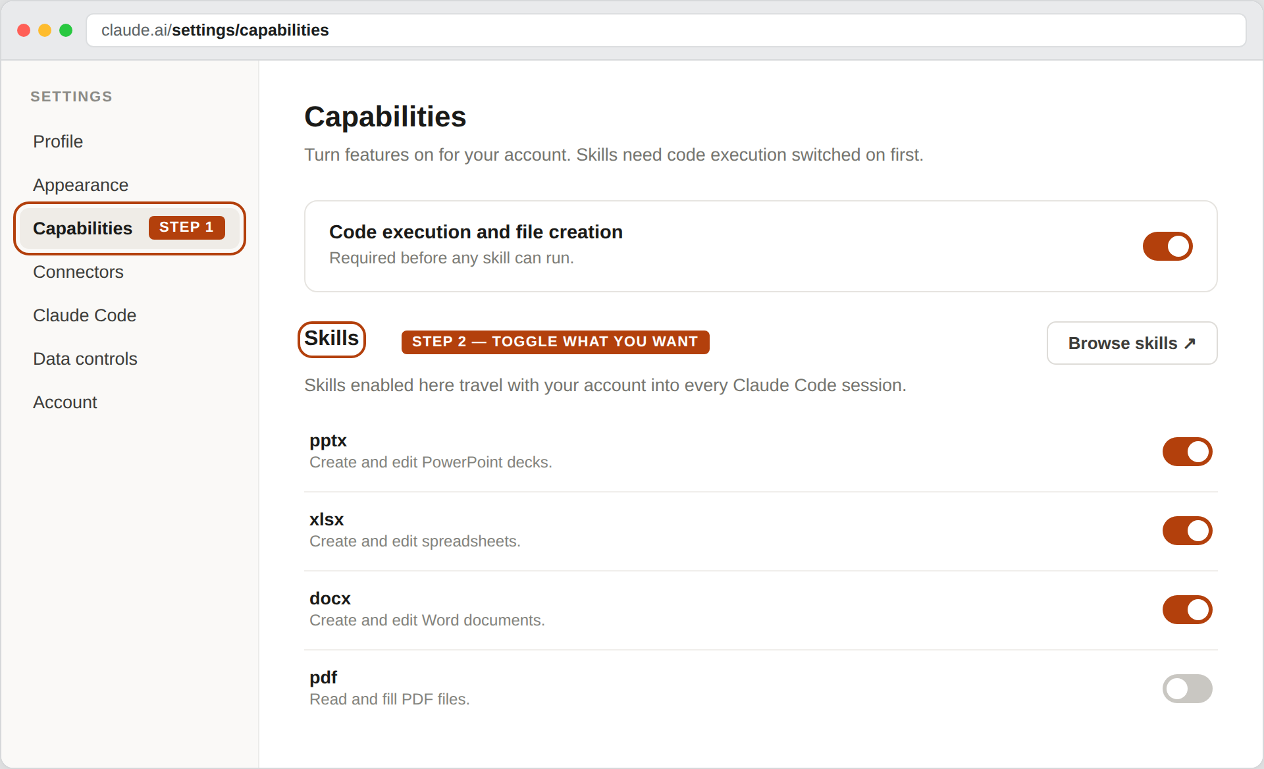
SKILLS
SATIS
GROUP
Where the skills are, and what one actually is.
A skill is a written playbook: a professional procedure Claude loads when a job calls for it, so the same work is done the same way every time. They reach a session from two places.
In the session — type “/” All 105 playbooks are committed to this repository, so they are there in every session, for everyone, with nothing to install. Type “/” to list them and keep typing to narrow it down.
In your account — Settings → Capabilities Skills you switch on here follow your Claude account into every session you start. “Code execution and file creation” has to be on first, or none of them can run.
SATIS GROUP · EDITING THE WEBSITE WITH CLAUDE
14
Notes:
Define a skill in one sentence and move on: it is a written procedure, not a plug-in and not a piece of software to install. Nobody in this room needs to install anything — the repository already carries all 105, which is why an accessibility audit or an SEO sweep is a one-sentence request. The account-level settings page only matters to people who also use Claude outside this website. Demonstrate the slash menu live if the connection allows; it lands better than the screenshot.

Slide 15
SKILLS
SATIS
GROUP
100+ specialist playbooks, already installed.
The repository carries a catalogue of professional “skills” Claude loads to work to a set standard. You never install anything; ask for the outcome and the right playbook loads:
GOOD TO KNOW
GOOD TO KNOW
GOOD TO KNOW
“Run an accessibility audit and fix what it finds.” WCAG accessibility review of the whole site.
“Audit the site's SEO and implement the quick wins.” Search-ranking audit and fixes.
“Review my last change for bugs and security issues.” A second pair of expert eyes on any change.
GOOD TO KNOW
GOOD TO KNOW
GOOD TO KNOW
“Rewrite this paragraph in the house voice.” Writing and editing to the Satis tone.
“/design-standards review the contact page.” Design QA against the site's spacing, contrast and type rules.
“Run SEO, accessibility and code-review agents in parallel and fix the findings.” Site-wide sweeps: how the current standards were set.
SATIS GROUP · EDITING THE WEBSITE WITH CLAUDE
15
Notes:
The examples are verbatim from the guide's Claude agents & skills chapter. Quarterly habit worth suggesting: an SEO audit and an accessibility audit cost one sentence each.

Slide 16
SAFETY
SATIS
GROUP
Nothing is ever lost, and nothing goes live unseen.
Every change is a dated snapshot that can be rolled back. Claude explains what it changed before it commits, and the live site only ever reprints from the master copy. If anything ever looks wrong: ask Claude to undo the last change. That is a one-sentence request too.
SATIS GROUP · EDITING THE WEBSITE WITH CLAUDE
16
Notes:
Close the loop on fear. The three safety properties: visibility before commit, audit trail after, rollback always. Invite the room to try one small real request this week, like a typo fix or a status change.

Slide 17
RECAP
SATIS
GROUP
What to remember.
The live site reprints from a master copy; Claude is how you edit the master.
Describe outcomes in plain English; include the page and exact wording you want.
Repository missing from the list? You are connected as the wrong GitHub account — Settings → Connectors.
Ask for a branch and you get a preview address; the live site only moves when it is merged.
End with “…then commit and push the change”, then verify on the live page.
New development = one request with five ingredients.
Ask for outcomes and the specialist skills load themselves.
WHERE TO GET HELP
The written walkthrough: /admin/guide → “Making changes with Claude”.
Stuck mid-session? Ask Claude itself: “explain what just happened” works.
Access to claude.ai/code, or to the Vercel dashboard: ask the development team once.
SATIS
GROUP
SATIS GROUP · EDITING THE WEBSITE WITH CLAUDE
17
Notes:
Recap the takeaways, answer questions, and point everyone at the written guide. The two new lines are the third and fourth: the connected GitHub account is the answer to almost every "I cannot see the repository", and asking for a branch is how you look before you leap. Invite the room to try one small real request this week — a typo fix or a status change — and to open its preview before merging it.

