Slide 1

SATIS GROUP · BACKEND WEBINAR SERIES
SATIS
GROUP
The newsletter studio.
Writing and publishing news stories that appear on the public News page the moment you press Publish.
BACKEND WEBINAR 02 OF 07
Notes:
This session covers the newsletter studio end to end: writing a story, the two formatting tricks, publishing, checking your work, and fixing mistakes. It takes 10 to 15 minutes to publish a typical story once you've done it twice.

Slide 2
IN THIS WEBINAR
SATIS
GROUP
What this session covers.
Everything about news stories (the site calls them “issues”). You need to be signed in to the admin area, and a story to tell.
01
Where stories appear
04
Publish and check
The public News page, and each story's own page.
It goes live immediately, and how to verify.
02
The studio tour
05
Fixing mistakes
One form, four boxes, and the published-issues list.
The overwrite guard, and the three correction routes.
03
Formatting
06
Signups & the live list
Plain typing, plus two optional tricks.
The subscribe box, and the new subscriber list in the admin.
SATIS GROUP · THE NEWSLETTER STUDIO
02
Notes:
Set expectations: publishing is genuinely a 10-minute job. The only rule that matters is at step 4. Publishing is immediate and public, so agree the text before it goes in the box.

Slide 3
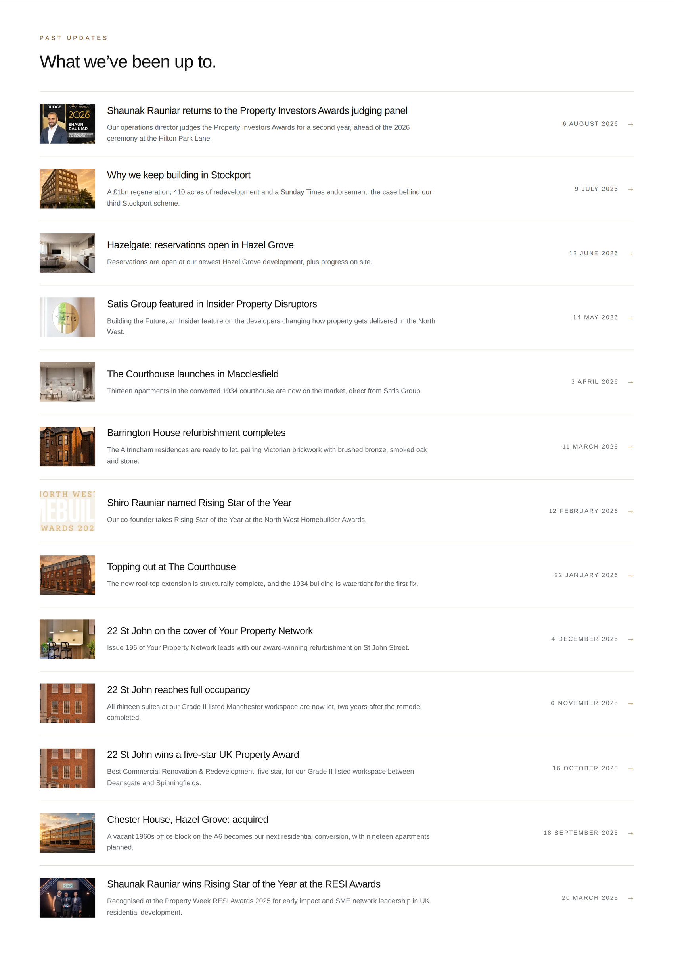
WHERE STORIES APPEAR
SATIS
GROUP
Every story lands on the public News page.
Stories appear in the archive list on the News page the moment they are published, newest at the top, and each story gets its own page and web address, like /news/2026-08-19-your-headline. Stories are also picked up by search engines: regular, dated news is the simplest ranking signal the site can send.
GOOD TO KNOW
One list, two purposes The same page doubles as the public archive and your quickest way to re-read a live story exactly as visitors see it.
The “What we've been up to” list on /news: newest first, immediately after publishing.
SATIS GROUP · THE NEWSLETTER STUDIO
03
Notes:
Show the live /news page in the browser if presenting with a connection. Mention the story address format: the title becomes the web address, which is why short factual titles work best.

Slide 4
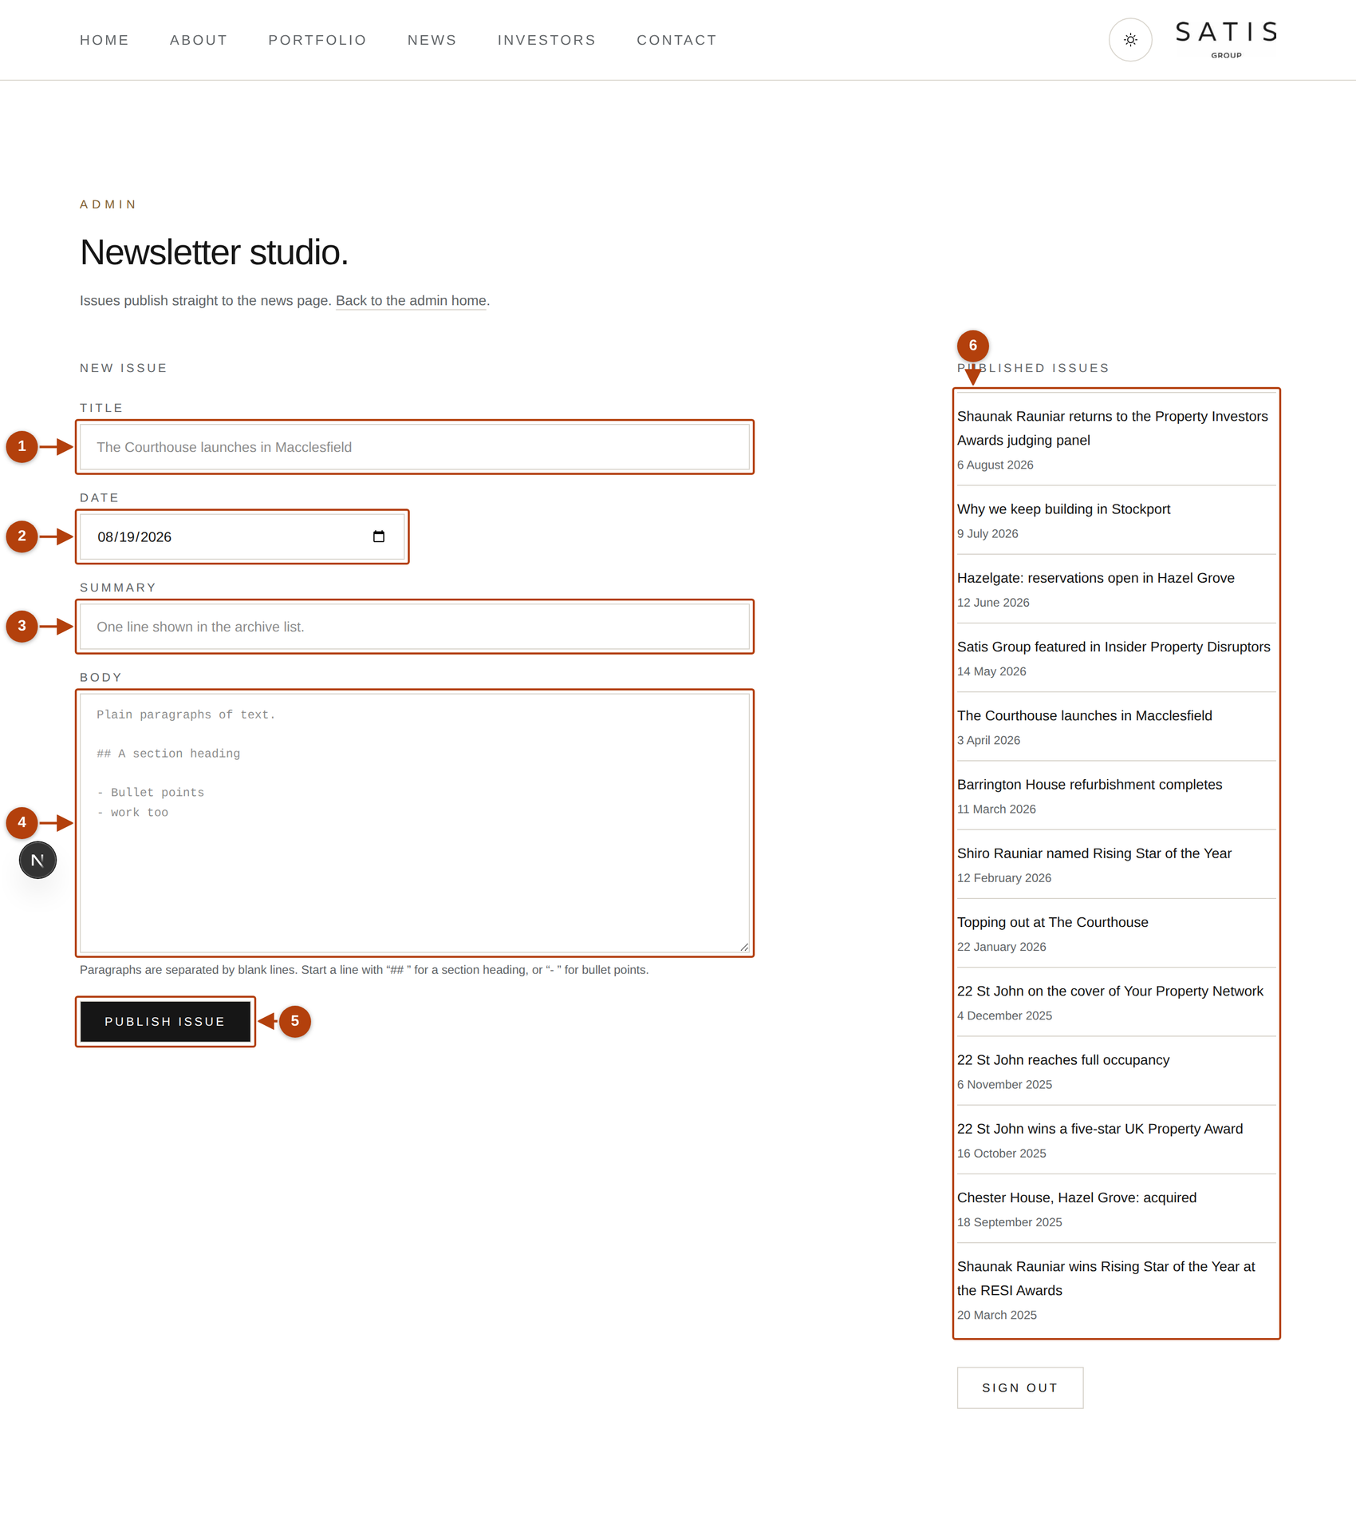
THE STUDIO TOUR
SATIS
GROUP
One form, four boxes, one button.
From the control room, click the Newsletter card. The numbers below match the numbers on the screen.
1
Title
The headline. Short and factual; it becomes the story's web address too.
2
Date
Today is pre-filled; click to pick another day if you are backdating.
3
Summary
One plain sentence shown under the headline in the news list. The story in fifteen words.
4
Body
The story itself, in normal paragraphs. Press Enter twice between them.
5
Publish issue
The story goes live the moment you click this.
6
Published issues
Everything already live, newest first. Click any title to read it as visitors do.
SATIS GROUP · THE NEWSLETTER STUDIO
The newsletter studio at /admin/newsletter.
04
Notes:
Walk the six numbered markers on the screenshot in order. All four boxes must be filled before Publish will work; the form tells you if one is missing.

Slide 5
FORMATTING
SATIS
GROUP
Plain typing, plus two optional tricks.
There is no bold/italic toolbar. The site styles every story for you, so every story matches the house look.
Paragraphs Press Enter twice (one empty line) between paragraphs. Miss the empty line and they run together into one block.
Section headings Start a line with ## and a space: ## What happens next …becomes a bold sub-heading.
Bullet lists Start each line with a dash and a space: - Planning approved in May Consecutive dash lines become one list.
SATIS GROUP · THE NEWSLETTER STUDIO
05
Notes:
Live demo moment: type a heading and a two-item list in the body box, publish to a test story later or just show the hint text under the box. Reassure: everything else is just normal typing.

Slide 6

PUBLISH
SATIS
GROUP
Publish, then check your work on the live page.
1
Click Publish issue
Two confirmations: a message under the form (“Issue published.” with a link) and the story at the top of the Published issues list.
2
Open the confirmation link
Read the live story. Check the headline, the date, and skim the text. Typos are far easier to spot on the finished page than in the typing box.
3
Glance at the News page
Your story should be at the top of the archive list.
TAKE CARE
Publishing is immediate and public There is no draft mode. Want a second pair of eyes? Agree the text in an email or document first, then paste it in and publish.
A published story as visitors read it.
SATIS GROUP · THE NEWSLETTER STUDIO
06
Notes:
The warning is the one thing to land on this slide. The workflow for review is deliberately outside the studio: agree the words first, then publish once.

Slide 7
CORRECTIONS
SATIS
GROUP
Fixing a mistake in a published story.
The studio deliberately refuses to overwrite: publishing again with the same title and date says “An issue named … already exists.” That guard protects live stories, so corrections go through Claude instead.
GOOD TO KNOW
Claude in one sentence Claude edits the website's master copy from plain-English requests. Webinar 01 covers it, and the written chapter is at /admin/guide → “Making changes with Claude”.
1
Small typo? Ask Claude
In a Claude session on the website repository: “In the news issue titled X, change … to …, then commit and push.” Done in minutes.
2
Replace a story
Ask Claude to remove the original file from content/newsletters/ first, then publish the corrected version with the same title and date.
3
Wrong date or headline
Publish the corrected story fresh, then have the old one removed.
SATIS GROUP · THE NEWSLETTER STUDIO
07
Notes:
If the audience hasn't seen webinar 01, spend a minute on what a Claude session is. The overwrite refusal surprises people; frame it as protection, not a bug.

Slide 8
ON THE LIVE SITE
SATIS
GROUP
If Publish refuses on the live site.
The live hosting keeps its files read-only, a safety feature of the platform, not a fault. In a writable environment (a Claude session, or the site running locally) the same form saves instantly.
1
You may see “Could not write the newsletter file”
Nothing is broken and nothing was lost. The site is telling you this story needs to go through the master copy.
2
Copy your text
Title, date, summary and body, into an email to yourself or a document.
3
Ask Claude to publish it
“Publish this news story: [paste your title, date, summary and text], then commit and push.” The story appears after the automatic republish, a few minutes later.
GOOD TO KNOW
Why it works this way Every change to the live site goes through the version-tracked master copy. That is what makes stories traceable and recoverable. Webinar 06 explains the machinery.
SATIS GROUP · THE NEWSLETTER STUDIO
08
Notes:
This is the guide's “Making changes stick on live hosting” routine applied to news. The error message is the site being honest, not failing. That reframe removes the panic.

Slide 9
SIGNUPS
SATIS
GROUP
The subscribe box, and the live subscriber list.
The News page carries a “Subscribe” box where visitors leave their email address to hear about new issues.
1
Visitors sign up on the News page
Name-free and instant: they enter an email address and get a confirmation message.
2
The admin gains a live subscriber list
A subscriber section on the admin newsletter page is being rolled out as this deck is written. It shows signups as a live list you can review and use for mailings.
3
Sending is still a manual step
Publishing a story does not email anyone automatically. When an issue should reach subscribers, send it from the team mailbox to the list, until a mailing provider is wired in.
TAKE CARE
Check the rollout before relying on it Until the subscriber section is live in your admin, signups are not stored anywhere. Treat the box as decorative and collect addresses another way.
SATIS GROUP · THE NEWSLETTER STUDIO
09
Notes:
Be straight with the room about the state of this feature at presentation time: open /admin/newsletter live and look for the subscriber section. If it is there, show it; if not, the warning panel applies. Update this slide once the rollout lands.

Slide 10
EXTRAS
SATIS
GROUP
Adding a picture to a story.
The composer keeps to the four boxes; a story image is a one-sentence Claude request afterwards.
GOOD TO KNOW
1
Publish the story as normal
Good alt text One sentence describing the picture for someone who cannot see it, e.g. “Topping-out ceremony at The Courthouse, Macclesfield”. It helps accessibility and search alike.
Words first. The image is an addition, not a requirement; stories without images use the house thumbnails.
2
Ask Claude to attach the image
“Add the attached photo to the news issue titled X, with alt text ‘…’, then commit and push.” Claude stores the image and links it to the story.
3
Check the story page
After the republish, the image appears on the story's own page.
SATIS GROUP · THE NEWSLETTER STUDIO
10
Notes:
Underneath, Claude adds image and imageAlt lines to the story's file. The composer doesn't expose those fields, which is fine: this keeps the common path simple.

Slide 11
RECAP
SATIS
GROUP
What to remember.
Four boxes, one button, and the story is live on /news immediately.
Two formatting tricks: ## headings and dash bullets. Everything else is plain typing.
No draft mode: agree the words before they go in the box.
Corrections go through Claude; the studio refuses to overwrite live stories.
On the live site, publishing goes through the repository. “Could not write” means use the Claude route.
WHERE TO GET HELP
Written walkthrough: /admin/guide → “Publishing a news story”.
Formatting reminders sit right under the Body box in the studio.
Story stuck or wrong? A Claude session fixes it in minutes.
SATIS
GROUP
SATIS GROUP · THE NEWSLETTER STUDIO
11
Notes:
Recap the takeaways, answer questions, and point everyone at the written guide.

