Slide 1

SATIS GROUP · BACKEND WEBINAR SERIES
SATIS
GROUP
The investor platform.
What investors see, how to run it from the platform studio, and the routines that keep every figure current.
BACKEND WEBINAR 04 OF 07
Notes:
The longest session in the series: the investor platform end to end. First what investors see, then the seven-tab studio that drives it, then the working routines: accounts, holdings, cash events, reports, insights, raises, documents and support. Take a break in the middle if you need one.

Slide 2
IN THIS WEBINAR
SATIS
GROUP
What this session covers.
Everything an investor sees is generated from a handful of datasets you edit in one place: the platform studio.
01
What investors see
04
Accounts & holdings
The portal, and the two kinds of account.
Create an investor, record their position, log cash.
02
The seven tabs
05
Publishing to the portal
The studio's mental model in five minutes.
Monthly reports, insights, and upcoming raises.
03
The golden rule
06
Figures, documents & support
Portfolio values are worked out, not typed in.
The quarterly routine, the data room, and the sign-in playbook.
SATIS GROUP · THE INVESTOR PLATFORM
02
Notes:
Fair warning on length. If the audience only remembers two things: the golden rule (slide on values), and the quarterly routine (near the end). Everything else can be looked up in the guide chapter by chapter.

Slide 3

WHAT INVESTORS SEE
SATIS
GROUP
The front door: satisgroup.co.uk/investors.
Investors sign in with their email address and a password you set for them. Sessions last 24 hours; five wrong tries pauses that connection for 15 minutes. The same protections as the admin. Not an investor yet? The “Become an investor” buttons lead to a short enquiry form at /investors/enquire (name, email, company), styled to match the platform.
GOOD TO KNOW
Separate doors, separate keys Investor accounts are managed inside the platform studio, not on the admin accounts page. Different system entirely.
The investor platform's own sign-in: black and gold, separate from the admin.
SATIS GROUP · THE INVESTOR PLATFORM
03
Notes:
Show the live page if connected. The enquiry form is new. It captures prospective investors in the platform's own branding and emails each submission to the enquiries inbox (covered in webinar 07).

Slide 4
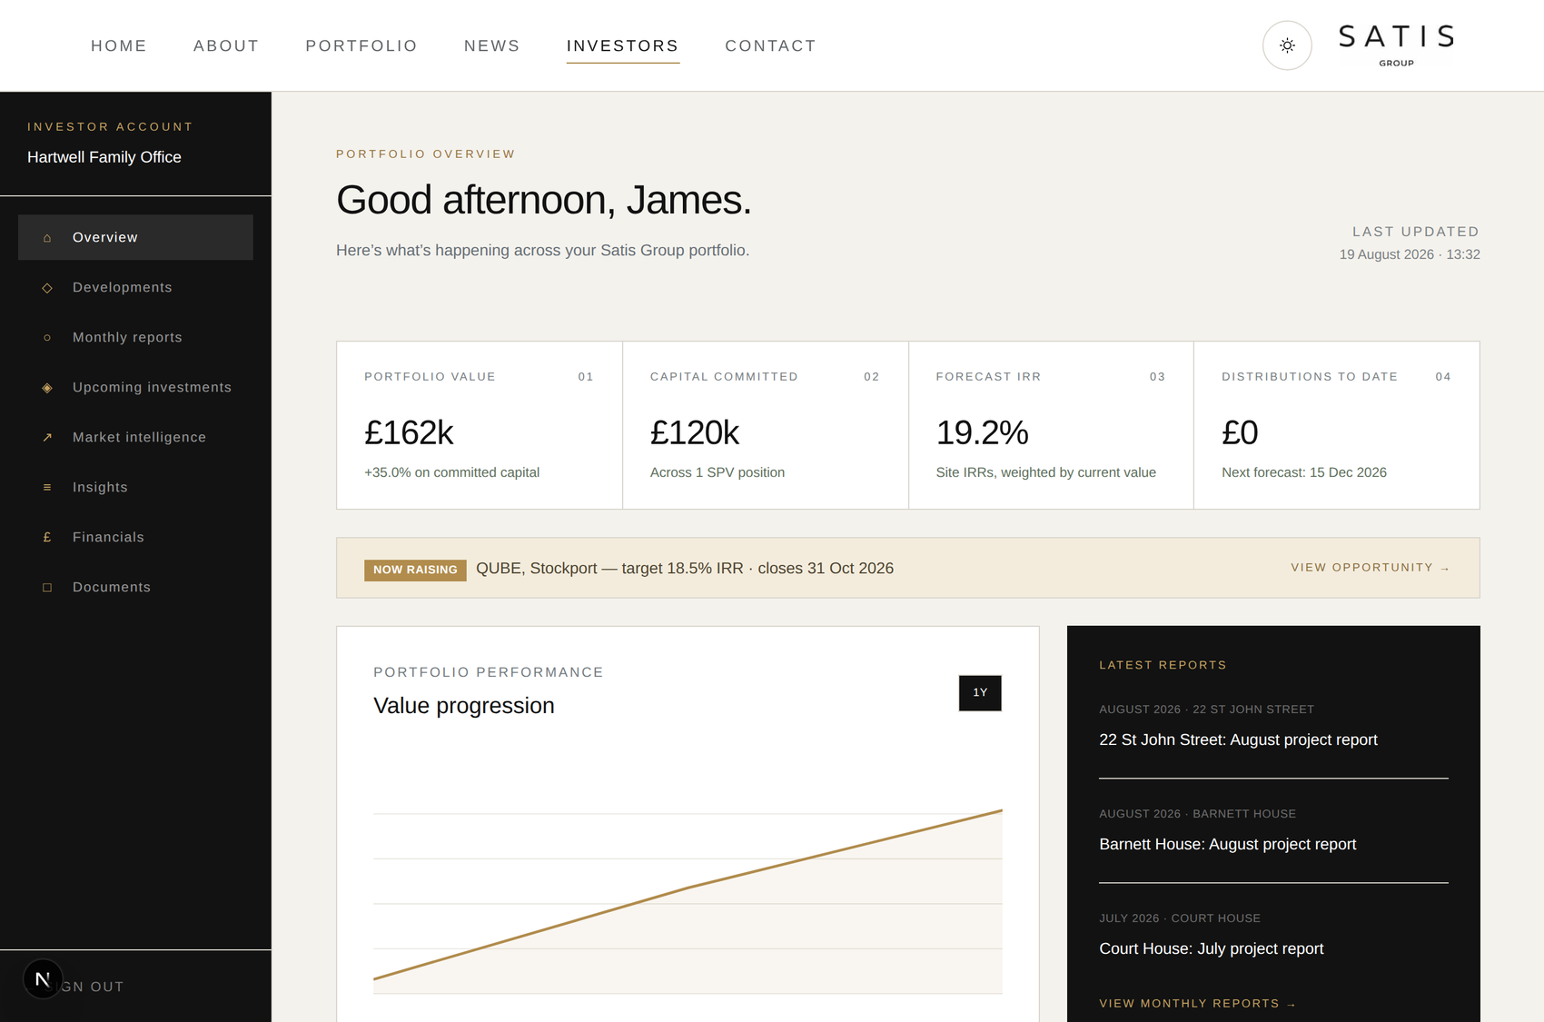
WHAT INVESTORS SEE
SATIS
GROUP
Inside the portal: every figure traces back to you.
The overview greets the investor by first name and shows their headline numbers, live raises, latest reports and a value-progression chart. Every single figure on this screen is generated from something you edit in the platform studio. Nothing on the portal is typed directly. The sidebar navigation adapts to the kind of account. Next slide.
An invested client's overview: portfolio value, committed capital, weighted IRR, distributions.
SATIS GROUP · THE INVESTOR PLATFORM
04
Notes:
Let the room absorb the screenshot; most of the team never sees the portal from the investor side. The framing sentence matters: the portal is a projection of the studio's data, which is why the studio routines are the whole game.

Slide 5
WHAT INVESTORS SEE
SATIS
GROUP
Two kinds of account, two different portals.
Every account is either prospective or invested, and the platform works the type out automatically: an account holding a position counts as invested.
Prospective: considering investing Sees: overview, upcoming investments (deal flow), the data room, track record, market intelligence, insights. Does not see: cap tables, financials, monthly reports. Construction detail stays with committed investors. The shop window: raises and research make the case.
Invested: money in Sees: overview (with live raises flagged), My portfolio (a tab per investment with its files), developments, monthly reports, market intelligence, insights, financials and documents. Figures update the moment you save in the studio. Becomes the account type automatically when a position is recorded.
SATIS GROUP · THE INVESTOR PLATFORM
05
Notes:
The automatic tier is a favourite support fact: record a cap-table position and the account upgrades itself to invested. No switch to remember. The override drop-down on the investor form exists for rare exceptions only. My portfolio is the newest section: one tab per investment, each with its own private file library.

Slide 6
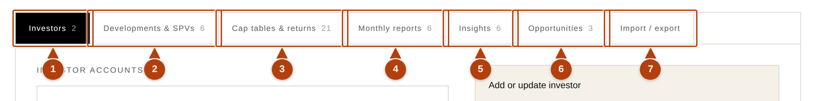
THE STUDIO
SATIS
GROUP
Seven tabs run the whole platform.
From the control room, click Investors. Each tab edits one kind of information, and the small number on a tab shows how many records it holds.
The platform studio's tab bar at /admin/platform.
1
Investors
Accounts and quarterly valuations.
2
Developments & SPVs
Each project and the company that owns it.
3
Cap tables & returns
Who owns what share; money in and out.
4
Monthly reports · 5 Insights · 6 Opportunities
What you publish to the portal: project updates, research, and raises.
7
Import / export
Everything as one file: backup, bulk edit, restore.
SATIS GROUP · THE INVESTOR PLATFORM
06
Notes:
Don't teach every tab now; this is the map. SPV in plain English: the limited company set up to own one development. Investors buy shares in the SPV, not the building. Cap table: the list of who owns what percentage of it.

Slide 7
THE GOLDEN RULE
SATIS
GROUP
Portfolio values are worked out, not typed in.
You never type an investor's portfolio value anywhere. The platform computes it from two numbers you do control:
Share %
from the cap table
SPV equity value
from Developments & SPVs
The investor's value
computed, per holding, summed
×
=
Two things follow. A revaluation is one edit: update the SPV's equity value and every holder's figures move at once. And when a portal figure looks wrong, the cause is always one of these two numbers, the share % or the equity value. Check both; the culprit is one of them.
SATIS GROUP · THE INVESTOR PLATFORM
07
Notes:
This is the platform's single most important idea and the diagnosis shortcut for every “my valuation looks wrong” call. Weighted IRR and distributions derive similarly, from SPV forecasts and paid cash events.

Slide 8
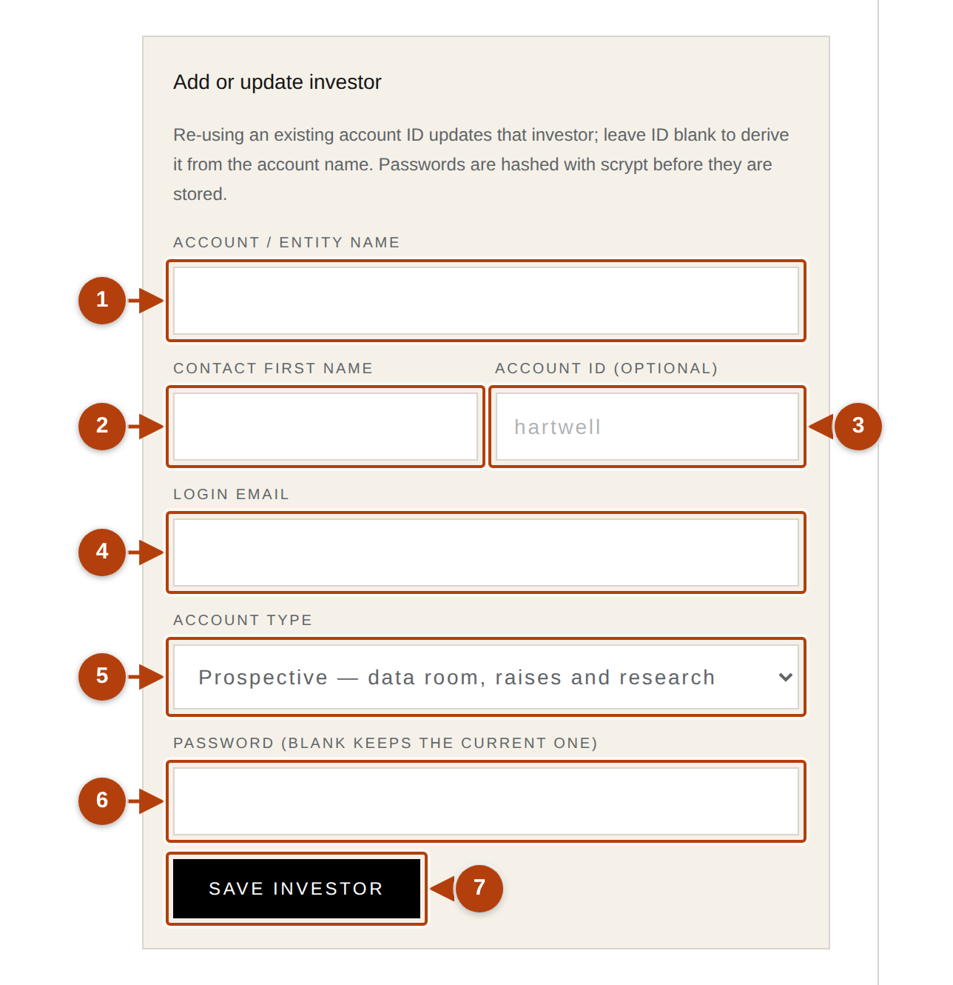
ROUTINE · ACCOUNTS
SATIS
GROUP
Creating an investor account.
Investors tab → the “Add or update investor” form. About five minutes.
1
Account / entity name
As it should appear in their portal, e.g. “Hartwell Family Office”.
2
Contact first name
Used for greetings (“Good morning, James”).
3
Account ID: leave empty
Derived automatically. You only type one to update an existing account.
4
Login email
What they sign in with. Double-check the spelling; a typo locks them out.
5
Account type: leave as is
The platform derives it from holdings.
6
Password: note it now
Scrambled the instant you save; never visible again.
SATIS GROUP · THE INVESTOR PLATFORM
Numbers match the on-screen badges. After Save investor: a green confirmation, and the account lists as “Prospective investor”, £0, 0 positions. Exactly right before any holding exists.
08
Notes:
Emphasise noting the starting password before saving. Hashed means unreadable afterwards. The account card's ID (shown as “ID …”) is how you address the account later for updates.

Slide 9
ROUTINE · ACCOUNTS
SATIS
GROUP
Handing over credentials, safely.
Use a trusted channel Ideally by phone. Or split across two channels: email address by email, password by text message.
TAKE CARE
Then encourage a prompt sign-in Point them at the website's Investors page. Trouble getting in? The support playbook near the end of this session covers every common case.
Never both in one email If that email is ever compromised, so is their portal. One thread must never carry the address and the password together.
SATIS GROUP · THE INVESTOR PLATFORM
09
Notes:
Same handover discipline as admin accounts. Investors are exactly the audience attackers would impersonate. A phone call for the password is thirty seconds well spent.

Slide 10
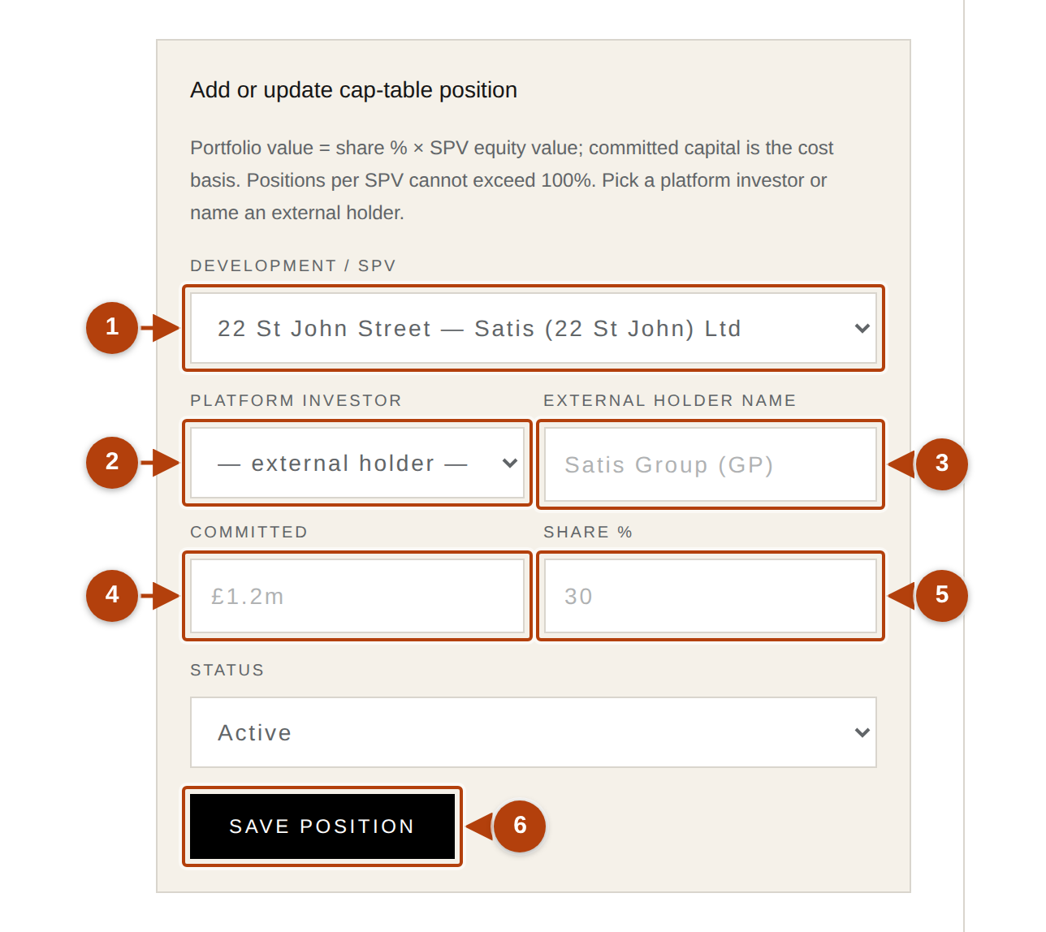
ROUTINE · MONEY
SATIS
GROUP
Recording a holding (a cap-table position).
Cap tables & returns tab, top half. This is what turns a prospect into an invested client.
1
Development / SPV
Which project the holding is in.
2
Platform investor, or external holder
Pick the account. Use the External holder box only for shareholders without a portal account (e.g. the Satis Group stake). One or the other, never both.
3
Committed
What they put in. £250k and £250,000 both work.
4
Share %
Their agreed percentage of the SPV, e.g. 12.5.
5
Status
Active for live; Realised or Exited for concluded holdings.
TAKE CARE
The 100% guard One SPV's positions can never exceed 100%. The form refuses and names the total it would have reached. Surprised? Something already on the table holds that share.
The add-or-update position form.
SATIS GROUP · THE INVESTOR PLATFORM
10
Notes:
Check after saving: on the Investors tab the account now shows the position, a value equal to share % × equity value, and reads “Invested” automatically. Re-saving the same investor and SPV replaces the position. That is also how you correct one.

Slide 11
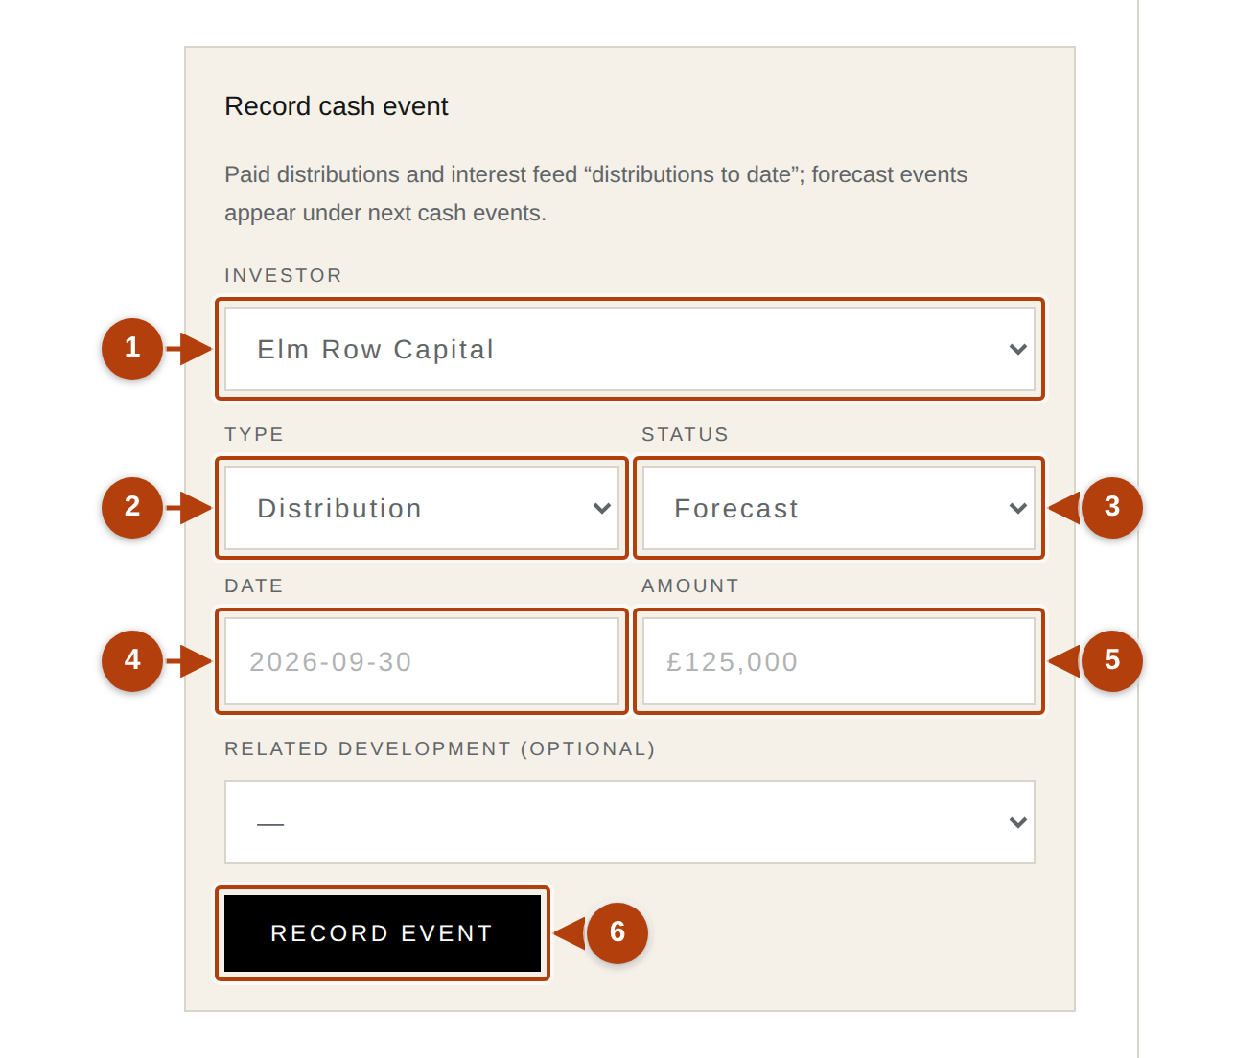
ROUTINE · MONEY
SATIS
GROUP
Logging cash events.
Same tab, lower half. Cash events are the money-movement history: paid events feed “distributions to date”; forecast events appear as upcoming.
1
Investor
Whose money is moving.
2
Type
Distribution (profit out) · Forecast distribution (planned) · Capital call (money in) · Interest payment.
3
Status
Paid if it happened; Forecast if expected.
4
Date and amount
Year-month-day, e.g. 2026-09-30 · £125,000.
5
Related development
Optional, but linking keeps the history tidy.
GOOD TO KNOW
When a forecast becomes real Record a new event with status Paid, then Remove the old forecast entry. Leaving both double-counts the history.
The record-cash-event form.
SATIS GROUP · THE INVESTOR PLATFORM
11
Notes:
Cash events don't replace like positions do: to fix a wrong event, Remove it and record it again correctly. Paid distributions and interest are what the portal sums into “distributions to date”.

Slide 12
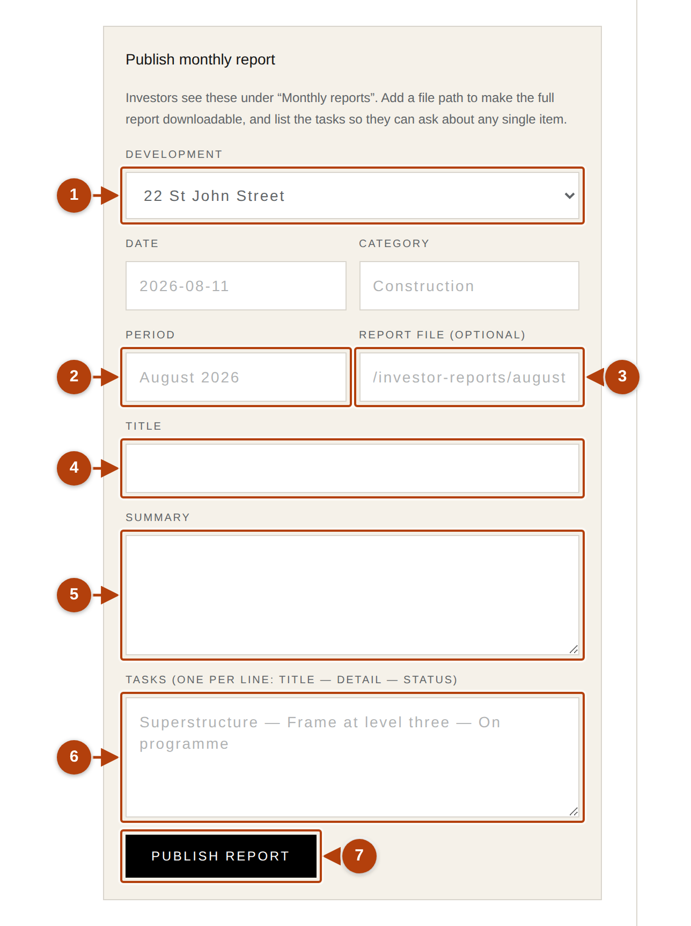
ROUTINE · PUBLISHING
SATIS
GROUP
Publishing a monthly report.
Monthly reports tab. Reports reach invested clients only, the moment you publish. Prospects never see construction detail.
1
Development and period
Which project, and the month written out. “August 2026” is the headline investors see.
2
Category and title
One word for the kind of update (Construction, Planning, Lettings) and a one-line headline for the month.
3
Summary
A paragraph or two: progress, issues, next steps.
4
Tasks, one per line
Three parts separated by spaced double dashes: Title -- detail -- status. For example: “Superstructure -- Frame at level three -- On programme”.
5
Report file: next slide
Leave empty for now; the report publishes fine without it.
GOOD TO KNOW
Why task lines matter Each line becomes its own item investors can ask about directly. Specific, honest lines generate fewer worried calls than vague ones.
SATIS GROUP · THE INVESTOR PLATFORM
The publish-monthly-report form.
12
Notes:
The task syntax is the only fiddly bit: two “ -- ” separators per line (a long dash works too). If a task looks wrong in the portal, a missing separator is almost always why. To see reports as investors do, keep an in-house invested account.

Slide 13
ROUTINE · PUBLISHING
SATIS
GROUP
Attaching the report PDF.
The Report file box records where the PDF lives on the website. It does not upload the file. Getting it there is a one-off step per report:
WHAT YOU SHOULD SEE
1
Ask Claude to add the file
In the published list Each report shows its period, task count, and “report uploaded” or “no report file yet”, so missing files are visible at a glance.
In a session on the website repository: “Add this PDF as public/investor-reports/august-2026.pdf”, and attach the file. Or hand it to the development team.
2
Type the matching path
Back in the form's Report file box, starting with a slash: /investor-reports/august-2026.pdf
3
Or skip it entirely
The report still publishes. The portal's download button stays an inactive placeholder until a file is added.
SATIS GROUP · THE INVESTOR PLATFORM
13
Notes:
The two-part design (file into public/investor-reports/, path in the form) is the pattern for every attached document on the platform. The same Claude request works for data-room files, two slides ahead.

Slide 14
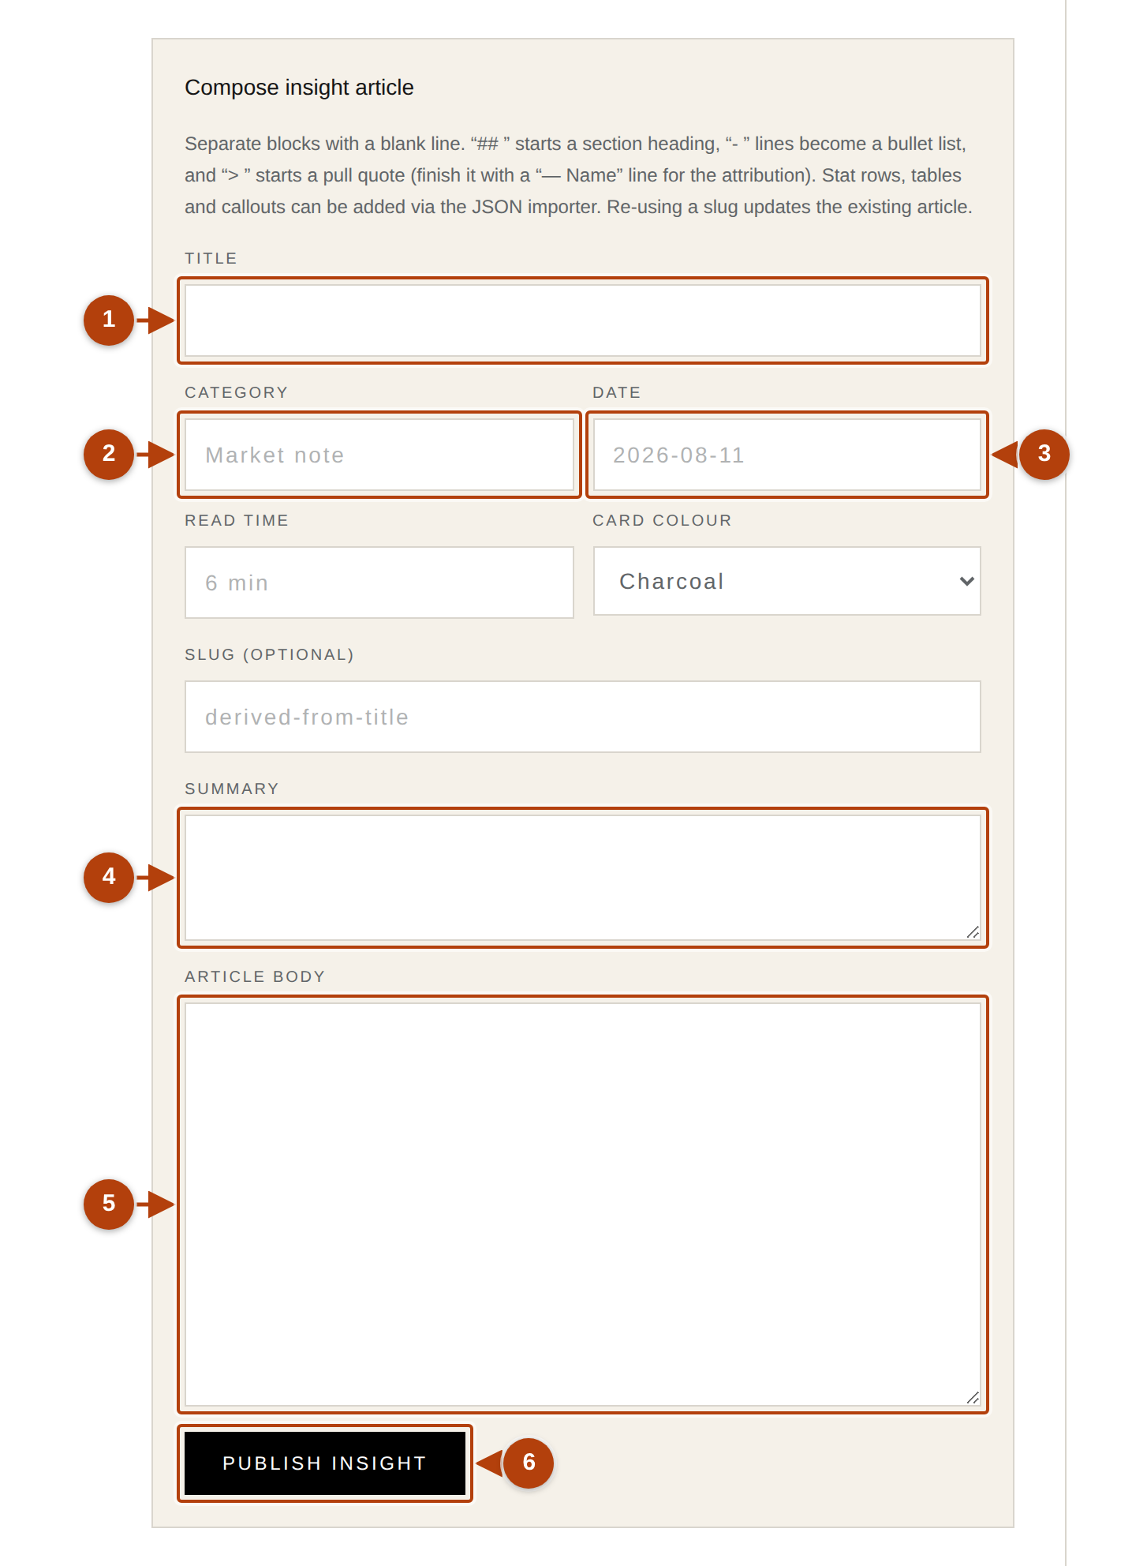
ROUTINE · PUBLISHING
SATIS
GROUP
Insights: research and market commentary.
Insights tab. Articles appear in the portal for both prospective and invested accounts, in the same plain-typing style as news stories, with one extra trick.
1
Title, category, date, read time
Category is the card label (“Market note”, “Research”). Read time: about one minute per 200 words.
2
Card colour and slug
Colour is purely cosmetic; balance the page. Slug: leave empty for new articles.
3
Summary and body
Paragraphs, ## headings and - bullets as in news stories, plus pull quotes: start a line with > and a space. To credit someone, start the next line with two dashes: -- Savills Research, 2026.
4
Publish insight
Live in the portal immediately; the published list shows the article's slug.
TAKE CARE
Slugs replace, by design Typing an existing slug and publishing replaces that article (that is how you update one). The opposite of news stories, so keep the slug box empty for new pieces.
SATIS GROUP · THE INVESTOR PLATFORM
The compose-insight form.
14
Notes:
Richer blocks (statistic rows, tables, coloured callouts) exist through the JSON importer; ask Claude to add one. The slug-replace behaviour is the one asymmetry with news stories worth calling out twice.

Slide 15
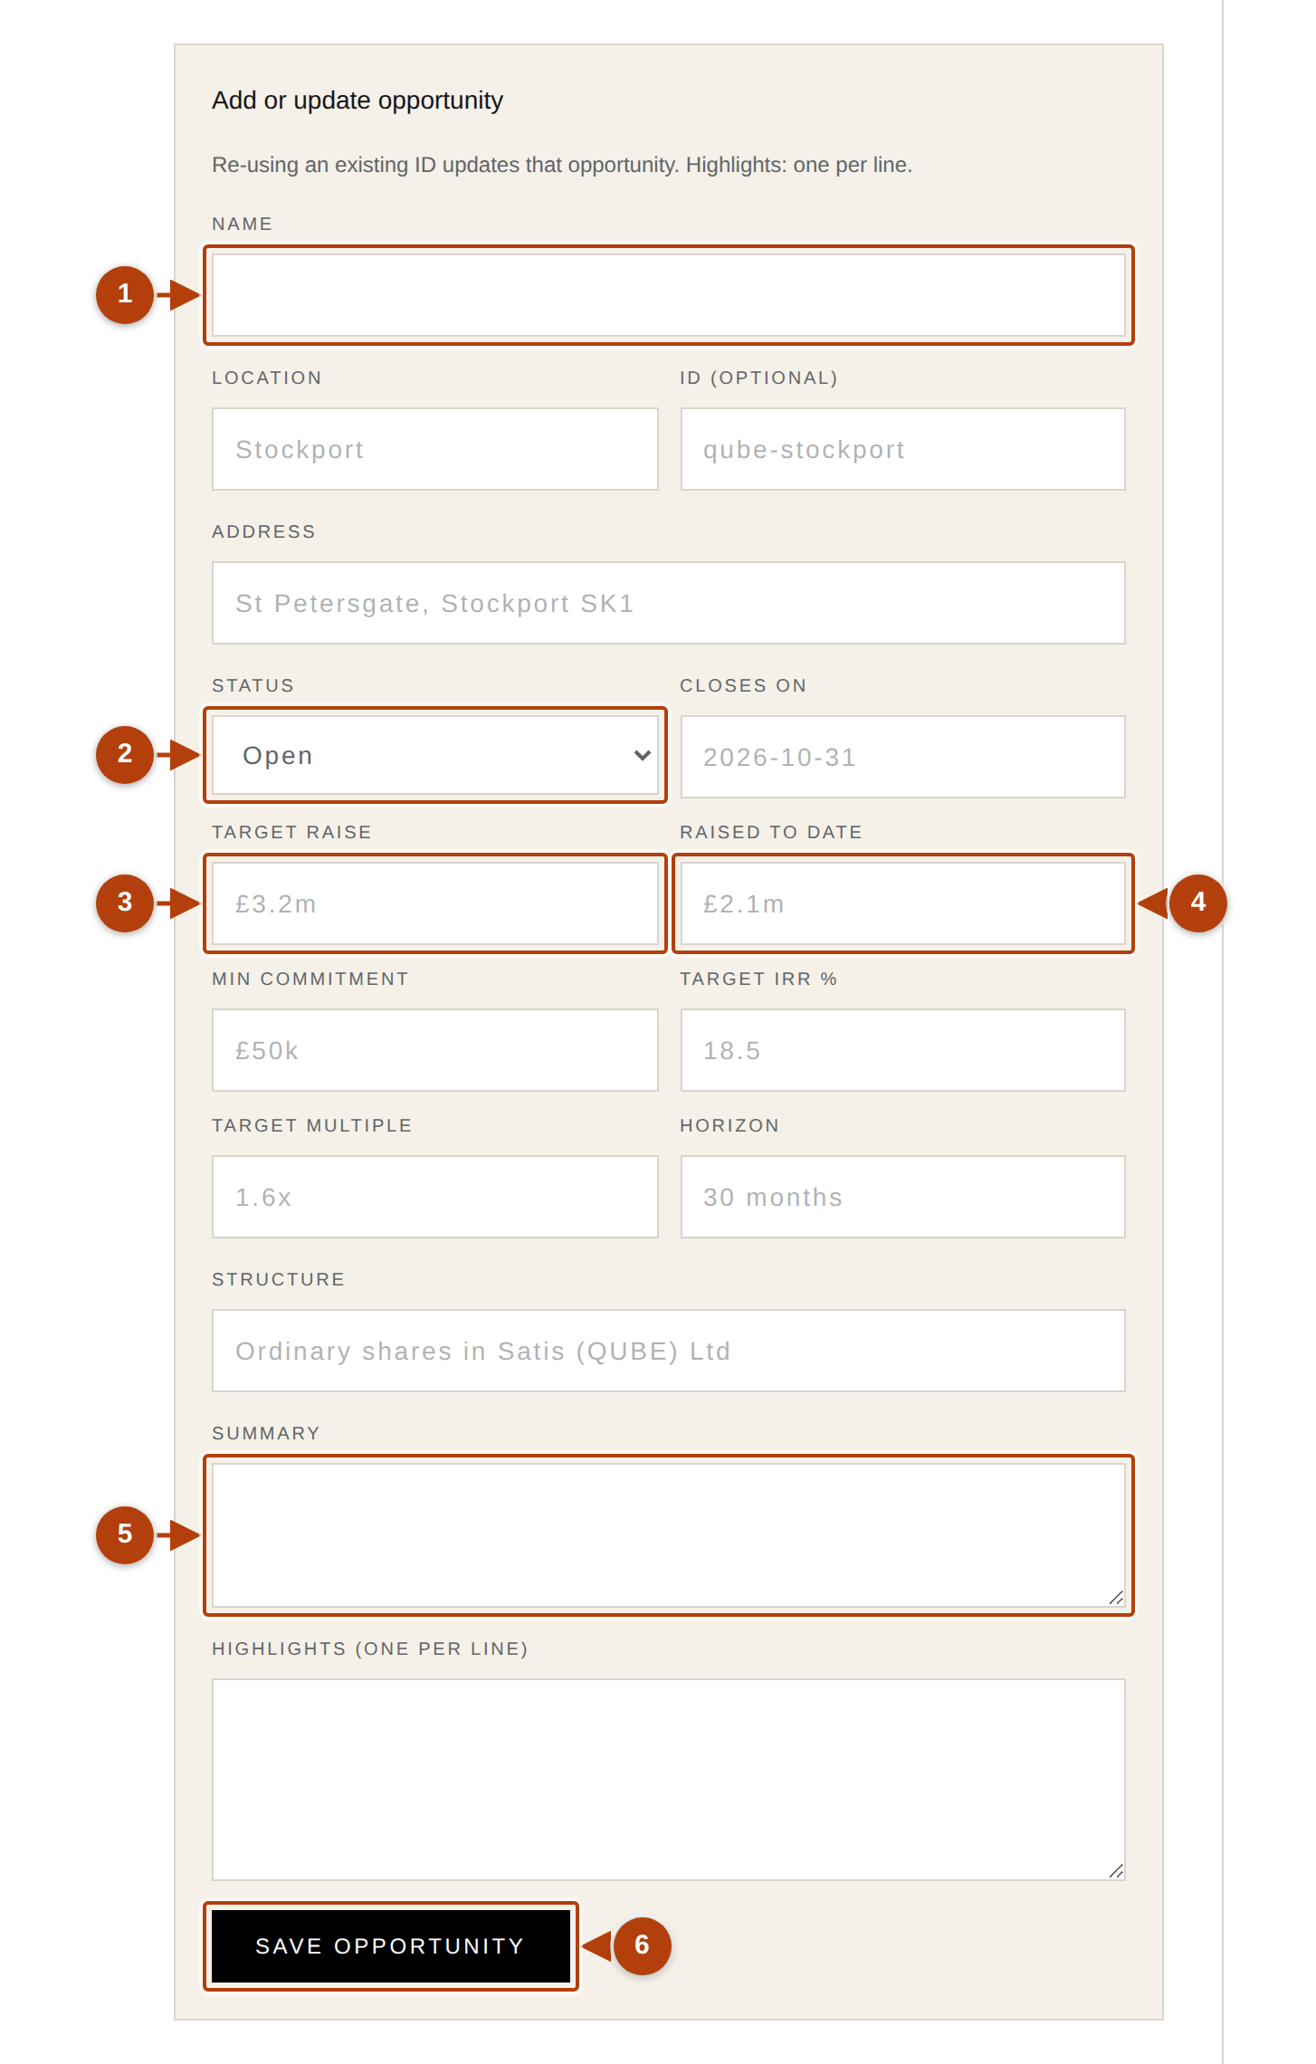
ROUTINE · PUBLISHING
SATIS
GROUP
Opportunities: advertising a raise.
Opportunities tab: the deal-flow page prospective investors browse, with live raises also flagged on every investor's overview. This is the shop window for prospects.
1
Name, location, status
Coming soon (visible, not open) · Open (accepting commitments) · Fully subscribed (closed, shown complete).
2
Target raise and raised to date
The progress bar is worked out from these two. £3.2m target with £2.1m raised shows 66%.
3
The headline terms
Min commitment, target IRR %, target multiple, horizon, and the structure: what investors actually buy, e.g. “Ordinary shares in Satis (QUBE) Ltd”.
4
Summary and highlights
The pitch. Highlights are one per line and render as a bulleted list.
GOOD TO KNOW
Keep the bar moving Update Raised to date as commitments land. A moving bar does more for momentum than any covering email. When the raise completes: status Fully subscribed, then record each position on the cap table. That is the moment prospects become invested.
SATIS GROUP · THE INVESTOR PLATFORM
The add-or-update opportunity form.
15
Notes:
Plain English for the terms: IRR is the annualised return the deal aims for; multiple is money back per pound in (1.6x means £1.60 per £1). Updating uses the fill-in-everything rule: type the opportunity's ID, complete the whole form, save.

Slide 16
ROUTINE · FIGURES
SATIS
GROUP
The quarterly routine that keeps every portal current.
Investor confidence lives and dies on figures being current. Fifteen minutes at each quarter end:
TAKE CARE
1
Update each SPV's equity value
The fill-in-everything rule Updating a development with only one box filled saves the other fields empty. Copy the card's current values into the form first, then edit.
Developments & SPVs tab. Type the development's ID to update it, and fill in the whole form: saving replaces everything, so copy current values across first, change what changed, save. This one number moves every holder's value.
2
Record each investor's quarterly valuation
Investors tab → “Record quarterly valuation”: investor, period label (“Q3 2026”), portfolio value. Normally exactly the computed value already shown on their card. Adds the point to their value-progression chart.
3
Publish the monthly reports
As covered: one per development, while the valuation numbers are fresh.
SATIS GROUP · THE INVESTOR PLATFORM
16
Notes:
Also update Progress %, phase/status and next-report date while in the development form; they set expectations in the portal. Do all three steps together and every portal is current at once.

Slide 17
ROUTINE · DOCUMENTS
SATIS
GROUP
The data room: memorandums, appraisals, private documents.
Documents are the one dataset without a form; the easiest way to change them is to ask Claude. Getting the audience right matters more than anything else here:
GOOD TO KNOW
1
Decide who should see it
Documents without files A document entry with no file still appears as a listed item. Useful for “available on request” material.
Every prospective (and invested) investor: marketing material like a raise memorandum. Or one investor only: a private document like their subscription agreement.
2
Ask Claude, two proven forms
“Add this PDF to the investor data room for all prospective investors: title ‘QUBE Stockport, Investment Memorandum’, dated 2026-08-19.” · “Add a private data-room document for the Hartwell account only, titled ‘Subscription agreement, signed’, using this PDF.”
3
Verify private really means private
Sign in as a different account (the in-house one) and confirm the document is NOT visible; then as the right account to confirm it is. Thirty seconds beats a confidentiality slip.
SATIS GROUP · THE INVESTOR PLATFORM
17
Notes:
Under the hood Claude sets the audience and stores the PDF under public/. Nothing you need to do. The verification habit in step 3 is non-negotiable for private documents.

Slide 18
ROUTINE · SUPPORT
SATIS
GROUP
The sign-in support playbook.
Every “I can't get in” comes down to one of these, all fixable in minutes:
Forgotten password → set a new one Investors tab → note the account's ID → type it into the form, re-enter name, first name and email exactly as shown, type a new password, save. Tell them by phone; then they sign in.
“Too many attempts” → 15 minutes Five failures pauses their connection. Have them wait 15 minutes, and reset the password meanwhile if they're unsure of it, so the next try succeeds.
“It signed me out” → normal Sessions last 24 hours then quietly expire. Protection, not a fault. They sign in again; nothing is lost.
SATIS GROUP · THE INVESTOR PLATFORM
18
Notes:
The blank-password rule works in your favour: leaving Password empty when updating keeps the current one, so routine detail edits can never accidentally lock anyone out. To see what an investor sees, keep one in-house invested and one prospective account.

Slide 19
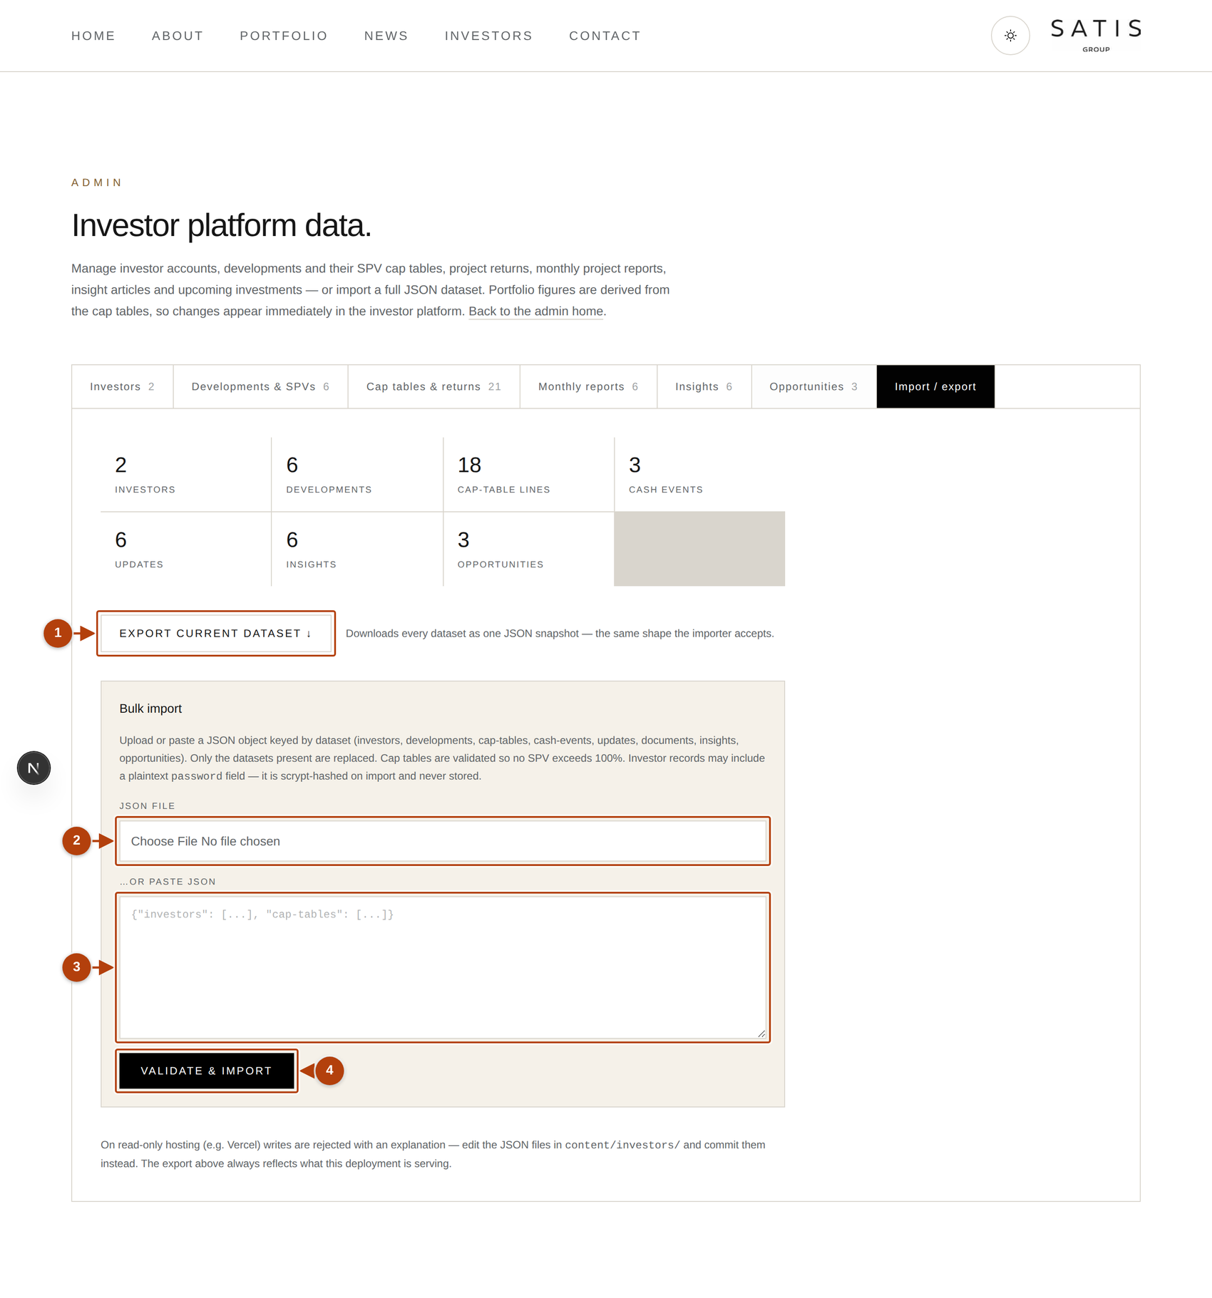
ROUTINE · DATA
SATIS
GROUP
Import, export, and the backup habit.
Export current dataset downloads everything (every investor, development, cap table, report, insight and opportunity) as one file, exactly as the live site serves it. The same tab accepts a prepared file back: Validate & import checks everything first (including the 100% cap-table rule) and only replaces the datasets present in the file. Export before any big editing session. The file is a perfect backup and a perfect restore.
GOOD TO KNOW
JSON, in plain English Structured text computers read reliably. You never write it by hand; Claude reads and edits it for you.
The Import / export tab: the platform's back-up door.
SATIS GROUP · THE INVESTOR PLATFORM
19
Notes:
The export is also the bridge to Claude for bulk edits: download, attach to a session, describe the changes, import. Or let studio saves commit directly on the live site (webinar 06 covers the token that enables that).

Slide 20
RECAP
SATIS
GROUP
What to remember.
Everything investors see is generated from datasets you edit in the seven-tab studio.
The golden rule: value = share % × SPV equity value. A wrong figure is always one of those two numbers.
Position saved → account becomes invested automatically and sees reports and financials.
Quarterly: equity values → valuations → reports. Fifteen minutes keeps every portal current.
Documents and bulk edits go through Claude; export before big sessions.
WHERE TO GET HELP
Written chapters: /admin/guide → the Investor platform group (six chapters).
Start with “How the investor platform fits together”. Five minutes.
Figures look wrong? Check share % and equity value before anything else.
SATIS
GROUP
SATIS GROUP · THE INVESTOR PLATFORM
20
Notes:
Recap the takeaways, answer questions, and point everyone at the written guide.

