Slide 1
PROJECT 3 • APPLIED CRYPTOGRAPHY & SECURITY
Diffie–Hellman Key Exchange & Man-in-the-Middle Attack
Simulating Ephemeral Key Agreement, Active Interception, HKDF Expansion, and Ed25519 Public-Key Authentication
X25519 (ECDH)
HKDF-SHA256
AES-256-GCM AEAD
Ed25519 Signatures
Python Cryptography 50.0.2
Environment: Python 3.13 / 3.14 • Local In-Memory Simulation • Zero Raw Sockets
Verification: 5 Automated Test Suites • 19 Test Cases / Assertion Groups • 0 Errors (100% Pass)
Security Scope: Curve25519 Ephemeral Exchange, Active Mallory MITM, Length-Prefixed Framing, AES Tampering

Slide 2
PROBLEM CONTEXT & THREAT MODEL
Vulnerabilities of Unauthenticated Key Agreement
Why Diffie-Hellman requires cryptographic identity authentication to resist active interception
THE FUNDAMENTAL DIFFIE-HELLMAN FLAW
Secrecy vs. Identity: DH computes a shared secret over an untrusted channel, but provides ZERO proof of who generated the public keys.
No Origin Proof: Alice cannot know if public key B came from Bob or an adversary.
Passive vs Active: Raw DH is secure against passive eavesdroppers, but completely broken by active network attackers.
CORE PROJECT OBJECTIVES
1. Key Agreement: Simulate legitimate ephemeral X25519 exchange; independently derive and verify matching 32-byte shared secrets without transmitting secrets.
2. Key Derivation: Apply HKDF-SHA256 (RFC 5869) to extract and expand uniform AES-256 keys with domain separation strings.
3. MITM Simulation: Demonstrate Mallory intercepting public keys, deriving bifurcated secrets, reading plaintext, and transparently relaying messages.
4. Cryptographic Defence: Implement Ed25519 digital signatures binding ephemeral keys to sender, recipient, and protocol ID to detect and block MITM attacks.
5. Tamper Resistance: Verify AES-256-GCM AEAD authentication by modifying ciphertext bytes and tags, confirming immediate rejection.
THREAT MODEL: DOLEV-YAO ACTIVE ADVERSARY
Attacker Identity: Mallory is an active adversary controlling the wire between Alice & Bob.
Capabilities: Can intercept, modify, drop, substitute, or inject arbitrary packets.
Adversary Goal: Establish independent shared secrets with both parties and act as a transparent proxy to eavesdrop and forge messages.

Slide 3
CRYPTOGRAPHIC ARCHITECTURE
Primitive Selection & Implementation Standards
Standardized algorithms implemented using the production-grade Python cryptography library
X25519 (ECDH)
RFC 7748 • Key Agreement
Curve: Curve25519 (Montgomery curve over 2^255 - 19)
Key Size: 32-byte private key, 32-byte public key
Security: ~128-bit security level, immune to timing side-channels
Purpose: Fast ephemeral key exchange without negotiation overhead
HKDF-SHA256
RFC 5869 • Key Derivation
Structure: Extract-and-Expand HMAC-based derivation
Input: Raw 32-byte non-uniform DH shared secret
Output: Uniformly distributed 32-byte symmetric AES key
Domain Separation: Explicit context info string (b'dh-mitm-project-v1')
AES-256-GCM
NIST SP 800-38D • Authenticated Encryption
Cipher Mode: Galois/Counter Mode (AEAD)
Parameters: 256-bit key, 12-byte random nonce, 16-byte GHASH tag
Properties: Provides simultaneous confidentiality and integrity
Tamper Action: Raises InvalidTag on any bit alteration; decrypts nothing
Ed25519 DSA
RFC 8032 • Digital Signatures
Signature Type: Edwards-curve Digital Signature Algorithm (EdDSA)
Properties: Deterministic signatures, high performance, collision-resistant
Framing: Length-prefixed canonical binding: Protocol + Sender + Recipient
Trust Model: Long-term pre-shared public verification keys

Slide 4
PROTOCOL ARCHITECTURE
Protocol 1: Normal Diffie-Hellman Key Exchange
End-to-end execution flow from ephemeral key creation to authenticated symmetric decryption
SIX-STEP PROTOCOL EXECUTION
Step 1: Ephemeral Key Generation — Alice and Bob independently sample 32 random bytes for private keys: priv_A, priv_B. Compute public keys: pub_A = priv_A * G, pub_B = priv_B * G.
Step 2: Public Key Exchange — Alice transmits pub_A to Bob; Bob transmits pub_B to Alice across the untrusted network.
Step 3: Shared Secret Derivation — Alice calculates: S = priv_A * pub_B; Bob calculates: S = priv_B * pub_A. Mathematical identity ensures both reach identical S.
Step 4: Constant-Time Verification — Shared secrets are verified locally with hmac.compare_digest() to protect against timing side-channel attacks.
Step 5: HKDF Key Derivation — Raw 32-byte secret S is processed with HKDF-SHA256 (RFC 5869) to derive uniform 32-byte AES key K_AES.
Step 6: Authenticated Messaging — Alice generates 12-byte random nonce and encrypts message with AES-256-GCM. Bob authenticates GHASH tag and recovers plaintext.
CRYPTOGRAPHIC GUARANTEES
Computational Diffie-Hellman (CDH): Given pub_A and pub_B, computing S is computationally infeasible for eavesdroppers on Curve25519.
Perfect Forward Secrecy (PFS): Ephemeral private keys are discarded immediately after secret derivation. Past recorded sessions cannot be decrypted if long-term credentials are ever leaked.
Non-Exposure Guarantee: Raw shared secrets and AES keys are never transmitted over the wire or printed into logs/reports.
Critical Limitation: Without authentication, this protocol cannot distinguish Bob from an imposter on the channel.

Slide 5
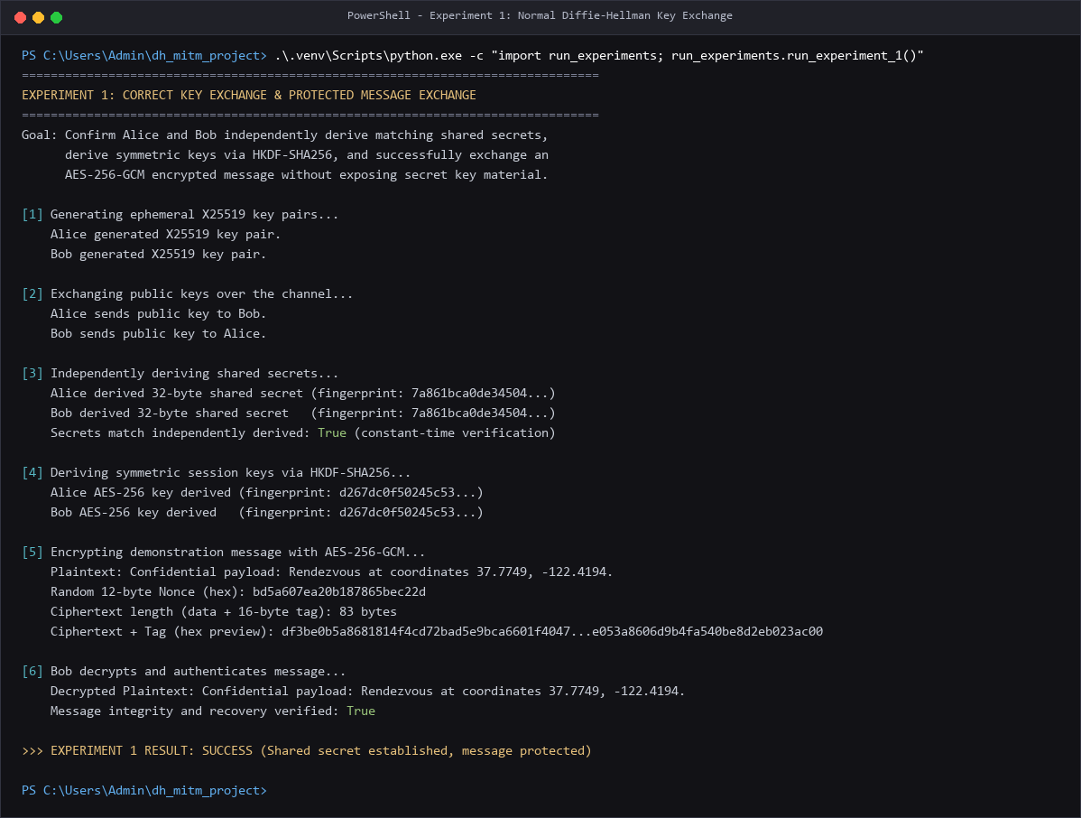
EXPERIMENTAL VERIFICATION
Experiment 1: Correct Key Agreement & Messaging
Live simulation confirming secret agreement, HKDF derivation, and AES-256-GCM encryption
EXECUTION METRICS & OUTCOMES
Shared Secret Agreement: Both parties independently calculated identical 32-byte raw shared secrets.
Secret Fingerprint: SHA256: 7a861bca0de34504... (Matches on Alice and Bob sides)
Match Status: True (Verified via constant-time hmac.compare_digest)
HKDF Key Derivation: Extracted and expanded into 32-byte AES-256 key: d267dc0f50245c53...
Plaintext Transmitted: 'Confidential payload: Rendezvous at coordinates 37.7749, -122.4194.'
Random Nonce (12B): bd5a607ea20b187865bec22d (Fresh per message)
Ciphertext Length: 83 bytes (67 bytes encrypted payload + 16-byte GHASH tag)
Decryption Recovery: Plaintext recovered perfectly; tag authenticated with zero errors.
TERMINAL PROOF: EXPERIMENT 1 SUCCESS (SHARED SECRET & RECOVERY VERIFIED)

Slide 6
ATTACK MECHANICS
Protocol 2: The Active Man-in-the-Middle Attack
How Mallory exploits unauthenticated key agreement to split the secret and eavesdrop undetected
FOUR PHASES OF MALLORY'S ATTACK
Phase 1: Public Key Interception — Alice sends pub_A to Bob. Mallory intercepts it on the wire. Bob sends pub_B to Alice; Mallory intercepts that too. Neither reaches genuine recipient.
Phase 2: Adversarial Key Substitution — Mallory generates two fresh X25519 key pairs: (priv_MA, pub_MA) to face Alice, and (priv_MB, pub_MB) to face Bob. Mallory sends pub_MB to Bob and pub_MA to Alice.
Phase 3: Bifurcated Shared Secrets — Alice derives S_AM = priv_A * pub_MA (shared with Mallory).
Bob derives S_MB = priv_B * pub_MB (shared with Mallory).
Alice and Bob derive NO shared secret: S_AM != S_MB.
Phase 4: Transparent Relay & Eavesdrop — Alice encrypts message M with K_AM. Mallory intercepts, decrypts with K_AM, inspects/modifies M, re-encrypts with K_MB, and relays to Bob. Bob decrypts M, believing Alice sent it.
ATTACK IMPACT & CONSEQUENCES
Total Loss of Confidentiality: Every byte of ciphertext sent by Alice is decrypted into cleartext in Mallory's memory before reaching Bob.
Total Loss of Integrity: Mallory can silently alter values (e.g. wire transfer routing numbers or monetary amounts) and re-encrypt with Bob's key.
Complete Absence of Detection: Neither Alice nor Bob observes any cryptographic error or abnormal behavior; both believe their communication is fully encrypted and secure.
Root Cause: Diffie-Hellman public keys do NOT verify sender identity.

Slide 7
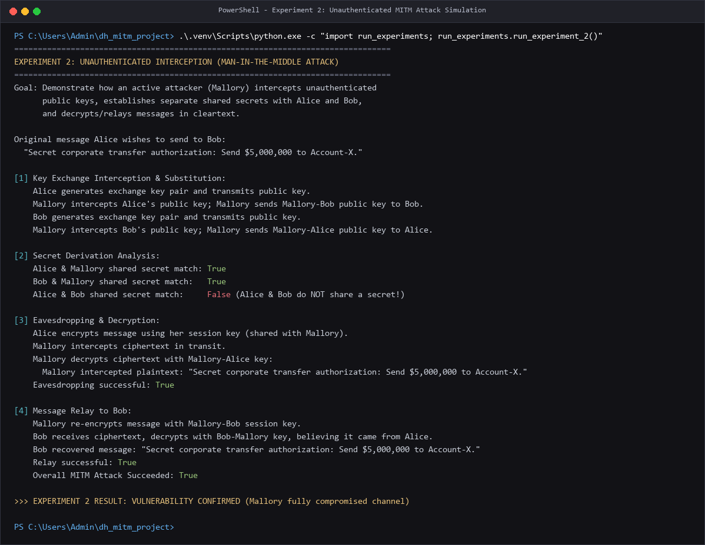
EXPERIMENTAL VERIFICATION
Experiment 2: MITM Attack & Compromised Channel
Live execution demonstrating intercepted financial authorization, cleartext leak, and relay
ATTACK OUTCOME METRICS
Target Payload: 'Secret corporate transfer authorization: Send $5,000,000 to Account-X.'
Alice-Mallory Secret: True (Alice and Mallory established shared secret S_AM)
Bob-Mallory Secret: True (Bob and Mallory established shared secret S_MB)
Alice-Bob Direct Secret: False (Alice and Bob share NO common key material)
Eavesdropping Successful: True (Mallory decrypted and read the $5M transfer payload in cleartext)
Relay Successful: True (Bob decrypted re-encrypted ciphertext without errors)
Attack Result: VULNERABILITY CONFIRMED — Channel completely compromised by active proxy.
TERMINAL PROOF: EXPERIMENT 2 MITM SUCCEEDED (MALLORY INTERCEPTED & RELAYED)

Slide 8
DEFENCE ARCHITECTURE
Protocol 3: Authenticated Key Exchange with Ed25519
Binding ephemeral public keys to identities and protocol context using length-prefixed digital signatures
OUT-OF-BAND TRUST & ED25519 SIGNING
Pre-Shared Trust Anchors: Alice and Bob possess long-term Ed25519 identity key pairs. Each party pre-distributes their public signing key out-of-band.
Ephemeral Public Key Signing: When Alice generates her ephemeral X25519 key pub_A, she digitally signs it using her private Ed25519 identity key.
Verify Before Derive: A party verifies the peer's digital signature against their pre-trusted identity key BEFORE performing Diffie-Hellman scalar multiplication.
Strict Failure Handling: If signature verification fails, the connection is instantly aborted with an InvalidSignature exception. Zero secrets or keys are derived.
CANONICAL CONTEXT-BOUND FRAMING
Framing Format: [2B len(proto)] + proto + [2B len(sender)] + sender + [2B len(recipient)] + recipient + pub_key (32B)
Why Length-Prefixes? Unambiguous 2-byte big-endian prefixes prevent delimiter injection attacks and canonical serialization ambiguities.
Explicit Sender & Recipient Binding: Binds sender='Alice' and recipient='Bob'. Defeats Unknown Key-Share (UKS) and reflection attacks.
Protocol Version Binding: Includes protocol_id=b'dh-mitm-v2'. Prevents cross-protocol replay and downgrade attacks into older or insecure protocol versions.

Slide 9
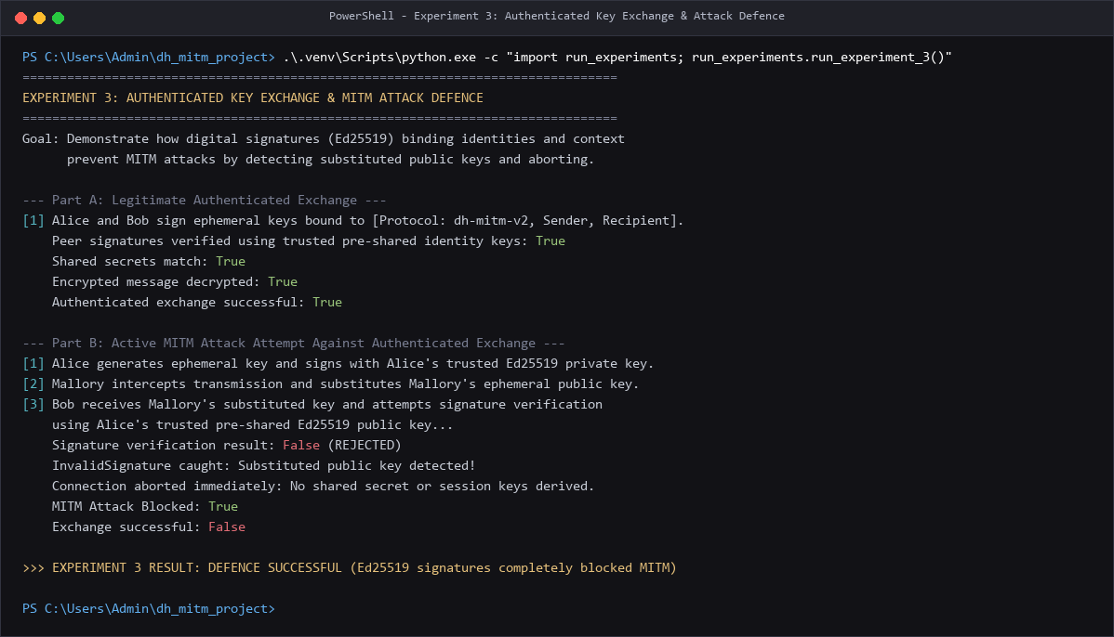
EXPERIMENTAL VERIFICATION
Experiment 3: MITM Blocked via Ed25519 Signatures
Live demonstration of legitimate authenticated exchange and immediate rejection of substituted keys
DEFENCE VERIFICATION OUTCOMES
Part A: Genuine Exchange: Alice & Bob exchange ephemeral keys with valid signatures.
Peer Verification: True (Signatures verified against trusted public keys)
Secrets Match: True (Alice and Bob reach identical shared secret)
Part B: Active MITM Attack: Mallory intercepts Alice's message and substitutes pub_M.
Signature Verification: False (Bob catches InvalidSignature; substituted key rejected)
Connection Aborted: True (Protocol terminates before DH scalar multiplication)
Secrets Derived: Zero (No shared secrets or session keys created)
MITM Attack Blocked: True (Ed25519 signatures completely thwarted the attack)
TERMINAL PROOF: EXPERIMENT 3 DEFENCE SUCCESSFUL (INVALIDSIGNATURE CAUGHT)

Slide 10
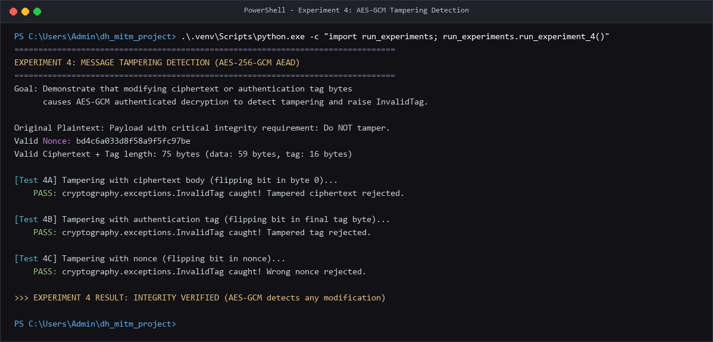
EXPERIMENTAL VERIFICATION
Experiment 4: Message Tampering & AEAD Integrity
Empirical validation that AES-256-GCM authenticated encryption rejects modified ciphertexts and tags
TAMPER RESISTANCE TEST CASES
AEAD Guarantees: AES-256-GCM combines CTR encryption with 16-byte GHASH authentication tag.
Test 4A (Ciphertext Bit Flip): Inverted bit 0 of ciphertext payload.
-> Result: InvalidTag raised immediately (PASS).
Test 4B (Tag Modification): Flipped bit in the 16th byte of the GHASH authentication tag.
-> Result: InvalidTag raised immediately (PASS).
Test 4C (Nonce Alteration): Modified 1 byte of the 12-byte initialization nonce.
-> Result: InvalidTag raised immediately (PASS).
Security Guarantee: AEAD decrypts NOTHING if the authentication tag fails. Zero partial plaintexts are leaked to the application.
TERMINAL PROOF: EXPERIMENT 4 INTEGRITY VERIFIED (ALL TAMPERING DETECTED)

Slide 11
CRYPTOGRAPHIC DEEP-DIVE
Key Derivation (HKDF) Analysis & Test Validation
Why HKDF is mandatory for Diffie-Hellman and summary of all 19 automated test cases
THE MANDATORY ROLE OF HKDF (RFC 5869)
1. Entropy Extraction & Smoothing: Raw Diffie-Hellman curve points are mathematically structured and NOT uniformly distributed random bits. HKDF-Extract concentrates entropy into a cryptographically uniform pseudorandom key (PRK).
2. Domain Separation: The context info parameter (b'dh-mitm-project-v1') ensures keys derived for different applications, protocols, or directions remain cryptographically independent.
3. Variable Key Expansion: HKDF-Expand can safely generate multiple independent keys (e.g. encryption key, MAC key, IV) from a single shared secret without key reuse.
4. Insecurity of Raw DH Keys: Using raw Diffie-Hellman secret bytes directly as AES keys violates cryptographic assumptions and risks weak keys.
AUTOMATED TEST SUITE EXECUTION SUMMARY
test_edge_cases.py (11 Tests): Invalid nonce lengths, modified tags, non-32-byte keys (0, 16, 24, 31, 33, 64B), untrusted signing keys, swapped public keys, wrong sender, wrong recipient, wrong protocol ID -> ALL PASS.
test_protocol.py (3 Scenarios): Unauthenticated MITM simulation, authenticated exchange, authenticated MITM rejection -> ALL PASS.
test_authentication.py (3 Checks): Genuine signature acceptance, forged identity rejection, substituted public key rejection -> ALL PASS.
test_encryption.py (1 Test): Ciphertext bit-flip tampering detection via InvalidTag -> PASS.
test_invalid_key.py (1 Test): Rejection of non-32-byte AES symmetric keys -> PASS.
Overall Validation: 19 / 19 test cases and assertion groups passed. Zero errors, zero regressions.

Slide 12
SUMMARY & IMPLICATIONS
Key Cryptographic Lessons & Real-World Relevance
How modern Internet standards implement authenticated key agreement and takeaways from this project
CORE LESSONS LEARNED
Key Agreement != Authentication: Diffie-Hellman establishes confidentiality against passive listeners, but digital signatures are mandatory to prove identity and prevent active MITM.
Verify Before Derive: Cryptographic authentication checks must occur prior to expensive scalar multiplication and key derivation to prevent resource exhaustion and data leakage.
Authenticated Encryption is Vital: AES-256-GCM ensures that even if an attacker alters a single bit in transit, the tampering is detected and decryption aborts.
REAL-WORLD PROTOCOL PARALLELS
TLS 1.3 Handshake: Combines ephemeral X25519 ECDHE key exchange with CertificateVerify (RSA/Ed25519 digital signatures) and HKDF key scheduling — identical to our architecture.
Signal Protocol (X3DH): Extended Triple Diffie-Hellman combines ephemeral and identity Curve25519 keys, using Safety Numbers (fingerprints) as the out-of-band trust anchor.
SSH v2 Protocol: Diffie-Hellman key exchange authenticated using host keys (Ed25519 / RSA) pinned on first connect (TOFU model).
PROTOTYPE LIMITATIONS & FUTURE WORK
Out-of-Band Trust Requirement: The simulation assumes Alice and Bob already trust each other's Ed25519 public keys. In the real world, this requires PKI (X.509) or decentralized trust networks.
In-Memory Simulation: Executed locally in memory; production systems require replay protection (timestamps/sequence numbers) and secure hardware key storage (TPM/HSM).

