Slide 1

SMART INDIA HACKATHON 2026
Problem Statement ID – SIH26155
Problem Statement Title- AI-Driven Multi-Vendor Network Security Compliance Auditor
Theme- Blockchain & Cybersecurity
PS Category- Software
Team ID- 172100
Team Name- KT@UnseenGeeks

Slide 2
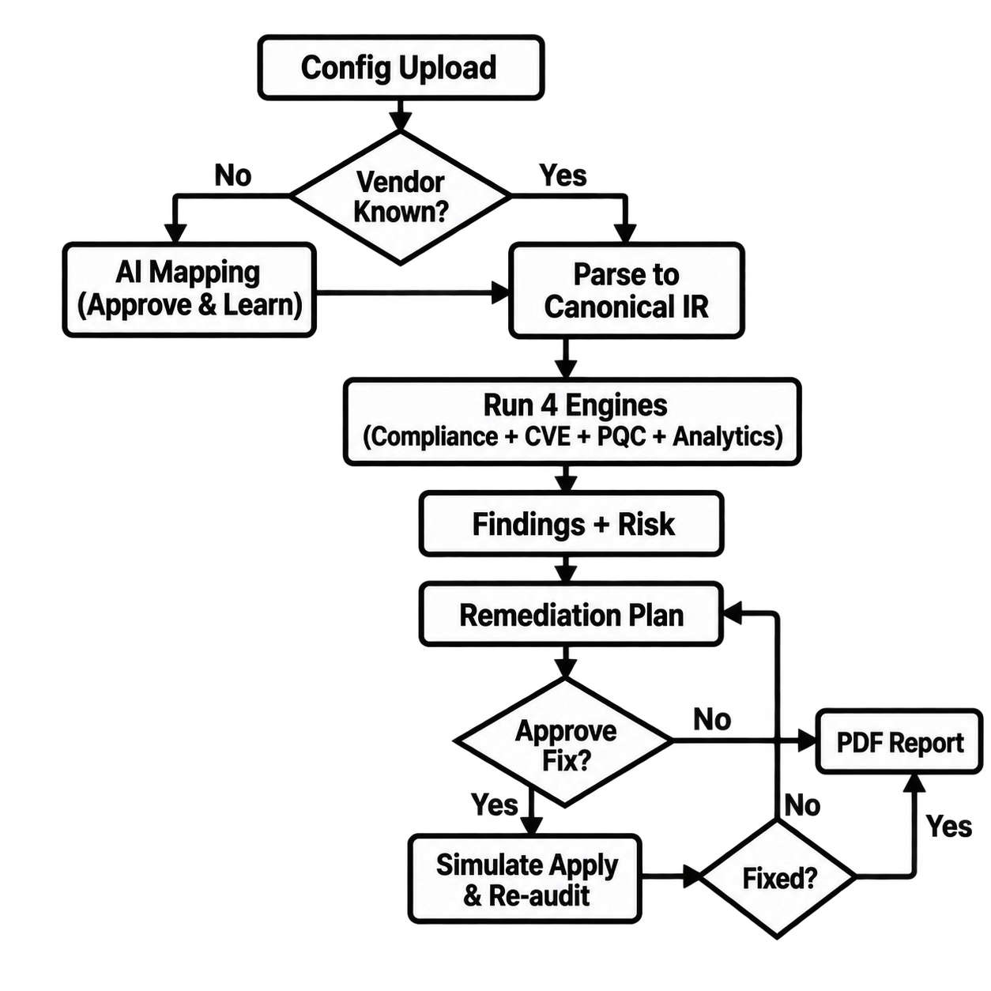
IDEA TITLE
KT@UnseenGeeks
Problem :
Heterogeneous networks use different vendor CLI, configuration structures and OS versions, making unified compliance auditing difficult to scale.
Manual/vendor-locked audits limit multi-framework checks, evidence generation and adaptation to new devices.
Our Idea: NOVAIR = Network-Oriented Vendor-Agnostic Intelligence & Risk
Normalize multi-vendor configurations into one Canonical IR.
Run compliance, CVE, PQC and analytics checks in parallel to generate evidence-backed findings and remediation.
AI-assisted human approval learns unknown syntax for future audits without redeployment.
Proposed Solution :
Normalize: Ingest single/bulk configs → convert to Canonical IR
Analyze: CIS + NIST + STIG + ISO + CERT-In
CVE + PQC + Analytics
Adapt: AI-assisted mapping of unknown syntax → human approval → reuse
Remediate & Verify: Device-specific fix → simulate → re-audit → PDF evidence
Innovation/Uniqueness :
One Canonical IR for multiple vendors
AI assists; deterministic rules decide compliance
Human-approved learning without backend redeployment
Compliance + CVE + PQC + Analytics in one audit
Evidence-backed remediation & re-audit
Quantified Impact:
Vendor Normalization: 6 vendor formats consolidated into 1 Canonical IR with 103 properties + 82 controls
Unified Compliance: CIS + NIST + STIG + ISO + CERT-In evaluated in a single audit run
Remediation Verification: Simulated fix reduced findings from 12 to 5, with 7 verified closures
Target Users:
Government & PSU security teams
Network/SOC administrators
Compliance auditors
Large enterprise network teams

Slide 3
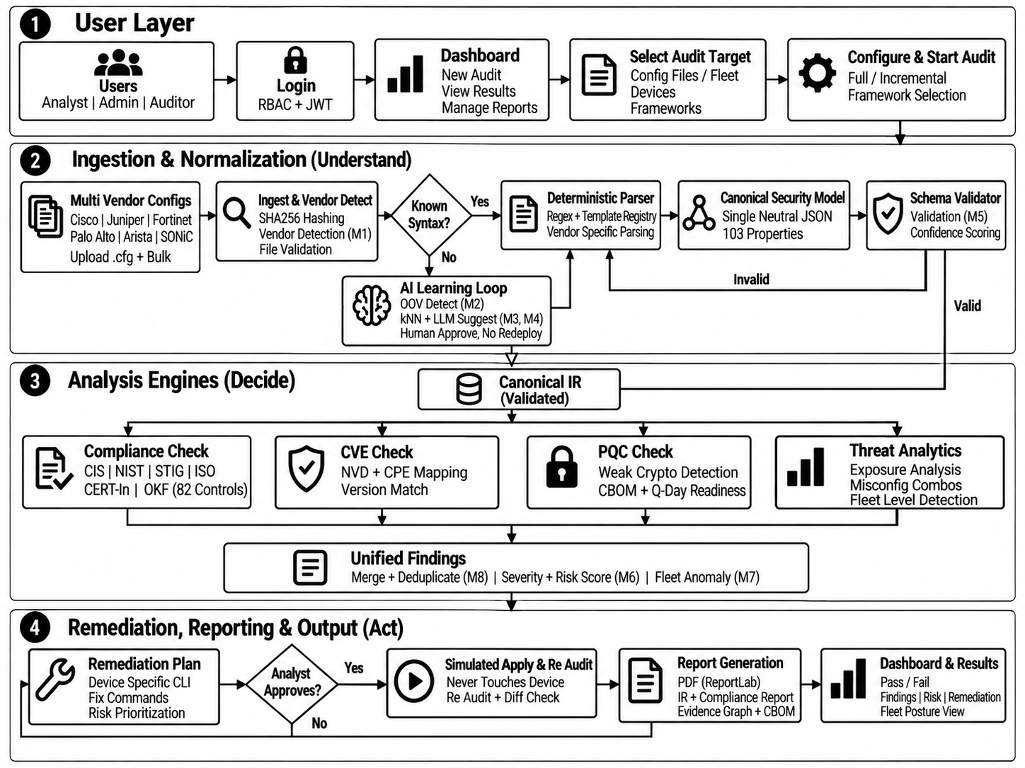
TECHNICAL APPROACH
KT@UnseenGeeks
Core Technologies:
Frontend: React
Backend: FastAPI
AI/ML: MiniLM, kNN, XGBoost, HDBSCAN, OKF
Compliance: YAML, Rule Engine, OSCAL
Security: NVD, CPE, CBOM
Deployment: Docker, On-Prem / Offline
Data Sources:
Configs: Cisco, Juniper, Fortinet, Palo Alto, Arista, SONiC, cloud SG (.cfg/.conf)
Frameworks: CIS, NIST-OSCAL, STIG, ISO, CERT-In + unified crosswalk
Intel: NVD CVE 208 golden + CPE range, CBOM 40 PQC rules, 200 golden configs, 10k fleet
Learning + Assets: approved learned mappings (hot-reload) + asset inventory + 5000 risk rows

Slide 4
FEASIBILITY AND VIABILITY
KT@UnseenGeeks
Feasibility :
Configs + NVD + framework data already available for us.
Models + parsers + APIs built with proven open tools.
Dry run only so live devices stay untouched and safe.
Docker based setup works on prem and offline without change.
New vendor added by mapping alone with no engine rewrite
Human approval keeps learning accurate and audit ready
36h plan: polish UI + add mappings + PDF core built
Commercial Feasibility :
Strong demand from govt + PSU + enterprise networks.
Replaces manual audit effort with faster, repeatable reports.
On prem licensing + support + PQC migration services.
Saves cost by early risk find and fleet wide reuse.
Scales to new vendors without extra tool cost.
Works offline so air gapped deals stay possible.
Recurring value via yearly compliance + audit renewals
Challenges :
Vendor syntax drift across OS and models
Unknown lines need human review before use
AI output must pass strict schema checks
CVE volume needs constant sync and triage
Old crypto still present in field devices
Large fleets need fast dedup and scoring
Offline mode limits live threat lookup
Approval load grows with each new vendor
PDF proof must stay readable for auditors
Strategy :
Single neutral model + registry absorbs drift
Queue + suggest + approve handles unknowns
Schema gate blocks bad AI before audit
Scheduled sync + range match keeps CVE exact
CBOM plus readiness plan drives crypto upgrade
Risk score + dedup + fleet view scales review
Offline fallback + cache keeps audits running
Learned reuse cuts repeat approvals to near zero
Short evidence + visual summary keeps PDF clear

Slide 5
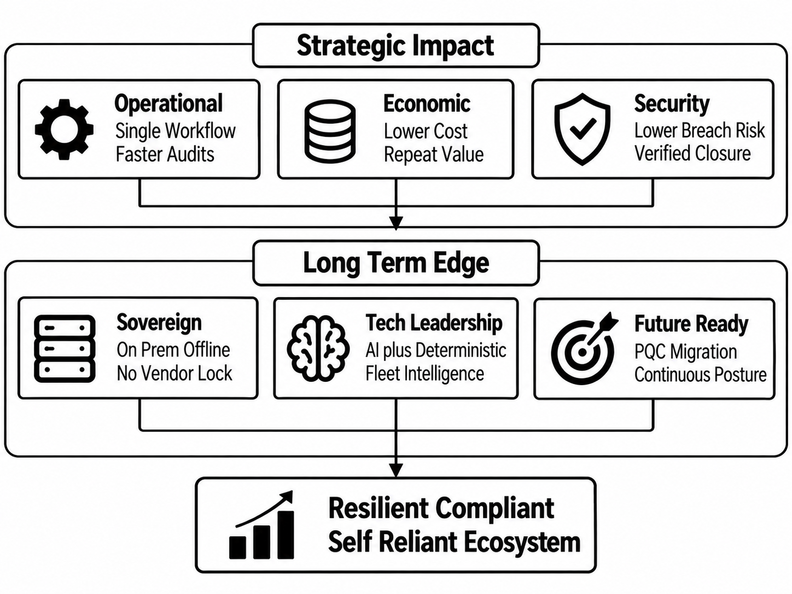
IMPACT AND BENEFITS
KT@UnseenGeeks
Economic Benefits:
Cuts manual audit effort to quick repeat runs
Early risk findings avoid costly breaches and downtime
One tool covers all vendors, so license load drops
Fleet reuse turns one learning into many audits
Offline use opens govt and air-gapped orders
Yearly reports + rescoring give repeat revenue
Quantum-ready plan avoids future rework costs
Less expert time needed per device so team scales
Direct Impact:
Misconfigs caught before exploitation with line proof
Unknown devices become auditable after one approval
Fleet outliers flagged before spread
Fixes applied in simulation with verified closure
Audit posture visible to leadership in one view
Weak crypto mapped to PQC path for future safety
CVE blast radius shows true exposure fast
Compliance score rises across repeat audits
Trust grows with provable evidence for every finding
Roadmap: live-SSH + scheduled NVD + full SSO

Slide 6
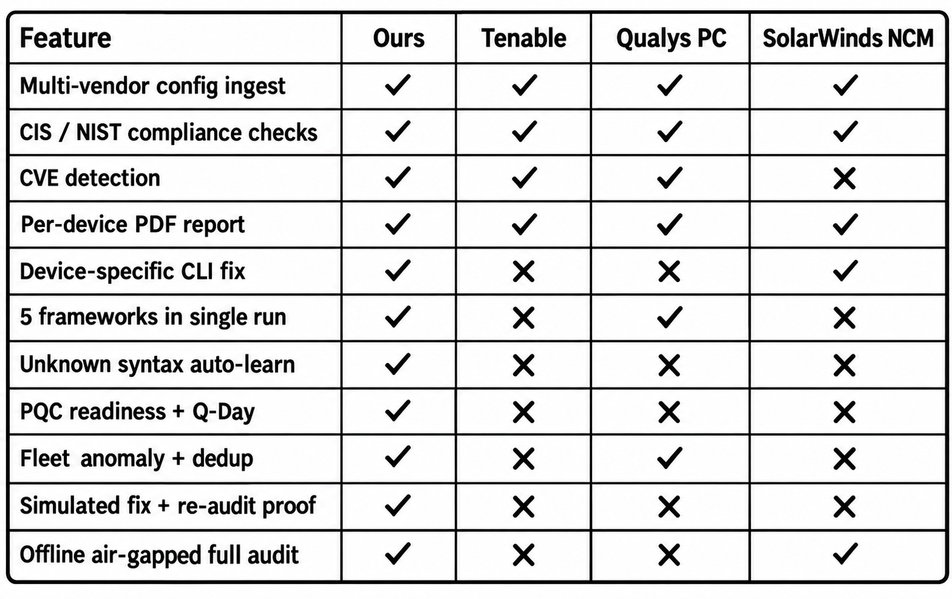
RESEARCH AND REFERENCES
KT@UnseenGeeks
Comparison:
References:
1. IEEE Survey - Forensics and Compliance Auditing: Survey of audit methods for critical infra, base for evidence-based auditing https://ieeexplore.ieee.org/document/10378648
2. IEEE/ACM ConfigChecker - LLM + Knowledge Graph Validation: LLM + knowledge graph for auto config validation, base for our M3/M4 + OKF design https://ieeexplore.ieee.org/document/10469536
3. CIS Benchmarks: Hardening guides for routers, switches, and firewalls https://www.cisecurity.org/cis-benchmarks
4. NIST SP 800-53 Rev.5 + PQC FIPS 203/204/205: Controls catalogue via OSCAL + quantum-safe standards for Q-Day mapping https://csrc.nist.gov/pubs/sp/800/53/r5/upd1/final
5. DISA STIGs: Defence checklists, strict pass/fail rules https://public.cyber.mil/stigs/
6. ISO 27001:2022: ISMS controls standard https://www.iso.org/standard/27001
GitHub link: https://github.com/Satish-vaishyar/Multi-Vendor-Security
Video Link: https://drive.google.com/drive/folders/1kFOQInvEfgVneLH1T5mVqNEMhsopbOY2?usp=sharing
Documentation Link: https://drive.google.com/drive/folders/1WnLyJpBmT2QIBJxoXJdHWmXa6L8iEWaU?usp=sharing

