Slide 1
Super Store Sales Dashboard
Summary with Visuals

Slide 2
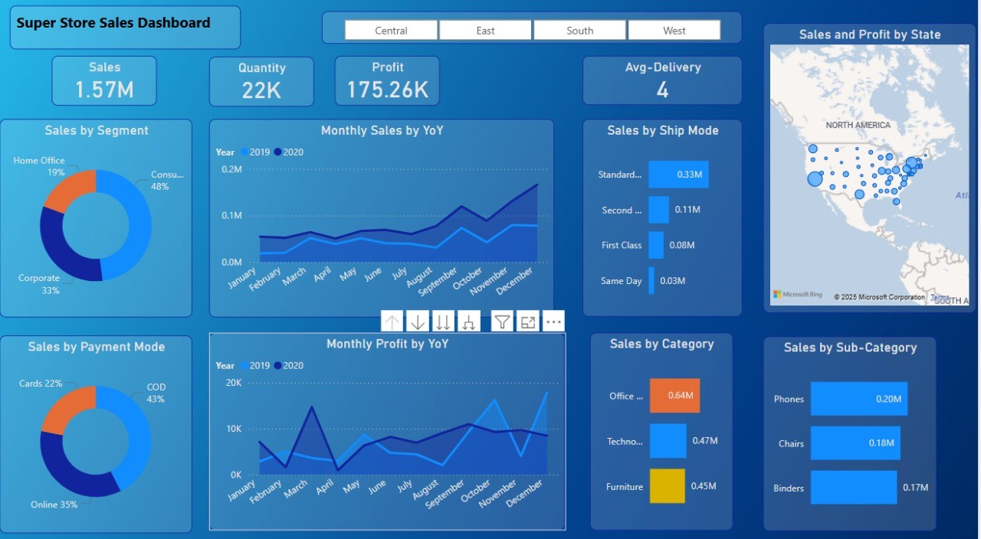

Slide 3
Overall Metrics
Sales: 1.57M | Quantity: 22K | Profit: 175.26K | Avg Delivery: 4 Days

Slide 4
Top Segments & Payment Modes
Consumer (48%), Corporate (33%), Home Office (19%)
COD (43%), Online (35%), Cards (22%)

Slide 5
Shipping and Categories
Standard Class: 0.33M
Top Categories: Office Supplies (0.64M), Technology (0.47M), Furniture (0.45M)

Slide 6
Performance Trends
December shows peak performance in both Sales and Profit across years.

Slide 7
Geographic Performance
Higher sales concentrations seen on East and West coasts.

