Slide 1
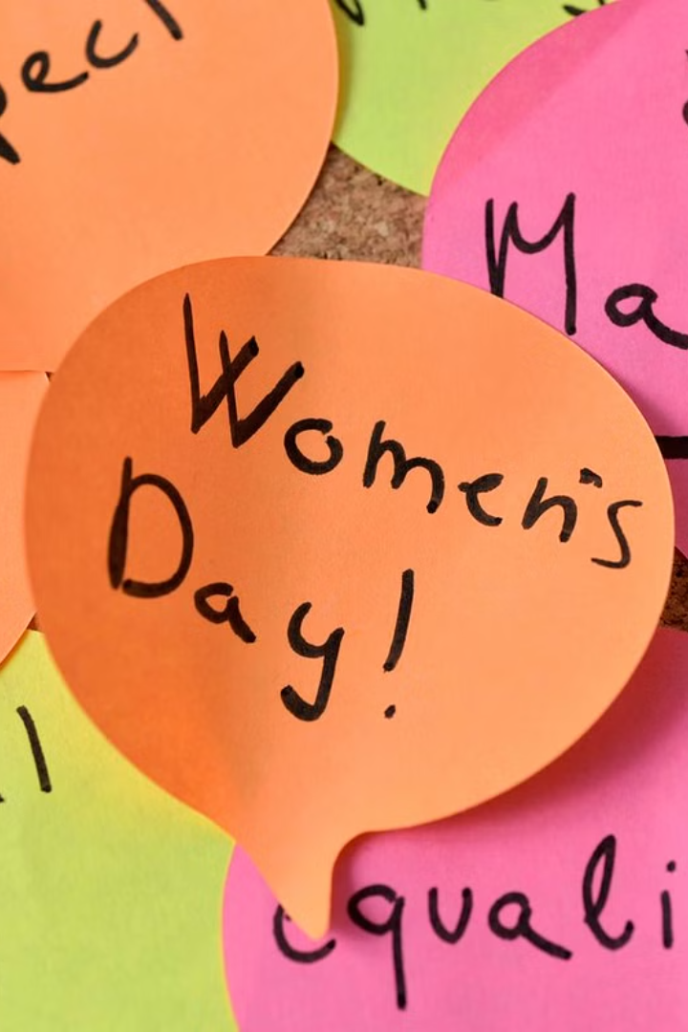
Introduction to International Women's Day
International Women's Day is a global celebration of the social, economic, cultural, and political achievements of women. It also serves as a call to action for accelerating gender parity. The day is observed annually on March 8 and is not affiliated with any one group, but brings together governments, women's organizations, corporations, and charities.
Sa
by Sachin Tiwari

Slide 2
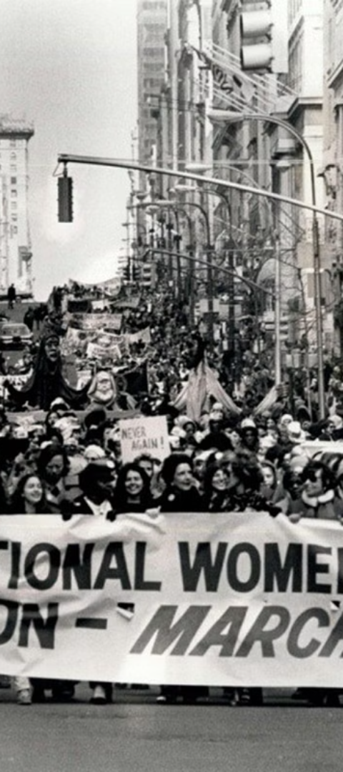
History and Significance of International Women's Day
The first National Women's Day was observed in the United States on February 28, 1909. The idea to establish an International Women's Day was proposed at an International Conference of Working Women in 1910. Since those early years, International Women's Day has grown in prominence and is celebrated worldwide. Its significance lies in honoring the achievements and resilience of women throughout history.
1
Pioneering Beginnings
The first International Women's Day was celebrated in 1911 in European countries such as Austria, Denmark, Germany, and Switzerland. It involved rallies advocating for women's rights to work, vote, and hold public office.
2
UN Recognition
In 1975, during International Women's Year, the United Nations began celebrating International Women's Day on March 8. This helped to create a global platform that has been strengthened over the years.
3
Modern-Day Observance
Today, the day is an official holiday in several countries and is marked by recognition of women's social, economic, cultural, and political achievements.

Slide 3



Theme for this Year's International Women's Day
The theme for International Women's Day 2022 is "Gender equality today for a sustainable tomorrow." It emphasizes the importance of gender equality to achieve a more sustainable and resilient world. The theme aims to inspire people to take action and challenge the status quo.
Gender Equality
Sustainable Future
Activism
Promoting equal opportunities for all genders.
Advocating for a sustainable and inclusive world.
Encouraging individuals to take an active role in promoting change.

Slide 4
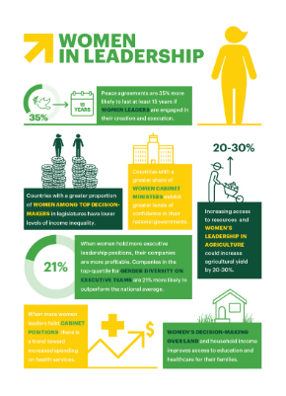
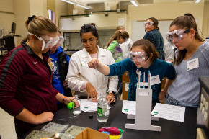
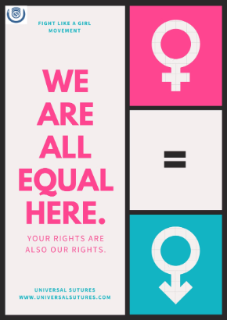
Achievements and Progress in Women's Rights
Women have made significant strides in various fields, including politics, business, education, and beyond. Their contributions have played a crucial role in shaping societies and communities around the world. The advancements in women's rights have paved the way for future generations to strive for greater equality.
Representation in Leadership
Education and Innovation
Legal and Economic Empowerment
More women are breaking barriers and holding leadership roles in governments, corporations, and nonprofit organizations.
Advancements in education and technology have empowered women to excel in STEM fields and pursue entrepreneurial endeavors.
Laws protecting women's rights and access to economic opportunities have been instrumental in reshaping societal norms.

Slide 5
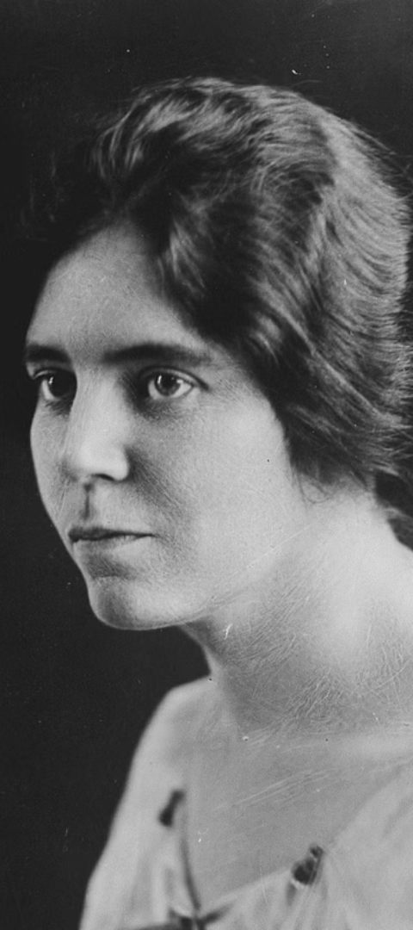
Talk about Women's Rights
Women's rights encompass the entitlements and freedoms claimed for women and girls. These rights have been integral to promoting gender equality and addressing gender-based discrimination. Women's rights are fundamental to achieving global development, peace, and security.
1
Equal Pay
2
Reproductive Rights
Advocating for fair compensation and closing the gender pay gap.
Ensuring access to reproductive healthcare and family planning services.
3
Legal Protections
Pushing for enhanced legal protection against gender-based violence and discrimination.

Slide 6
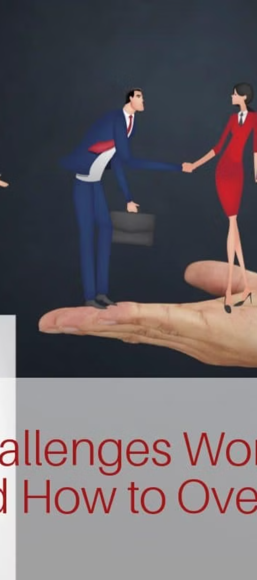



Challenges and Barriers that Women Still Face
Despite progress, women continue to face challenges such as gender-based violence, underrepresentation in decision-making processes, and limited access to education and healthcare. Breaking these barriers is essential to achieving full gender equality and empowering women and girls globally.
Gender-Based Violence
Addressing pervasive issues of domestic violence, harassment, and human trafficking.
Underrepresentation
Advocating for increased representation in political and corporate leadership roles.
Access to Opportunities
Ensuring equitable access to education, healthcare, and economic resources for women.

Slide 7

Celebrating Women's Achievements Around the World
The accomplishments of women across diverse cultures and communities deserve recognition. Their contributions have been integral to social progress, innovation, and positive change. Celebrating women's achievements helps to inspire future generations and acknowledges the impact of their efforts.
Academic Excellence
Cultural Impact
Recognizing women's contributions to academia and research across various fields of study.
Celebrating women's influence on the arts, literature, and cultural preservation.
Humanitarian Work
Honoring women's efforts in philanthropy, community service, and humanitarian initiatives.

Slide 8
Promoting Gender Equality and Women's Empowerment
Promoting gender equality involves advocating for the rights, interests, and needs of all genders. Empowering women across all facets of life—from education and employment to healthcare and representation—benefits societies as a whole. When women are empowered, communities thrive and progress is realized.
50%
85
10K
Economic Participation
Education Access
Women-led Enterprises
Ensuring access to quality education for girls and women worldwide.
Striving for equal participation and opportunities for women in the workforce.
Promoting the growth and sustainability of women-owned businesses and startups.

Slide 9
Call to Action and Ways to Get Involved
Engagement and active participation are crucial to advancing gender equality and women's rights. Individuals and organizations can take meaningful action to support women's empowerment and drive positive change, both locally and globally.
Advocacy
Speak up for women's rights and advocate for gender equality in your community and workplace.
Support
Donate to organizations promoting women's rights, mentor women, and provide support to women-led initiatives.
Education
Learn about gender issues, engage in discussions, and educate others about the importance of gender equality.

