Slide 1

SPEECH SIGNAL DENOISING ALGORITHM AND SIMULATION BASED ON WAVELET THRESHOLD
Presented by:
211FA05089-K.SATISH BABU
211FA05097-Y.UMA MAHESH
211FA05109-M.HARI VARDHAN
211FA05229-P.SAI TEJA
Under the guidance of:
DR.LAKSHMI SRINIVAS

Slide 2
PROBLEM DESCRIPTION:
Speech signals are prone to noise interference during transmission which distorts the original signal. This is a major problem for applications like voice control that rely on clear voice input.
Traditional denoising methods like digital filters are not effective for non-stationary random speech signals. The noise cannot be properly separated from the speech signal using these techniques.

Slide 3
Abstract:
The gradual development of artificial intelligence, people use sound to control the machine to complete the work. Common speech signals are non-stationary random signals, mixed with various noises, and it is difficult to filter out common denoising methods. The characteristics of wavelet transform multi-resolution analysis to improve the wavelet threshold denoising algorithm. It uses the improved wavelet threshold function to remove noise and get the original speech signal. The simulation results show that the improved wavelet threshold denoising algorithm has better performance.

Slide 4
Objective:
Develop an improved wavelet threshold denoising algorithm specifically for speech signals that can handle non-stationary random signals.

Slide 5
CONTENTS
Introduction
wavelet speech denoising technology
Wavelet decomposition of discrete sequence
Wavelet reconstruction of discrete sequence
Denoising algorithm based on wavelet threshold
Block diagram
Advantages

Slide 6
Introduction:
Speech signals are prone to noise interference during transmission, distorting the original signal.
Speech signals are often non-stationary random signals mixed with various noises.
Traditional filters like IIR is ineffective for these signals.

Slide 7
wavelet transform:
A wavelet transform (WT) is the decomposition of a signal into a set of basis functions consisting of contractions, expansions, and translations of a mother function ψ(t), called the wavelet.
Discrete wavelet transform:
A discrete wavelet transform (DWT) is a transform that decomposes a given signal into a number of sets, where each set is a time series of coefficients describing the time evolution of the signal in the corresponding frequency band.

Slide 8
WAVELET SPEECH DENOISING TECHNOLOGY:
Traditional IIR Digital Filter Design:-
IIR digital filters are used to design the analog low-pass filter.
According to the digital technical index, the technical index of the corresponding analog filter is obtained according to the frequency conversion.
Design an analog filter to get the system function. Convert the frequency conversion into a digital filter that meets the technical indicators.

Slide 9

Wavelet decomposition of discrete sequence:
It can be seen from the decomposition diagram that 𝐶0 has passed through the high-pass filter H and the low-pass filter G respectively.
When passing through the high-pass filter H , only the high-frequency part of the signal is retained, and when it passes through the low-pass filter G, only the low-frequency part of the signal is retained part.
Fig .a: Discrete sequence Wavelet decomposition

Slide 10
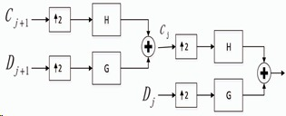
Wavelet reconstruction of discrete sequence :
The second-order discrete wavelet reconstruction of 𝐶j+1 and 𝐷j+1 through high-pass filters and low-pass filters, respectively.
Fig.b : reconstruction of a discrete sequence wavelet

Slide 11
Denoising algorithm based on wavelet threshold:
The wavelet transform is used to decompose the noisy speech signal at multiple scales to obtain wavelet coefficients in different scales.
The wavelet coefficients are composed of pure speech signal wavelet coefficients and noise wavelet coefficients.
The pure speech wavelet coefficients are mainly distributed in the low-frequency part.

Slide 12
The noise wavelet coefficients are mainly distributed in the high-frequency part.
When performing wavelet denoising, a suitable threshold is given, and it is judged that the wavelet coefficients of the speech signal are more than the threshold.

Slide 13
Selection of Threshold:
It directly affects the performance of denoising.
Choosing a too-large threshold may retain the noisy wavelet coefficients and distort the original speech signal.
If the selected threshold is too small, the wavelet coefficients of the useful signal may be filtered out, which will also distort the original signal.

Slide 14
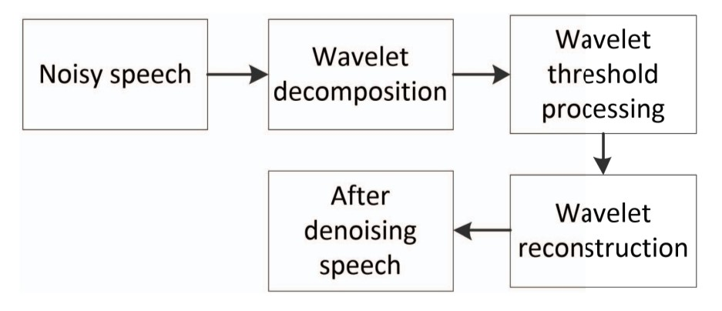
Block diagram:
Fig.c : wavelet threshold denoising method

Slide 15
Advantages:
Effectively removes noise from non-stationary random speech signals where traditional filters fail.
Decomposes signal into discrete scales using Mallat algorithm to isolate speech and noise.
Retains useful low frequency speech coefficients while removing high frequency noise.

Slide 16


