Slide 1

Description of Methods

Slide 2
The Algorithms
The Algorithms that we are going to use in this project are
LGBM-LightGBM
2. LSTM

Slide 3

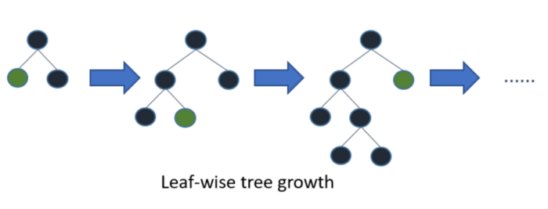
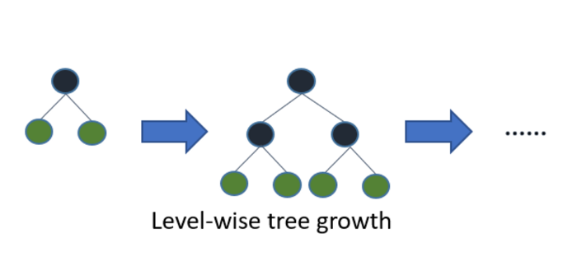
LGBM (LightGBM)
What is LightGBM?
Light GBM is a gradient boosting framework that uses tree based learning algorithm.
Light stands for the Lighter version which supposedly
Makes this faster, more efficient and a bit more accurate.
Fig1: Explains how LightGBM is working
How it is different from other Algorithms?
Light GBM grows tree vertically, it splits the tree leaf wise.
while other algorithms grows trees horizontally meaning, it grows tree leaf-wise while other algorithms grows level-wise
Fig2: Explains how other boosting algorithm works

Slide 4
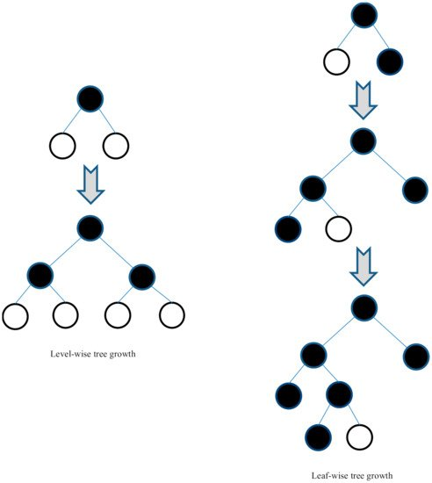
Properties of LGBM :
Light GBM is prefixed as ‘Light’ because of high speed
Light GBM can handle the large size of data and takes lower memory to run
It mainly focus on accuracy of results and can also supports GPU learning.(A GPU is a specialized processing unit with enhanced mathematical computation capability, which can speed up the computational processes for deep learning)
Light GBM is not appropriate on small datasets. It is sensitive to overfitting and can easily overfit small data.

Slide 5
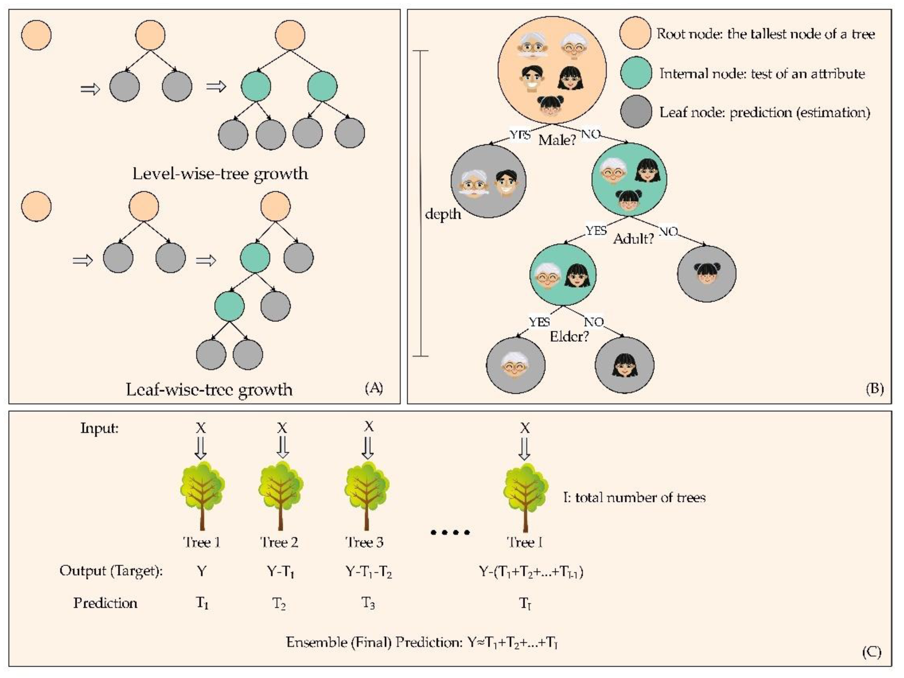
Implementation of LGBM :
Implementation of Light GBM is easy. The only complicated thing is parameter tuning
Light GBM covers more than 100 parameters
There are few parameters that are important for an implementer to keep in mind.
The key classes of parameters are:
Control parameters
Core parameters
Metric parameter
IO parameter(Input/output)

Slide 6
Control Parameters-LGBM :
Max_depth: describes depth of tree- used to handle model overfitting
Min_data_in_leaf: min no. of records a leaf may have- default if 20, optimum value
Feature_fraction: select % of parameters randomly in each iteration of building trees
Bagging_fraction: fraction of data used for each iteration and generally used to speed up the training and avoid overfitting
Early_stopping_round: model will stop training if one metric of one validation data doesn’t improve in last early_stopping round rounds. This will reduce excessive iterations.
Lambda: specifies regularization value ranges 0 to 1
Min_gain_split: minimum gain to make a split. It can used to control number of useful splits in tree
Max_cat_group : When the number of category is large, finding the split point on it is easily over-fitting. So LightGBM merges them into ‘max_cat_group’ groups, and finds the split points on the group boundaries, default:64

Slide 7
Core Parameters-LGBM :
Task: It specifies the task you want to perform on data. It may be either train or predict.
application: This is the most important parameter and specifies the application of your model, whether it is a regression problem or classification problem. LightGBM will by default consider model as a regression model.
boosting: defines the type of algorithm you want to run, default=gdbt (random forest, dart: Dropouts meet Multiple Additive Regression Trees, goss: Gradient-based One-Side Sampling)
num_boost_round: Number of boosting iterations, typically 100+
learning_rate: This determines the impact of each tree on the final outcome. Typical values: 0.1, 0.01, 0.001…
num_leaves: number of leaves in full tree, default: 31
device: default: cpu, can also pass gpu

Slide 8
Metric Parameters-LGBM :
metric: the important parameter as it specifies loss for model building.
Below are few general losses for regression and classification.
mae: mean absolute error
mse: mean squared error
binary_logloss: loss for binary classification
multi_logloss: loss for multi classification
IO Parameters-LGBM :
max_bin: it denotes the maximum number of bin that feature value will bucket in.
categorical_feature: It denotes the index of categorical features.
ignore_column: same as categorical features just instead of considering specific columns as categorical, it will completely ignore them.
save_binary: specifying this parameter as ‘True’ will save the dataset to binary file, this binary file will speed the data reading time for the next time

Slide 9
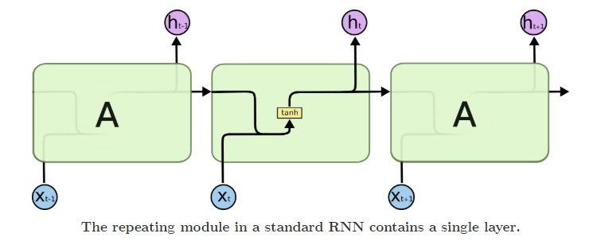
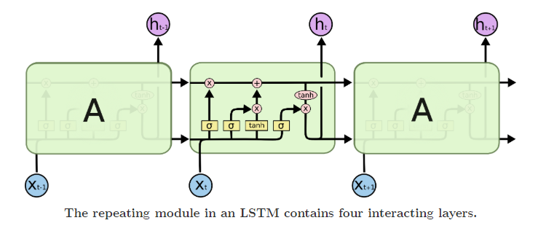
Parallel LSTM
RNN
What is Parallel LSTM?
Long Short-Term Memory (LSTM) networks are a type of recurrent neural network capable of learning order dependence in sequence prediction problems
How it is different from other Algorithms?
RNNs (Recurrent Neural Networks) suffer from vanishing and exploding gradient problems.
LSTMs deal with these problems by introducing new gates, such as input and forget gates, which allow for a better control over the gradient flow and enable better preservation of “long-range dependencies”.
The long range dependency in RNN is resolved by increasing the number of repeating layer in LSTM.
LSTM

Slide 10
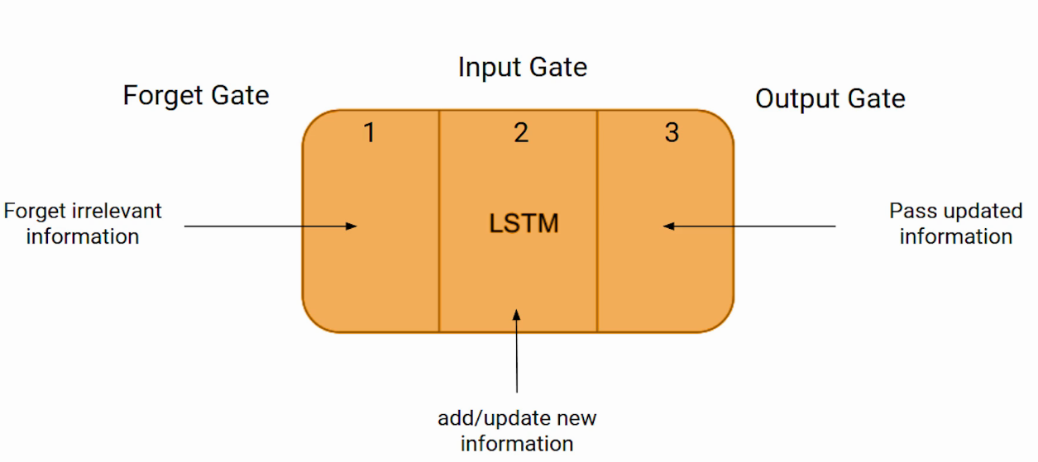
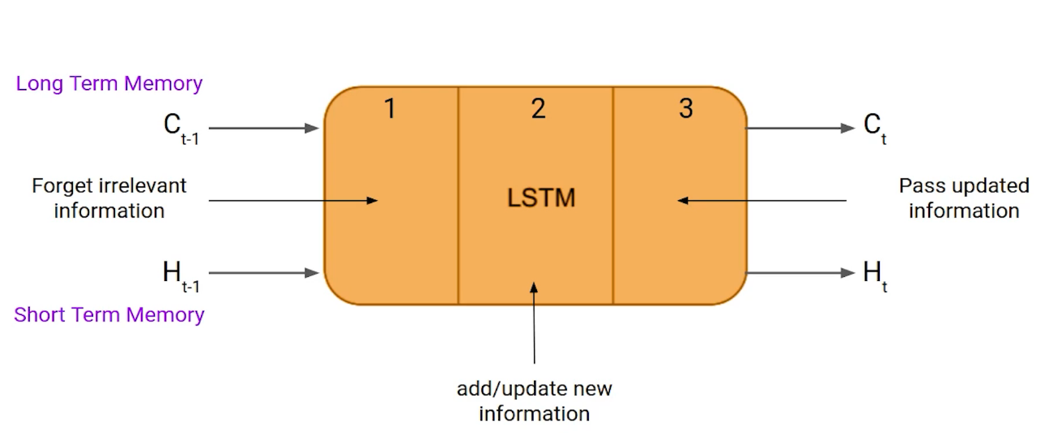
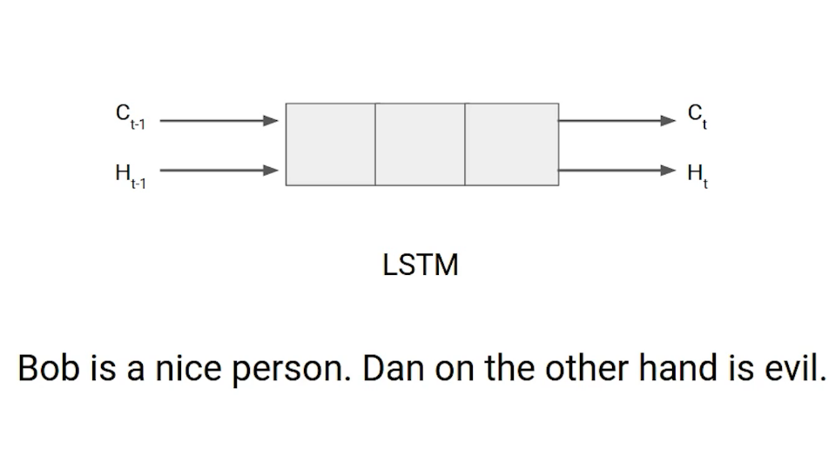
LSTM-Architecture
The LSTM consists of three parts, and each part performs an individual function.
These three parts of an LSTM cell are known as gates.
The first part is called Forget gate.
The second part is known as the Input gate and
The last one is the Output gate.

Slide 11
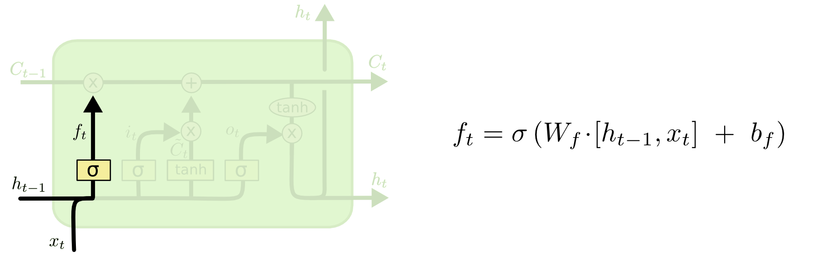
Forget gate layer
The first step in our LSTM is to decide what information we’re going to throw away from the cell state.
This decision is made by a sigmoid layer called the “forget gate layer.” It looks at ht−1 and xt, and outputs a number between 0 and 1 for each number in the cell state Ct−1.
A 1 represents “completely keep this” while a 0 represents “completely get rid of this.”

Slide 12
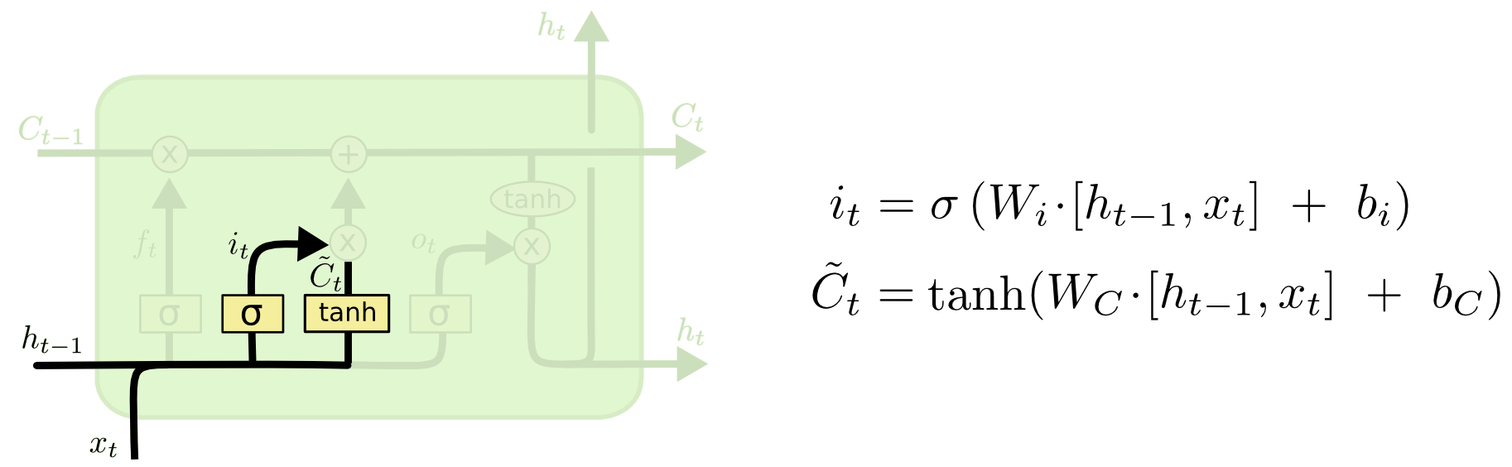
Input gate layer
The next step is to decide what new information we’re going to store in the cell state.
This has two parts.
First, a sigmoid layer called the “input gate layer” decides which values we’ll update.
Next, a tanh layer creates a vector of new candidate values, C̃ t, that could be added to the state.

Slide 13
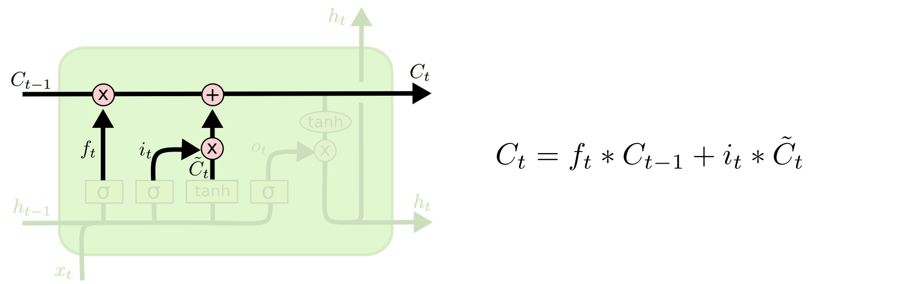
Update the old cell state
We update the old cell state, Ct−1, into the new cell state Ct.
The previous steps already decided what to do, we just need to actually do it.
We multiply the old state by ft, forgetting the things we decided to forget earlier.
Then we add it∗C̃ t. This is the new candidate values, scaled by how much we decided to update each state value.
In the case of the language model, this is where we’d actually drop the information about the old subject’s gender and add the new information, as we decided in the previous steps.

Slide 14
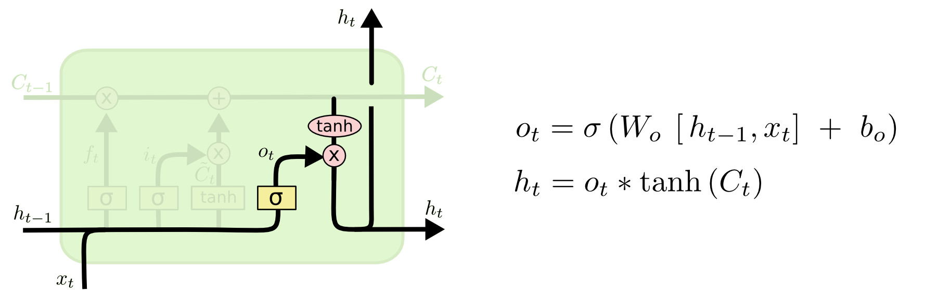
Output layer
Finally, we need to decide what we’re going to output.
This output will be based on our cell state, but will be a filtered version.
First, we run a sigmoid layer which decides what parts of the cell state we’re going to output.
Then, we put the cell state through tanh (to push the values to be between −1 and 1) and
multiply it by the output of the sigmoid gate, so that we only output the parts we decided to.

Slide 15
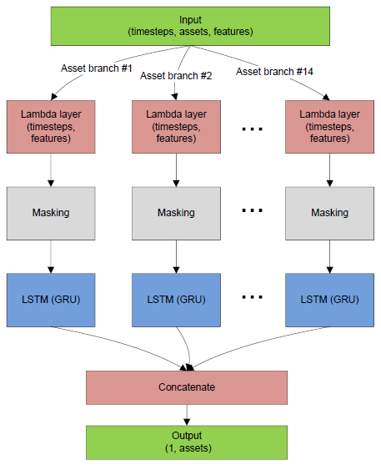
LSTM Steps for current project
Fill gaps/impute missing values/remove missing values in the training set
Lambda layer needed for assets separation;
Masking layer. Generated records (filled gaps) has zeros as features values, so they are not used in the computations
Core LSTM or GRU layer operations
Concatenate layers and result the output

Slide 16



Dry-run process of algorithms
Importing Libraries
Loading Datasets
Exploratory data analysis
Feature extraction
Prediction
Hyperparameters tuning-Grid Search
Evaluation

Slide 17

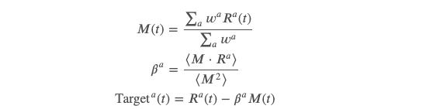
Prediction & Evaluation
aims to predict returns in the near future for prices Pa, for each asset a. For each row in the dataset, we include the target for prediction, Target is derived from log returns (Ra) over 15 minutes.
Crypto asset returns are highly correlated, following to a large extend the overall crypto market. As we want to predict returns for individual assets, we will perform a linear residualization, removing the market signal from individual asset returns when creating the target.
In more detail, if 𝑀(𝑡) is the weighted average market returns, the target is:
where the bracket ⟨.⟩ represent the rolling average over time (3750 minute windows), and same asset weights 𝑤𝑎 used for the evaluation metric.

Slide 18
References
https://colah.github.io/posts/2015-08-Understanding-LSTMs/
https://www.analyticsvidhya.com/blog/2021/03/introduction-to-long-short-term-memory-lstm/
https://lightgbm.readthedocs.io/en/latest/
https://www.analyticsvidhya.com/blog/2021/05/bitcoin-price-prediction-using-recurrent-neural-networks-and-lstm/
https://medium.com/tech-break/recurrent-neural-network-and-long-term-dependencies-e21773defd92
https://rohitgr7.github.io/content/images/2019/03/Screenshot-from-2019-03-27-23-09-47-1.png
https://www.mdpi.com/jmse/jmse-09-00496/article_deploy/html/images/jmse-09-00496-g001.png

Slide 19
To be Continued…………………..

