Slide 1


Procure.AI

Slide 2
GP operations is driven on emails and platform fixes
Source to Contract
Procure to Pay
Develop Sourcing Strategy & Planning
Manage Vendors
Initiate Sourcing
Manage Contracts
Manage Requisitions and Orders
Manage Receipts & Returns
Manage Assets
Manage Accounts Payable
Process Vendor Payments
L2 Processes (9)
Develop Annual Procurement Plan
Manage Categories
Manage item / service Master
Manage Catalog
Analyze MIS & Spends
Register Vendor
Assess Performance & Risk
Manage Vendor Relationships
Conduct Market Analysis & Identify Vendor
Conduct E-Bidding/ Float Request for Quotes
Conduct Vendor Evaluation and Selection
Prepare contract structure
Create and Administer Contract
Close Contract
Create & approve Requisition (PR)
Create & Issue Purchase Order (PO)
Manage Purchase Order Changes
Short-Close Purchase Order
Administer Petty Cash Purchases
Receipt and Issue Material
Manage Item Returns
Manage Inventory
Track and Maintain Assets
Transfer Assets
Manage Asset Disposal
Process and Validate Invoices
Record and Approve Invoice
Prepare and Approve Vendor Payments
Release and Confirm Vendor Payments
L3 Processes (29)
Oracle procurement module does not provide solutions for our sourcing needs where Agentic AI solutions are being evaluated.
Oracle fusion
Email/Spreadsheet

Slide 3
We can target autonomous outcomes without waiting for Deloitte to recommend a fit for purpose tech stack in month 4
Option 1
Option 2
Option 3
AI-first sourcing & intake layered on Oracle for execution and financial control.
Single-vendor ERP-native Source-to-Pay across the full procurement lifecycle.
Replace Oracle sourcing with a specialist S2P platform; Oracle retained for finance only.
Procure AI
Intake, Sourcing
Oracle
PR,PO, Payment, System of record
Oracle
Sourcing, PR,PO, Payment, Masters, System of record
Best of breed system
Sourcing, PR,PO, Payment, Masters, System of record
STRENGTHS
STRENGTHS
STRENGTHS
↑ Highest AI maturity: autonomous intake, RFQ & negotiation
↑ Deep sourcing sophistication (especially Ivalua)
↑ Lowest enterprise risk — single vendor, native integration
↑ Strong supplier portals & lifecycle management
↑ Touchless PR potential for compliant scenarios (17k PRs/ year
↑ Strong compliance, DOA enforcement & auditability
↑ Advanced analytics and category-level optimisation
↑ Preserves Oracle financial, audit & approval controls
↑ Continuous Oracle roadmap improvements (Redwood UX)
↑ Growing agentic AI capabilities (esp. Coupa)
↑ Faster value realization - augmentation, not replacement
↑ Clear separation: innovation layer vs control layer
LIMITATIONS
LIMITATIONS
LIMITATIONS
↓ Supplier onboarding AI partially roadmap-dependent
↓ AI is assistive, not autonomous
↓ Highest change management and business disruption
↓ Requires integration governance (scoped to S2C)
↓ Slower sourcing cycles vs AI-first platforms
↓ Licensing overlap with Oracle capabilities
↓ Limited differentiation beyond standard ERP
↓ Longest time-to-value (~9–18 months)
Module Costs- AED 400k/year
Intake+ Autonomous sourcing,
Supplier onboarding under development
Minimum contract period 24 months
↓ Risk of fragmented ownership (IT / Procurement / Finance)
Innovation Speed
AI-led Savings
Controlled Risk
Standardisation
Compliance
Low IT Complexity
Best-in-class
Governance
Global Scale

Slide 4
Proposed “interim” tech landscape
Source to Contract
Procure to Pay
Develop Sourcing Strategy & Planning
Manage Vendors
Initiate Sourcing
Manage Contracts
Manage Requisitions and Orders
Manage Receipts & Returns
Manage Assets
Manage Accounts Payable
Process Vendor Payments
L2 Processes (9)
Develop Annual Procurement Plan
Manage Categories
Manage item / service Master
Manage Catalog
Analyze MIS & Spends
Register Vendor
Assess Performance & Risk
Manage Vendor Relationships
Conduct Market Analysis & Identify Vendor
Conduct E-Bidding/ Float Request for Quotes
Conduct Vendor Evaluation and Selection
Prepare contract structure
Create and Administer Contract
Close Contract
Create & approve Requisition (PR)
Create & Issue Purchase Order (PO)
Manage Purchase Order Changes
Short-Close Purchase Order
Administer Petty Cash Purchases
Receipt and Issue Material
Manage Item Returns
Manage Inventory
Track and Maintain Assets
Transfer Assets
Manage Asset Disposal
Process and Validate Invoices
Record and Approve Invoice
Prepare and Approve Vendor Payments
Release and Confirm Vendor Payments
L3 Processes (29)
Oracle procurement module does not provide solutions for our sourcing needs where Agentic AI solutions are being evaluated.
General Procurement Policy
Oracle fusion
Potential Agentic AI use case

Slide 5
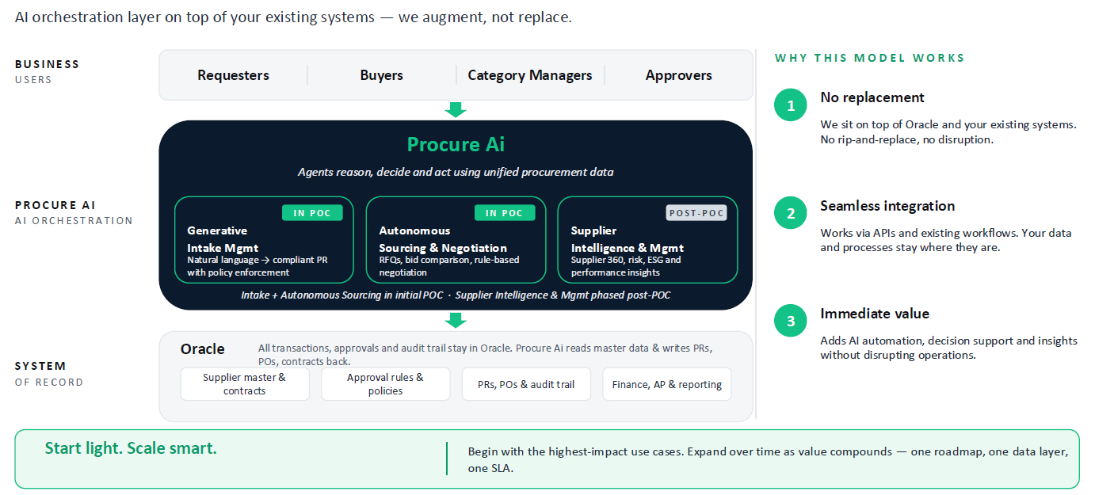
This helps operationalise missing/broken elements in our S2C cycle

Slide 6
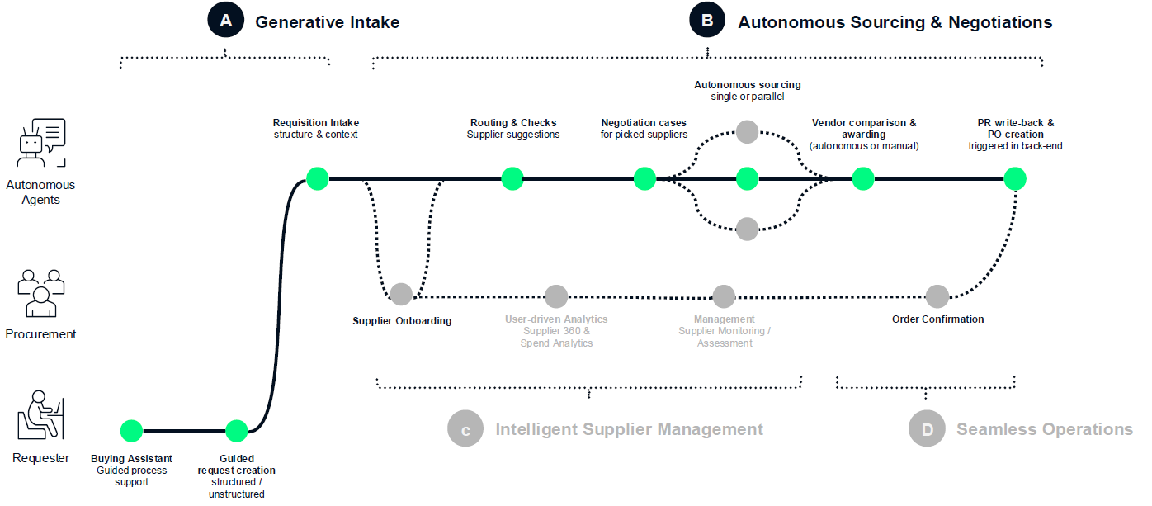
Potential workflow with Agentic solution

Slide 7
Next Steps
Proof of Concept
Pilot Implementation
Expand and Scale
1 week, No Cost
8 weeks, AED 50K
9-12 months, Annual subscription, AED 400K/year
Standalone Procure Ai demo environment — no Oracle integration or live DAMAC data connection required.
Fully hosted and facilitated by Procure Ai, with dedicated onboarding support and scenario walkthroughs tailored to DAMAC's procurement context.
Covers the following Procure Ai agents and capabilities
  Purchasing Requisition Agent
  Guided Buying agent
  Sourcing Agent
  Negotiation Agent
  Agent Builder
  Purchasing assistant
Supplier onboarding will be out of scope
PoC hosted on DAMAC environment
Integrations built with Oracle.
Continuous data extraction from source systems to Procure AI.
Data model deployed and validation rules in place
Connection of enrichers and setup of initial autonomous rule framework
Business validation workshops
Value realization workshops
Technical Documentation created
Expand across categories and use cases
Increase automation scope
Continuous optimization
Potential full process integration
Continuous value delivery

Slide 8
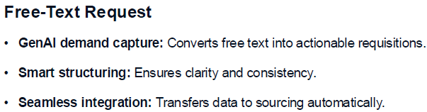
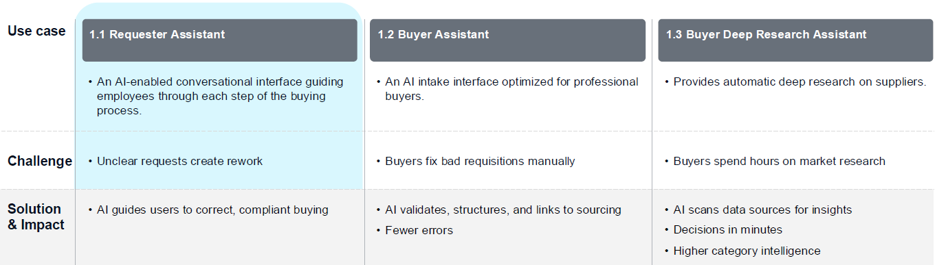
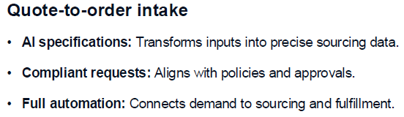
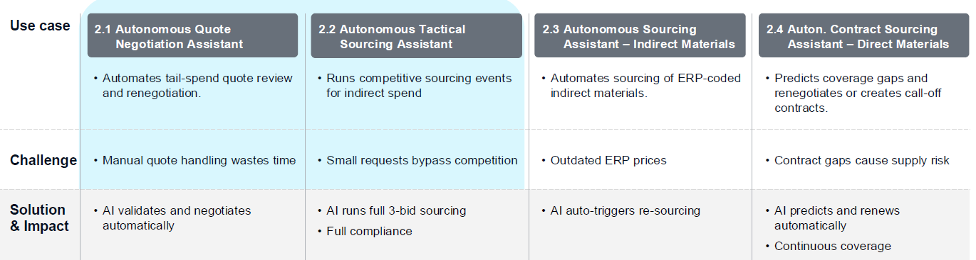
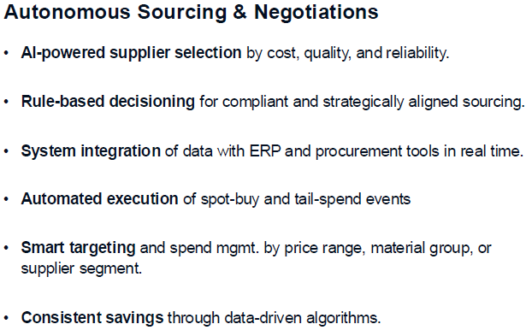
3
Define Operating Model
Identified Agentic AI use cases
Use case #1 - Intake management – From manual data entry to AI driven demand orchestration
Use Case #2- First level sourcing negotiations- Ai enabled rate levelling negotations

Slide 9
3
Define Operating Model
Oracle fixes identified by Deloitte (1/2)
Process- Sub process | Requirement | Remarks | Business Benefits
Manage Vendors Register Vendor | Mandatory details are should be captured in all source systems and documents are available in each vendor record in vendor master. (BRD Complete) | Oracle self service portal could be the primary mode of vendor registrations and integrations between SF and PMWeb working seamlessly | Clean vendor master with assigned responsibilities
 | No automatic notifications to Supplier (BRD Complete) | Mail is sent to Supplier/Supplier Portal activation | The suppliers are notified on the timely basis
Develop Sourcing Strategy & Planning Manage item / service Master | Missing Item and Service catalogue Agentic AI use case | This includes implementation of 3 new modules Product Management (Item Master Management) / Inventory Module / Costing Management | Proper Item and pricing can be maintained in the system which ensures uniformity, better tracking
Manage Requisitions and Orders Create & approve Requisition (PR) | Business wise PR visibility is missing | PRs are created under a single Business unit | Helps to segregate PRs based on Business Unit this ensuring better maintenance and tracking
 | No visibility on PR approval cycle and approved PR not reflected in system on real-time basis | Purchase Requisition Dashboard need to be built | Dashboard helps up check the status in real-time thus enabling better decision making
 | System allows end users to assign PR to Buyers those who have left the organization. | Deactivation of the User account | Deactivation of Ex-employees with help in Data filtration and prevent manual mistakes
 | PRs are manually assigned to buyers on daily basis by admin team | PRs can be assigned to Buyers using Buyer assignment rules. | Automatic assignment ensures error free, reduced effort by admin team
 | Duplicity in weekly PR to PO report - Same PR number reflected multiple times One to many relationship for PR to PO is leading to incorrect amount adjustments | Grouping of PR can be stopped
Being serviced through demand

Slide 10
3
Define Operating Model
Oracle fixes identified by Deloitte (2/2)
Process- Sub process | Requirement | Remarks | Business Benefits
Manage Requisitions and Orders- Create & Issue Purchase Order (PO) | Purchase Orders are created manually by consolidating individual line items from multiple Purchase Requisitions and there is no standardization in creating requisitions i.e. description of items, UOMs, qty etc. | This can be solved by using Agreements and Smart forms. Intake management- Agentic AI use case | Standard process in creating requisition, less time consumption and less error prone
 | Purchases orders are manually downloaded and shared over email to vendors. | It is an Oracle standard functionality where the PO PDF is sent to the Supplier – Need Supplier master data cleansing/updation. | The process is automatic which reduces manual work also email notification is sent without any fail
Manage Contracts- Create and Administer Contract | Contracts are signed manually, and changes are done based on email communications from stakeholders | Can be done through Contract Management Module of Oracle and implementing the DocuSign for Digital signature | Reduces manual work
 | Contracts stored in SharePoint gets renamed and not able to retrieve the latest version of the document. | Legora could solve this potentially | Human error like rename/deletion can be avoided
Process wide issues | DOA workflow approval issues | Approvals can be configured | Approval workflow is routed to the correct person ensuring compliance

