Slide 1
Modernization With MongoDB
Name: Satish Kalla
Date: 27-10-2021

Slide 2
Use Case:
Cylinder Manufacturing
Cylinder manufacturing is a daily process of creating batches with thousands of cylinders in the database.
Each Cylinder goes through separate process based on customer requirements.
The workflow will be captured at each and every step of the process and saves in database, It is real time using mobile app.
Displays lot of information in batch/cylinder wise on dashboards or in reports.

Slide 3
Pain Points:
Infrastructure
Performance
Scalability
Cost
Infrastructure on premises:
Server downtimes are the major issue.
Maintenance of data backups & disaster recovery.
Performance:
Retrieving data with relations for more records leading to a performance issue even with indexes.
Scalability:
Application is not scalable due to increase in data size and large amounts of traffic.
Cost:
Have to bare licenses and environment costs.

Slide 4
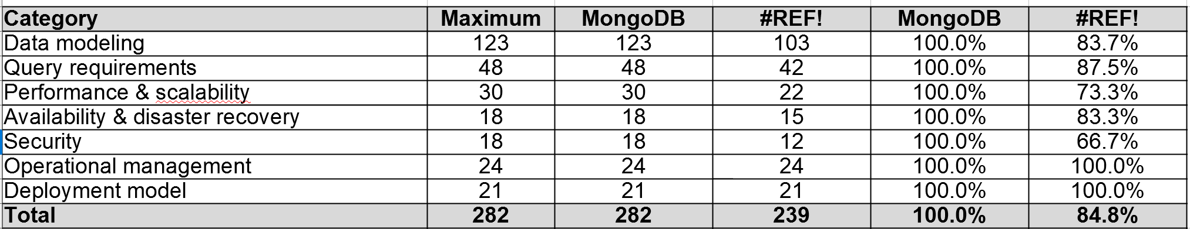
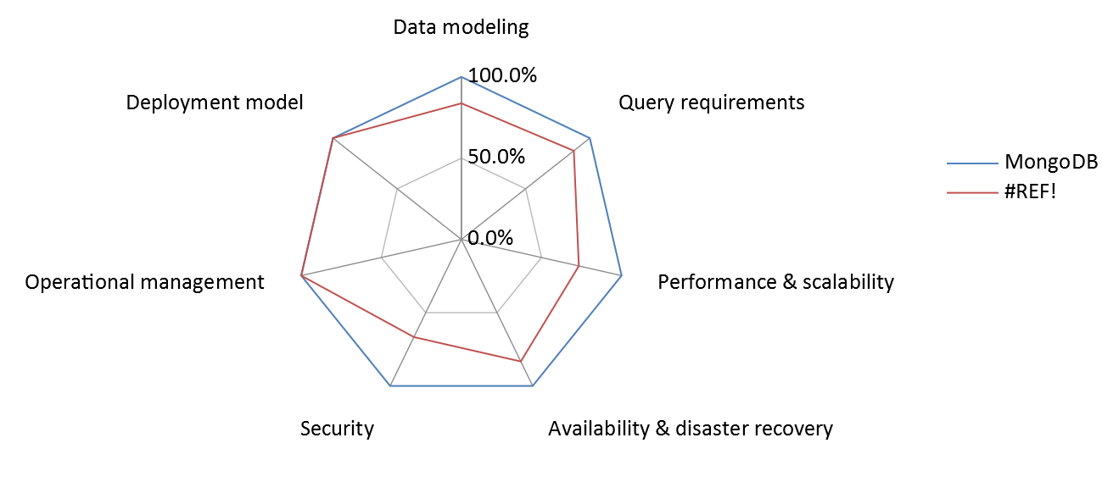
Modernization Score Card
Modernization score card results.

Slide 5
Migrate to MongoDB:
User-Friendliness
Scalability
User-Friendliness:
Simple and readable data storage which can understand by developers.
Ease of handling structured/unstructured/semi-structured data
Scalability:
Data can be distributed across many servers.
Replication of data among group of mongoDB servers that hold same data ensures high availability and disaster recovery.

Slide 6
Migrate to MongoDB:
Performance
Flexibility
Security
Performance:
Follows a hierarchical data model that can store data in one document.
Usage of secondary indexes
Flexibility:
Schemaless design makes easy to build and enhance applications without any complex migrations.
Security:
Various security features such as authentication,access control,encryption to secure mongoDB deployments.

Slide 7
Migrate to Cloud:
MongoDB Atlas
MongoDB Atlas is the cloud infrastructure for running MongoDB.
Hardware and Infrastructure will be handled by Atlas team.
Maintenance of database will be done by Atlas team.
High availability without downtimes.
Pay as you go for the services you used.
Automated database backups.
Auto-Scaling.
Data visualization using MongoDB Charts.
Realm-Mobile app data management.
.

Slide 8

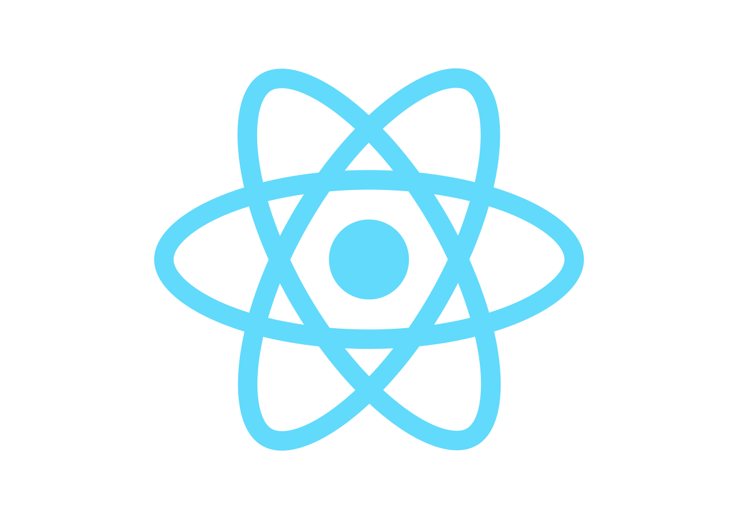


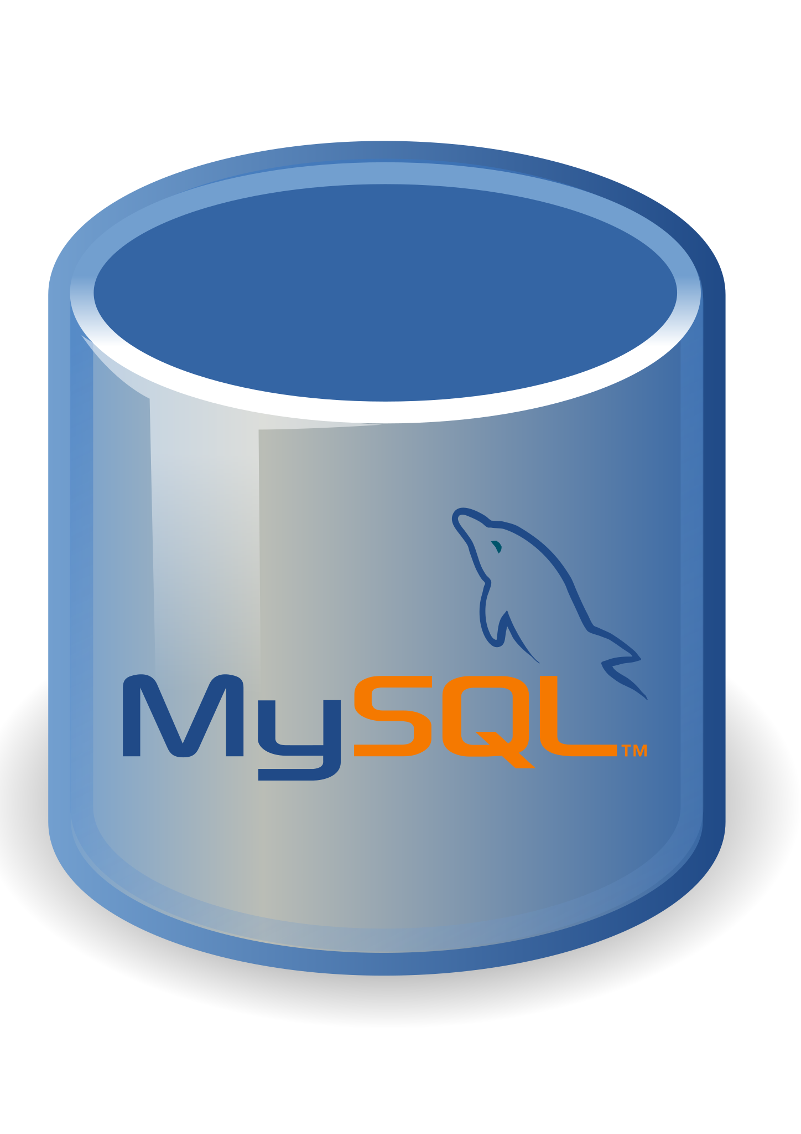

Basic Architecture:
With MySQL
With MongoDB
OLD
NEW
HTTP
HTTPS
APIS
APIS
APIS
APIS
Sequelize ORM
Mongoose ODM
Cloud

Slide 9
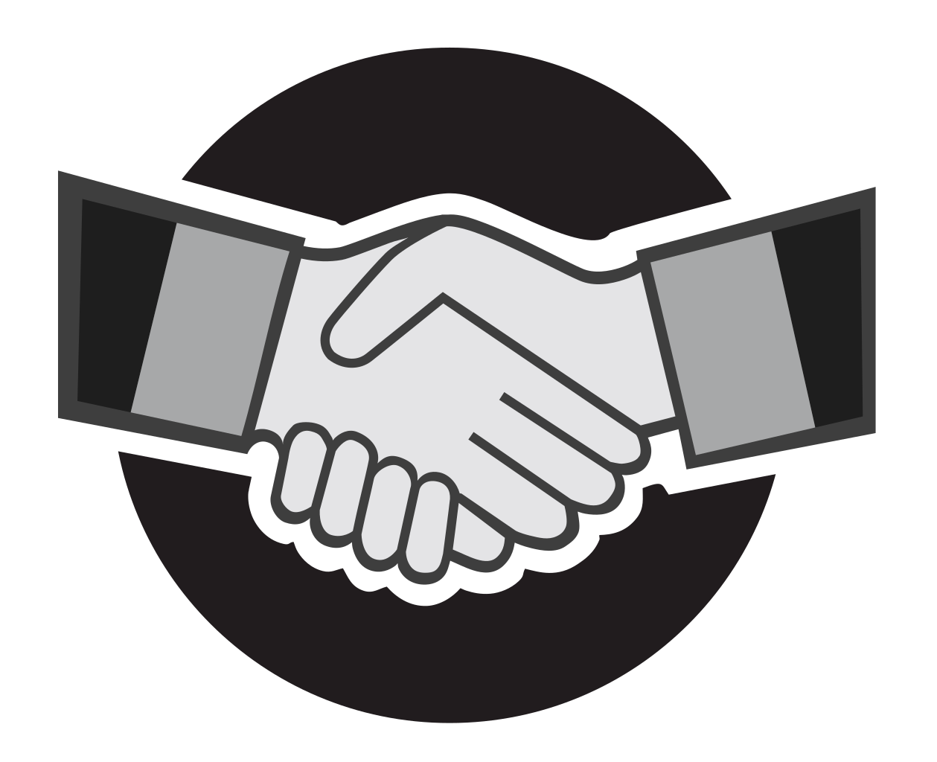
Thank you

