Slide 1

waste to wonder Changing Waste into Useful Things Turning Various Wastes into Valuable Products
Presented by :-
Karan Kumar (22/CSE-017) Satish Kumar( 22/CSE-022) Sanket Kumar(23/CSE/LE-601) Satyam Kumar Sharma(23/CSE/LE-606)
Guided by :-
Er.Sandeep Kumar

Slide 2
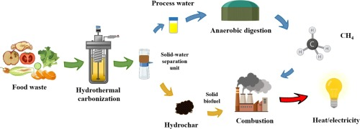
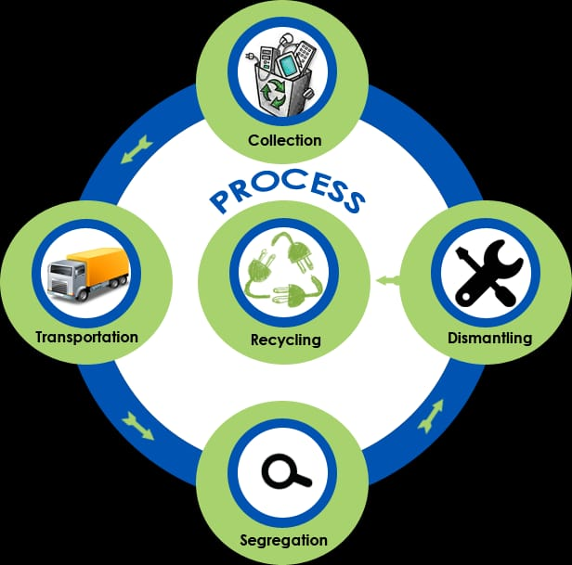
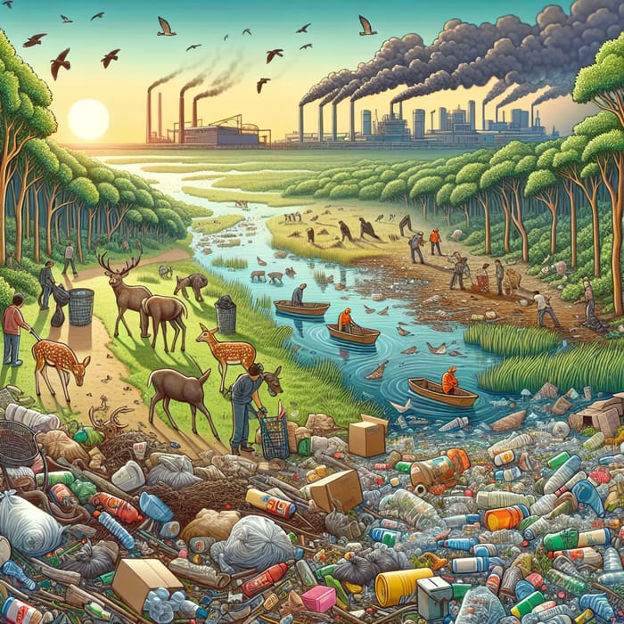
Introduction
My project focuses on turning different types of waste into useful products.
We aim to transform items like organic waste, plastic, and more into valuable resources.
This helps reduce waste and create new, sustainable products.

Slide 3
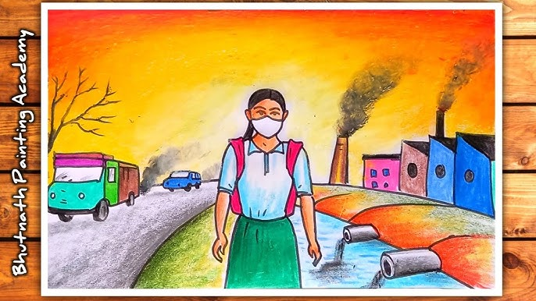
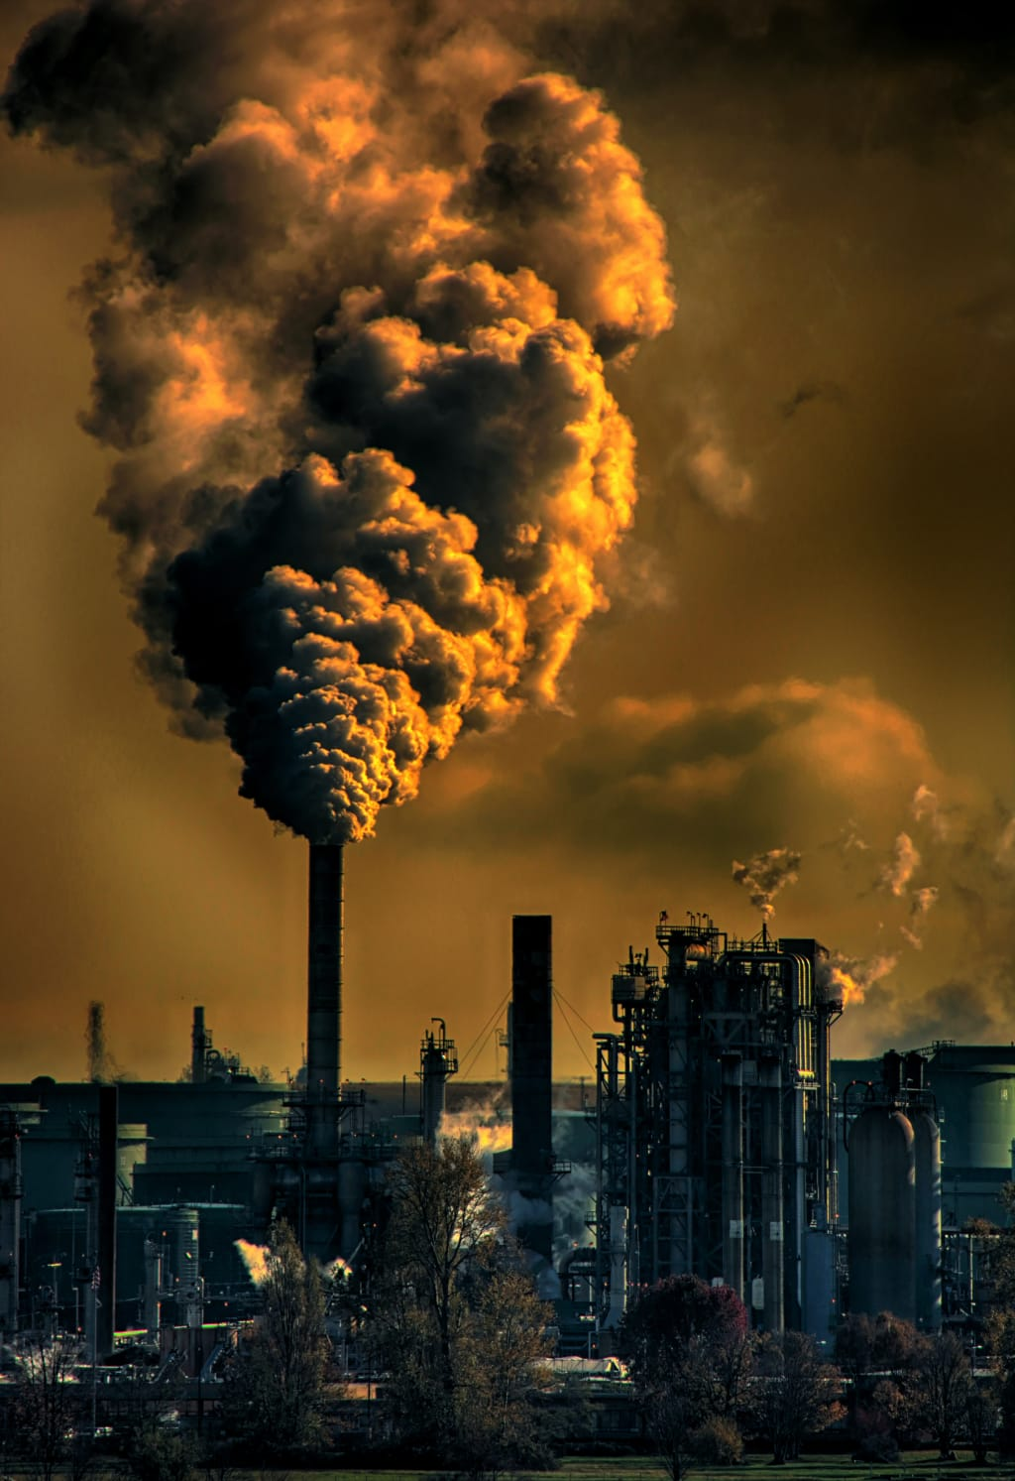
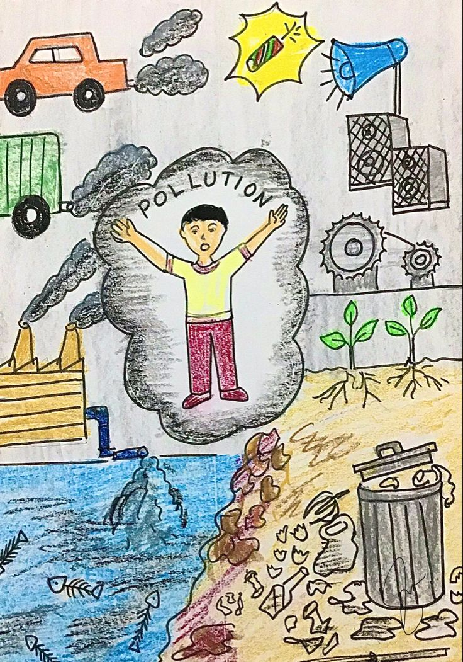
Problem Statement
Every day, a large amount of waste is discarded, leading to environmental pollution.
Traditional waste disposal methods are harmful to the earth and not sustainable.
There is a need for better ways to manage and repurpose waste.

Slide 4
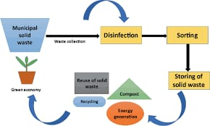
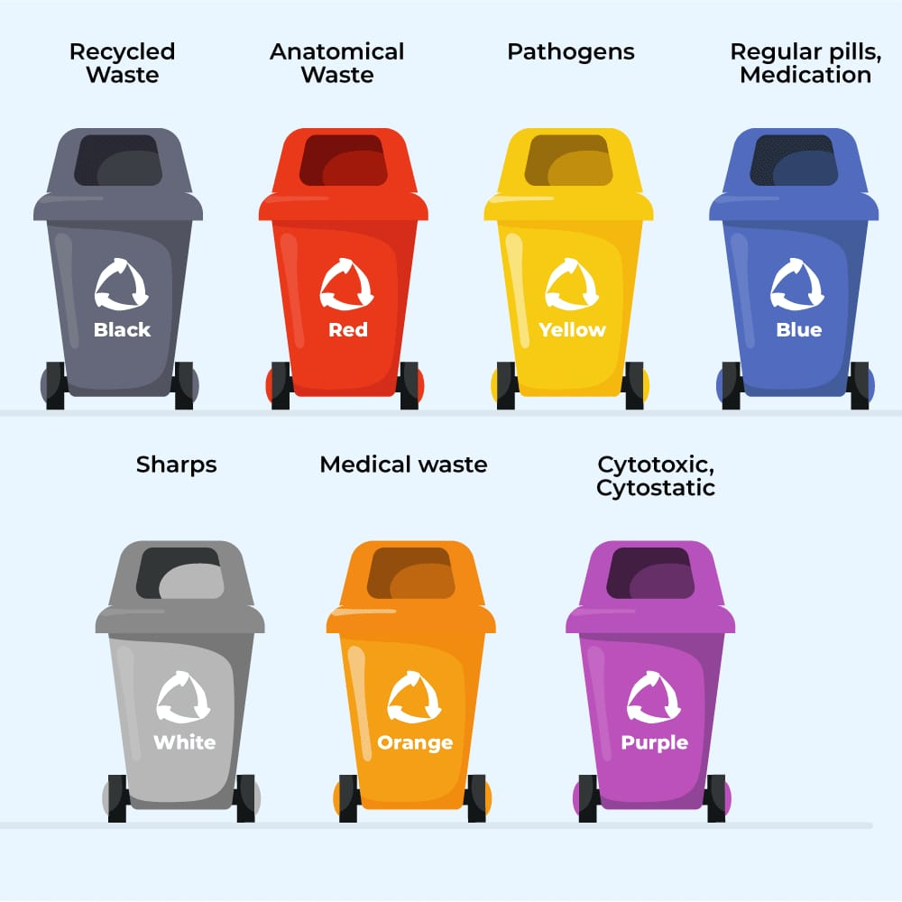
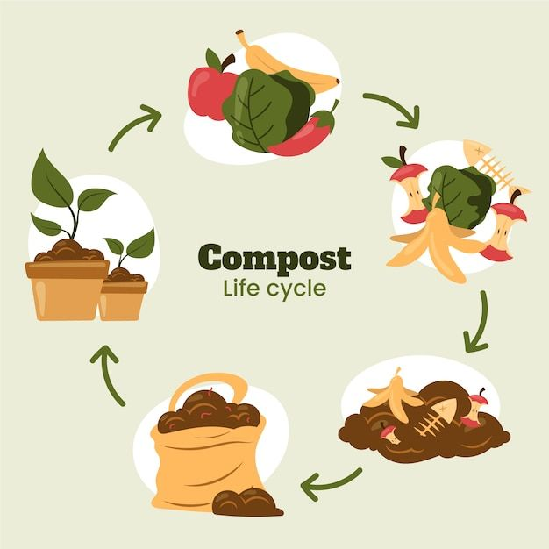
Project Objective
Our goal is to repurpose various types of waste, including organic and plastic materials.
We aim to create useful products like paper, bags, and compost from waste.
This process helps reduce waste and offers eco-friendly alternatives.

Slide 5

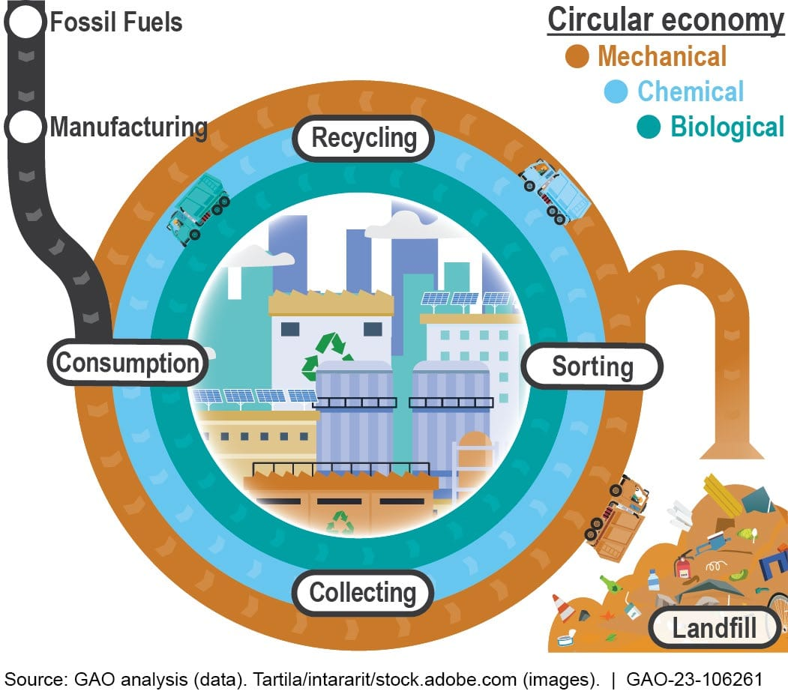
Methodology
Collect waste materials from different sources.
Process the waste to convert it into new products.

Slide 6
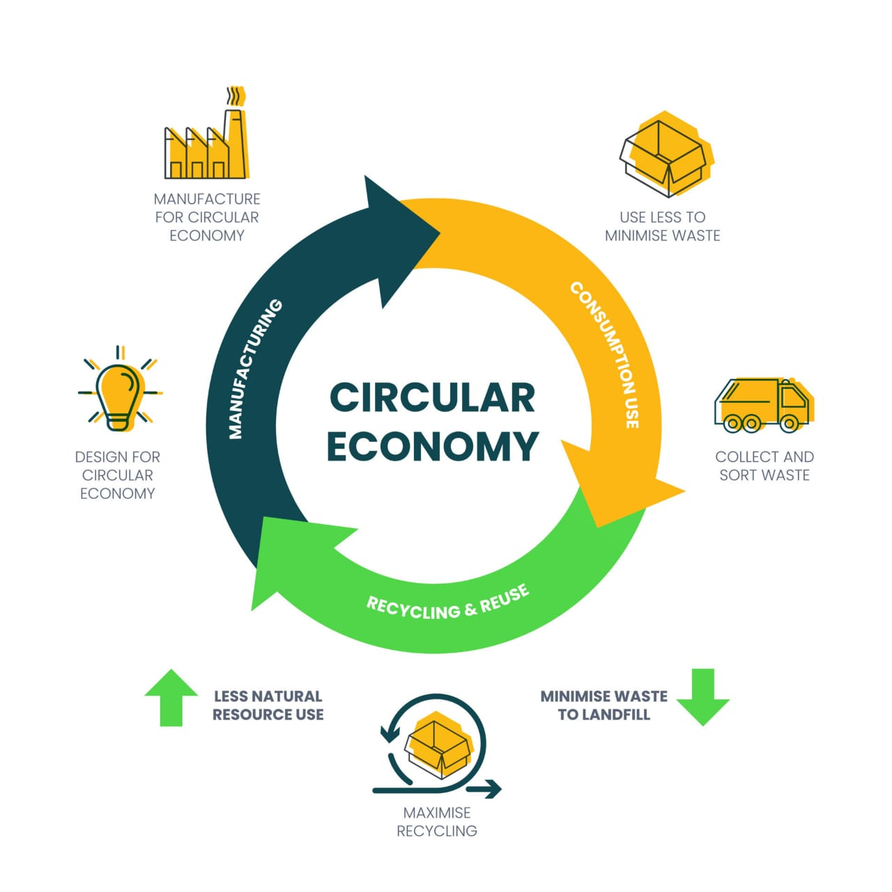
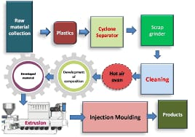
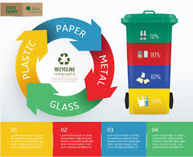
Benefits
Reduces environmental pollution by reusing waste.
Supports a circular economy where waste is valued as a resource.

Slide 7
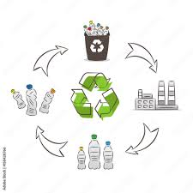

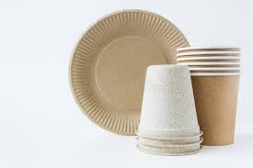
Product Examples
Organic Waste → Compost
Used Plastics → Recycled Bags
Various Wastes → New Products

Slide 8


Future Prospects
Develop new and innovative products from waste materials.
Aim to make waste a valuable resource for the future.

Slide 9







Website Overview
Used Languages :-
Software and Website Used :-

Slide 10
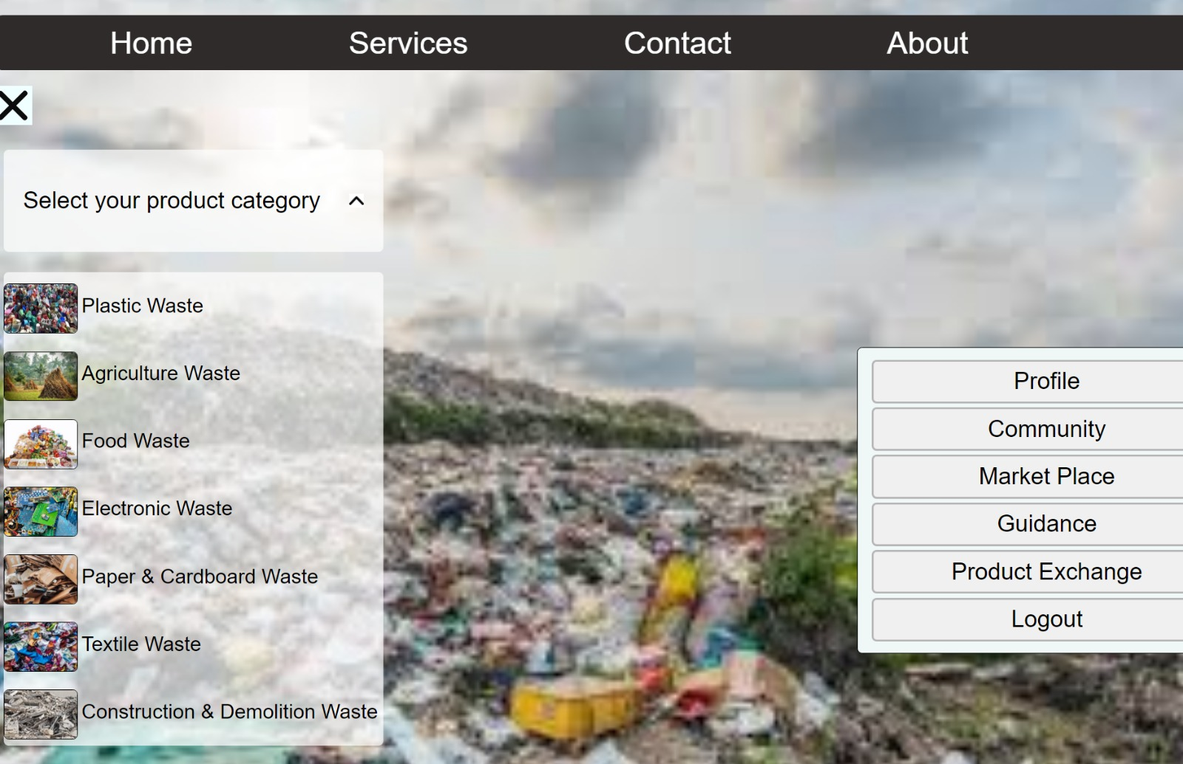
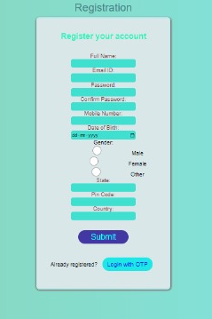
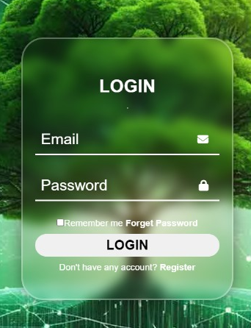
Website modules

Slide 11

Work in Website and Future Plans
Current Work
Future Plans
AI Camera :- Detects waste, Suggests recycling methods.

Slide 12


Conclusion
Turning waste into useful products helps create a cleaner, greener planet.

Slide 13
Thank You
Thank you for your attention!
Special thanks!
Er. Sandeep Kumar
(HOD of CSE)

