Slide 1

ASP.NET MVC TRAINING
By
SATISH RATHORE
ASHISH PEDNEKAR

Slide 2
TOPICS
Fundamentals of ASP.NET MVC
Routing
Layout and HTML Helpers
Client-Side Development
Action Method and Filters
Mobile Web Development
Logging
Security
Caching
Unit Testing
Going Live/ Deployment

Slide 3
What is MVC?
Model - Data, business rules, logic, etc.
View - Presentation layer, be it a chart, a table, an image gallery. The front end of things
Controller - The link between model and view, the commander-in-chief that takes signals and issues command.

Slide 4
MVC Version | Visual Studio | .Net Version | Release date | Features
MVC 1.0 | VS2008 | .Net 3.5 | 13-Mar-2009 | MVC architecture with webform engine Routing HTML Helpers Ajax Helpers Auto binding
MVC 2.0 | VS 2008, | .Net 3.5/4.0 | 10-Mar-2010 | Area Asynchronous controller Html helper methods with lambda expression DataAnnotations attributes Client side validation Custom template Scaffolding
MVC 3.0 | VS 2010 | .Net 4.0 | 13-Jan-2011 | Unobtrusive javascript validation Razor view engine Global filters Remote validation Dependency resolver for IoC ViewBag
MVC 4.0 | VS 2010 SP1, VS 2012 | .NET 4.0/4.5 | 15-Aug-2012 | Mobile project template Bundling and minification Support for Windows Azure SDK
MVC 5.0 | VS 2013/ | .NET 4.5 | 17-oct-2013 | Authentication filters Bootstrap support New scaffolding items ASP.Net Identity Attribute based routing
MVC 6 | VS 2015 | .NET 4.5.2 | 18-Nov-2015 | Can be run other hosts then IIS GruntJS, NPM, and Bower Support ASP.NET Dependency Injection Framework

Slide 5
Difference between ASP.NET and ASP.NET MVC
Asp.Net Web Forms | Asp.Net MVC
Asp.Net Web Form follow a traditional event driven development model. | Asp.Net MVC is a lightweight and follow MVC (Model, View, Controller) pattern based development model.
Asp.Net Web Form has server controls. | Asp.Net MVC has html helpers.
Asp.Net Web Form supports view state for state management at client side. | Asp.Net MVC does not support view state. Use viewbag,viewdata,tempdata
Asp.Net Web Form follows Web Forms Syntax | Asp.Net MVC follow customizable syntax (Razor as default)
Asp.Net Web Form has Master Pages for consistent look and feels. | Asp.Net MVC has Layouts for consistent look and feels.
Asp.Net Web Form is not Open Source. | Asp.Net Web MVC is an Open Source.

Slide 6
Advantages of ASP.NET MVC
Separation of concern/code
TDD
Extensible and pluggable
Full control over application behavior
ASP.NET features are supported
URL routing mechanism

Slide 7
Create First ASP.NET MVC Application:
Demo
ASP.NET Folder Structure

Slide 8
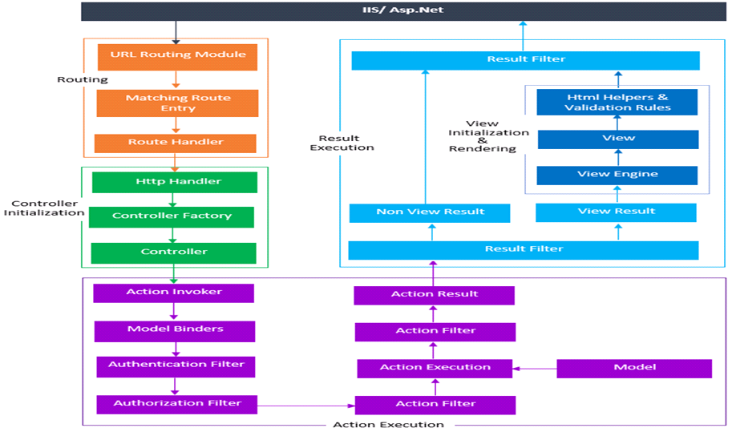
ASP.NET MVC PIPELINE

Slide 9
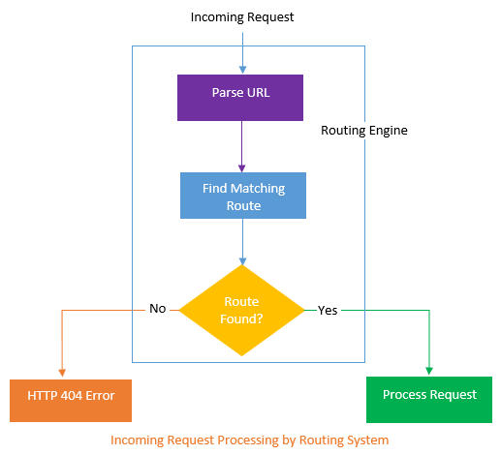
Routing in ASP.NET MVC

Slide 10
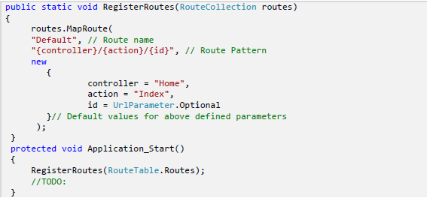
Define a route in ASP.NET MVC

Slide 11
Advanced Routing in ASP.NET MVC
URLs and SEO
Building Routes
Routing Order and Priority
Routing to Existing Files
Ignoring Routes
Catch-All Routes

Slide 12
Layout in ASP.NET MVC
What is Layout ?
Return Layout from Action Result
Control Layouts rendering by using _Viewstart file in the root directory of the views folder

Slide 13
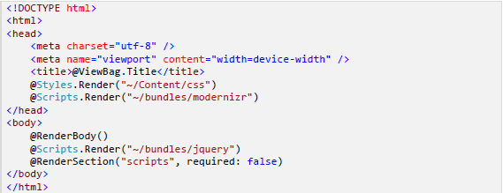
Layouts Example in ASP.NET MVC

Slide 14

Sections in ASP.NET MVC
You can render above defined section header on the content page as given below:

Slide 15
Helpers in ASP.NET MVC
HTML HELPERS IN MVC
Built-In Html Helpers
      Standard Html Helpers
      Strongly Typed HTML Helpers
      Templated HTML Helpers
Inline Html Helpers
URL HELPERS IN MVC
04.04.16 SATISH AND ASHISH

Slide 16
Partial View in ASP.NET MVC
What is a Partial View?
Different ways of rendering a Partial View in ASP.NET MVC
1. Html.RenderPartial
@{Html.RenderPartial(“_Comments”);}
2. Html.Partial
@Html.Partial(“_Comments”)
04.04.16 SATISH AND ASHISH

Slide 17
Client Side Development in ASP.NET MVC
Data annotation - Demo.
Unobtrusive Validation – Demo.

Slide 18
What is bundling and minification ?
Advantage of bundling and minification .
Bundling and Minification in ASP.NET MVC

Slide 19
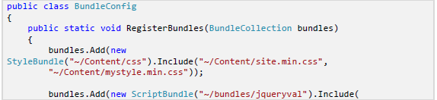

Bundling and Minification configuration in ASP.NET MVC

Slide 20

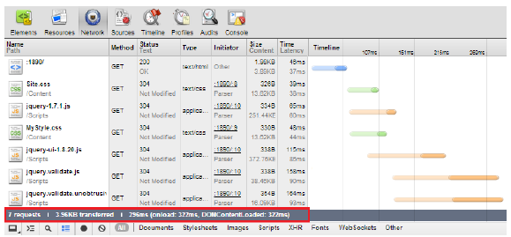
CSS and JS files Without Bundling and Minification
04.04.16 SATISH AND ASHISH

Slide 21
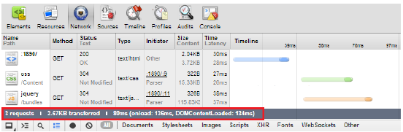
CSS and JS files with Bundling and Minification

Slide 22
Action Method in ASP.NET MVC
ActionResult
ViewResultBase
PartialView
RedirectResult
ContentResult
JsonResult
JavaScriptResult
FileResult
EmptyResult

Slide 23
Filters in ASP.NET MVC
ASP.NET MVC Filters and Attributes
Different types of Filters in ASP.NET MVC
1. Authentication Filters
2. Authorization Filters
3. Action Filters
4. Result Filters
5. Exception Filters
Order of execution of filters in ASP.NET MVC

Slide 24

Caching in ASP.NET MVC
What is caching and when to use it
Output
04.04.16 SATISH AND ASHISH

Slide 25
Logging in ASP.NET MVC
What is HandleError?
How to handle error in the MVC Application?
How to handle 404 Error in MVC
How to Logs the error in the MVC?

Slide 26
Unit Testing in ASP.NET MVC
Very basic definition will be, testing of every smallest testable block of a code in an automated manner.
Code Demonstration
Testing for ViewResult
Testing of ViewData/ ViewBag
Testing For RedirectResult

Slide 27
Security in ASP.NET MVC
Authentication of the user
Page access control where you can decide what pages the user can open depending on his role or access rights
Preventing security attacks

Slide 28
Going Live and Deployment :
Demo

Slide 29
Github Repo link (source code)
https://github.com/SatishRathore/MVC-Training

Slide 30


