Slide 1
Customer scenario
Let’s take a look at the customer scenario: "Our security team is asking for help ensuring proper reviews are being done to code being added into our repositories. We have hundreds of repositories in our organization. What is the best way we can achieve at scale? We are new to some of the out-of-the-box settings and the GitHub API. Can you please help us create a solution that will accomplish this for our security team?"

Slide 2
High-Level Solution Summary
Customer should leverage GitHub advance security features, along with some of other best practices
Code Security configuration would help with Secret scanning and also blocking commits by Push Protection
Code scanning with CodeQL default configuration automatically detects vulnerabilities and coding errors
Dependency graph would give details about vulnerabilities with dependencies and also auto remediation by security updates.
Private vulnerability reporting: Allow your community to privately report potential security vulnerabilities in public repositories
GitHub API and webhook to leverage alerts integration
Repository Rulesets for enforcing Branch protection
Organization Team and events for notifying team or individual about code review

Slide 3
GitHub Advanced Security features has below solutions for challenges faced by customer
Repository Security
Private repositories: Host code that you don't want to share with the world in private GitHub repositories only accessible to you and people you share them with.
Repository rules Elevate your organization's security with source code protections that scale. Rule insights make it easy to review how and why code changed in your repositories.
Code scanning: Secure code as you write it. Automatically review every change to your codebase and identify vulnerabilities before they reach production.
Secret scanning: Automatically detect and deactivate secrets committed to your repos. Receives alerts when secrets or keys are checked in and defines custom patterns.
Dependency review: Shows the full effect of changes to dependencies and sees details of any vulnerable versions before you merge a pull request.
GitHub Advisory Database Browse or search for the vulnerabilities that GitHub knows about. The database contains all curated CVEs and security advisories on the GitHub dependency graph.

Slide 4
Security built into the Developer Lifecycle
Benefits of Organization level Code Security configuration
Dependency graph: Display license information and vulnerability severity for your dependencies. Always enabled for public repositories.
Dependabot: Receive alerts for vulnerabilities that affect your dependencies
Security updates: Allow Dependabot to open pull requests automatically to resolve alerts
Code scanning: Receive alerts for automatically detected vulnerabilities and coding errors using CodeQL default configuration
Secret scanning: Receive alerts for detected secrets, keys, or other tokens
Push protection: Block commits that contain supported secrets
Private vulnerability reporting: Allow your community to privately report potential security vulnerabilities in public repositories

Slide 5
GitHub API and Security Alerts
Code Scanning Alerts:
CodeQL Analysis Alerts: Generated by CodeQL, GitHub's semantic code analysis engine, these alerts identify potential security vulnerabilities in the codebase. They cover a wide range of issues, including but not limited to SQL injection, cross-site scripting, and other code vulnerabilities.
Secret Scanning Alerts:
These alerts are triggered when potentially sensitive information, such as API keys or credentials, is identified within the repository's source code.
Dependency Alerts:
Dependabot automatically detects outdated dependencies in a project and creates pull requests to update them to the latest, secure versions.
Security Overview Alerts:
The Security Overview provides a comprehensive dashboard summarizing the security status of the repository.
Third Party Alerts:
Integrate third-party code analysis tools with GitHub code scanning by uploading data as SARIF files.

Slide 6
GitHub Security Overview
Dependabot
Code scanning
Secret scanning
CodeQL
Integrating with code scanning
GitHub security features
About GitHub Advanced Security
About code scanning
About secret scanning
About dependency review
About security overview
Enabling or disabling a feature for all existing repositories
Enabling GitHub Advanced Security for your enterprise
Enforcing a policy for the use of GitHub Advanced Security in your enterprise
Adding a security policy to your repository
REST API
GraphQL API
Automatic token authentication

Slide 7
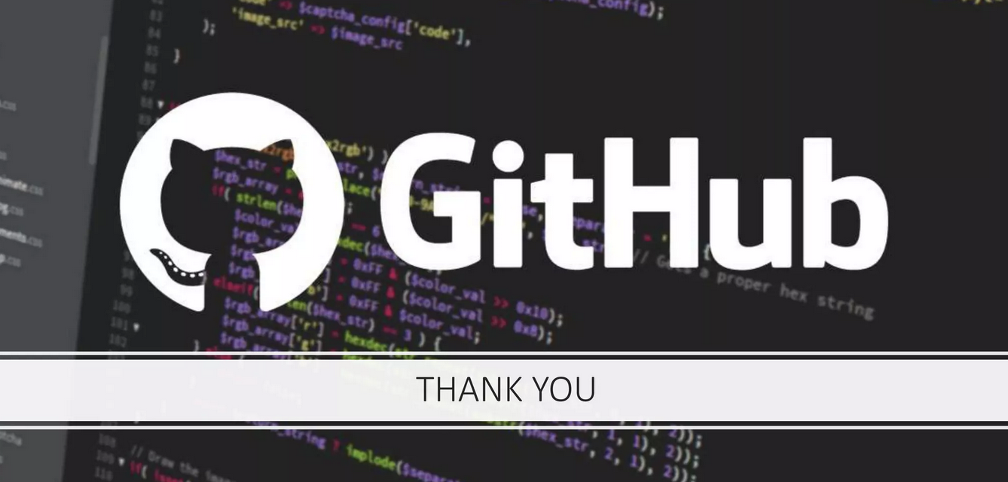

Slide 8
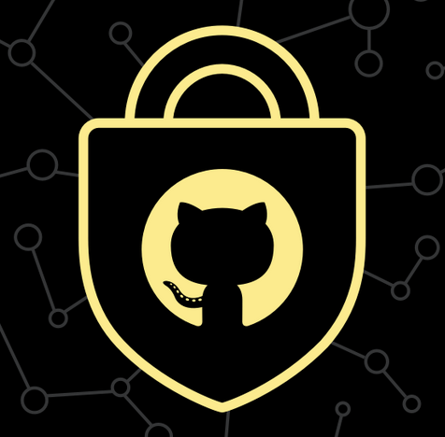


The GitHub Advanced Security features
Secret scanning: Automatically detect and deactivate secrets committed to your repos. Receives alerts when secrets or keys are checked in and defines custom patterns.
Code scanning: Secure code as you write it. Automatically review every change to your codebase and identify vulnerabilities before they reach production.
Dependency review: Shows the full effect of changes to dependencies and sees details of any vulnerable versions before you merge a pull request.

Slide 9
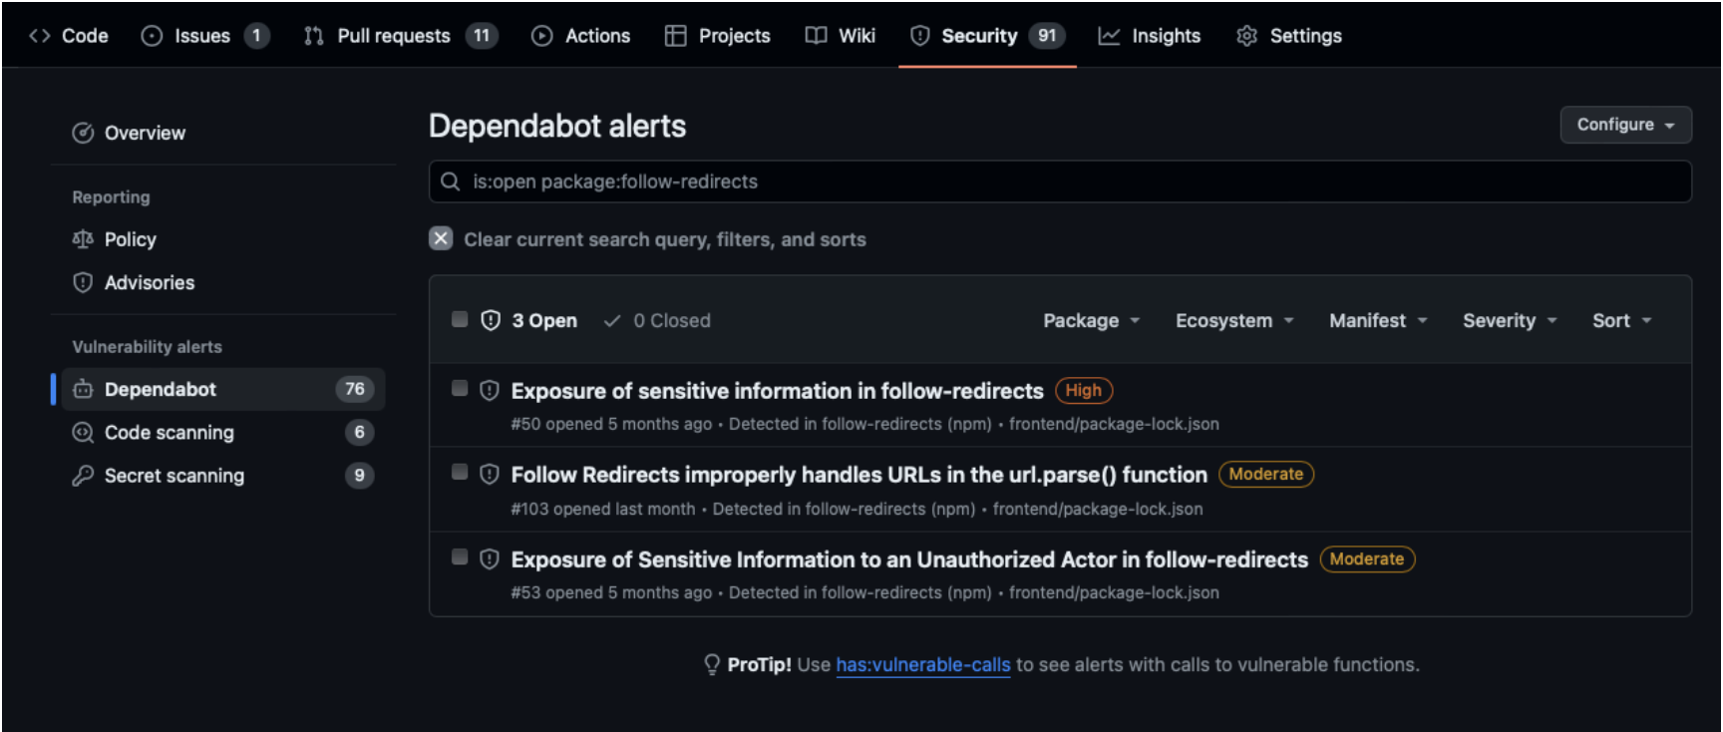
Security Overview: Reviews the security configuration and alerts for an organization and identifies the repositories at greatest risk.

Slide 10
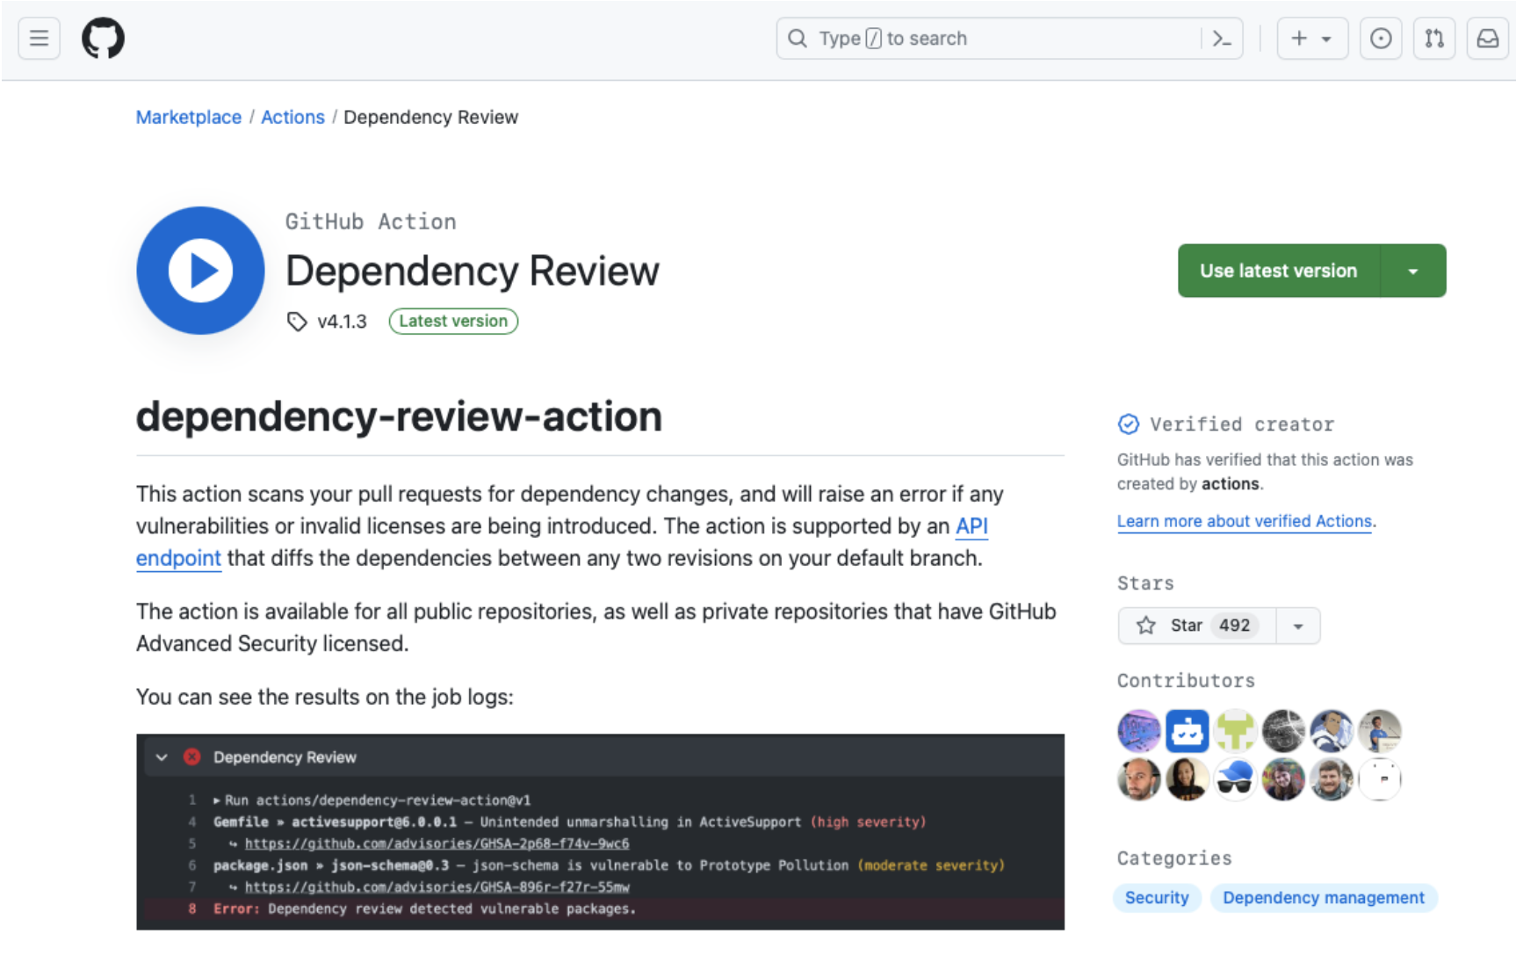
If you're already familiar with GitHub Actions, another approach to start with dependency review is through the GitHub marketplace. From here, you can learn what the dependency-review-action workflow does and copy sample code to use in your project.
Dependency review

Slide 11
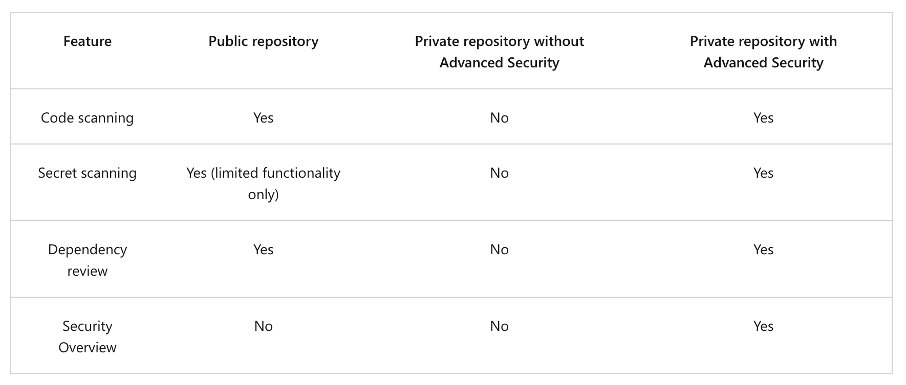
The GitHub Advanced Security features

