Slide 1
ELLM – Session – 7
Foundations of Language Models
Statistical Language Models - n-Gram
Neural Language Models - RNN, LSTM, GRU
Sequence-to-Sequence Evolution
Transformer Models

Slide 2
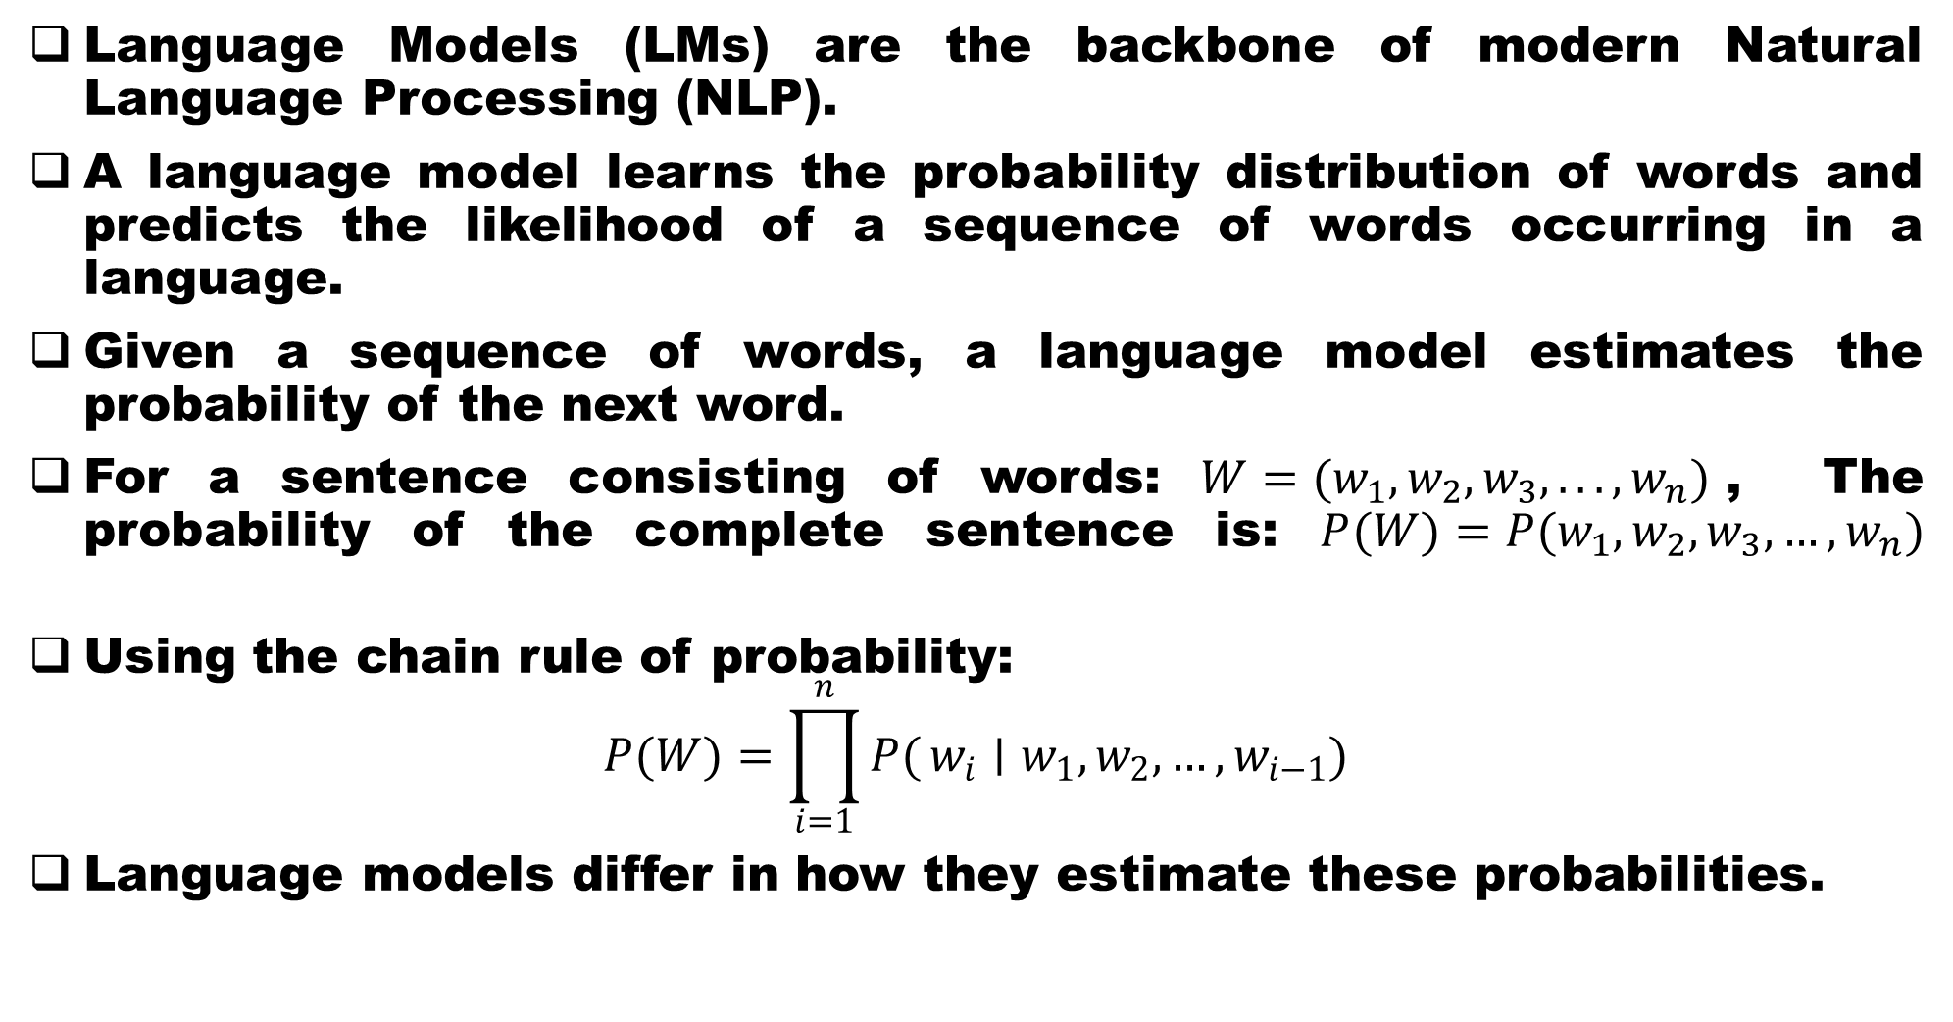
Foundations of Language Models
Language Models (LMs) are the backbone of modern Natural Language Processing (NLP).
A language model learns the probability distribution of words and predicts the likelihood of a sequence of words occurring in a language.
Given a sequence of words, a language model estimates the probability of the next word.
For a sentence consisting of words: $W=(w_{1},w_{2},w_{3},...,w_{n})$, The probability of the complete sentence is: $P(W)=P(w_{1},w_{2},w_{3},…,w_{n})$
Using the chain rule of probability:
$$P(W)=\prod_{i=1}^{n}{P(}w_{i}∣w_{1},w_{2},…,w_{i−1})$$
Language models differ in how they estimate these probabilities.

Slide 3
Types of Langage Models
Statistical Language Models
Neural Language Models
Sequence-to-Sequence Models
Attention Models
Transformer models

Slide 5
Statistical Language Models - n-gram
Statistical Language Models estimate word probabilities based on statistical occurrences in large text corpora.
An n-gram is a sequence of n consecutive words.
Examples: Sentence: "I love natural language processing"
Unigram (n=1): [I], [love], [natural], [language], [processing]
Bigram (n=2): [ I love], [love natural]
Trigram (n=3): [ I love Natural]

Slide 6
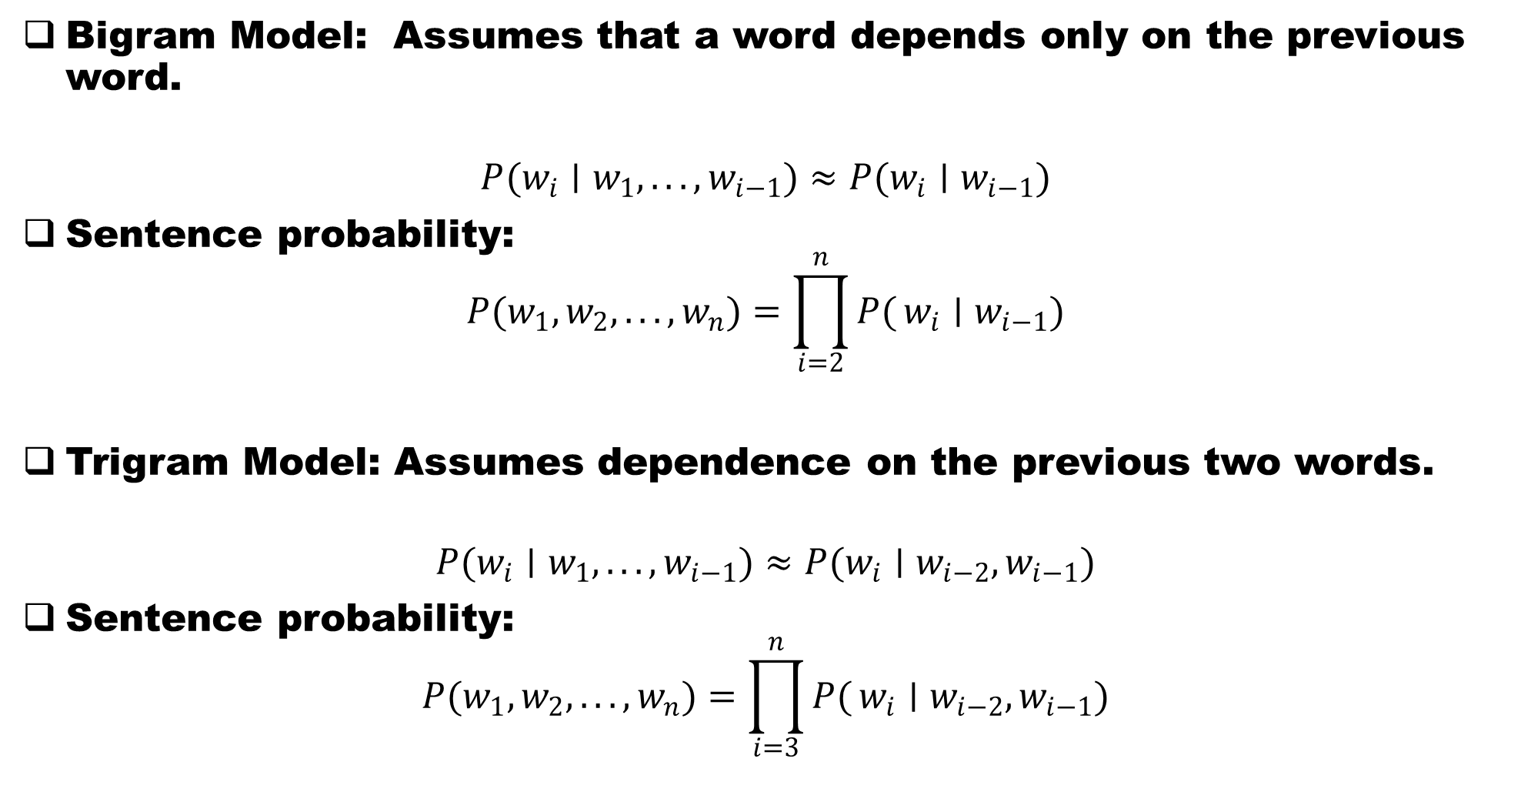
Estimating the probabilities of grams
Bigram Model: Assumes that a word depends only on the previous word.
$$P(w_{i}∣w_{1},...,w_{i−1})≈P(w_{i}∣w_{i−1})$$
Sentence probability:
$$P(w_{1},w_{2},...,w_{n})=\prod_{i=2}^{n}{P(}w_{i}∣w_{i−1})$$
Trigram Model: Assumes dependence on the previous two words.
$$P(w_{i}∣w_{1},...,w_{i−1})≈P(w_{i}∣w_{i−2},w_{i−1})$$
Sentence probability:
$$P(w_{1},w_{2},...,w_{n})=\prod_{i=3}^{n}{P(}w_{i}∣w_{i−2},w_{i−1})$$

Slide 7
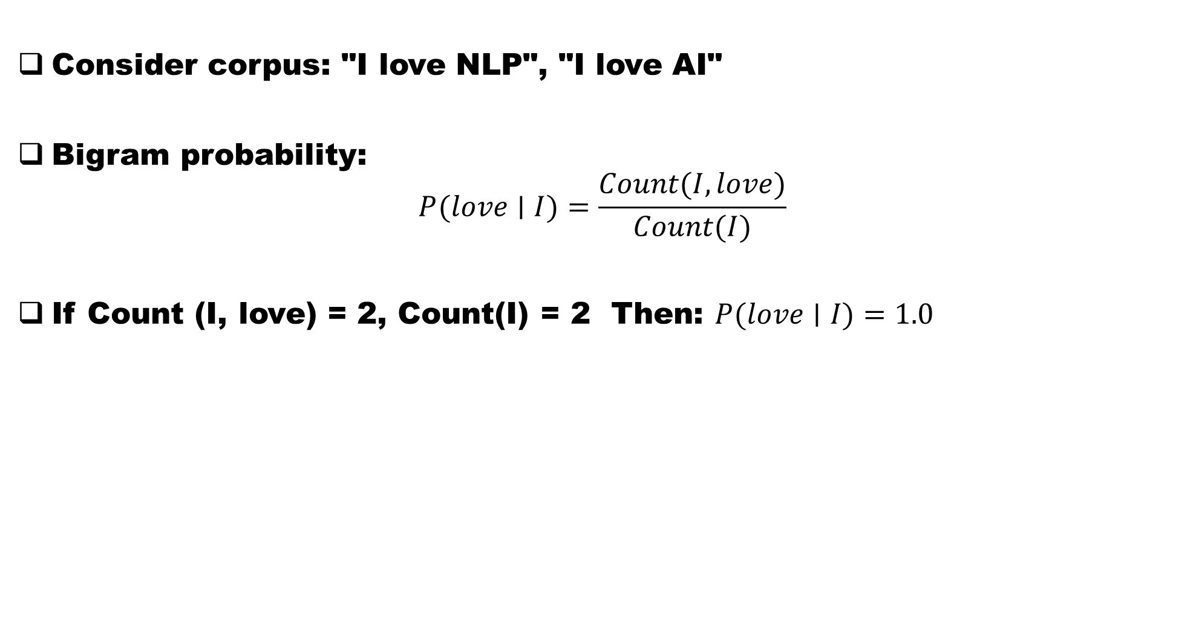
Estimating the probabilities of n-grams
Consider corpus: "I love NLP", "I love AI"
Bigram probability:
$$P(love∣I)=\frac{Count(I,love)}{Count(I)}$$
If Count (I, love) = 2, Count(I) = 2 Then: $P(love∣I)=1.0$

Slide 8
n-grams Advantages and Limitations
Advantages: Easy to understand: Fast computation, Works well on small datasets, Requires no deep learning
Limitations:
Data Sparsity: Many word combinations never appear in training, such as "Artificial intelligence revolution", which may never occur.
Fixed Context Window: Bigram sees only one previous word.
Example: "The animal didn't cross the road because it was tired.", Bigram cannot identify what "it" refers to.
For a large n, Vocabulary Explosion is extremely large
The probability of a set of words may be zero, requiring the implementation of smoothing

Slide 9
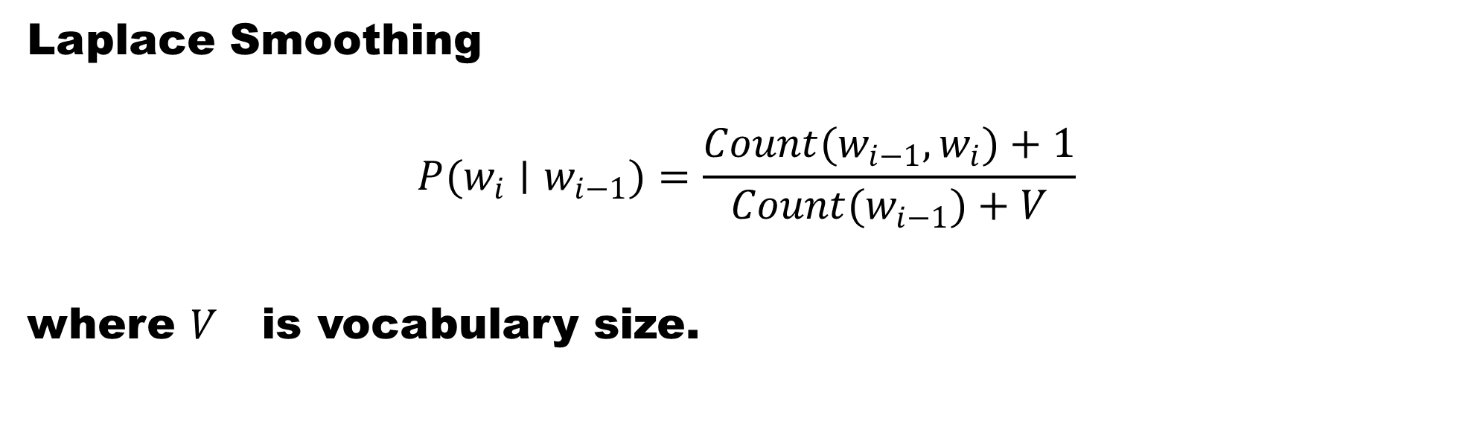
Smoothing through Laplace Transfermation
Laplace Smoothing
$$P(w_{i}∣w_{i−1})=\frac{Count(w_{i−1},w_{i})+1}{Count(w_{i−1})+V}$$
where $V$ is vocabulary size.

Slide 10
Neural Language Models
Neural Language Models use neural networks to automatically learn word representations and language patterns.
Advantages: Learn semantic relationships, handle unseen combinations better, generalise effectively, and reduce sparsity issues
The frequently used models include RNN, LSTM and GRU

Slide 11
RNN Models
RNNs were the first successful neural language models designed for sequential data.
Motivation: Words in a sentence depend on previous words.
Example: "The sun rises in the ____”, Prediction depends on preceding words.

Slide 12
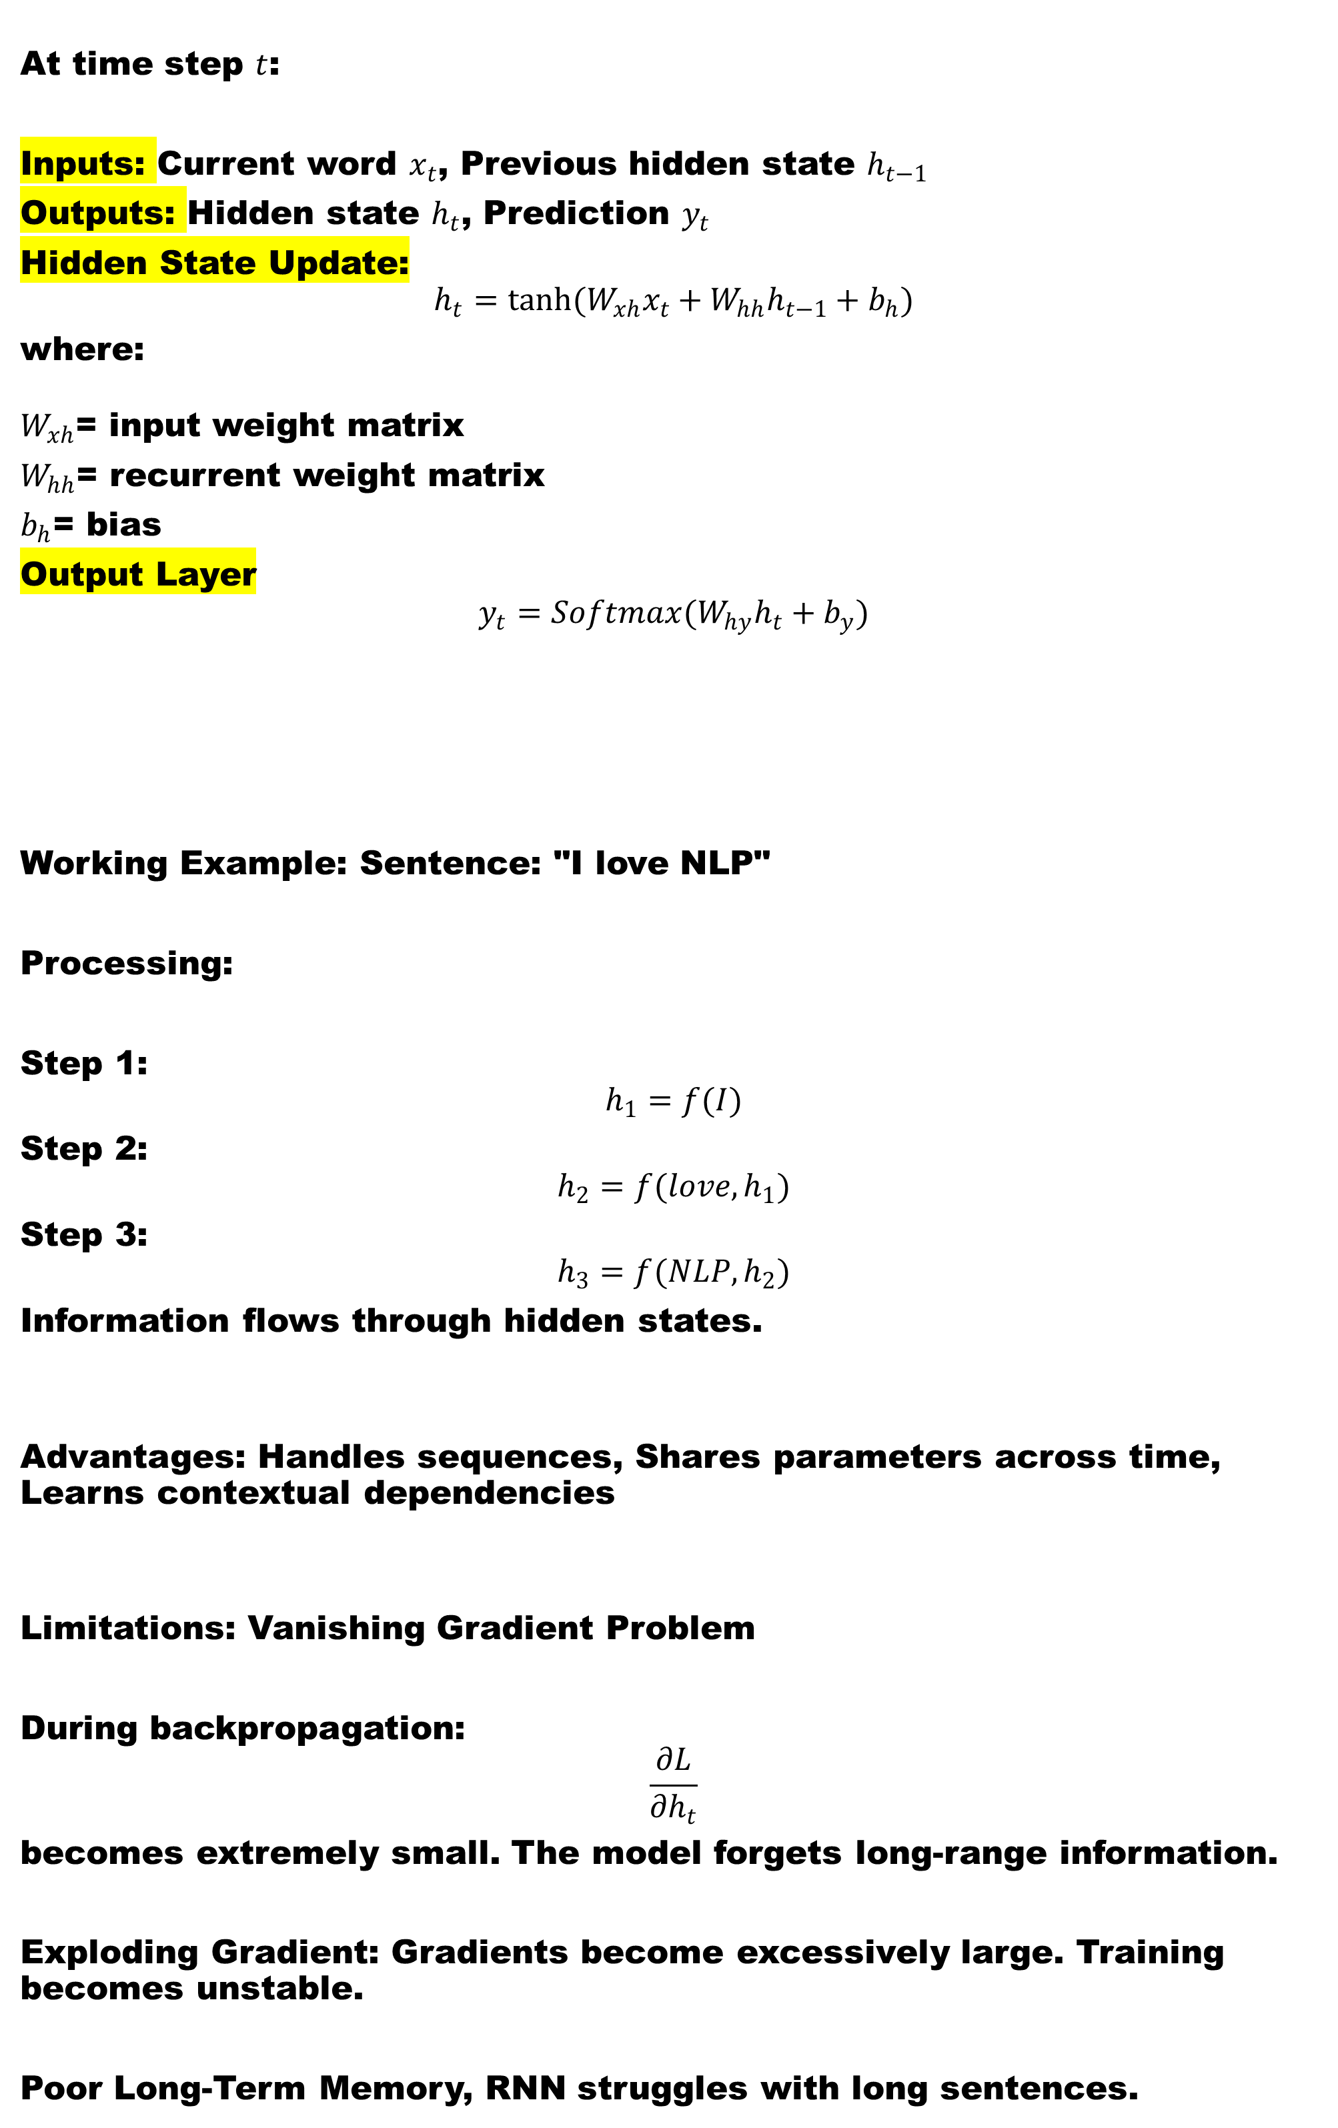
RNN Architecture description
At time step $t$:
Inputs: Current word $x_{t}$, Previous hidden state $h_{t−1}$
Outputs: Hidden state $h_{t}$, Prediction $y_{t}$
Hidden State Update:
$$h_{t}=tanh(W_{xh}x_{t}+W_{hh}h_{t−1}+b_{h})$$
where:
$W_{xh}$= input weight matrix
$W_{hh}$= recurrent weight matrix
$b_{h}$= bias
Output Layer
$$y_{t}=Softmax(W_{hy}h_{t}+b_{y})$$
Working Example: Sentence: "I love NLP"
Processing:
Step 1:
$$h_{1}=f(I)$$
Step 2:
$$h_{2}=f(love,h_{1})$$
Step 3:
$$h_{3}=f(NLP,h_{2})$$
Information flows through hidden states.
Advantages: Handles sequences, Shares parameters across time, Learns contextual dependencies
Limitations: Vanishing Gradient Problem
During backpropagation:
$$\frac{∂L}{∂h_{t}}$$
becomes extremely small. The model forgets long-range information.
Exploding Gradient: Gradients become excessively large. Training becomes unstable.
Poor Long-Term Memory, RNN struggles with long sentences.

Slide 13
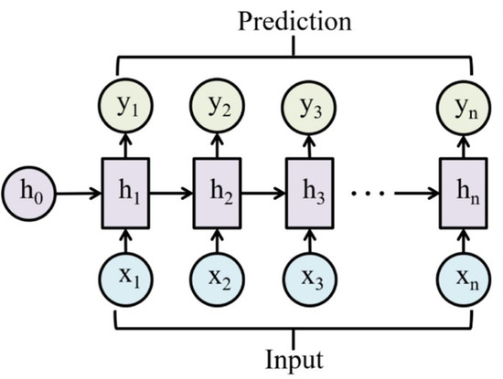

Slide 14
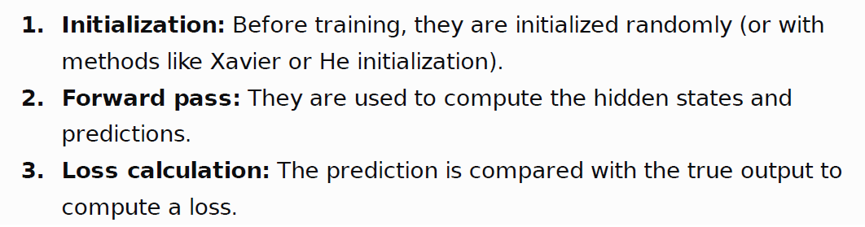
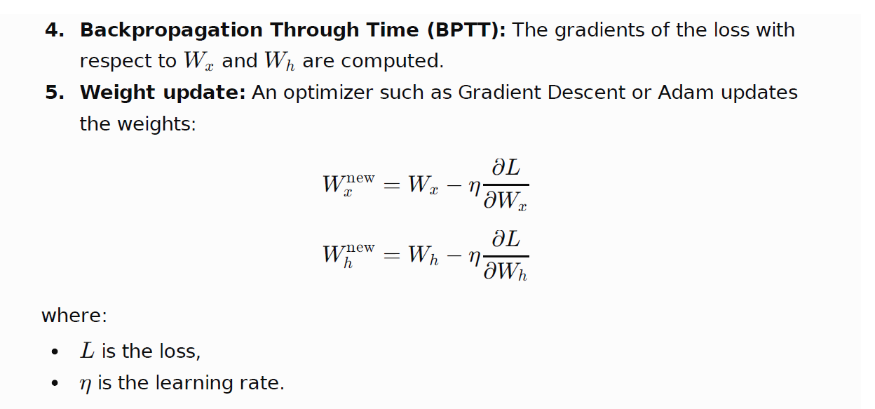

Slide 15
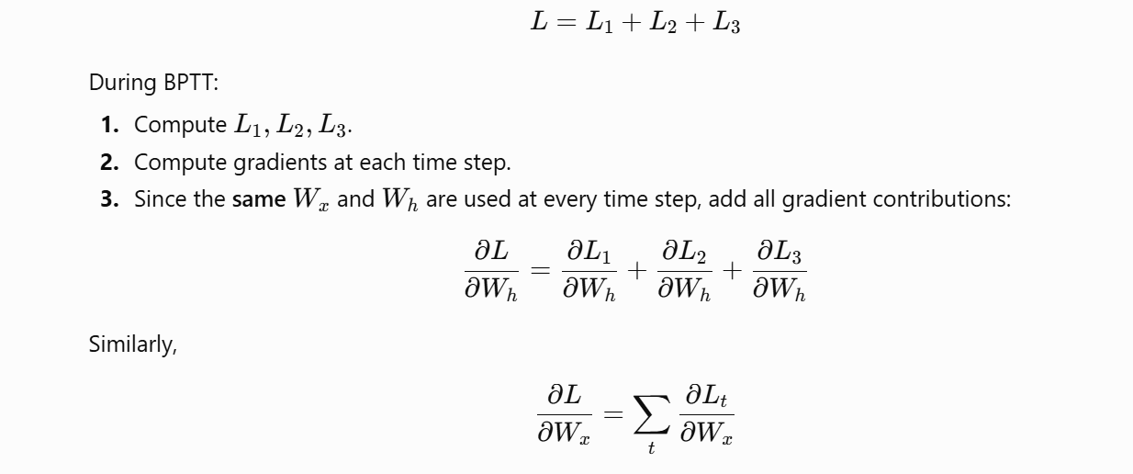

Slide 16
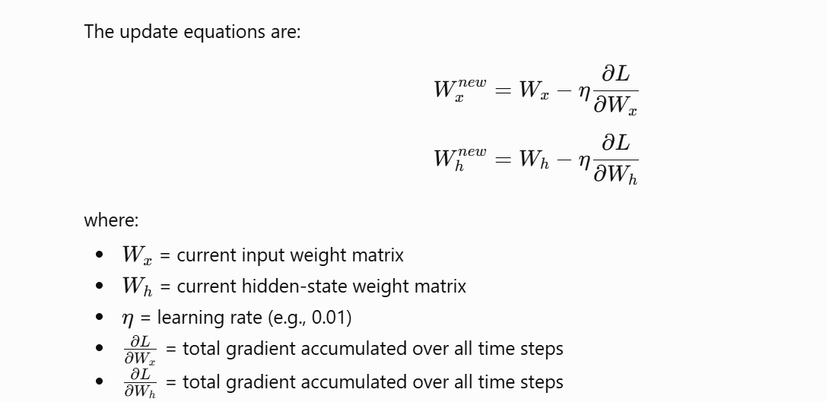

Slide 17
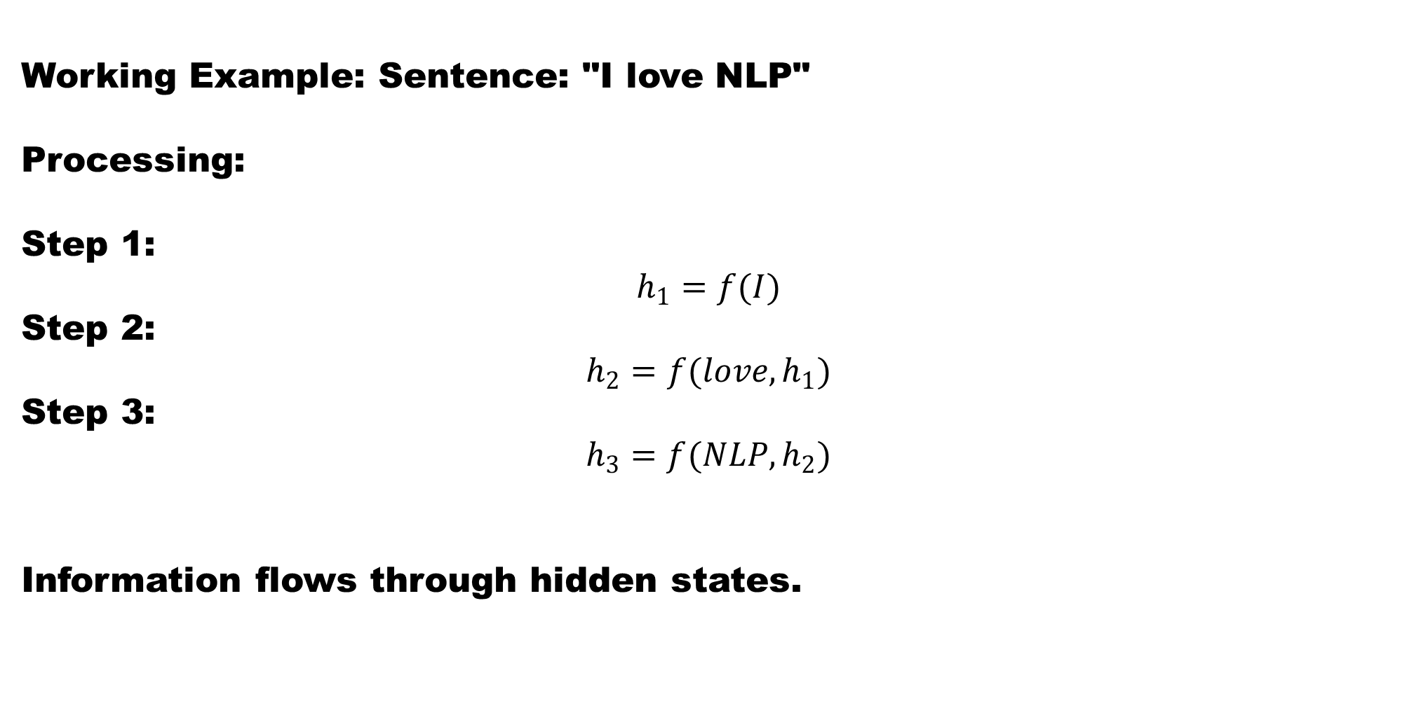
RNN Architecture Example
Working Example: Sentence: "I love NLP"
Processing:
Step 1:
$$h_{1}=f(I)$$
Step 2:
$$h_{2}=f(love,h_{1})$$
Step 3:
$$h_{3}=f(NLP,h_{2})$$
Information flows through hidden states.

Slide 18
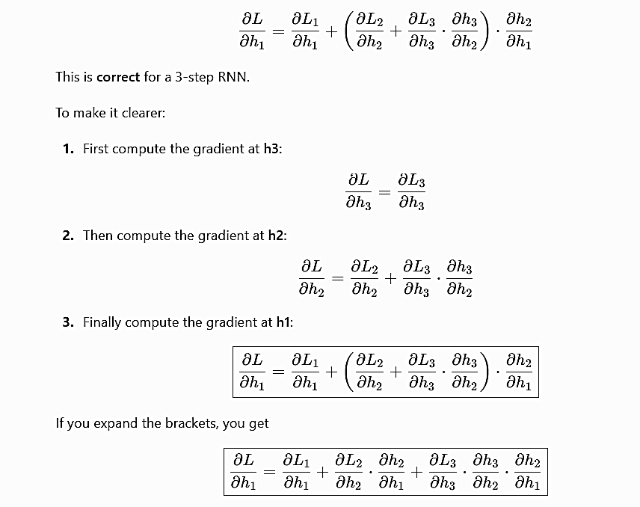

Slide 19
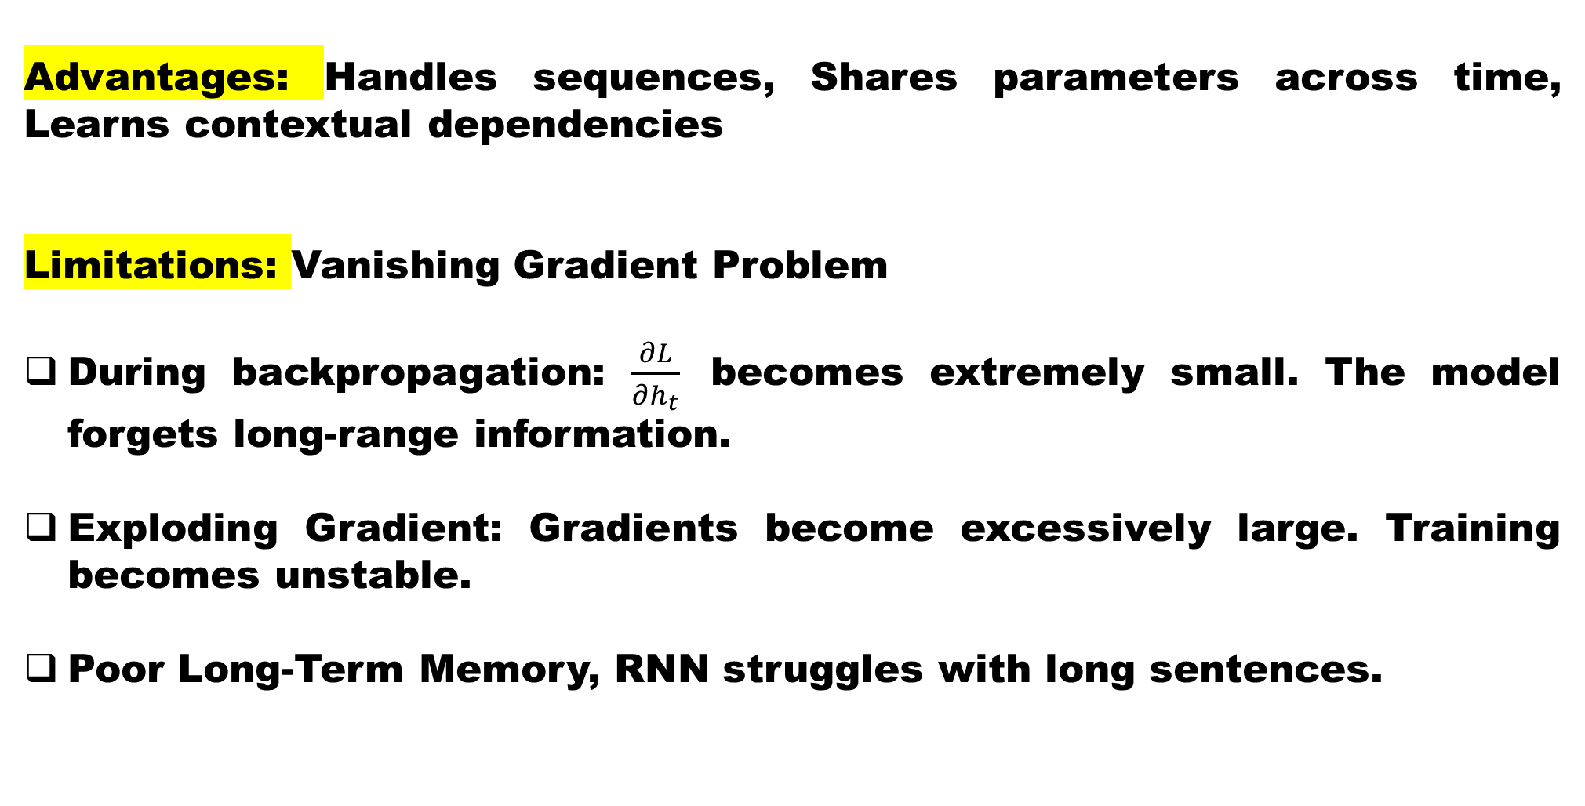
RNN Advantages and Limitations
Advantages: Handles sequences, Shares parameters across time, Learns contextual dependencies
Limitations: Vanishing Gradient Problem
During backpropagation: $\frac{∂L}{∂h_{t}}$ becomes extremely small. The model forgets long-range information.
Exploding Gradient: Gradients become excessively large. Training becomes unstable.
Poor Long-Term Memory, RNN struggles with long sentences.

Slide 20
Long Short-Term Memory (LSTM)
LSTM was introduced by Sepp Hochreiter and Jürgen Schmidhuber (1997). LSTM solves the long-term dependency problem.
Core Idea: Maintain a memory cell: c_t that carries information across long sequences.

Slide 21
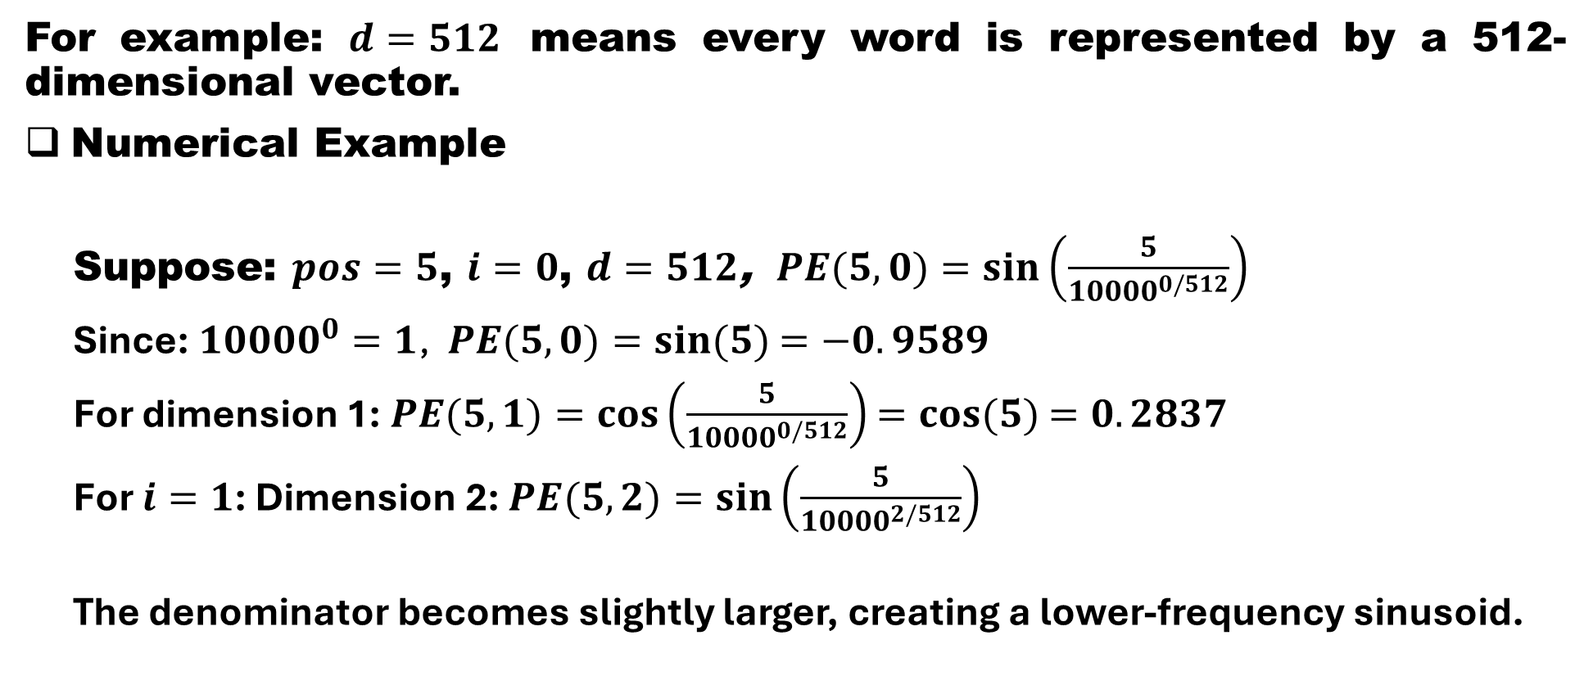
Long Short-Term Memory (LSTM) - Architecture

Slide 22
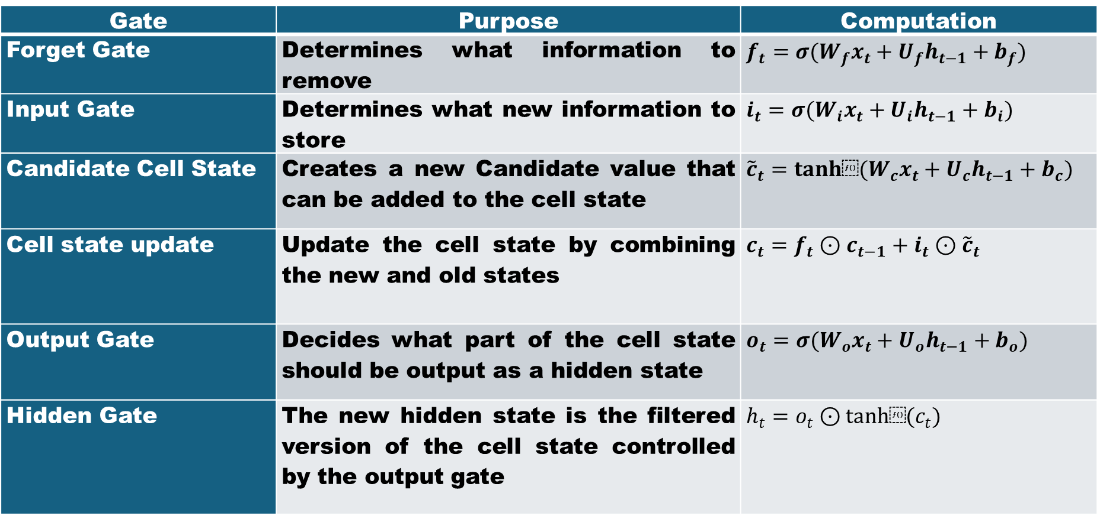
LSTM Components: Forget Gate, Input Gate, Cell State, Output Gate
Gate | Purpose | Computation
Forget Gate | Determines what information to remove | $$f_{t}=σ(W_{f}x_{t}+U_{f}h_{t−1}+b_{f})$$
Input Gate | Determines what new information to store | $$i_{t}=σ(W_{i}x_{t}+U_{i}h_{t−1}+b_{i})$$
Candidate Cell State | Creates a new Candidate value that can be added to the cell state | $${\tilde{c}}_{t}=tanh⁡(W_{c}x_{t}+U_{c}h_{t−1}+b_{c})$$
Cell state update | Update the cell state by combining the new and old states | $$c_{t}=f_{t}⊙c_{t−1}+i_{t}⊙{\tilde{c}}_{t}$$
Output Gate | Decides what part of the cell state should be output as a hidden state | $$o_{t}=σ(W_{o}x_{t}+U_{o}h_{t−1}+b_{o})$$
Hidden Gate | The new hidden state is the filtered version of the cell state controlled by the output gate | $$h_{t}=o_{t}⊙tanh⁡(c_{t})$$

Slide 23
Long Short-Term Memory (LSTM) –
Advantages and Limitations
Advantages: Learns long-range dependencies, Solves vanishing gradient problem, Excellent for sequence modelling
Limitations: Large parameter count, Slow training, Sequential computation

Slide 24
GRU (Gated Recurrent Unit)
(GRU is often what is meant in language-model evolution; GRU was introduced by Kyunghyun Cho and colleagues. GRU simplifies LSTM while maintaining performance.
GRU Architecture Contains: Update Gate and Reset Gate

Slide 25
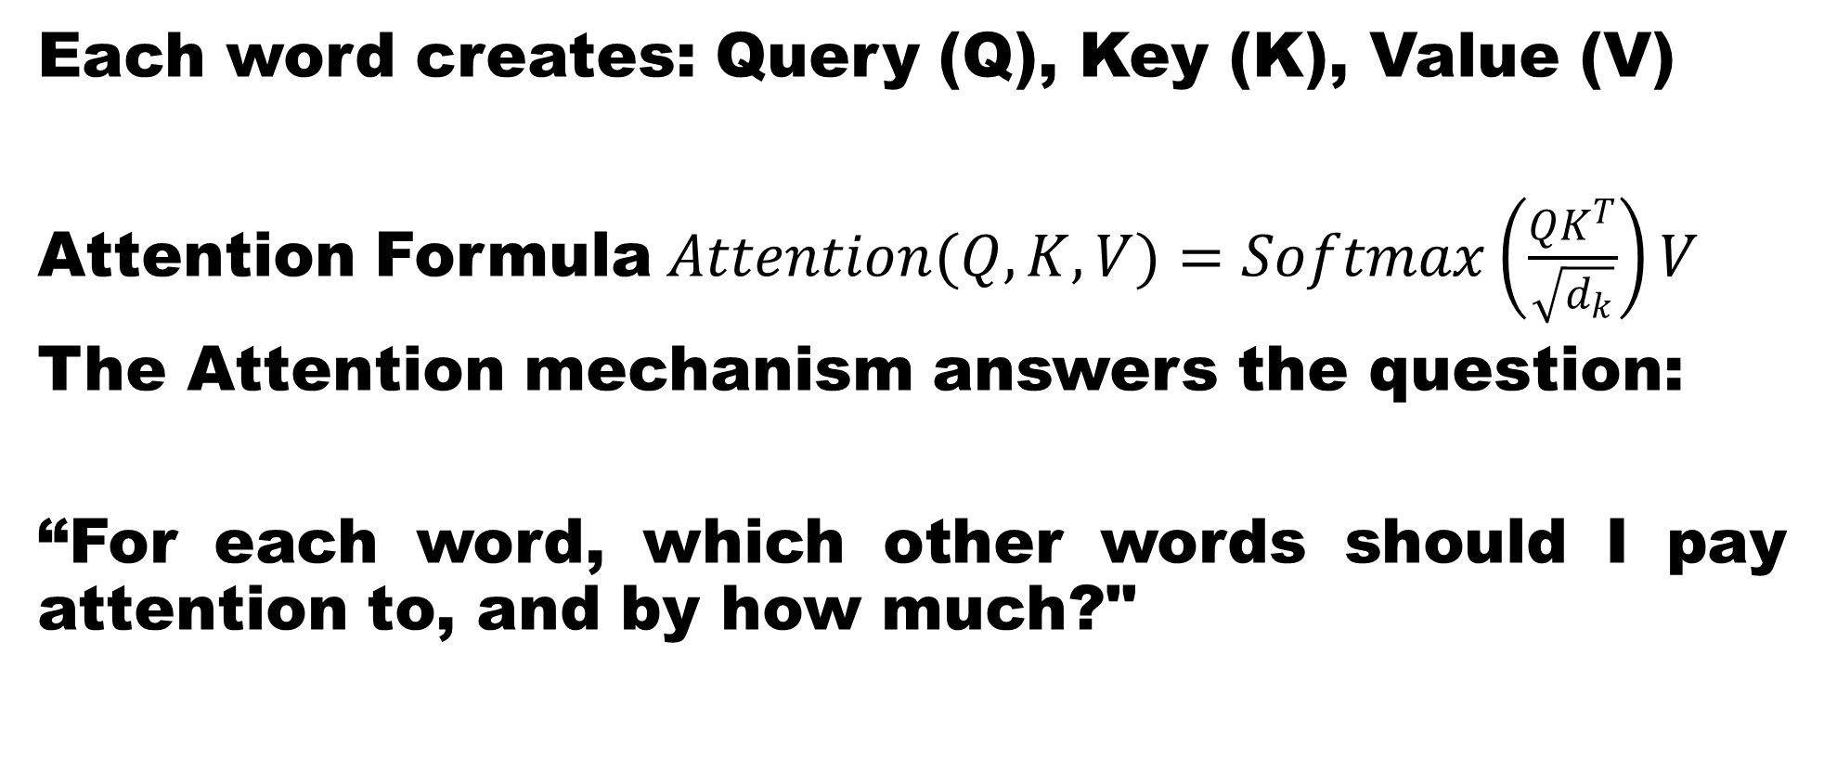
GRU (Gated Recurrent Unit) - Architecture

Slide 26
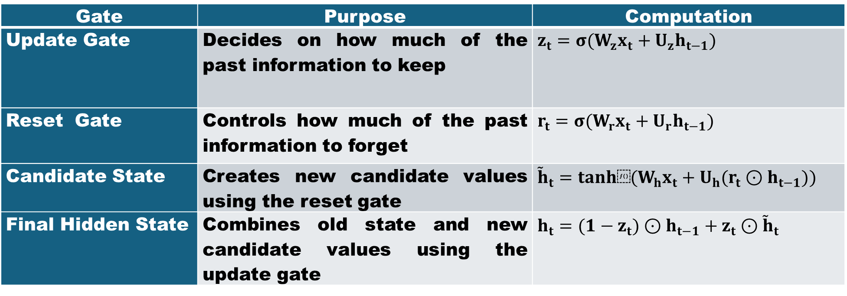
GRU – Components
Gate | Purpose | Computation
Update Gate | Decides on how much of the past information to keep | $$z_{t}=σ(W_{z}x_{t}+U_{z}h_{t−1})$$
Reset Gate | Controls how much of the past information to forget | $$r_{t}=σ(W_{r}x_{t}+U_{r}h_{t−1})$$
Candidate State | Creates new candidate values using the reset gate | $${\tilde{h}}_{t}=tanh⁡(W_{h}x_{t}+U_{h}(r_{t}⊙h_{t−1}))$$
Final Hidden State | Combines old state and new candidate values using the update gate | $$h_{t}=(1−z_{t})⊙h_{t−1}+z_{t}⊙{\tilde{h}}_{t}$$

Slide 27
GRU – Advantages and Limitations
Advantages: Fewer parameters than LSTM, Faster training, Comparable performance

Slide 28
Comparison: RNN vs LSTM vs GRU
Feature | RNN | LSTM | GRU
Memory Cell | No | Yes | No
Gates | No | 3 | 2
Long-Term Dependency | Poor | Excellent | Very Good
Parameters | Low | High | Medium
Training Speed | Fast | Slow | Faster
Performance | Moderate | High | High

Slide 29
Sequence-to-Sequence (Seq2Seq) Evolution Model
Seq2Seq models revolutionised machine translation and text generation.

Slide 30
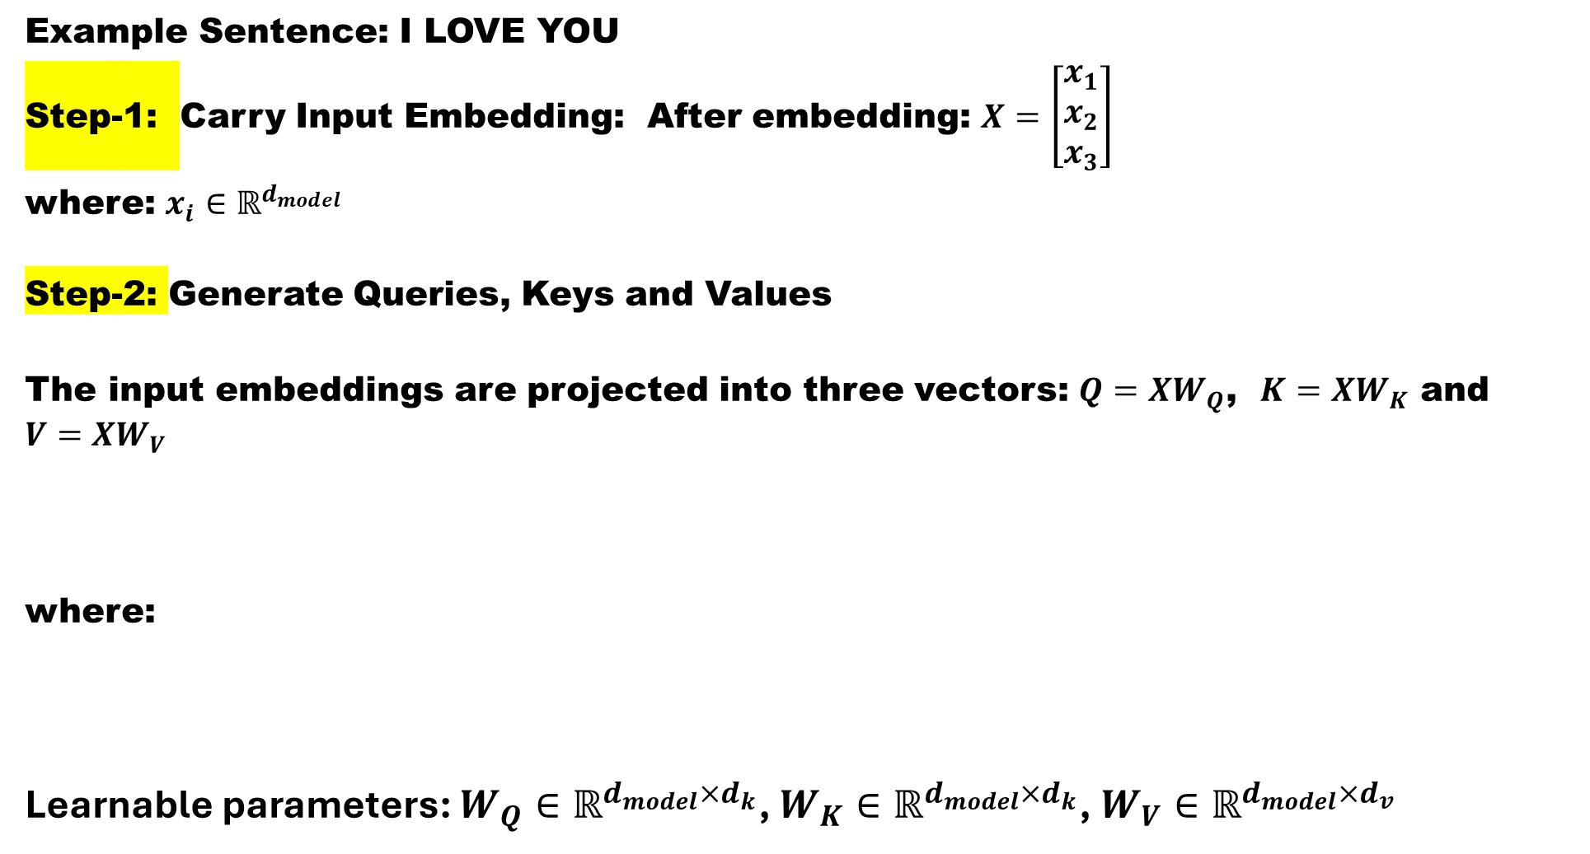
Sequence-to-Sequence (Seq2Seq) Architetcure

Slide 31
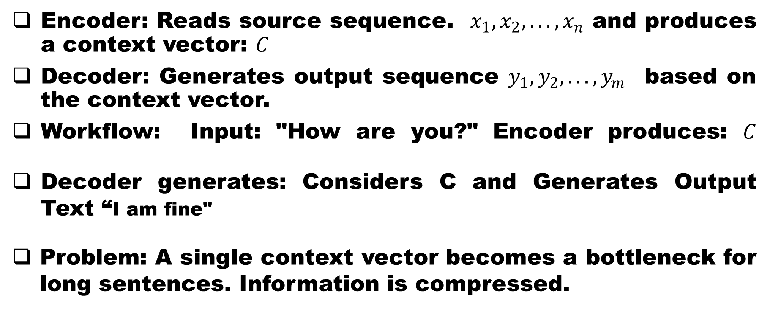
Sequence-to-Sequence (Seq2Seq)- Encoder-Decoder
Encoder: Reads source sequence. $x_{1},x_{2},...,x_{n}$ and produces a context vector: $C$
Decoder: Generates output sequence $y_{1},y_{2},...,y_{m}$ based on the context vector.
Workflow: Input: "How are you?" Encoder produces: $C$
Decoder generates: Considers C and Generates Output Text “I am fine"
Problem: A single context vector becomes a bottleneck for long sentences. Information is compressed.

Slide 32
Attention Mechanisms
Introduced to overcome the Seq2Seq bottleneck. Instead of one context vector, the decoder attends to all encoder states.
Introduced to overcome the Seq2Seq bottleneck.
Instead of one context vector: Decoder attends to all encoder states

Slide 33
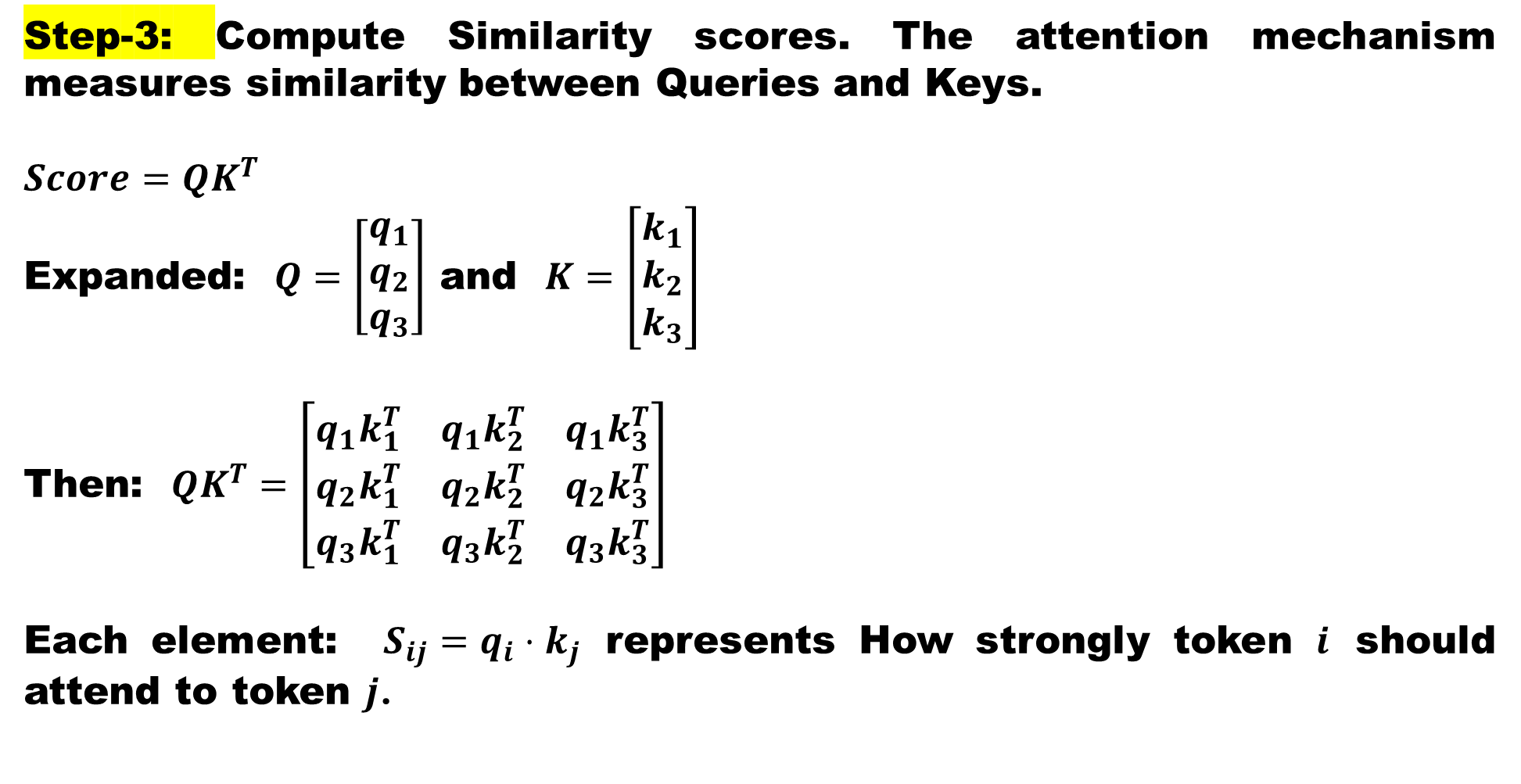
Attention Architecture

Slide 34
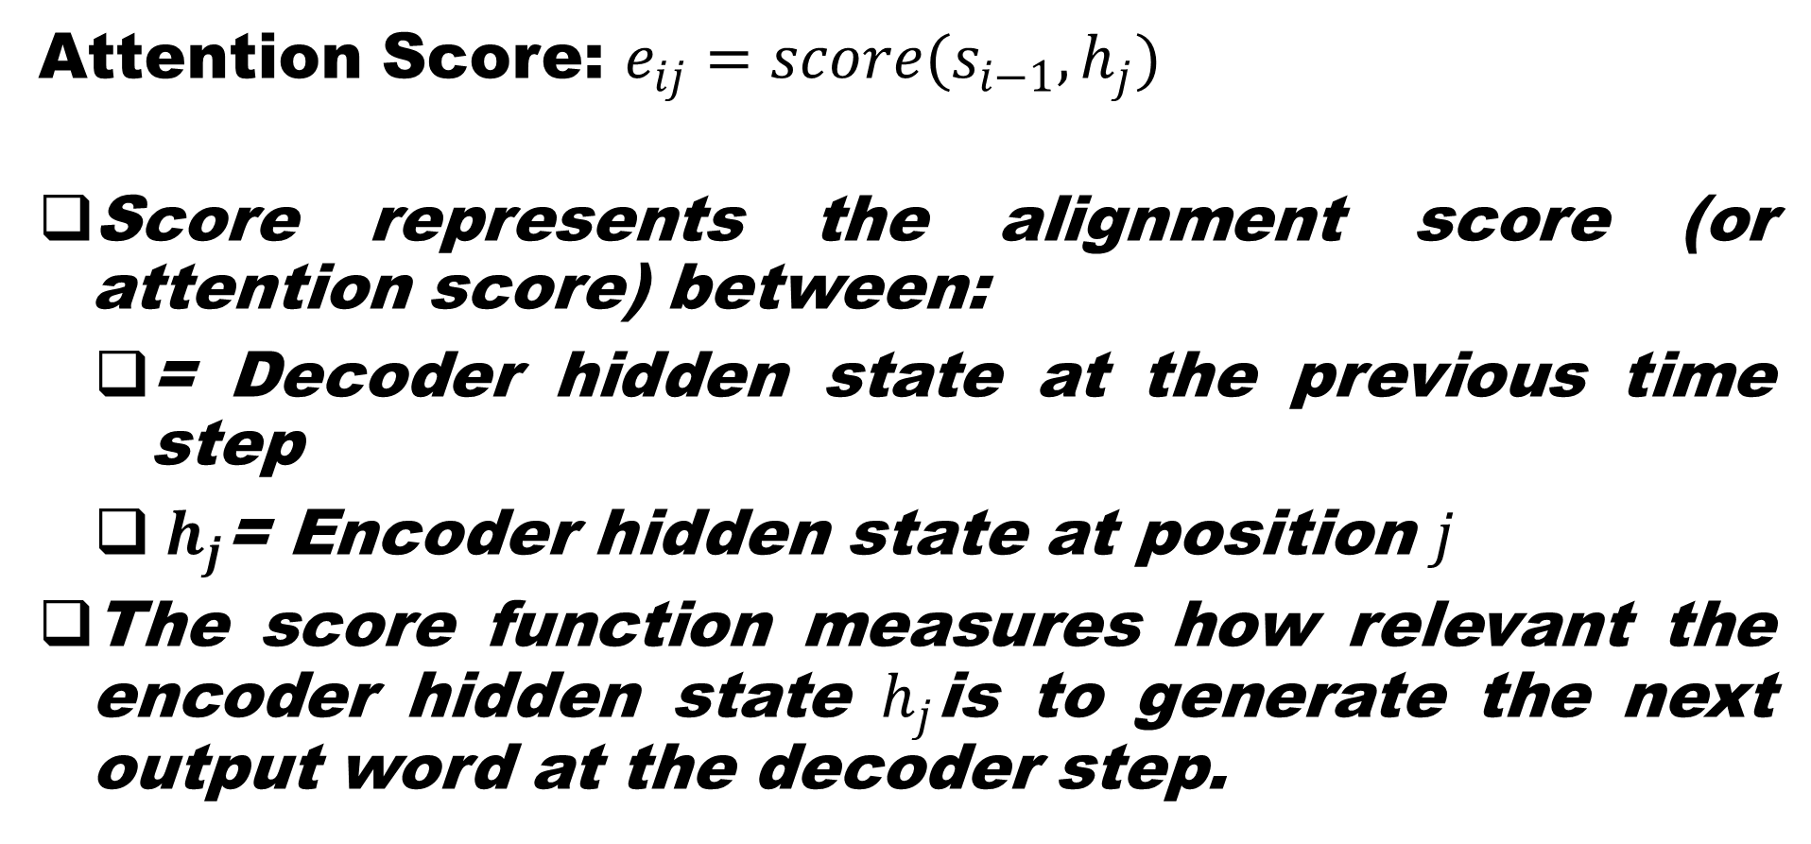
Attention Score Computation
Attention Score: $e_{ij}=score(s_{i−1},h_{j})$
Score represents the alignment score (or attention score) between:
= Decoder hidden state at the previous time step
${ h}_{j}$= Encoder hidden state at position $j$
The score function measures how relevant the encoder hidden state $h_{j}$is to generate the next output word at the decoder step.

Slide 35
Attention Score Computing Functions
Dot Product attention
General Attention (Luong Attention)
Additive Attention (Bahdanau Attention)

Slide 36
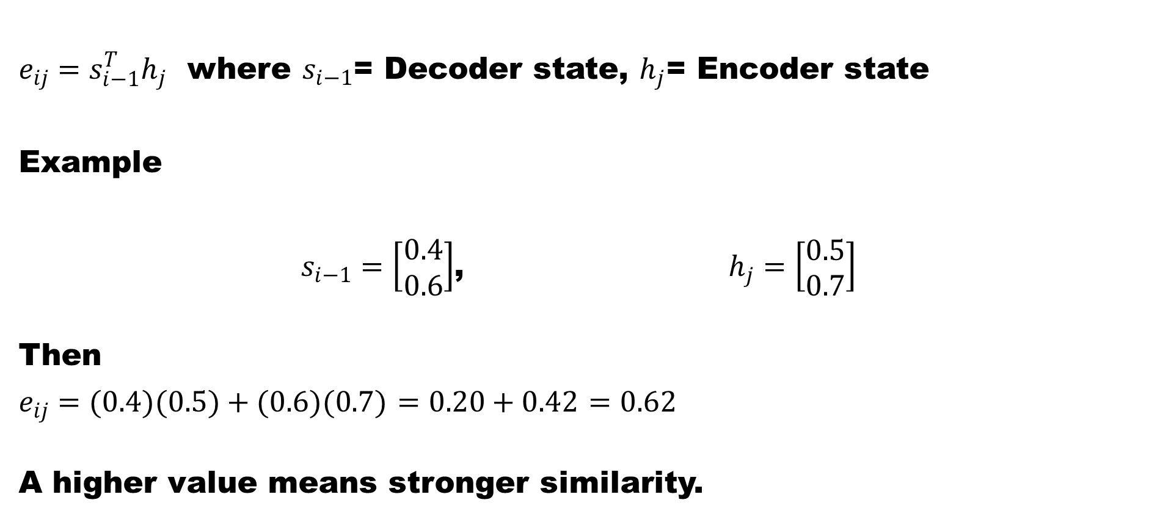
Computing the Attention Score through dot product attention function
$e_{ij}=s_{i−1}^{T}h_{j}$ where $s_{i−1}$= Decoder state, $h_{j}$= Encoder state
Example
$s_{i−1}=\left[\begin{aligned}0.4 \\ 0.6\end{aligned}\right]$, $h_{j}=\left[\begin{aligned}0.5 \\ 0.7\end{aligned}\right]$
Then
$e_{ij}=(0.4)(0.5)+(0.6)(0.7)$ $=0.20+0.42$ $=0.62$
A higher value means stronger similarity.

Slide 37
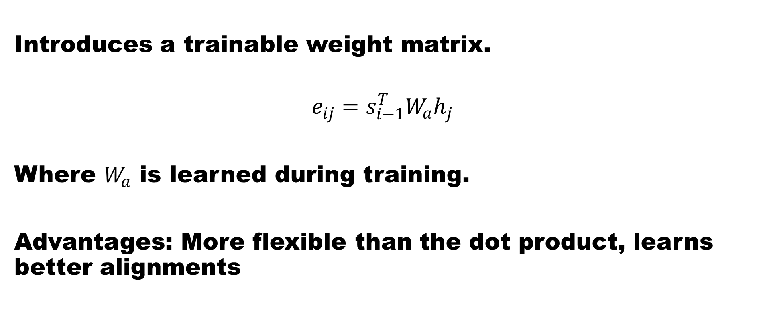
Computing the Attention Score through
General Attention (Luong Attention)
Introduces a trainable weight matrix.
$$e_{ij}=s_{i−1}^{T}W_{a}h_{j}$$
Where $W_{a}$ is learned during training.
Advantages: More flexible than the dot product, learns better alignments

Slide 38
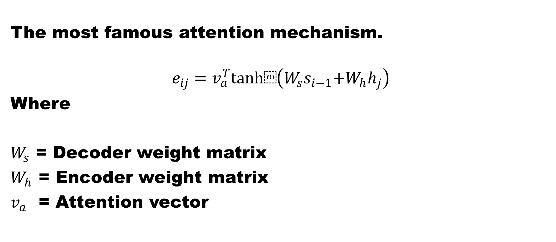
Computing the Attention Score through
Additive Attention (Bahdanau Attention)
The most famous attention mechanism.
$$e_{ij}=v_{a}^{T}tanh⁡\left(W_{s}s_{i−1} + W_{h}h_{j}\right)$$
Where
$W_{s}$ = Decoder weight matrix
$W_{h}$ = Encoder weight matrix
$v_{a}$ = Attention vector

Slide 39
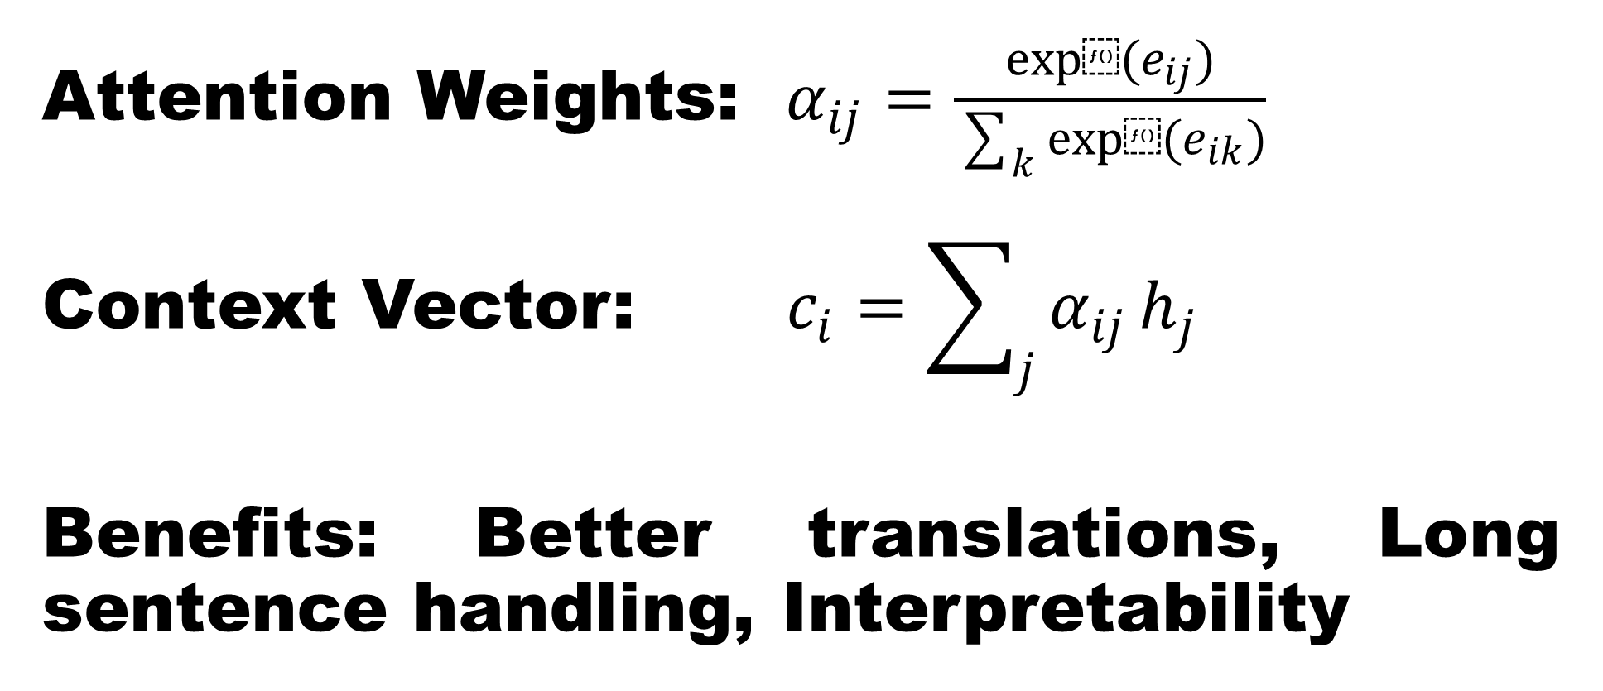
Computing the Attention Weights and Context Vector
Attention Weights:$α_{ij}=\frac{exp⁡(e_{ij})}{\sum_{k}{exp⁡(}e_{ik})}$
Context Vector:$c_{i}=\sum_{j}{α_{ij}}h_{j}$
Benefits: Better translations, Long sentence handling, Interpretability

Slide 40
Transformers
Transformer Models: Published in the landmark paper, “Attention Is All You Need (2017)”.
Transformers completely removed recurrence.

Slide 41
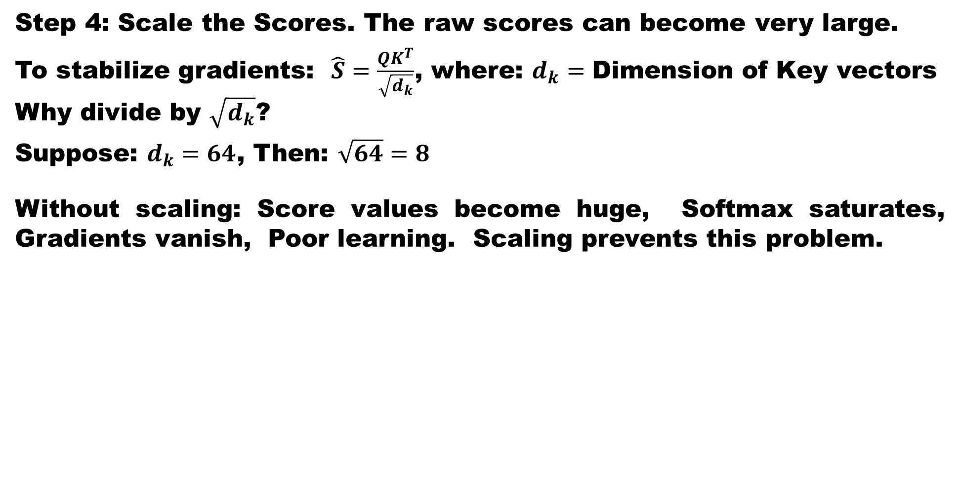
Transformers - Architecture

Slide 42
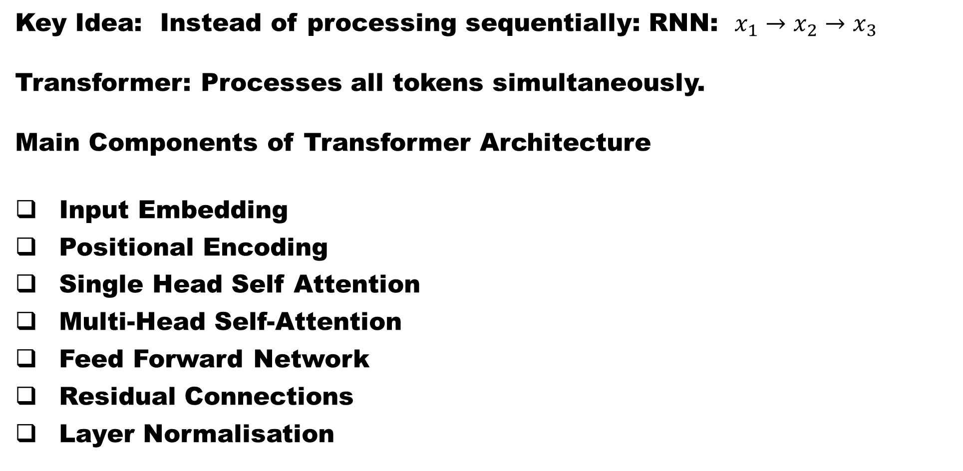
Main Components of Transformer Architecture
Key Idea: Instead of processing sequentially: RNN: $x_{1}→x_{2}→x_{3}$
Transformer: Processes all tokens simultaneously.
Main Components of Transformer Architecture
Input Embedding
Positional Encoding
Single Head Self Attention
Multi-Head Self-Attention
Feed Forward Network
Residual Connections
Layer Normalisation

Slide 43
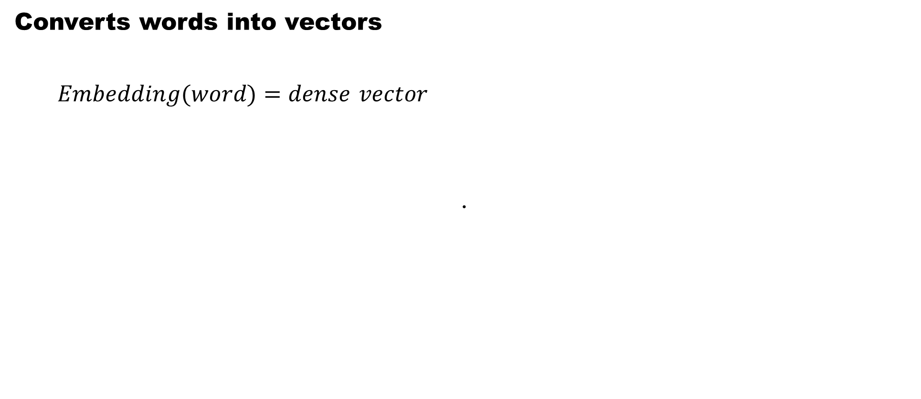
Input Embedding - Transformer
Converts words into vectors
$Embedding(word)=dense vector$
.

Slide 44
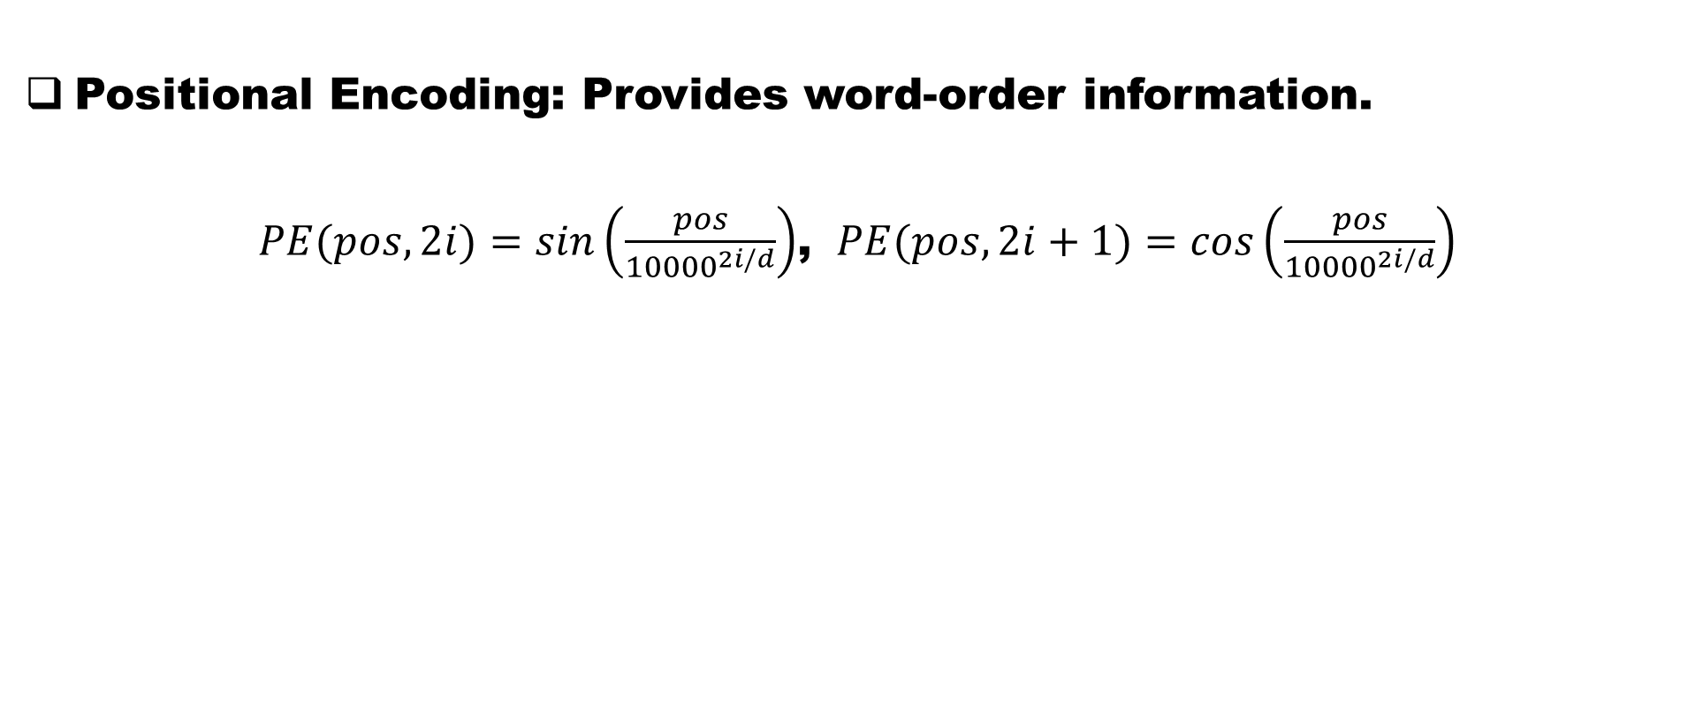
Positional Embedding- Transformer
Positional Encoding: Provides word-order information.
$PE(pos,2i)=sin\left(\frac{pos}{{10000}^{2i/d}}\right)$, $PE(pos,2i+1)=cos\left(\frac{pos}{{10000}^{2i/d}}\right)$
Variable | Meaning
(PE(pos,2i)) | Positional encoding value at position (pos) and even dimension (2i)
(PE(pos,2i+1)) | Positional encoding value at position (pos) and odd dimension (2i+1)
(pos) | Position of the token in the sequence (0, 1, 2, 3, ...)
(i) | Index of the embedding dimension pair
(d) | Embedding dimension size ((d_{model}))
(10000) | Constant used to generate different frequencies

Slide 45
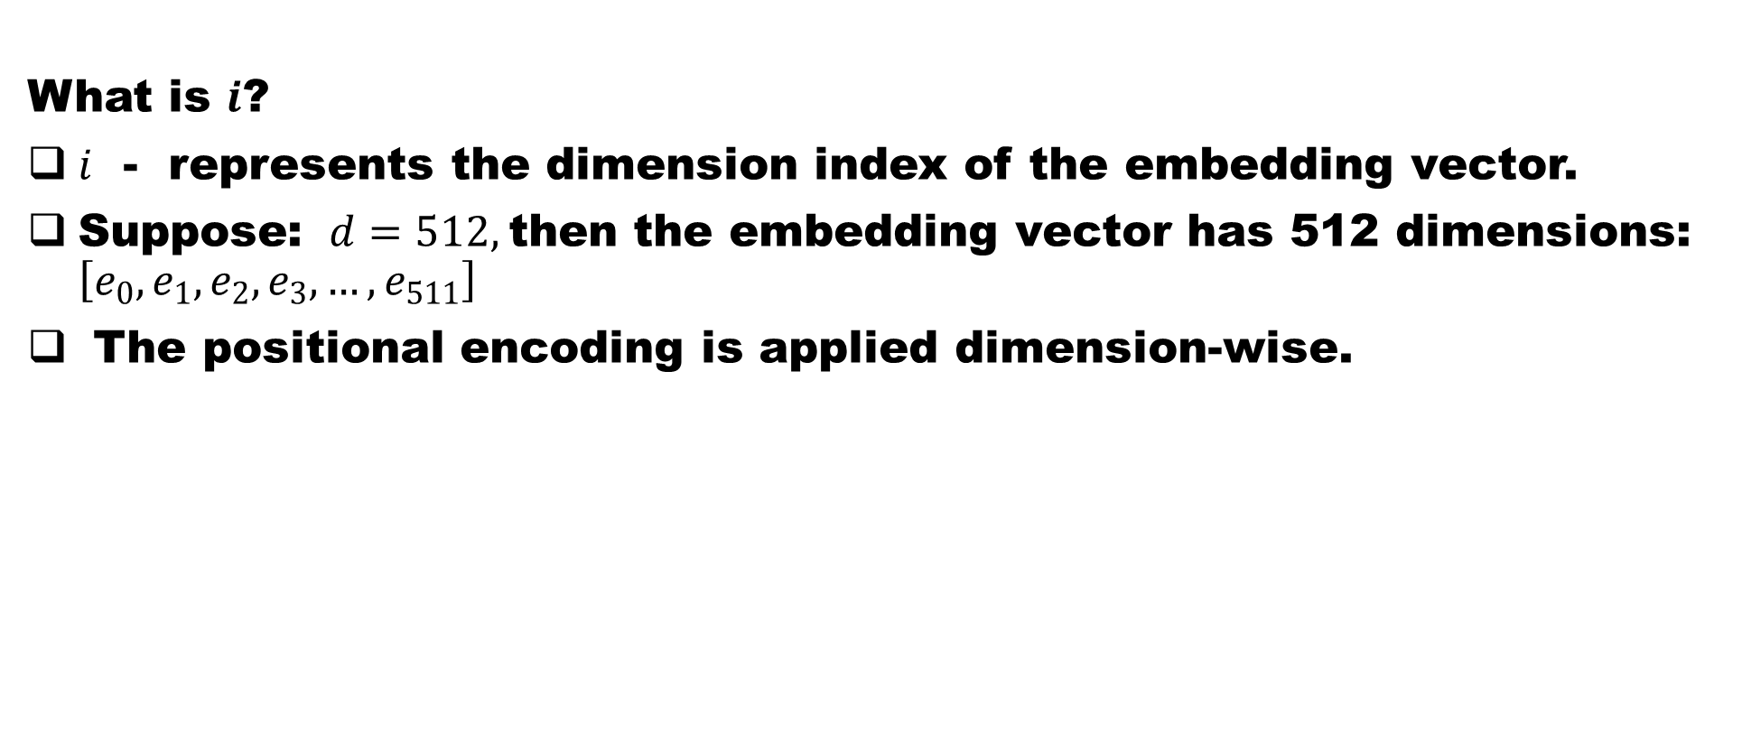
Positional Embedding- Transformer
What is $i$?
$i$ - represents the dimension index of the embedding vector.
Suppose: $d=512,$then the embedding vector has 512 dimensions: $\left[e_{0},e_{1},e_{2},e_{3},…,e_{511}\right]$
The positional encoding is applied dimension-wise.
i | Even Dimension (2i) | Odd Dimension (2i+1)
0 | 0 | 1
1 | 2 | 3
2 | 4 | 5
3 | 6 | 7
... | ... | ...
255 | 510 | 511

Slide 46
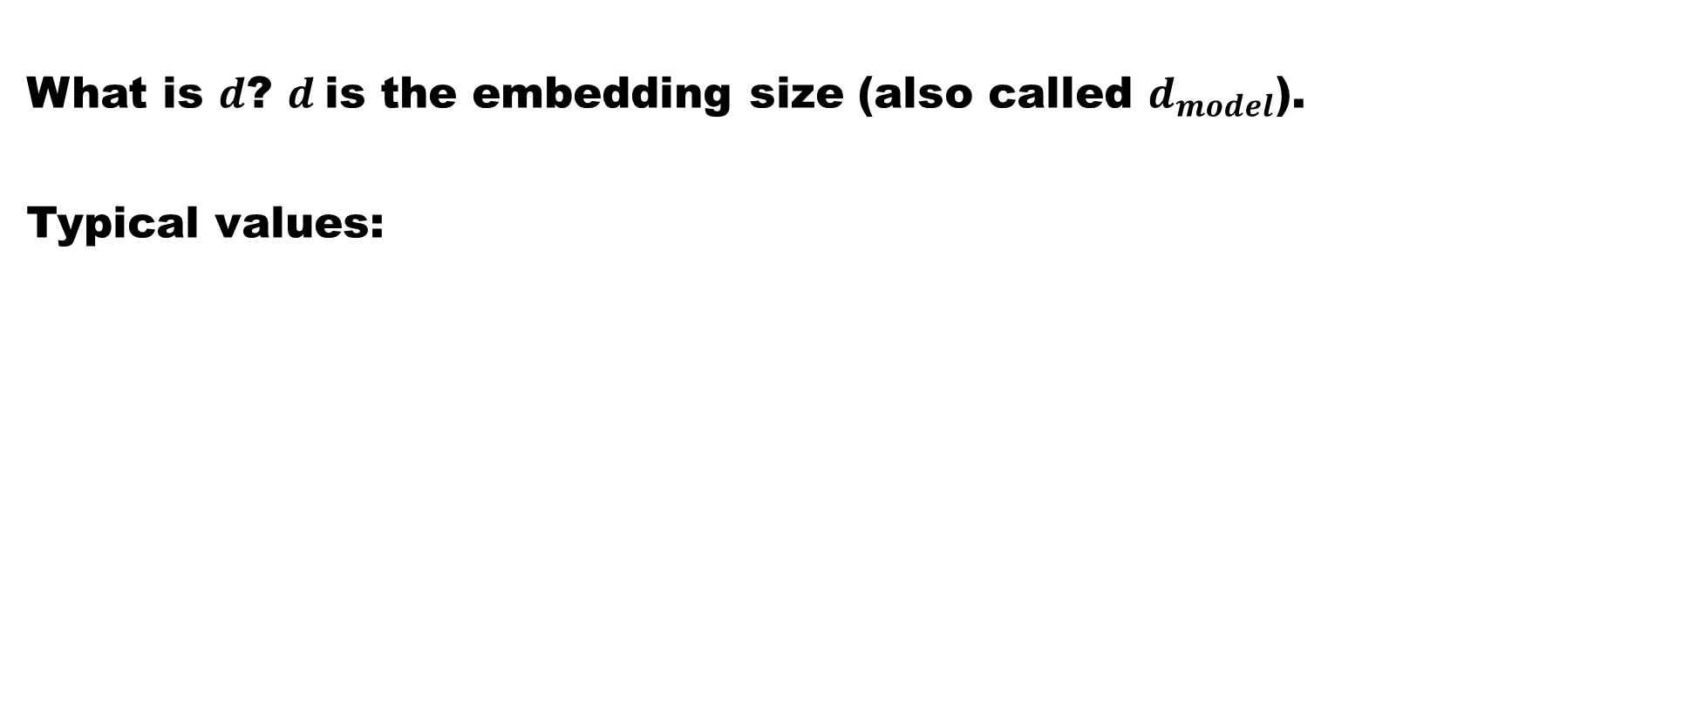
Positional Embedding- Transformer
What is $d$? $d$is the embedding size (also called $d_{model}$).
Typical values:
Transformer Model | (d_{model})
Original Transformer | 512
BERT Base | 768
BERT Large | 1024
GPT-2 Small | 768
GPT-3 | 12288

Slide 47
Positional Embedding- Example
For example: $d=512$ means every word is represented by a 512-dimensional vector.
Numerical Example
Suppose: $pos=5$, $i=0$, $d=512$, $PE(5,0)=sin\left(\frac{5}{{10000}^{0/512}}\right)$
Since: ${10000}^{0}=1$, $PE(5,0)=sin(5)$ $=−0.9589$
For dimension 1: $PE(5,1)=cos⁡\left(\frac{5}{{10000}^{0/512}}\right)$ $=cos⁡(5)$ $=0.2837$
For $i=1$: Dimension 2: $PE(5,2)=sin\left(\frac{5}{{10000}^{2/512}}\right)$
The denominator becomes slightly larger, creating a lower-frequency sinusoid.

Slide 48
Core Attention Mechanism used in the Transformer
Each word creates: Query (Q), Key (K), Value (V)
Attention Formula$Attention(Q,K,V)=Softmax\left(\frac{QK^{T}}{\sqrt{d_{k}}}\right)V$
The Attention mechanism answers the question:
“For each word, which other words should I pay attention to, and by how much?"

Slide 49
Core Attention Mechanism used in the Transformer
Example Sentence: I LOVE YOU
Step-1: Carry Input Embedding: After embedding: $X=\left[\begin{aligned}x_{1} \\ x_{2} \\ x_{3}\end{aligned}\right]$
where: $x_{i}∈ℝ^{d_{model}}$
Step-2: Generate Queries, Keys and Values
The input embeddings are projected into three vectors: $Q=XW_{Q}$, $K=XW_{K}$ and $V=XW_{V}$
where:
Learnable parameters: $W_{Q}∈ℝ^{d_{model}×d_{k}}$, $W_{K}∈ℝ^{d_{model}×d_{k}}$, $W_{V}∈ℝ^{d_{model}×d_{v}}$
Symbol | Meaning | Purpose
(Q) | Query Matrix | What I am Looking for
(K) | Key Matrix | What Information do I contain
(V) | Value Matrix | The Actual Information stored
(W_{Q}) | Query Weight Matrix
(W_{K}) | Key Weight Matrix
(W_{V}) | Value Weight Matrix

Slide 50
Core Attention Mechanism used in the Transformer
Step-3: Compute Similarity scores. The attention mechanism measures similarity between Queries and Keys.
$$Score=QK^{T}$$
Expanded: $Q=\left[\begin{aligned}q_{1} \\ q_{2} \\ q_{3}\end{aligned}\right]$ and $K=\left[\begin{aligned}k_{1} \\ k_{2} \\ k_{3}\end{aligned}\right]$
Then: $QK^{T}=\left[\begin{matrix}q_{1}k_{1}^{T} & q_{1}k_{2}^{T} & q_{1}k_{3}^{T} \\ q_{2}k_{1}^{T} & q_{2}k_{2}^{T} & q_{2}k_{3}^{T} \\ q_{3}k_{1}^{T} & q_{3}k_{2}^{T} & q_{3}k_{3}^{T}\end{matrix}\right]$
Each element: $S_{ij}=q_{i}⋅k_{j}$ represents How strongly token $i$ should attend to token $j$.

Slide 51
Core Attention Mechanism used in the Transformer
Step 4: Scale the Scores. The raw scores can become very large.
To stabilize gradients: $\hat{S}=\frac{QK^{T}}{\sqrt{d_{k}}}$, where: $d_{k}=\text{Dimension of Key vectors}$
Why divide by $\sqrt{d_{k}}$?
Suppose: $d_{k}=64$, Then: $\sqrt{64}=8$
Without scaling: Score values become huge, Softmax saturates, Gradients vanish, Poor learning. Scaling prevents this problem.

Slide 52
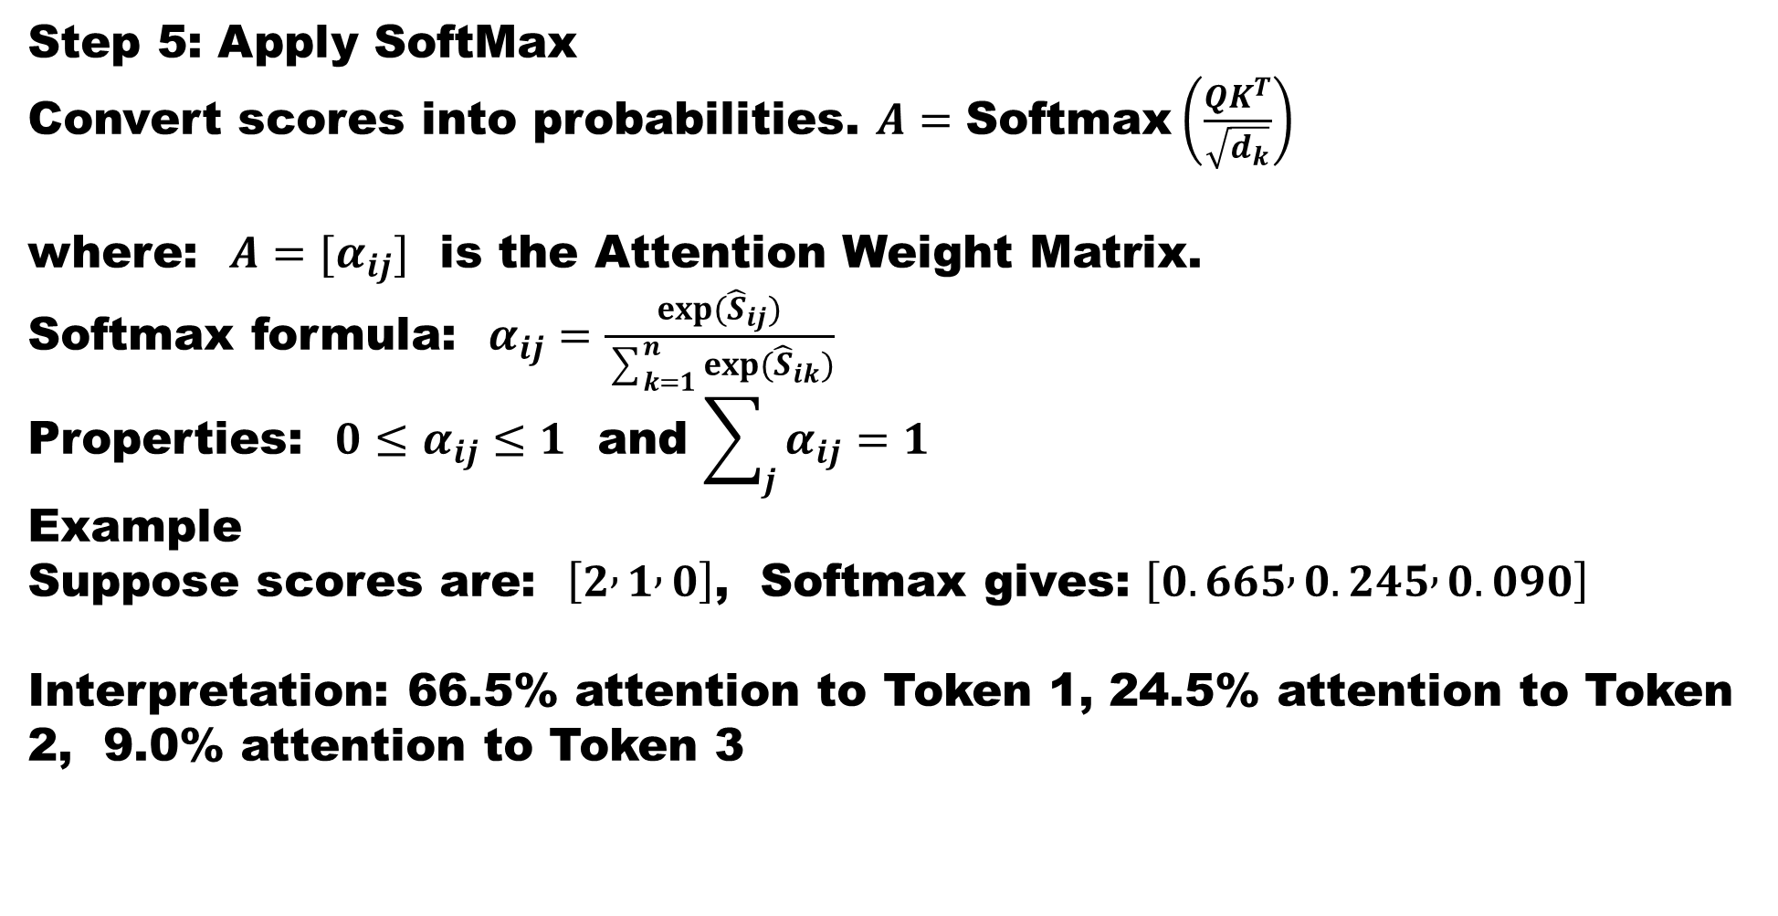
Core Attention Mechanism used in the Transformer
Step 5: Apply SoftMax
Convert scores into probabilities. $A=\text{Softmax}\left(\frac{QK^{T}}{\sqrt{d_{k}}}\right)$
where: $A=[α_{ij}]$ is the Attention Weight Matrix.
Softmax formula: $α_{ij}=\frac{exp({\hat{S}}_{ij})}{\sum_{k=1}^{n}{exp(}{\hat{S}}_{ik})}$
Properties: $0≤α_{ij}≤1$ and $\sum_{j}{α_{ij}}=1$
Example
Suppose scores are: $\left[2 , 1 , 0\right]$, Softmax gives: $\left[0.665 , 0.245 , 0.090\right]$
Interpretation: 66.5% attention to Token 1, 24.5% attention to Token 2, 9.0% attention to Token 3

Slide 53
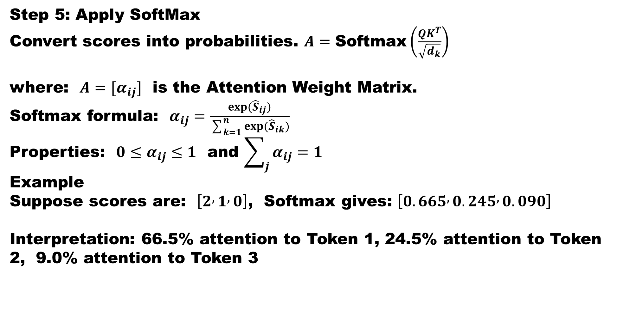
Core Attention Mechanism used in the Transformer
Step 5: Apply SoftMax
Convert scores into probabilities. $A=\text{Softmax}\left(\frac{QK^{T}}{\sqrt{d_{k}}}\right)$
where: $A=[α_{ij}]$ is the Attention Weight Matrix.
Softmax formula: $α_{ij}=\frac{exp({\hat{S}}_{ij})}{\sum_{k=1}^{n}{exp(}{\hat{S}}_{ik})}$
Properties: $0≤α_{ij}≤1$ and $\sum_{j}{α_{ij}}=1$
Example
Suppose scores are: $\left[2 , 1 , 0\right]$, Softmax gives: $\left[0.665 , 0.245 , 0.090\right]$
Interpretation: 66.5% attention to Token 1, 24.5% attention to Token 2, 9.0% attention to Token 3

Slide 54
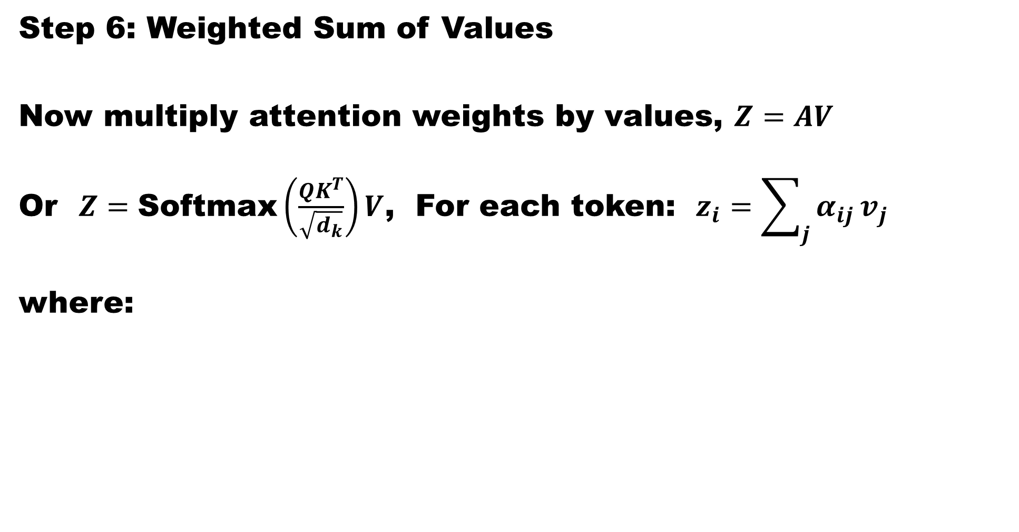
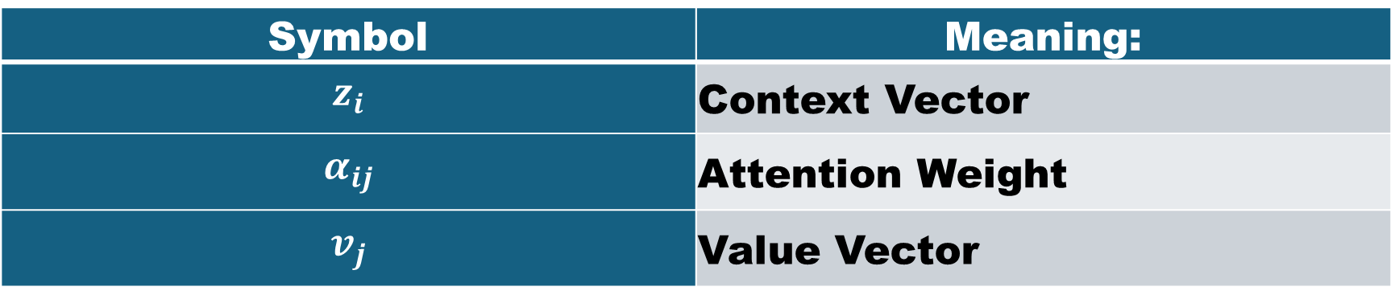
Core Attention Mechanism used in the Transformer
Step 6: Weighted Sum of Values
Now multiply attention weights by values, $Z=AV$
Or $Z=\text{Softmax}\left(\frac{QK^{T}}{\sqrt{d_{k}}}\right)V$, For each token: $z_{i}=\sum_{j}{α_{ij}}v_{j}$
where:
Symbol | Meaning:
$$z_{i}$$ | Context Vector
$$α_{ij}$$ | Attention Weight
$$v_{j}$$ | Value Vector

Slide 55
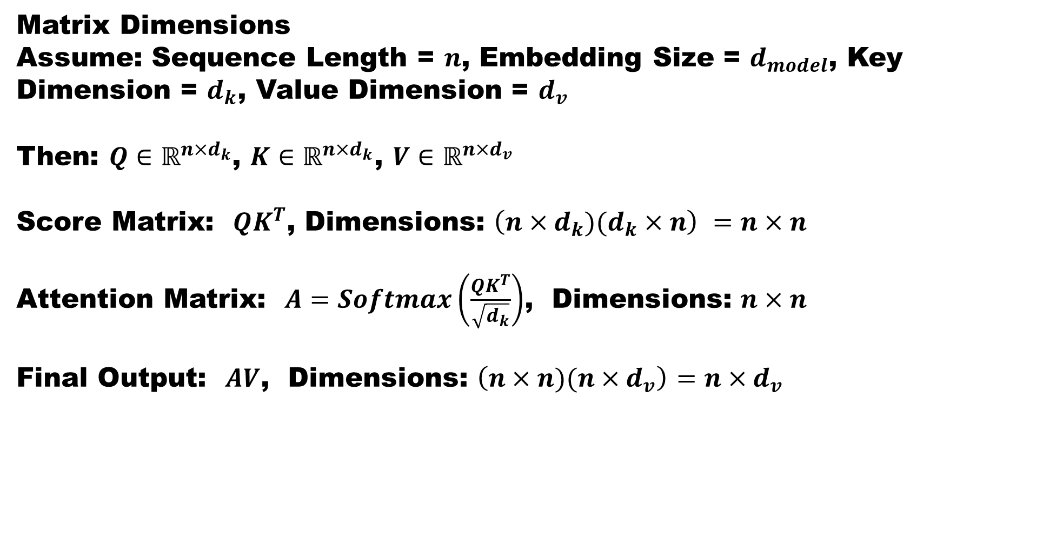
Core Attention Mechanism used in the Transformer
Matrix Dimensions
Assume: Sequence Length = $n$, Embedding Size = $d_{model}$, Key Dimension = $d_{k}$, Value Dimension = $d_{v}$
Then: $Q∈ℝ^{n×d_{k}}$, $K∈ℝ^{n×d_{k}}$, $V∈ℝ^{n×d_{v}}$
Score Matrix: $QK^{T}$, Dimensions: $\left(n×d_{k})(d_{k}×n\right)$ $=n×n$
Attention Matrix: $A=Softmax\left(\frac{QK^{T}}{\sqrt{d_{k}}}\right)$, Dimensions: $n×n$
Final Output: $AV$, Dimensions: $\left(n×n)(n×d_{v}\right)$ $=n×d_{v}$

Slide 56
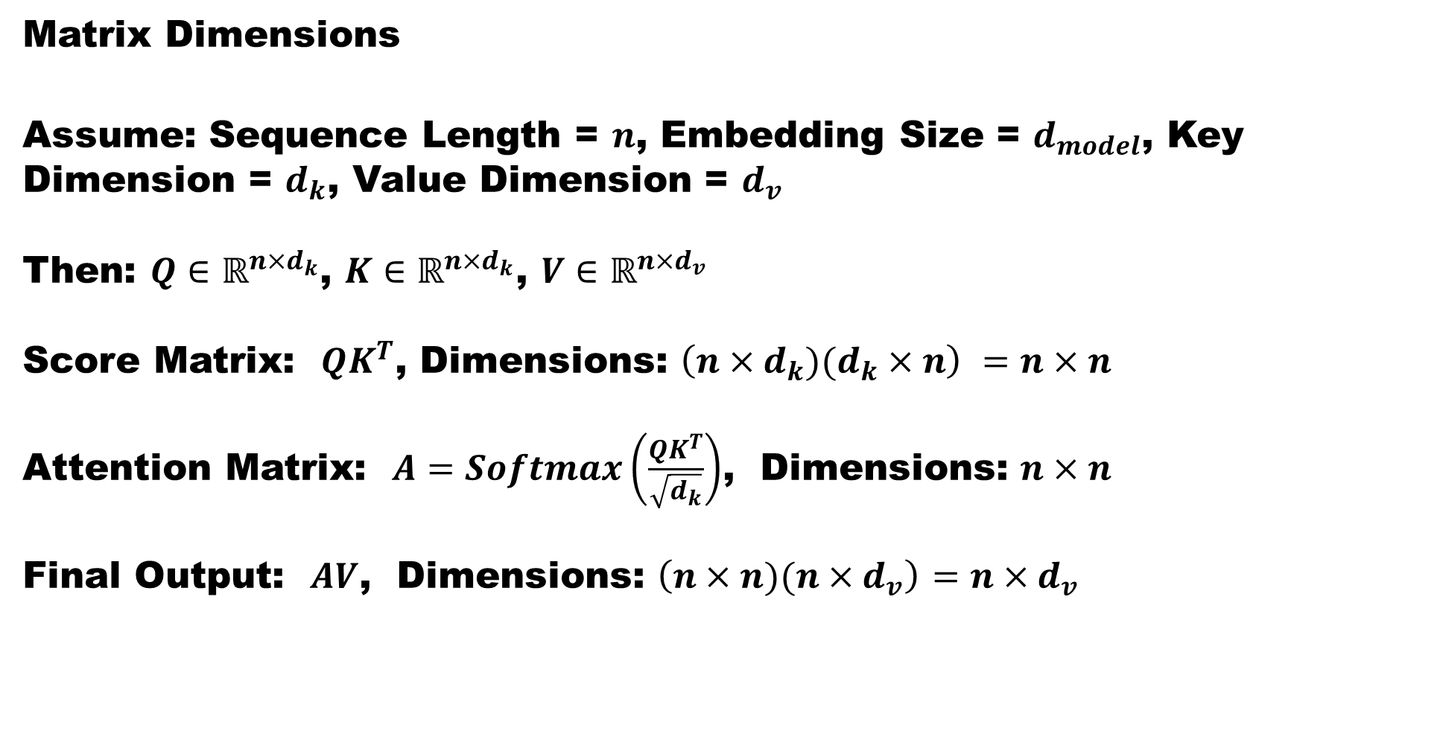
Core Attention Mechanism used in the Transformer
Matrix Dimensions
Assume: Sequence Length = $n$, Embedding Size = $d_{model}$, Key Dimension = $d_{k}$, Value Dimension = $d_{v}$
Then: $Q∈ℝ^{n×d_{k}}$, $K∈ℝ^{n×d_{k}}$, $V∈ℝ^{n×d_{v}}$
Score Matrix: $QK^{T}$, Dimensions: $\left(n×d_{k})(d_{k}×n\right)$ $=n×n$
Attention Matrix: $A=Softmax\left(\frac{QK^{T}}{\sqrt{d_{k}}}\right)$, Dimensions: $n×n$
Final Output: $AV$, Dimensions: $\left(n×n)(n×d_{v}\right)$ $=n×d_{v}$

Slide 57
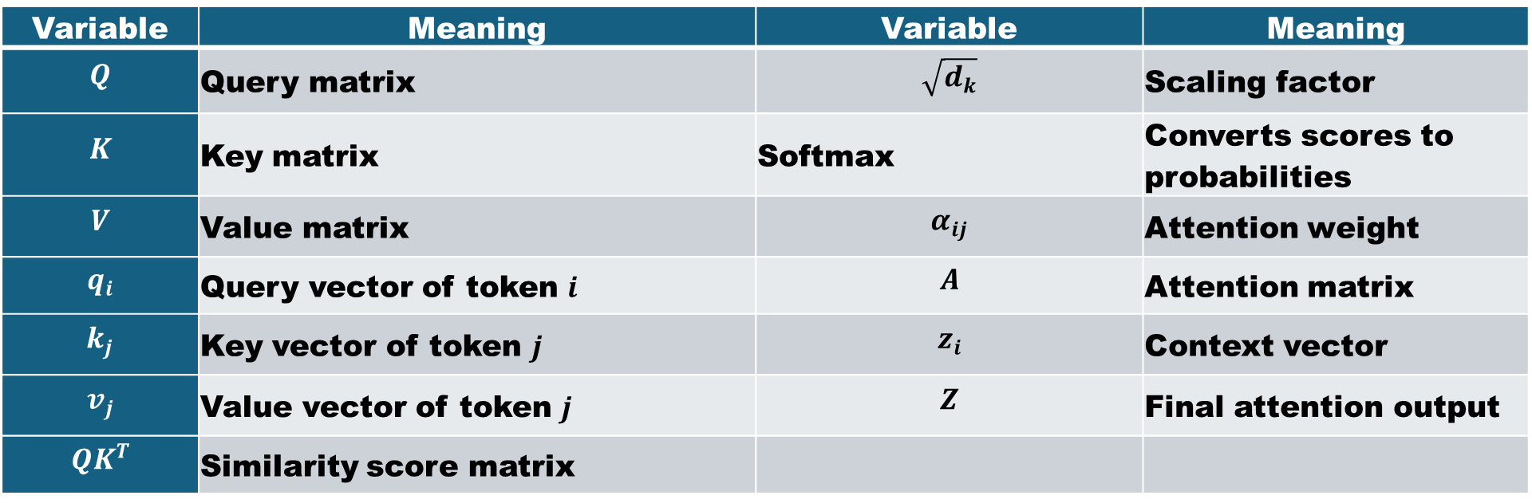
Core Attention Mechanism used in the Transformer
Meaning of Variables
Variable | Meaning | Variable | Meaning
$$Q$$ | Query matrix | $$\sqrt{d_{k}}$$ | Scaling factor
$$K$$ | Key matrix | Softmax | Converts scores to probabilities
$$V$$ | Value matrix | $$α_{ij}$$ | Attention weight
$$q_{i}$$ | Query vector of token $i$ | $$A$$ | Attention matrix
$$k_{j}$$ | Key vector of token $j$ | $$z_{i}$$ | Context vector
$$v_{j}$$ | Value vector of token $j$ | $$Z$$ | Final attention output
$$QK^{T}$$ | Similarity score matrix

Slide 58
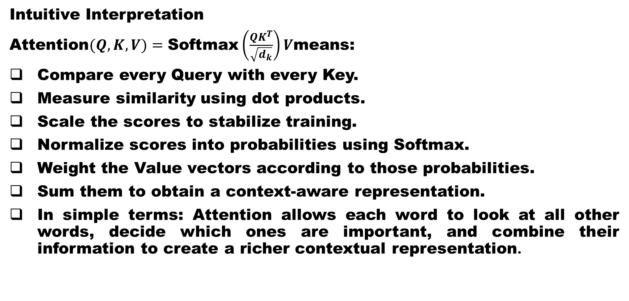
Core Attention Mechanism used in the Transformer
Intuitive Interpretation
$\text{Attention}(Q,K,V)=\text{Softmax}\left(\frac{QK^{T}}{\sqrt{d_{k}}}\right)V$means:
Compare every Query with every Key.
Measure similarity using dot products.
Scale the scores to stabilize training.
Normalize scores into probabilities using Softmax.
Weight the Value vectors according to those probabilities.
Sum them to obtain a context-aware representation.
In simple terms: Attention allows each word to look at all other words, decide which ones are important, and combine their information to create a richer contextual representation.

Slide 59
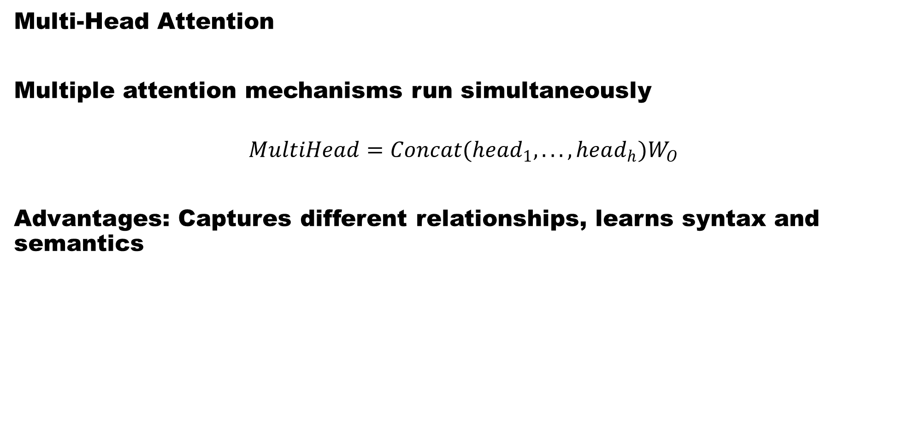
Multihead Attention Mechanism used in the Transformer
Multi-Head Attention
Multiple attention mechanisms run simultaneously
$$MultiHead=Concat(head_{1},...,head_{h})W_{O}$$
Advantages: Captures different relationships, learns syntax and semantics

