Slide 1
ELLM – Session – 15
Data Preparation:
Advanced Data Curation Methods
Complete Real-World LLM Dataset Pipeline
Popular Open Datasets for LLM Training

Slide 2
Advanced Data Curation Methods)
As Large Language Models (LLMs) continue to grow in capability, the importance of advanced data curation has become increasingly significant.
Data curation extends beyond basic preprocessing by employing sophisticated techniques to improve dataset quality, diversity, factual reliability, safety, and representativeness.
Properly curated datasets enable LLMs to generate accurate, coherent, unbiased, and contextually relevant responses while minimizing hallucinations and harmful outputs.
Objectives: Improve dataset quality and diversity, reduce noisy and redundant data, increase factual consistency, Minimize harmful or biased content, enhance model generalization, Support scalable data management

Slide 3
Advanced Data Curation Techniques
Intelligent Deduplication
Semantic Quality Assessment
Factual Verification
Toxicity and Safety Filtering
Bias Detection and Mitigation
Active Learning
Synthetic Data Generation
Curriculum Data Curation
Data Versioning
Continuous Dataset Refresh

Slide 4
Advanced Data Curation Techniques
Intelligent Deduplication
      Web-scale datasets often contain duplicate and near-duplicate documents that can cause overfitting and reduce data diversity.
      Methods: Exact hashing, MinHash, SimHash, Locality Sensitive Hashing (LSH), Embedding-based semantic similarity
      Benefits: Reduces redundancy, improves vocabulary diversity, lowers storage requirements
2. Semantic Quality Assessment
      Rather than relying solely on document length or grammar, modern pipelines estimate semantic quality using machine learning models.
      Evaluation Criteria: Logical consistency, Coherence, Informativeness, Readability, Completeness
      Documents with low semantic scores are discarded before training.

Slide 5
Advanced Data Curation Techniques
3. Factual Verification
Incorrect or misleading information may cause hallucinations during inference.
Verification Techniques: Cross-reference multiple trusted sources: Knowledge graph validation, Retrieval-based verification, Human expert review, Automated fact-checking systems
4. Toxicity and Safety Filtering
Specialized classifiers identify harmful content before it is included.
Categories: Hate speech, Harassment, Violence, Explicit content, Self-harm instructions, Illegal activities
This improves model safety and responsible AI deployment.

Slide 6
Advanced Data Curation Techniques
5. Bias Detection and Mitigation
Training data should represent different cultures, genders, languages, and viewpoints fairly.
Bias Reduction Techniques: Balanced sampling, Fairness-aware filtering, Demographic balancing, Counterfactual data augmentation, Human auditing
6. Active Learning
Instead of manually labelling every document, the model identifies uncertain samples for human annotation.
Advantages: Lower annotation cost, Faster dataset creation, Higher annotation efficiency

Slide 7
Advanced Data Curation Techniques
7. Synthetic Data Generation
Powerful teacher models generate additional high-quality training samples.
Applications include Question–Answer generation, Summarization, Code generation, Translation, and instruction tuning
Synthetic data expands coverage while reducing dependence on manual annotation.
8. Curriculum Data Curation
Documents are organized according to complexity.
Training progression: Simple Text → Medium Complexity → Technical Documents → Long Context Documents → Reasoning Tasks
This curriculum learning strategy improves convergence and stability.

Slide 8
Advanced Data Curation Techniques
10. Data Versioning
Each dataset update is tracked using version control.
Metadata includes Dataset version, Collection date, Source, Processing pipeline, Quality metrics, and license information
11. Continuous Dataset Refresh
Modern LLM datasets are periodically updated to include Recent news, Scientific discoveries, newly published books, Software documentation, updated regulations
Continuous refresh helps maintain current knowledge while preventing outdated information.
Benefits of Advanced Data Curation: Higher factual accuracy, reduced hallucinations, Better reasoning ability, Increased robustness, improved multilingual performance, Enhanced model safety

Slide 9
Complete Real-World LLM Dataset Pipeline
Industrial-scale LLM development requires a comprehensive pipeline that transforms raw web-scale data into high-quality, model-ready datasets.
The pipeline combines automated preprocessing, distributed computing, human feedback, and continuous monitoring to ensure efficient, scalable, and reliable data preparation.
Objectives: Build scalable data pipelines, produce high-quality datasets, Support distributed training, enable continuous dataset improvement

Slide 10
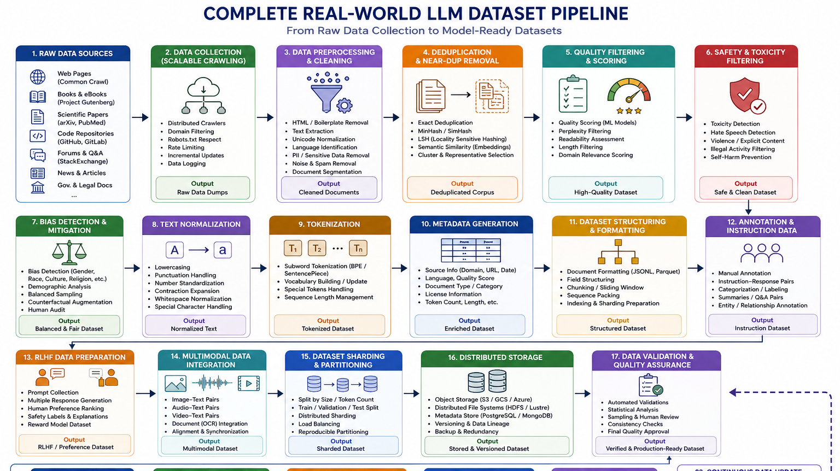

Slide 11
Pipeline Components
Data Acquisition: Collect text from Websites, Books, Scientific literature, Code repositories, News articles, Forums and Government documents
Preprocessing: Includes HTML removal, Duplicate removal, Noise elimination, and Unicode normalization, Language detection
Quality Assurance: Performs: Spam filtering, Toxicity detection, Perplexity filtering, Readability assessment, Human review
Annotation: Human annotators provide: Labels, Categories, Preference rankings, Safety labels, Instruction-response pairs
Dataset Construction: Prepared datasets include Pretraining corpus, Instruction tuning dataset, RLHF dataset, Multimodal dataset, Evaluation benchmark
Storage: Datasets are stored in optimized formats: JSONL, Parquet, TFRecord, WebDataset
Model Training: Training stages: Pretraining, Supervised Fine-Tuning (SFT), RLHF or Direct Preference Optimization (DPO), Evaluation, Deployment
Continuous Improvement: The deployed model generates user interactions that can be incorporated—after appropriate review, filtering, and privacy safeguards—into future dataset updates, enabling iterative improvement.

Slide 12
Characteristics of Real-World Pipelines
Distributed computing
Fault tolerance
Continuous monitoring
Version-controlled datasets
Automated quality assurance
Human-in-the-loop validation
High scalability

Slide 13
Advantages of real-time Pipelines
High-quality datasets
Faster training
Better alignment
Improved reproducibility
Reduced maintenance cost

Slide 14
Popular Open Datasets for LLM Training
Large Language Models are pretrained and fine-tuned using massive datasets collected from diverse domains.
Publicly available datasets have played a major role in advancing open-source LLM research by providing large-scale, high-quality corpora for language understanding, reasoning, dialogue generation, code synthesis, and multilingual learning.
Objectives: Provide diverse linguistic knowledge, support multilingual learning, improve reasoning capability, enable domain adaptation, and encourage reproducible research

Slide 15
Popular Open Datasets
Dataset Number | Name of the dataset | Description | Applications
1 | Common Crawl | One of the largest publicly available web crawl datasets, containing billions of web pages collected from the Internet. | General LLM pretraining Web knowledge acquisition Benefits: Massive scale, Regular updates, Broad domain coverage
2 | C4 (Colossal Clean Crawled Corpus) | A cleaned subset of Common Crawl with extensive filtering and deduplication | Transformer pretraining Language modelling
3 | The Pile | A diverse corpus containing text from books, academic papers, GitHub repositories, Wikipedia, Stack Exchange, legal documents, and more | Large-scale LLM pretraining Scientific language modelling Approximately 8GB of Text
4 | RedPajama | An open-source reproduction of the training corpus used for LLaMA-style models, combining Common Crawl, GitHub, arXiv, Wikipedia, Stack Exchange, and Books | Open LLM training Foundation model research

Slide 16
Popular Open Datasets
Dataset Number | Name of the dataset | Description | Applications
5 | FineWeb | A high-quality web corpus curated from Common Crawl with extensive filtering, deduplication, and quality scoring | Foundation model pretraining Efficient large-scale language modelling
6 | Wikipedia | A collaboratively curated encyclopaedia containing high-quality factual knowledge across numerous languages. | Knowledge-intensive language tasks Question answering Summarization
7 | BookCorpus | A collection of unpublished novels providing long-form narrative text. | Long-context understanding Story generation Dialogue modelling
8 | OSCAR (Open Super-large Crawled Aggregated Corpus | A multilingual corpus extracted from Common Crawl using language identification and filtering | Multilingual LLMs Cross-lingual transfer learning

Slide 17
Popular Open Datasets
Dataset Number | Name of the dataset | Description | Applications
9 | SlimPajama | A compact, deduplicated version of RedPajama designed for computational efficiency while maintaining high data quality | Efficient pretraining Resource-constrained LLM development
10 | Dolma | A large, openly available corpus emphasizing transparency in data collection, filtering, and documentation | Foundation model research Open-source LLM training
11 | Code Datasets | GitHub repositories The Stack CodeSearchNet | Code generation Program synthesis Code completion
12 | Dialogue and Instruction Datasets | Alpaca Dolly OpenAssistant Conversations FLAN Collection ShareGPT-style conversation datasets (where licensing and usage permit) | Instruction tuning Conversational AI Chatbots

Slide 18
Comparative Study
Dataset | Primary Source | Main Use | Key Strength
Common Crawl | Web pages | Pretraining | Massive web-scale corpus
C4 | Cleaned web corpus | Language modelling | High-quality filtered text
The Pile | Mixed domains | Pretraining | Diverse high-quality corpus
RedPajama | Multi-source corpus | Open LLMs | LLaMA-style reproduction
FineWeb | Curated web corpus | Foundation models | High-quality filtering
Wikipedia | Encyclopedia | Knowledge learning | Reliable factual information
BookCorpus | Books | Long-context learning | Rich narrative text
OSCAR | Multilingual web | Multilingual LLMs | 100+ languages
SlimPajama | Filtered RedPajama | Efficient pretraining | Reduced redundancy
Dolma | Curated multi-source | Foundation models | Transparent curation
The Stack | Source code | Code LLMs | Large-scale programming corpus
FLAN / Alpaca / Dolly | Instruction datasets | Fine-tuning | Instruction-following behavior

Slide 19
Summary
Advanced data preparation is the foundation of modern LLM development.
Advanced data curation methods employ semantic filtering, factual verification, deduplication, bias mitigation, toxicity detection, synthetic data generation, and continuous dataset refresh to maximize quality and reliability.
A complete real-world LLM dataset pipeline integrates large-scale data collection, preprocessing, quality assurance, annotation, instruction tuning, RLHF preparation, multimodal integration, distributed storage, and iterative model refinement into a unified workflow.
Finally, popular open datasets such as Common Crawl, C4, The Pile, RedPajama, FineWeb, Wikipedia, OSCAR, SlimPajama, Dolma, and instruction-tuning datasets provide the diverse linguistic knowledge required to train and evaluate state-of-the-art Large Language Models across general-purpose, multilingual, domain-specific, and conversational tasks.

