Slide 1

Naoures CHEHATA
Salma CHERAIBAT
Mohamed DAKKOURI
Salma ESSAOUI
Satnam SINGH
Jihane WADI

Slide 2
1. Critical Analysis of Data

Slide 3



1. Critical Analysis of Data
Relevance
ESG Database
ESG Rating
By Issuer
By Criteria
By Country
By Sector
Accuracy
Completeness

Slide 4
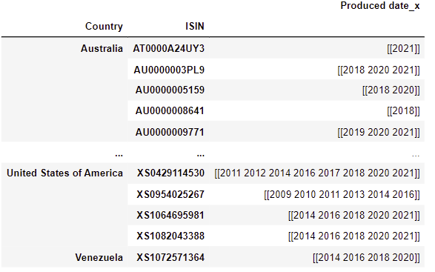
1. Critical Analysis of Data
Unconsistent Data
Uncoherent publication period
Gaps in the data
=> Screening & Monitoring issue

Slide 5
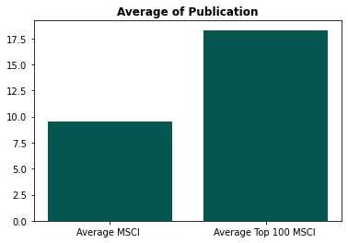
1. Critical Analysis of Data
Rating depending on size and weights
Bias favoring large cap
Bias favoring most weight stock in MSCI World
=> Small cap/weight more complicated to analyse

Slide 6
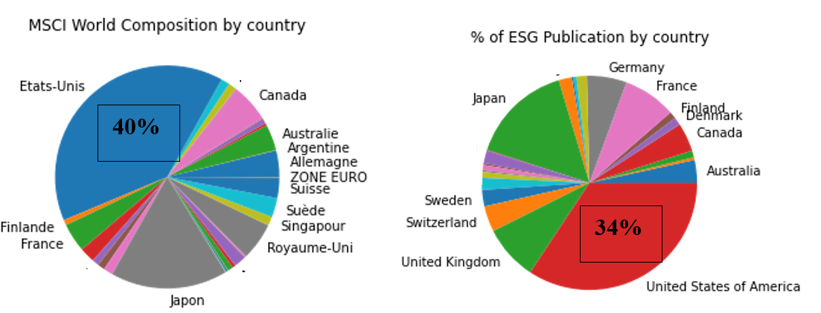
1. Critical Analysis of Data
m
Geographical bias
ESG PUBLICATION BY COUNTRY
MSCI WORLD COMPOSITION BY COUNTRY
Bias favoring US
Discrepancies between the weight of a country in the Index and the number of publication
=> To be considered if investment in emerging countries

Slide 7
2. ESG rating classification & Impact on Credit spreads

Slide 8
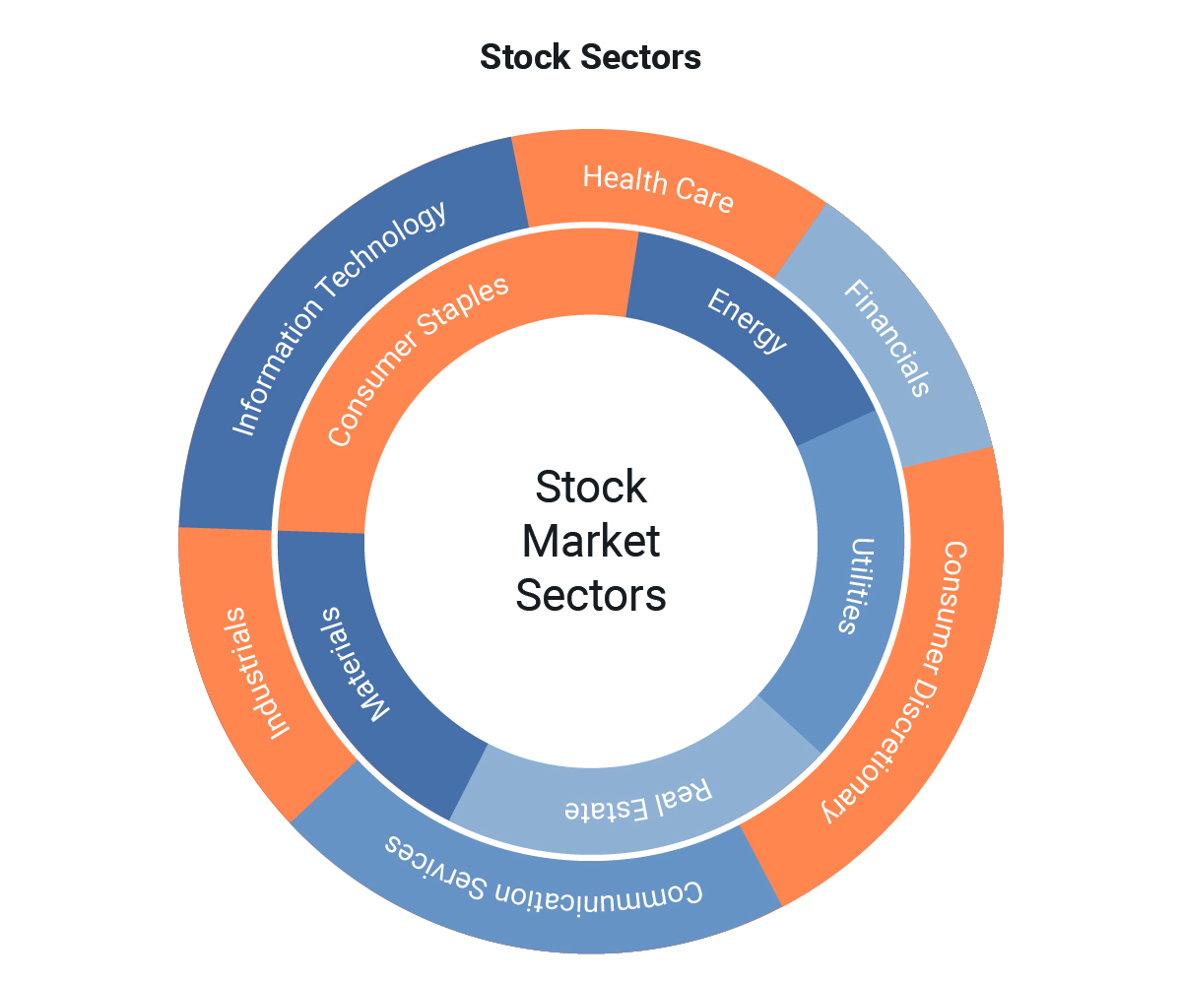
2.1 ESG rating criteria classification
Our approach:
Classification by sector:
Group the stocks by sector
Compute the average annual return by sector
Compute the average annual sector ESG scores for the selected criteria
Analyse the correlations between ESG scores and sector returns
Period:
-From January 2012 to December 2021
Data used:
The MSCI ESG Ratings and the companies returns in the MSCI World Index.

Slide 9
2.1 ESG rating criteria classification
Results:
A remarkable positive correlation: (>0,60)
-Global Risk Reputation with each of the Financials sector (0,91) and Discretionary consumer sector (0,91).
-Global Risk Operations with the Financials sector(0,84).
-Global Risk Legal with the Health Care sector (0,62).
A weak positive correlation: (between 0,20 and 0,60)
-Global Risk Reputation with the Information Technology sector (0,48).
-Global Risk Human Capital with the Telecom sector (0,54).
A very weak positive correlation: (<0,20)
The Energy, Industries and materials are the least impacted sectors by the ESG criteria, mainly by the Global Risk Human Capital(0,19 and 0,14).

Slide 10
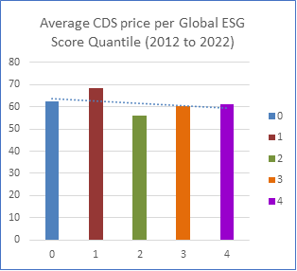
2.2 Impact of ESG performance on credit spreads

Slide 11
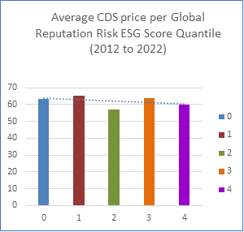
2.2 Impact of ESG performance on credit spreads

Slide 12
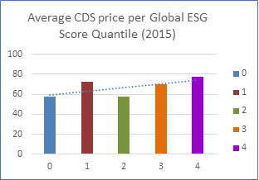
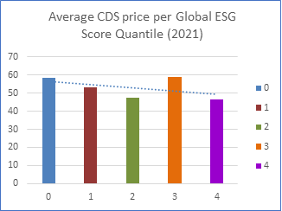
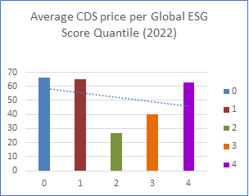
2.2 Impact of ESG performance on credit spreads
Time evolution

Slide 13
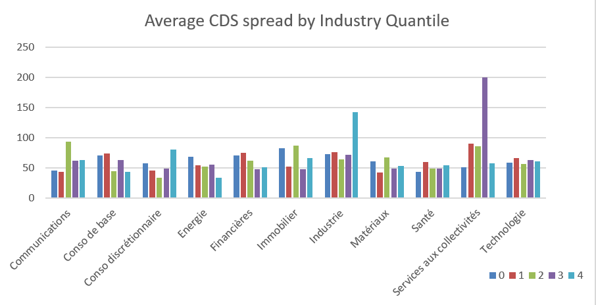
2.2 Impact of ESG performance on credit spreads
By Sertor Charcteristics

Slide 14
3. Optimizing the risk/return profile

Slide 15
3. Optimizing the risk/return profile
Portfolio Construction :
Select top 100 stock performers (with elimination of outliers)
Constraints:
Max 5% weight on a stock
Min 0,5% weight on a stock
Max Volatility of 13,3%*
Result of the strategy
*10Y Annualized Volatility of the MSCI World Index

Slide 16
3. Optimizing the risk/return profile
Portfolio Construction :
Select top 100 stock with the best ESG Rating
Constraints:
Max 5% weight on a stock
Min 0,5% weight on a stock
Max Volatility of 13,3%*
Result of the strategy
**
*10Y Annualized Volatility of the MSCI World Index
*10Y Annualized Performance of the MSCI World Index

Slide 17
4. Link between strategy and an SRI investment

Slide 18

4. Link between strategy and an SRI investment
To fit an SRI strategy to our portfolio allocation :we evaluated the SDG (Sustainable Development Goals) effect of the resulting active portfolio relative to the benchmark while considering the MSCI World index as the benchmark to beat.
Among the roughly 600 stocks in the index, we suggest creating an active portfolio of about 50 stocks using the MSCI ESG ratings which show positive ESG momentum, to measure ESG completion and track its performance relatively to the index.
The expected results are such that the portfolio significantly outperforms the index when relative momentum is used. We, therefore, will try to evaluate this outperformance persistence when controlling for the Fama French three-/five-factor models.

Slide 19

4. Link between strategy and an SRI investment
‘Best in class’: Adjusting the composition of our portfolio by the active selection of only those companies that meet a defined ranking hurdle established by environmental, social and governance criteria
• ‘Best efforts’: favoring issuers that demonstrate an improvement or good prospects in their ESG practices and performance over time
• ‘Exclusions strategy’: adopting a sectoral and/or normative type of exclusions, for instance almost all sustainable funds today exclude the tobacco, thermal coal, and unconventional weapons sectors, as well as nuclear, alcohol, gambling, etc. As well as firms that do not respect the UN Global Compact.

