Slide 1
CSCI 154 – Simulation Projects
Ryan McArthur & Sarah Hang

Slide 2
Monty Hall

Slide 3
Motivation
To better understand the chance of winning in selection/choice types of games / scenarios

Slide 4
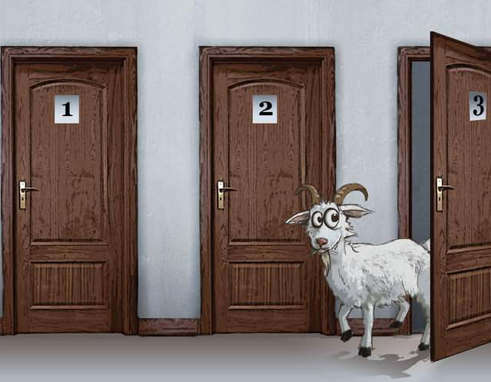
Problem Statement
Contestant has option to choose from 3 doors
Host reveals door containing a goat
Contestant can either switch or stick with door
Expanding this problem to 6, 9, 20, 100 doors (n doors)
Monty Fall variant

Slide 5
Approach
Monty Hall and Monty Fall
Host reveals n-2 doors and we switch on last door
Each time host reveals a door, contestant can switch to any door
Contestant keeps door

Slide 6
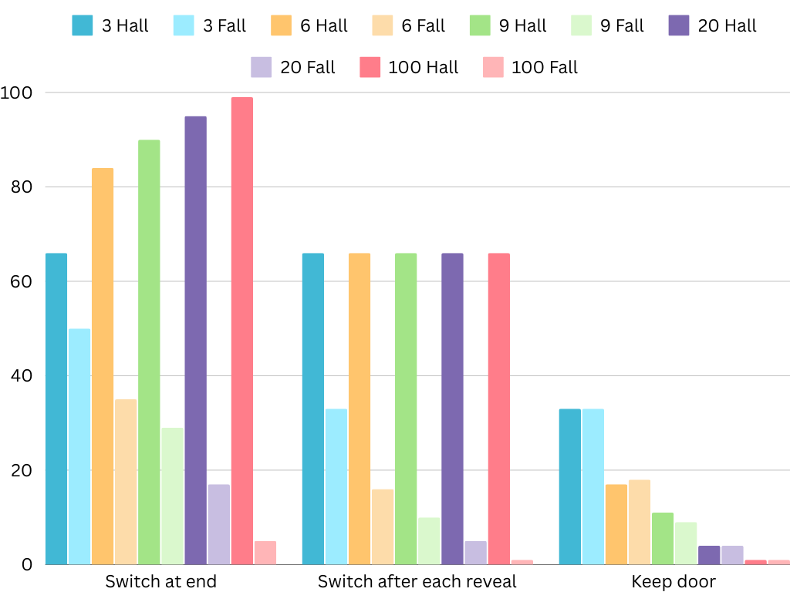
Results & Discussion

Slide 7
Findings
Monty Hall
Higher chance of winning by switching doors
Low chance of winning by sticking with door
Monty Fall
Somewhat equal chance of winning by switching / sticking with door for original problem
Host options are random, so low chance of winning overall

