Slide 1

Negation Effect on Emotion Recognition in Twitter
Zach Stallbohm, Yang Liu, Zhongyu Wei
University of Texas at Dallas
July 11, 2016
Social NLP Workshop
New York Hilton Midtown, New York City, USA

Slide 2
Roadmap
Background
Proposed Method
Experiments
Conclusion

Slide 3
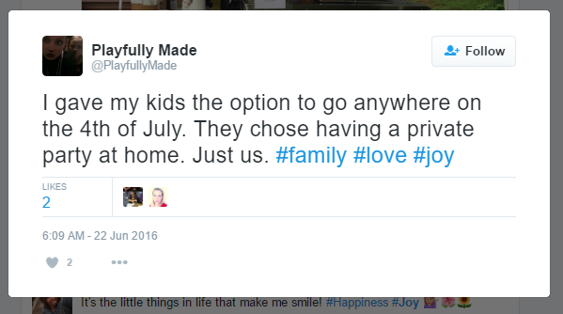
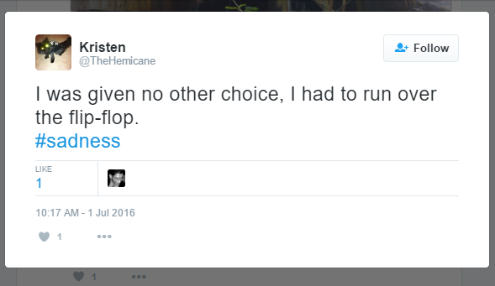
Emotion Recognition in Twitter
Notes:
Twitter is a widely used framework for people to share opinions.
Emotion Recognition can help track how people feel about certain people, products, or events that have happened or currently happening.

Slide 4
Negation
Negation plays an important role in emotion recognition.
This is not a good beginning of my day… #pissed
Not quite sure. It certainly wasn’t soft like a dummy #ew
Without modeling negation, the system cannot recognize the actual emotion being portrayed
-How about proposing a method to model negation to fix this problem?

Slide 5
Existing Negation Models
Most systems use emotion related lexical weights to help classify the emotion being portrayed.
Rest of Sentence (ROS)
Use the rest of the sentence as the negation scope
Window Size
Use the next ‘X’ number of words as the negation scope
Next Non-Adverb (NNA)
Use all words up to the next non-adverb as the negation scope
First Word With Lexical Weight (NLW)
Use all the words up to the first word with a lexical weight as the negation scope
End of Phrase (EOP)
Use all the words in the phrase as the negation scope
Dependency Parser (DP)
Create features based on the dependency relation to model the negation

Slide 6
Problems
Rest of Sentence, Window Size, Next Non-Adverb, First word With Lexical Weight
These methods do not consider any syntactic or semantic information
End Of Phrase
Ignores basic grammar rules.
Dependency Parser
Phrase information is ignored
Incorporating phrase relations based on simple grammar rules
Notes:
Talk about problems.
Ask how can we solve these issues then click and red bullet appears.

Slide 7
Roadmap
Background
Proposed Method
Experiments
Conclusion

Slide 8
Method Framework
Preprocessing
Candidate Phrase
Identification
Rule Based Phrase Cut
Tweet
Negation Scope

Slide 9
Preprocessing
Given a tweet we first get the POS tags using the CMU POS tagger.
Replace all emoticons and hashtags with special symbols
That was a #dicey move and didn’t work well for him #sc2 #HSC #rottibuild
That was a dicey move and didn’t work well for him # # #
Detect the negation cue
That was a dicey move and didn’t work well for him # # #
Split the tweet into two parts
Non-negated
That was a dicey move and
Negated
Didn’t work well for him # # #

Slide 10
Candidate Phrase Identification
Obtain the phrase candidate by applying the rule based on the POS tag of the word following the negation cue
Part of Speech | Rule | Example
Noun/Determiner | Entire noun phrase | That was not a sign
Adjective | The adjective itself | That was not amazing popcorn
Adverb | Adverbial comparative then the adverb phrase is the candidate Otherwise adverb is the negation scope | That movie was not very good The food was not quite as good as last time
Verb | Entire verb phrase | It did not run as long
Preposition | Entire prepositional phrase | He is not at home

Slide 11
Rule Based Phrase Cut
Trim the phrase to obtain the final negation scope:
Find the first occurrence of a pronoun, preposition, proper noun, and conjunction
Segment the phrase based on the following rules:
Both pro/proper noun and preposition occur, phrase is cut at the preposition
Conjunction happens before a pro/proper noun, preposition, or both, the phrase is cut at the conjunction
Phrase is entirely pro/proper nouns and prepositions then no cut
Remove all trailing hashtags that appear at the end
Notes:
If both pro/proper noun and preposition occur, the preposition has more precedence so the phrase is cut at the preposition
If a conjunction happens along with a pro/proper noun, preposition, or both, the phrase is cut at the conjunction if it appears first in the tweet. If it comes after you apply rule (a).
If the phrase is entirely pro/proper nouns and prepositions then nothing needs to be cut
Remove all trailing hashtags that appear at the end since they are tags and not part of the phrase itself.

Slide 12
Roadmap
Background
Proposed Method
Experiments
Corpus and Lexicons
Features and Model
Results
Conclusion

Slide 13
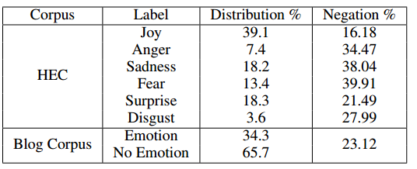
Existing Corpora
Hashtag Emotion Corpus (HEC) (Mohammad and Kiritchenko, 2015)
Collected from Twitter
Emotion related hashtags for label generation
21,000 emotion tweets
Blog Corpus (Aman and Szpakowicz, 2007).
Collected from web blog
Mechanical Turk service for annotation
4,266 sentences.
Labeled emotion and no-emotion

Slide 14
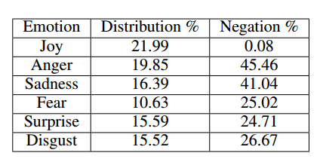
Our Emotion Corpus
We created our own Emotion Corpus by following the method in Mohammad and Kiritchenko [2015].
We polled the Twitter Search API, using emotion related hashtags, during May and August 2015.
The corpus is made up of 62,400 emotion labeled tweets.
Notes:
We forced the distribution to be more even so each emotion has enough samples for experiments.
Although it does not reflect the real world frequency.

Slide 15
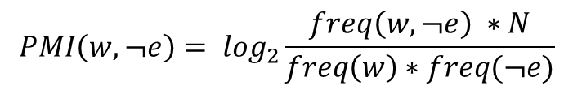
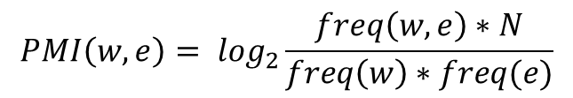
NRC Lexicon
Pointwise Mutual Information (PMI) to calculate the Strength of Association (SoA) between a n-gram, w, and an emotion, e.
N is the size of the vocabulary
$$SoA\left(w,e\right)=PMI\left(w,e\right)−PMI\left(w,¬e\right)$$
$$PMI\left(w,e\right)= \log_{2}\frac{freq\left(w,e\right)∗N}{freq\left(w\right)∗freq(e)}$$
$$PMI\left(w,¬e\right)= \log_{2}\frac{freq\left(w,¬e\right) ∗N}{freq\left(w\right)∗freq(¬e)}$$
NRC lexicon is from Mohammad and Kiritchenko [2015]
Notes:
Lexicons are important because they relate n-grams with what emotion they are connected with.
We use lexicons to help with feature generation.

Slide 16
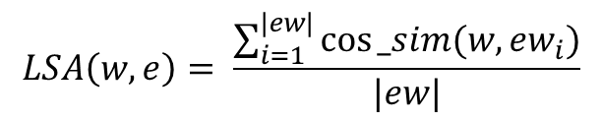
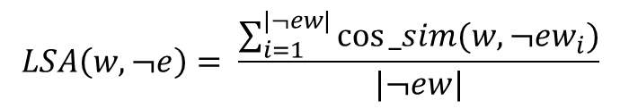

Our Lexicon
Created from a corpus of 300K tweets.
The Strength of Association (SoA) was calculated between an n-gram, w, and an emotion, e, using Latent Semantic Analysis (LSA)
All n-grams with a positive score were kept, which resulted in 32,677 unique n-grams.
$$SoA\left(w,e\right)=LSA\left(w,e\right)−LSA(w,¬e)$$
$$LSA\left(w,e\right)= \frac{\sum_{i=1}^{|ew|}{cos⁡_sim(w,{ew}_{i})}}{|ew|}$$
$$LSA\left(w,¬e\right)= \frac{\sum_{i=1}^{|¬ew|}{cos⁡_sim(w,¬{ew}_{i})}}{|¬ew|}$$

Slide 17
Roadmap
Background
Proposed Method
Experiments
Corpus and Lexicons
Features and Experiments
Results
Conclusion

Slide 18
Features
Word N-grams:
Presence of unigrams and bigrams
POS:
The number of occurrences of each POS tag
Elongated Words:
Number of words with one character repeating over two times.
Emoticons:
The number of emoticons that occur for each emotion
Words per Emotion (affected by negation):
The number of words that occur per emotion. For each word, its emotion is the one with the highest lexical weight.
Emotion Score (affected by negation):
The weight of each emotion in the tweet. This is computed as the sum of the lexical weights of all the words in the tweet per emotion.

Slide 19
Experiments
Task I: Binary Classification
One-vs-all classification for each emotion
Task II: Multi-Class Emotion Classification
Consider all the emotion classes during classification
Task III: Emotion Detection
Detect if a sentence expresses emotion or not.

Slide 20
Setting
Data
Task I and Task II: Hashtag Emotion Corpus and Our Emotion Corpus
Task III: Web Blog Corpus
Evaluation Metric
Macro-F1
SVM with 10-fold cross validation.

Slide 21
Roadmap
Background
Proposed Method
Experiments
Corpus and Lexicons
Features and Experiments
Results
Conclusion

Slide 22
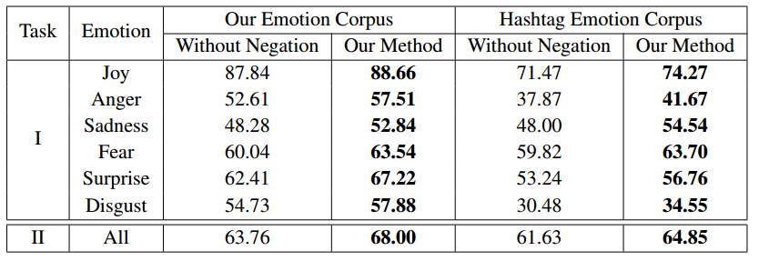

Results
Emotion Classification
Emotion Detection
Notes:
We observe a improvement in our system over the one with negation in both emotion classification and emotion detection

Slide 23
Results
Emotion Classification
Emotion Detection
Notes:
The improvement is the lowest for joy since it does not contain very little negation.
As we can see our system made a higher improvement on emotions that contained more samples with negation.
From the results of Task I we can see that joy has the highest f1 score. This could be due to words expressing joy have very little overlap with words that express other emotions. Even when using just unigrams as a feature joy dominates in F1 score.

Slide 24
Results
Emotion Classification
Emotion Detection
Notes:
Similarly in the Hashtag Emotion Corpus we can see a higher improvement for those emotions containing more negation samples.
In this case joy has the highest f1 score since it dominates the corpus along with the scores for disgust and anger being the lowest since the corpus contains fewest samples for those two emotions.
The results of Task I and II on both corpora indicate the effectiveness of modeling negation for emotion classification

Slide 25
Results
Emotion Classification
Emotion Detection
Notes:
A improvement is achieved by our system over the system without negation for task III.
This shows that our method can also work for web blogs and for the binary emotion detection task.

Slide 26
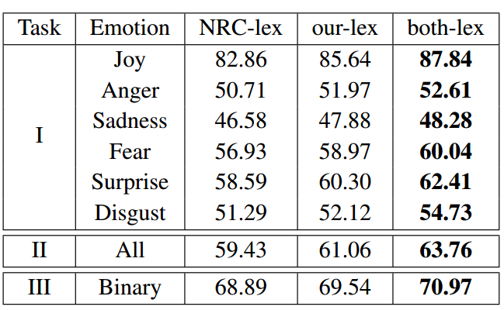
Results
Our Lexicon compared to NRC Lexicon
The results for Task I and II is obtained on Our Emotion Corpus
Notes:
The experiments for Task I, II, and III were performed without modeling negation in order to focus on the impact of the three lexicons alone.
For all three tasks our-lex performs better than NRC-lex, showing the effectiveness of our emotion lexicon.
The best results are achieved when using the combined version of the lexicons.
When combining the lexicons if two words overlap we use the weights of our-lex.

Slide 27
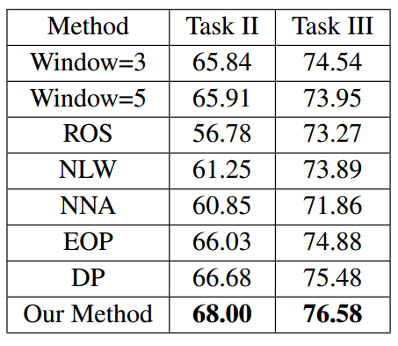
Results
Our Negation Method compared with other negation methods
The results for Task II is obtained on Our Emotion Corpus
Notes:
As expected, our method outperforms the static methods, because our method is able to dynamically capture the negation scope.
Our method also includes phrase relation information where static methods do not.

Slide 28
Results
Our Negation Method compared with other negation methods
The results for Task II is obtained on Our Emotion Corpus
Notes:
Our method performs better than Next-Lexical Weight and Next non adverb, since our method is able to determine relationships between words.
Whereas Next-Lexical weight and Next non adverb do not capture any relationship between words.

Slide 29
Results
Our Negation Method compared with other negation methods
The results for Task II is obtained on Our Emotion Corpus
Notes:
End of Phrase does also not use any grammar rules to determine the phrase it choses and if it chooses the correct negation scope it could also be too long.
Our method out performs End of Phrase since we make use of grammar rules to choose the correct phrase and use simple rules to shorten the phrase to the correct scope.

Slide 30
Results
Our Negation Method compared with other negation methods
The results for Task II is obtained on Our Emotion Corpus
Notes:
Our method outperforms the Dependency Parser method, since it uses the phrase relation between words which is important in determining the negation scope.

Slide 31
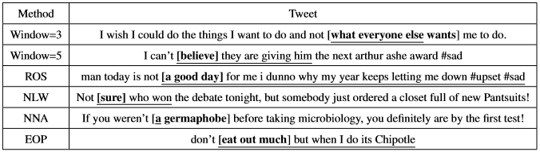
Results

Slide 32
Error Analysis
Sarcastic or Passive aggressive tweets
Working late on a Monday #joy
Tweets with flipped words or missing words
Without to play him? Are you joking me!
Multi-Emotional tweets
Why is life so awful? #sad #anger
Tweet requires more information
@User, I agree that was poorly handled

Slide 33
Roadmap
Background
Proposed Method
Experiments
Corpus and Lexicons
Features and Experiments
Results
Conclusion

Slide 34
Conclusion
Develop new method to model negation for Twitter Emotion Recognition
Create new Emotion labeled corpus and lexicon.
Show the effectiveness of modeling negation for Twitter Emotion Recognition
Show that the grammar phrase method can better detect the negation scope in tweets over other methods.
Include sarcasm and passive aggression detection, multi-emotional classification, and test neural network moethods.

Slide 35
Reference
[Aman and Szpakowicz, 2007] Saima Aman and Stan Szpakowicz. Identifying expressions of emotion in text. In Text, Speech and Dialogue, pages 196–205. Springer, 2007.
[Mohammad and Kiritchenko, 2015] Saif M Mohammad and Svetlana Kiritchenko. Using hashtags to capture fine emotion categories from tweets. Computational Intelligence, 31(2):301–326, 2015.

Slide 36

Question and Answering

