Slide 1
AI Tutor

Slide 2
TABLE OF CONTENTS
01
02
Introduction By Muneef Khan
Why We Need This ? By Gaurav Kumar
03
04
Who Else Is Doing This ? By Mayank Singh Rawat
Why Choose Our AI Tutor ? By Palak Bisht

Slide 3
TABLE OF CONTENTS
05
06
How It Works ? By Susparsh Jakhmola
Target Users By Samridhi Uprethi
07
08
Implementation Timeline By Aditya Negi
Conclusion By Shreyash Raj Bamrara

Slide 4
01
Introduction

Slide 5
Online/Offline Tutor : Ai Companion
AI that adapts to the learner’s mood, energy, and personality
Designed not just for academic help but for personal growth
Continuously learns and evolves with the user
Operates offline, ensuring privacy and emotional intelligence

Slide 6
02
Why We Need this ?

Slide 7
Why
We Need this ?
Many learners struggle with generic tutoring systems that fail to recognize emotional needs. These rigid, one-dimensional tools lead to disengagement and burnout. At the same time, most platforms prioritize data collection over privacy. There's a clear need for a tutor that understands, adapts, and respects the learner.

Slide 8
03
Who Else Is Doing This?

Slide 9
Who Else Is Doing This?
Khan Academy – Khanmigo Offers AI tutoring with step-by-step help. However, it lacks emotional depth and still feels generic.
ChatGPT & Similar Tools While powerful, tools like ChatGPT don’t retain your mood, energy, or long-term personality traits unless explicitly instructed.
Duolingo & BYJU’s Duolingo uses gamified, rule-based learning. BYJU’s provides rich video content — but both lack real personalization or mood adaptation.

Slide 10
Most tools respond — but they don’t relate. NeuroX fills this gap with an AI that builds trust, adapts emotionally, and promotes holistic growth.

Slide 11
04
Why Choose Our AI Tutor ?

Slide 12
Our Solution
Emotion-Aware AI NeuroX adjusts its tone, pace, and style based on the learner’s current mood and mental state, making interactions feel more human and supportive.
Offline & Online Unlike cloud-based systems, NeuroX also runs offline, ensuring complete privacy and access anytime — without sacrificing performance.

Slide 13
05
How it Works?

Slide 14
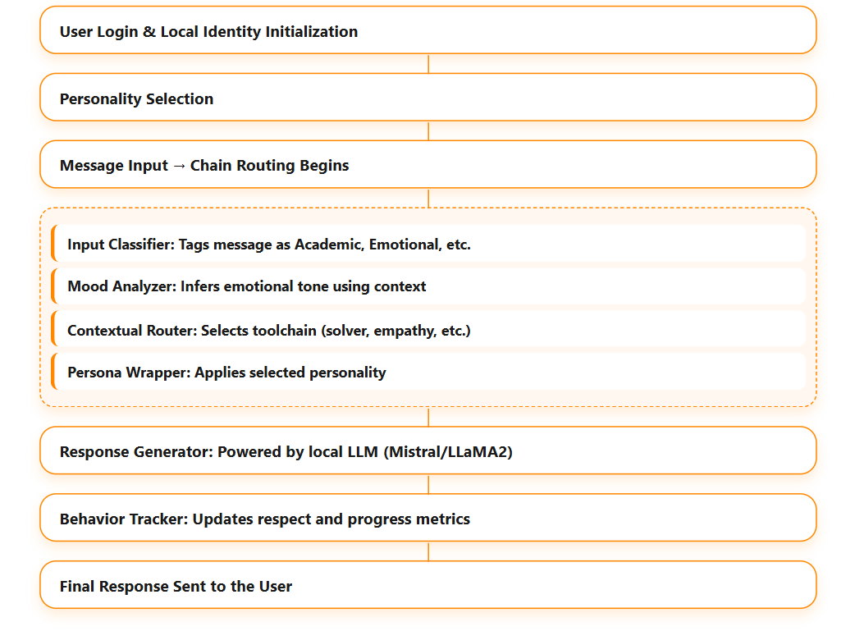
How it Works?
W o r k I n g
Our AI tutor uses a chain of intelligent, privacy-first tools to adapt responses based on user input, mood, and context.
Responses are generated locally and personalized through selected personas.

Slide 15
06
Targeted Users

Slide 16
Targeted Users
School Students (K–12)
Age: 9–17
Focus: Homework help, fundamentals, behavior-building
Why We Fit: Emotion-aware replies, gamified progress, discipline support
College Students & Young Adults
Age: 18–25
Focus: Concept mastery, productivity coaching
Why We Fit: Persona-based interaction, mood-adaptive learning, accountability
Corporate Learners
Use Case: Onboarding, soft skills, upskilling
Why We Fit: Role-specific tutors, feedback loops, team insights

Slide 17
07
Implementation Timeline

Slide 18
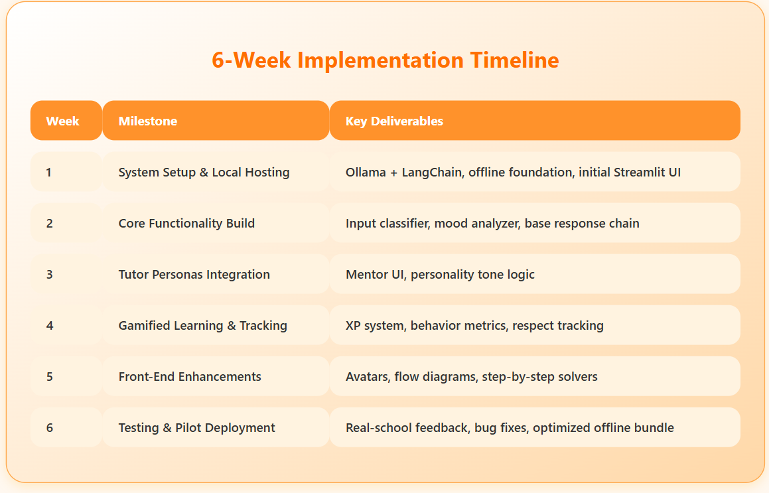
Implementation Procedure

Slide 19
08
Conclusion

Slide 20
Why It Matters ?
"Today’s students live with AI, yet most tools remain robotic and detached.
We built something different — a local, offline-ready AI tutor that adapts like a mentor, motivates like a coach, and listens like a friend.
It doesn’t just answer — it inspires, disciplines, and evolves with the learner."

Slide 21
THANK YOU!
By Team NeuroX
Susparsh Jakhmola
Muneef Khan
Gaurav Kumar
Aditya Negi
Palak Bisht
Samridhi Upreti
Shreyash Raj Bamrara
Mayank Rawat

