Slide 1
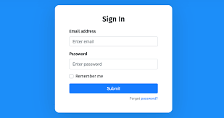
Login
Email Address
Enter Email
Password
Enter Password
Remember Me
Submit
Forget Password?

Slide 2

Profil
Email : Admin1@gmail.com
Password : *************
Username : Admin01
Profil
Foto :
Absensi
Tambah Data
Data Rombel
Hak Akses : Admin
Data User
Logout

Slide 3
Absensi
NIS
Nama
Rombel
JK
Rayon
Aksi
1810****
Martin
RPL XII - 3
L
Sukasari 3
Profil
Absensi
Tambah Data
Data Rombel
Data User
Logout

Slide 4
Tambah Data
NIS
Masukan NIS
Nama
Masukan Nama
Profil
JK
Masukan Jenis Kelamin
Absensi
Rombel
Masukan Rombel
Tambah Data
Rayon
Masukan Rayon
Data Rombel
Batal
Simpan
Data User
Logout

Slide 5
Data Rombel
RPL
RPL XII - 1
RPL XII - 2
RPL XII - 3
RPL XII - 4
MMD
TKJ
Profil
OTKP
Absensi
BDP
Tambah Data
HTL
Data Rombel
TBG
Data User
Logout

Slide 6
Data User
Hadir = 75%
Alpa
Alpa = 8%
Profil
Izin
Sakit = 9%
Hadir
Absensi
Izin = 8%
Sakit
Tambah Data
Data Rombel
Data User
Logout

