Slide 1
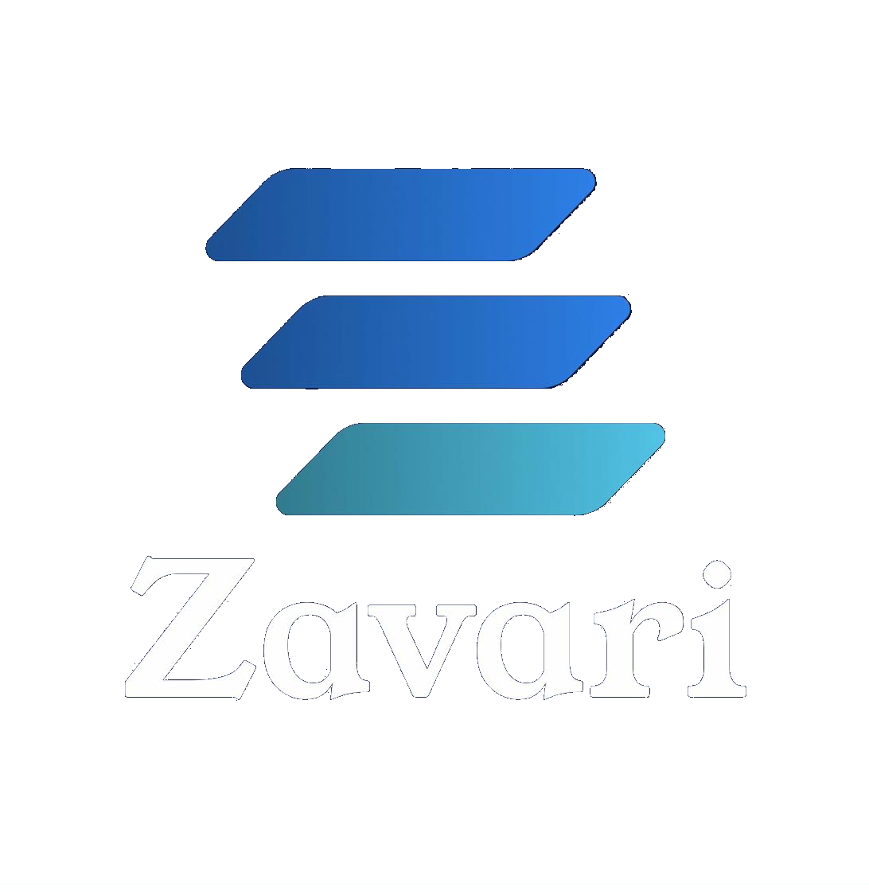
The tools exist.
What's missing is the OS
that makes them work as one.
Zavari — Strategic Intelligence for Product Organizations
1

Slide 2
Individual AI
Institutional AI
Answers questions
Surfaces what you didn't know to ask
Synthesizes one source
Triangulates across many sources
→
Individual productivity
Organizational intelligence
76%
of product leaders say most AI tools target individual, not team, productivity — and rank it as their top AI ROI blocker
AI made every individual 10× more productive.
No company became 10× more valuable.
George Sivulka, a16z — March 2026 · Forrester / HBR Analytic Services, September 2025 (Miro-commissioned, n=518 / n=332)
2

Slide 3
Every quarter, your CPO manually synthesizes this.
D
C
N
A
G
Dovetail
Crayon
Notion
what customers say
Amplitude
what the market's doing
Gong
what we decided last quarter
what customers do
what prospects are asking
None of these talk to each other.
87%
say highly effective product development is critical to business success
34%
describe their organization's approach as highly effective
Forrester / HBR Analytic Services, September 2025 (Miro-commissioned, n=328–332)
3

Slide 4
Strategic planning without institutional memory has real costs.
Decisions-to-delivery
Institutional memory
Measured in quarters, not weeks
Leaves with every VP of Product
Translation cost
Strategic analysis
Every handoff from signal to recommendation degrades fidelity — the CPO who synthesizes manually is doing information routing, not strategy
Requires either a $50K–$500K consulting engagement or a very experienced CPO
The choice has been: fly blind, synthesize manually, or pay a consultant. Zavari is the fourth option.
4

Slide 5
Zavari is the operating system
for strategic product decisions.
Intelligence Layer
Watches continuously — surfaces what nobody asked for
↓
System of Record
Captures what was decided and why, permanently
↓
Operating Layer
Connects existing tools into one intelligence workflow
Not a tool. Not a platform. An OS — in the full sense of the metaphor.
5

Slide 6
The Triangulation Engine.
Strategic
Opportunity Brief
1st-Party Qualitative
→
What customers say
1st-Party Quantitative
3rd-Party Market
What customers do
What the market is doing
Where signals converge: high-confidence strategy. Where they conflict: the tension worth examining.
Developed during MBA internship at Dell (End User Computing strategy) under Ansgar Chorhummel · Confirmed at Magellan GPS
6

Slide 7
Two surfaces. One system.
Strategic Command Layer
Execution Surfaces
CPO · VP of Product · Head of Strategy
PMs · Engineering Leads · Delivery Teams
→ Open strategic questions
→ Jira — strategic context on every epic
→ Review & accept Briefs
→ Confluence — Briefs & OKRs as system of record
→ Manage OKR cascade
→ Monitor strategic health
→ Slack — Strategic Instinct alerts
→ Respond to alerts
Same intelligence layer, different surfaces
7

Slide 8
Three things just changed.
①
Microsoft shut down Viva Goals
December 2025 — thousands of organizations lost their OKR infrastructure overnight. The strategy alignment gap is open and uncontested.
②
Ecosystem convergence is documented, not inferred
Miro's March 2026 commissioned Forrester/HBR research explicitly names planning, roadmapping, and OKR management as active product priorities. Every major platform is building toward strategic intelligence from an adjacent position. None have reached cross-source synthesis. The window is 12–18 months.
③
Learning speed replaces execution speed as the moat
Individual AI productivity gains are real but not translating to organizational value — 76% of product leaders confirm this. The companies that pull ahead will be the ones whose organizational intelligence compounds over time. That requires infrastructure, not just tools.
8

Slide 9
A $180M–$420M serviceable market — and a much larger displacement opportunity.
TAM
~$10–12B
Beyond the SaaS market
Product mgmt + strategy execution + CI + AI analytics
Series B–D companies currently either go without rigorous strategic analysis or pay $50K–$500K per engagement.
Zavari is the fourth option — McKinsey-quality strategic synthesis, continuous, at a SaaS price point.
SAM
$180–420M
6,000–7,000 Series B–D companies at $30K–60K platform ACV
SOM
~$6.5M ARR Y3
1–2% SAM penetration at midpoint ACV
Platform ACV model — not per-seat — justified by intelligence infrastructure value.
9

Slide 10
Platform + seat. Justified by intelligence infrastructure, not headcount.
Component | Rate | What it covers
Platform fee | $18K–$24K/year | Triangulation Engine · Signal Architecture · Strategic Learning Layer
Creator seats | $150–200/seat/mo | CPO · VP Product · senior PMs in command layer
Contributor access | Included | Executives & delivery teams viewing outputs in native tools
10-person org (4 Creator seats)
~$29K/year
20-person org (6 Creator seats)
~$37K/year
Year 1–2: Platform + seat → Year 2–3: Outcome-based pricing tier → Year 3+: API & marketplace
10

Slide 11
Founder-led to $1M ARR. Then the flywheel.
Phase 01
Phase 02
Phase 03
Design Partner Program
Early Commercial
Ecosystem + Community
Months 1–9
Months 9–18
Months 18–36
→ 5–10 partners
→ 25–40 customers
→ First sales hire
→ $10K–20K/year
→ $40K–60K ACV
→ Co-selling: Amplitude, Dovetail, Miro
→ Founder network, Expedia/Virtuoso/Porch alumni, LinkedIn
→ LinkedIn, integration marketplaces, referrals
→ Annual Strategic Intelligence Report
[Design partner case study — specific strategic decision traceable to revenue outcome — Q3 2026]
11

Slide 12
Built by someone who lived the problem.
Matt
Technical Co-Founder
Founder
Actively recruiting
Expedia Group · Virtuoso Travel · Porch Group · Magellan GPS
→ AI/ML engineering · multi-agent systems
125% margin growth
→ Product tooling ecosystem experience
35% CLV increase
3× planning cycle acceleration
→ Equity-motivated seed-stage mindset
MBA, UT Austin McCombs
Triangulation Engine: developed at Dell (MBA internship, Ansgar Chorhummel) · confirmed at Magellan GPS
Sourced from Expedia, Porch, Virtuoso, UT Austin McCombs alumni networks
[Senior Product Leader]
[Enterprise AI / LLM]
[B2B SaaS GTM]
12

Slide 13
$1.5M–$2.5M to prove the intelligence layer.
Technical co-founder recruitment
25–30%
Engineering and product development
35–40%
Design partner program
15%
Sales, marketing, community
10%
Legal, compliance, infrastructure
10%
The tools exist. What's missing is the OS that makes them work as one.
18–24 month runway · Series A readiness at ~$1M ARR · 3–5 revenue-attributable decisions documented
13

