Slide 1
GANS
Generative Adversarial Networks

Slide 2
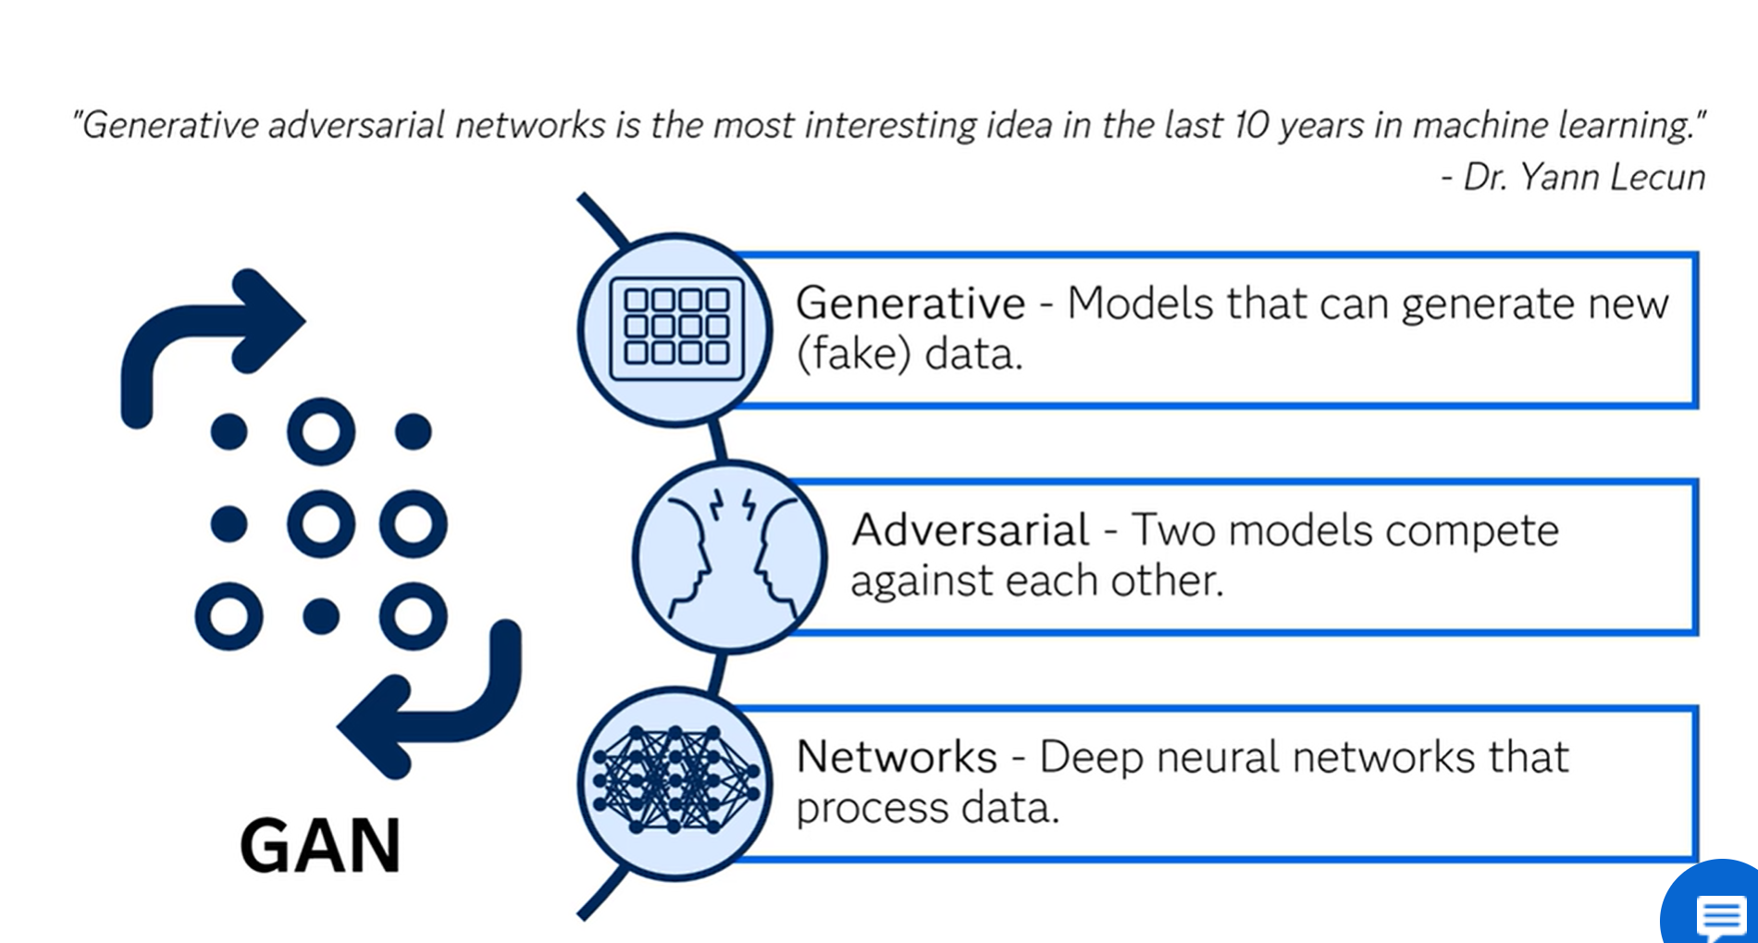
GANS

Slide 3
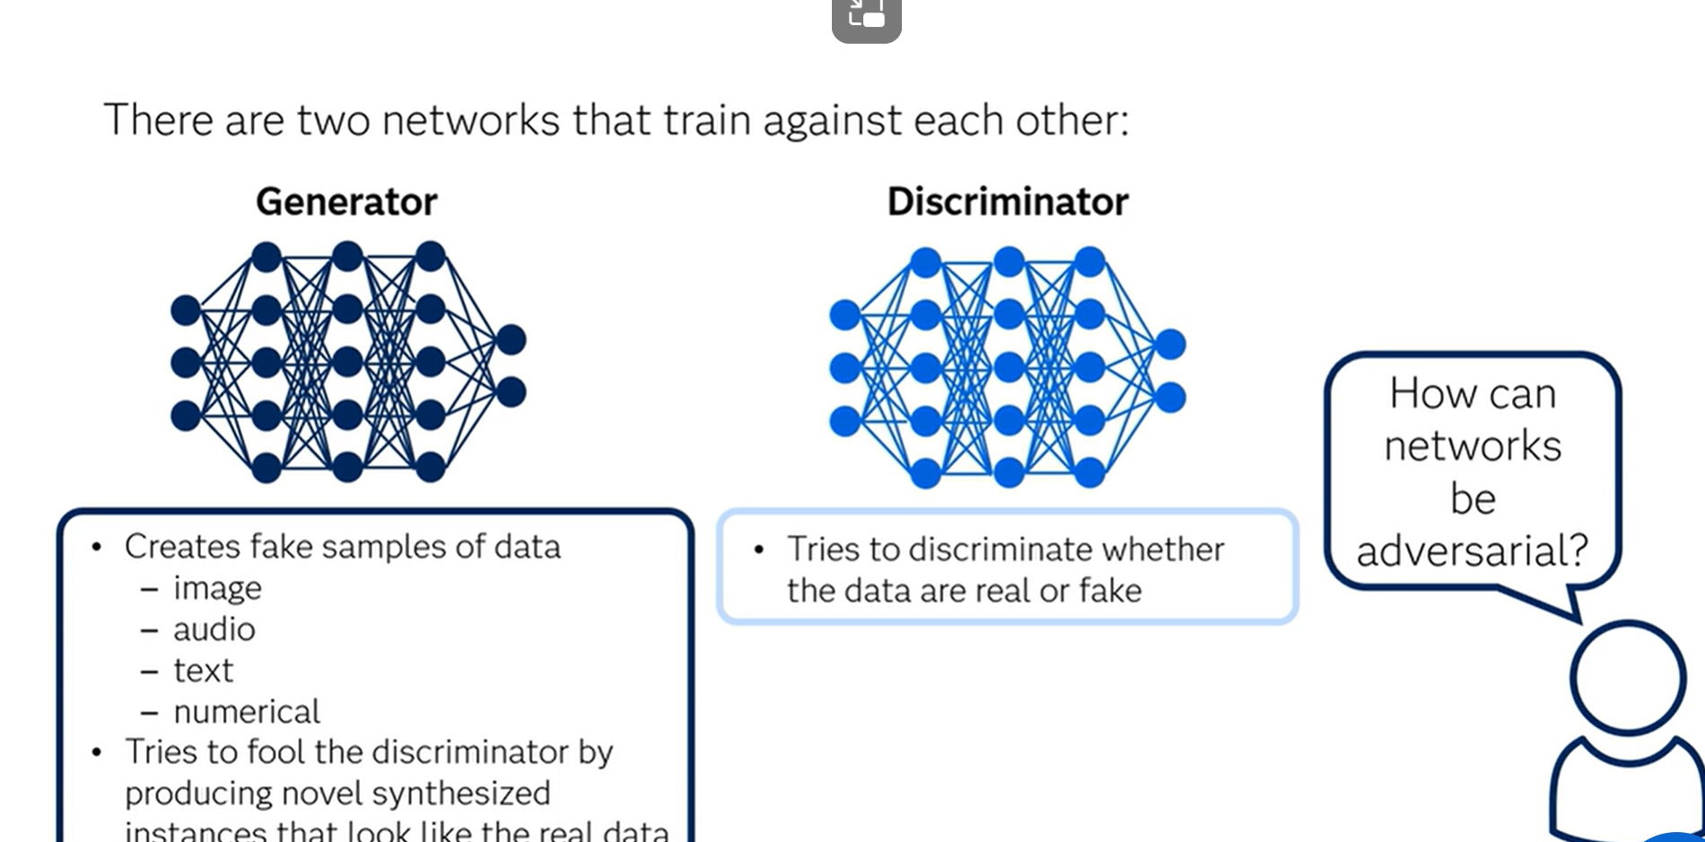

Slide 4
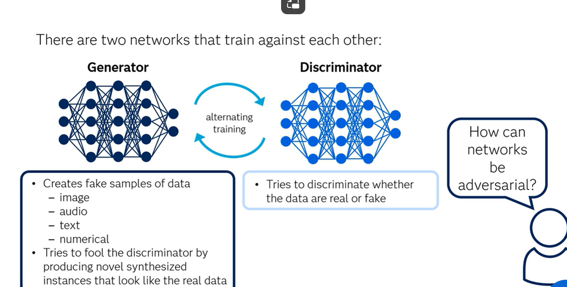
Notes:
French computer scientist Dr. Yann Lecun has called generative adversarial networks the most interesting idea of the decade in machine learning. Generative adversarial networks, or GANs, are a deep-learning-based generative model that is used to generate new data. It is a system in which two adversarial neural networks compete with each other to generate new observations that are indistinguishable from real data. GAN models consist of several deep neural networks that process data. They work great for synthetic data generation, particularly for image data.
You might be wondering, "How can networks be adversarial?" Well the two networks, called generator and discriminator, compete with each other to win, hence the name adversarial. The generator learns to create fake samples of data, which can be image, audio, text, or simply numerical data. The generator tries to fool the discriminator by producing novel synthesized instances that ideally look like the real data. The discriminator evaluates the generated data and tries to discriminate whether the data are real or fake.
The key to GANs lies in how we alternate the training of the two networks. As the generator becomes more adept at fooling the discriminator, the discriminator must adapt in order to maintain its ability to correctly identify which observations are fake. This drives the generator to find new ways to fool the discriminator, and so the cycle continues. Through multiple cycles of generation and discrimination, both networks train each other, while simultaneously trying to deceive each other.

Slide 5
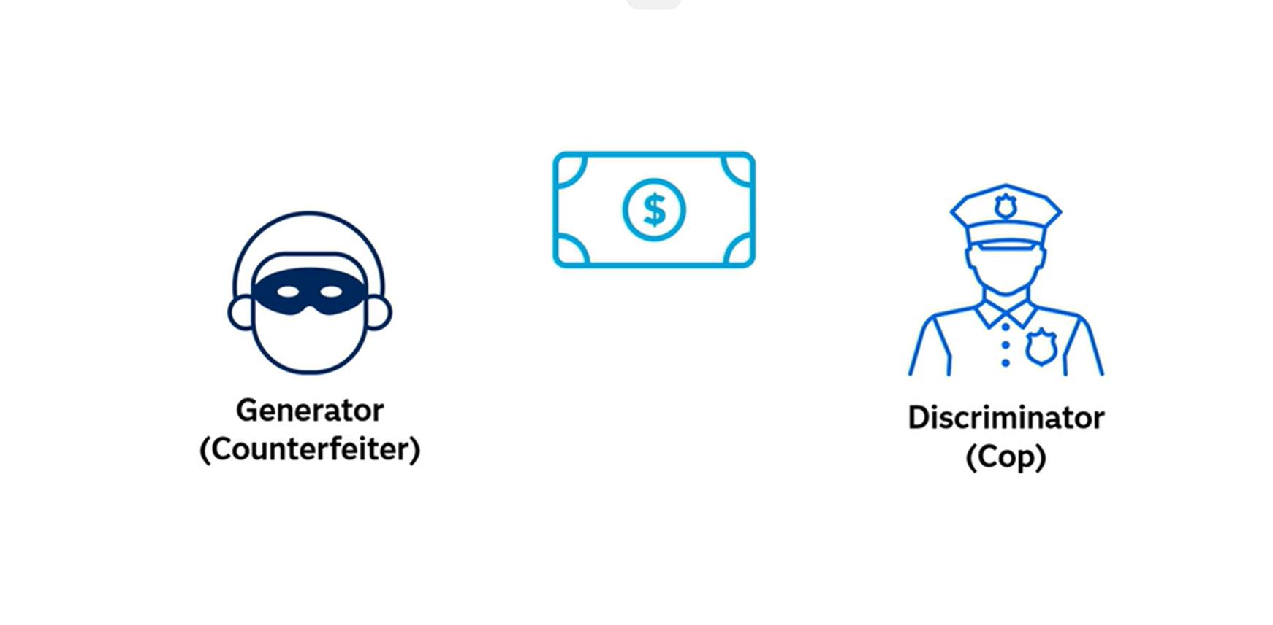
example
Notes:
Let us consider an example where you want to create an image of a one-dollar bill. When the training begins. the generator produces an obviously fake image of a one-dollar bill, and the discriminator quickly determines that the image is fake. When the generator is caught with the fake dollar-bill image it tries harder the next time to get better at creating one-dollar-bill images. But, the discriminator also gets better, so they both compete to win. As training progresses, the generator gets closer to producing output that can deceive the discriminator.
Eventually, there comes a point where the generator becomes good enough at generating realistic-looking fake images that the discriminator cannot discriminate whether the bill is fake or real, and it starts to classify the fake bill as real. It is important to focus on each of these components to understand how they come together.

Slide 6
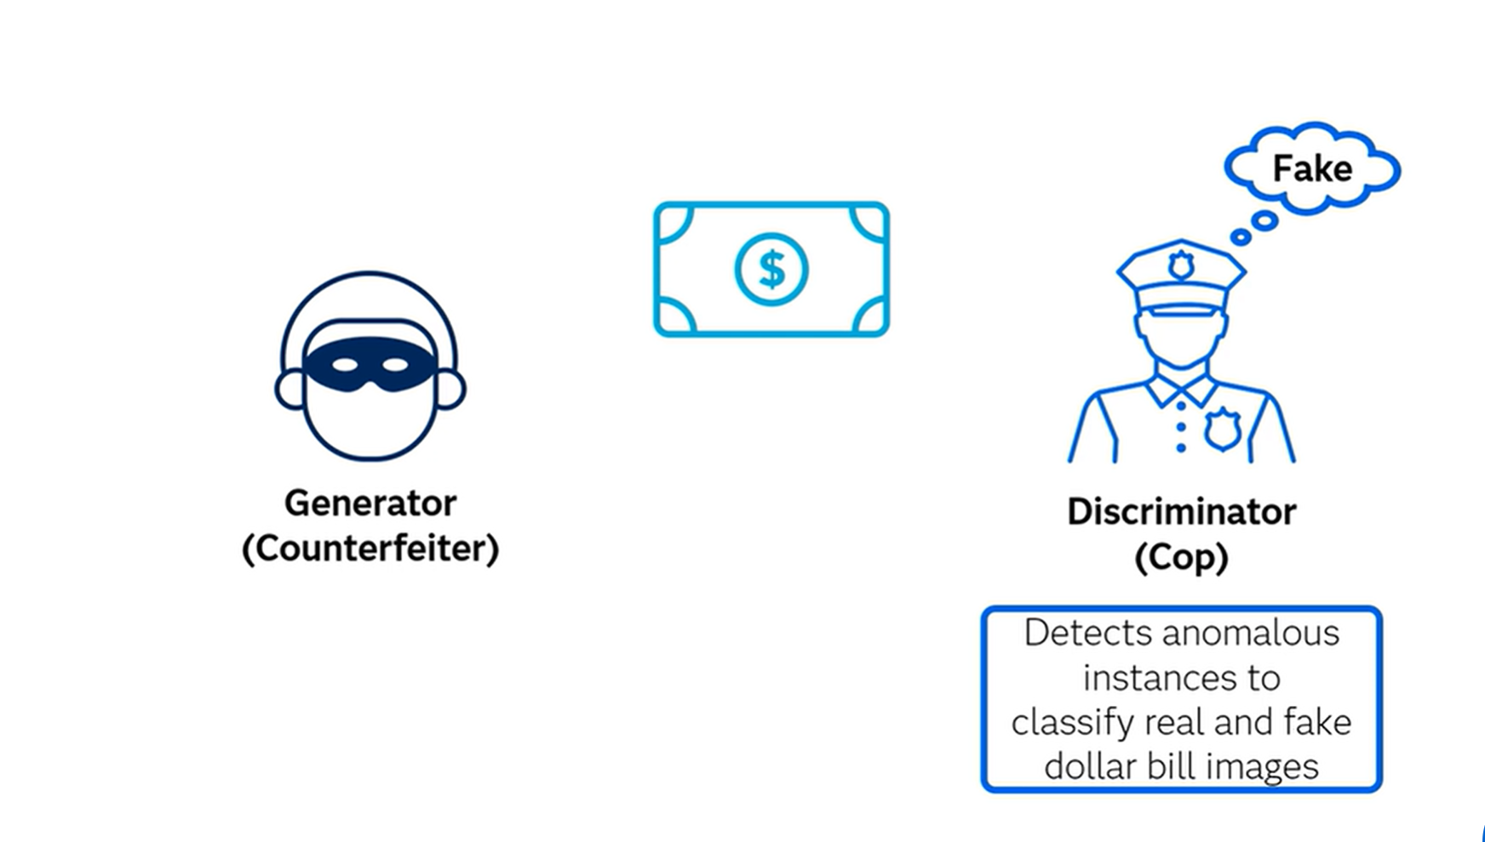

Slide 7
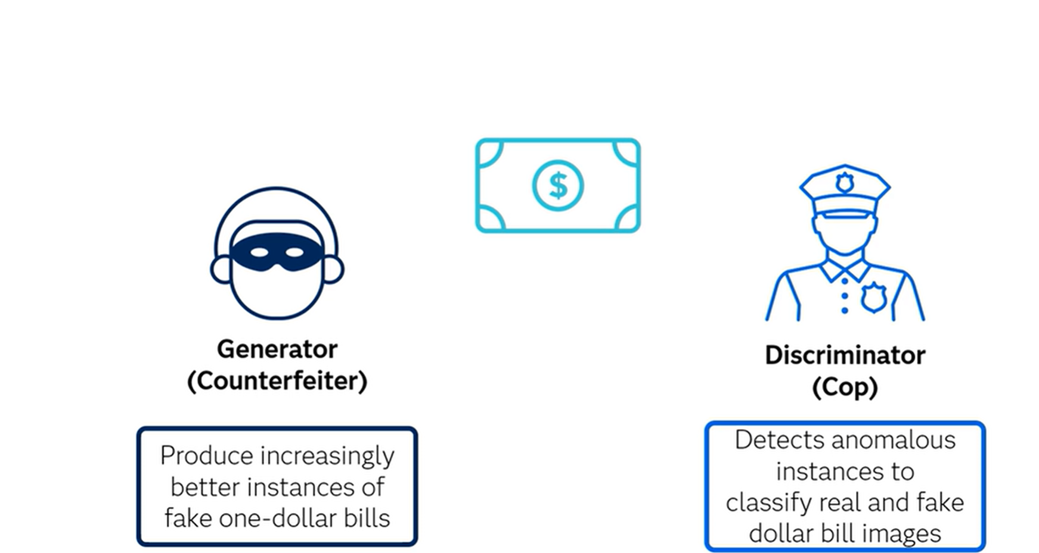

Slide 8
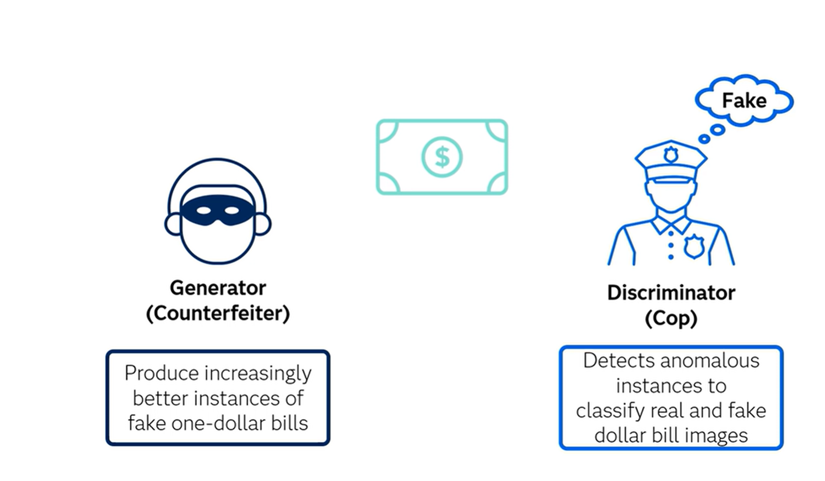

Slide 9
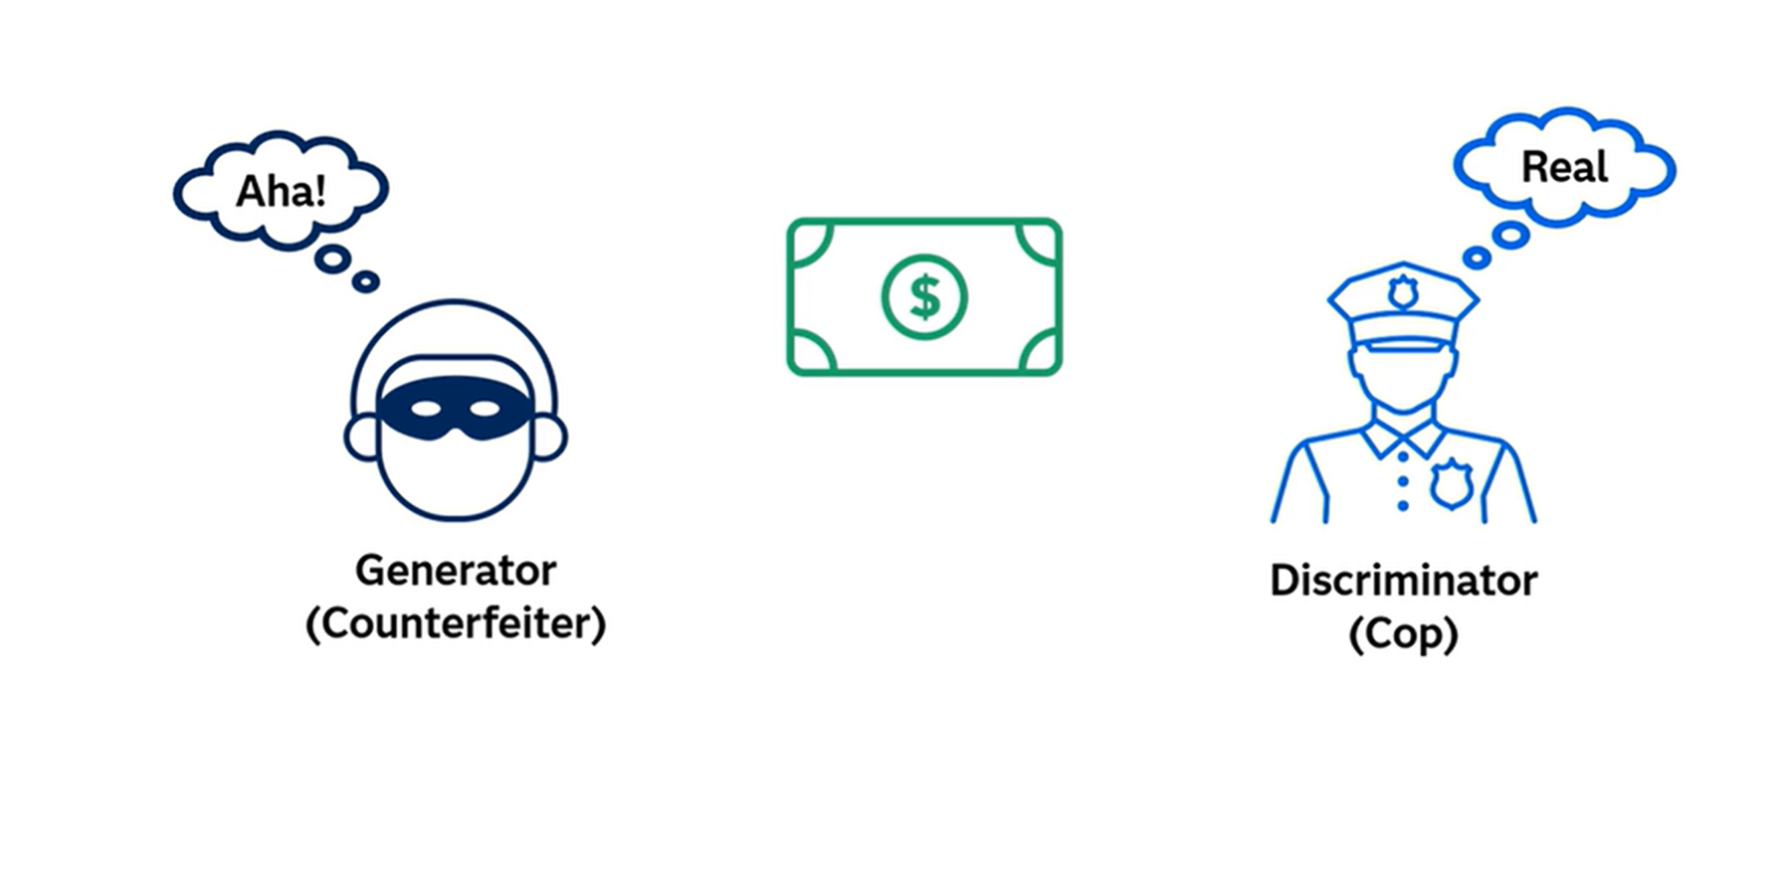

Slide 10
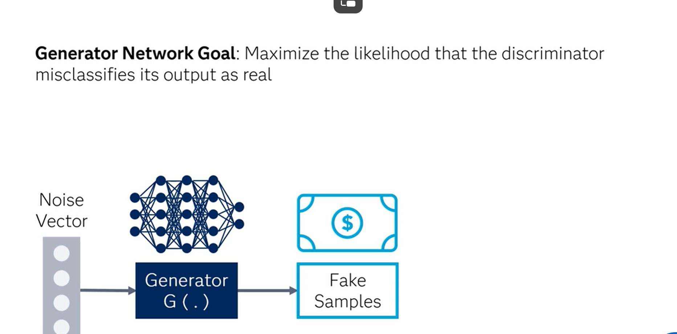
Training networks
Notes:
What is a generator network? The generator network tries to learn the data distribution by using random noise as inputs and producing instances that look like real data. The main goal of the generator network is to maximize the likelihood that the discriminator misclassifies its output as real.
The generator network training process, the fake sample produced by the generator is trained on the discriminator.

Slide 11
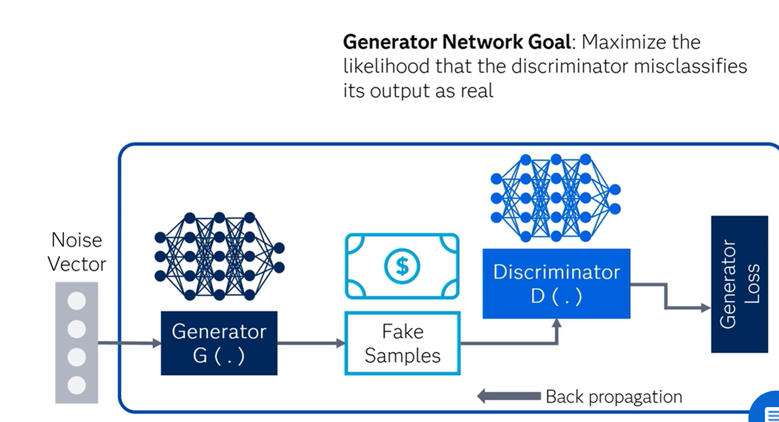
Notes:
The discriminator network classifies the generated data as real or fake and produces generator loss. This generator loss penalizes the generator for failing to dupe the discriminator. Remember, the main goal of the generator is to fool the discriminator into classifying its output as real.
The back propagation method is used to adjust each weight by calculating the weight's impact on the output. The back propagation method is used to obtain gradient, and these gradients can help change the generator weights. The generated, or fake, examples become negative training cases for the discriminator.
The training data feeding into the discriminator network comes from two sources: the real data instances, which are used as positive examples during the training process, and the fake data instances, which were generated by the generator network and are used as negative examples during the training process.
The discriminator network generates predictions for how likely the instances are to be real or fake, where the labels are 1 for the real instances and 0 for fake instances, with binary cross-entropy as the lossfunction. So, the main goal of discriminator network is to accurately distinguish between real and fake data.
In the process of training the discriminator network, it classifies both the real data and the fake data from the generator. Notice that the discriminator connects to two loss functions. However, during discriminator training, the discriminator ignores the generator loss and simply uses the discriminator loss. The discriminator loss penalizes the discriminator for misclassifying a real data instance as fake or a fake data instance as real. The discriminator updates its weights throughback propagation from the discriminator loss through the discriminator network.

Slide 12
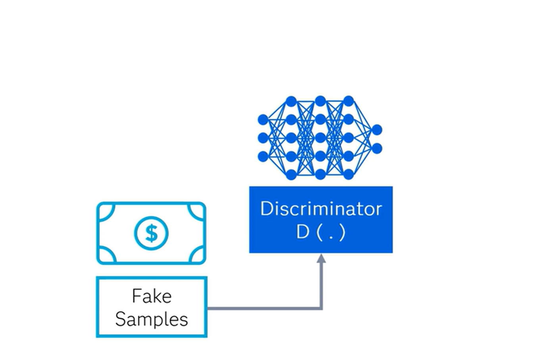
Notes:
Discriminator network tries to differentiate between the fake data produced by the generator network and real data. Thus, the discriminator network is simply a classifier that could use any network architecture appropriate to the type of data that it's classifying.

Slide 13
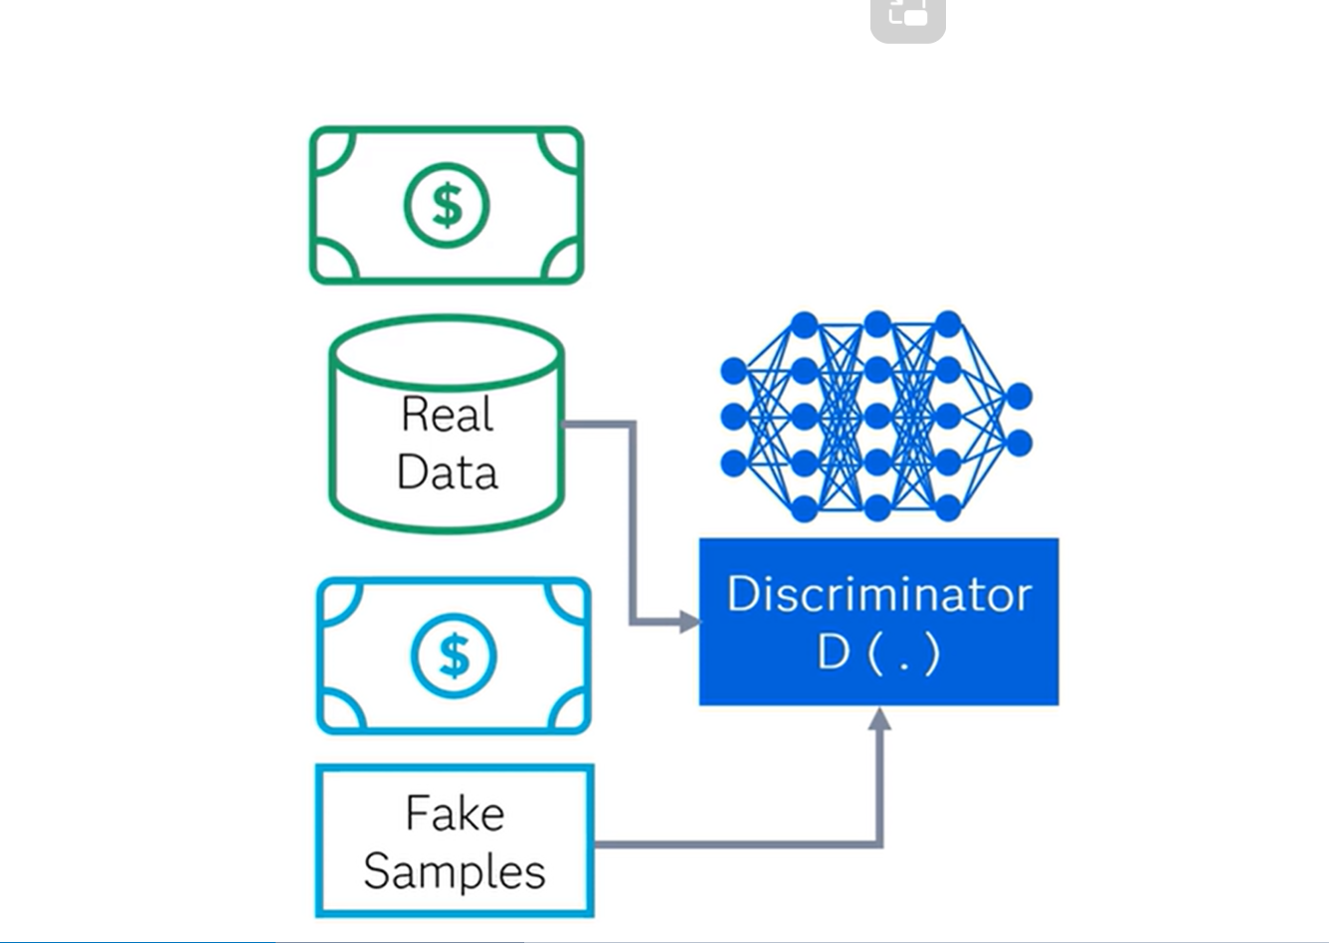
Notes:
In the process of training the discriminator network, it classifies both the real data and the fake data from the generator. Notice that the discriminator connects to two loss functions. However, during discriminator training, the discriminator ignores the generator loss and simply uses the discriminator loss. The discriminator loss penalizes the discriminator for misclassifying a real data instance as fake or a fake data instance as real. The discriminator updates its weights throughback propagation from the discriminator loss through the discriminator network.

Slide 14
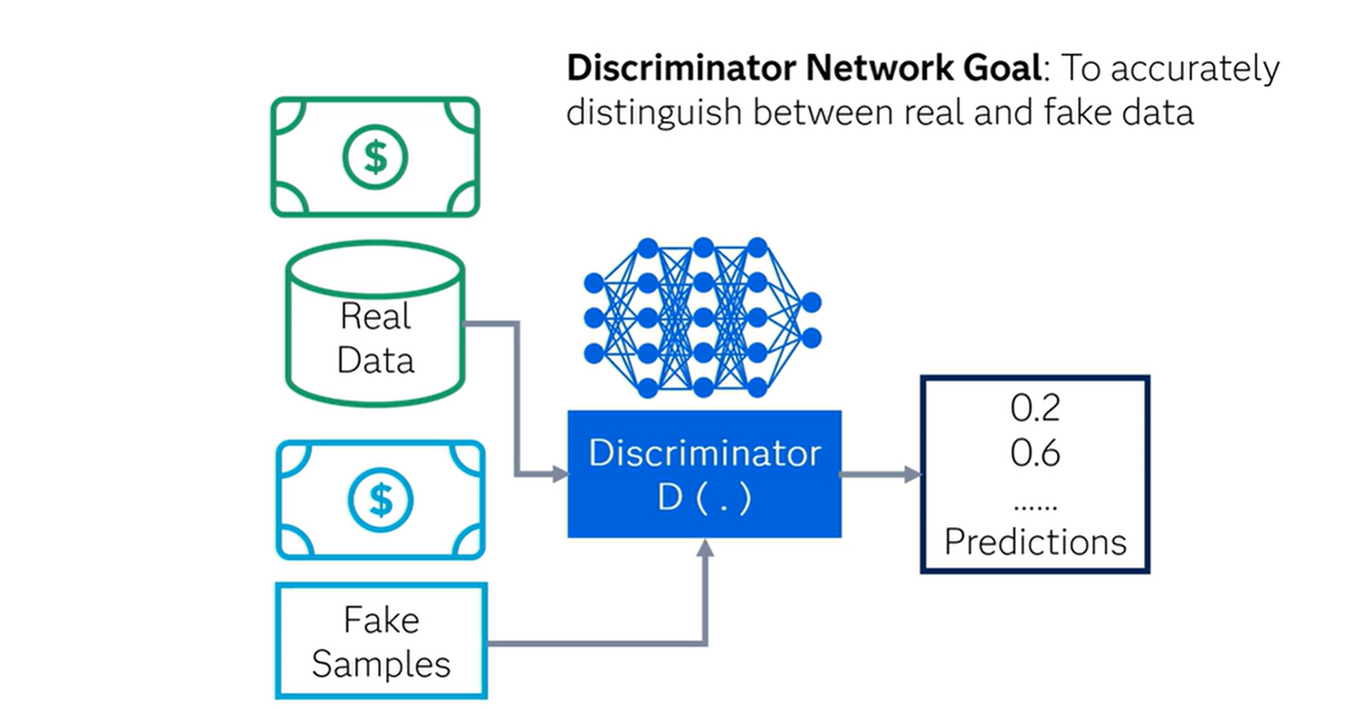
Notes:
We have seen that the generator and discriminator have different training processes. So, you must be wondering, "How are GANs trained as a whole?"
Well, the two networks are trained in alternating fashion. Note that the discriminator needs to train for a few epochs prior to starting the adversarial training, as the discriminator will need to be able to actually classify the data (images) as real or fake.
While alternating the training of these two networks, we also must make sure that we update the weights of only one network at a time. For example, during the generator training process, only the generator's weights are updated. If we allowed the discriminator's weights to change at this time as well, the discriminator would just adjust so that it is more likely to predict the generated images to be real, which is not the desired outcome. We want generated data to have predictions close to 1 (real) because the generator is strong, not because the discriminator is weak.

Slide 15
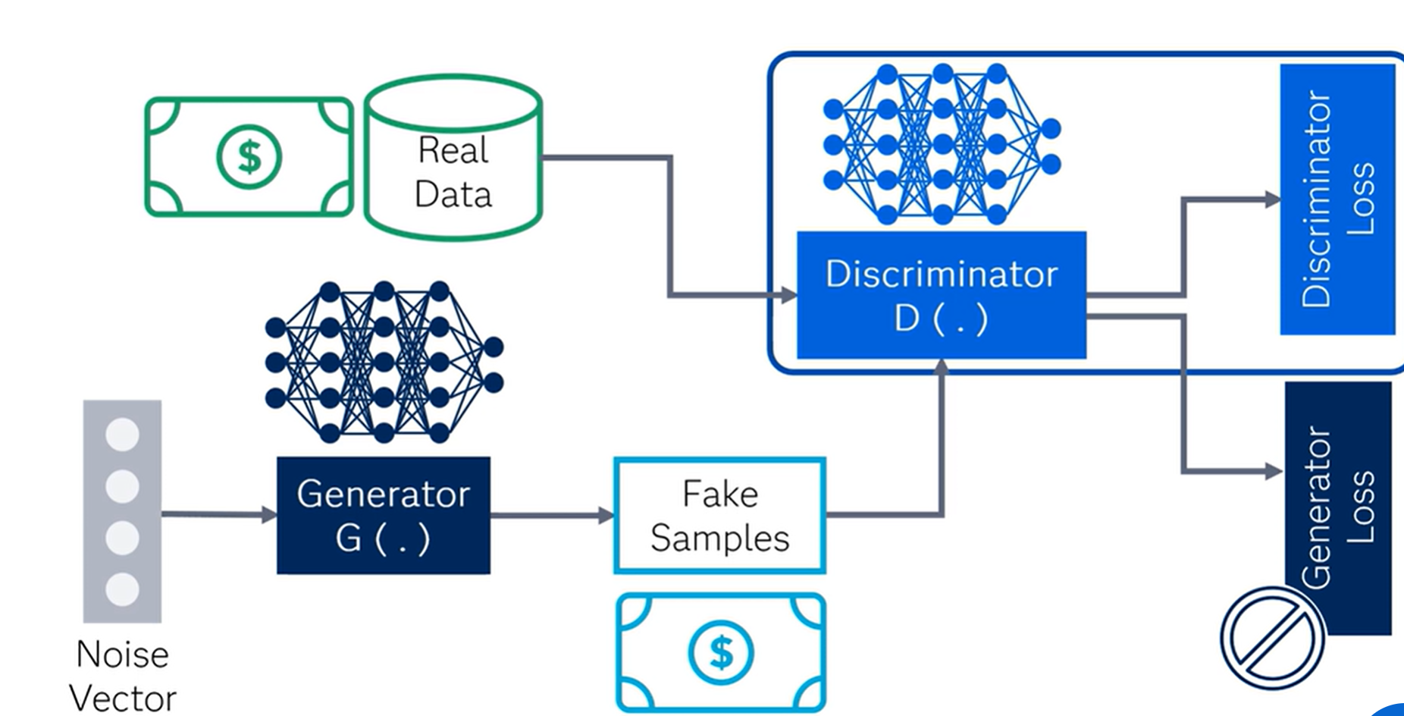
Notes:
The discriminator network generates predictions for how likely the instances are to be real or fake, where the labels are 1 for the real instances and 0 for fake instances, with binary cross-entropy as the loss function. So, the main goal of discriminator network is to accurately distinguish between real and fake data.
In the process of training the discriminator network, it classifies both the real data and the fake data from the generator. Notice that the discriminator connects to two loss functions. However, during discriminator training, the discriminator ignores the generator loss and simply uses the discriminator loss. The discriminator loss penalizes the discriminator for misclassifying a real data instance as fake or a fake data instance as real. The discriminator updates its weights throughback propagation from the discriminator loss through the discriminator network.
as a whole?"
Well, the two networks are trained in alternating fashion.

Slide 16
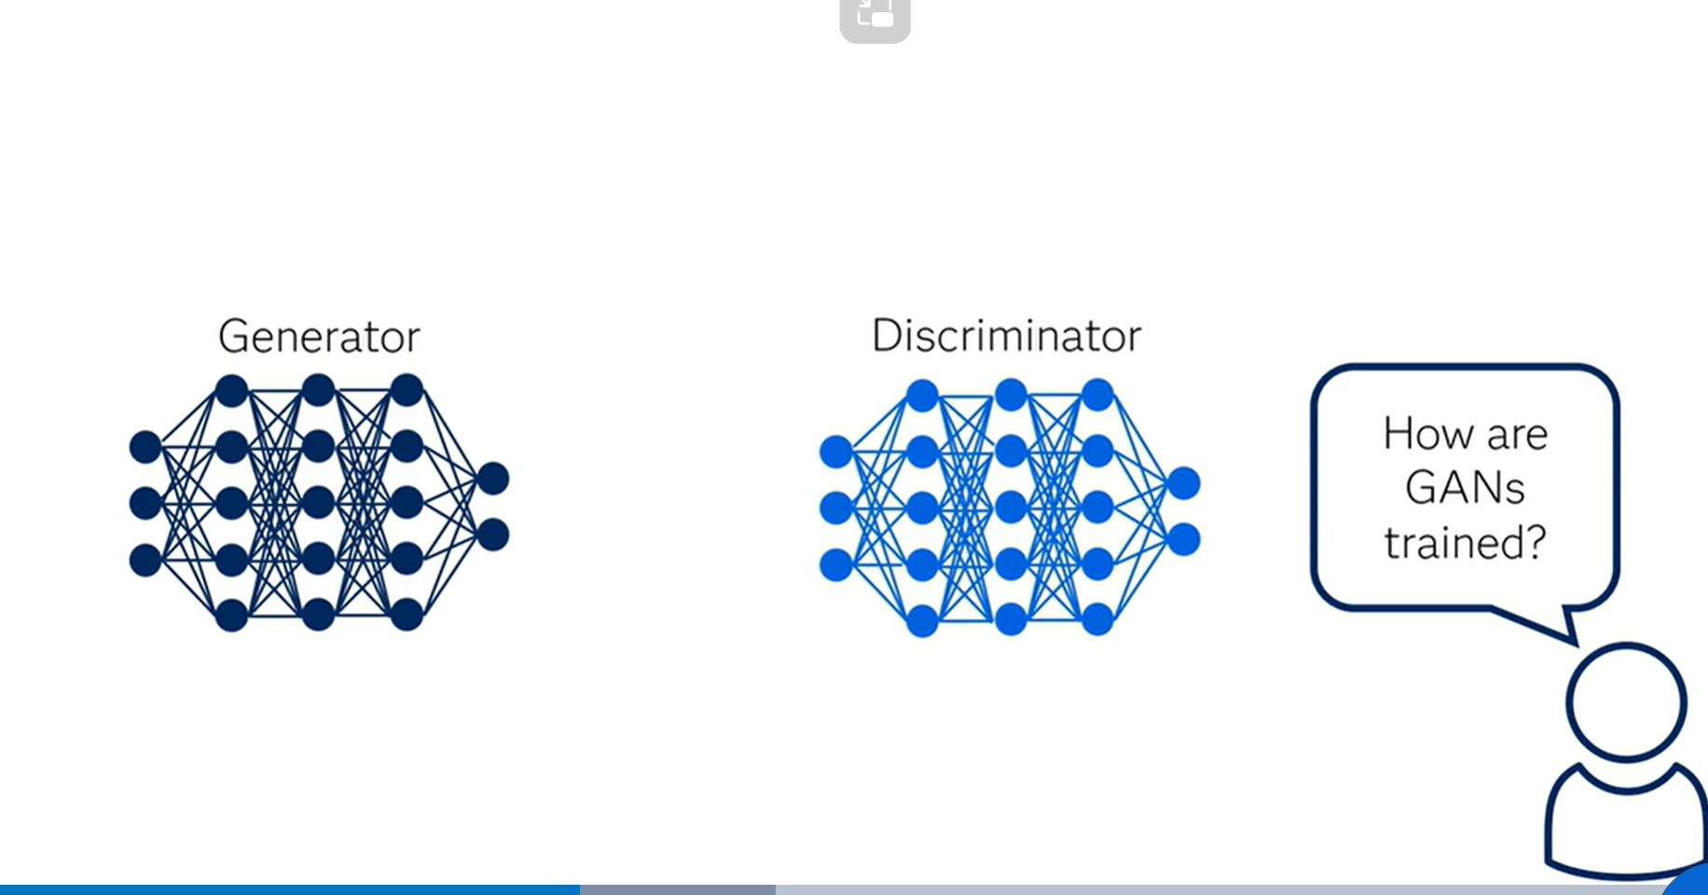
Training Gans
Notes:
We have seen that the generator and discriminator have different training processes. So, you must be wondering, "How are GANs trained as a whole?"
Well, the two networks are trained in alternating fashion. Note that the discriminator needs to train for a few epochs prior to starting the adversarial training, as the discriminator will need to be able to actually classify the data (images) as real or fake.

Slide 17
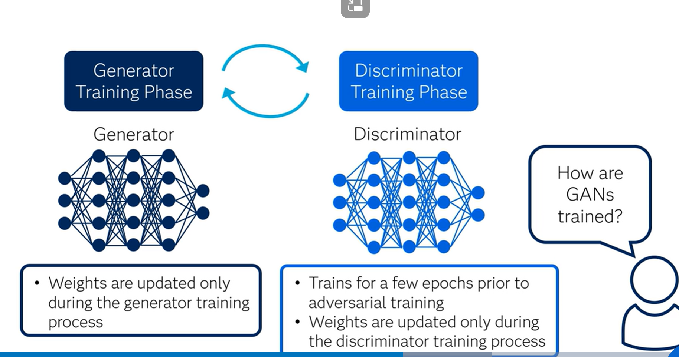
Notes:
While alternating the training of these two networks, we also must make sure that we update the weights of only one network at a time. For example, during the generator training process, only the generator's weights are updated. If we allowed the discriminator's weights to change at this time as well, the discriminator would just adjust so that it is more likely to predict the generated images to be real, which is not the desired outcome. We want generated data to have predictions close to 1 (real) because the generator is strong, not because the discriminator is weak.
Similarly, we keep the generator's weights constant during the discriminator training phase and update the discriminator's weights only during this phase. As discriminator training tries to figure out how to distinguish real data from fake data, it has to learn how to recognize the generator's flaws. This is a different problem for a thoroughly trained generator than it is for an untrained generator producing random output.
This back-and-forth training enables GANs to tackle otherwise intractable generative problems. We get a toehold in the difficult generative problem by starting with a much simpler classification problem. Conversely, if you can't train a classifier to tell the difference between real and generated data for even the initial random generator output, you can't get the GAN training started.

Slide 18
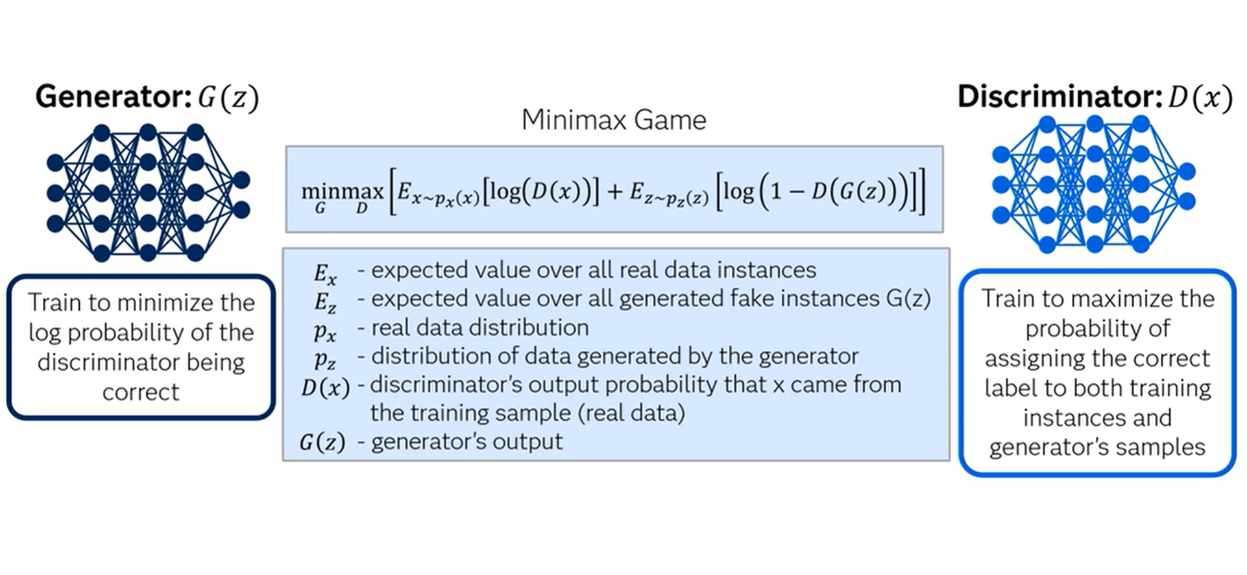
Notes:
recall that the generator network generates data that are similar to the real data, and to measure the similarity, we use objective functions. Both networks have their own objective functions, which they try to optimize during training. We train D to maximize the probability of assigning the correct label to both training instances and samples from the generator. We simultaneously train G to minimize the discriminator's reward. In other words, D and G play the two-player minimax game with the final objective function.
In this equation, represents the expected value over all real data instances. represents the expected value over all generated fake instances . represents the real data distribution. represents the distribution of data generated by the generator. represents the discriminator's output (that is, the probability that came from the training sample or from the real data), and represents the generator's output given noise .
During training,the discriminator wants to maximize the objective function, whereas the generator wants to minimize it. In this way, the generator and the discriminator repeatedly learn to work together, and eventually the GAN can reach a Nash equilibrium when the following conditions are met: The discriminator is unable to distinguish between real and fake instances. The generator can produce fake samples that are indistinguishable from the real data in the training data set.

Slide 19
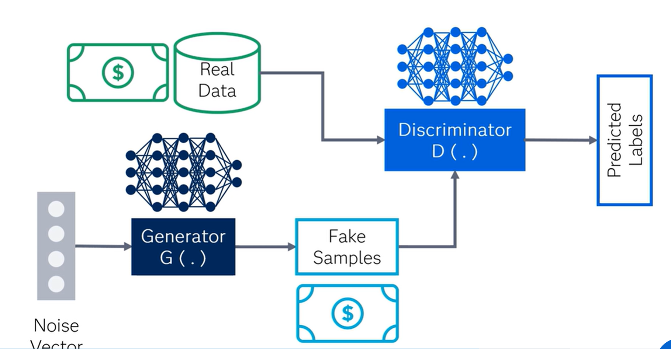
Example explanation
Notes:
Let's revisit the currency example where the aim is to generate images of one-dollar bills that look real. First, a random noise vector is fed into the generator. Using this latent input, the generator network creates a fake one-dollar bill image. As discussed earlier, now the discriminator is fed with the fake images of one-dollar bills created by the generator as well as real images of one-dollar bills. The discriminator classifies each image as real or fake. Next, the generator, tries to fool the discriminator by creating more realistic one-dollar-bill images over multiple iterations. The discriminator tries to outwit the generator by continuing to refine its own criteria for determining a fake image. Hence, they guide each other by providing feedback from the successful changes that they make in their own process in each iteration. Ultimately, the discriminator trains the generator to a point at which it no longer can determine which one-dollar-bill images are real and which are fake. Remember our goal as modelers is to generate data, which is different from either of the network goals. Note that during generator training, gradients propagate through the discriminator network to the generator network (although the discriminator does not update its weights during generator training). So, the weights in the discriminator network influence the updates to the generator network.

Slide 20
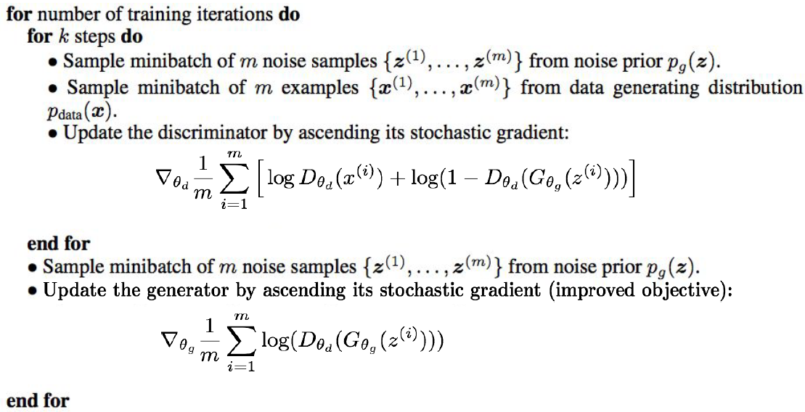
GAN algorithm
20

Slide 21
GANs: Convolutional Architectures
Replace pooling layers with strided convs (discriminator) and factional-strided convs (generator)
Strided conv means having stride greater than 1
Fractional-strided conv means inserting zeros in input before applying filter (to increase size of image)
Use batch normalization in both
Remove fully connected hidden layers
Use ReLU activation in Gen for all layers except output which uses tanh
Use LeakyReLU activation in Discriminator for all layers
21

Slide 22
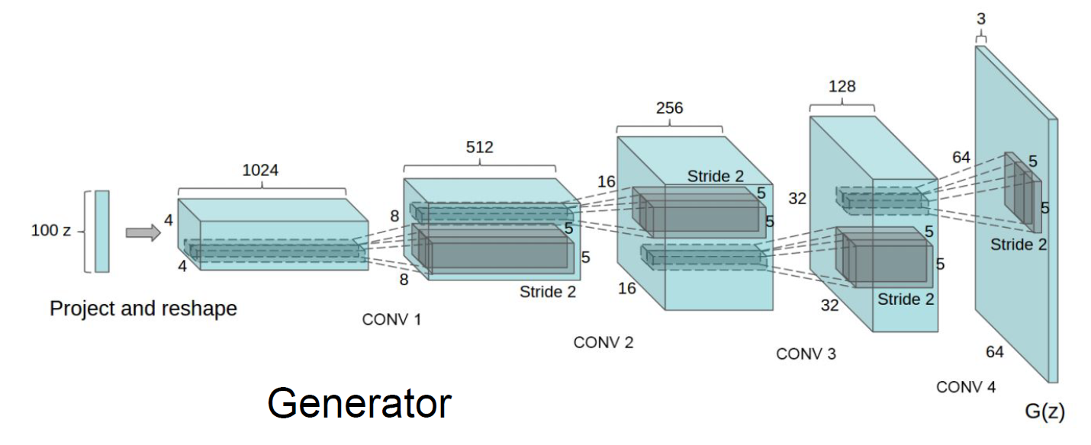
GANs: Convolutional Architectures
22

Slide 23
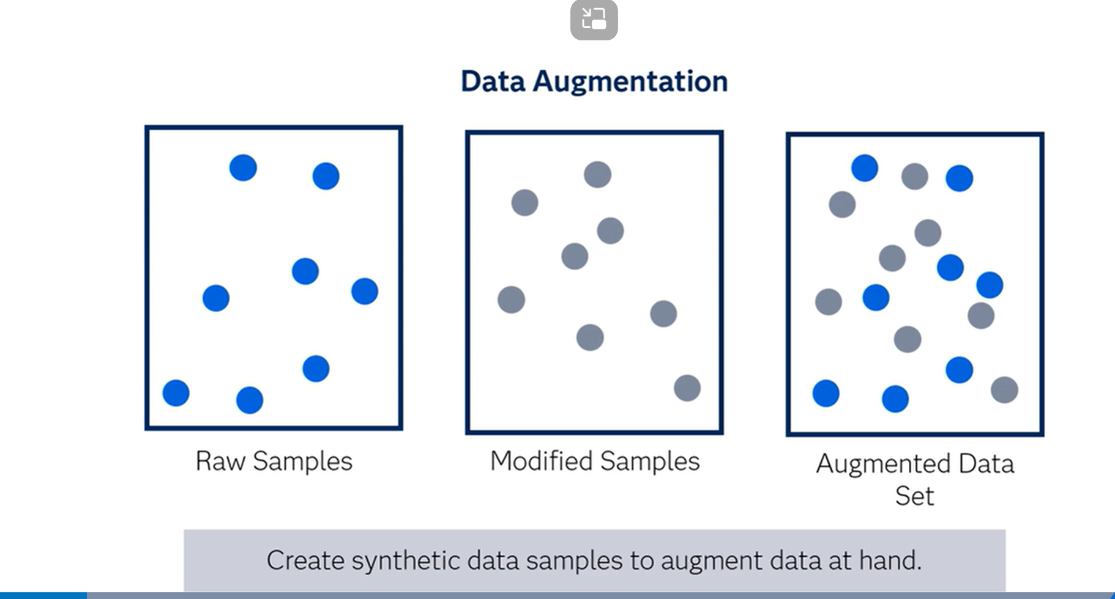
Applications of GANS

Slide 24
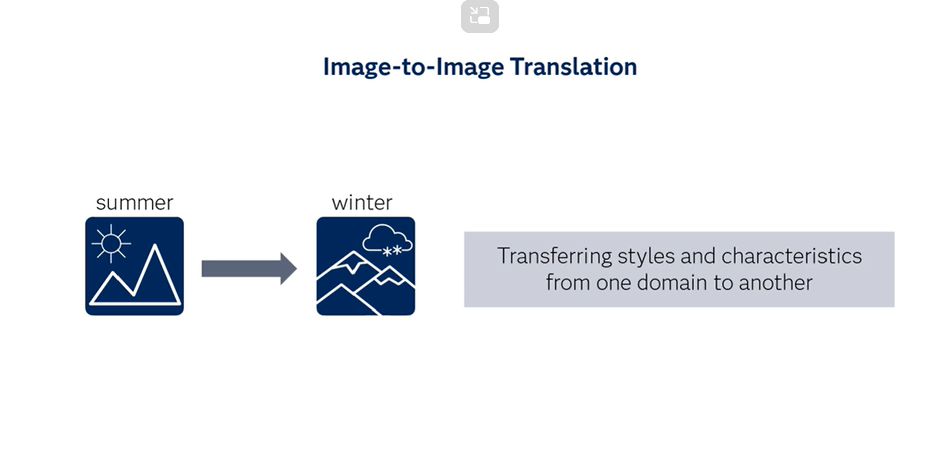

Slide 25
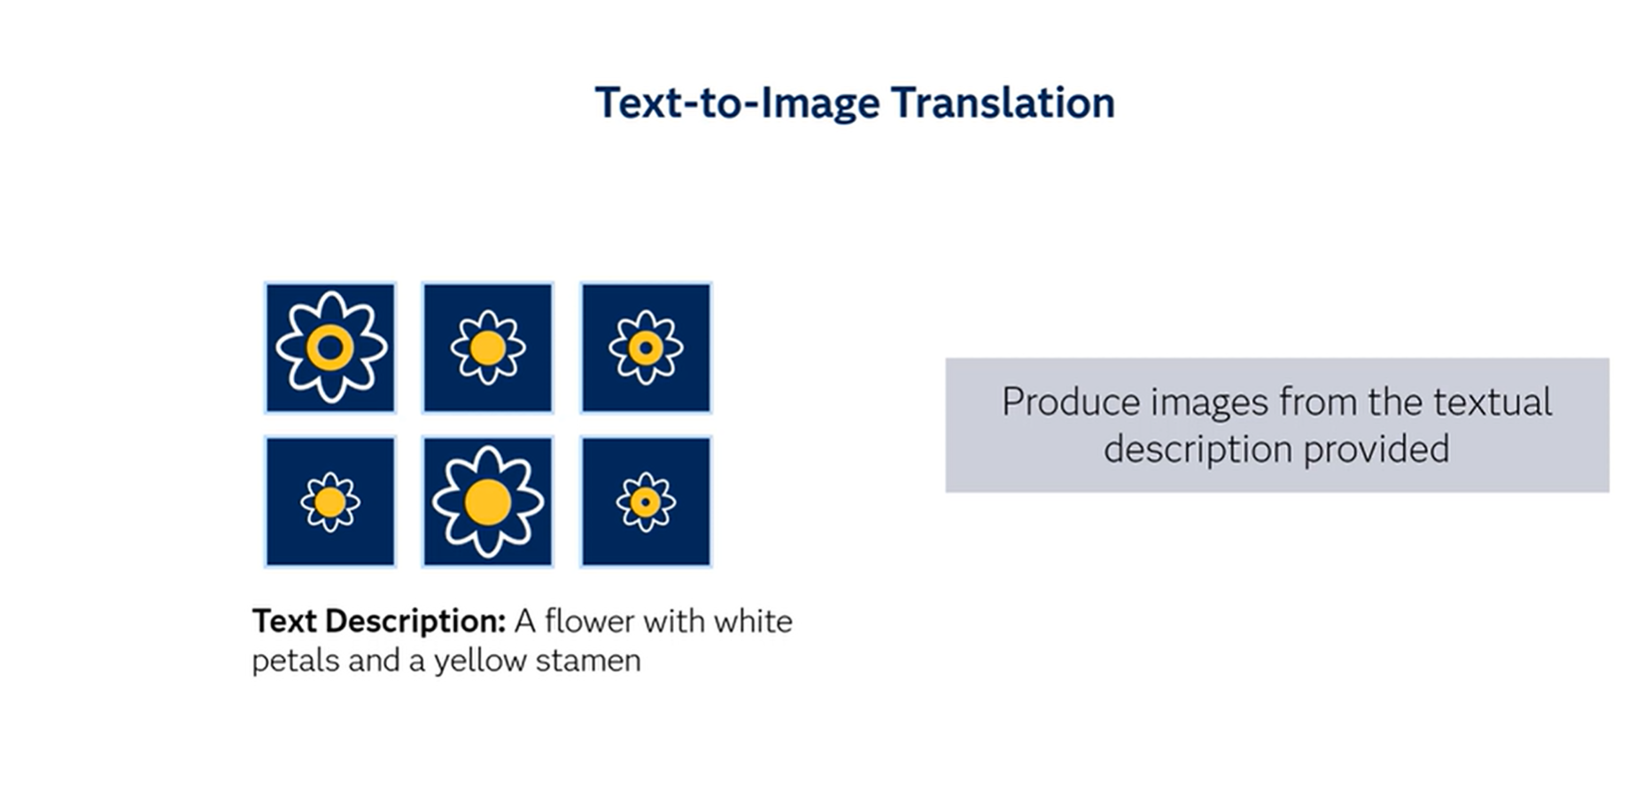

Slide 26
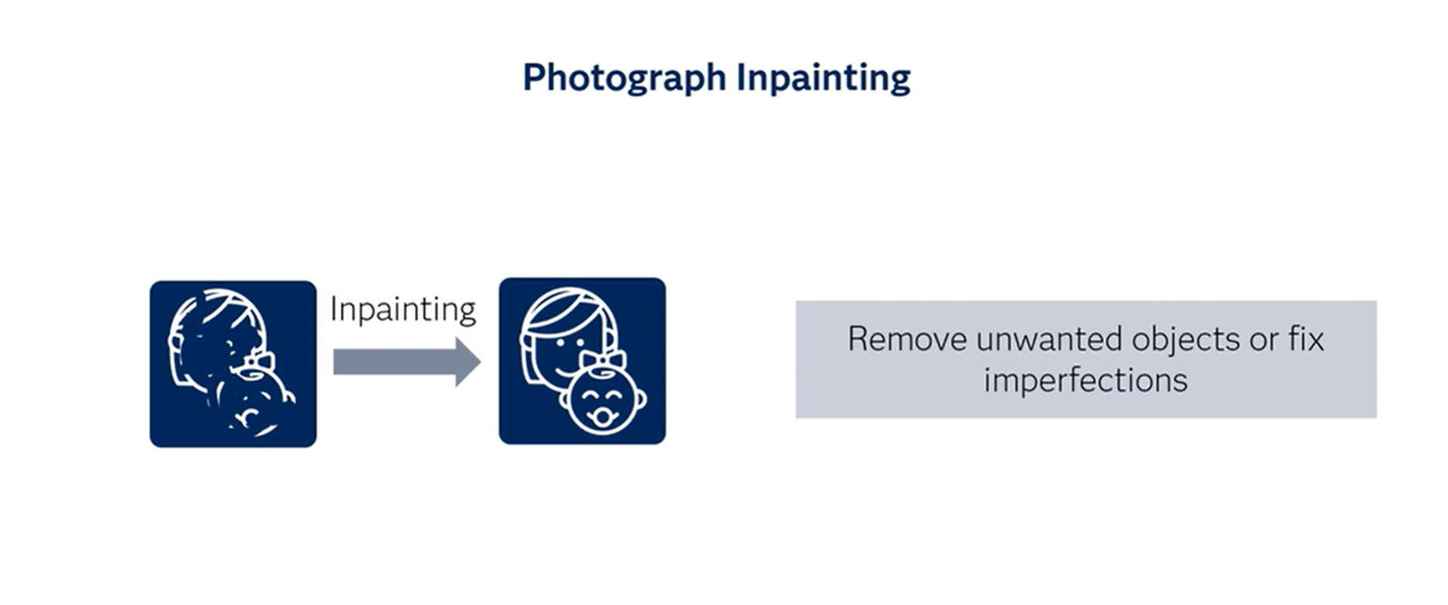

Slide 27
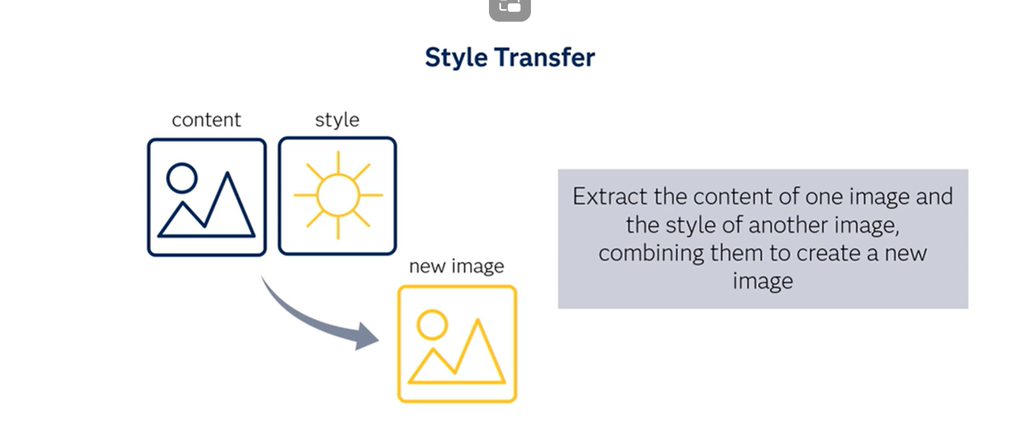

Slide 28
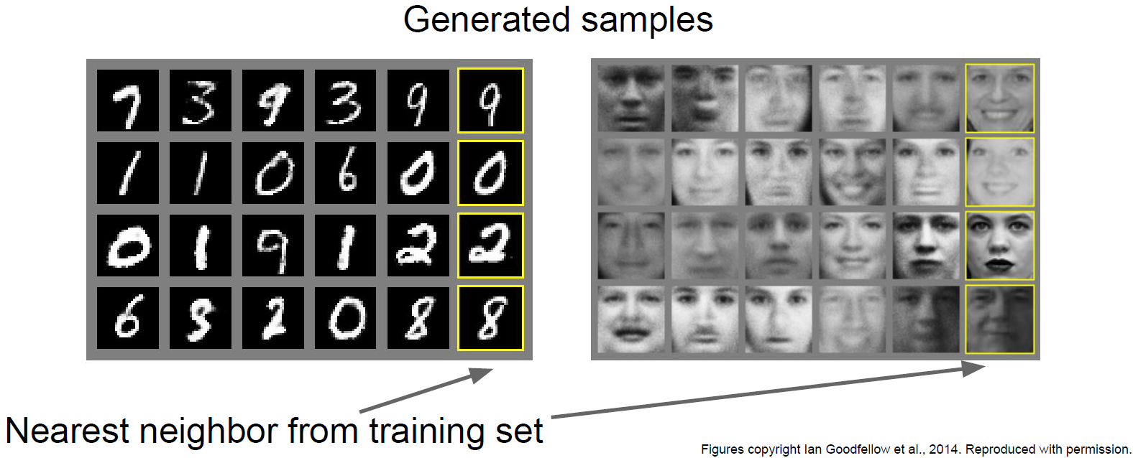
GAN Examples
28

Slide 29
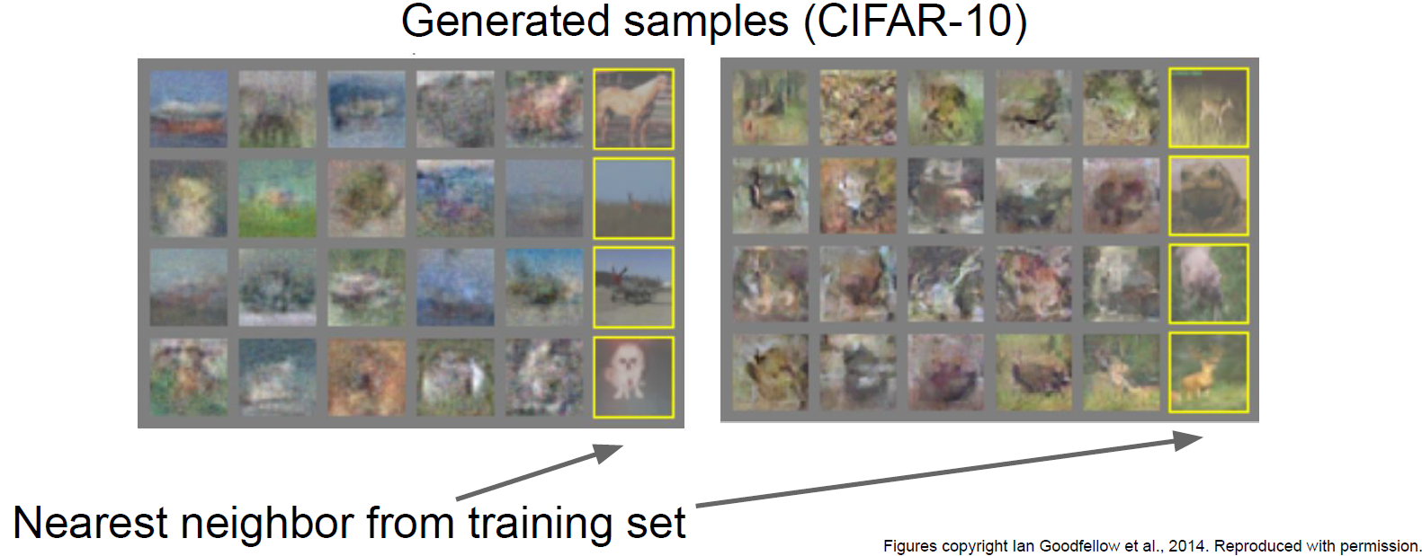
GAN Examples
29

Slide 30
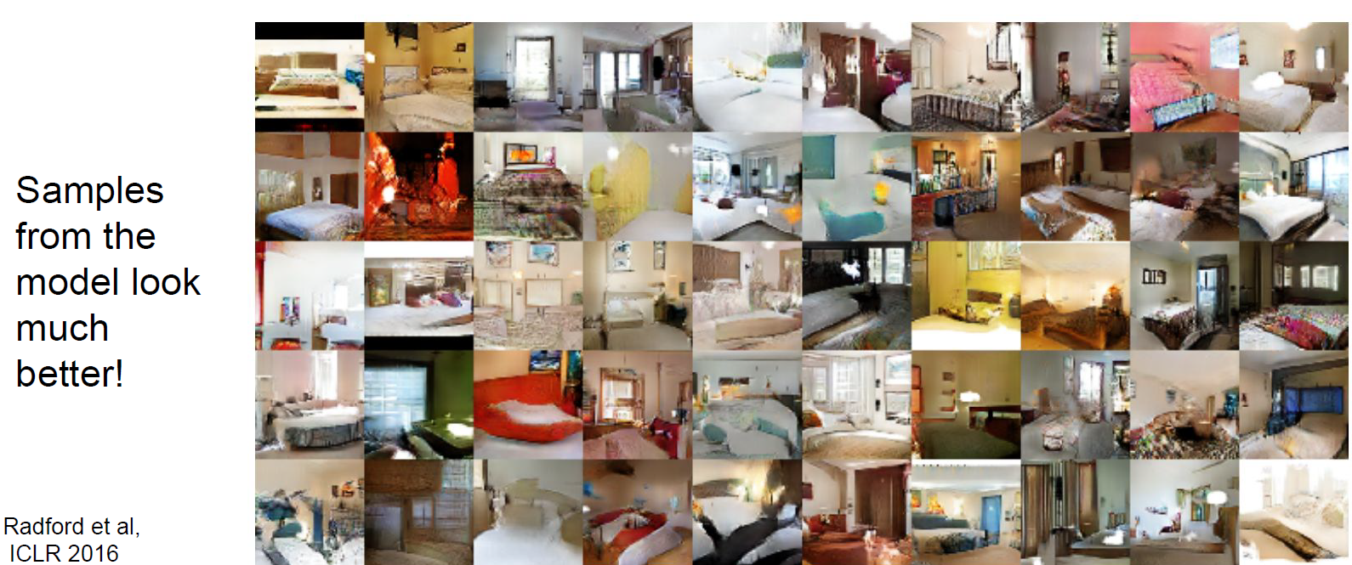
GANs: Convolutional Architectures
30

Slide 31
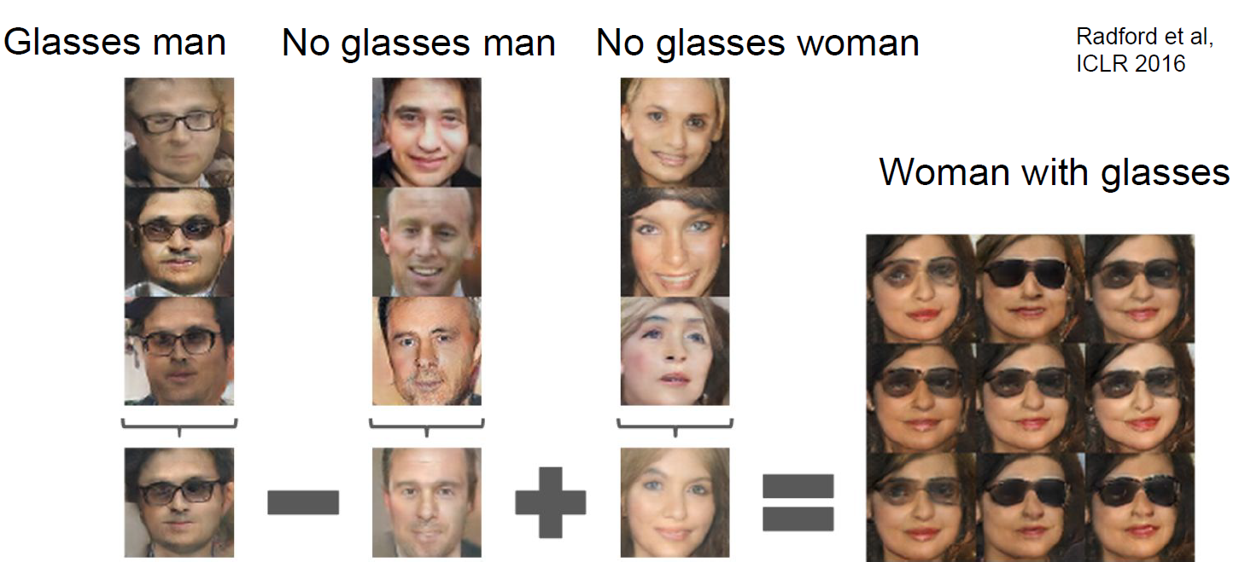
GANs: Convolutional Architectures
31

Slide 32
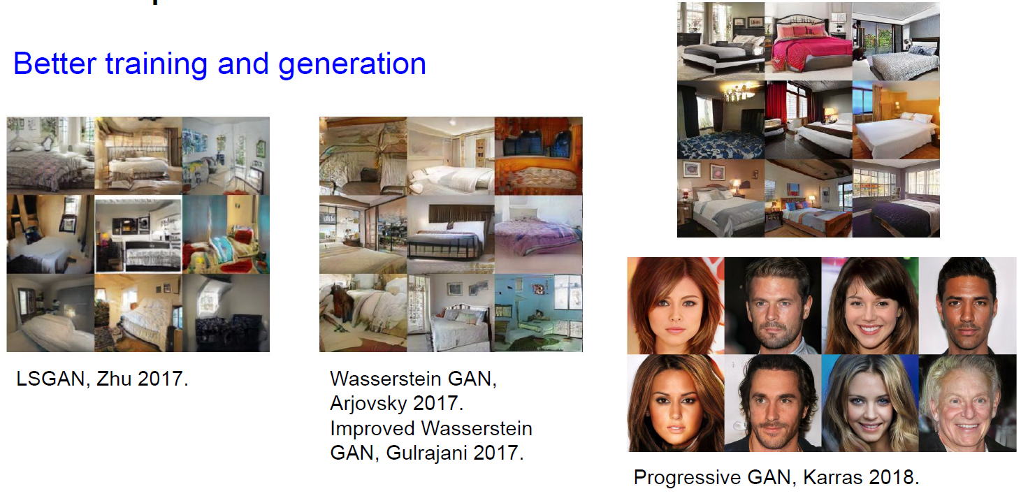
GANs: Advanced Architectures
32

Slide 33
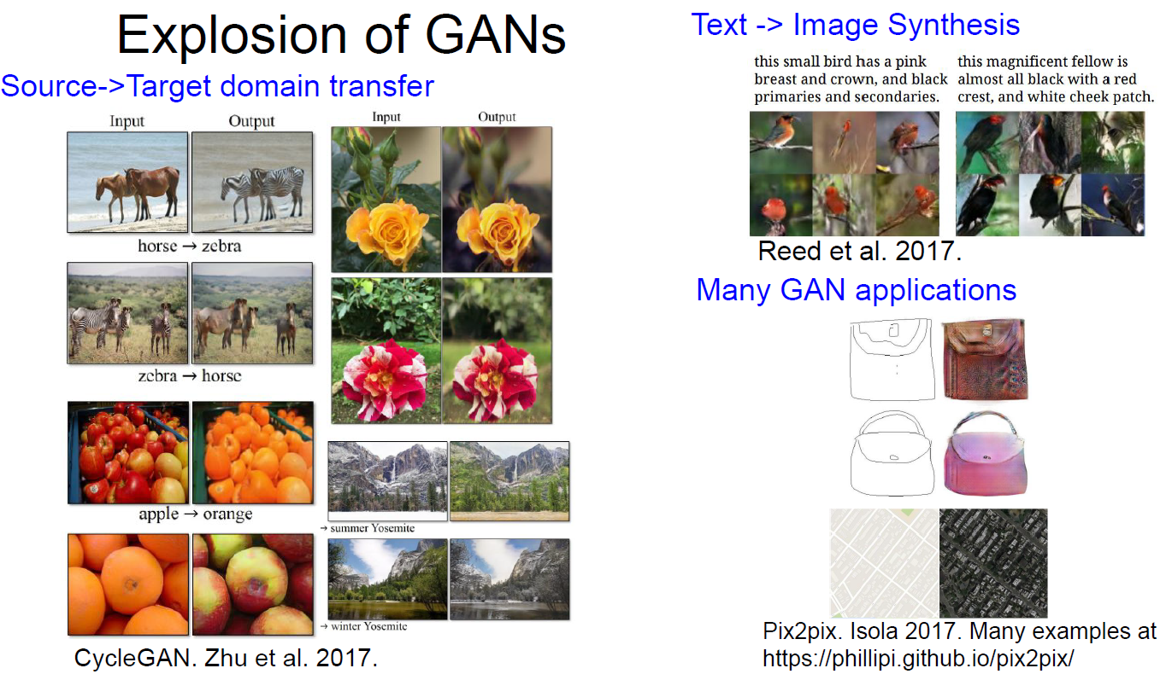
GANs: Advanced Architectures
33

Slide 34
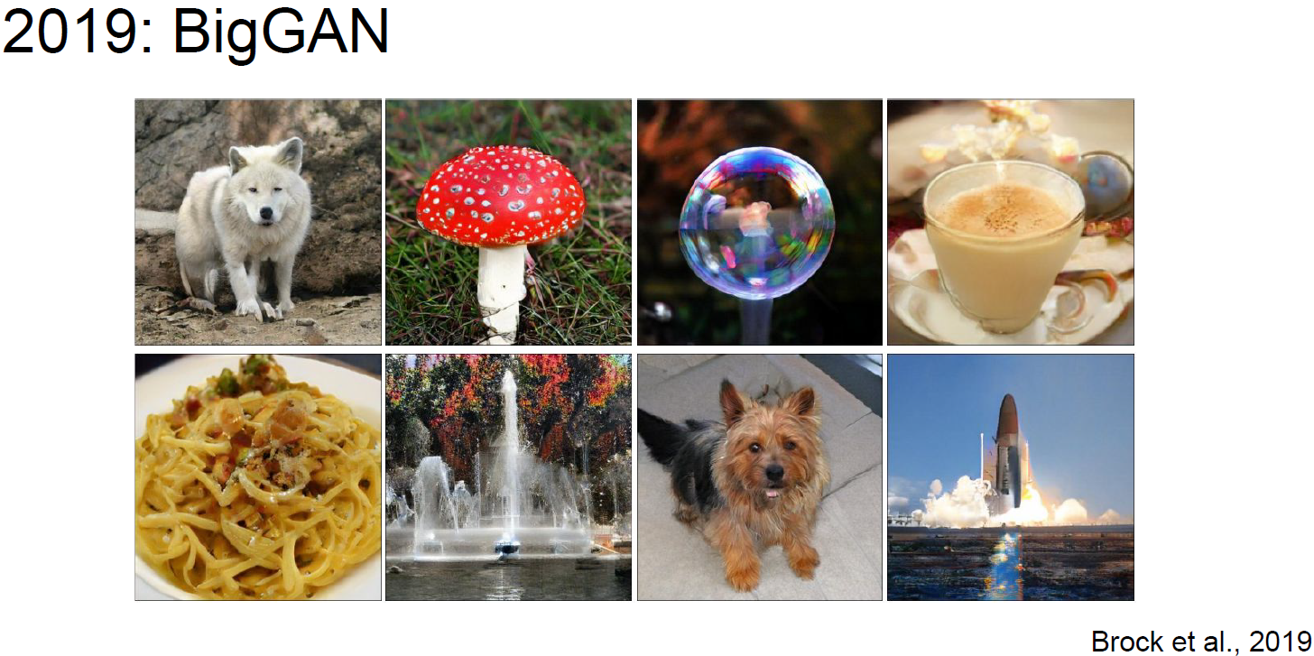
GANs: Advanced Architectures
34

