Slide 1


Predicting Divorce Likelihood
Using Socio-Behavioral Data & Machine Learning
7PAM2002 Data Science Project
Student ID: 23030670
NAME : SATTENAPALLI VENKATESH
Semester B 2025/2026
Github Link : https://github.com/SattenapalliVenkatesh/Data-Science-Project-New

Slide 2


Introduction & Project Motivation
The Problem
Project Aim
Traditional marital therapy relies heavily on subjective observation. There is a critical need for objective, data-driven tools that can identify at-risk couples early in their relationship.
To develop a user-friendly Machine Learning framework that accurately predicts divorce probability based on the Gottman Couples Therapy Model.
Current methods often intervene too late, when negative behavioral patterns have already solidified.
By pinpointing specific conflict-resolution deficits, we can enable targeted, non-invasive coaching interventions.

Slide 3






Research Questions
ML vs. Statistics
Key Drivers
Class Balance
To what extent can Machine Learning models outperform traditional statistical approaches in predicting divorce outcomes?
Which communication and conflict-resolution attributes most strongly contribute to divorce prediction?
How do data characteristics (balance/imbalance) impact the trade-off between false positives and false negatives?

Slide 4


Literature Review Highlights
Previous Findings
Identified Gaps
Ahsan (2023): SVM achieved ~99% accuracy on UCI data; highlighted importance of LIME for interpretability.
Many existing studies suffer from limited generalizability due to small sample sizes or lack of rigorous external validation.
Kumar et al. (2023): Feature selection is key; Random Forest and MLP attained 100% on small subsets.
There is often a trade-off between model accuracy and practical interpretability for counselors.
Moumen et al. (2024): Partner knowledge sharing is a critical predictor in regional datasets.

Slide 5
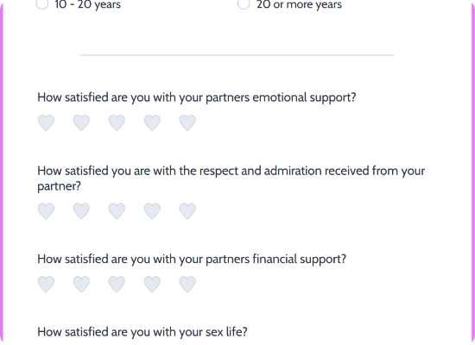

Dataset Overview
Source: UCI Machine Learning Repository (Dr. S. Yöntem).
Participants: 170 Married Couples.
Features: 54 Attributes based on the Gottman Model.
Scale: Likert Scale (0-4), measuring frequency of feelings/behaviors.
Target: Binary Classification (0 = Married, 1 = Divorced).

Slide 6




Methodology Workflow
Preprocessing
Splitting
Modeling
Evaluation
Data cleaning, null check, and StandardScaler for distance-based algorithms.
Stratified Shuffle Split (20 folds) to ensure robustness given small sample size.
Logistic Regression, Random Forest, Decision Tree, Naïve Bayes, KNN.
ROC-AUC, Accuracy, Precision, Recall, and Monte-Carlo Cross Validation.

Slide 7
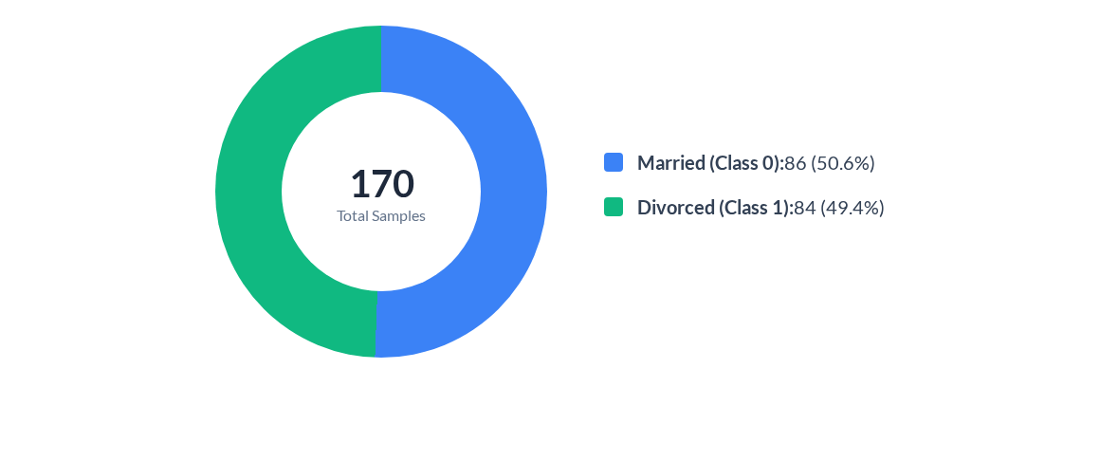
Exploratory Data Analysis: Class Balance
The dataset is perfectly balanced, eliminating the need for synthetic oversampling (SMOTE).

Slide 8

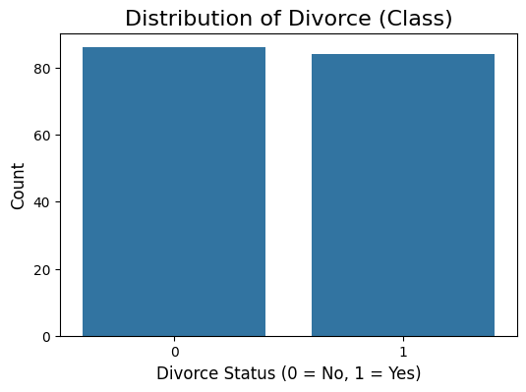
Feature Distribution Analysis
Separation of Classes
Box plots for the highest correlated features reveal a distinct lack of overlap between the two classes.
Class 0 (Married): Consistently low scores (0-1) on negative attributes like "Break in Calm".
Class 1 (Divorced): Consistently high scores (3-4), indicating frequent conflict.
This visible separation explains why simple linear models perform so well.

Slide 9
Top Predictors (Correlation Analysis)
Break in Calm (0.94): Frequent interruptions of calm during discussions.
Happiness Views (0.93): Disagreement on what constitutes happiness.
Role Views (0.93): Diverging beliefs about roles in the marriage.
Marriage Views (0.92): Fundamental differences in the concept of marriage.
Future Harmony (0.92): Pessimism regarding future peace.
Enjoy Traveling (0.91): Lack of shared enjoyment in travel/leisure.
Insight: The ability to maintain calm during conflict ("Break in Calm") is the single strongest indicator of relationship stability.

Slide 10
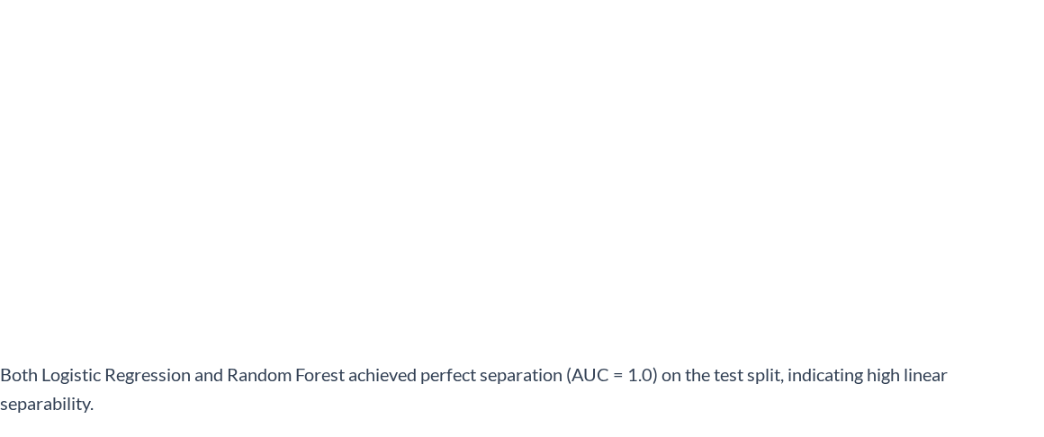
Model Performance Summary (Test Set)
Model | ROC AUC | Accuracy | Precision | F1 Score
Logistic Regression | 1.000 | 0.941 | 1.000 | 0.938
Random Forest | 1.000 | 0.941 | 1.000 | 0.938
Decision Tree | 0.971 | 0.971 | 1.000 | 0.970
Naïve Bayes | 0.967 | 0.912 | 0.938 | 0.909
KNN | 0.941 | 0.941 | 1.000 | 0.938

Slide 11

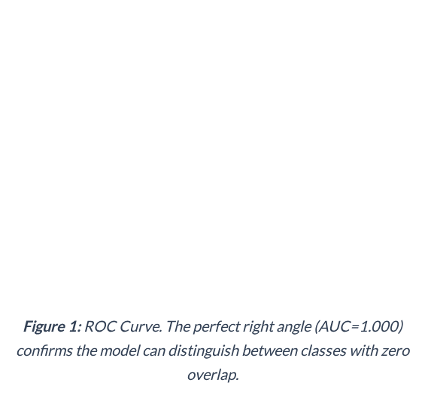

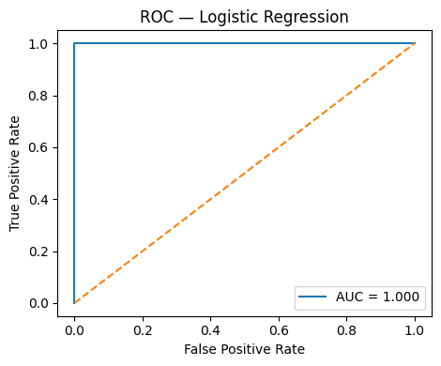
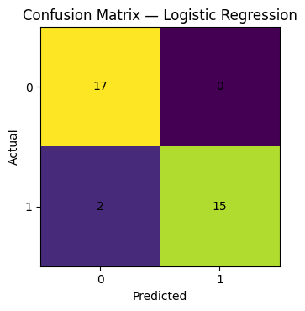
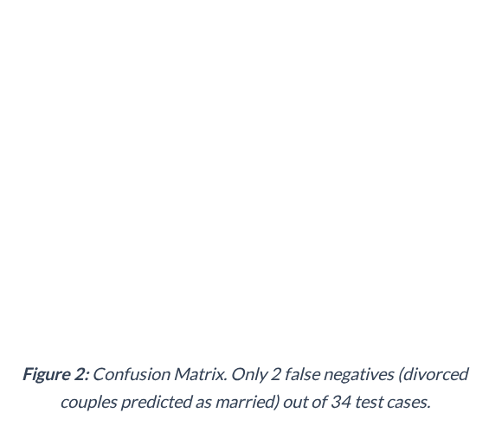
Detailed Evaluation: Logistic Regression

Slide 12
Robustness Check: Monte-Carlo CV
Results averaged over 20 Stratified Shuffle Splits to validate reliability.
0.999
97.8%
0.001
Mean ROC AUC
Mean Accuracy
Standard Deviation
Winner: Logistic Regression

Slide 13


Critical Insight
The "Break in Calm"
Our analysis reveals that the primary differentiator between divorced and married couples is not the absence of conflict, but the regulation of emotion during conflict.
Couples who can maintain composure and avoid escalating negativity ("Break in Calm") are statistically almost guaranteed to belong to the "Married" class.
This validates the Gottman theory: repair attempts are crucial.

Slide 14


Conclusion & Future Work
Conclusion
Machine Learning models significantly outperform baseline guessing, achieving near-perfect accuracy.
Simple models (Logistic Regression) perform as well as complex ones, suggesting the behavioral patterns of divorce are highly distinct.
Future Work
Test on datasets from different cultures (e.g., UK/US) to ensure generalizability beyond the Turkish cohort.

Slide 15
References
Ahsan, M.M. (2023). Divorce Prediction with Machine Learning: Insights and LIME Interpretability.
Aimran, N. (2022). Prediction of Malaysian Women Divorce Using Machine Learning Techniques. Malaysian Journal of Computing.
Kumar, A., et al. (2023). Prediction of the Probability of Divorce Using Machine Learning Algorithms. International Journal of Engineering Technology and Management Sciences.
Moumen, A., et al. (2024). Divorce prediction using machine learning algorithms in Ha’il region, KSA. Scientific Reports.
Sadiq Fareed, M.M., et al. (2022). Predicting Divorce Prospect Using Ensemble Learning. Computational Intelligence and Neuroscience.
Yöntem, M. K. (2019). Divorce Predictors Scale Dataset. UCI Machine Learning Repository.

Slide 16
Q&A
Thank you for your attention.
Predicting Divorce Likelihood Using Socio-Behavioral Data

Slide 17




Image Sources
https://cdn.jotfor.ms/templates/screenshot/form-templates/couples-survey.png?v=2148174743&t=classic
Source: www.jotform.com
https://img.freepik.com/free-vector/flat-design-couple-arguing-silhouette_23-2150362414.jpg
Source: freepik.com
https://media.istockphoto.com/id/879763336/photo/love-couple-walking-while-holding-hands.jpg?s=612x612&w=0&k=20&c=b1Up-DVX6FZHiXfpgTzBcE_yxpljUJS3d4xTgNjUQMk=
Source: www.istockphoto.com

