Slide 1

Azure Capstone Project
Mounika Sattiraju
F09563

Slide 2

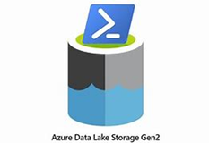

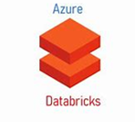
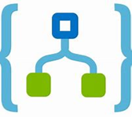
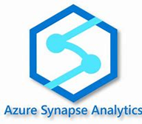
GitHub
Azure Data Factory
Logic Apps
Azure Synapse Analytics
Azure Databricks
Azure Data Lake Storage
Services Used

Slide 3

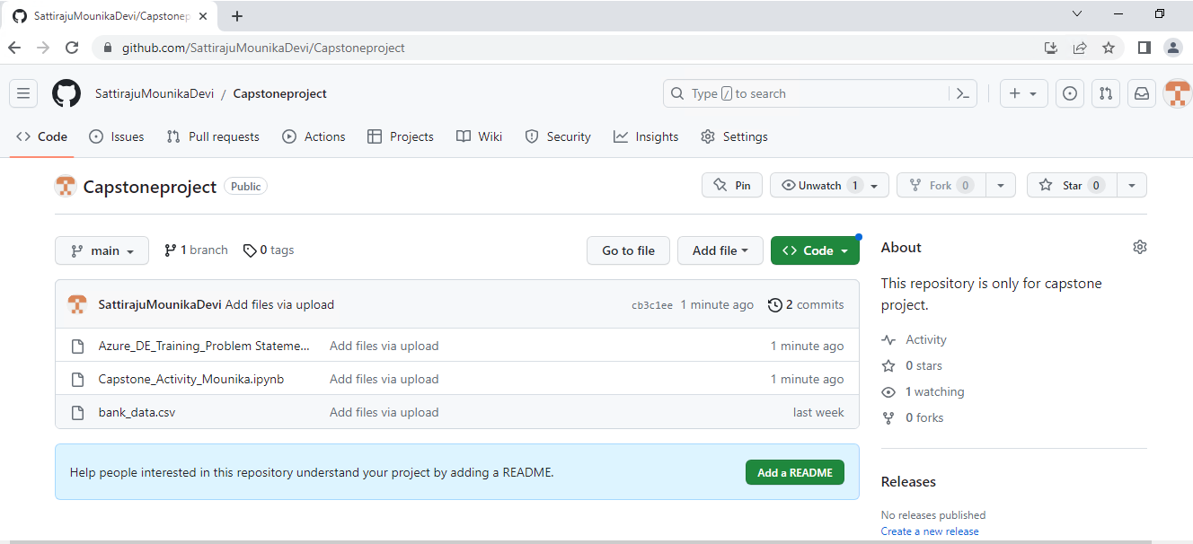
GitHub
Create a GitHub Repo to store the dataset and all the related documents of the project.
Upload the dataset, Problem statement and Worked DB Notebook to the Repo.
GitHub Link:
SattirajuMounikaDevi/Capstoneproject: This repository is only for capstone project. (github.com)

Slide 4
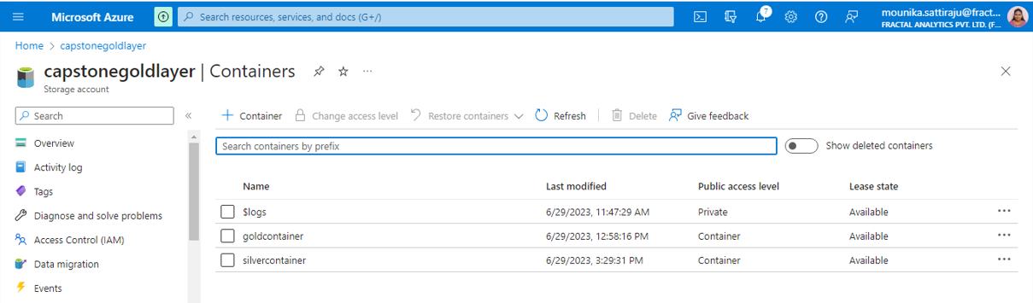
Azure Data Lake Storage
Create two ADLS accounts to import the raw data into Bronze Layer from the GitHub repository and to store the transformed data into gold Layer and silver layer, respectively.
Import the raw data into Bronze Layer from GitHub using the “Copy Data” activity in azure data factory.
Store the data that is transformed in the Azure Databricks in Gold layer and upload dataset to the Silver layer.

Slide 5

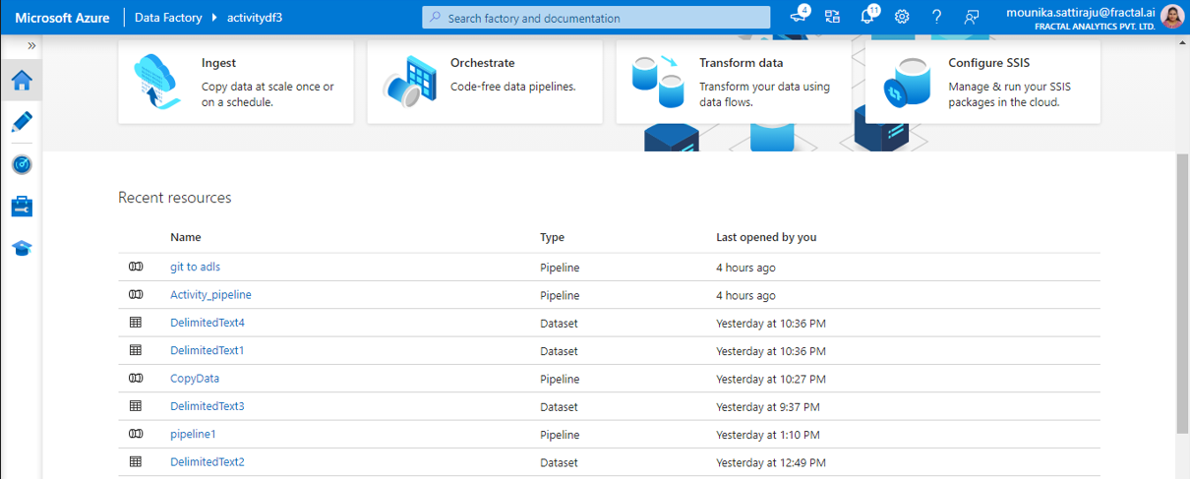
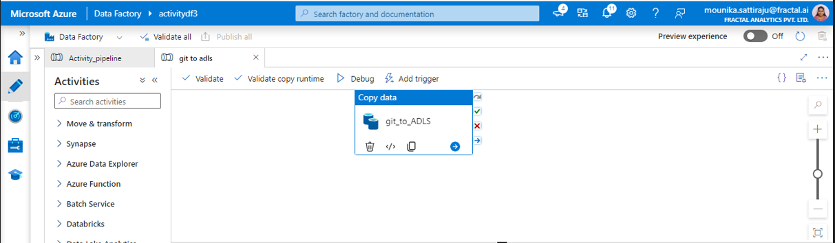
Azure Data Factory
Create Azure Datafactory by navigating to the Azure portal.
Create two pipelines in the ADF.
Another pipeline to trigger the notebook activity that is created in the Azure Databricks.
One pipeline to copy the data from GitHub to Bronze Layer as shown below.

Slide 6
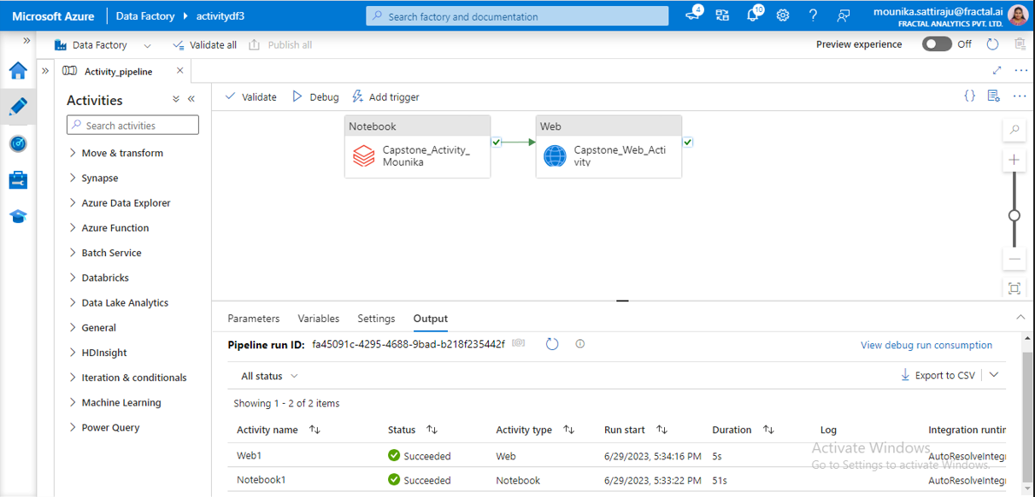
Final Pipeline in Azure Data Factory

Slide 7
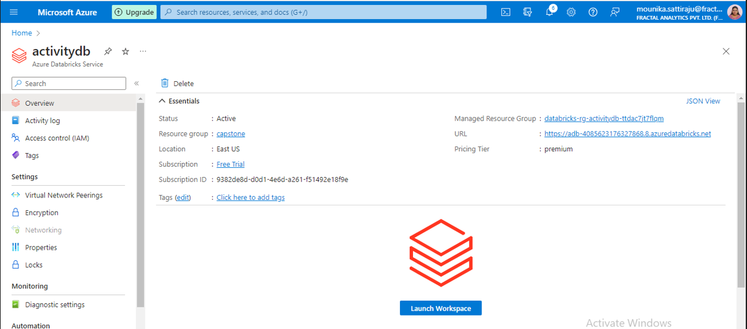
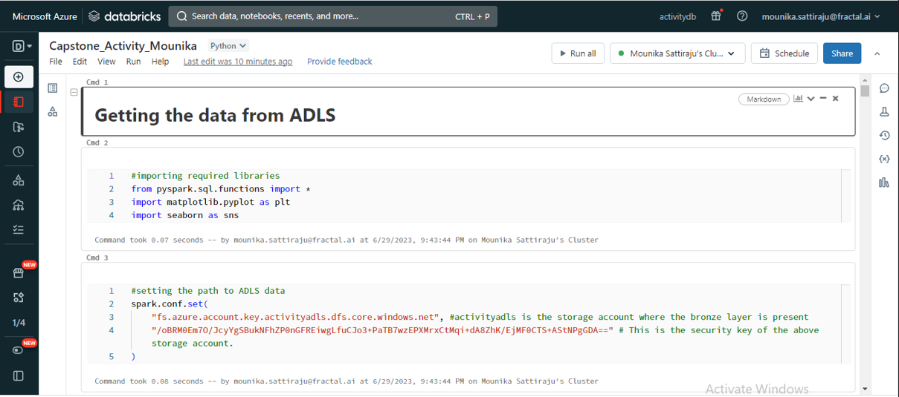
Azure Databricks
Create Azure Databricks.
Under Workspace tab create new Notebook to perform the preprocessing steps.
Import the data from Bronze Layer of ADLS into Databricks notebook and perform the required transformation.
After performing the transformations write data back to the Gold Layer of ADLS account.

Slide 8
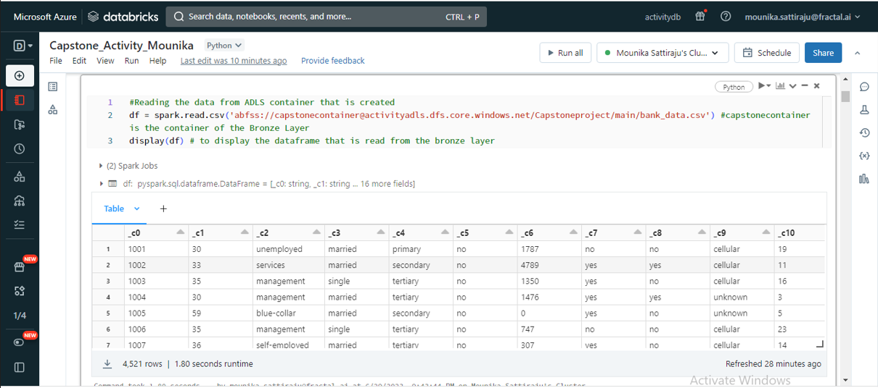
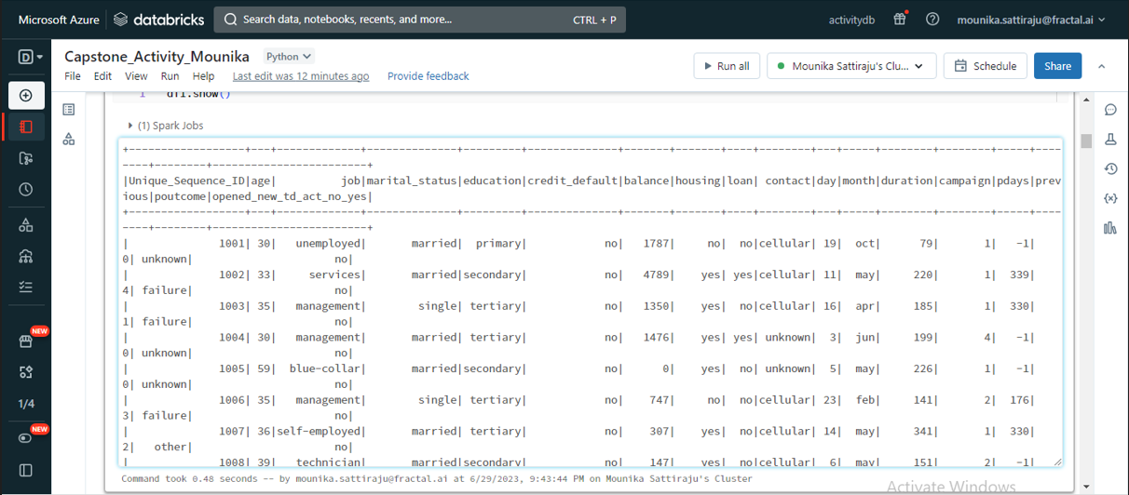
Transformations in ADB Notebook
Raw dataset without headers
Dataset after assigning headers

Slide 9
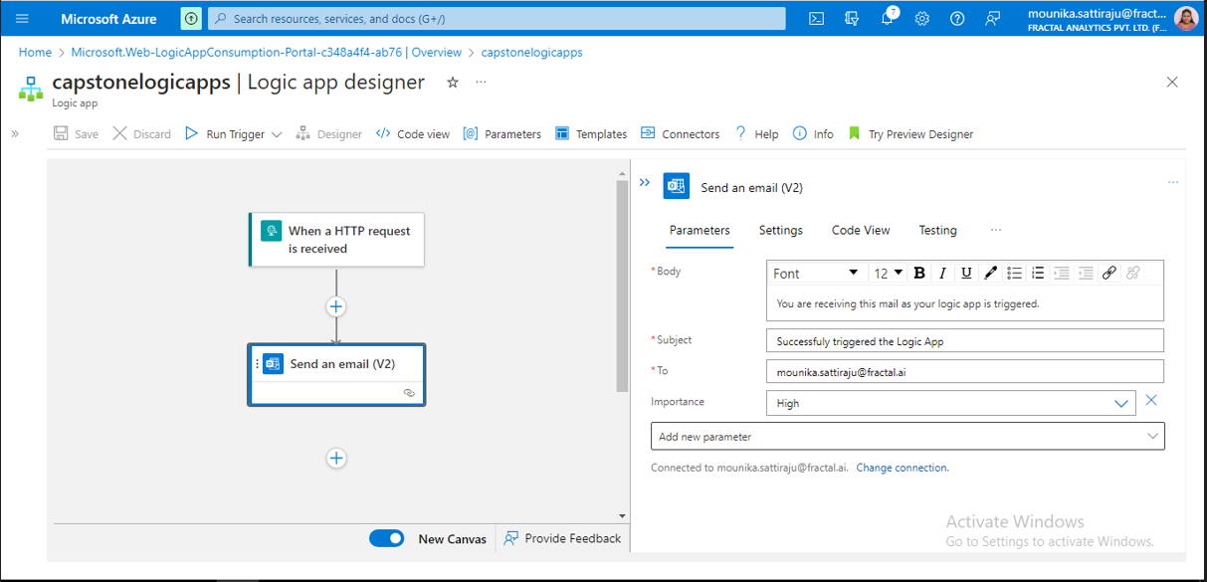
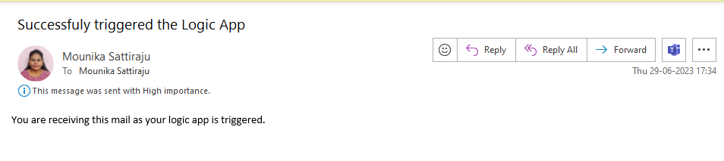
Logic Apps & Web Activity
Create Logic apps service.
Go to Logic app designer to trigger the message once the action is done.
Select “When a HTTP request is received” trigger and select “Send an email” action to get the message.
Connect the logic app with the web activity to get the message once the web activity runs successfully.

Slide 10
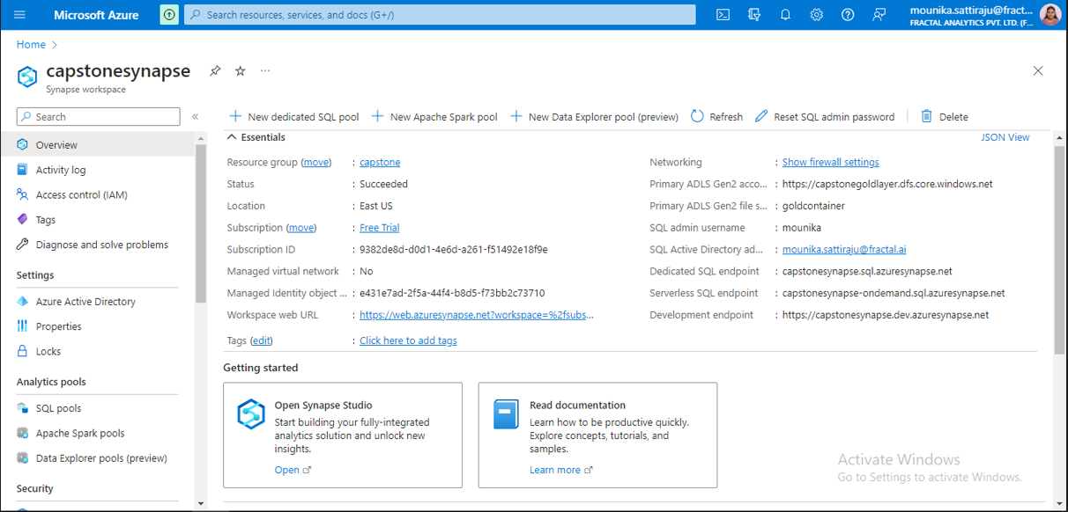
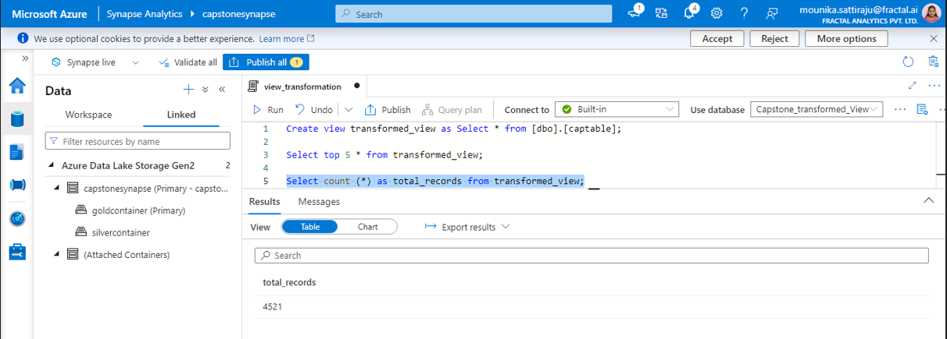
Azure Synapse Analytics
Create Azure Synapse Analytics service using the gold layer storage account.
Launch the synapse studio by clicking on the open studio.
Create a view and display the data that is present in the gold layer using serverless SQL.

Slide 11

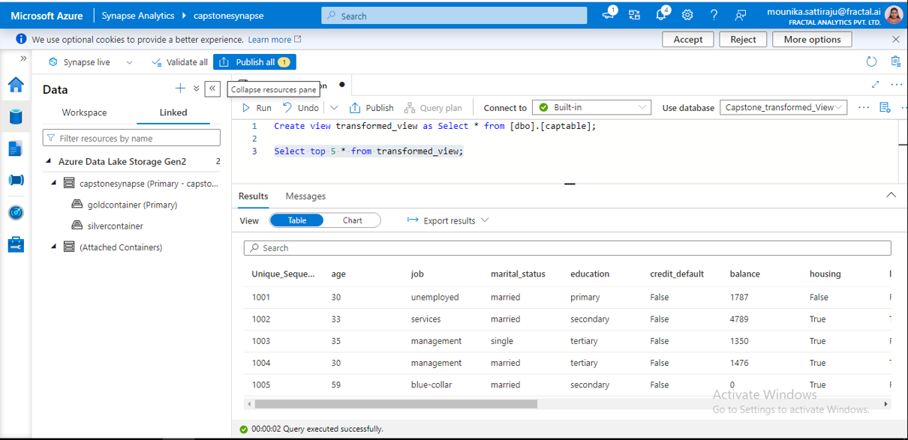
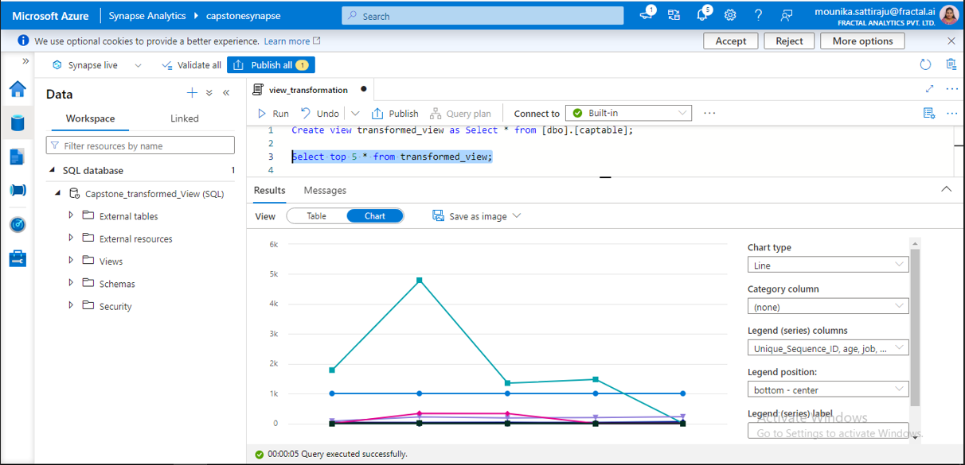
Creating a View in Synapse

Slide 12
Thank you

