Slide 1

Charging Everywhere EVs with Machine learning
MARIANNA POLINI, SANTIAGO FRIAS, LUIS ULLOA
Tarragona, July 31, 2018

Slide 2



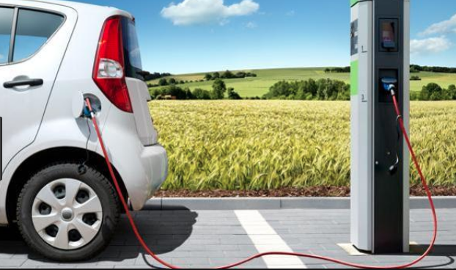
https://placetoplug.com/
Marc Ruiz
CTO&Co-Founder at place to Plug

Slide 3
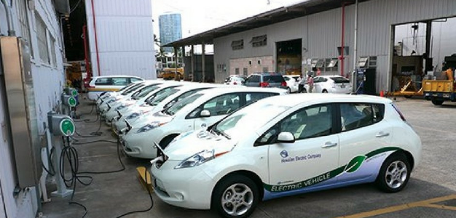


NO FREE PLACE

Slide 4

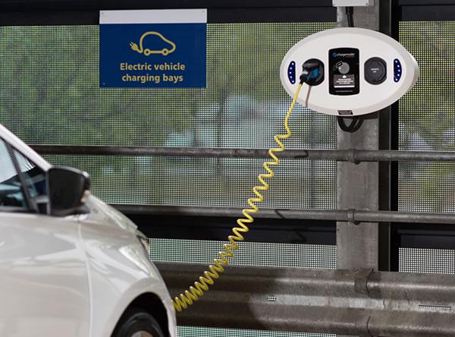


FREE PLACE

Slide 5
AI APPROACH

Slide 6
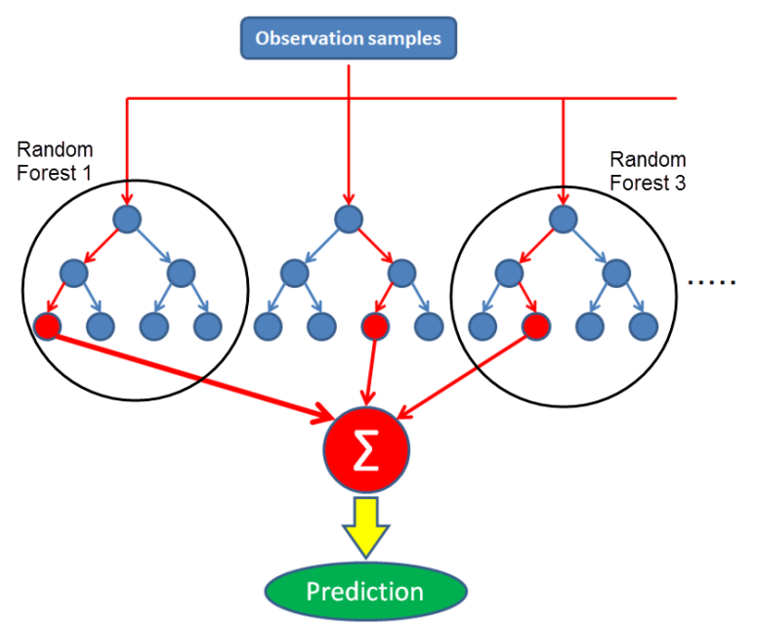

To say it in simple words: Random forest builds multiple decision trees and merges them together to get a more accurate and stable prediction.

Slide 7
HISTORICAL DATABASE WITH THE DATA OF THE CAR ELETRIC STATIONS
PREDICTION OF OCCUPANCY FOR THE ELETRICAL STATIONS

Slide 8
LESSON LEARNT

Slide 9
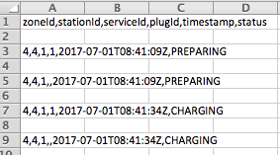
DATASET OF 5 LOCATIONS IN CATALONIA
ANALYSIS OF THE DATA
DATA CLEANING AND CONVERSIONS
FEATURE ENGEERING
IMPLEMENTATION OF TWO KAGGLE* EXAMPLES IN THE JUPYTER NOTEBOOK:
1) FIRST RESULTS LESS ACCURATE
2) SECOND RESULTS MORE ACCURATE

Slide 10



https://www.kaggle.com/arnabghose128/house-price-prediction-random-forest
https://www.kaggle.com/danavg/random-forest-implementation/notebook

Slide 11
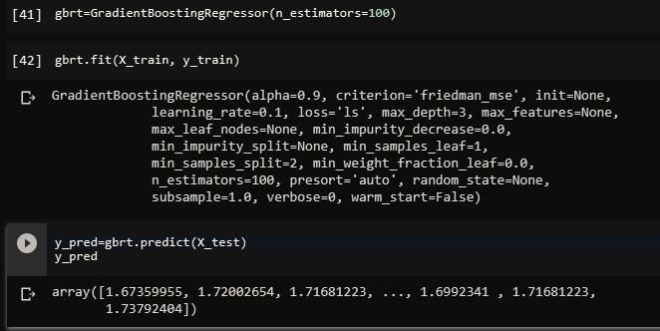
FIRST RESULTS LESS ACCURATE
R^2 training= 0,76 Estimator=10
R^2 training=0,78 Estimator=40
R^2 training=0,78 Estimator=100

Slide 12
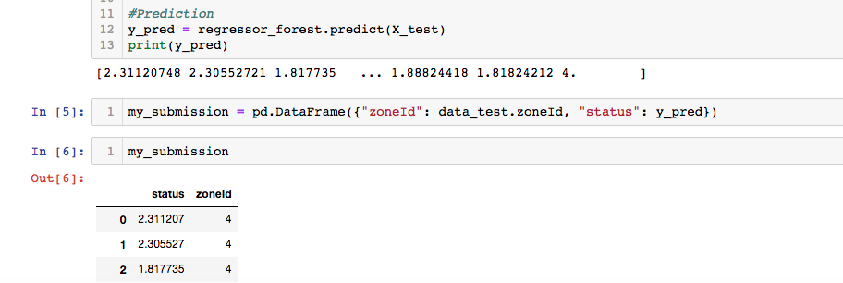
SECOND THE RESULTS MORE ACCURATE

