Slide 1
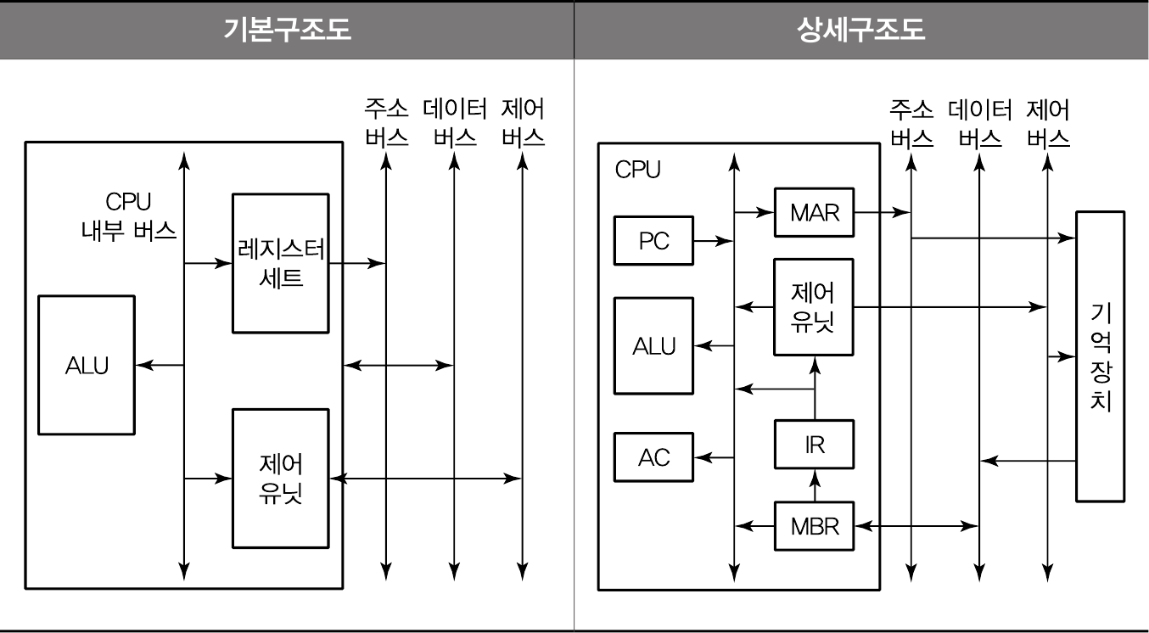


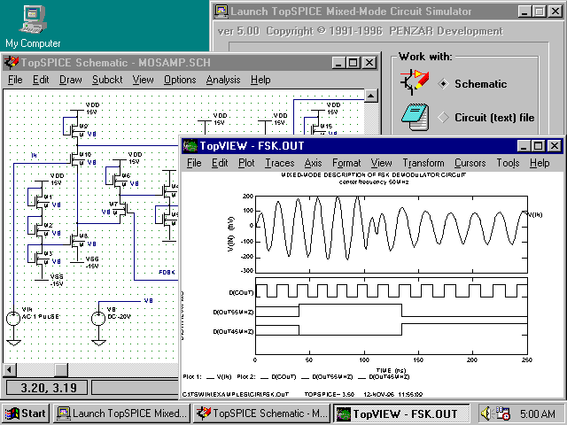

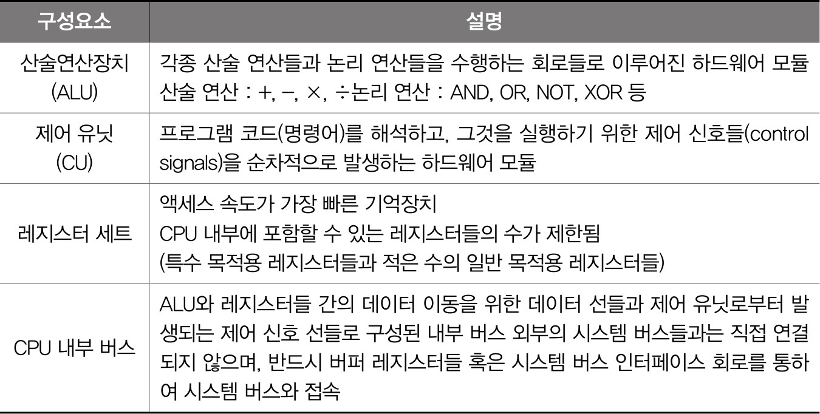



컴퓨터 시스템
CPU Internal Architecture
This material is reproduced based on
핵심 컴퓨터구조 및 운영체제 해설(최종언저, 예문사), Computer Organization and Architecture, 9ed(by William Stallings) and
Computer Architecture(by Behrooz Parhami),
Copyrights are reserved by corresponding authors.
CPU 구조도
© 2021 Computer System
CPU 구성요소
© 2021 Computer System
The Instruction Execution Unit
Next addr
jta
PC
rs,rt,rd
(rs)
Instr cache
inst
Reg file
ALU
Address Data
Data cache
(rt)
imm
op fn
Control
Abstract view of the instruction execution unit for MicroMIPS.
© 2021 Computer System

Slide 2
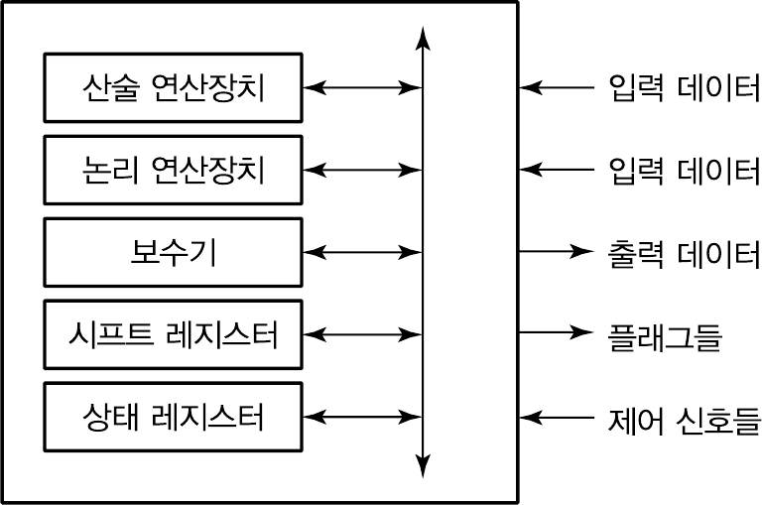
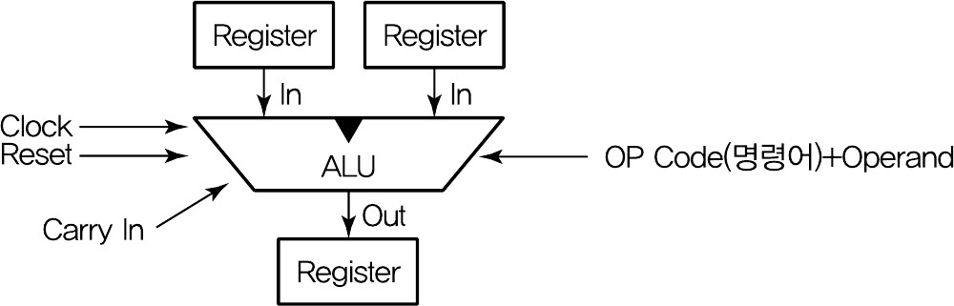
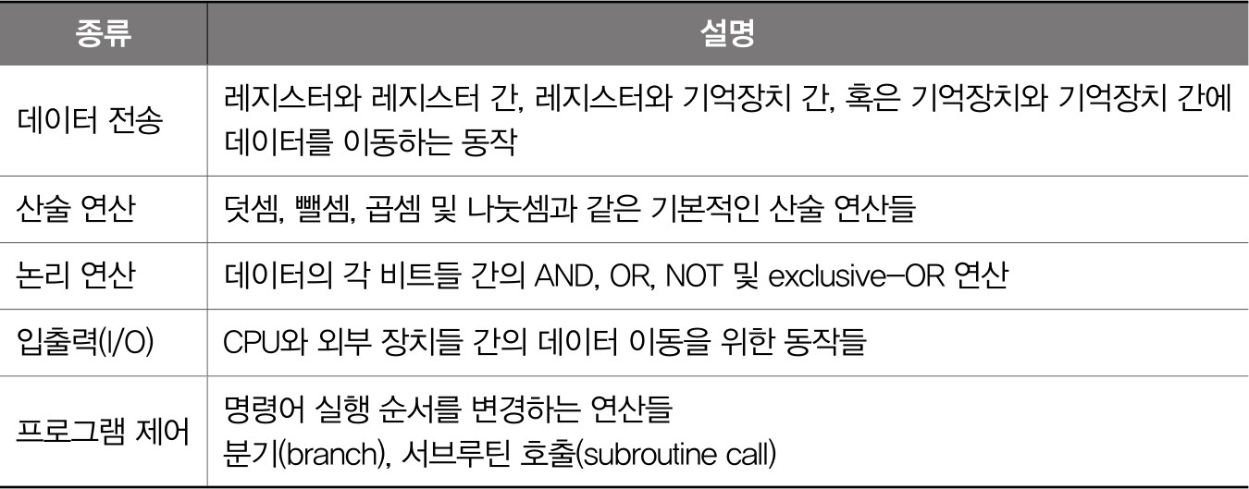
ALU(Arithmetic and Logic Unit)
© 2021 Computer System
© 2021 Computer System
Instruction Set
© 2021 Computer System
ALU Sample
Constant amount
Const′Var
00 No shift
^{Shift function} 01 Logical left
2 10 Logical right
11 Arith right
5 ₀
Amount
5
00 Shift
Variable ⁵ 1
amount
Shifter _{Function} ^{01 Set less}
32
_{class} 10 Arithmetic
11 Logic
5 LSBs
Shifted y
0
2
x
32
c
0
0 or 1
1
s
Shorthand symbol for ALU
Control
Adder
x ± y
32
MSB
2
32
y
32
k
/
c ^{c 31}
3
x
Add′Sub
32
Func
ALU
s
Logic unit
32-
input NOR
y
Zero
Ovfl
AND 00
OR 01
XOR 10
NOR 11
2
Logic function
Zero
Ovfl
© 2021 Computer System

Slide 3
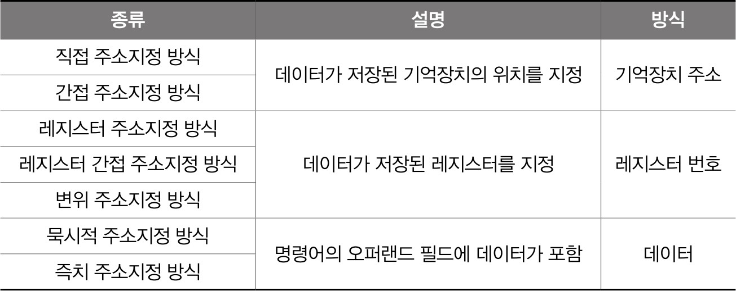
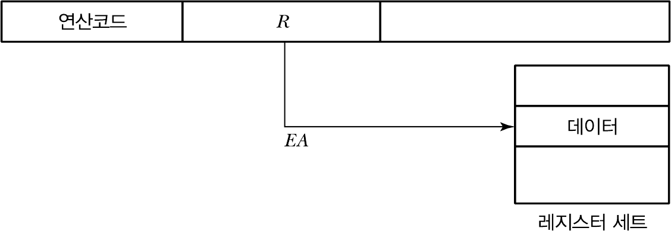
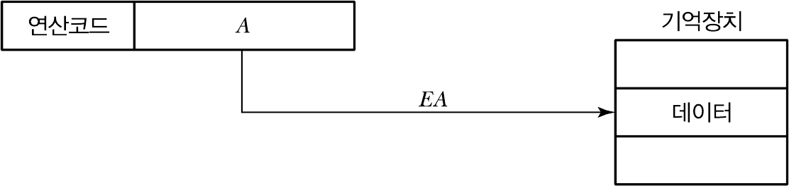
Instruction Set
Register Type
연산이 Register의 데이터에서만 이루어 지는 명령어
Data Load from Memory
연산에 필요한 데이터가 외부 메모리에 존재하여 메모리로부터 데이터를 읽는 동작이 필요한 명령어
Data Save to Memory
연산 결과를 외부 메모리에 저장하는 명령어
Jump(Branch)
프로그램의 진행 순서를 변경하는 명령어
Addressing Mode
© 2021 Computer System
© 2021 Computer System
Direct Addressing
Register Addressing
© 2021 Computer System
© 2021 Computer System

Slide 4
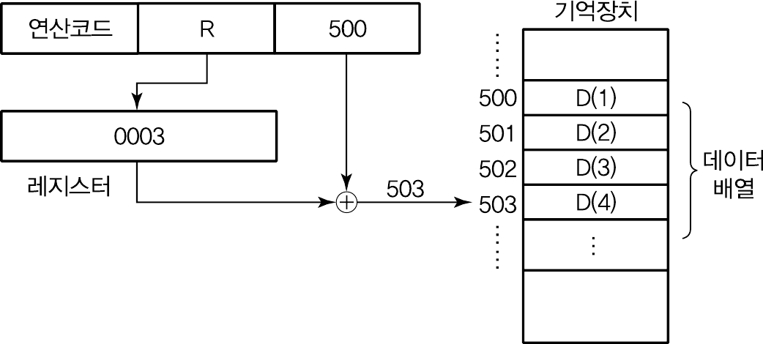
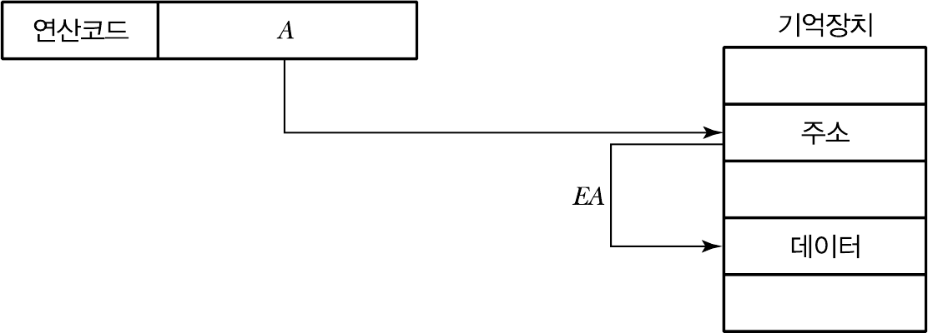




Register Indirect Addressing
© 2021 Computer System
Memory Indirect Addressing
© 2021 Computer System
Immediate Addressing
© 2021 Computer System
Performance of the Single-Cycle Design
ALU-type
P C
Not used
Load
P C
Store
P C
Not used
Branch
(and jr)
P C
Not used
Not used
Not used
Jum p (except jr & jal)
P C
Not used
Not used
Not used
Not used
© 2021 Computer System

Slide 5
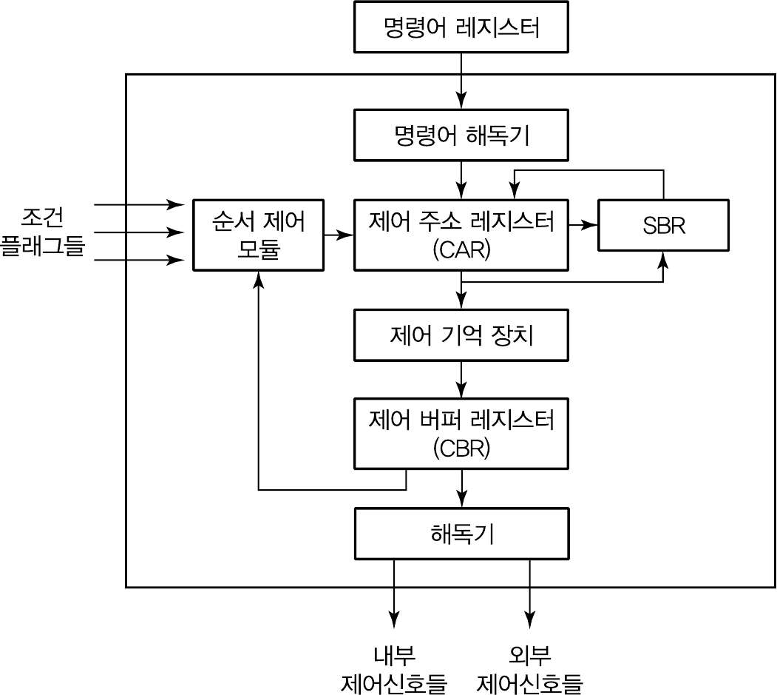
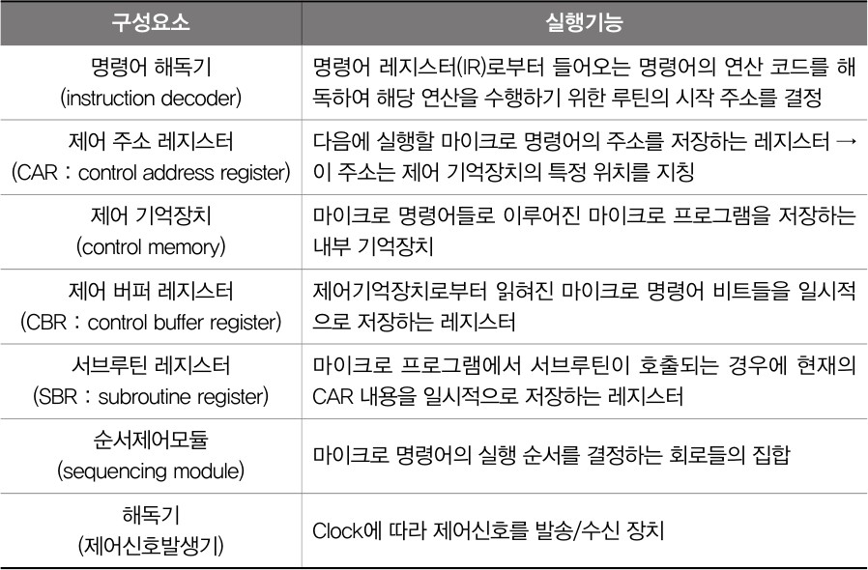
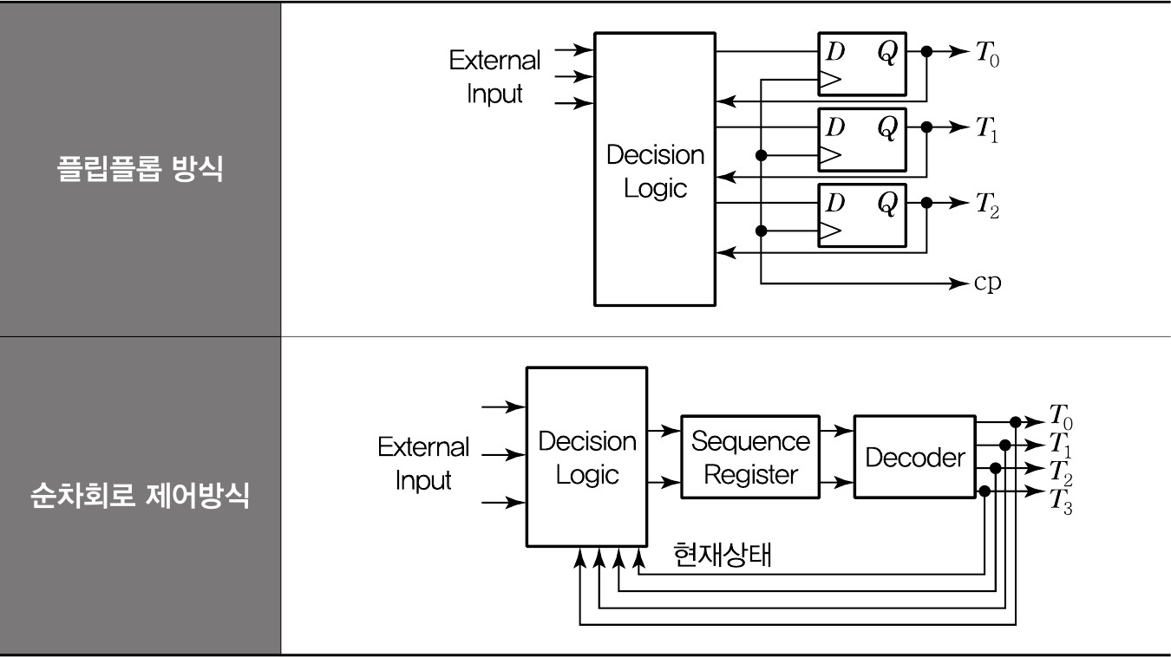
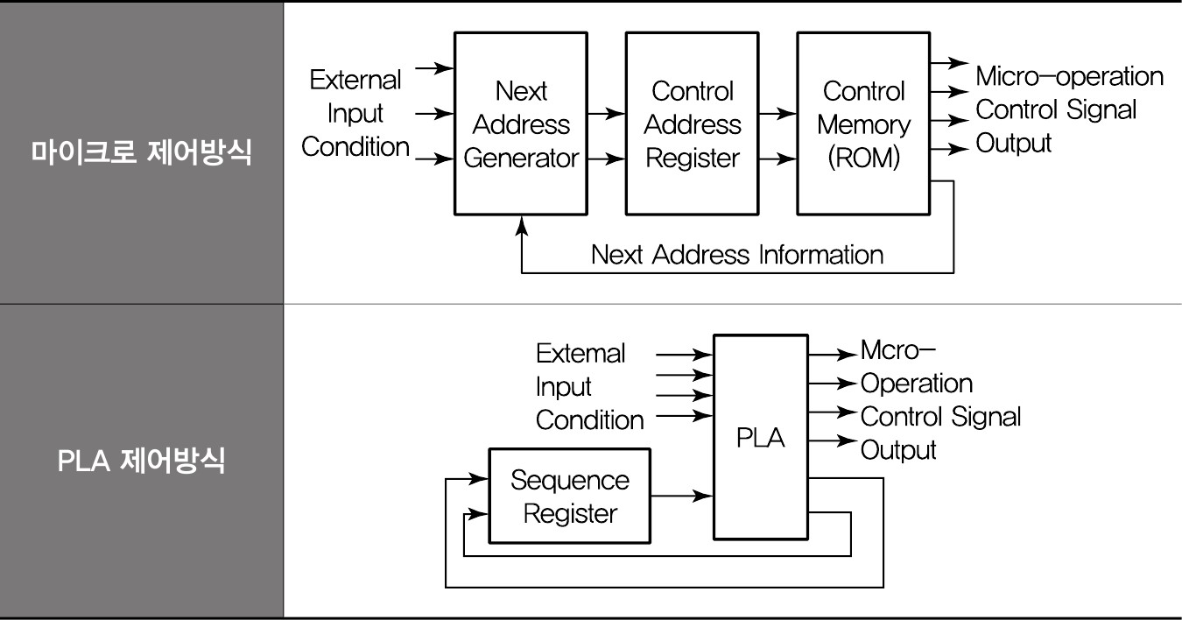
CPU Control Unit
Control Unit 구성 요소
© 2021 Computer System
© 2021 Computer System
Hard-wired 방식(고정 하드웨어 방식)
마이크로 프로그래밍 방식(S/W 방식)
© 2021 Computer System
© 2021 Computer System

Slide 6
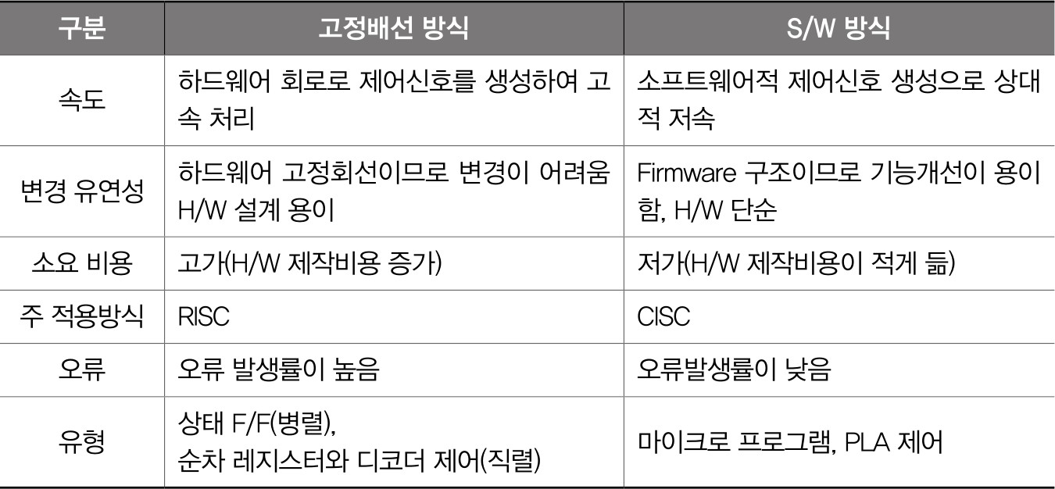

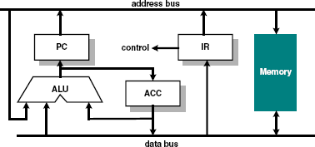
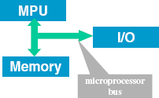
구현 방식 비교
A Simple Processor
MU 0
© 2021 Computer System
A Simple Processor
Based on von Neumann model
Instruction for the micro- processor
(stored program) and the data for computation are both stored in memory
Microprocessing Unit (MPU) contains:
Arithmetic/Logic Unit (ALU)
Control Unit
Registers
Input/output block interfaces to the outside world (e.g. user, disc storage etc.)
The communication between memory, MPU and I/O is through the microprocessor bus
MU0 – Very simple processor
Let us design a simple processor MU0 with 16-bit instruction and minimal hardware:-
Program Counter (PC) - holds address of the next instruction to execute
Accumulator (ACC) - holds data being processed
Arithmetic Logic Unit (ALU) - performs operations on data
Instruction Register (IR) - holds current instruction code being executed
© 2021 Computer System
© 2021 Computer System

Slide 7

MU0
A Program Counter (PC) register to hold the address of the current instruction. (Visible to Programmer)
One register - the Accumulator (ACC). (Visible to Programmer).
An Arithmetic-Logic Unit (ALU) for doing, eh, arithmetic and logic. (Invisible to Programmer).
An Instruction Register (IR) for holding the current instruction. (Invisible to Programmer.)
Instruction Decode Logic and Control Logic to use the components of MU0 to give effect to the instructions.
MU0 instructions
Let us further assume that the processor only has 8 instructions and can only access
a maximum of 8k byte of memory. This implies that the address bus is only 12-bit wide.
We also assume that this is a 16-bit MPU and ALL instructions are 16 bits wide.
The 16-bit instruction code (machine code) has a format:
Note that top 4 bits define the operation code (opcode), i.e. it defines what operation the instruction is to perform.
The bottom 12 bits define the memory address of the operand data.
© 2021 Computer System
© 2021 Computer System
MU0 Instruction Set
Data Path & Control Logic
Data Path : all the components that carry or handle bits in parallel
ACC, PC, the ALU, IR
memory
Buses
Control Logic : the logic needed to use the datapath components to give effect to the instructions in the instruction set. A finite state machine.
Instruction | Opcode | Semantics
LDA S | 0000 | ACC := mem₁₆[S]
STO S | 0001 | mem₁₆[S] := ACC
ADD S | 0010 | ACC := ACC + mem₁₆[S]
SUB S | 0011 | ACC := ACC + mem₁₆[S]
JMP S | 0100 | PC := S
JGE S | 0101 | if ACC ≥ 0 PC := S
JNE S | 0110 | if ACC ≠ 0 PC := S
STP | 0111 | stop
2 load/store instructions: LDA, STO
2 computation instructions: ADD, SUB
4 control flow instructions: JMP, JGE, JNE, STP
© 2021 Computer System
© 2021 Computer System

Slide 8
Execution Step 1 : Fetch Instruction
Execution Step 2 : Instruction Decode
MPU outputs value of program counter (PC) on address bus.
Memory puts contents at the instruction address on the data bus.
Instruction is stored in instruction registers (IR).
The instruction word stored in IR is decoded by internal logic to provide control signals to ALU and other internal circuits inside MPU.
Program counter value (PC) is pushed onto the address bus, the ALU increment this value by k and put it back into the Program Counter.
© 2021 Computer System
© 2021 Computer System
Execution Step 3 : Operand Fetch
Execution Step 4 : Execute Instruction
The instruction register provides the address of the data to be processed (i.e. operand address).
Memory supplies the operand data on the data bus to the MPU, ready for processing either by the ALU or the ACC.
Processing is performed on the operand by the ALU according to the instruction.
The result is put back into the Accumulator (ACC).
© 2021 Computer System
© 2021 Computer System

Slide 9
Execution Step 5 : Write Back (may not exist)
This step may not be needed.
The result from the Accumulator is written back into memory. In many processors, this will be done as a separate instruction.
© 2021 Computer System

