Slide 1




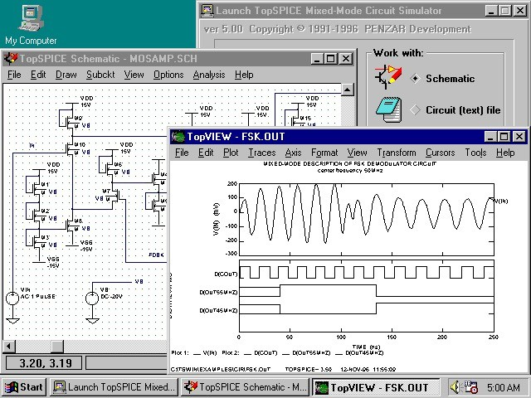

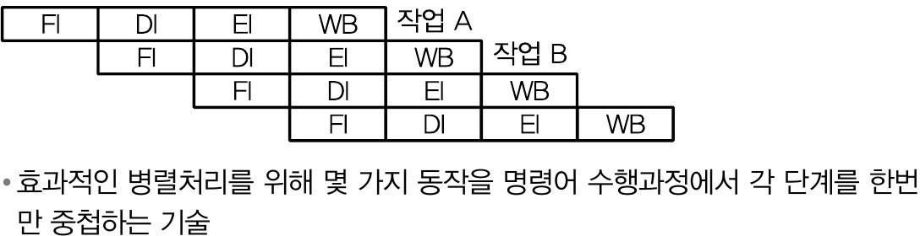
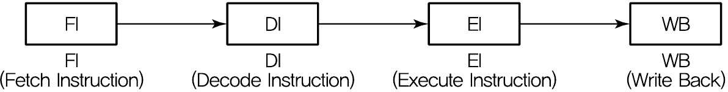
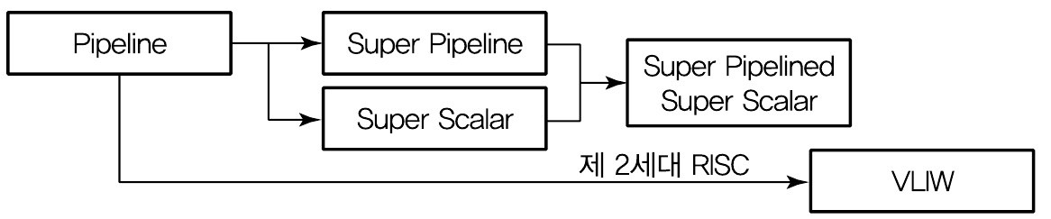
Pipelining Concepts
Strategies for improving performance
– Use multiple independent data paths accepting several instructions that are read out at once: multiple-instruction-issue or superscalar
– Overlap execution of several instructions, starting the next instruction before the previous one has run to completion: (super)pipelined
컴퓨터 시스템
Approval
1
Cashier
2
Registrar
ID photo
Pickup
Parallelism
Start
3
4
5
Exit
here
This material is reproduced based on
핵심 컴퓨터구조 및 운영체제 해설(최종언저, 예문사), Computer Organization and Architecture, 9ed(by William Stallings) and
Computer Architecture(by Behrooz Parhami),
Copyrights are reserved by corresponding authors.
Pipelining in the student registration process.
© 2021 Computer System
파이프라인
명령어 처리 과정을 여러 단계로 세분화해서 동시에 서로 다른 작업들이 수행되도록 하여 병렬성을 높이는 기법
CPU의 프로그램 처리 속도를 높이기 위하여 CPU 내부 하드웨어를 여러 단계로 나누어 동시에 처리하는 기술
수행과정
단일 파이프라인
파이프라인 유형
© 2021 Computer System
© 2021 Computer System

Slide 2
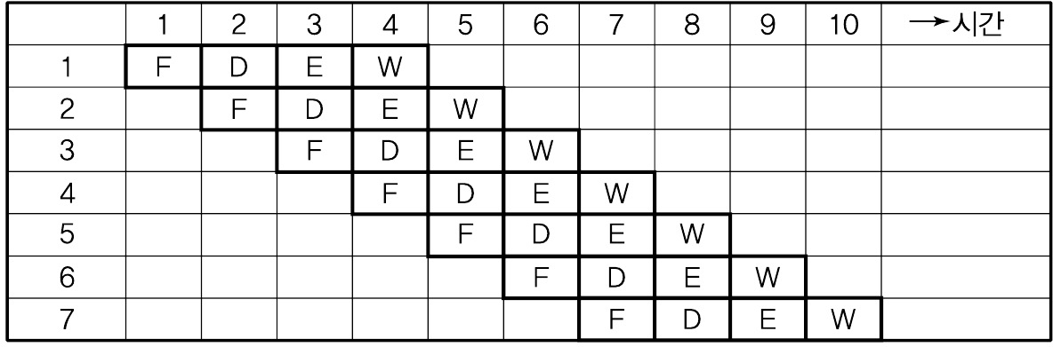


Pipelined Instruction Execution
파이프라인 사용시 성능향상
Cycle 1
Cycle 2
Cycle 3
Cycle 4
Cycle 5
Cycle 6
Cycle 7
Cycle 8 Cycle 9
Instr 5 Instr 4 Instr 3 Instr 2 Instr 1
Instr cache
Reg file
ALU
Data cache
Reg file
Time dimension
Instr cache
Reg file
ALU
Data cache
Reg file
Instr cache
Reg file
ALU
Data cache
Reg file
Instr cache
Reg file
ALU
Data cache
Reg file
Task dimension
Instr cache
Reg file
ALU
Data cache
Reg file
Pipelining in the MicroMIPS instruction execution process.
© 2021 Computer System
© 2021 Computer System
파이프라인의 문제점
파이프라인의 근본적 문제점
모든 명령어들이 파이프라인 단계를 모두 거치지는 않는다
어떤 명령어는 오퍼랜드를 인출할 필요가 없으나 구조를 단순화하기 위하여
4단계의 파이프라인을 통과
클럭 스피드는 가장 긴 파이프라인 단계를 기준으로 설정
구조적 문제점
FI단계와 EI 단계가 동시에 기억장치를 사용할 경우 기억장치 충돌에 따른 지연시간
데이터 문제점
이전 명령어의 실행 결과를 다음 명령어가 사용할 때 생기는 데이터 의존성에 따른 문제
제어 문제점
분기(특히 조건분기)의 경우 미리 인출한 명령어를 사용할 수 없는 문제
Pipeline Stalls or Bubbles
First type of data dependency
Cycle 1 Cycle 2 Cycle 3
Cycle 4
Cycle 5
Cycle 6
Cycle 7 Cycle 8
$5 = $6 + $7
Instr cache
Reg file
ALU
Data cache
Reg file
Data forwarding
$8 = $8 + $6
Instr cache
Reg file
ALU
Data cache
Reg file
$9 = $8 + $2
Instr cache
Reg file
ALU
Data cache
Reg file
sw $9, 0($3)
Instr cache
Reg file
ALU
Data cache
Reg file
Read-after-write data dependency and its possible resolution through data forwarding .
© 2021 Computer System
© 2021 Computer System

Slide 3
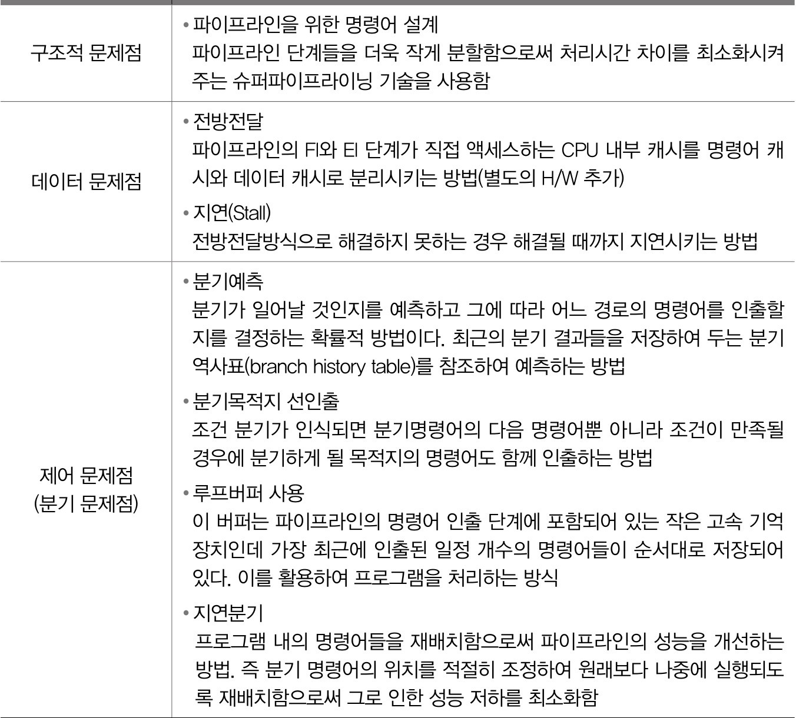
파이프 라인의 문제점
© 2021 Computer System
Second Type of Data Dependency
Cycle 1 Cycle 2 Cycle 3 Cycle 4 Cycle 5 Cycle 6 Cycle 7 Cycle 8
sw $6, . . .
Instr mem
Reg file
ALU
Data mem
Reg file
Instr mem
Reg file
Data mem
Reg file
Reorder?
lw $8, . . .
ALU
Insert bubble?
Instr mem
Reg file
ALU
Data mem
Reg file
$9 = $8 + $2
Instr mem
Reg file
ALU
Data mem
Reg file
Read-after-load data dependency and its possible resolution through bubble insertion and data forwarding.
© 2021 Computer System
Control Dependency in a Pipeline
Data Dependencies and Hazards
Cycle 1 Cycle 2 Cycle 3 Cycle 4 Cycle 5 Cycle 6 Cycle 7 Cycle 8
Cycle 1 Cycle 2 Cycle 3 Cycle 4 Cycle 5 Cycle 6 Cycle 7 Cycle 8 Cycle 9
$6 = $3 + $5
Instr mem
Reg file
Data mem
Reg file
Instr cache
Reg file
ALU
Data cache
Reg file
$2 = $1 - $3
ALU
Reorder? (delayed branch)
beq $1, $2, . . .
Instr mem
Reg file
Data mem
Reg file
Instr cache
Reg file
ALU
Data cache
Reg file
Instructions that read register $2
ALU
Insert bubble?
Instr mem
Reg file
Data mem
Reg file
Instr cache
Reg file
ALU
Data cache
Reg file
ALU
$9 = $8 + $2
Instr mem
Reg file
Data mem
Reg file
Instr cache
Reg file
ALU
Data cache
Reg file
ALU
Assume branch resolved here
Here would need 1-2 more bubbl es
Instr cache
Reg file
ALU
Data cache
Reg file
Control dependency due to conditional branch.
Data dependency in a pipeline.
© 2021 Computer System
© 2021 Computer System

Slide 4

Resolving Data Dependencies via Forwarding
Certain Data Dependencies Lead to Bubbles
Cycle 1
Cycle 2
Cycle 3
Cycle 4
Cycle 5
Cycle 6
Cycle 7
Cycle 8 Cycle 9
Cycle 1
Cycle 2
Cycle 3
Cycle 4
Cycle 5
Cycle 6
Cycle 7 Cycle 8 Cycle 9
Instr cache
Reg file
ALU
Data cache
Reg file
$2 = $1 - $3
Instr cache
Reg file
ALU
Data cache
Reg file
lw $2,4($12)
Instr cache
Reg file
Data cache
Reg file
Instructions that read register $2
Instr cache
Reg file
Data cache
Reg file
Instructions that read register $2
ALU
ALU
Instr cache
Reg file
ALU
Data cache
Reg file
Instr cache
Reg file
ALU
Data cache
Reg file
Instr cache
Reg file
ALU
Data cache
Reg file
Instr cache
Reg file
ALU
Data cache
Reg file
When a previous instruction writes back a value computed by the ALU into a register, the data dependency can always be resolved through forwarding.
When the immediately preceding instruction writes a value read out from the data memory into a register, the data dependency cannot be resolved through forwarding (i.e., we cannot go back in time) and a bubble must be inserted in the pipeline.
© 2021 Computer System
© 2021 Computer System
Pipeline Branch Hazards
Branch Prediction
Software-based solutions
Compiler inserts a “no-op” after every branch (simple, but wasteful) Branch is redefined to take effect after the instruction that follows it Branch delay slot(s) are filled with useful instructions via reordering Hardware-based solutions
Mechanism similar to data hazard detector to flush the pipeline Constitutes a rudimentary form of branch prediction:
Always predict that the branch is not taken, flush if mistaken
More elaborate branch prediction strategies possible
Predicting whether a branch will be taken
Always predict that the branch will not be taken
Use program context to decide (backward branch is likely taken, forward branch is likely not taken)
Allow programmer or compiler to supply clues
Decide based on past history (maintain a small history table); to be discussed later
Apply a combination of factors: modern processors use elaborate techniques due to deep pipelines
© 2021 Computer System
© 2021 Computer System

Slide 5
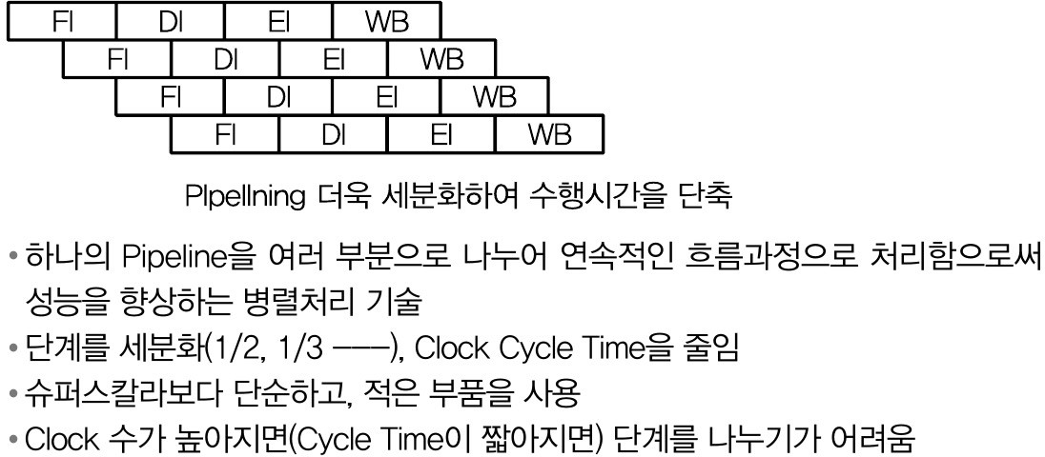
A Simple Branch Prediction Algorithm
Hardware Implementation of Branch Prediction
Taken
Not taken
Addresses of recent branch instructions
Target addresses
History bit(s)
Incremented
Not taken
Not taken
Taken
Low-order
Predict taken
Predict taken again
Predict not taken
Predict
bits used as index
PC
Taken
Not taken
not taken again
0
1
Next PC
Taken
Read-out table entry
Fig. 16.6 Four-state branch prediction scheme.
Example 16.1
From PC
Compare ⁼
Logic
L1: ----
10 iter’s
Impact of different branch prediction schemes
Solution
Always taken: 11 mispredictions, 94.8% accurate
bit history: 20 mispredictions, 90.5% accurate
bit history: Same as always taken
Fig. 16.7 Hardware elements for a branch prediction scheme.
L2: ----
----
20 iter’s
br <c2> L2
----
br <c1> L1
The mapping scheme used to go from PC contents to a table entry is the same as that used in direct-mapped caches (Chapter 18)
© 2021 Computer System
© 2021 Computer System
Advanced Pipelining
슈퍼 파이프라인
Deep pipeline = superpipeline; also, superpipelined, superpipelining
Parallel instruction issue = superscalar, j-way issue (2-4 is typical)
Stage 1 Stage 2 Stage 3 Stage 4 Stage 5 Variable # of stages Stage q−2 Stage q−1 Stage q
Function unit 1
Instr cache
Ope- rand prep
Function unit 2
Instr decode
Instr issue
Function unit 3
Instruction fetch
Retirement & commit stages
© 2021 Computer System
© 2021 Computer System

Slide 6
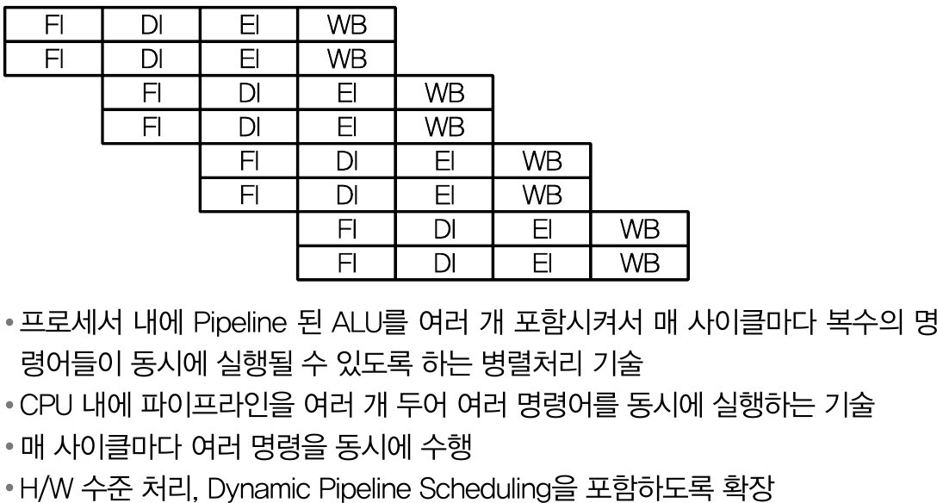
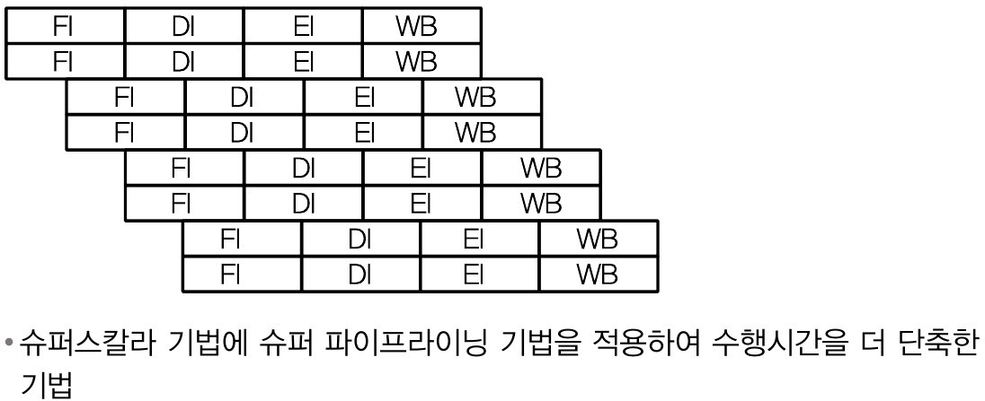
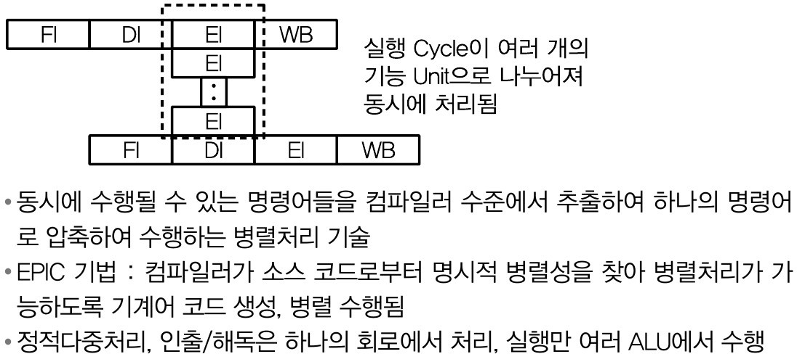
슈퍼스칼라
슈퍼파이프라인-슈퍼스칼라
© 2021 Computer System
© 2021 Computer System
VLIW(Very Long Instruction Word)
Performance Improvement for Deep Pipelines
Hardware-based methods
Lookahead past an instruction that will/may stall in the pipeline (out-of-order execution; requires in-order retirement)
Issue multiple instructions (requires more ports on register file) Eliminate false data dependencies via register renaming
Predict branch outcomes more accurately, or speculate
Software-based method
Pipeline-aware compilation
Loop unrolling to reduce the number of branches
Loop: Compute with index i Increment i by 1 | Loop: | Compute with index i Compute with index i + 1
Go to Loop if not done |  | Increment i by 2 Go to Loop if not done
© 2021 Computer System
© 2021 Computer System

Slide 7


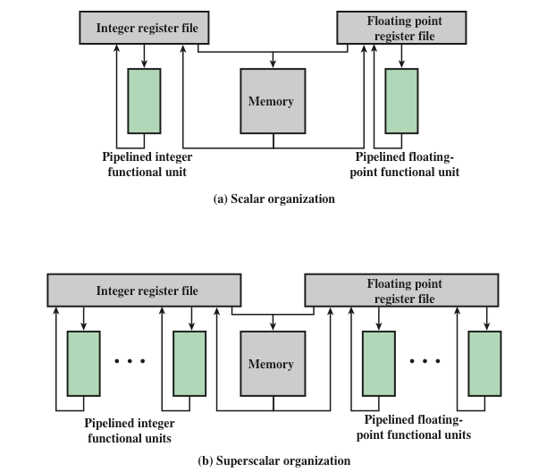

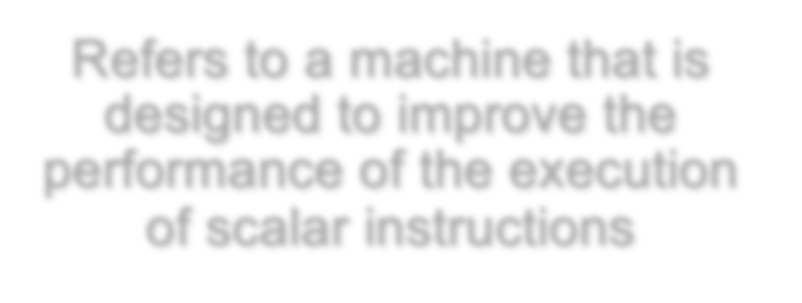








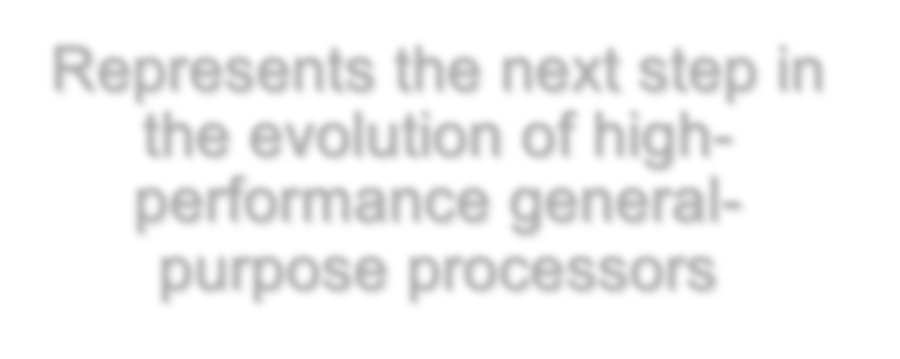












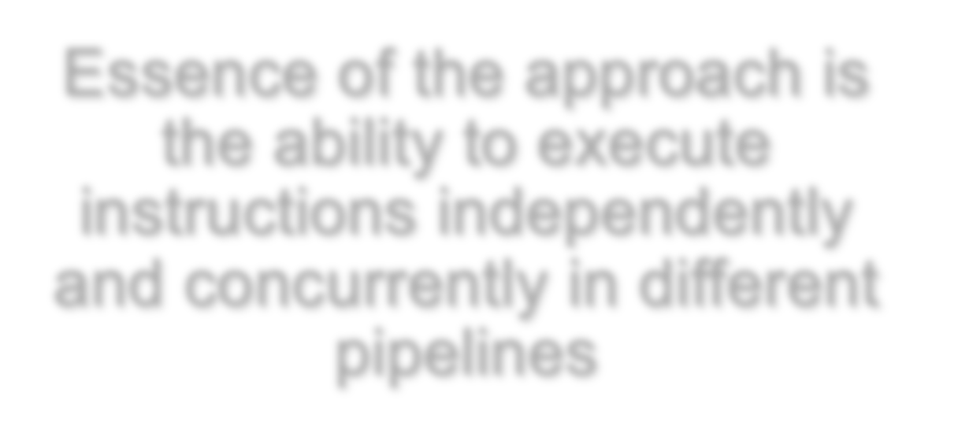
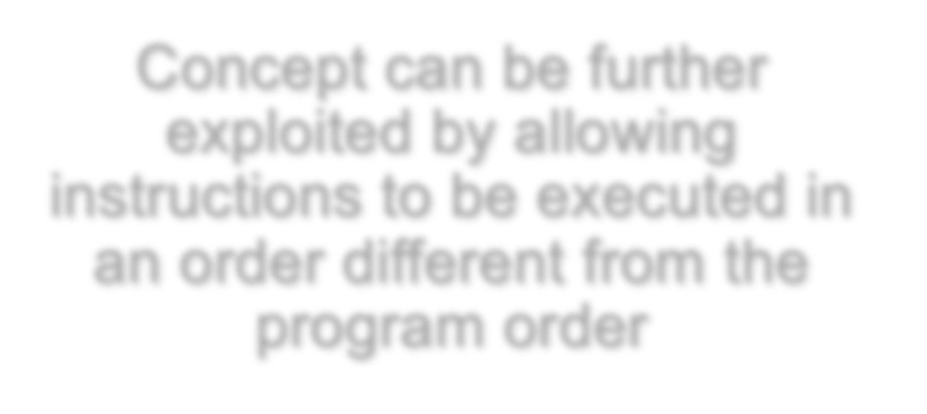










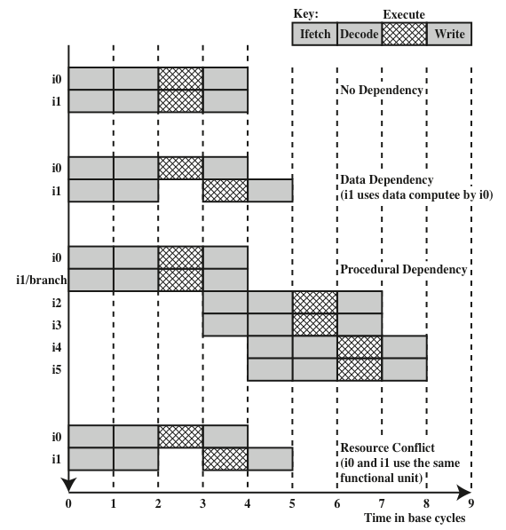
Superscalar
Superscalar vs. Ordinary Scalar
Refers to a machine that is designed to improve the performance of the execution of scalar instructions
Term first coined in 1987
In most applications the bulk of the operations are on scalar quantities
Represents the next step in the evolution of high- performance general- purpose processors
Essence of the approach is the ability to execute instructions independently and concurrently in different pipelines
Concept can be further exploited by allowing instructions to be executed in an order different from the program order
© 2021 Computer System
© 2021 Computer System
Constraints
Effect of Dependencies
Instruction level parallelism
Refers to the degree to which the instructions of a program can be executed in parallel
A combination of compiler based optimization and hardware techniques can be used to maximize instruction level parallelism
Limitations:
True data dependency
Procedural dependency
Resource conflicts
Output dependency (WAW: Write after Write)
Antidependency(WAR: Write after Read)
B = 3
A = B + 1
B = 7
© 2021 Computer System
© 2021 Computer System

Slide 8

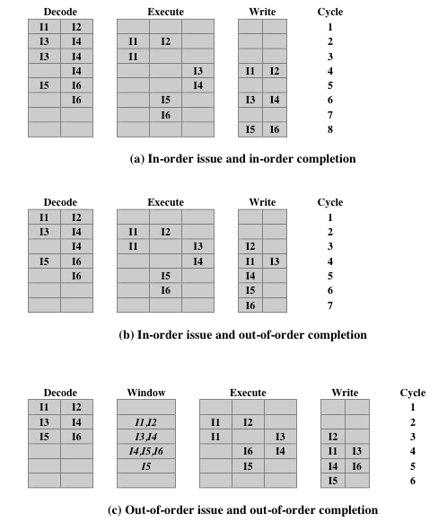
Branch Prediction
Design Issues – Instruction vs. Machine level
Instruction level parallelism
Instructions in a sequence are independent
Execution can be overlapped
Governed by data and procedural dependency
Machine Parallelism
Ability to take advantage of instruction level parallelism
Governed by number of parallel pipelines
Any high-performance pipelined machine must address the issue of dealing with branches
Intel 80486 addressed the problem by fetching both the next sequential instruction after a branch and speculatively fetching the branch target instruction
RISC machines:
Delayed branch strategy was explored
Processor always executes the single instruction that immediately follows the branch
Keeps the pipeline full while the processor fetches a new instruction stream
Superscalar machines:
Delayed branch strategy has less appeal
Have returned to pre-RISC techniques of branch prediction
© 2021 Computer System
© 2021 Computer System
Instruction Issue Policy
Superscalar Instruction Issue and Completion Policies
Instruction issue
Refers to the process of initiating instruction execution in the processor’s functional units
Instruction issue policy
Refers to the protocol used to issue instructions
Instruction issue occurs when instruction moves from the decode stage of the pipeline to the first execute stage of the pipeline
Three types of orderings are important:
The order in which instructions are fetched
The order in which instructions are executed
The order in which instructions update the contents of register and memory locations
Superscalar instruction issue policies can be grouped into the following categories:
In-order issue with in-order completion
In-order issue with out-of-order completion
Out-of-order issue with out-of-order completion
© 2021 Computer System
© 2021 Computer System

Slide 9
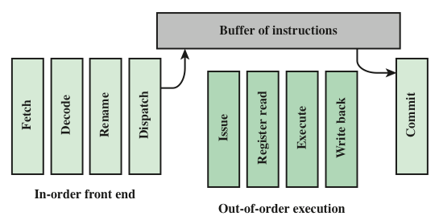
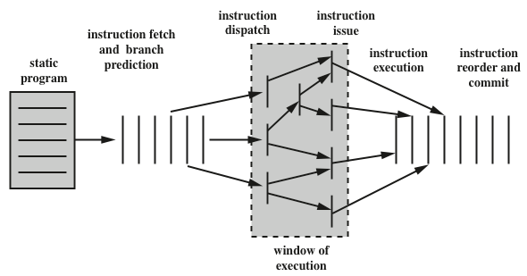
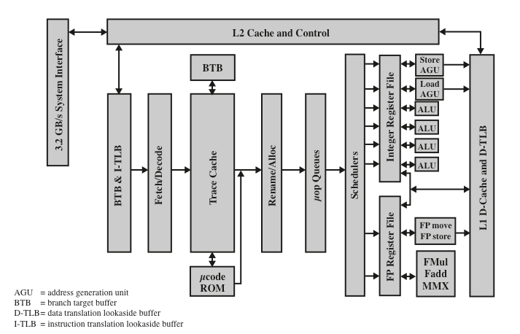
Organization for Out-of-Order Issue
Conceptual Depiction of Superscalar Processing
© 2021 Computer System
© 2021 Computer System
Pentium 4 Block Diagram
Pipeline Throughput with Dependencies
Assume that one bubble must be inserted due to read-after-load dependency and after a branch when its delay slot cannot be filled. Let β be the fraction of all instructions that are followed by a bubble.
Pipeline speedup =
q
(1 + qτ/ t)(1 + β)
R-type | 44%
Load | 24%
Store | 12%
Branch | 18%
Jump | 2%
Example 15.3
Calculate the effective CPI for MicroMIPS, assuming that a quarter of branch and load instructions are followed by bubbles.
Solution
Fraction of bubbles β = 0.25(0.24 + 0.18) = 0.105
CPI = 1 + β = 1.105 (which is very close to the ideal value of 1)
© 2021 Computer System
© 2021 Computer System

