Slide 1
Recovery Techniques
Department of Computer Science and Engineering,
Chitkara University, Himachal Pradesh

Slide 2
INTRODUCTION TO RECOVERY OF DATA
Data recovery is the process of restoring the database of the most recent consistent state that existed just before the failure.
Data recovery is important in managing a database system.
Having a good plan will help to make a quick and successful recovery from failure.

Slide 3
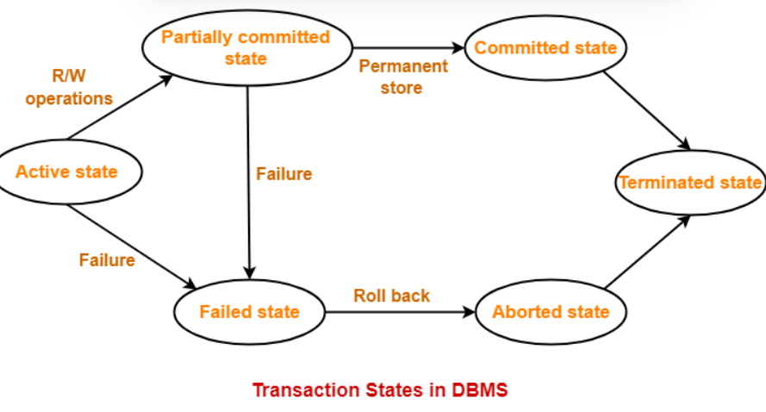
PURPOSE OF DATABASE RECOVERY
To bring the database into the last consistent state, which existed prior to the failure.
To preserve transaction (ACID) properties:
Atomicity
Consistency
Isolation
Durability

Slide 4
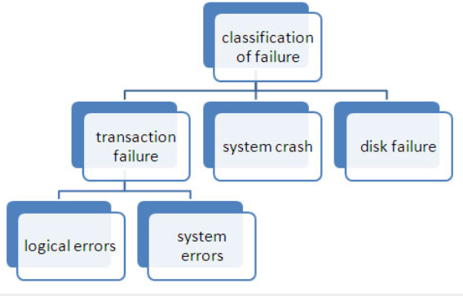
DATABASE FAILURE
A failure is a state where the data inconsistency is visible to transactions if they are scheduled for execution. In databases usually three types of failures are encountered:
Transaction failure
System failure
Disk failure

Slide 5
WHAT CAUSES DATABASE FAILURE?
Database server computer or program crashes
Database client computer or program crashes
Network failure between client and server
Data on a disk drive is corrupted
A transaction executes an illegal operation
Two or more transactions deadlock
Transactions introduce errors into the database

Slide 6
NEED OF DATA RECOVERY
The storage of data usually includes four types of media with an increasing amount of reliability: the main memory, the magnetic disk, the magnetic tape, and the optical disk. Many different forms of failure can affect database processing and/or transaction, and each of them has to be dealt with differently. Some data failures can affect the main memory only, while others involve non-volatile or secondary storage also. Among the sources of failure are:
Due to hardware or software errors, the system crashes, which ultimately resulting in loss of main memory.
Failures of media, such as head crashes or unreadable media that results in the loss of portions of secondary storage.
There can be application software errors, such as logical errors that are accessing the database that can cause one or more transactions to abort or fail.
Natural physical disasters can also occur, such as fires, floods, earthquakes, or power failures.
Carelessness or unintentional destruction of data or directories by operators or users.
Damage or intentional corruption or hampering of data (using malicious software or files) hardware or software facilities.
Whatever the grounds of the failure are, there are two principal things that you have to consider:
Failure of main memory, including that database buffers.
Failure of the disk copy of that database.

Slide 7
Recovery Techniques
Recovery Techniques of the information base are demonstrated as follows −
Log Based Recovery
Cascadeless Schedule
Checkpoints

Slide 8


