Slide 1
Conflict Serializability
22.12

Slide 2
Contents
Conflict Serializability

Slide 3
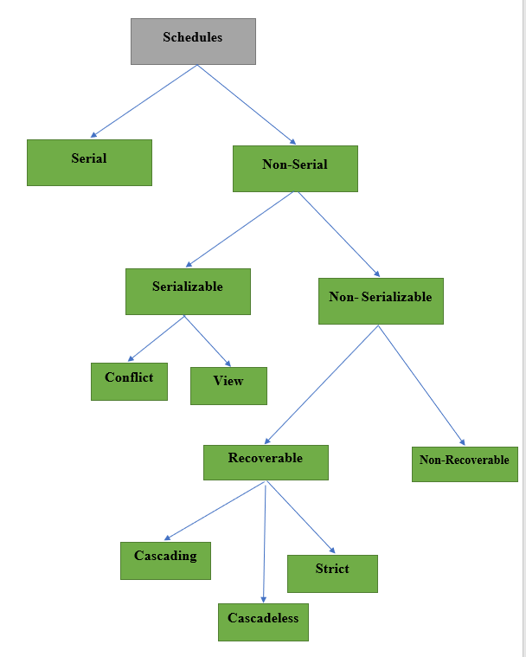

Slide 4
Testing of Conflict Serializability
Precedence Graph or Serialization Graph is used commonly to test Conflict Serializability of a schedule. It is a directed Graph (V, E) consisting of a set of nodes V = {T₁, T₂, T₃……….T_{n}} and a set of directed edges E = {e₁, e₂, e₃………………e_{m}}.
The graph contains one node for each Transaction T_{i}. An edge e_{i} is of the form T_{j} –> T_{k} where T_{j} is the starting node of e_{i} and T_{k} is the ending node of e_{i}. An edge e_{i} is constructed between nodes T_{j} to T_{k} if one of the operations in T_{j} appears in the schedule before some conflicting operation in T_{k} .
The Algorithm can be written as:
Create a node T in the graph for each participating transaction in the schedule.
For the conflicting operation read_item(X) and write_item(X) – If a Transaction T_{j} executes a read_item (X) after T_{i} executes a write_item (X), draw an edge from T_{i} to T_{j} in the graph.
For the conflicting operation write_item(X) and read_item(X) – If a Transaction T_{j} executes a write_item (X) after T_{i} executes a read_item (X), draw an edge from T_{i} to T_{j} in the graph.
For the conflicting operation write_item(X) and write_item(X) – If a Transaction T_{j} executes a write_item (X) after T_{i} executes a write_item (X), draw an edge from T_{i} to T_{j} in the graph.
The Schedule S is serializable if there is no cycle in the precedence graph.

Slide 5
Testing of Conflict Serializability
If there is no cycle in the precedence graph, it means we can construct a serial schedule S’ which is conflict equivalent to schedule S.

Slide 6
Conflict Serializability (If the schedule conflict serializable, if yes determine the equivalent serial schedule)
S1
T1 | T2 | T3
 |  | R(X)
 | R(X)
 |  | W(X)
R(X)
W(X)

Slide 7
Conflict Serializability (If the schedule conflict serializable, if yes determine the equivalent serial schedule)
S1
T1 | T2 | T3
R(X)
 |  | R(Y)
 |  | R(X)
 | R(Y)
 | R(Z)
 |  | W(Y)
 | W(Z)
R(Z)
W(X)
W(Z)

Slide 8
Serial Schedules vs. Serializable Schedules
Serial Schedules | Serializable Schedules
No concurrency is allowed. Thus, all the transactions necessarily execute serially one after the other. | Concurrency is allowed. Thus, multiple transactions can execute concurrently.
Serial schedules lead to less resource utilization and CPU throughput. | Serializable schedules improve both resource utilization and CPU throughput.
Serial Schedules are less efficient as compared to serializable schedules. (due to above reason) | Serializable Schedules are always better than serial schedules. (due to above reason)

Slide 9


