Slide 1
Transaction Processing Concepts in DBMS (Part-3)
22.3

Slide 2
Contents
Transaction state in DBMS
Different types of transaction failures

Slide 3
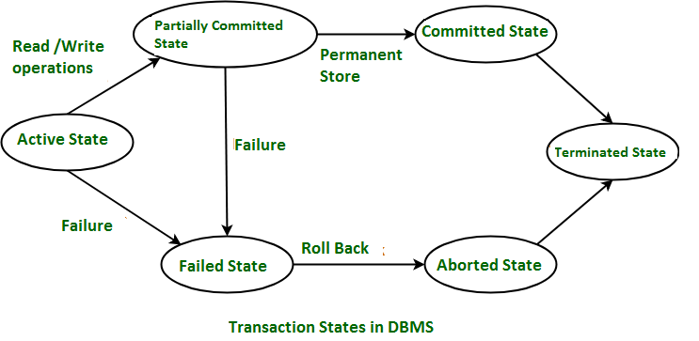
Transaction state

Slide 4
Transaction state
A transaction may not always complete its execution successfully. For every purposes, the system needs to keep track of when the transaction starts, terminates and commits or aborts. Hence the recovery manager keep track of following operation:
Begin Transaction
Read or Write
End Transaction
Commit
Rollback

Slide 5
Transaction state
Active State – When the instructions of the transaction are running then the transaction is in active state. If all the ‘read and write’ operations are performed without any error then it goes to the “partially committed state”; if any instruction fails, it goes to the “failed state”.
Partially Committed – After completion of all the read and write operation the changes are made in main memory or local buffer. If the changes are made permanent on the Database then the state will change to “committed state” and in case of failure it will go to the “failed state”.
Failed State – When any instruction of the transaction fails, it goes to the “failed state” or if failure occurs in making a permanent change of data on Database.
Aborted State – After having any type of failure the transaction goes from “failed state” to “aborted state” and since in previous states, the changes are only made to local buffer or main memory and hence these changes are deleted or rolled-back.
Committed State – It is the state when the changes are made permanent on the Database and the transaction is complete and therefore terminated in the “terminated state”.
Terminated State – If there isn’t any roll-back or the transaction comes from the “committed state”, then the system is consistent and ready for new transaction and the old transaction is terminated.

Slide 6
Different types of Transaction Failure
Computer Failure
Transaction or system error
Local errors or exceptions
Disk failure
Physical problems or catastrophes

Slide 7


