Slide 1
Transaction Processing Concepts in DBMS (Part-4)
22.4

Slide 2
Contents
Schedules

Slide 3
Schedules
A series of operation from one transaction to another transaction is known as schedule. It is used to preserve the order of the operation in each of the individual transaction.
A schedule is a set of transaction.

Slide 4
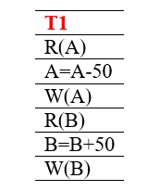
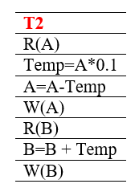
Schedules (T1 is followed by T2)

Slide 5
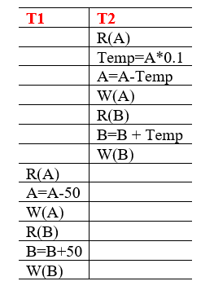
Schedules (T2 is followed by T1)

Slide 6
Types of schedules (Serial schedule)
The serial schedule is a type of schedule where one transaction is executed completely before starting another transaction. In the serial schedule, when the first transaction completes its cycle, then the next transaction is executed.
There is not any risk of consistency.
T1 | T2
R(A)
W(A)
R(B)
W(B)
 | R(B)
 | W(B)
 | R(A)
 | W(A)

Slide 7
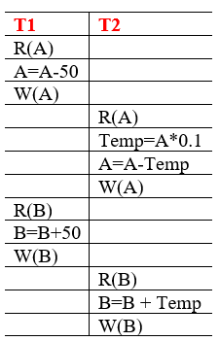
Types of schedules (Non-Serial schedule)
T1 | T2
R(A)
W(A)
 | R(B)
 | W(B)
R(B)
W(B)
 | R(A)
 | W(A)
This is a type of Scheduling where the operations of multiple transactions are interleaved. This might lead to a rise in the concurrency problem.
Unlike the serial schedule where one transaction must wait for another to complete all its operation, in the non-serial schedule, the other transaction proceeds without waiting for the previous transaction to complete.

Slide 8
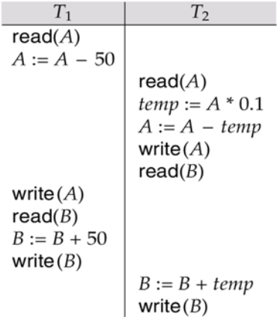
Types of schedules (Non-Serial schedule)

Slide 9
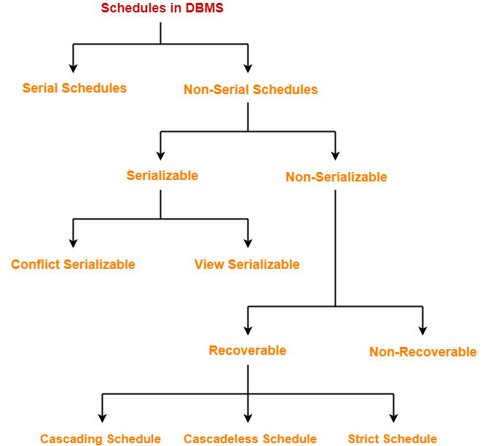
Types of schedules

Slide 10


