Slide 1
Transaction Processing Concepts in DBMS (Part-6)
22.6

Slide 2
Contents
Read Write (RW) Conflict
Or
Read Write Problem
Or
Unrepeatable read

Slide 3
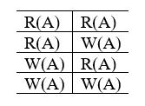
Read Write Conflict

Slide 4
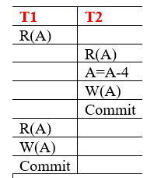
Read Write Conflict
S

Slide 5
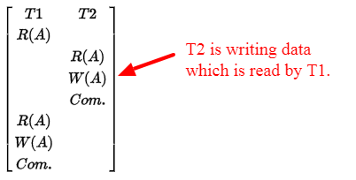
Read Write Conflict
Transaction T2 is Writing data which is previously read by transaction T1.
Here if you look at the diagram above, data read by transaction T1 before and after T2 commits is different.

Slide 6


