Slide 1
Transaction Processing Concepts in DBMS (Part-7)
22.7

Slide 2
Contents
Write-Read (WR) conflict
OR
Write-Read (WR) problem
OR
Dirty Read problem

Slide 3
Write Read Conflict
This conflict occurs when a transaction read the data which is written by the other transaction before committing.
The dirty read problem occurs when one transaction updates an item of the database, and somehow the transaction fails, and before the data gets rollback, the updated database item is accessed by another transaction. There comes the Write-Read Conflict between both transactions.

Slide 4
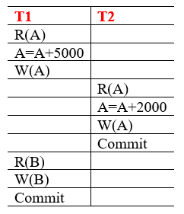
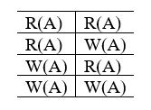
Write Read Conflict

Slide 5
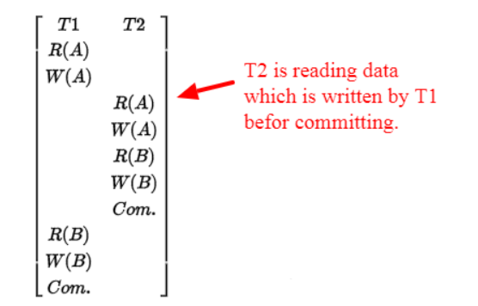
Write Read Conflict

Slide 6


