Slide 1
Transaction Processing Concepts in DBMS (Part-8)
22.8

Slide 2
Contents
Write-Write (WW) conflict
OR
Write-Write (WW) problem
OR
Lost Update Problem/ Blind Write Problem

Slide 3
Write Write Conflict
It occurs when two transactions that access the same database items have their operations interleaved in a way that makes the value of the database item incorrect.
In the lost update problem, update done to a data item by a transaction is lost as it is overwritten by the update done by another transaction.

Slide 4
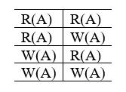
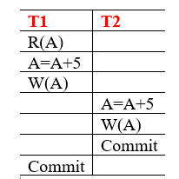
Write Write Conflict

Slide 5


