Slide 1
Transaction Processing Concepts in DBMS (Part-9)
22.9

Slide 2
Contents
Phantom Read Problem

Slide 3
Phantom Read Problem
The phantom read problem occurs when a transaction reads a variable once but when it tries to read that same variable again, an error occurs saying that the variable does not exist.

Slide 4
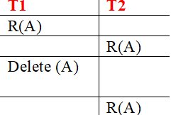
Phantom Read Problem

Slide 5


