Slide 1
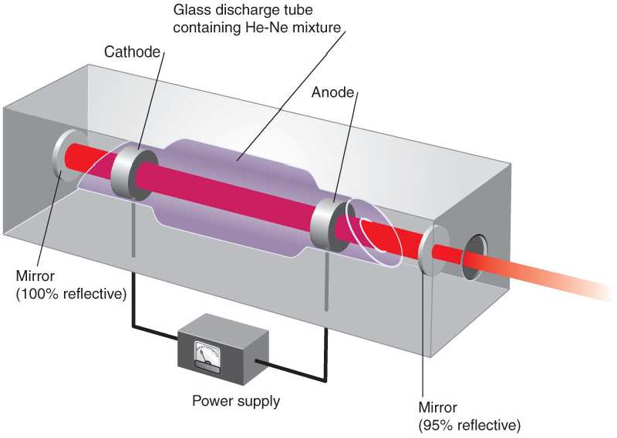
He-Ne Laser

Slide 2
Introduction
It was first built in 1961 by Ali Javan.
A helium-neon laser, usually called a He-Ne laser, is a type of small gas laser.
In gases, the energy levels of atoms involved in the lasing process are narrow and as such require sources with sharp wavelength to excite atoms. Hence appropriate optical source for pumping poses a problem.
The most common method of exciting gas medium is by passing an electric discharge through the gases.

Slide 3
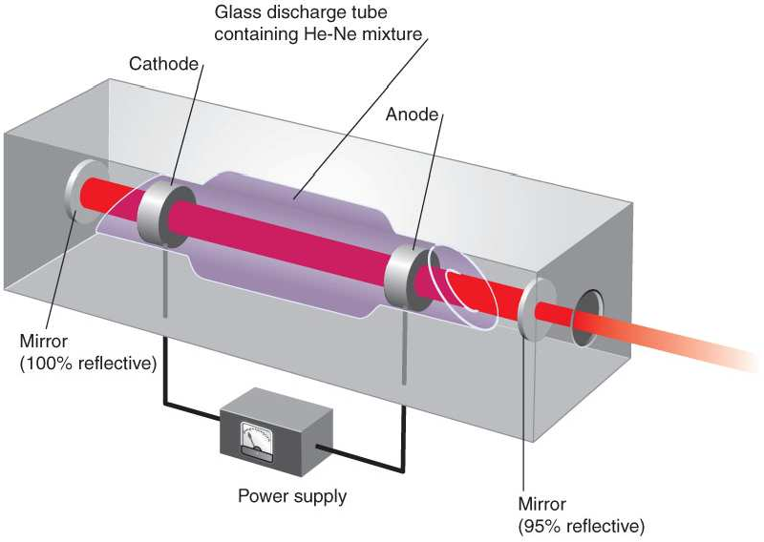
Laser medium is mixture of Helium and Neon gases in the ratio 10:1
Pumping Action: Electric discharge is passed through the gas and excite them to higher energy levels.

Slide 4
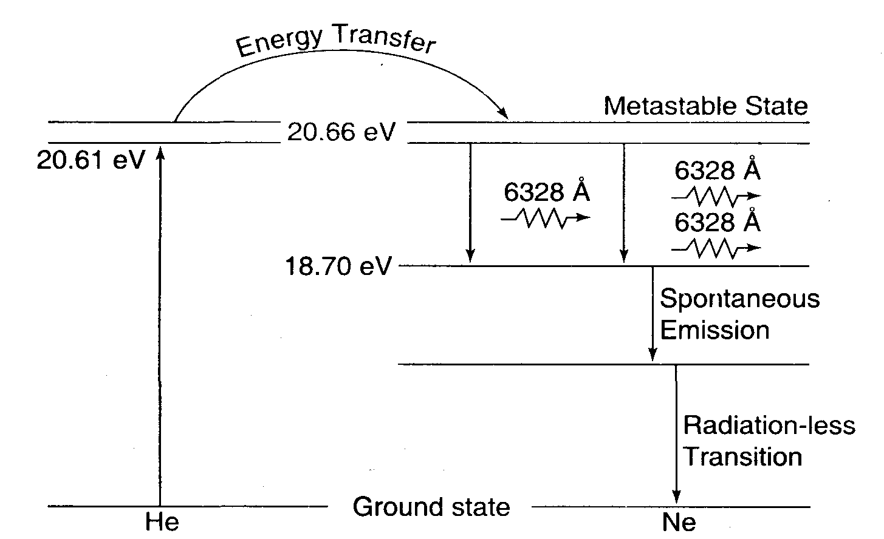
Fig. 4.14

Slide 5
SALIENT FEATURES
Uses four level pumping scheme
The active centers are neon atoms
Electrical discharge is pumping agent
Its usual operation wavelength is 632.8 nm, in the red portion of the visible spectrum.
Low efficiency and low power output
Operates in Continuous Working CW mode.

Slide 6
APPLICATIONS OF LASERS
In Communication
Industrial Applications
Medical Applications
Military Applications
In Computers
In thermonuclear fusion
In Scientific Research
Entertainment
Holography

Slide 7
Applications of Laser Light:
The smallest lasers used for telephone communication over optical fibres have as their active medium a semiconducting gallium arsenide crystal about the size of the pin-head.
The lasers are used for laser fusion research. They can generate pulses of laser light of 10⁻¹⁰ s duration which have a power level of 10¹⁴ W.
It is used for drilling tiny holes in diamonds for drawing fine wires.
It is used in precision surveying.
It is used for cutting cloth (50 layers at a time, with no frayed edges).
It is used in precise fluid-flow velocity measurements using the Doppler effect.
It is used precise length measurements by interferometry.
It is used in the generation of holograms.
It is used to measure the x, y and z co-ordinates of a point by laser interference techniques with a precision of ± 2 x 10⁻⁸ m. It is used in measuring the dimensions of special three-dimensional gauges which, in turn are used to check the dimensional accuracy of machine parts.
Medical applications: It has been used successfully in the treatment of detached retinas and cancer. A single pulse of laser beam of duration of a thousandth of a second only is needed for welding the retina.

Slide 8
Applications of Laser Light:
Communication: Modulated laser beams are being used for transmitting messages. Due to high degree of coherence, the loss of transmitted energy is comparatively much less.
Surgery: Laser beam has been used successfully for bloodless surgery. For Example:
It can be used to weld the detected retinas. The Laser beam can be used for drilling the teeth, removal of tumors, removal of infected cell etc.
It can further be used fro preventing the tooth decay by depositing hard materials on the surface of the tooth.
Industry: Laser can be focus into very fine beam, resulting in raising of temperature to about 1000 K and can be used for drilling holes and fusing and melting of metals

Slide 9
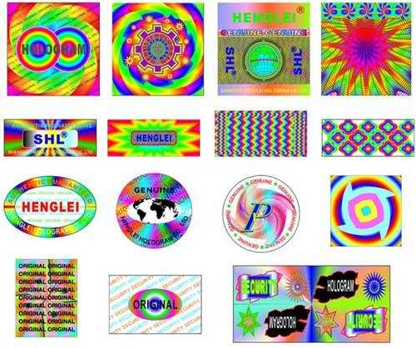
Holography

Slide 10
The method of producing the 3-dimensional image of an object due to the interference phenomena of coherent light waves on a photographic plate is known as holography.
The idea of holography was first developed by Dennis Gabor in 1948. The invention of laser during 1960 enhanced research in this field.
When an object is photographed by a camera, a 2-dimensional image of 3-dimensional object is obtained. Here only the amplitude of the light wave is recorded on the photographic film. In holography, both the phase and the amplitude of the light waves are recorded in the film. The resulting photograph is called hologram. In Greek, ‘holo’ means whole and ‘graphy’ means writing. So holography stands for whole writing.
The recorded hologram has no resemblance to the original object. It has in it a coded form of information of the object. The image is reproduced by a process called reconstruction

Slide 11
Comparison
Photography
A conventional photography is a 2-D image of a 3-D scene
A conventional photograph
Holography
Holography represents a photographic process in a broad sense, but essentially it differs from a usual photo, as the phase of light wave scattered by the object carries the complete information about 3-D structure of the object.
Hologram contains depth and parallax, which provides the ability to see around the object placed behind.
lacks depth
the perception of the or the parallax with
which we view a real life scene. Since a conventional photograph only records the intensity pattern, 3-D character of the object scene is lost.

Slide 12
Comparison
Holography
It gives information about amplitude as well as the phase of an object. So hologram
Photography
The intensity variations are recorded on the photographic plate while the phase distribution prevailing at the plane of the photographic plate is completely lost.
In conventional photography, there is one to one relationship between object and image point as the light originating from a particular point of scene is collected by a lens focused on that particular point.
preserve information about
later
the object for
observation.
Hologram received light from every point of a scene and hence there is no one to one relationship. This is a record of entire signal wave.

Slide 13
Photography
Holography
Two dimensional (2-D) image of a three dimensional (3-D) object
The quality of depth is missing
Each region contains separate and individual part of the original object.
In conventional photography, radiated energy is recorded and phase relationship of wave arriving from different distances and direction is lost.
Ordinary light can be used for recording
It is based on lens systems
A 6×9 mm photograph can hold one printed page only
Three dimensional (3-D) image of an object
It provides depth perception also
Each part contain information about the entire object.
In holography phase relationship is recorded by using technique of interference of light waves.
Only laser beam should be used for recording (or) constructing a hologram
It is a lensless systems
A 6×9 mm hologram can store up to 300 such pages.

Slide 14
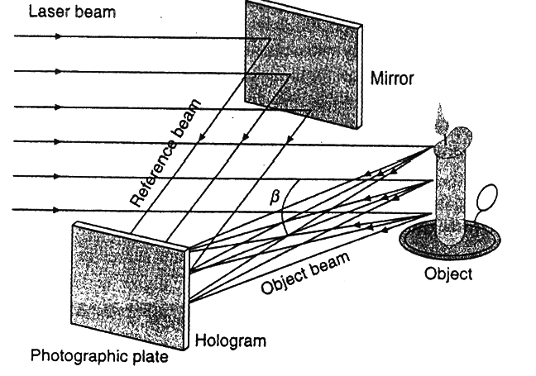
Construction of Hologram: Recording Process

Slide 15
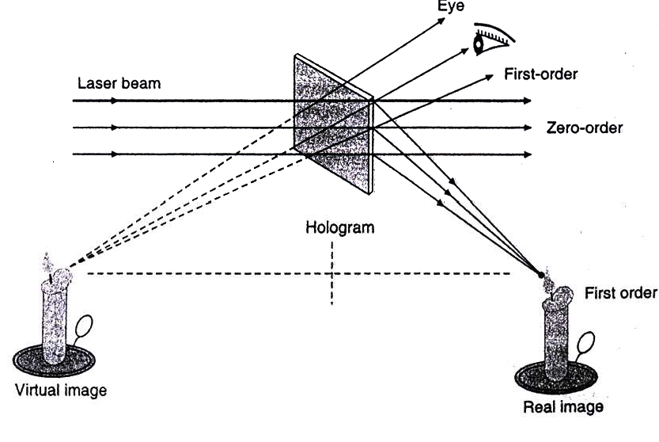
Reconstruction Process:

Slide 16
Applications of Holography
1) In information storage in computers.
2) In holographic cinema.
3) In data processing.
4) Hologram can be used as an optical grating.
5) In information coding.
6) In pattern recognition. and many more…….

